Slide 1

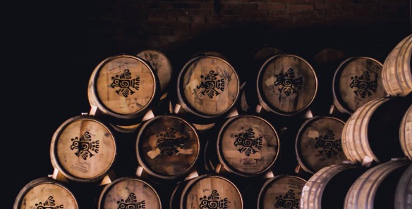
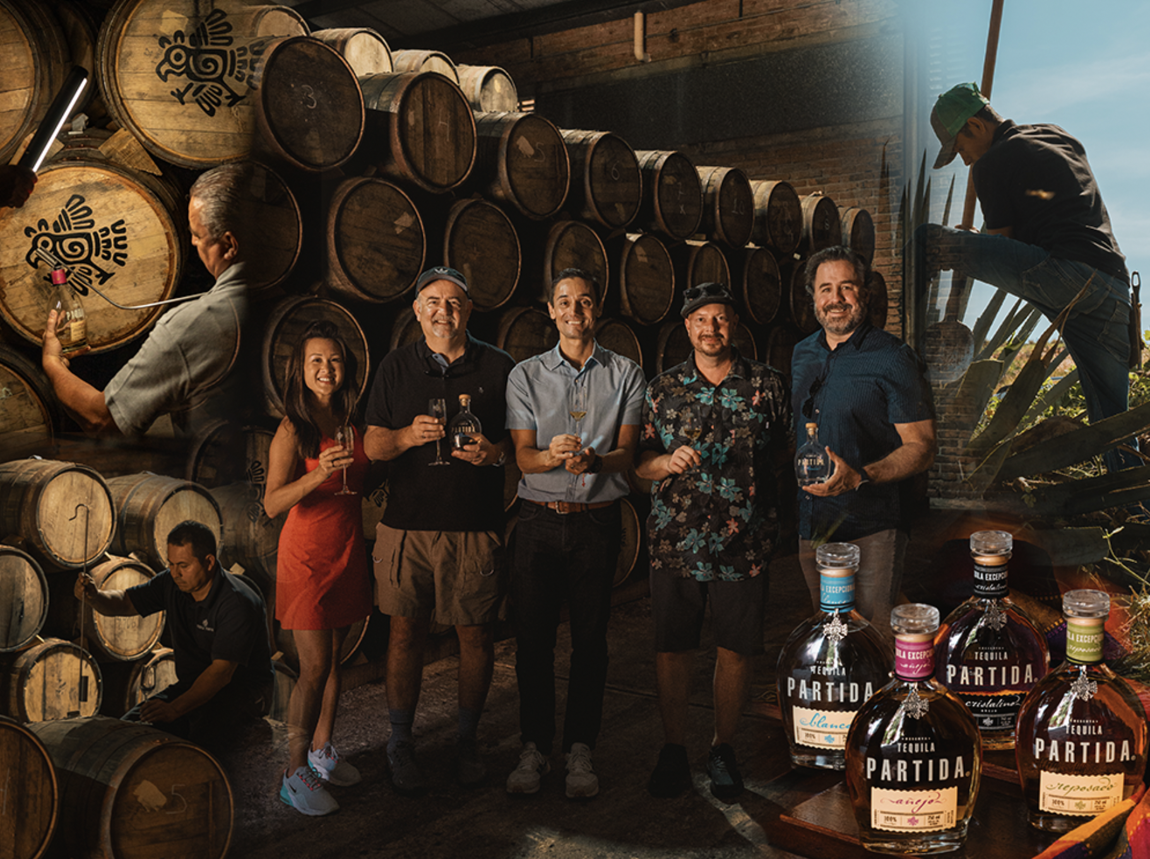
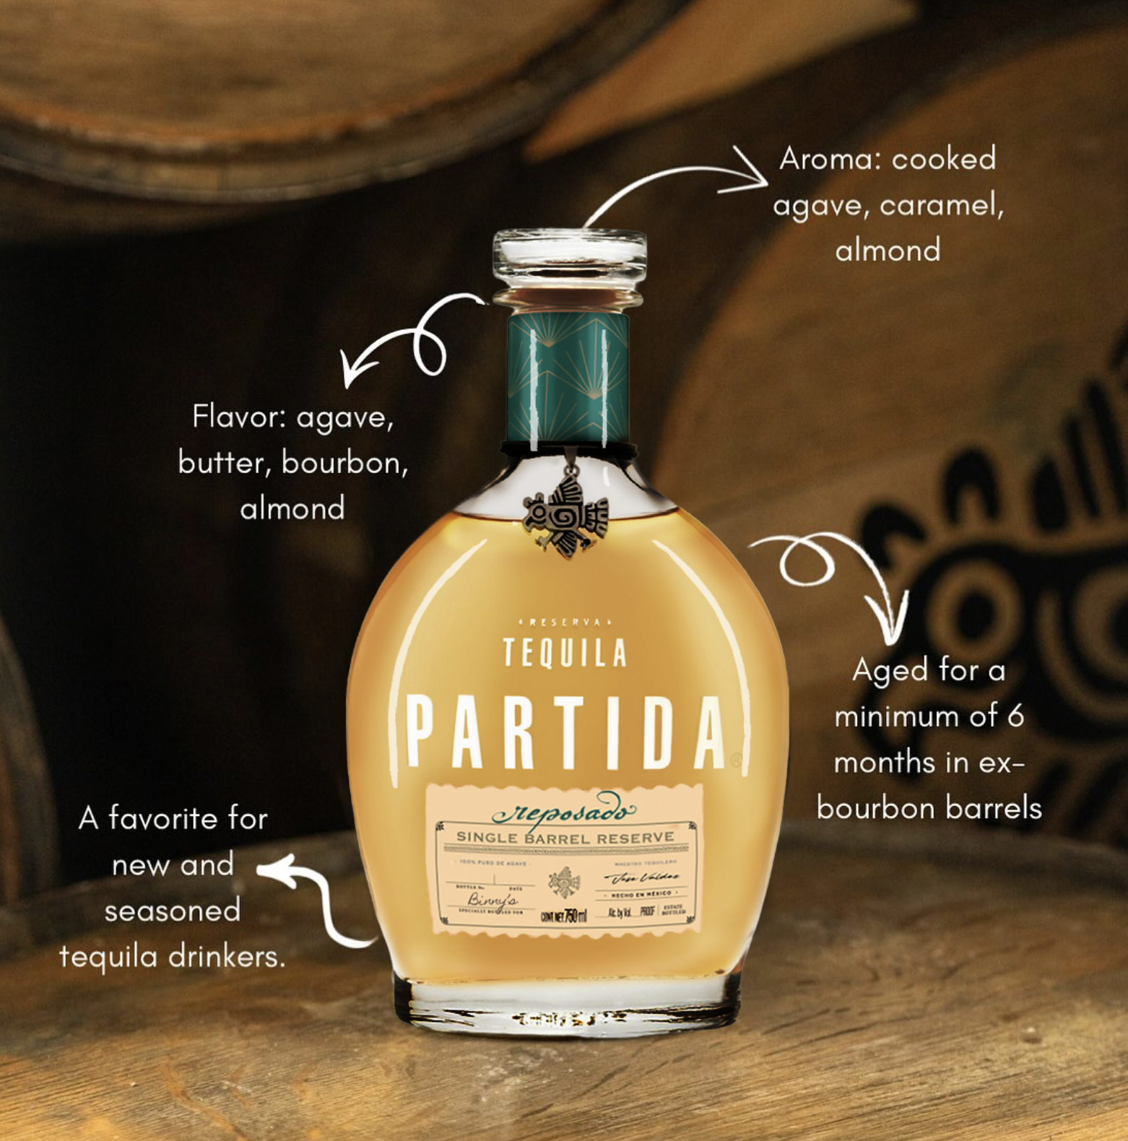


REPOSADO
HIGH PROOF
SINGLE BARREL
For the first time, our distinguished Maestro Tequilero José Valdez, is releasing single barrels of our highly regarded Reposado tequila.
THE ORIGINAL ADDITIVE FREE TEQUILA
SINCE 2005
What’s special about our barrel?
Tequila Partida is aged in custom-toasted, single-use American oak barrels, sourced from Jack Daniel’s and delivered within seven days of containing whiskey
This process enhances soft vanilla, caramel, and spice notes while preserving the tequila’s clean, additive-free agave profile
Aged a minimum of six months
What is personalized?
Each bottle is personalized with your name, barrel number and selection date
The barrel or two-barrel heads the product was aged and finished in, personalized with account logo
Key Details
1 barrel will yield roughly 40-47 cs ABV 45-55%
750ML btl
Pallet shipped with two-barrel heads or barrel
Selection of SIB open March 15th
Delivery: 3 months from selection
Each bottle will be customized with gold plated label and blazoned with account logo
Wholesale price, depends on ABV selection
Suggested retail pricing $49

Slide 2
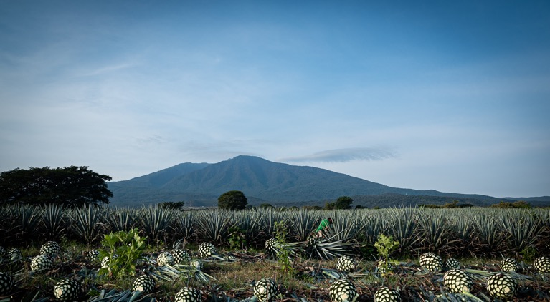
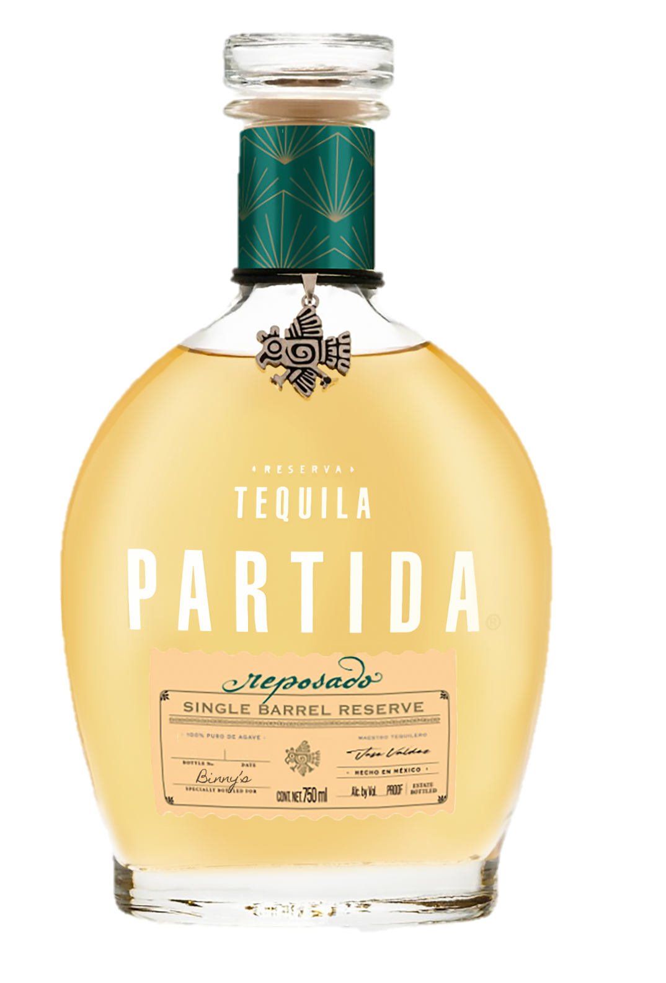
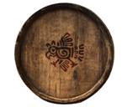
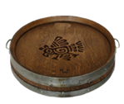
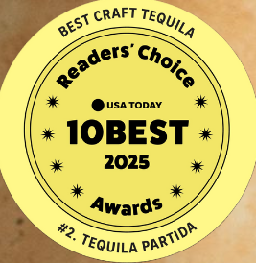
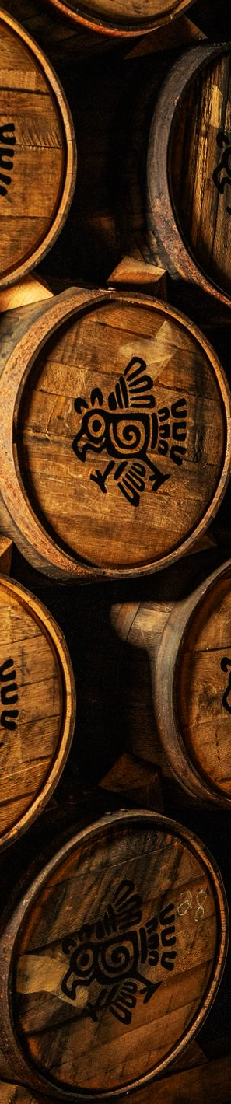
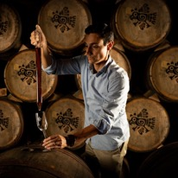
REPOSADO
HIGH PROOF
SINGLE BARREL
TWO BARREL SELECTION OPTIONS
TWO BARREL SELECTION OPTIONS
Experience No 1*
Visit us at Tequila Valley
Visit the Tequila Valley to embark on a unique journey to choose your single barrel.
*Minimum 2-barrel purchase, Trip for 1 individual incl: (Flight, two nights hotel and transportation in Mexico)
The tour begins with an immersive walk through the agave fields, where expert jimadors demonstrate the centuries-old process of harvesting the piñas, the heart of the agave plant
Next, you’ll head to the distillery, where you’ll take a guided tour
to witness the magic of tequila production firsthand
Next, you’ll head to the aging room, lined with rows of our unique barrels. You’ll be guided through the art of barrel selection by Partida’s Master Distiller, José Valdez
Experience No 2
Via Sample
We will present you with three samples straight from the barrels.
Go through your samples at your own pace and choose the hand selected barrel that you like best.
“Choosing a single barrel is the beginning of a deeper collaboration. It reflects the trust we build with our partners and our commitment to creating lasting relationships with the accounts that champion Partida. This connection naturally extends across the entire Partida expressions - from Blanco to Añejo and Roble Fino lineup - all crafted with the same care and philosophy.”
José Valdez, Maestro Tequilero, Tequila Partida

