Slide 1
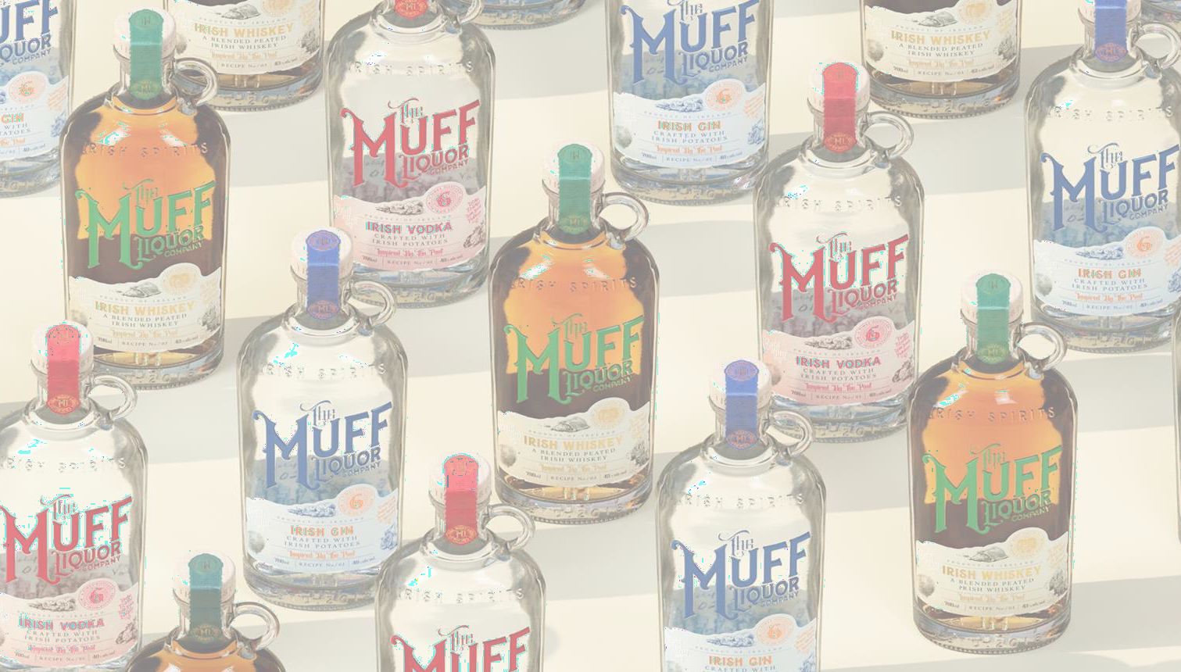

Slide 2
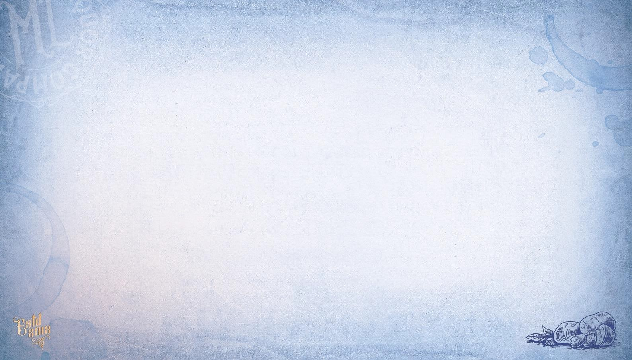
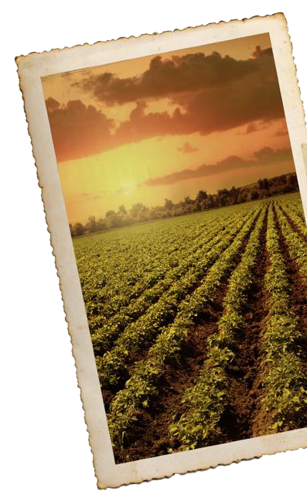
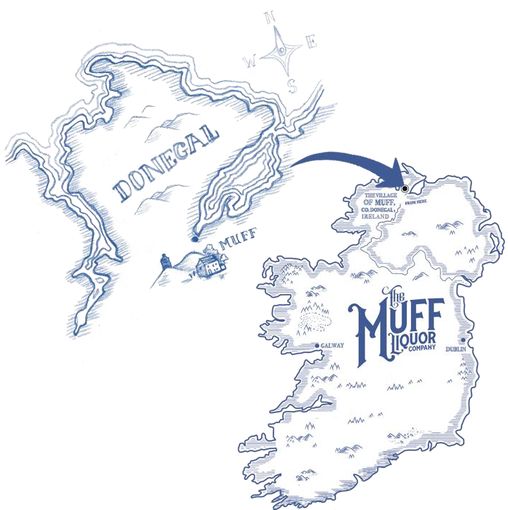
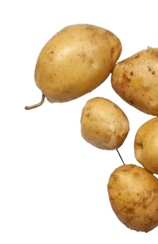
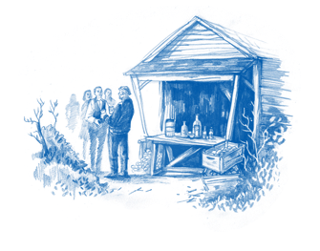

MUFF, THE MEANING.
(It’s a Place.)
We are The Muff Liquor Company, named after the town of Muff on the Inishowen peninsula in County Donegal, where our founder’s grandfather, Philip
McClenaghan, farmed the bountiful soil and started using potatoes to make his unique ‘potion’ using his own recipe and distillation process.
it’s also where our brand home is.

Slide 3
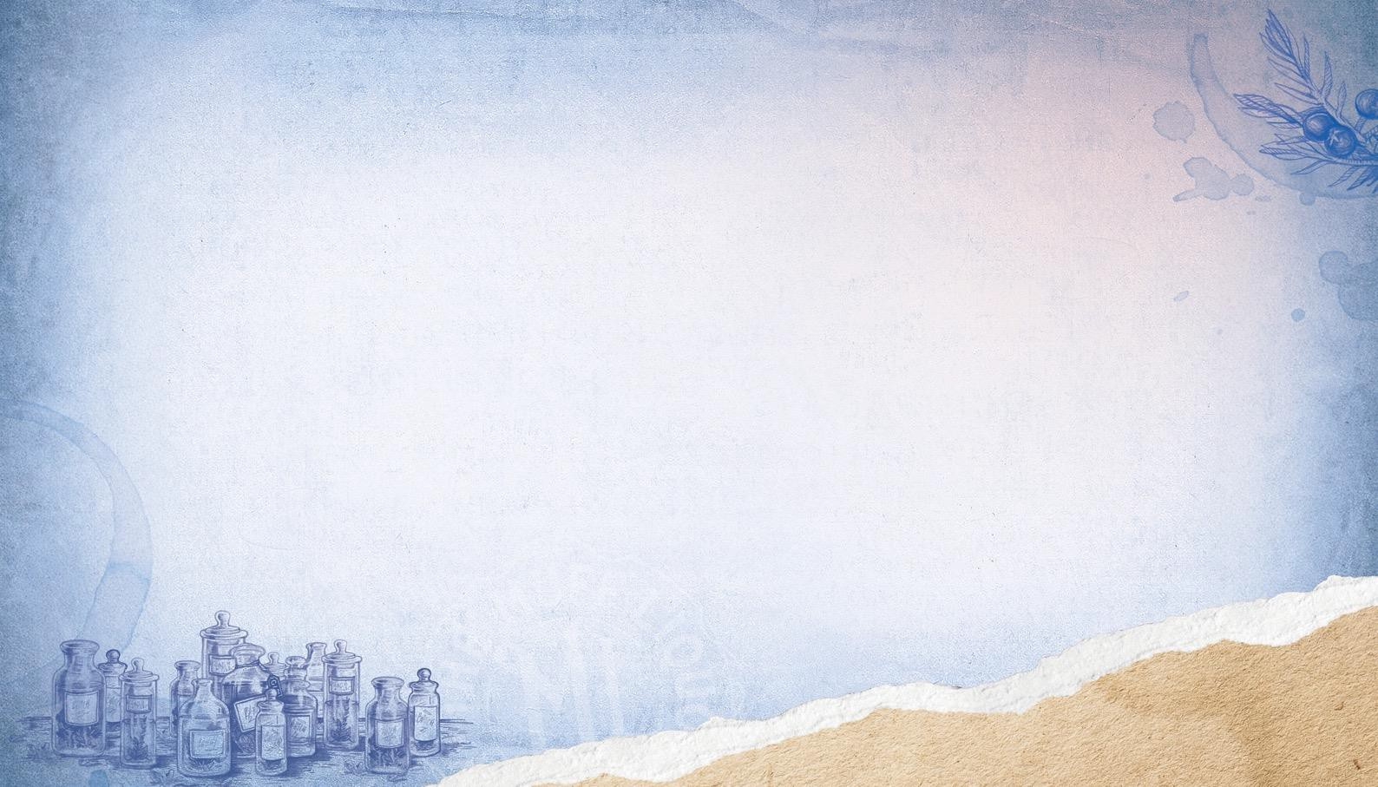
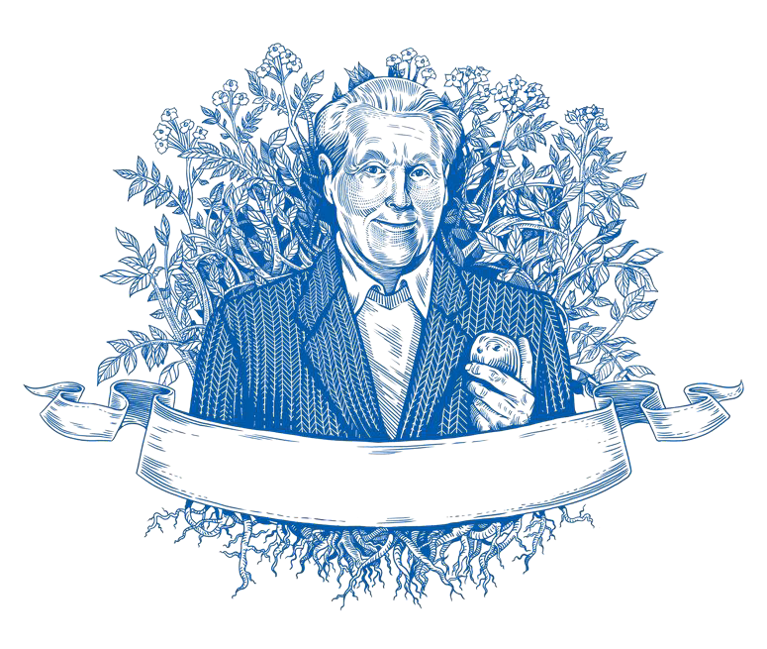
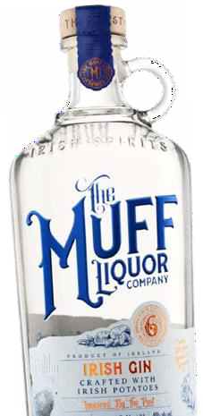
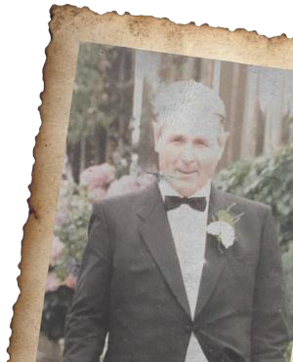

OUR HISTORY & INSPIRATION
Our co-founder Laura’s grandfather, Philip McClenaghan is the inspiration behind our brand. A potato farmer who enjoyed experimenting with his crop, he developed the traditional Irish Poitín recipes upon which our spirits are based
c

Slide 4
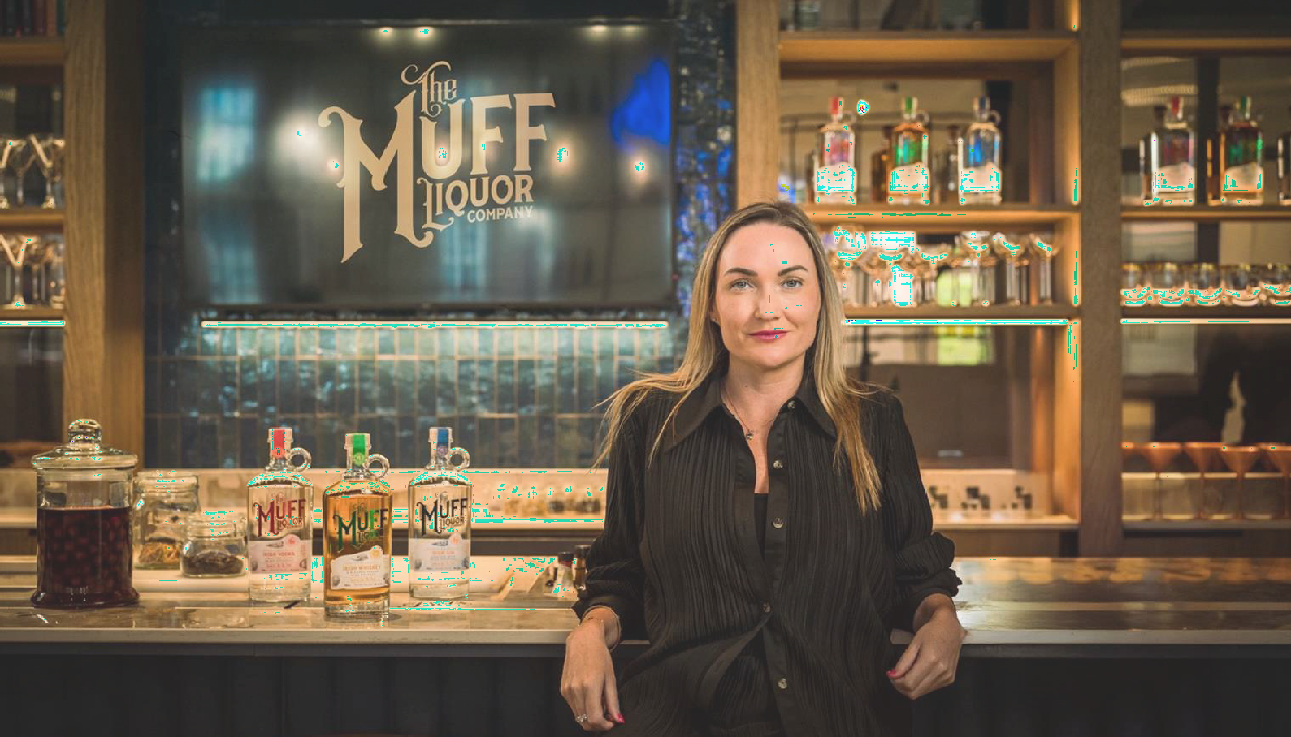


Slide 5
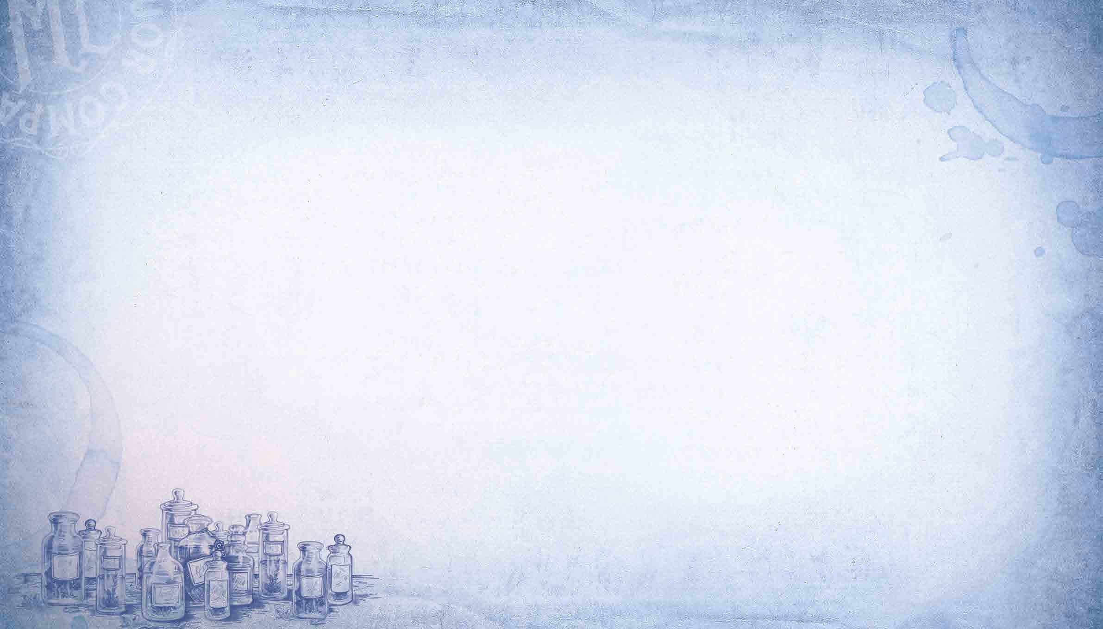
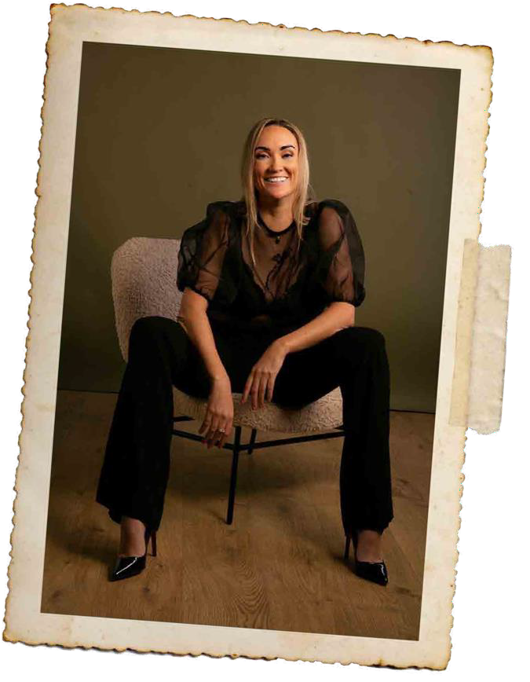
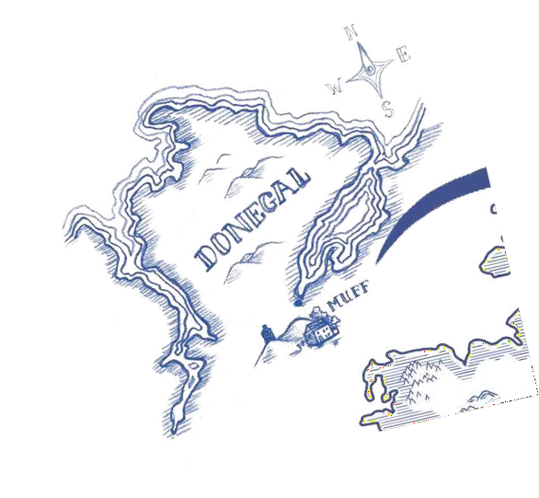

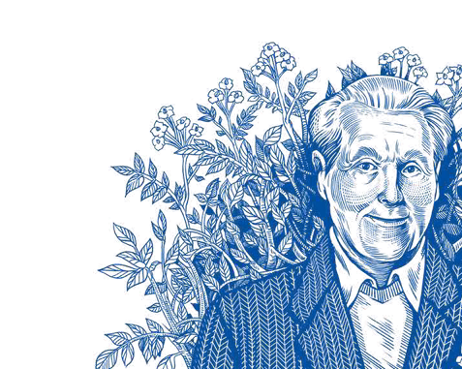
LAURA’S STORY
The legacy continues..
A proud native of Donegal hailing from the very shores upon which the company is based, Laura is the CEO,
Co-Founder and original visionary of The Muff Liquor Company. An instinctive entrepreneurial mind with
an uncompromising work ethic, Laura’s knowledge
and experience in the business world is vast.
Having graduated with a Law degree from Dublin Business
School, Laura embarked on a career in real estate
that spelled success on a global scale.
Laura return home in late 2017 to continue her Granda legacy by establishing her own premium Liquor company centered around family tradition, quality local produce and a firm devotion to a place that affords every bottle of our delicious craft spirits their unique, authentic taste.

Slide 6
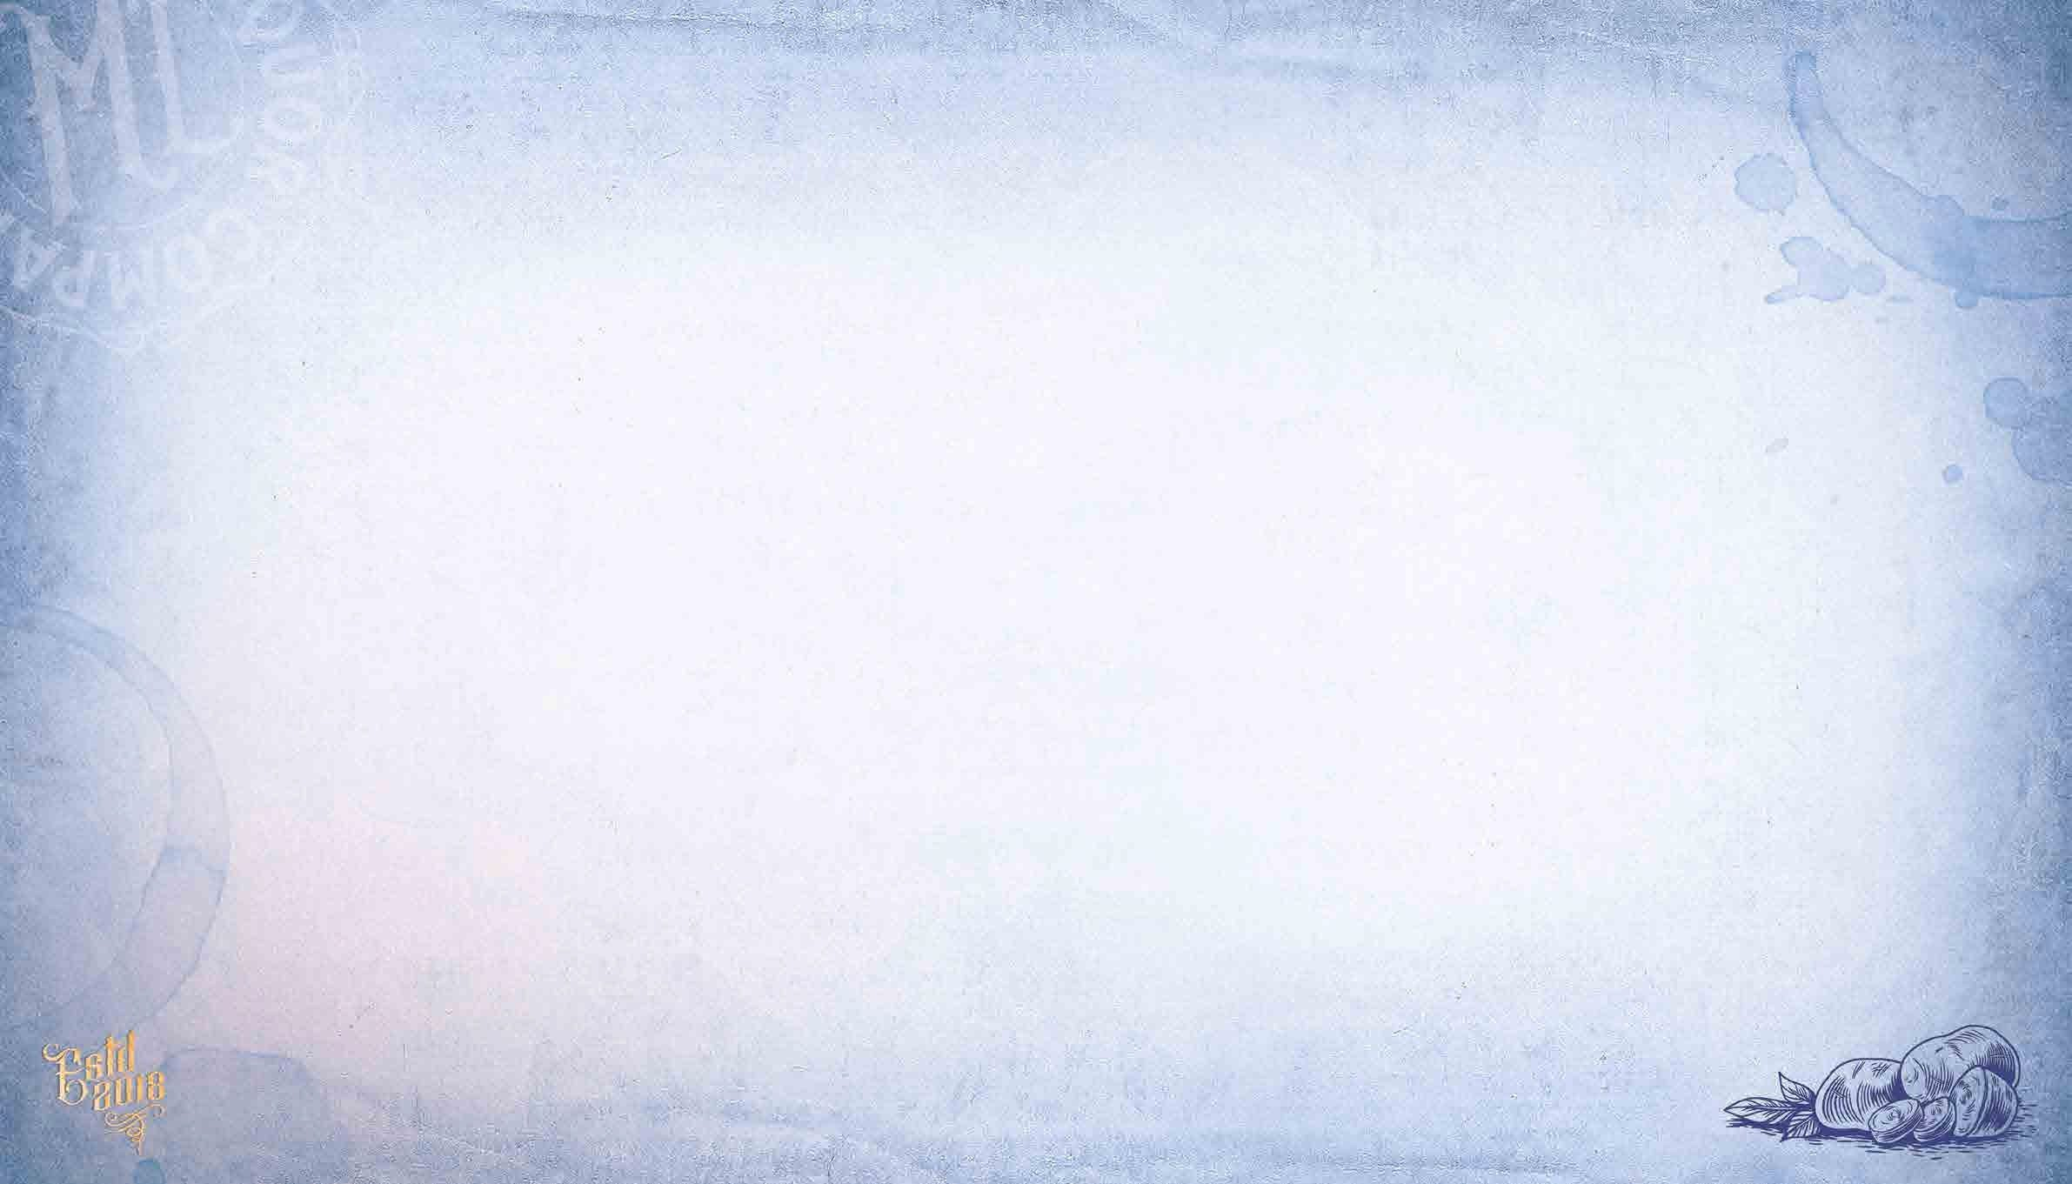
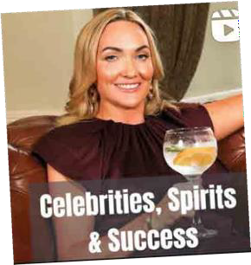
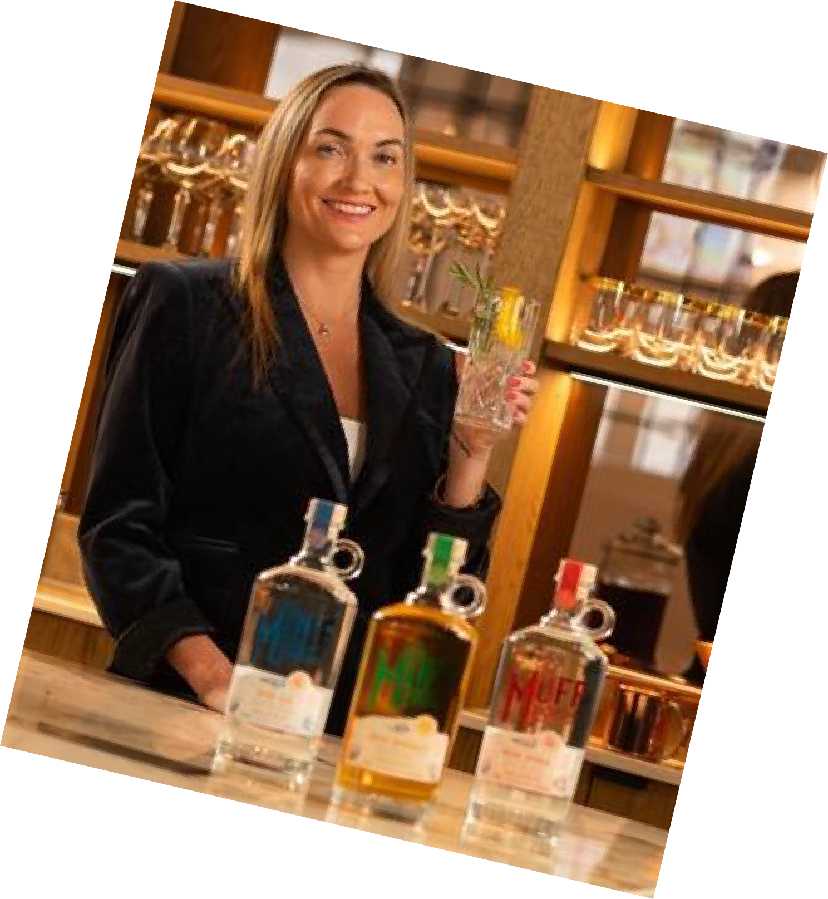
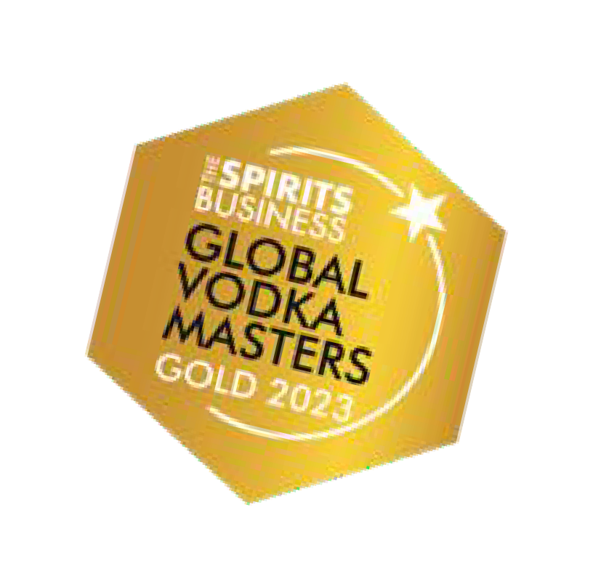
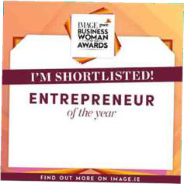
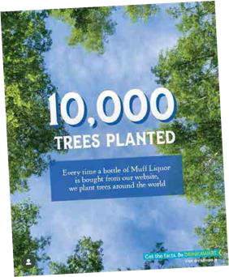
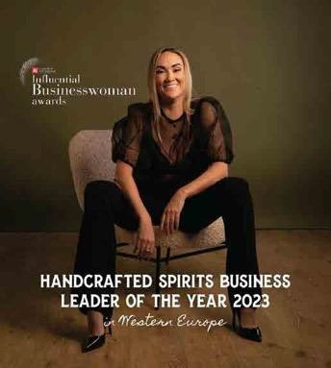
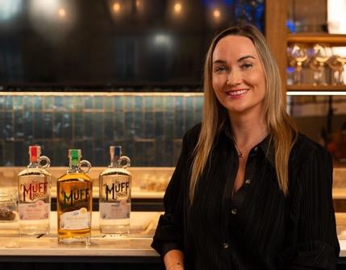
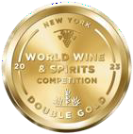
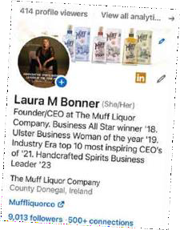
LAURA’S STORY
For her pioneering work in the establishment of The Muff Liquor Company, Laura won a Business All Star award in 2018 and was selected as a key spokesperson for the ‘Back to Business’ roundtable sessions with the Department of Foreign Affairs & Trade in 2019.
In the same year, she was named Most Inspiring Ulster Businesswoman of The Year and is a respected member of ‘Women in Business’. In 2022, Laura was shortlisted as an Entrepreneur of the Year by IMAGE Magazine and PwC for Businesswoman of the Year Awards 2022 and rewarded Hand-crafted spirit leader in Western Europe 2023.

Slide 7

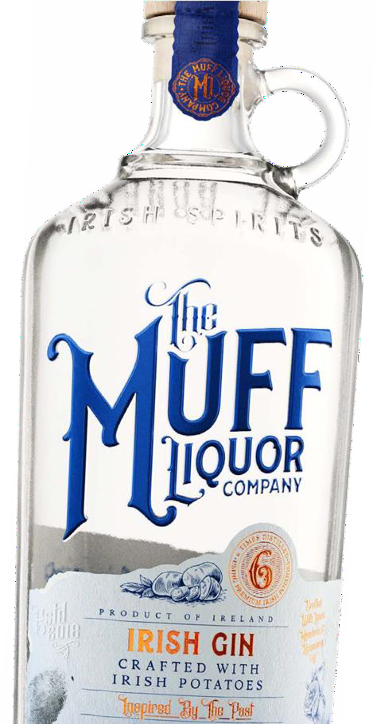
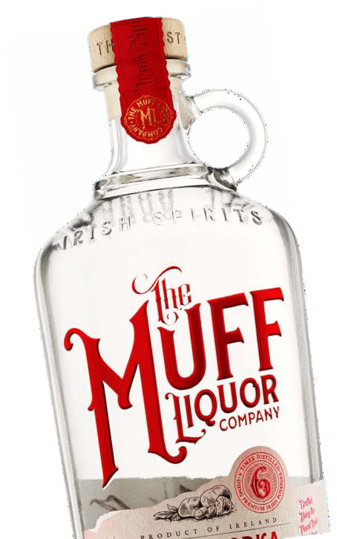
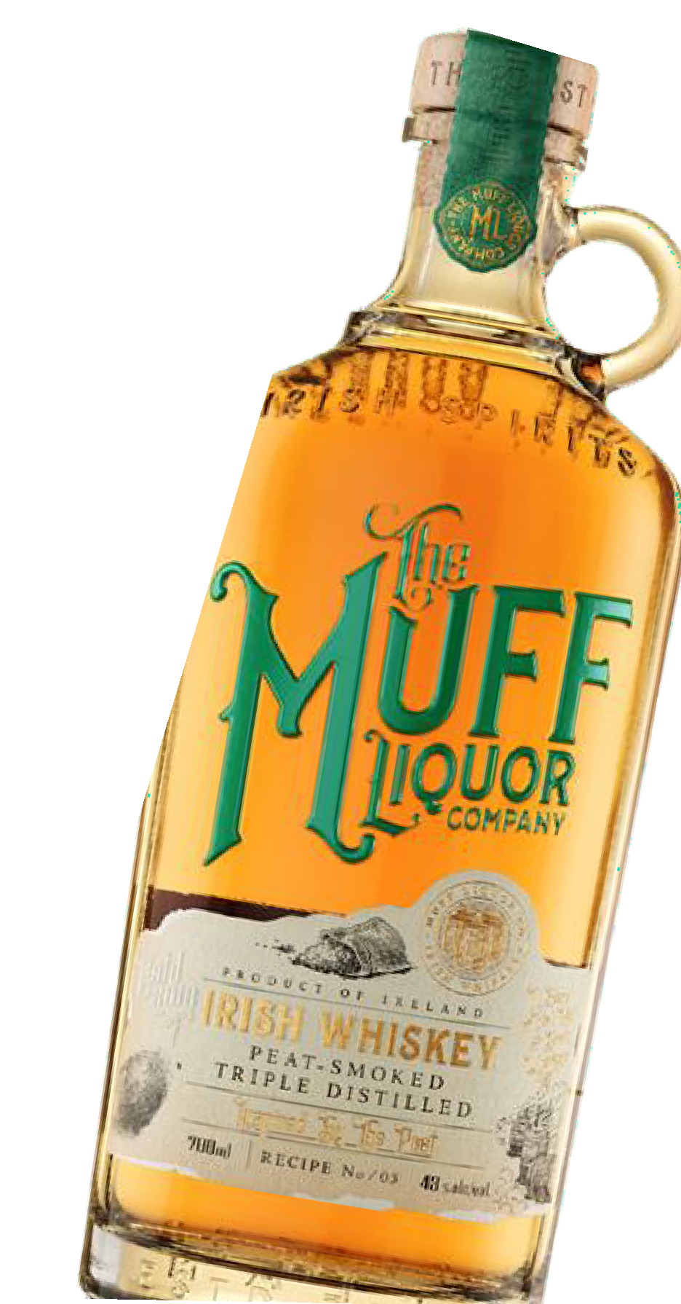
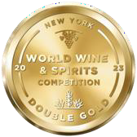
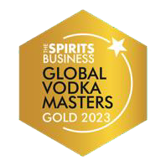


WHAT WE DO
The Muff Liquor Company produces award winning spirits: Muff Irish Whiskey, Vodka & Gin
89
POINTS
CONSUMER BENEFIT:
better brand stories & experiences!
TRADE BENEFIT:
greater profits!

Slide 8
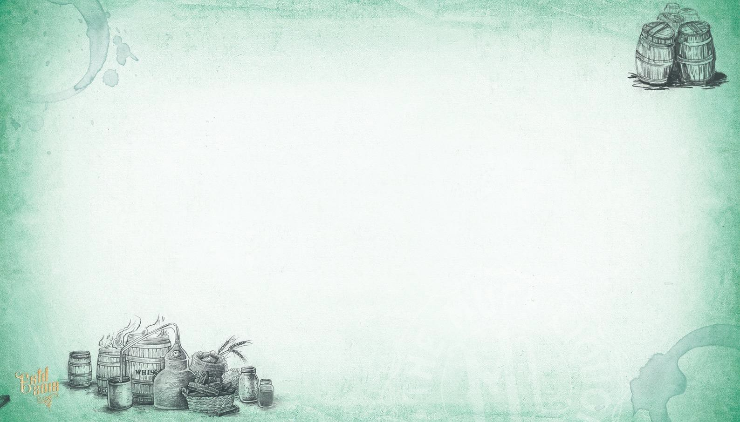

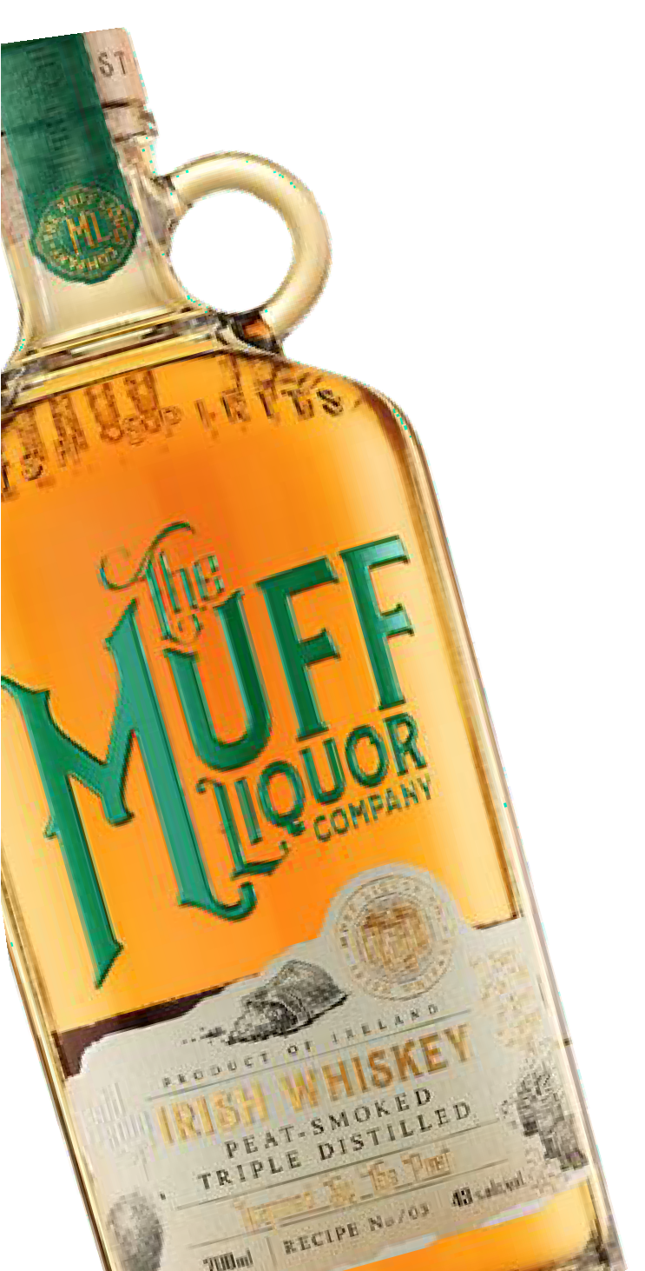
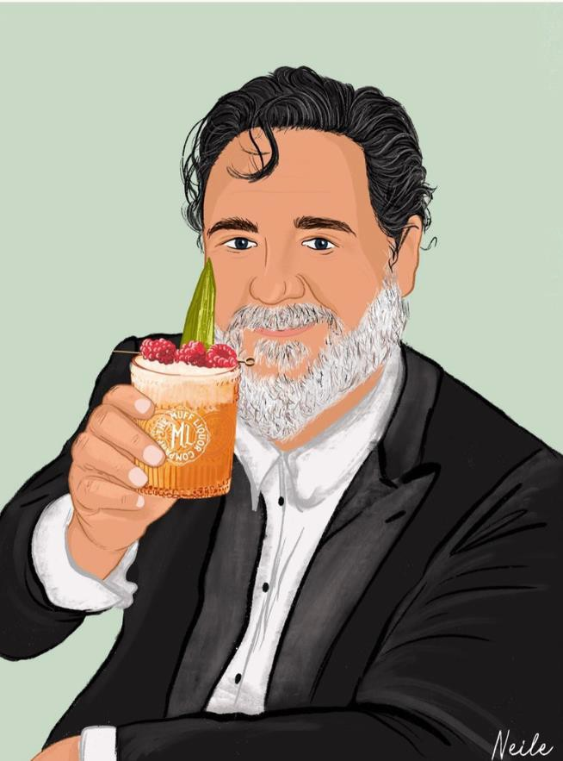

IRISH WHISKEY
Muff Irish Whiskey is a 5-part blend of Irish Malt and Grain Whiskeys, each one bringing an individual element. These combine to give multiple layers of flavor on the nose, middle- palate and end of the tasting experience.
gives a body to the drink
Russell Crowe Loves….
The Muff Liquor Co. Whiskey
straight up or in a Penicillin
Penicillin Cocktail
2 oz The Muff Liquor co. Whiskey
¾ oz Fresh Lemon Juice
¾ oz Honey-ginger syrup
Garnish: Candied ginger
Blend #1
Irish triple distilled grain whiskey in a
Blend #4
virgin cask will get a very dark color from Double distilled Irish malt whiskey will
the heavy char toasting and give sweet have fruity-esters present vanilla note
Blend #5
Blend #2
Peated triple distilled malt whiskey is
Irish triple distilled grain whiskey maturedagain matured in ex-American bourbon in ex-American bourbon casks will give a casks and will bring a smoky flavor and
light, sweet note to the mix
Blend #3
Sherry matured triple distilled malt
whiskey
long finish
89
POINTS

Slide 9

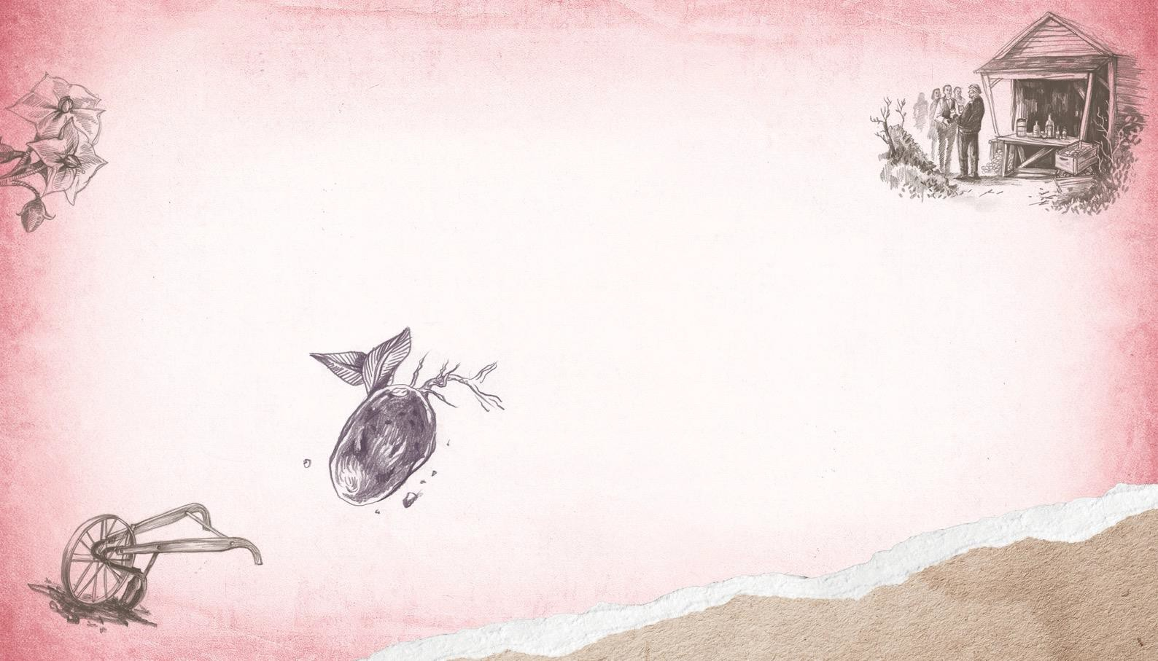
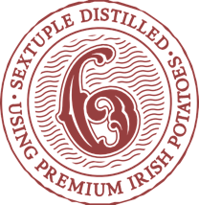

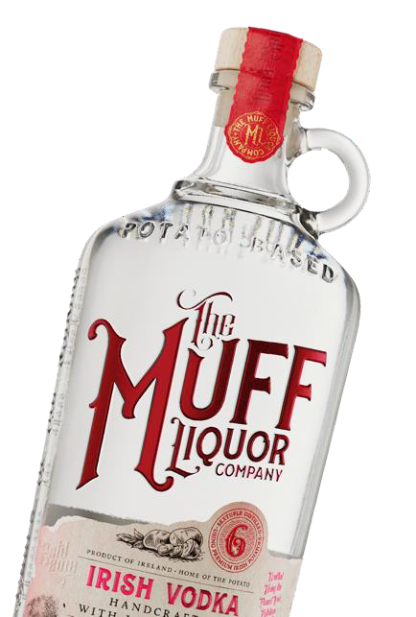
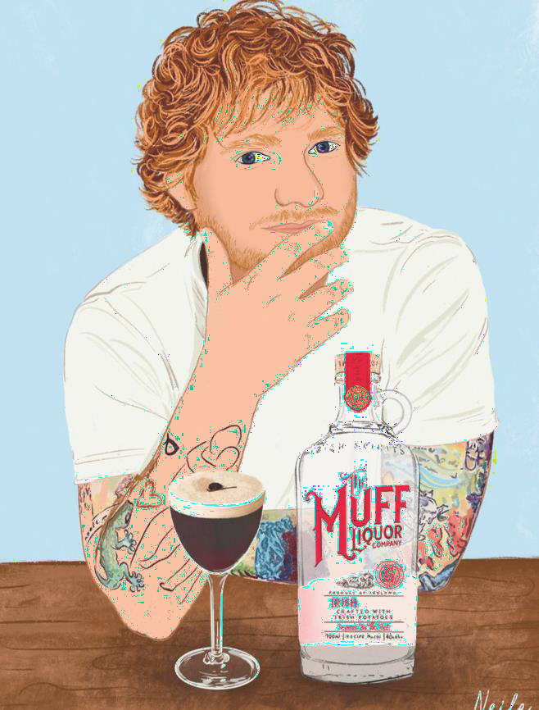
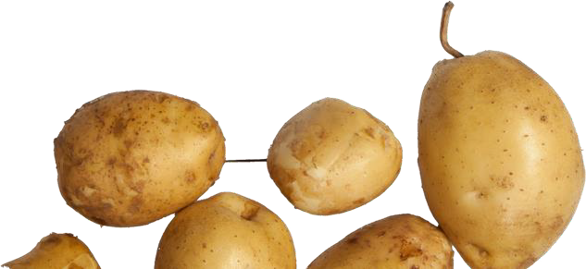
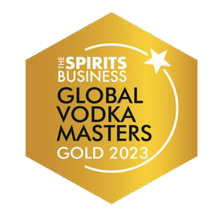
IRISH VODKA
Ed She e ran Love s….
The Muff Liquor Co. Espresso Martini
1.5 oz The Muff Liquor Co,
Vodka
1 oz Galliano espresso Liqueur 1 oz Espresso
Garnish: 3 coffee beans
Crafted by using the fine s t Iris h potatoe s
Inspired by the old recipes of Granda McClenaghan. Muff vodka is distilled six times creating a crisp, clean liquid hand crafted by using the finest Irish potatoes.
The result is a premium vodka which is finely balanced with a creamy and earthy taste and a hint of vanilla on the nose.

Slide 10
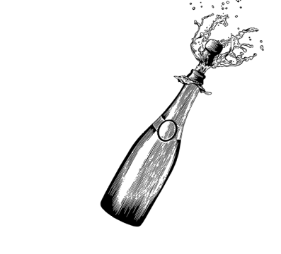


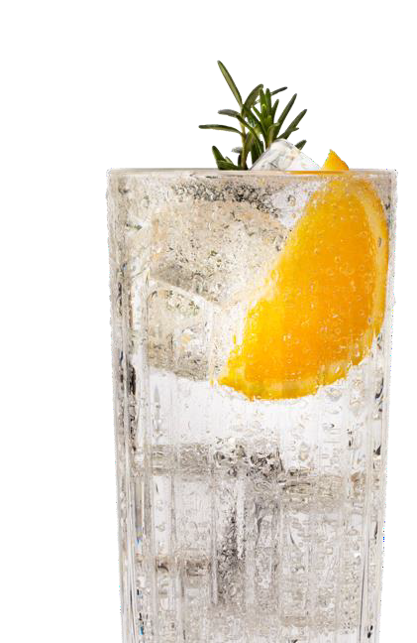
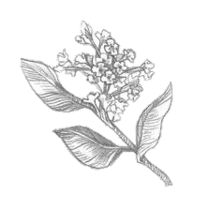
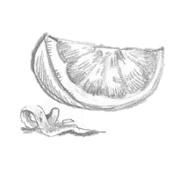
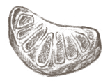
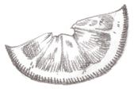
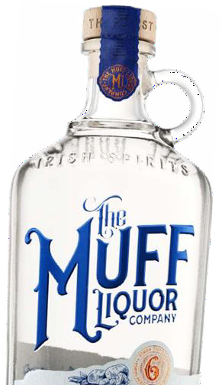


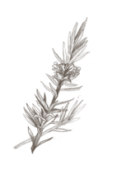
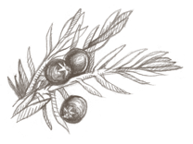

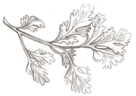



IRISH GIN
While authentically potato bas e d in nature, the Muff Liquor Gin also contains a carefully selected blend of natural botanicals
Prior to bottling, a Champagne extract is added to the gin at the end of the process.

Slide 11
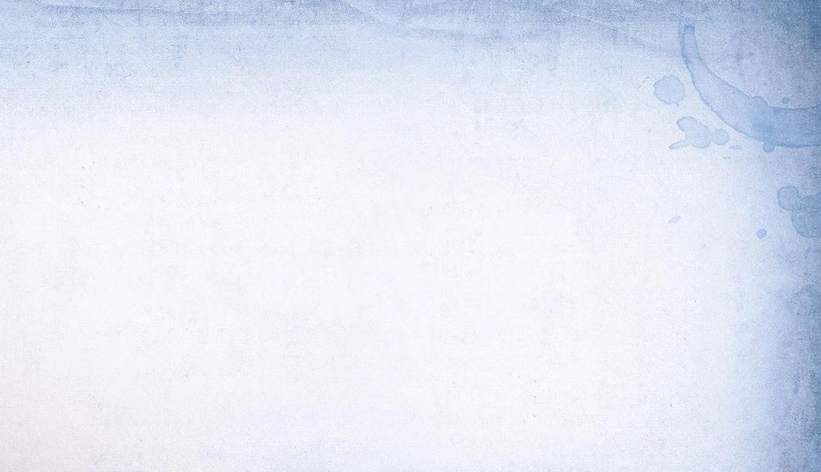






KEY COMPETITORS GIN
SAME PRICE TIER & QUALITY
VS CRAFT BRANDS
Market Insights:
Gin is experiencing a resurgence, with a growing
number of craft and premium brands entering
the market
Botanical diversity and unique flavor profiles are major trends
Category Insights:
Premium and craft gins with unique flavor profiles are highly
sought after
The narrative around
ingredients and craftsmanship
$34.99
$26
35% TRADE UP VS MAINSTREAM BRAND

Slide 12







KEY COMPETITORS VODKA
SAME PRICE TIER & QUALITY
VS
“CRAFT” BRANDS
$34.99
Market Insights:
Vodka remains one of the most popular spirits in the
USA
Health-conscious consumers
are driving demand for Gluten-free options
Category Insights:
Consumers are looking for brands with unique stories and premium ingredients
Sustainability and ethical production practices are becoming more important
$20
+50% TRADE UP VS
“MAINSTREAM” BRANDs

Slide 13






KEY COMPETITORS IRISH WHISKEY
SAME PRICE TIER & QUALITY
VS CRAFT BRANDS
Category Insights:
Authenticity and tradition are key selling points
Consumers appreciate transparency about the production process and
origin
Innovation in flavor profiles and aging processes is driving interest
Market Insights:
American bourbon and Scotch whisky are particularly popular for
their deep flavors and peat smokiness
$34.99
$30
16% TRADE UP VS MAINSTREAM BRANDs

Slide 14





BOTTLE DESIGN
Clear glass showcasing product
Cork, resealable with logo etched roundel
Etched, premium glass bottle
Distinctive, visually memorable, 700ml bottle,
wide front face to assist with brand visibility on shelf.
Specific segment colors to assist with easy identification
6 times distilled
Made from potatoes
Awards & expert recognition
Craft paper labels show authentic feel, secret notebook style upon which recipes were refined and perfected
Brand origin story on side, back of pack &
inside print of label
Illustrations to show tradition
‘Its that good, Russell Crowe wanted to invest in the business and told his good friends to join him”

Slide 15


THE "MUFFMEN"
OUR CELEBRITY PARTNERS
125 Million followers combined
Our celebrity investors are a group of friends who believed in the brand so much, they chose to invest
in us
and support our growth forward. With significant successes in the entertainment industry, our celebrity investors are highly regarded and
influential with consumers eager for their every recommendations.
russellcrowe
1.2M + 4M
jimmycarr
1.0M +2.5M + 7M + 1.1M
rokeating
496K + 684K + 800K
teddysphotos
51M +23M +17.1M + 15.3M

Slide 16

MUFF BRAND HOME

Slide 17







PRESS
Muff Liquor’s founder Laura Bonner crowned Global Irish Business Entrepreneur of the Year
High spirits as comedian Jimmy Carr visits Muff Liquor Company's Brand Home

Slide 18













AWARD WINNING SPIRITS
THE TEAM
IRELAND

Slide 19



SHELF PRICING
line priced at $34.99

Slide 20




CHANNEL GUIDELINE KIT
6 PAGE GUIDE FOR BEST
OFF & ON-PREMISE
PLACEMENT EXECUTION

Slide 21



SHIPPING CASES

Slide 22




POS-PRINT
Shelf talkers
Window Posters
Print POS to become available on Brand Muscle

Slide 23




POS-MERCH
Be like
Ed Sheeran
wear His favorite trucker cap
T-shirts available in Black and White
Available in three colors

Slide 24


