Slide 1


MEDIA COVERAGE
2024-2025

Slide 2


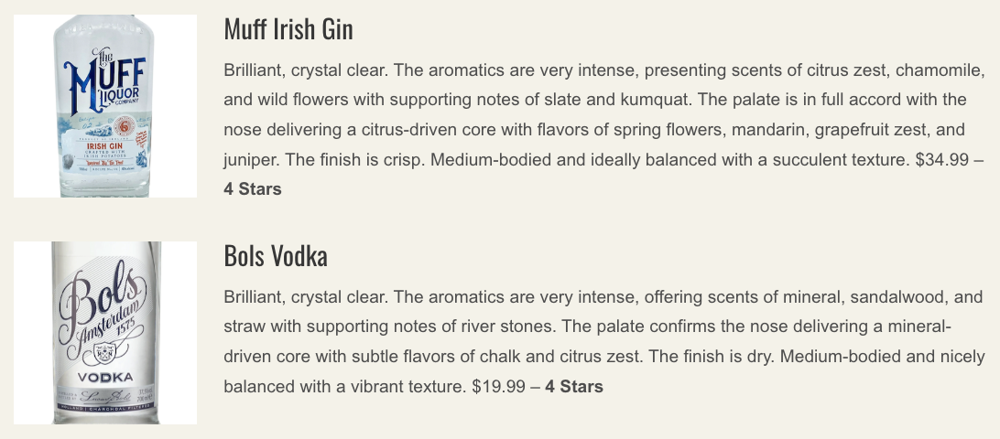
Date: 8/20/2025
Online Visits: 5,000
Click to view article

Slide 3


August 2025 Issue
Print Circulation: 34,000

Slide 4



Slide 5


Slide 6


Slide 7



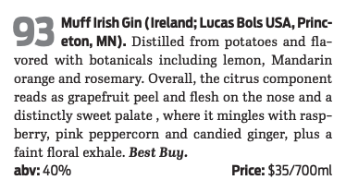
August/September 2025 Issue
Print Circulation: 337,516
Click to view article

Slide 8


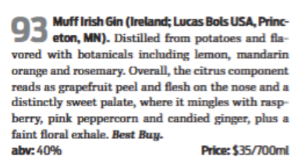
August/September 2025 Issue
Print Circulation: 337,516

Slide 9


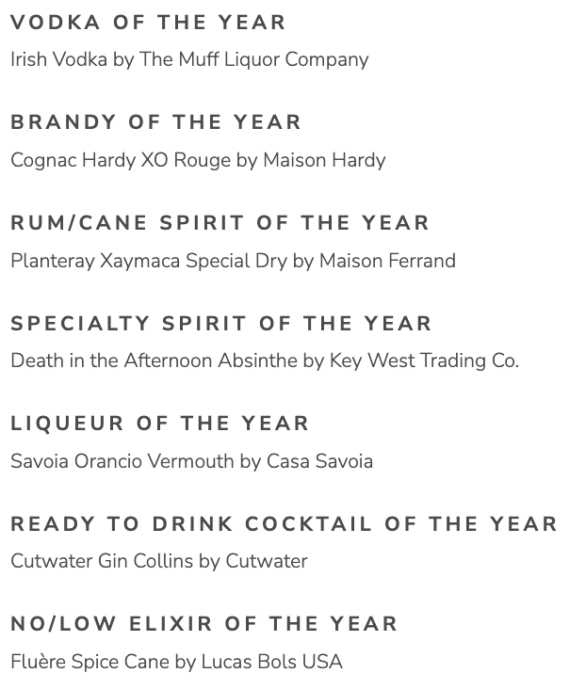
Date: 7/23/2025
Online Visits: 78,095
Click to view article

Slide 10


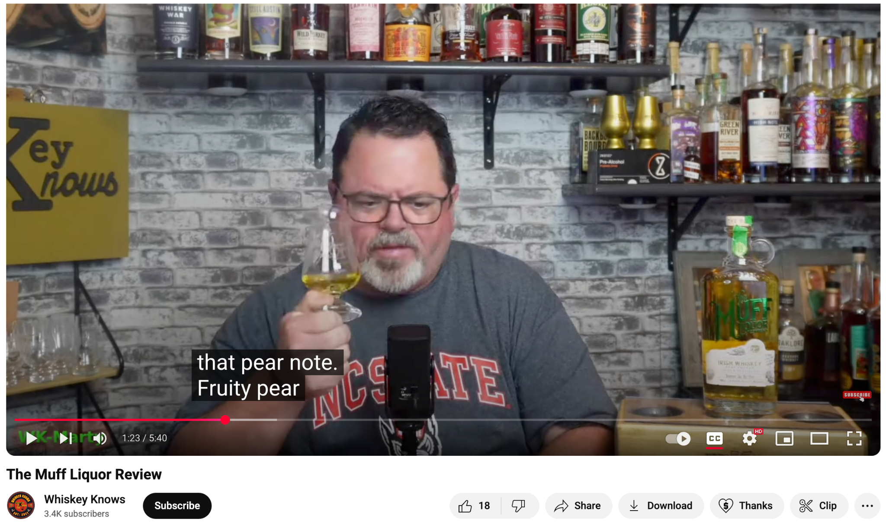
Date: 7/18/2025
Followers: 3,400
Click to view video

Slide 11

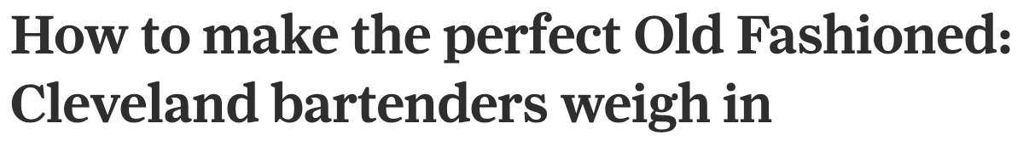
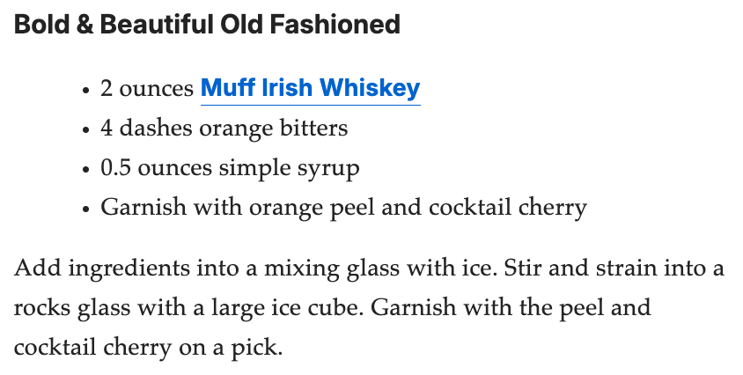
June 14, 2025
Online Visits: 280,690
Click to view article

Slide 12

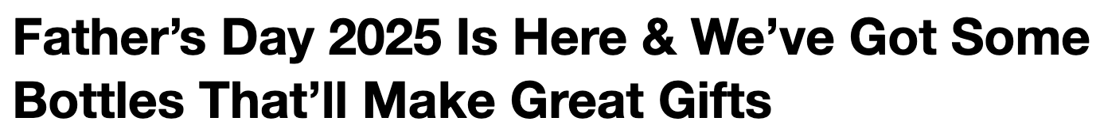
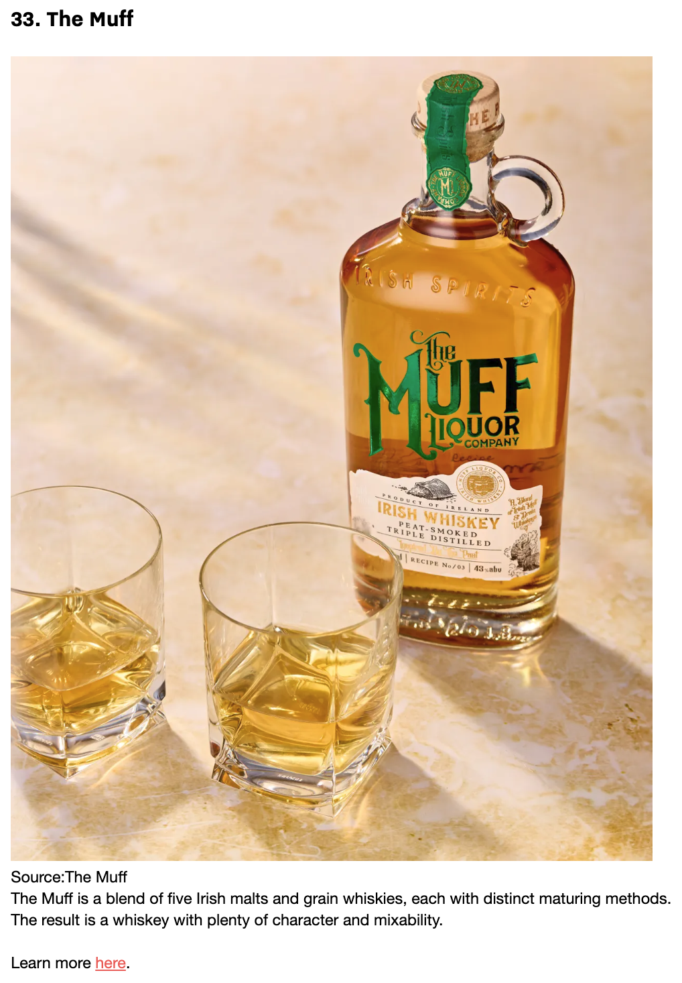
Date: 6/14/2025
Online Visits: 32,310
Click to view article

Slide 13



 | Date: 6/14/2025 Online Visits: 5,000 Click to view article
 | Date: 6/14/2025 Online Visits: 24,715 Click to view article
 | Date: 6/14/2025 Online Visits: 10,172 Click to view article
Syndications from Cassius

Slide 14

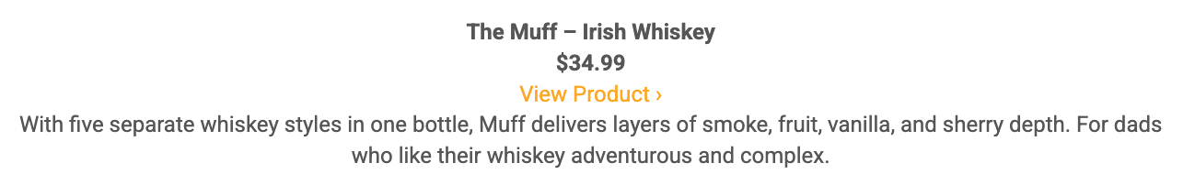
Date: 6/9/2025
Online Visits: 5,000
Click to view article

Slide 15


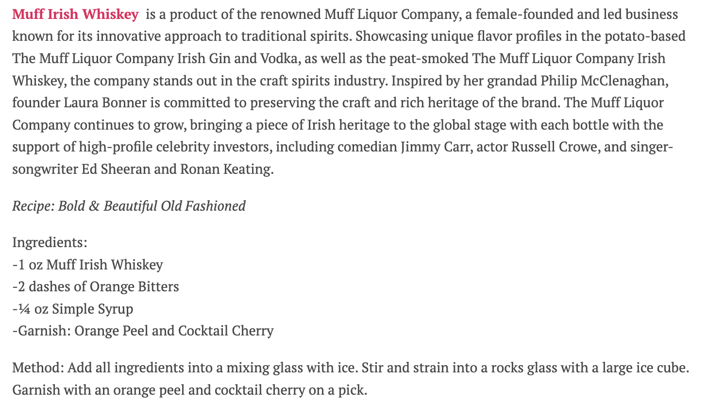
June 4, 2025
Online Visits: 47,058
Click to view article

Slide 16

 | June 4, 2025 Online Visits: 5,000 Click to view article
Syndications from Woman Around Town

Slide 17



June 2, 2025
Online Visits: 7,851
Click to view article

Slide 18

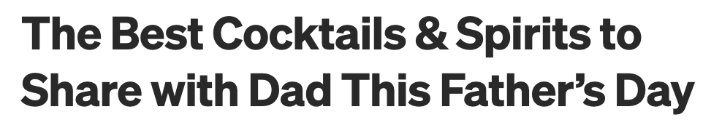


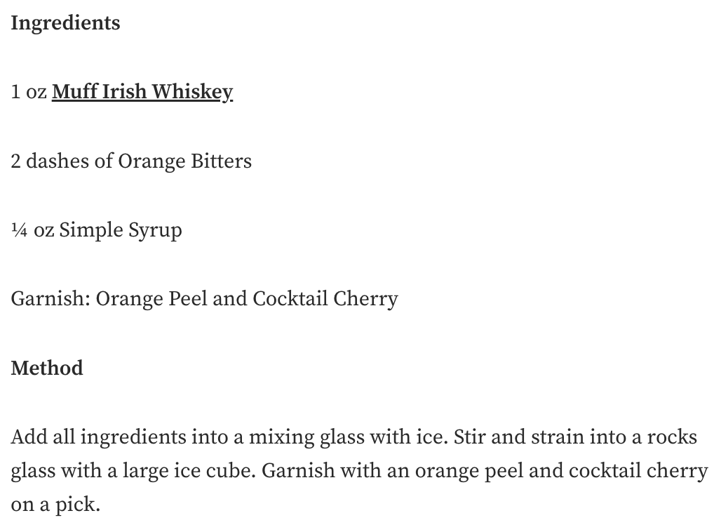
May 29, 2025
Online Visits: 5,000
Click to view article

Slide 19


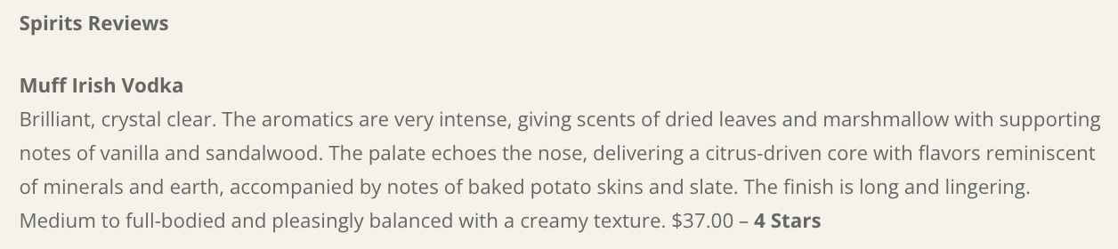
May 14, 2025
Online Visits: 5,000
Click to view article

Slide 20

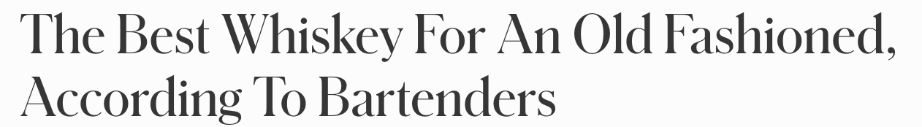
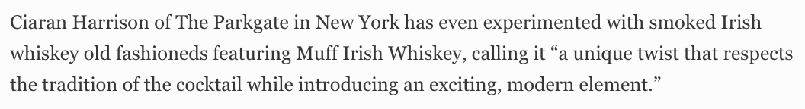
May 13, 2025
Online Visits: 78,108,059
Click to view article

Slide 21

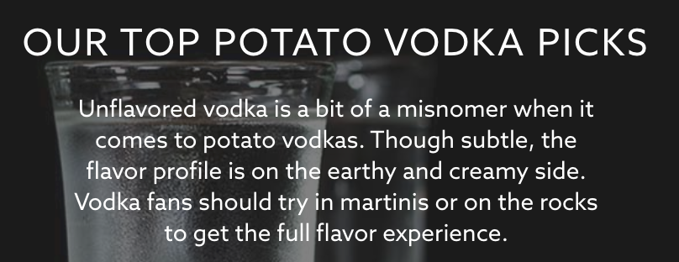
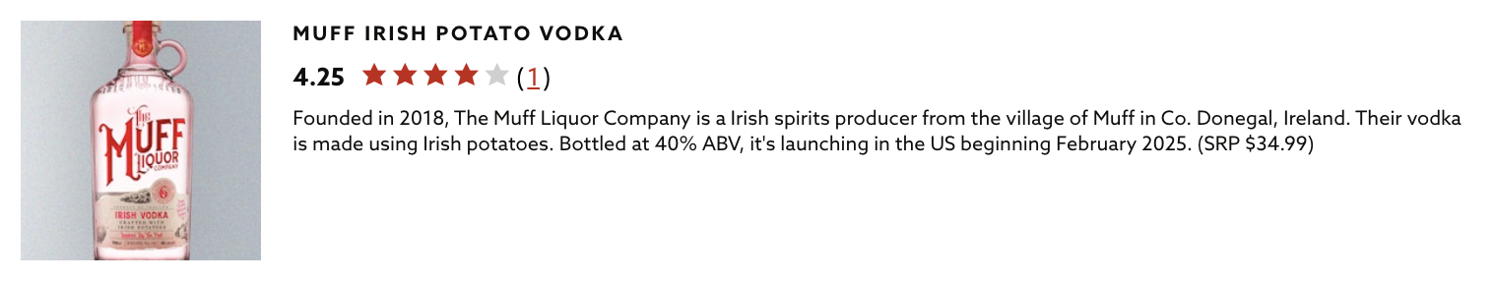
May 8, 2025
Online Visits: 51,265
Click to view article

Slide 22


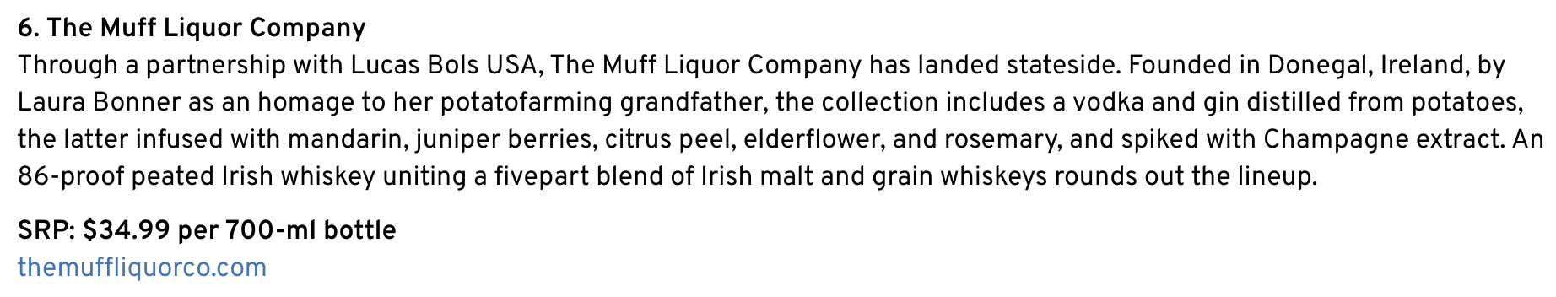
May 1, 2025
Online Visits: 5,000
Click to view article

Slide 23



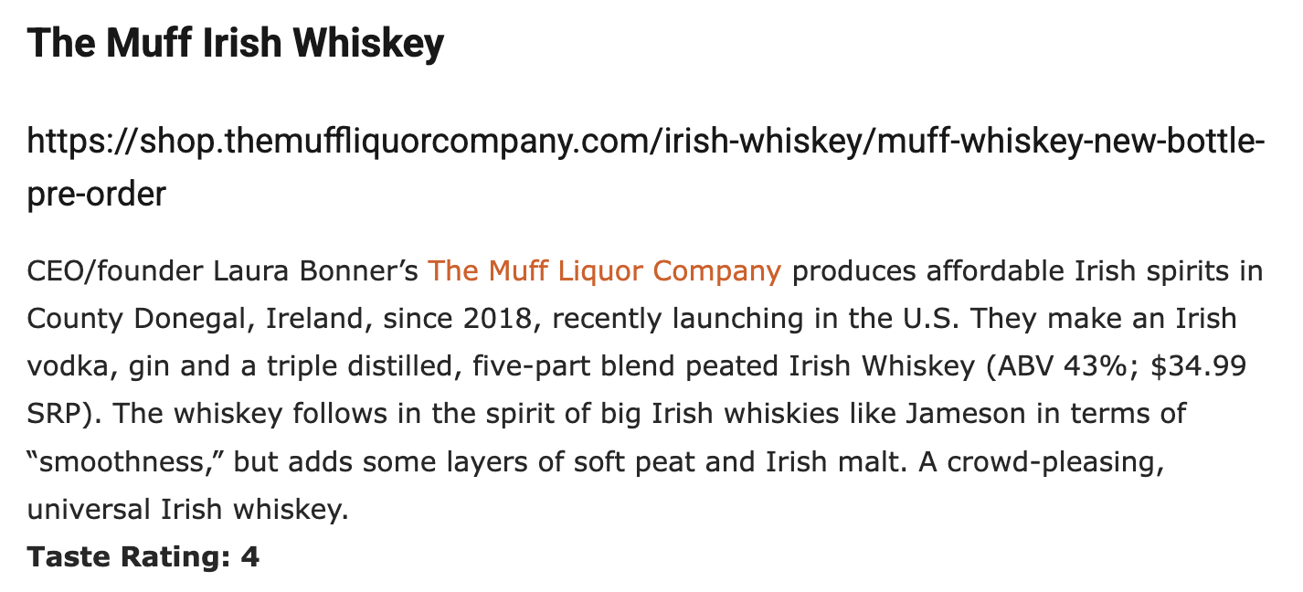
May 1, 2025
Online Visits: 16,241
Click to view article

Slide 24



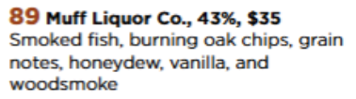
2025 Summer Issue
Print Circulation: 141,774

Slide 25




May 2025 Issue
Print Circulation: 45,000

Slide 26


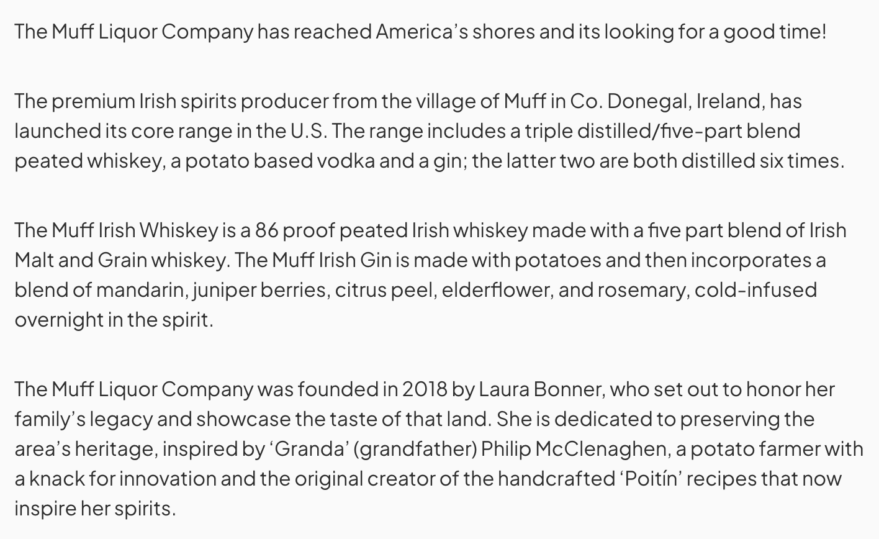
April 16, 2025
Online Visits: 5,000
Click to view article

Slide 27


Slide 28

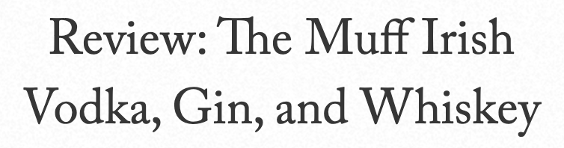

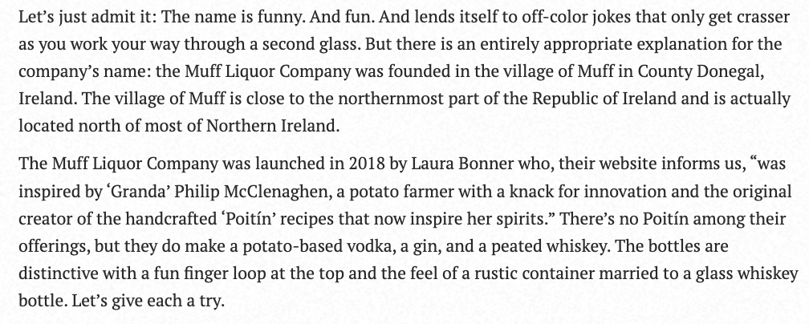
April 10, 2025
Online Visits: 47,296
Click to view article

Slide 29
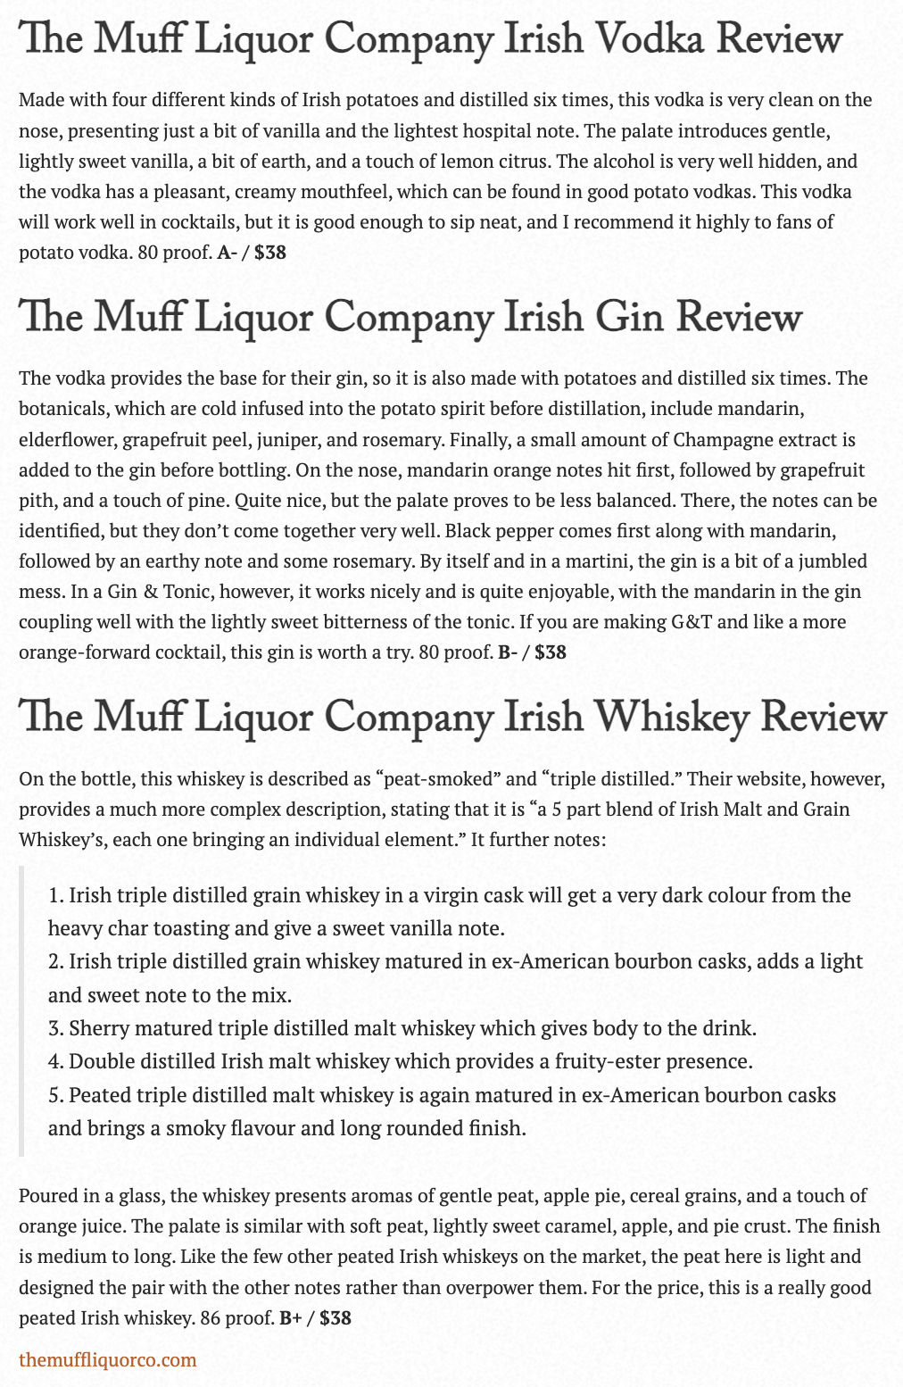

Slide 30


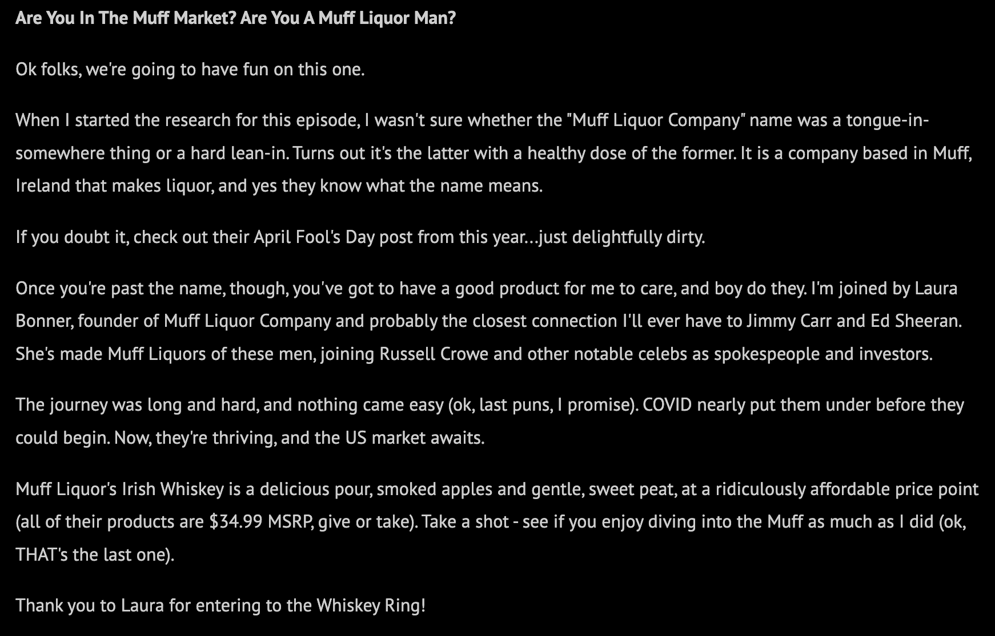
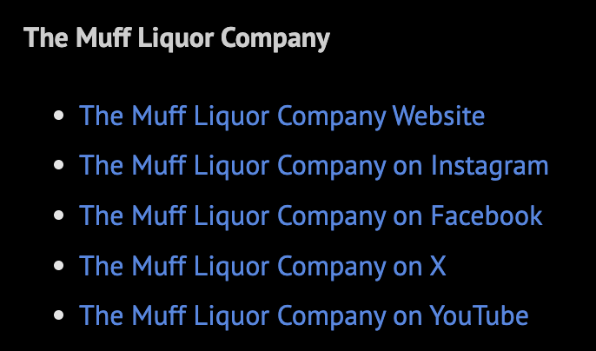
April 9, 2025
Listenership: 15,000
Click to view podcast

Slide 31
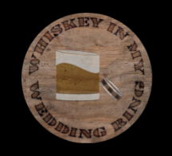

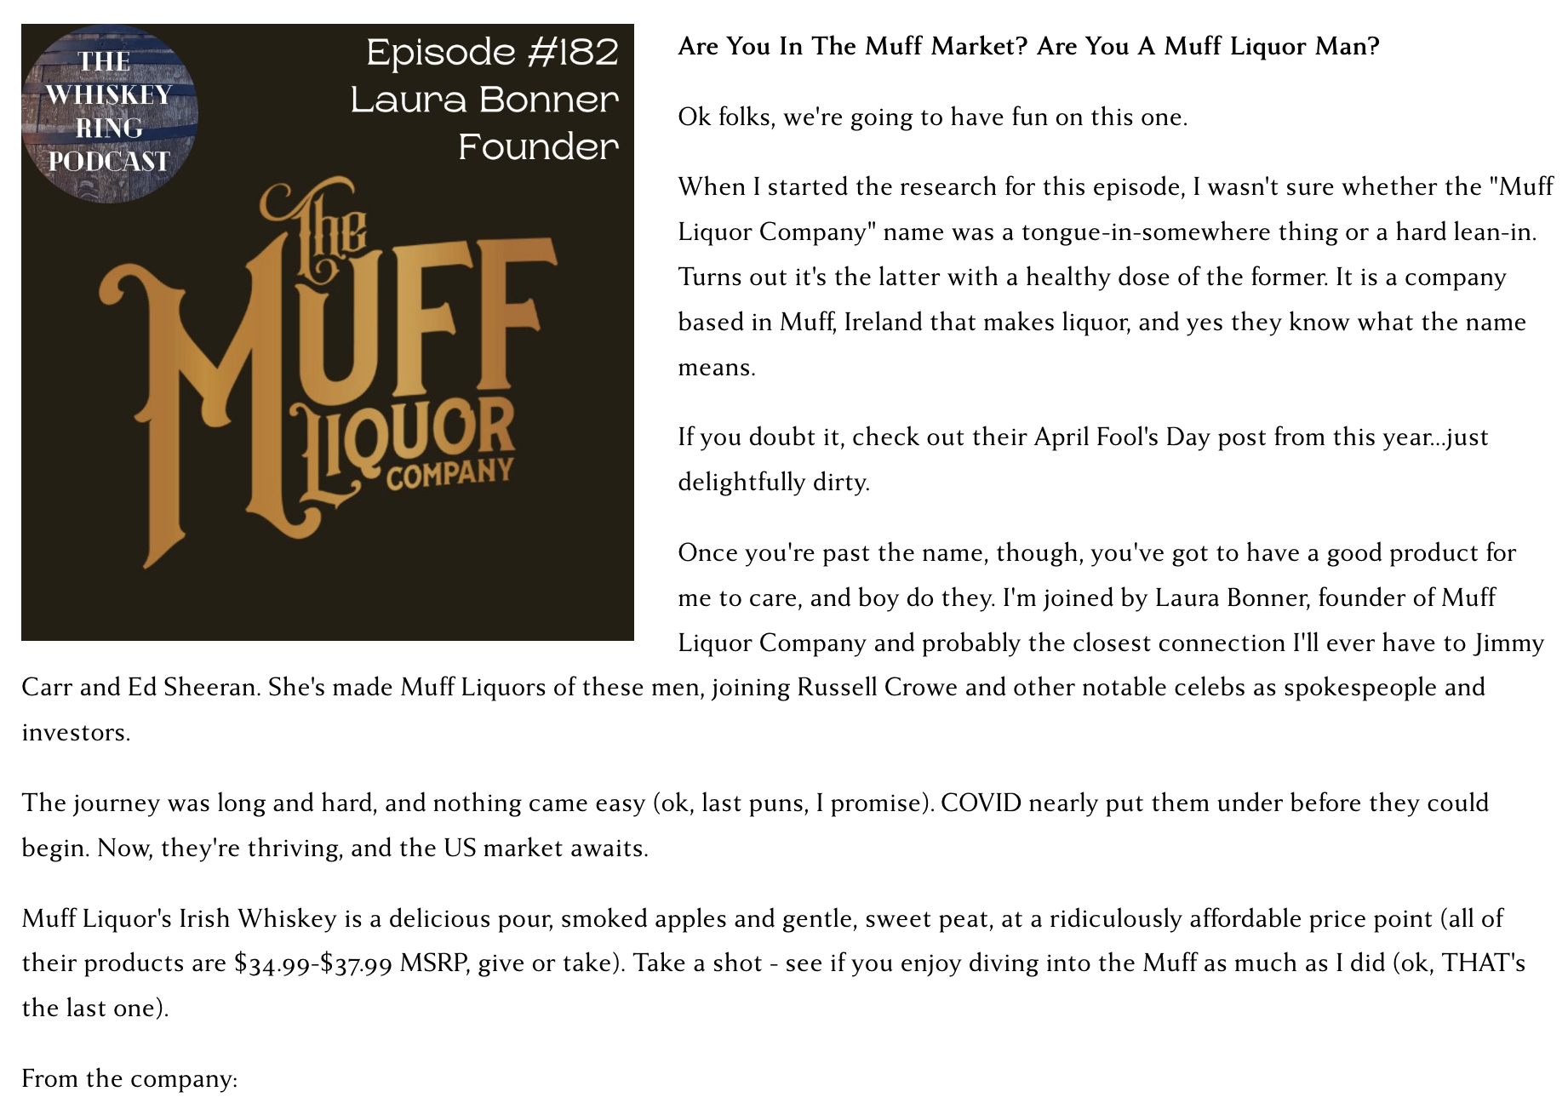
April 9, 2025
Online Visits: 5,000
Click to view article

Slide 32
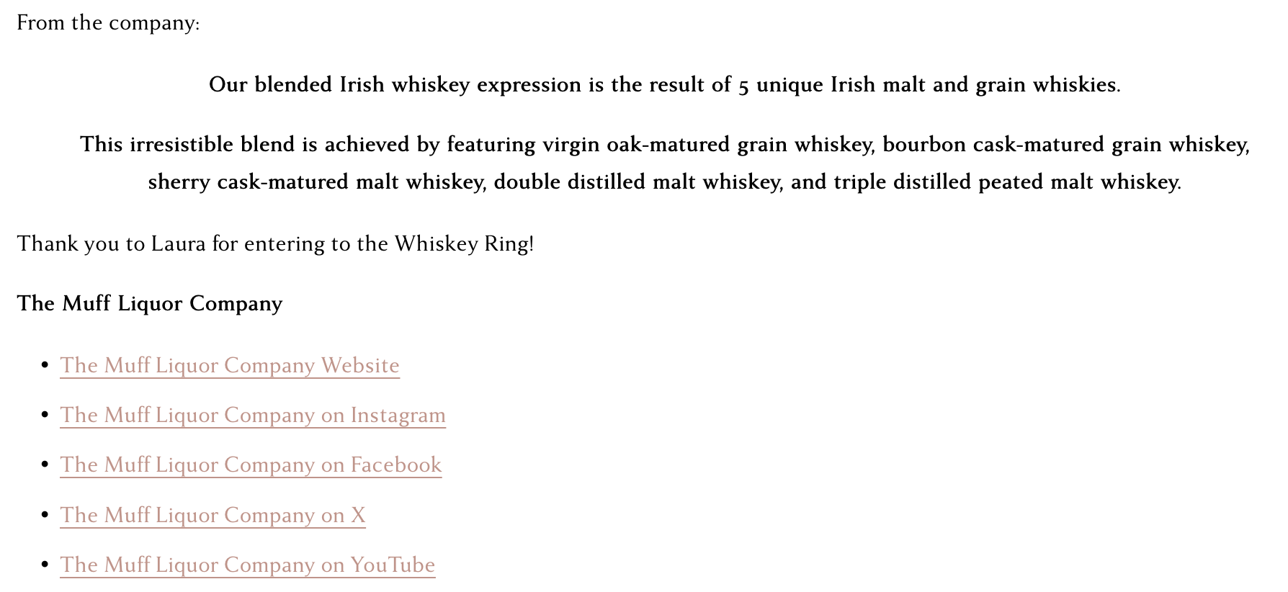
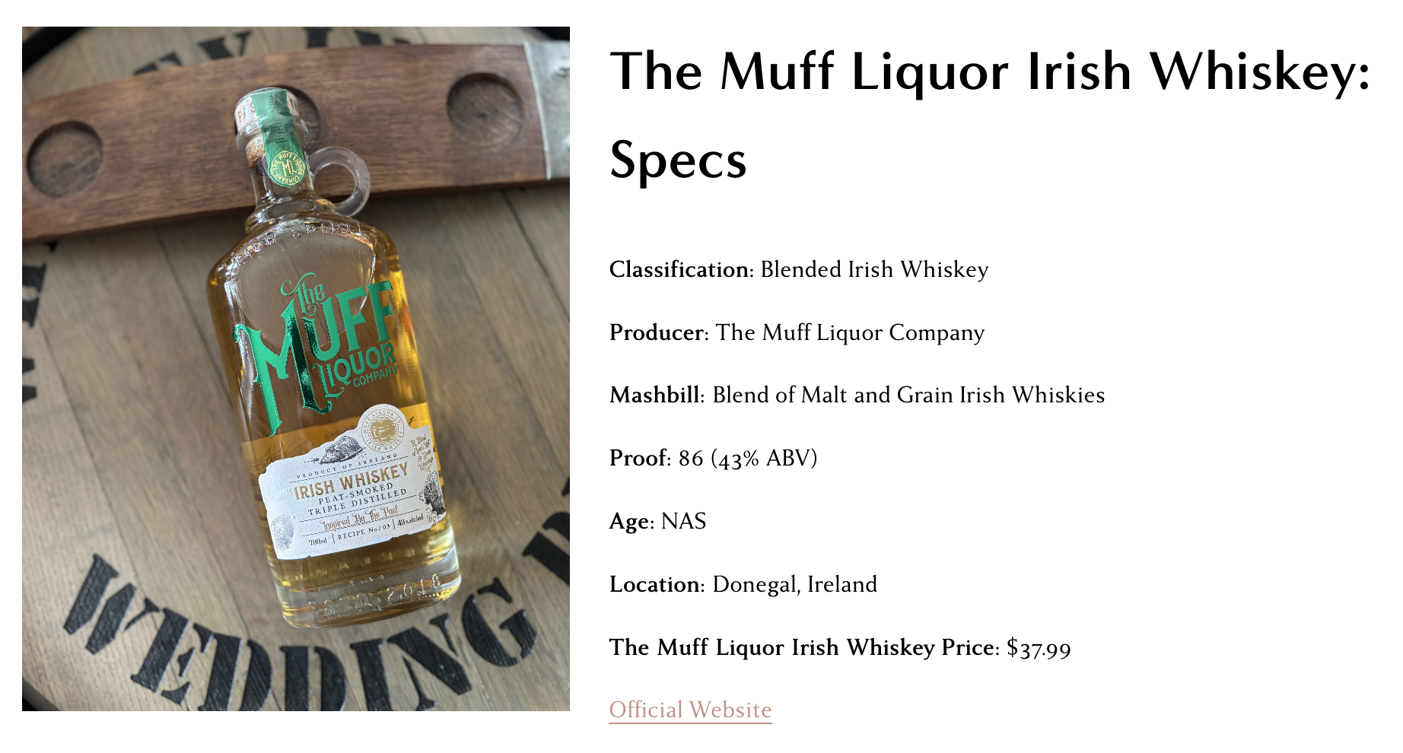
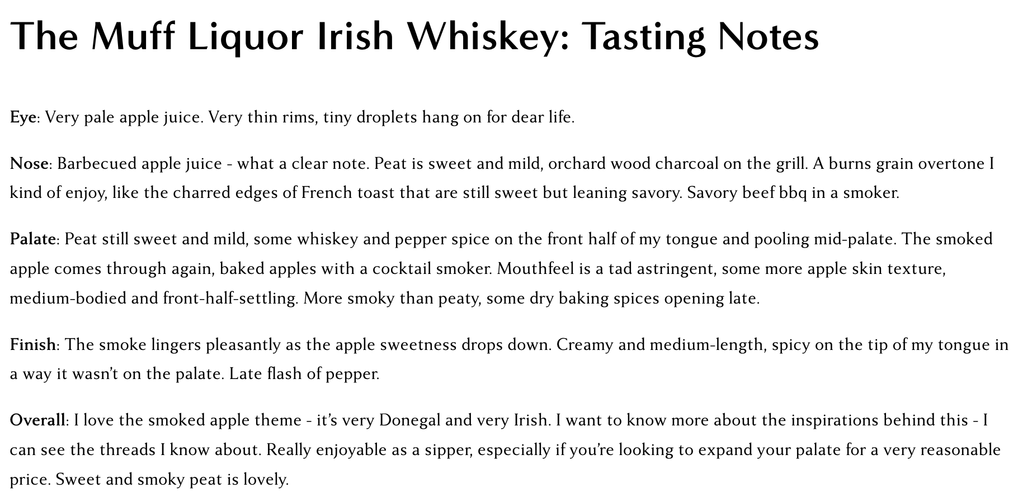


Slide 33

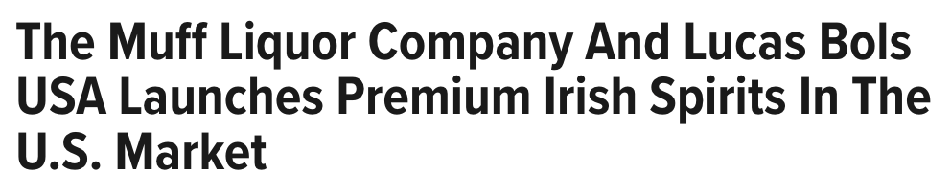


March 27, 2025
Online Visits: 120,419
Click to view article

Slide 34


Slide 35
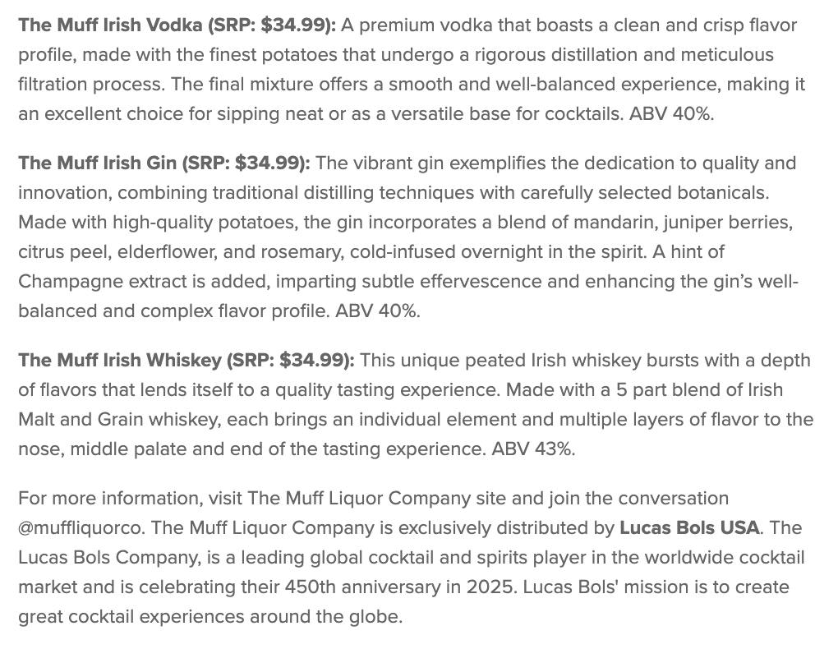

Slide 36

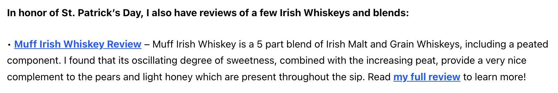
March 17, 2025
Online Visits: 5,000
Click to view article

Slide 37


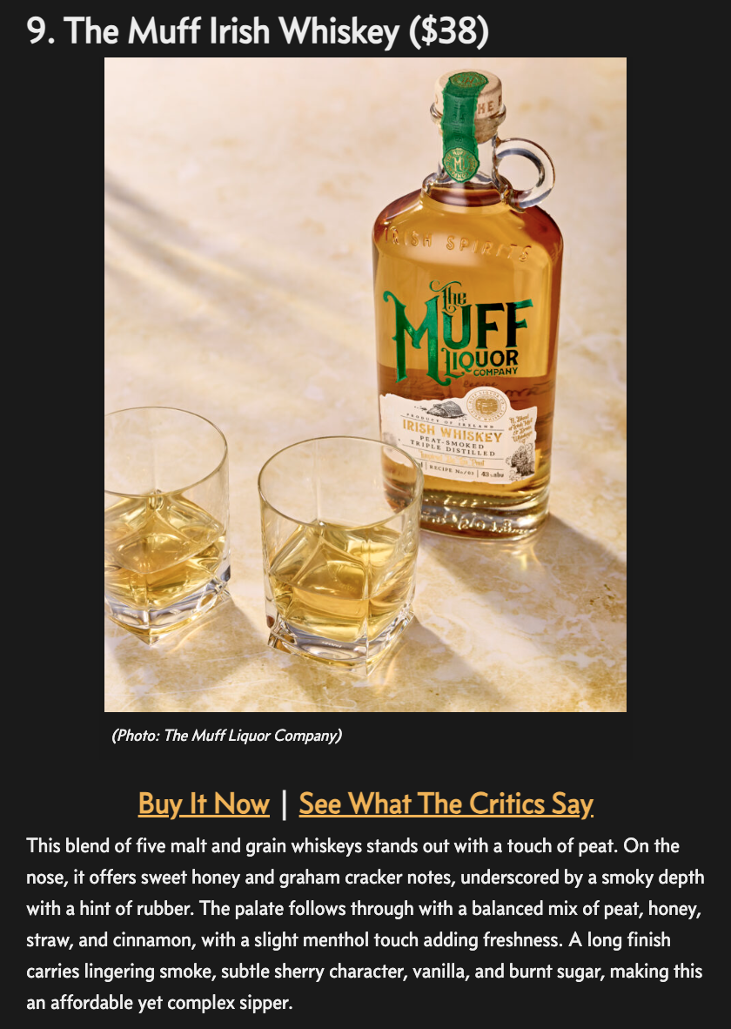
March 17, 2025
Online Visits: 57,799
Click to view article

Slide 38





March 15, 2025
Followers: 1,548
Click to view profile

Slide 39



March 14, 2025
Online Visits: 42,949
Click to view article

Slide 40



 | March 14, 2025 Online Visits: 68,071 Click to view article
 | March 17, 2025 Online Visits: 50,623 Click to view article
 | March 17, 2025 Online Visits: 5,000 Click to view article
Syndications from Cassius

Slide 41

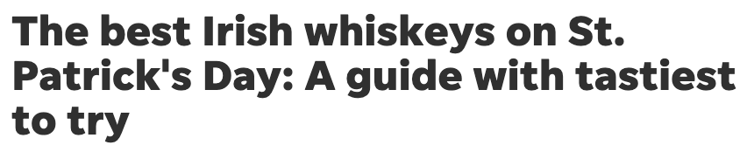
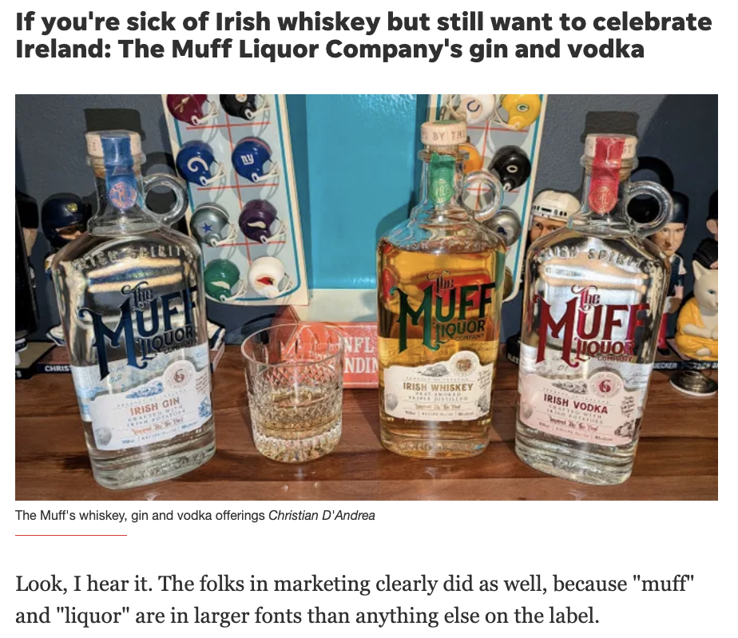
March 14, 2025
Online Visits: 3,949,934
Click to view article

Slide 42
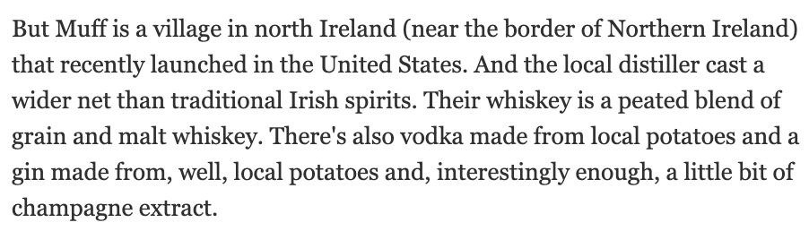
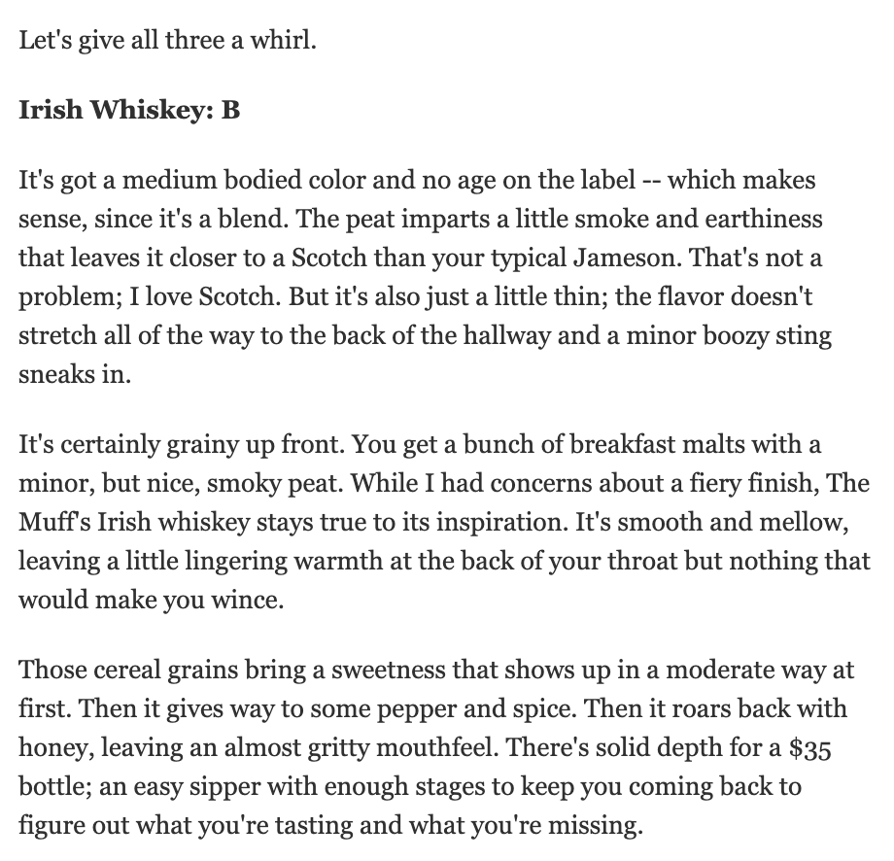
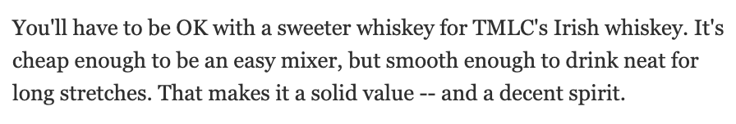

Slide 43
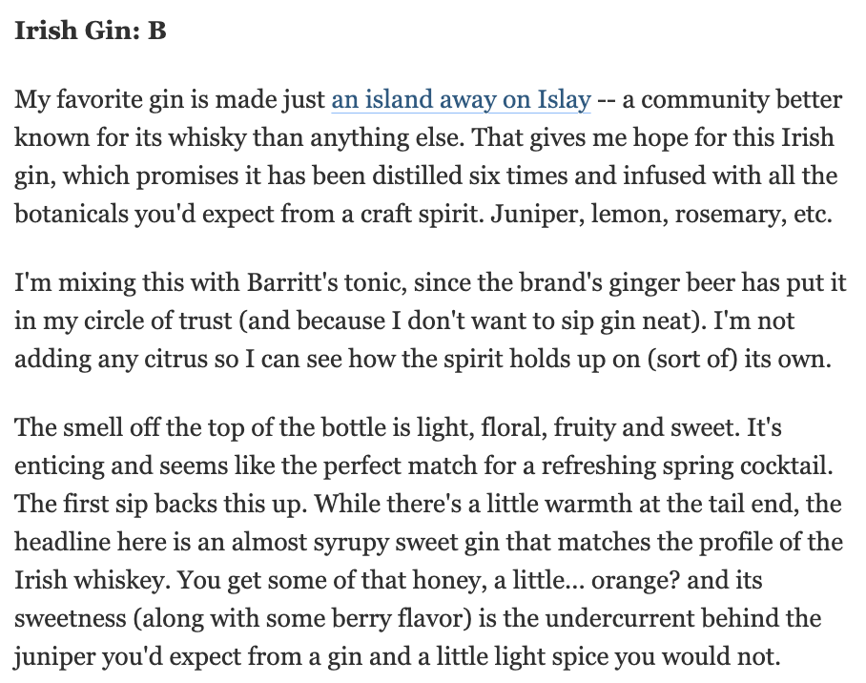
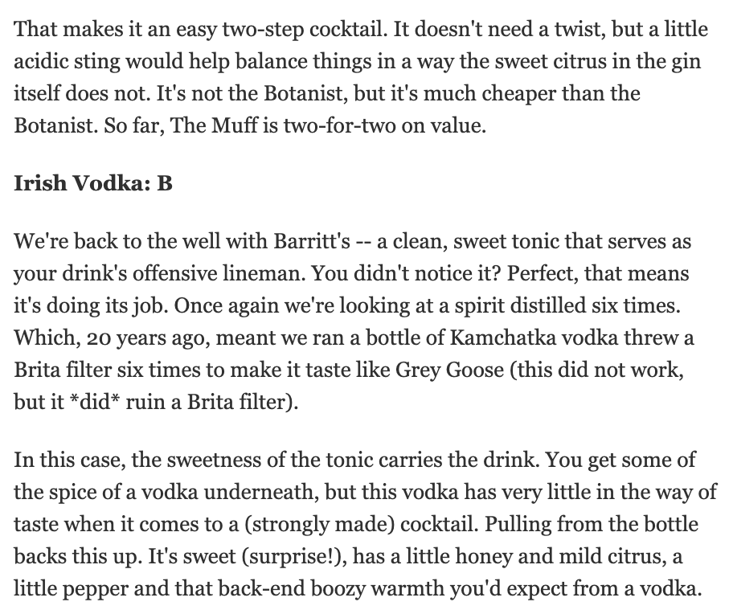

Slide 44
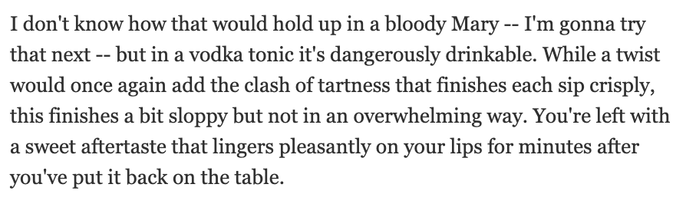

Slide 45

 | March 14, 2025 Online Visits: 407,199,536 Click to view article
Syndications from For The Win

Slide 46

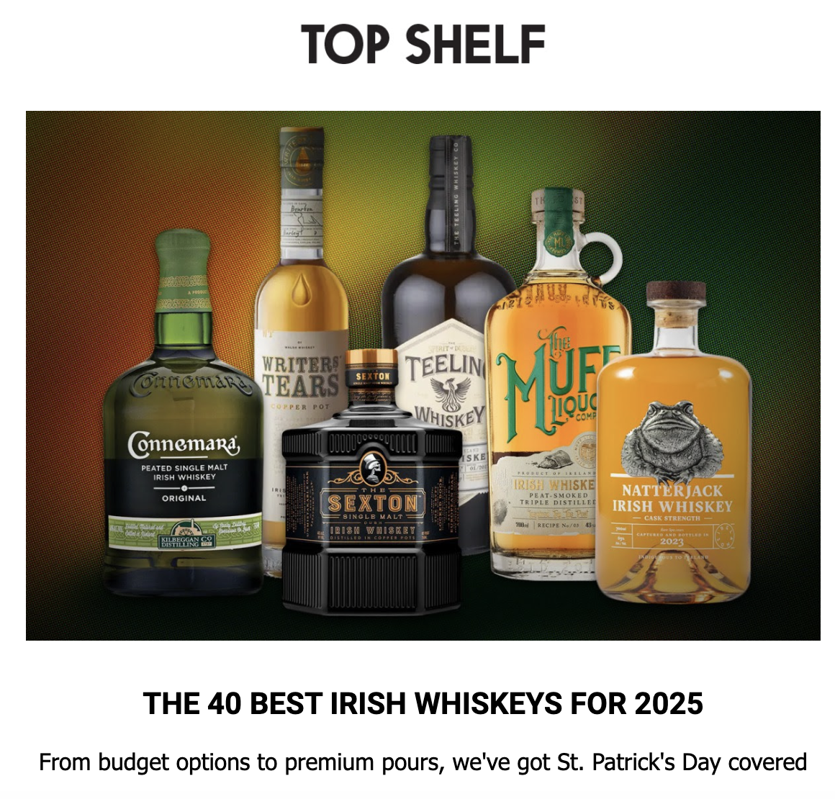
March 13, 2025
Online Visits: 596,478

Slide 47


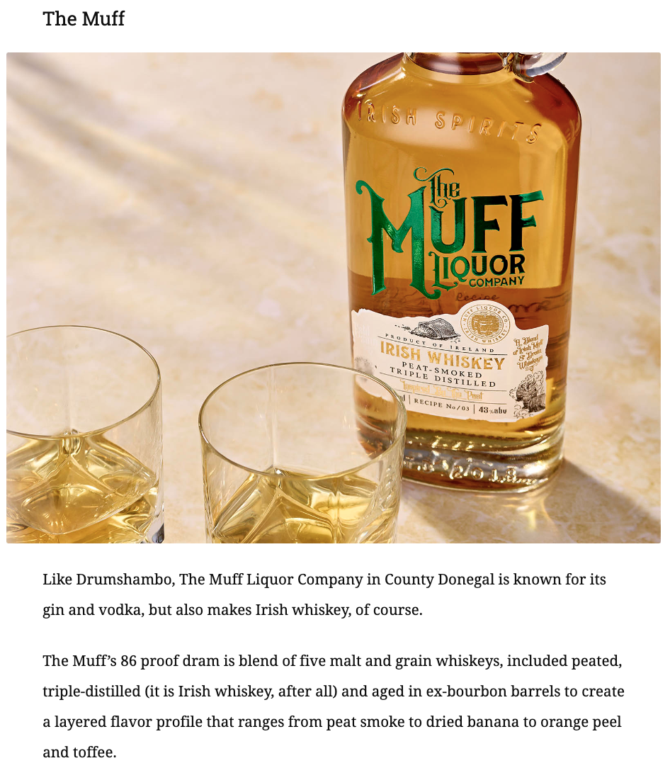
March 13, 2025
Online Visits: 270,575
Click to view article

Slide 48



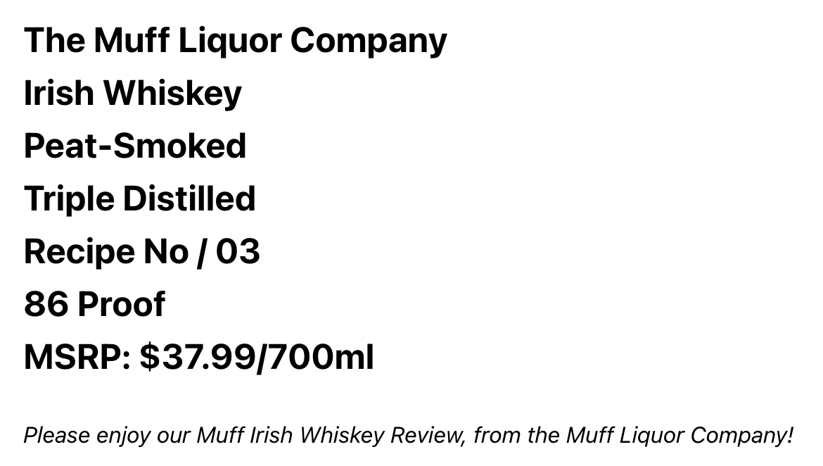
March 13, 2025
Online Visits: 5,000
Click to view article

Slide 49
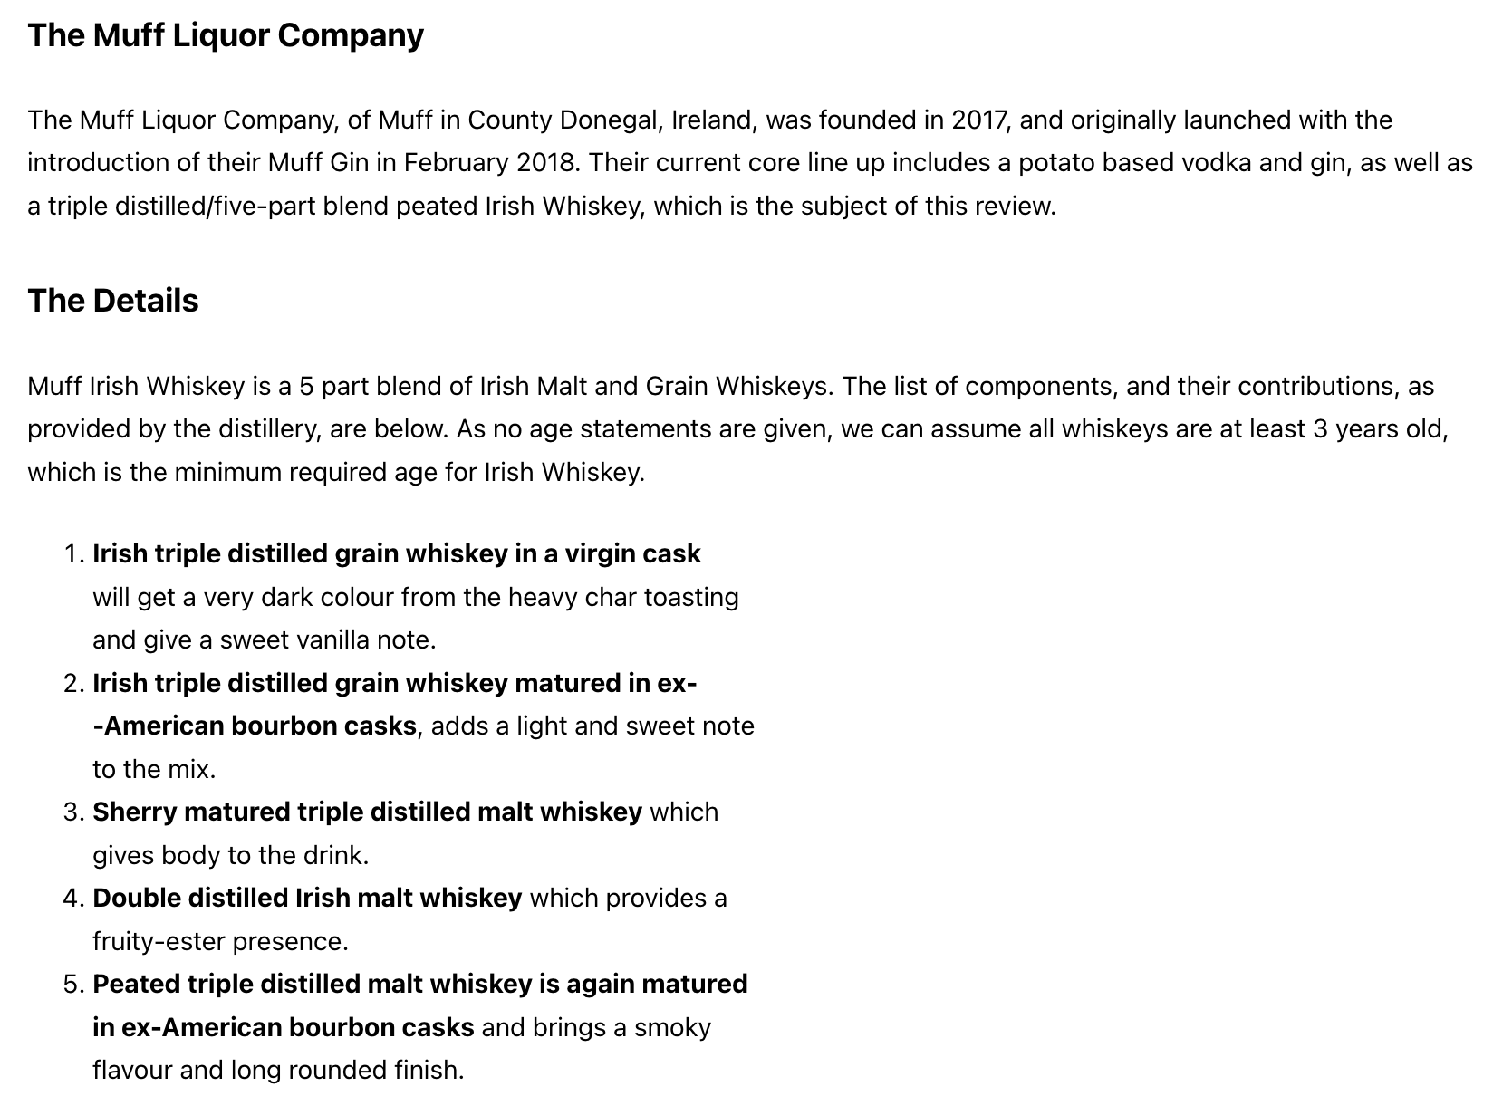
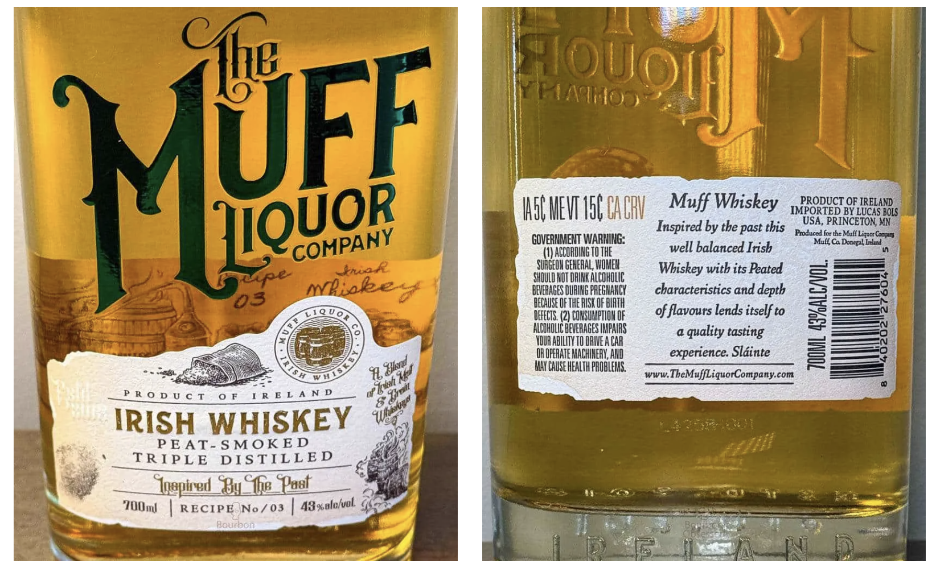

Slide 50
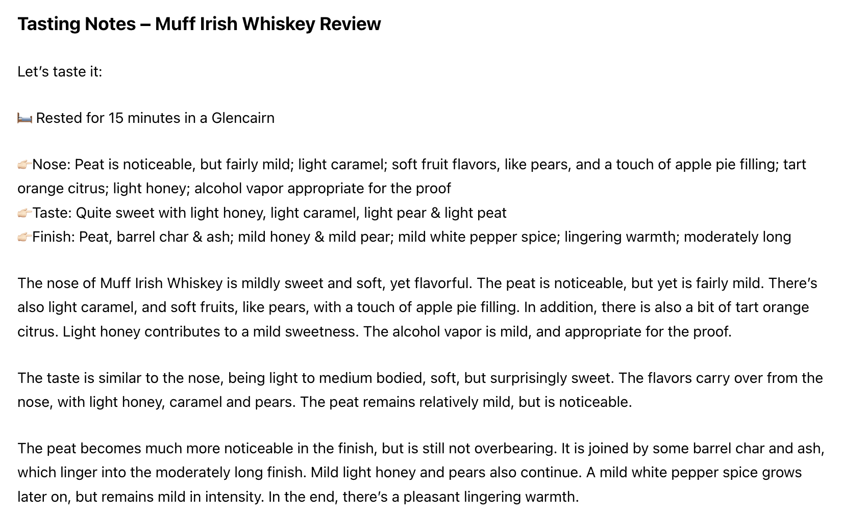



Slide 51


Slide 52



March 12, 2025
Online Visits: 596,478
Click to view article

Slide 53



March 7, 2025
Online Visits: 178,530
Click to view article

Slide 55




March 7, 2025
Online Visits: 88,209,424
Click to view article

Slide 56


Slide 57



March 6, 2025
Online Visits: 5,000
Click to view article

Slide 58


Slide 59


Slide 60



March 5, 2025
Online Visits: 88,209,424
Click to view article

Slide 61





February 28, 2025
Online Visits: 13,047,128
Click to view article

Slide 62



February 25, 2025
Online Visits: 1,909,766
Click to view article

Slide 63


February 19, 2025
Online Visits: 57,799
Click to view article

Slide 64



Slide 65




February 13, 2025
Online Visits: 5,000
Click to view article

Slide 67




February 12, 2025
Online Visits: 596,478
Newsletter Subscriptions: 596,478
Click to view article

Slide 68



Slide 69



Slide 70

 | February 12, 2025 Online Visits: 21,544,598 Click to view article
Syndication from InsideHook

Slide 71



February 11, 2025
Followers: 1,532
Click to view profile

Slide 72



February 11, 2025
Online Visits: 88,209,424
Click to view article

Slide 73



February 7, 2025
Online Visits: 68,979
Click to view article

Slide 74



February 6, 2025
Online Visits: 5,000
Click to view article

Slide 76




February 6, 2025
Online Visits: 12,706
Click to view article

Slide 77


Slide 78


February 5, 2025
Followers: 8,200
Click to view article

Slide 79



Slide 80




February 5, 2025
Online Visits: 953,553
Click to view article

Slide 81




Slide 82


Slide 83





February 5, 2025
Online Visits: 23,295
Click to view article

Slide 84




January 8, 2025
Online Visits: 480,560
Click to view article

Slide 85



December 17, 2024
Online Views: 156,944
Click to view article

Slide 86




December 2024 Issue
Print Circulation: 910,000

Slide 87



November 12, 2024
Followers: 3,989
Click to view profile

Slide 88


November 12, 2024
Followers: 3,371
Click to view profile

Slide 89


November 12, 2024
Followers: 1,522
Click to view profile

