Slide 1


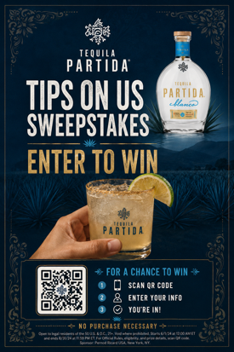
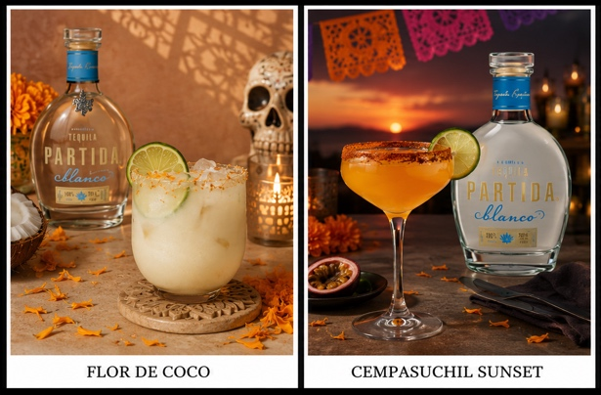
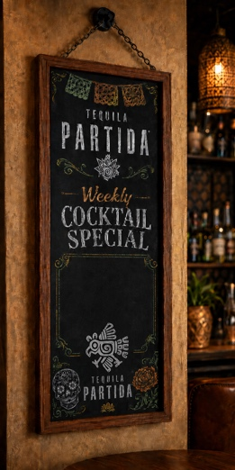
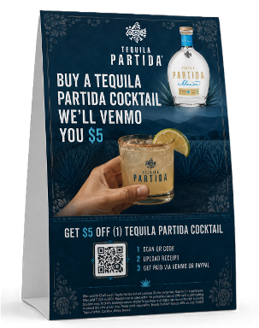
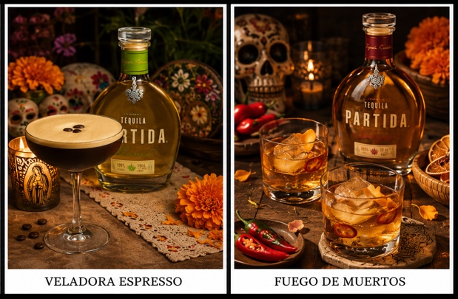
HALLOWEEN + DÍA DE MUERTOS
October 15 – November 15 | built to drive premium Partida cocktail trial, account visibility, and bartender engagement.
400
200 + 200
FL | TX | CA
TARGET ON-PREMISE ACCOUNT ACTIVATIONS
EAST + WEST FOCUS
PRIORITY STATES
PROGRAM OVERVIEW
• A ready-to-activate seasonal account kit for bars and restaurants during two high-energy tequila occasions.
• Halloween and Día de Muertos create a high-relevance tequila occasion window.
• Supports Partida’s cocktail strategy with pricing designed to better fit bar ounce-cost needs.
• Turnkey POS and décor create instant table, bar, and bathroom visibility.
PROGRAM MECHANIC
• Account features a Partida cocktail.
• Guest engages with table tent / poster and orders the featured cocktail.
• Guest provides proof via QR experience.
• Standard markets redeem “Tip On Us” up to $5;
Texas uses sweepstakes entry mechanics.
POSTER-INSPIRED VISUAL SYSTEM
Tip On Us / Sweepstakes platform keeps the activation flexible by market.
FEATURE COCKTAILS
WHAT THE ACCOUNT GETS
• 1 Partida chalkboard, size 1’ x 2’.
• 24 table tents.
• 2 posters for bathrooms / bar walls.
• 3 packs of 12 ft papel picado tissue décor.
• 2 sets of edible cocktail toppers (100 total).

Slide 2
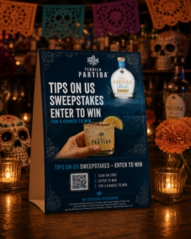
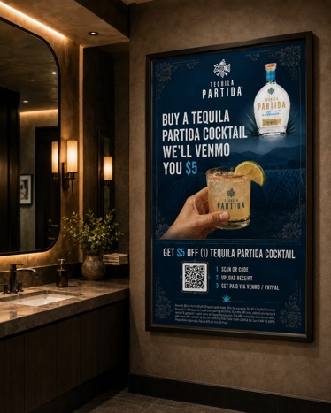
HALLOWEEN + DÍA DE MUERTOS
October 15 – November 15 | built to drive premium Partida cocktail trial, account visibility, and bartender engagement.
SALES TEAM ASK
• Secure buyer commitment for a Partida cocktail feature.
• Account purchase requirement (2 six pack mix case Partida)
• Confirm table tent placement and chalkboard special.
• Lock qualifying order and kit allocation before POS delivery.
• Target POS delivery: first week of September.
Activation window: October 15 – November 15 | 400 account kits available
WHY BUYERS SHOULD SAY YES
• Seasonal relevance across Halloween and Día de Muertos.
• Turnkey visibility with poster + table tent + chalkboard.
• Supports premium cocktail pull-through and menu placement.
• Texas-ready legal-friendly consumer mechanic.
Accounts will be featured on Tequila Partida social media campaign
TABLE TENTS & POSTERS
OPEN MARKETS
TEXAS

