Slide 1
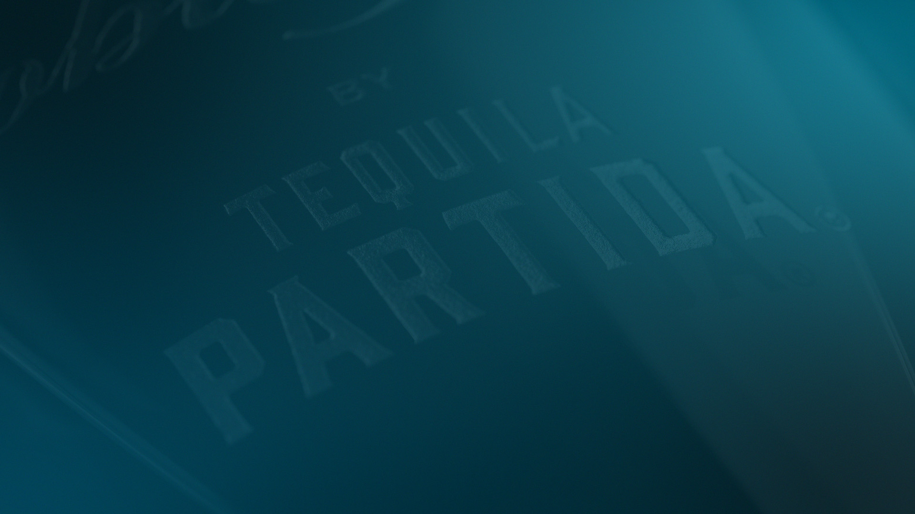

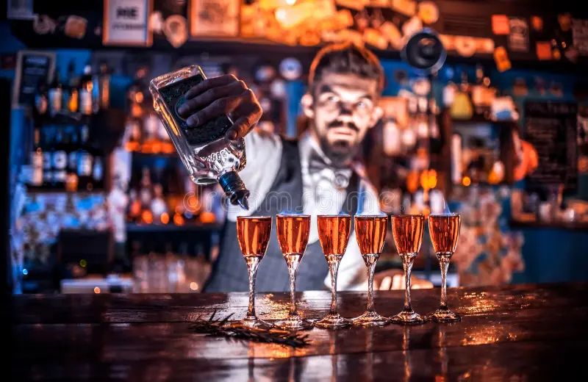
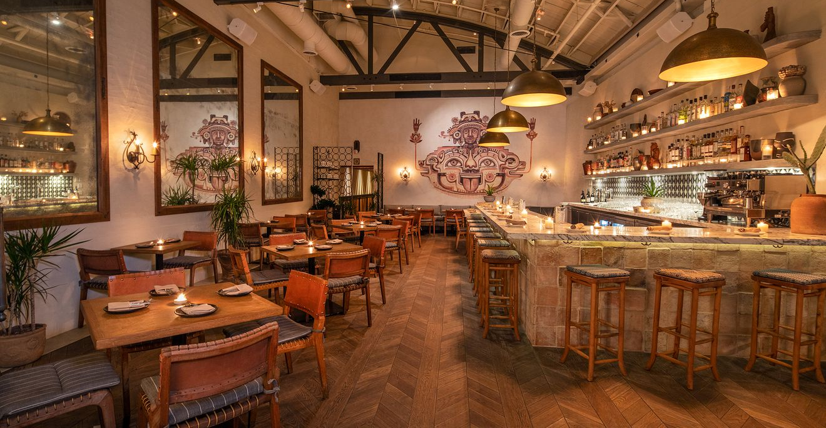
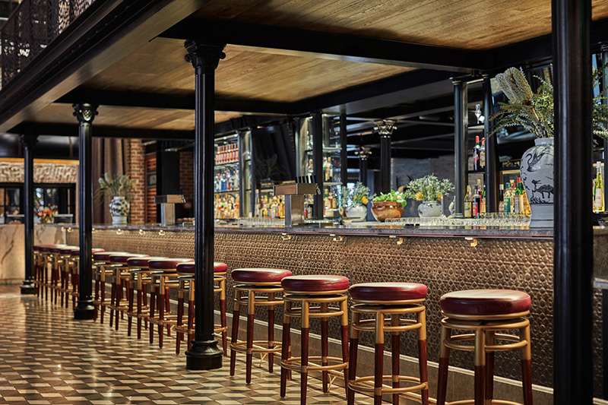
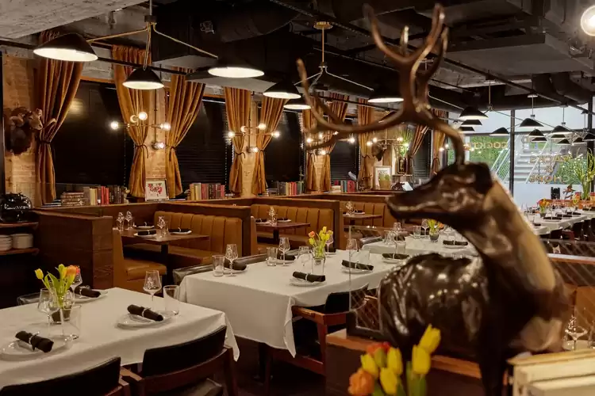
TRIAL
ON PREMISE
RF TARGET ACCOUNTS
AND SUGGESTED COCKTAIL VARIATIONS
Craft Cocktail Bars
Upscale Mexican Restaurants
RF Old Fashioned
RF Cristalino Margarita
RF Reposado Paloma
RF Añejo Sour
High End Hotel Bars
Steak Houses
RF Old Fashioned
Served On the rocks
RF Cristalino Fizz
RF Smoky Reposado Margarita

