Slide 1

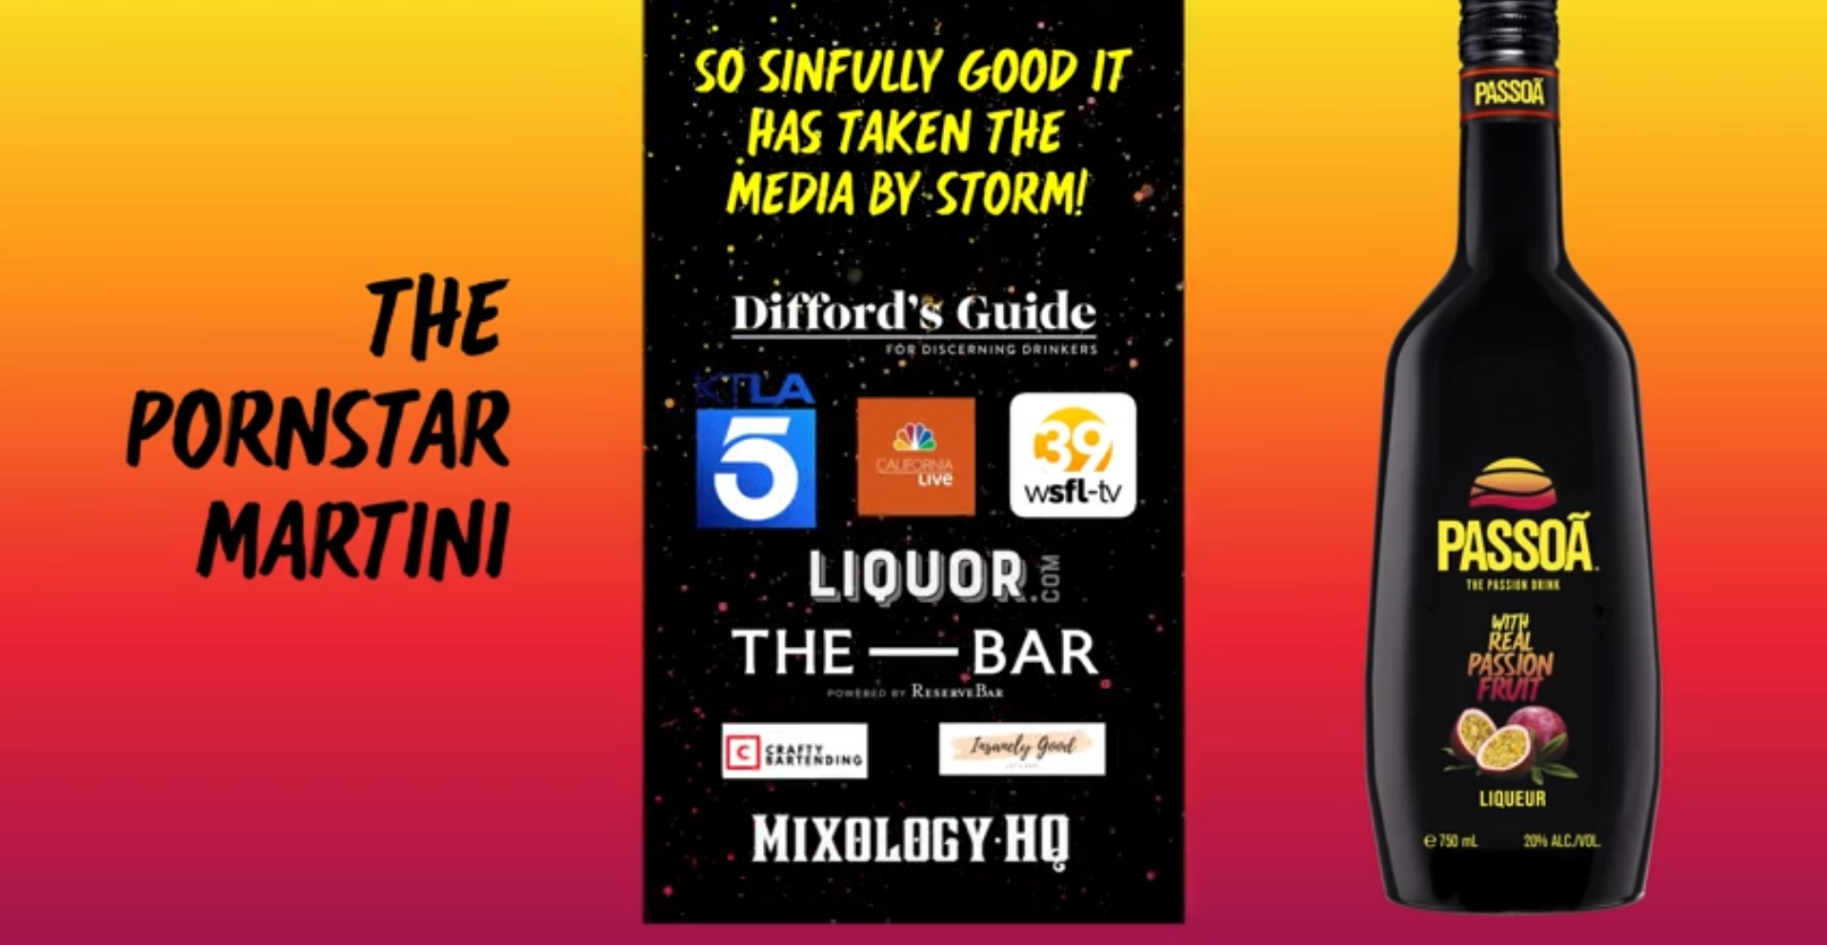
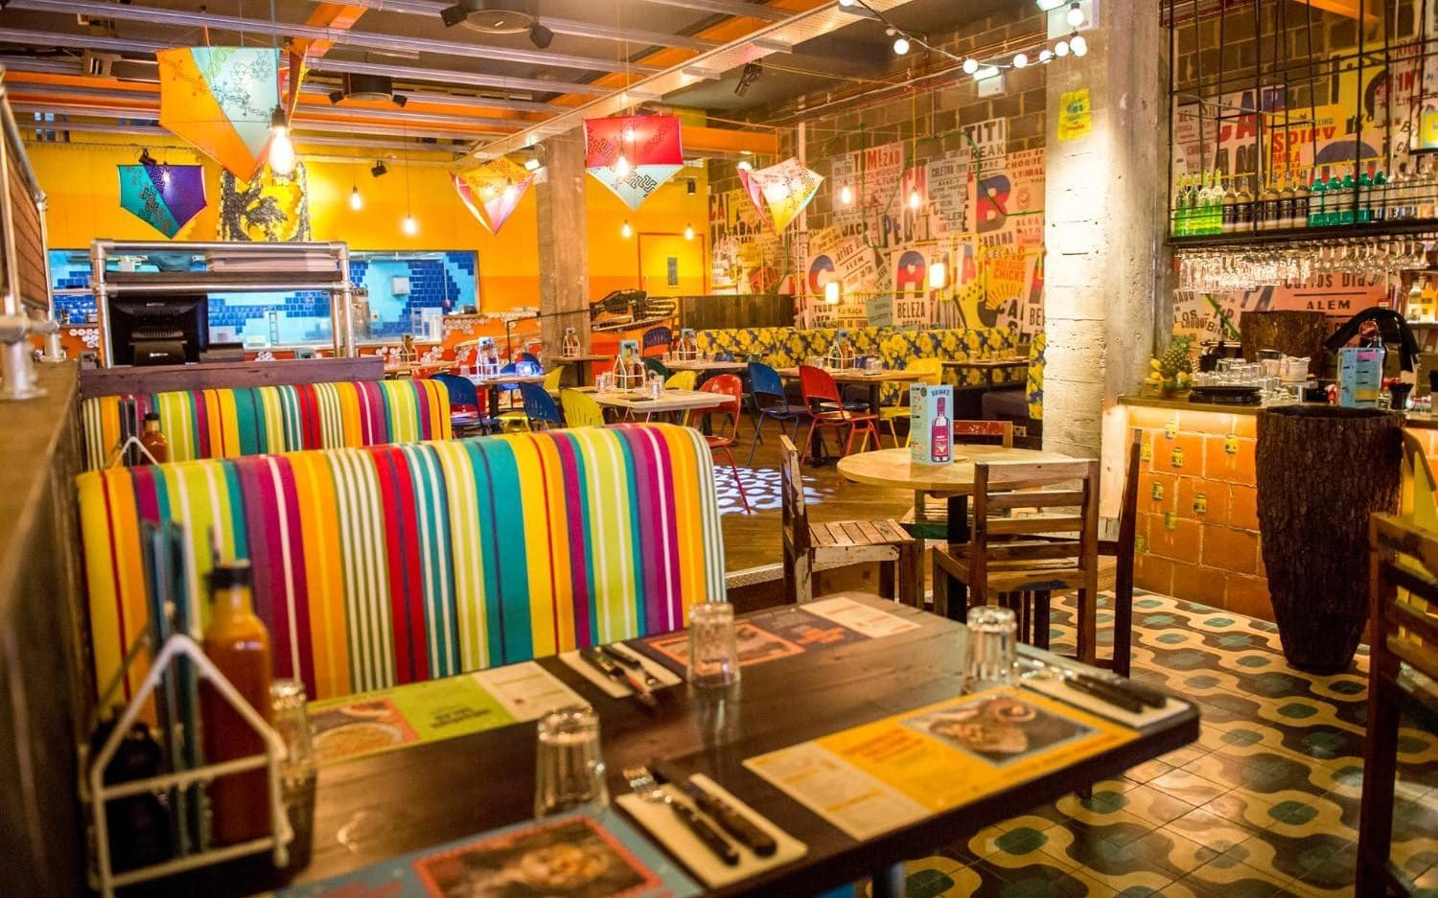
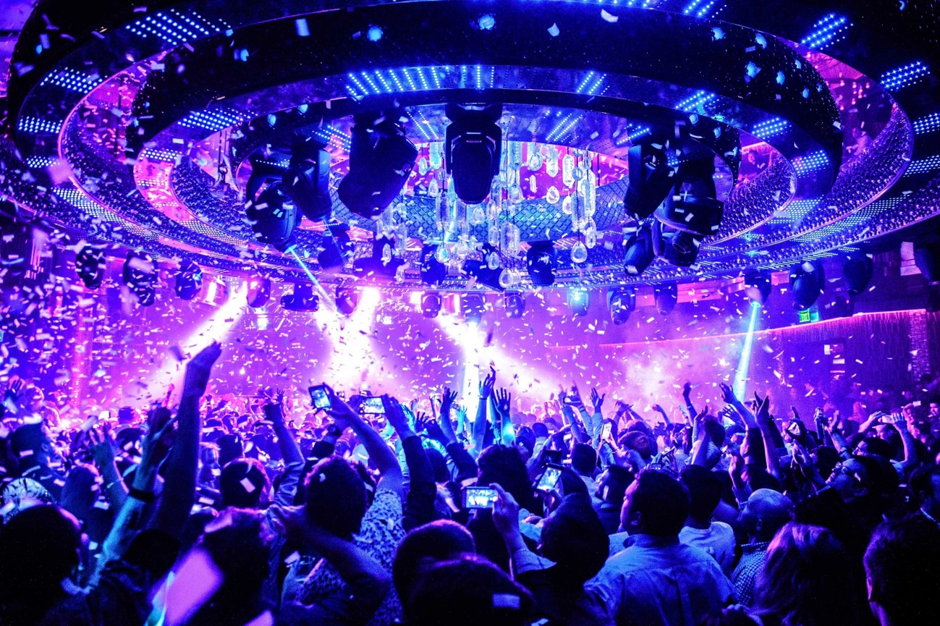
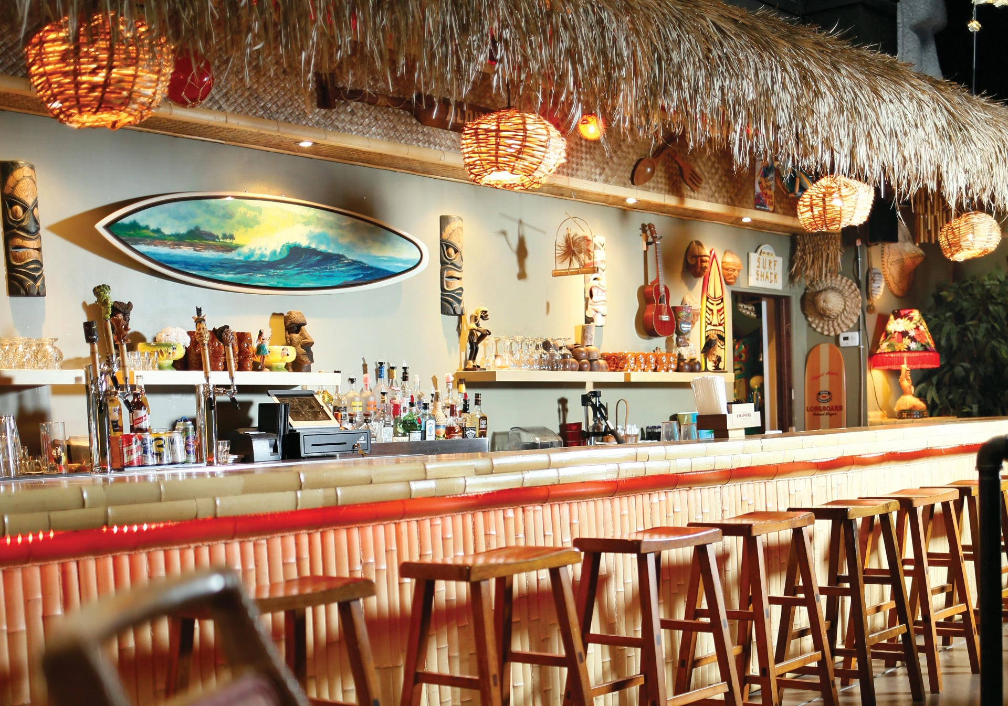

TRIAL
ON PREMISE
TARGET ACCOUNTS
COCKTAIL STRATEGY & VARIATIONS
Mexican & Latin Restaurants
Nightclub & Dance Venue
Passoa Margarita
Passoa Caipirinha
Passoa Mojito
Porn Star Martini
Electric Passoa
Passoa Punch
Beach & Poolside Bars
Rooftops & Brunch Spots
Passoa Daiquiri
Frozen Margarita
Passoa
Mai Tai
Passoa Spritz
Passoa Mimosa
Passoa Bellini

