Slide 1
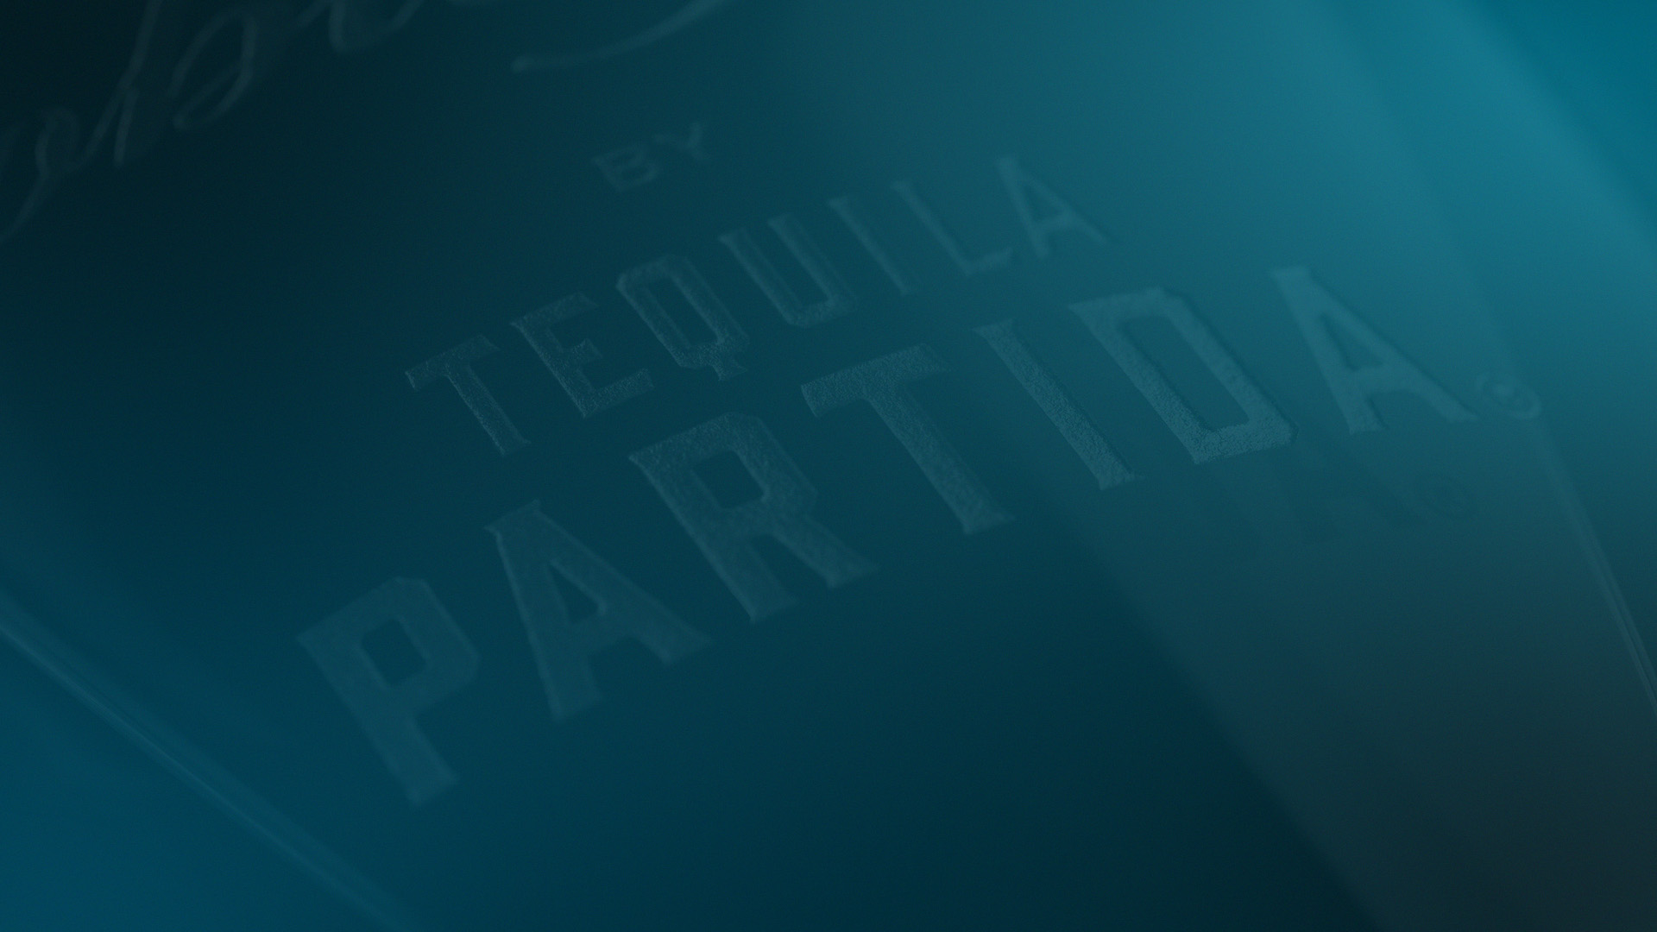

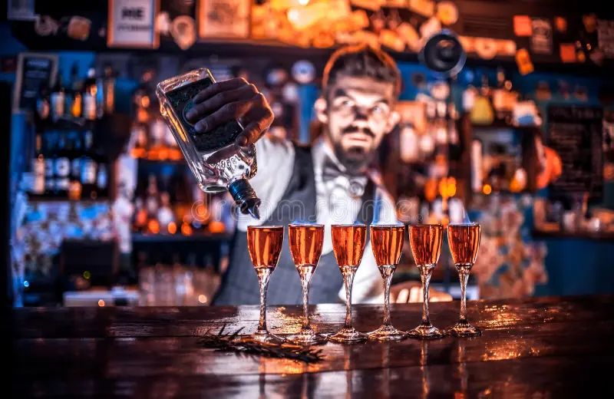
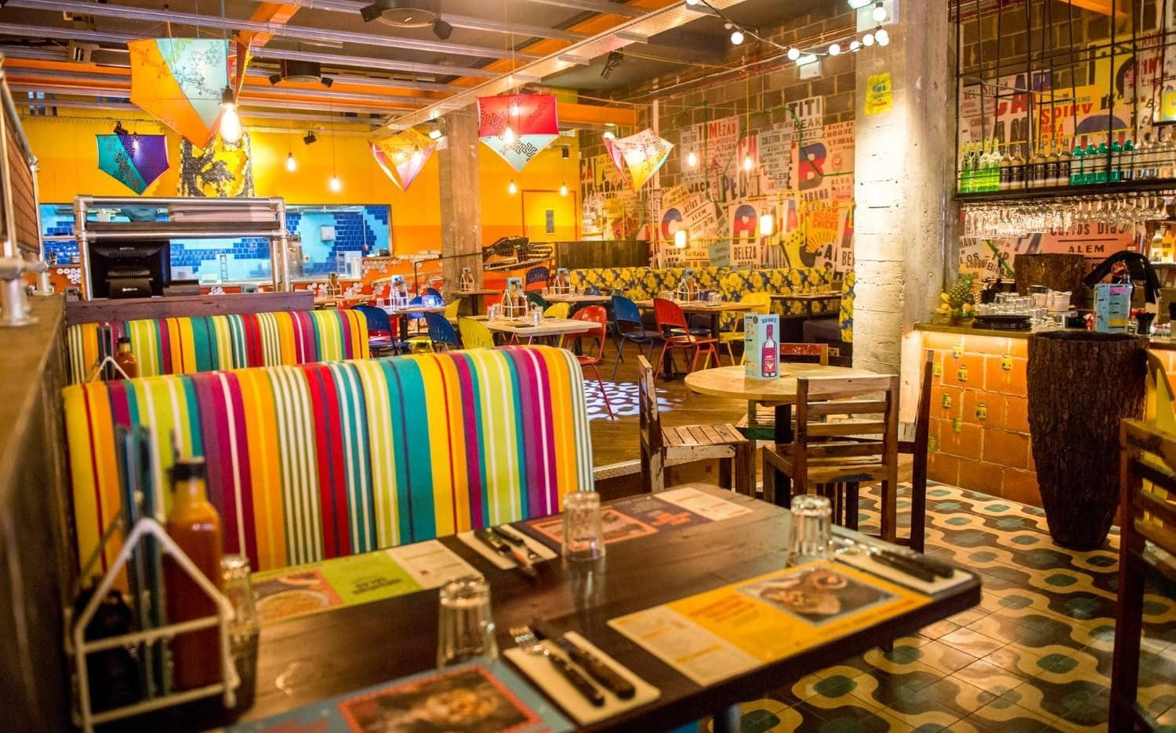
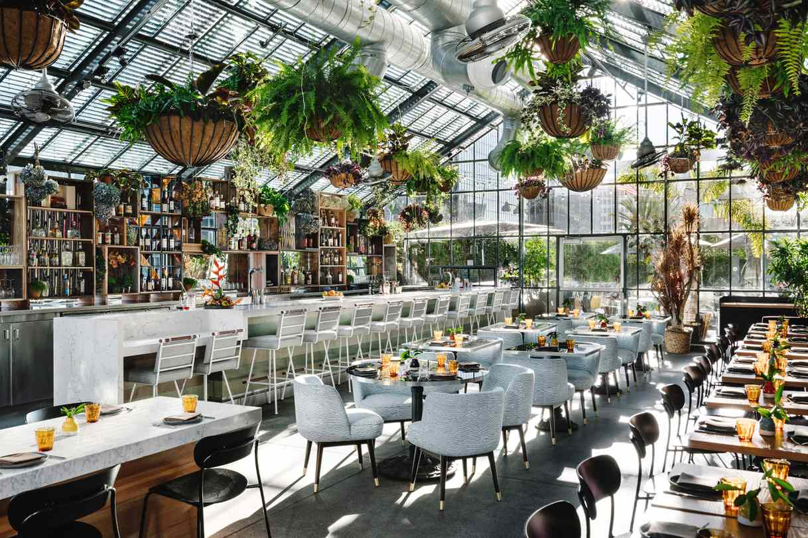
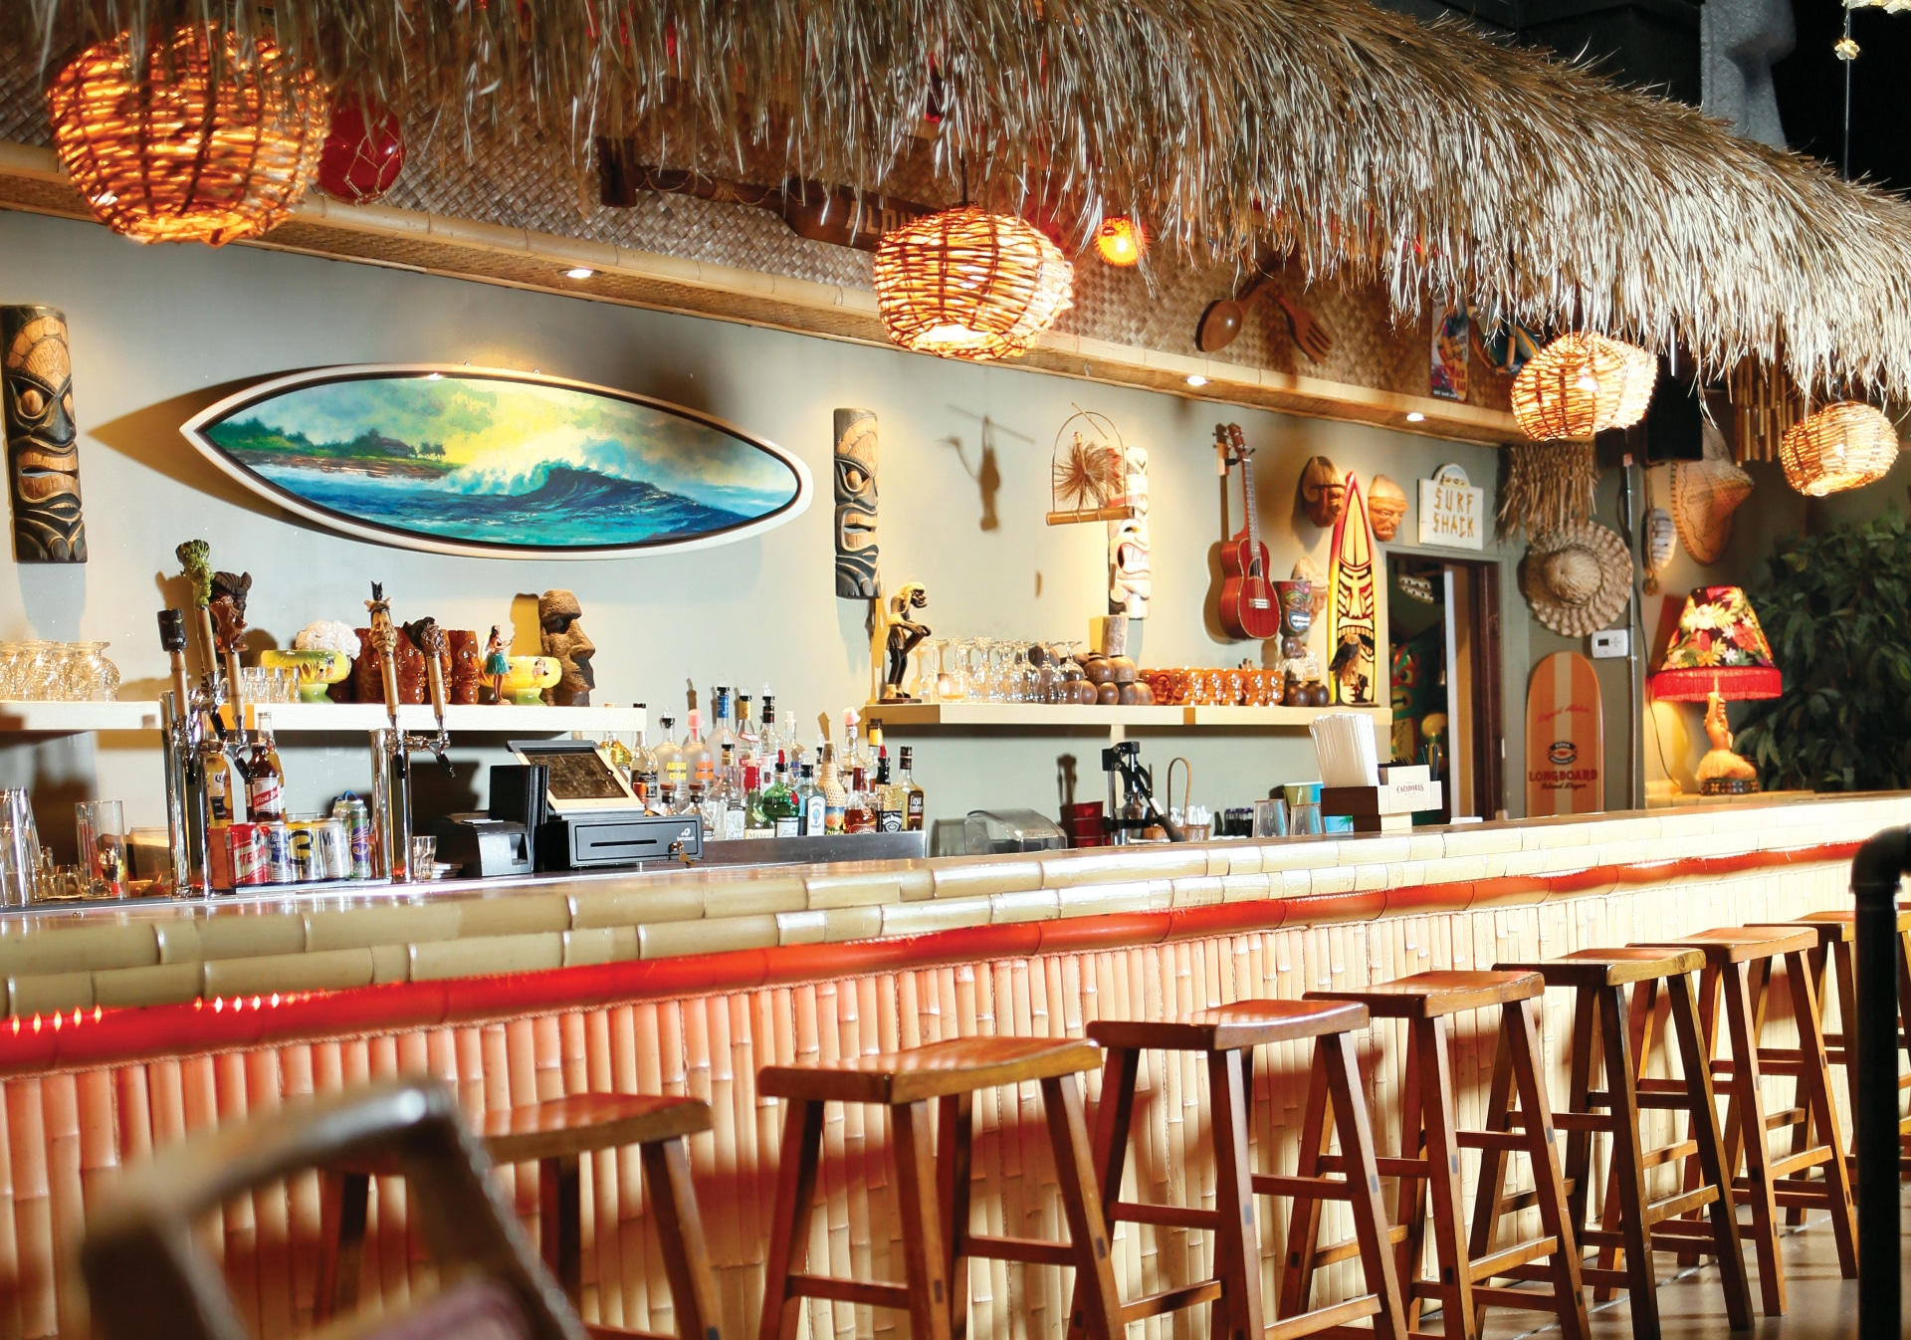
TRIAL
ON PREMISE
TARGET ACCOUNTS
AND SUGGESTED COCKTAIL VARIATIONS
Craft Cocktail Bars
Latin & Mexican Restaurants
Partida Margarita
Partida Old Fashioned
Partida Paloma
Spicy Partida Margarita
Brunch Spots
Beach & Poolside Bars
Partida Mimosa
Partida Bloody Mary
Frozen Partida Daiquiri
Partida Tropical Punch

