Slide 1


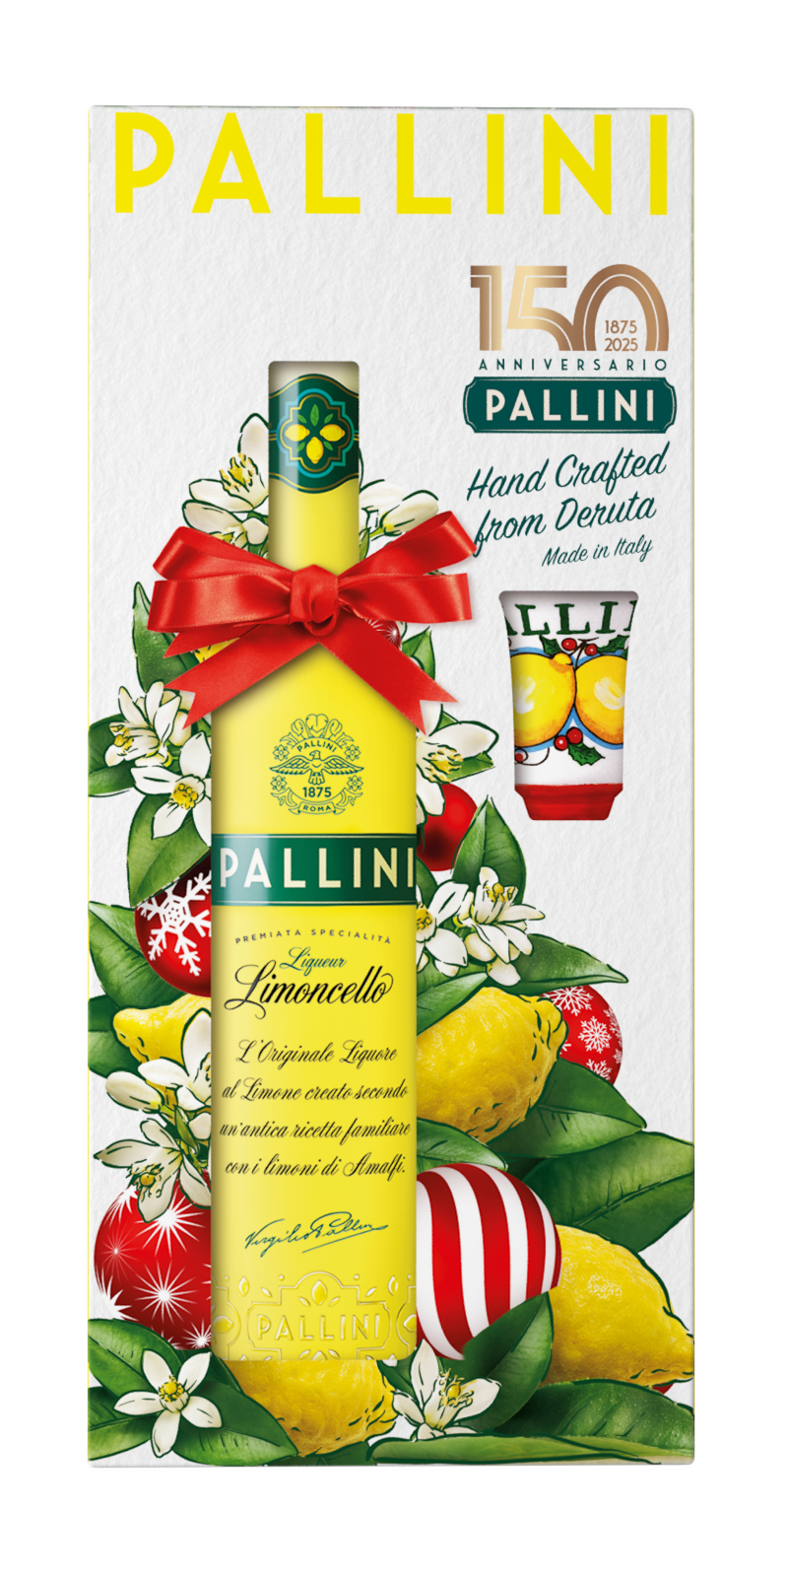
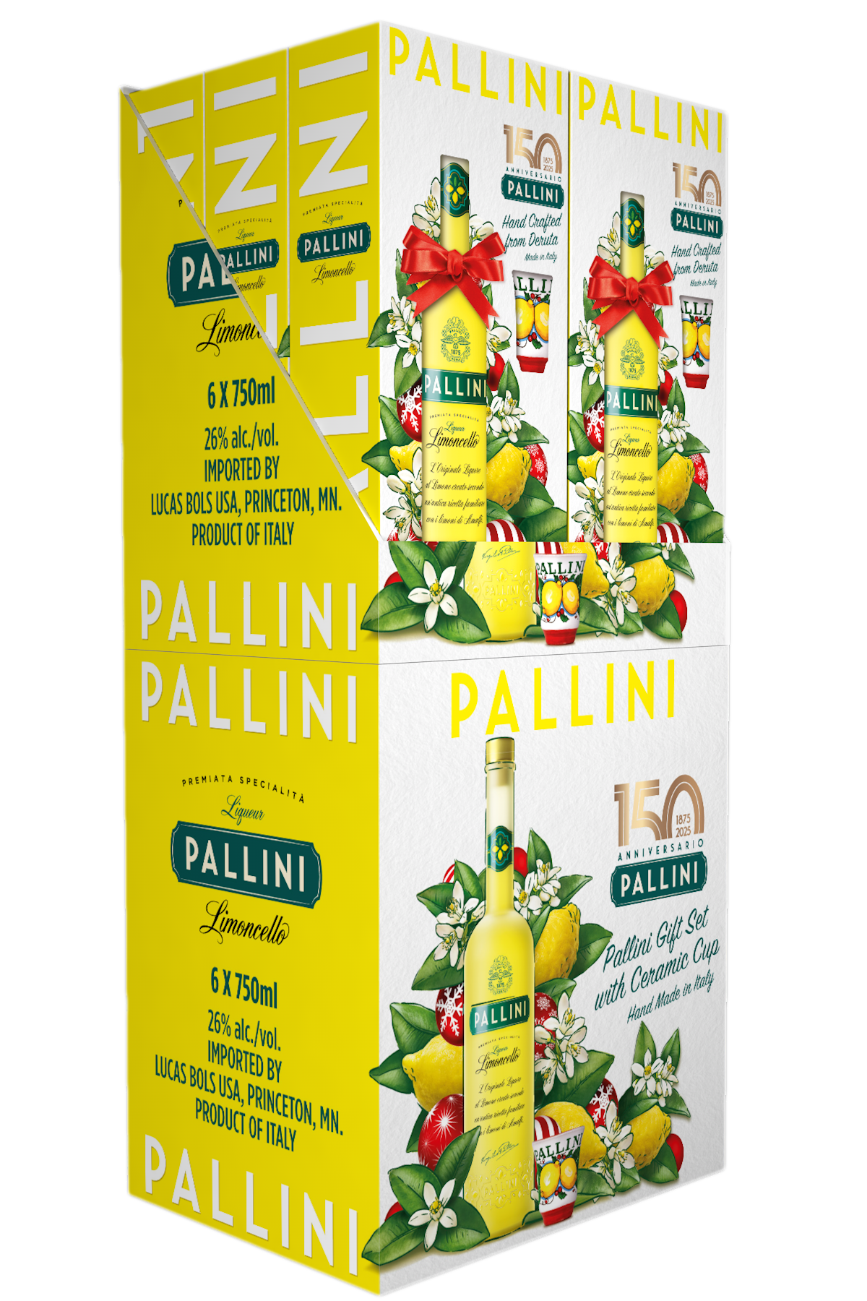
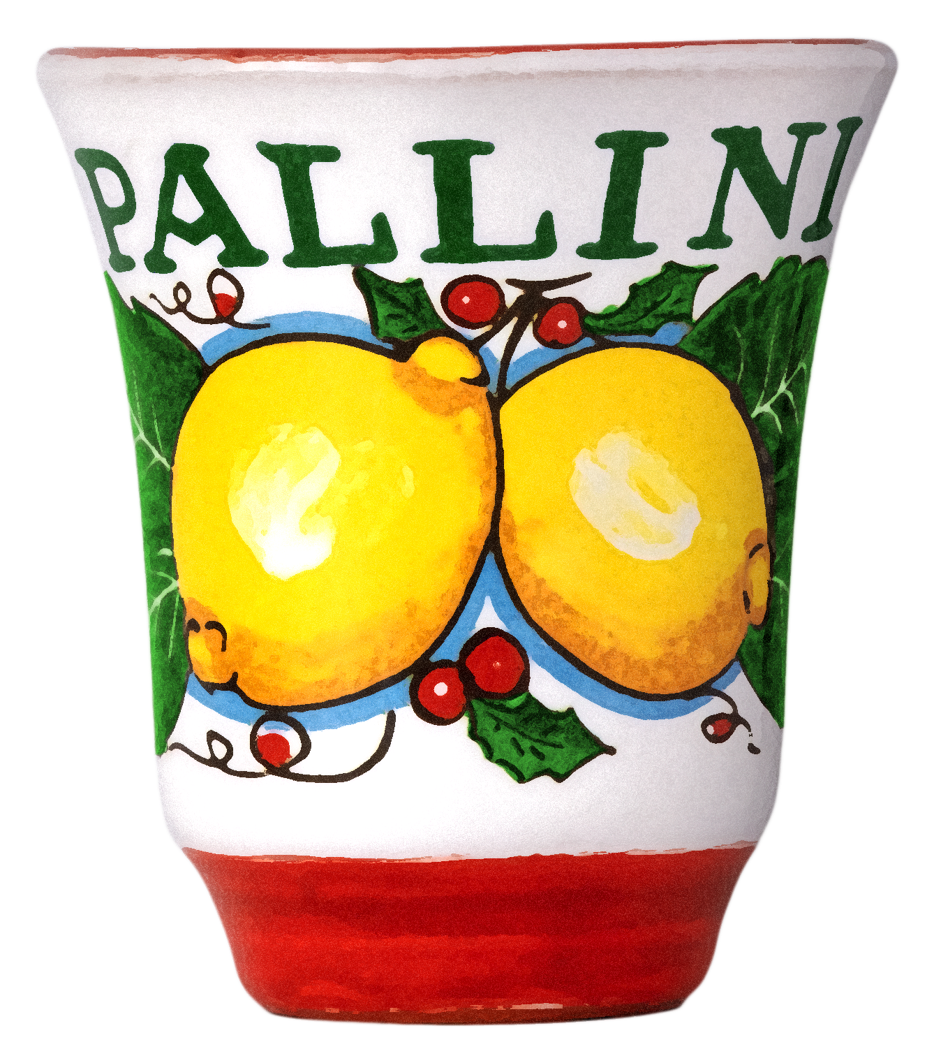
Introducing a special 150th anniversary edition:
Pallini HOLIDAY VAP 2025
Perfect gift for any holiday occasion: Pallini bottle with special 150th anniversary edition edition of Pallini signature collectible ceramic cup. Bellissimo!
Hand made in Deruta, Italy – the village of ceramics artisans, exporting pottery worldwide since 15th century.
Top quality liquid: made from organically grown Amalﬁ sfusato lemons, known to be the finest in the world. Zesty, tangy, fresh and crisp.
Extremely versatile, enjoyable straight from the fridge, on the rocks, or mixed into countless cocktails like the spritz.
GMO free; Gluten free; Kosher certified; Vegan certified
$29.99
Limited supply:
Only 5.000 cs!
the Same upc code as pallini 750 ml
Collectible Hand-painted ceramic cup inside!
logistics
Size | 750ml
Proof | 52
BOT/CS | 6
CS/LAY | 14
CS/PAL | 70
Case Weight | 22.05 lbs
Case Height (in) | 14.17
Case Length (in) | 13
Case Width (in) | 10
UPC | 736040501381
SCC Code | 10195414156874
VISIBILIty pos
Case card
WWW.pallini.us @PALLINILIMONCELLO
Get festive!

