Slide 1
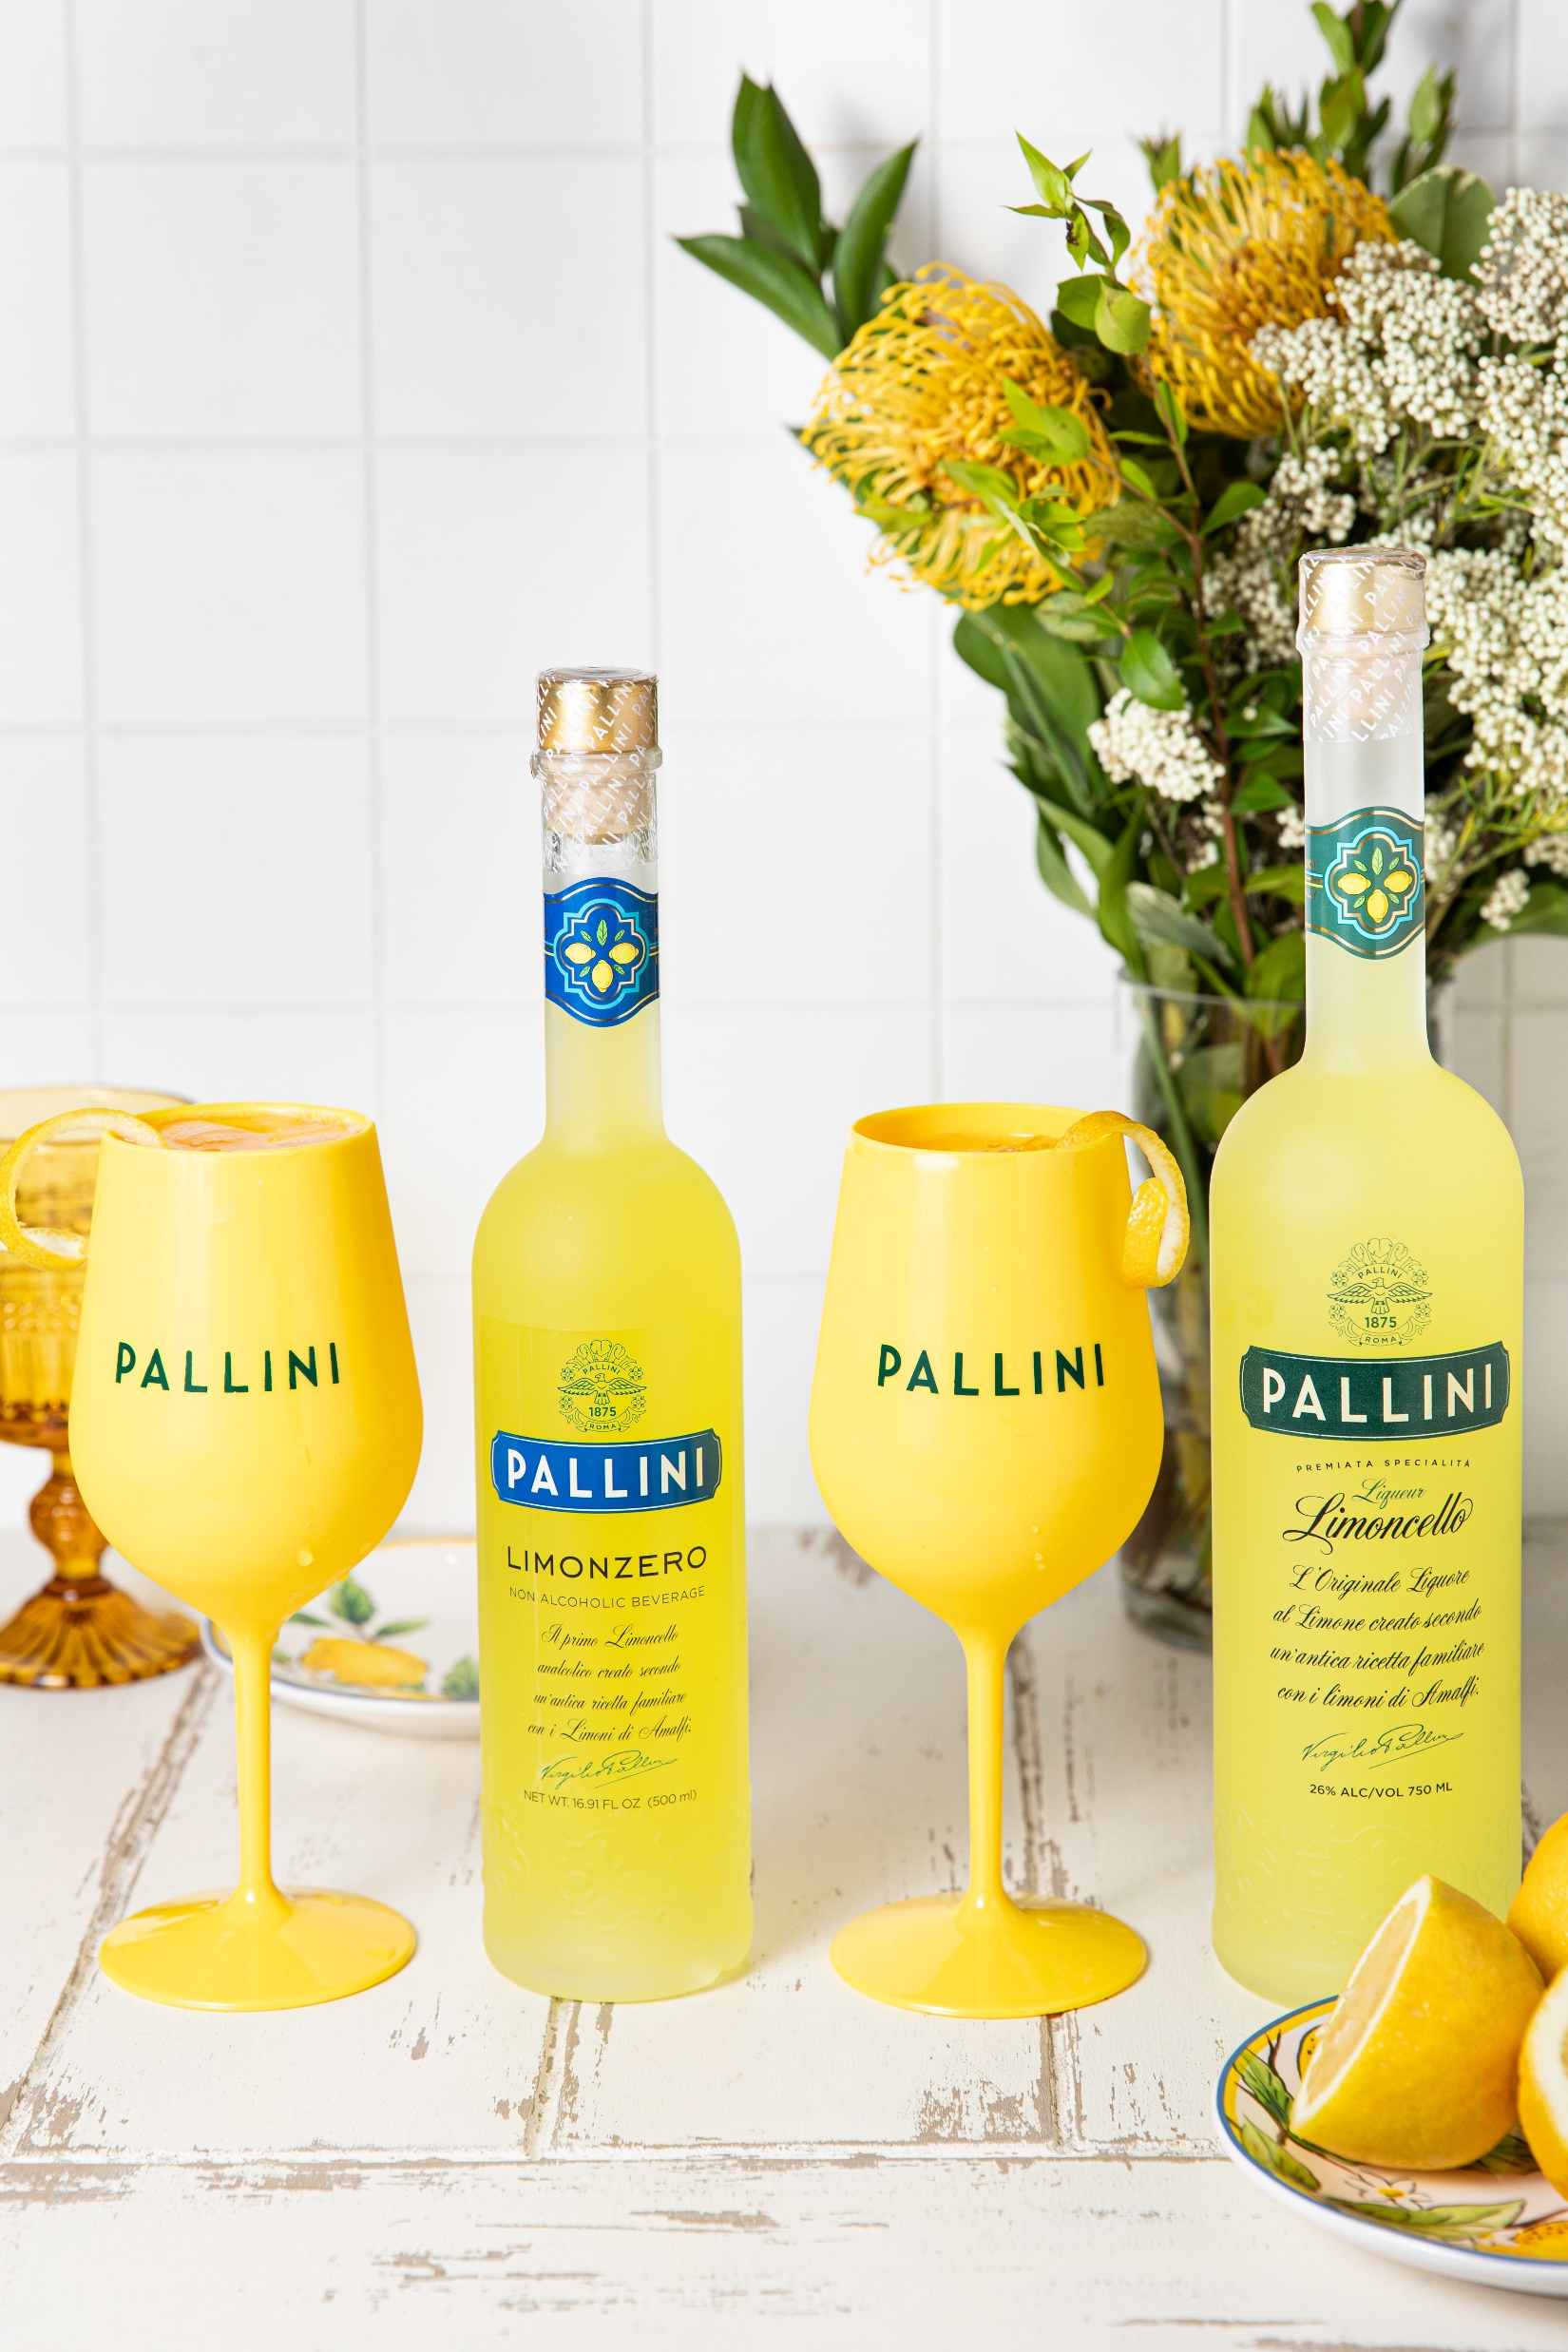

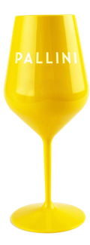
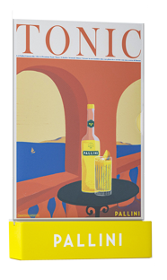
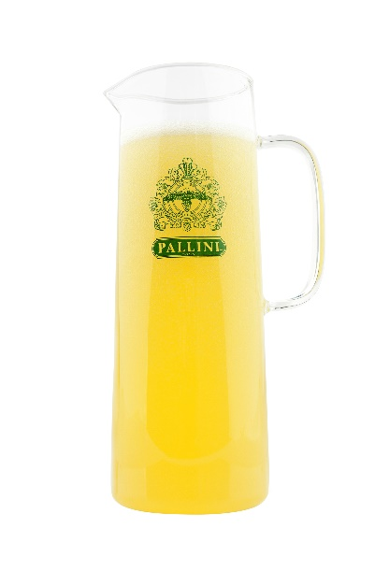
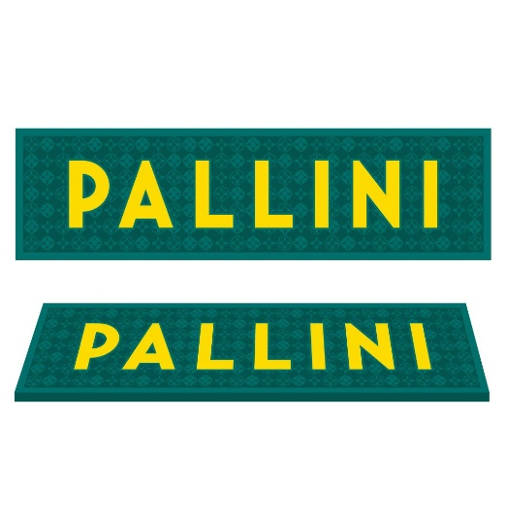
Kick off the summer of pallini spritz: pallini spritz pos
WHY PALLINI SPRITZ
Spritz-style cocktails are trending in popularity especially during the summer
Pallini Spritz flavor pallet is a sure crowd pleaser with refreshing natural flavors
Easy to make behind the bar, easy to serve in high volume in a pitcher
Pallini Spritz generated 5+ mln impressions with PR & social media campaign in 2024
Sparkling water
3x
2x
Pallini
limoncello
1x
recipe
Prosecco
Meet the Spritz pos collection
Menu holder (inserts on dropbox)
pitchers
Bar mats
Spritz Glass acrylic
WWW.pallini.us @PALLINILIMONCELLO
Order now

