Slide 1


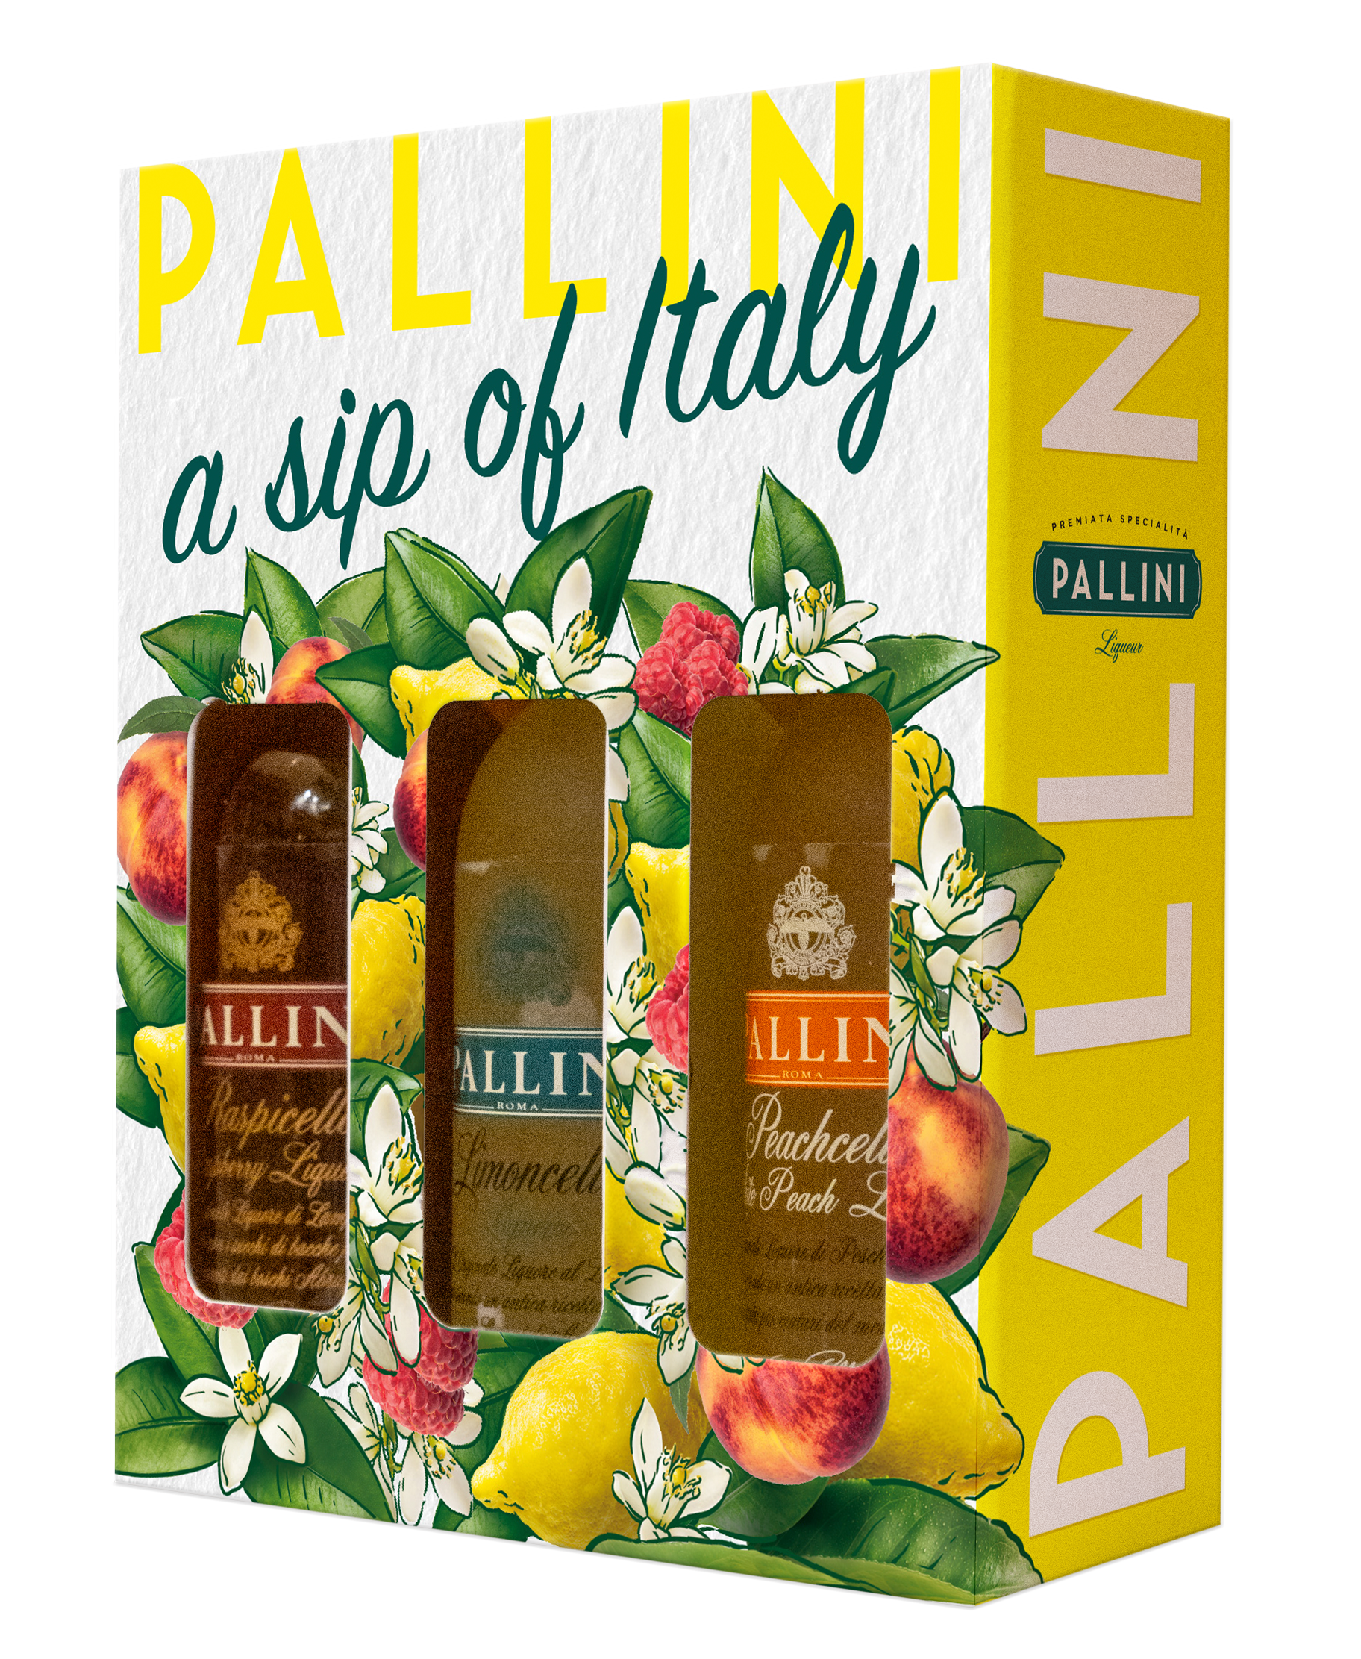
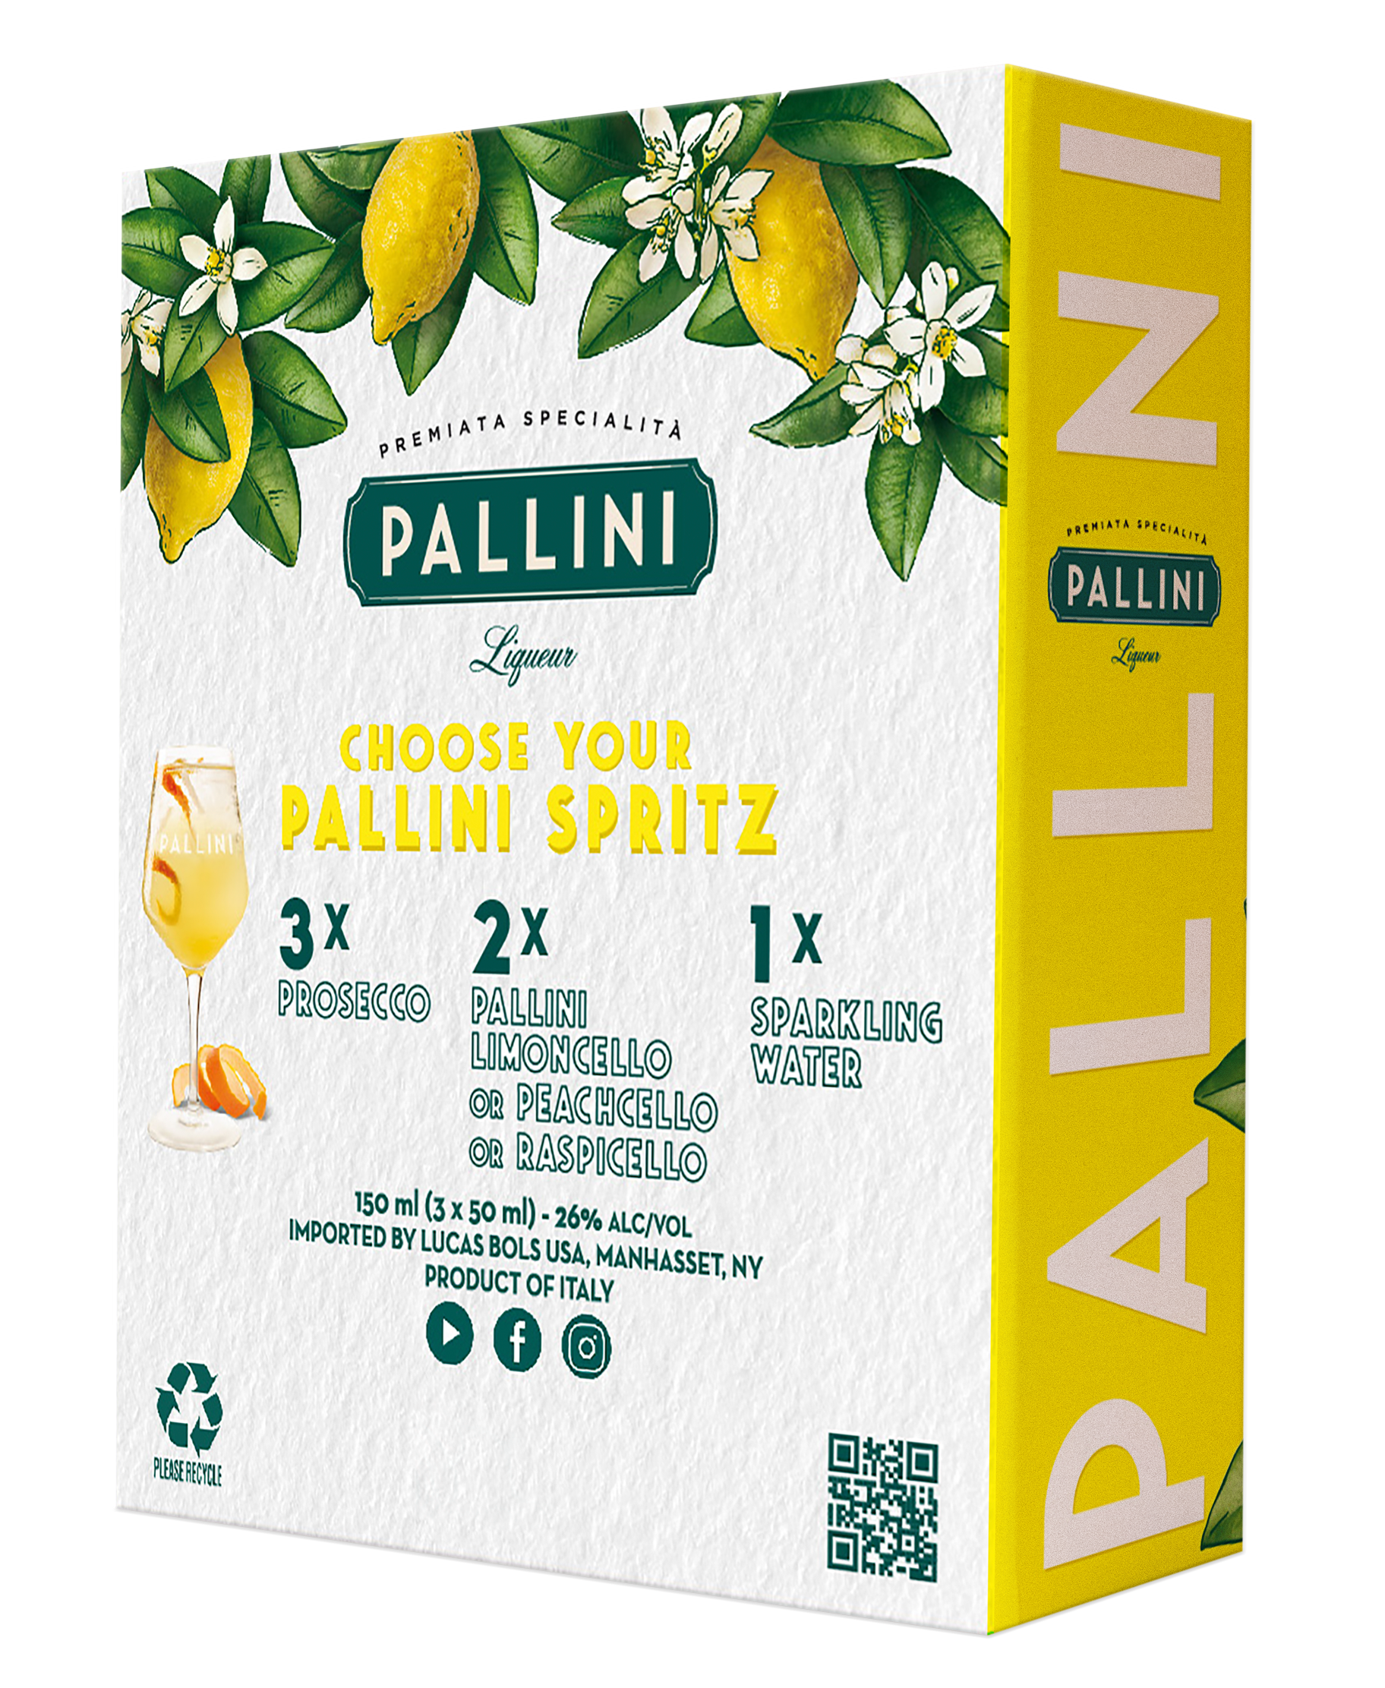
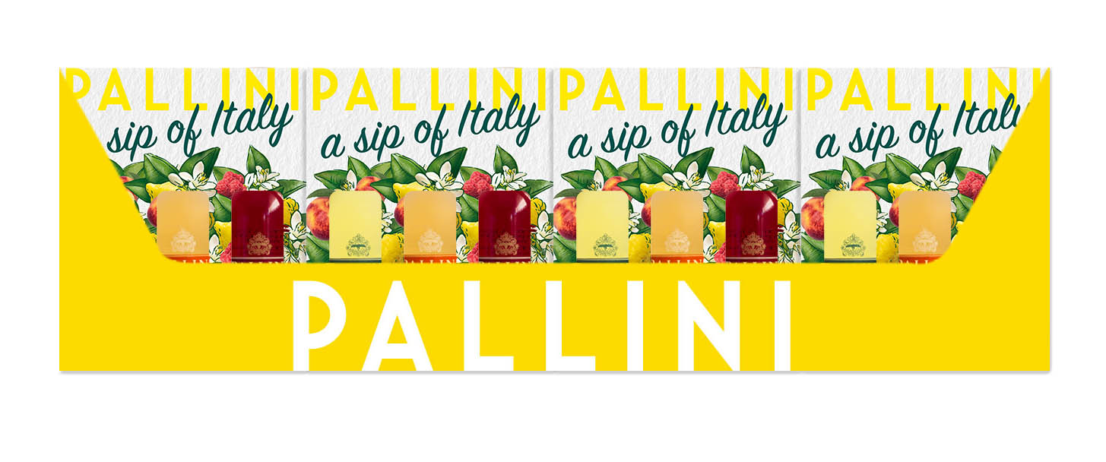
Taste the pallini collection in one go: Sip of Italy gift pack
$9.99
Perfect impulse purchase gift for any holiday occasion to be displayed at the check out in a ready to go box
3 Pallini 50ml bottles: Limoncello, Peachcello & Raspicello
Available September 2023
Top quality liquid: made from organically grown Amalﬁ sfusato lemons, Emilio Romagna white peaches and Abruzzi mountains berries.
Extremely versatile, enjoyable straight from the fridge, on the rocks, or mixed into countless cocktails like the spritz.
BOX/CS | 24
CS/LAY | 8
CS/PAL | 64
Case Weight | 22.54 lbs
Case Height (in) | 5.35
Case Length (in) | 17.48
Case Width (in) | 8.66
UPC | 850052573003
SCC Code | 08005713650018
Limited supply:
Only 1.000 cs!
Logistics
WWW.pallini.us @PALLINILIMONCELLO
new

