Slide 1
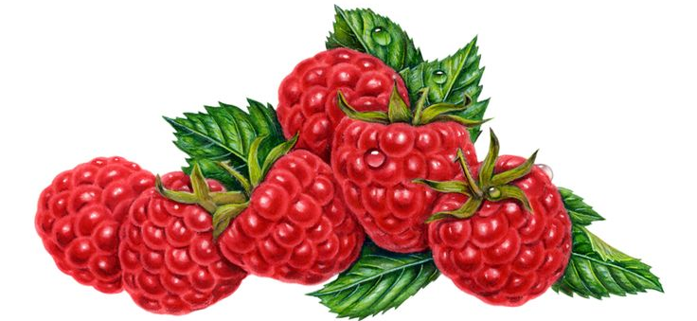
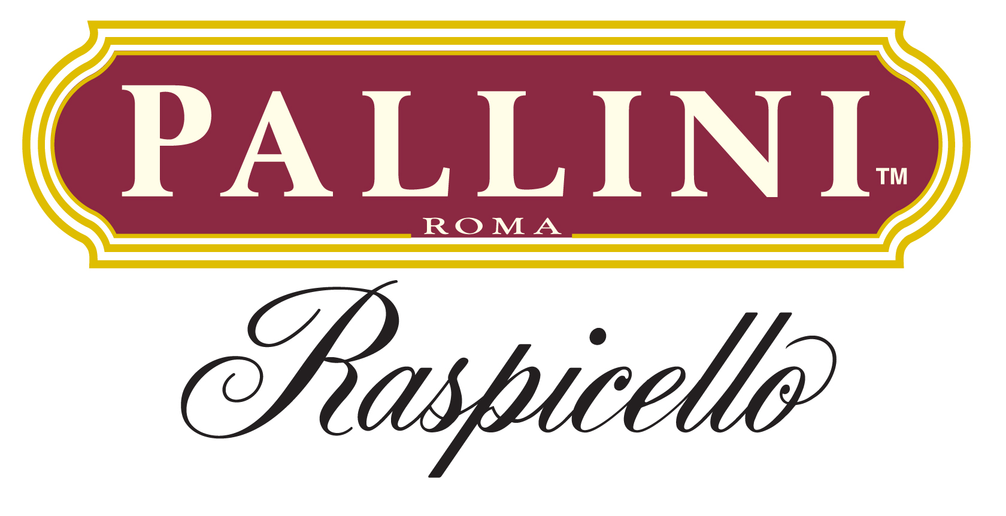
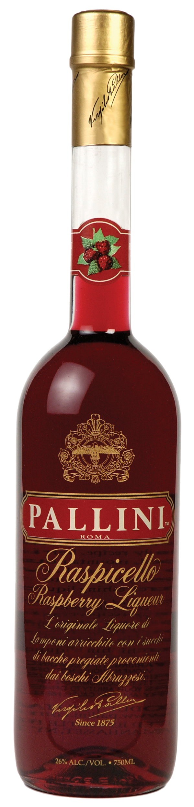
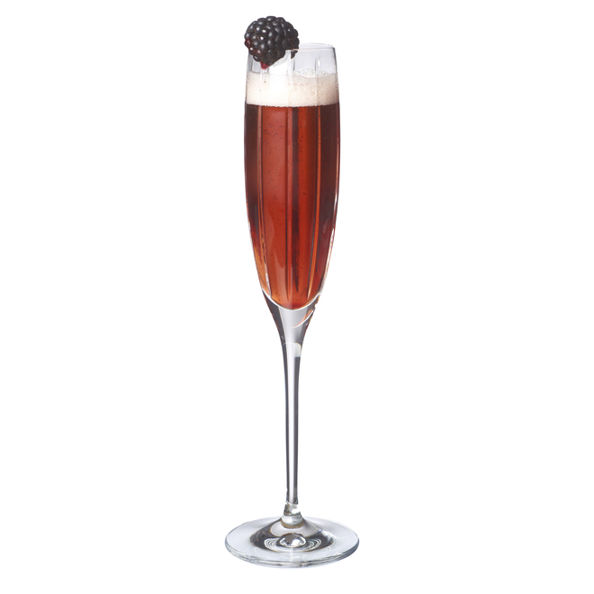
About pallini raspicello
Pallini Raspicello has enhanced the basic raspberry liqueur recipe by adding blueberries and black currants, grown in the mountainous Abruzzi region in Italy, evoking the flavor of the raspberries in a pure alcohol infusion.
The result is an outstanding liqueur full of ripe flavor that would compliment any cocktail.
Key cocktAILs
Pallini Raspicello will shine best in low ABV and sparkling cocktails. Simply mixing it with soda water or tonic is enough for a bright and ripe refreshing sipper.
Vodka and gin-based long drinks would benefit from this juicy addition as well.
Pallini Rossini
1 part Pallini Raspicello
2 parts Sparkling Wine
Add all the ingredients to a champagne flute and garnish with a berry of choice.
WWW.LIMONCELLOPALLINI.COM @PALLINILIMONCELLO

