Slide 1
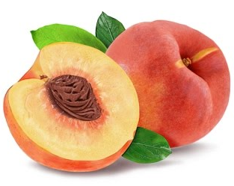
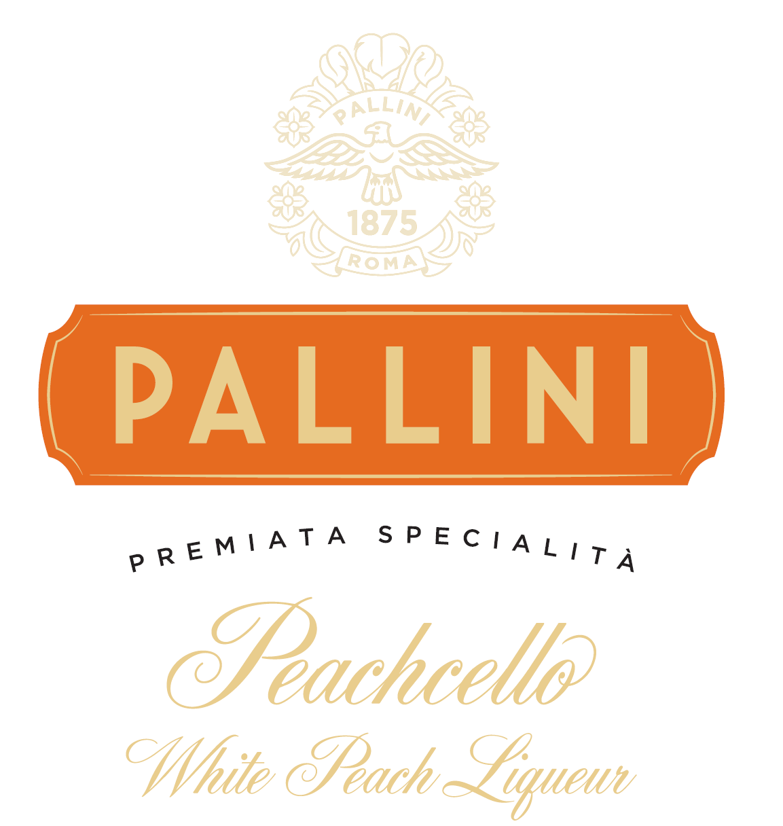
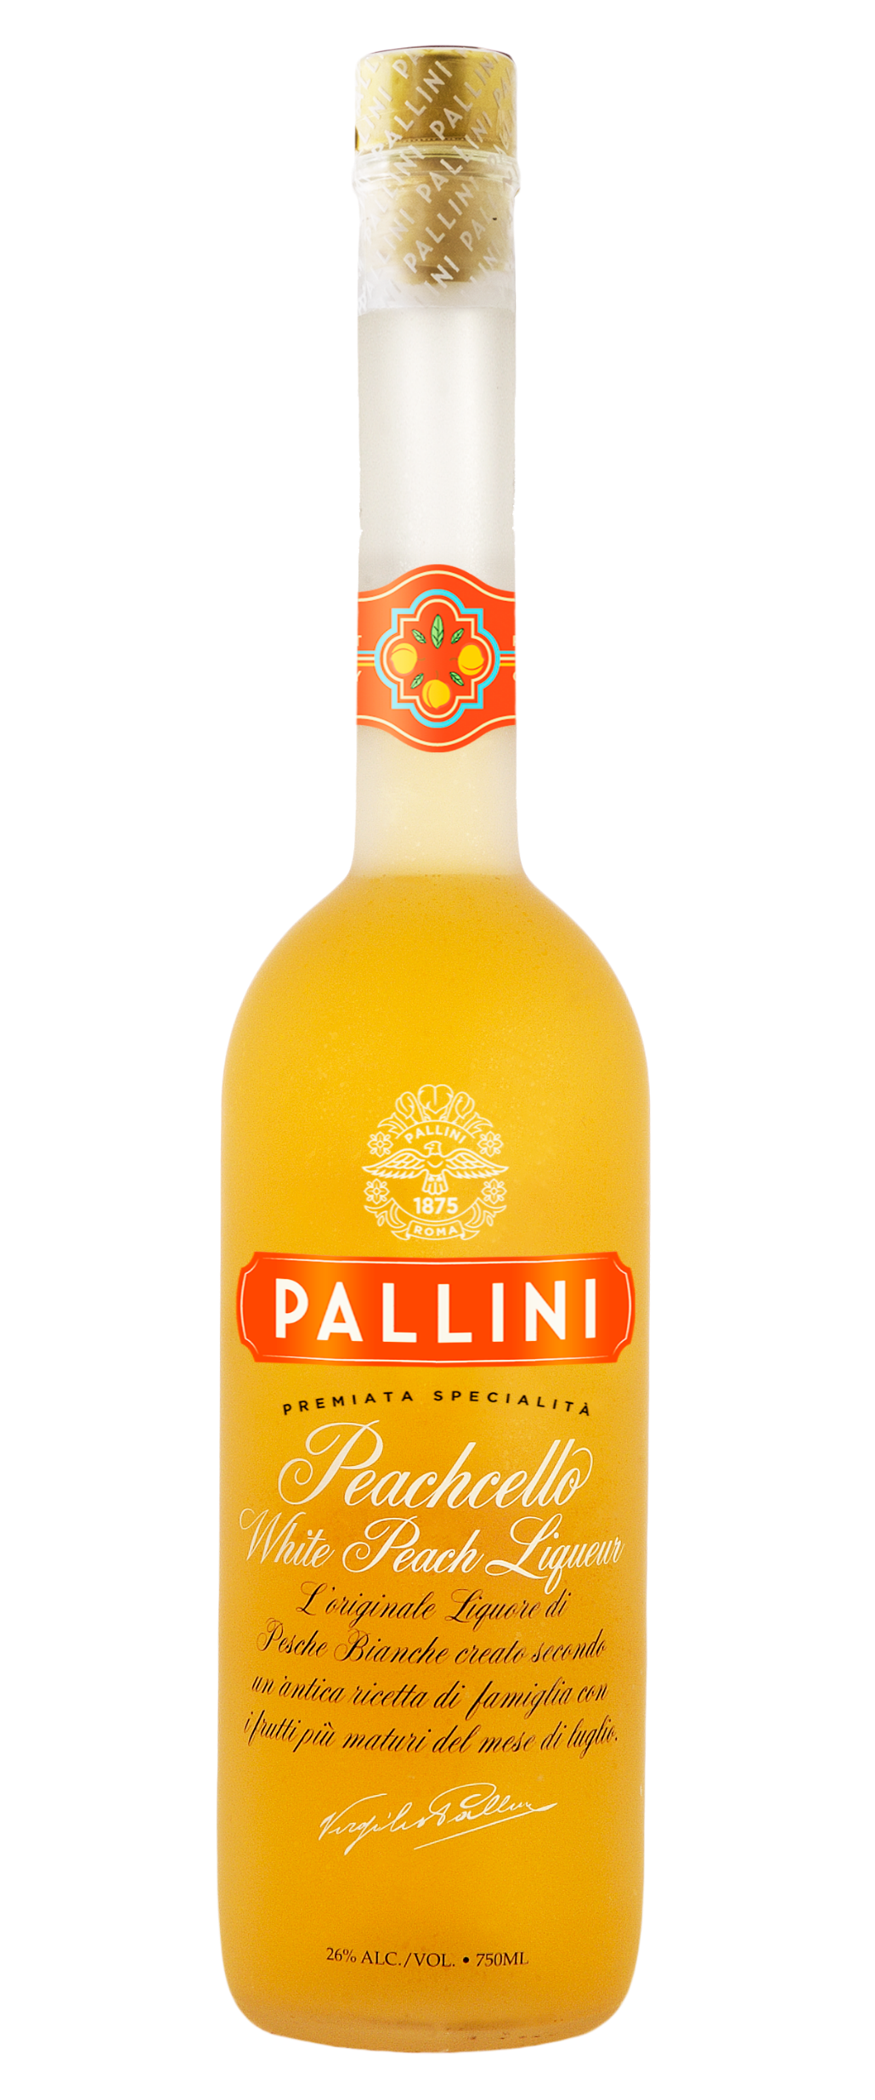
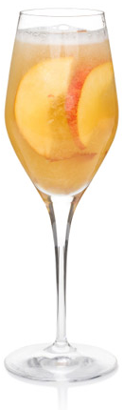
About pallini PEACHCELLO
Pallini Peachcello is an Italian fruit liqueur made from Italy’s finest white peaches.
White peaches, native to Emilia Romagna, grow mainly in the first part of summer and reach maximum ripeness in July, these luscious peaches are picked at their peak of flavor and infused in pure alcohol to create this exquisite liqueur.
Key cocktAILs
Pallini Peachcello will make a sensational addition to the essential brunch cocktail – Bellini. The juicy peachy flavor rivals that of a fresh peach puree while providing stable shelf life and consistency.
Try it in bourbon-based drinks for a spirited take or simply adding to ice tea for a low ABV sipper.
Pallini Bellini
1 part Pallini Peachcello
3 parts Sparkling Wine
Add all the ingredients to a champagne flute.
WWW.LIMONCELLOPALLINI.COM @PALLINILIMONCELLO

