Slide 1

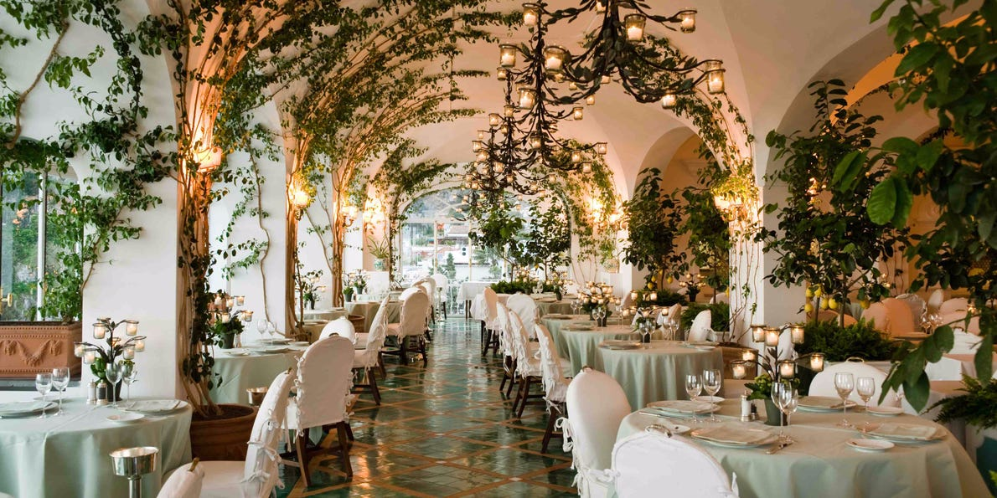
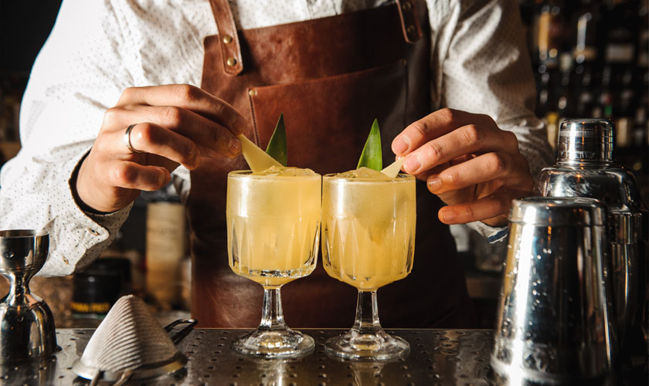
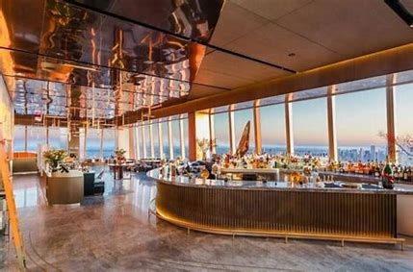

TRIAL
ON PREMISE
TARGET ACCOUNTS
AND SUGGESTED COCKTAIL VARIATIONS
Premium Italian Restaurants
Premium Dining
Pallini Spritz
Raspicello Martini
Peachello Old Fashioned
Limonzero Sour
Hotel / Rooftop Bars
Brunch Spots
Pallini Bellini
Pallini Spritz
Limonzero Spritz
Peachello Bellini

