Slide 1
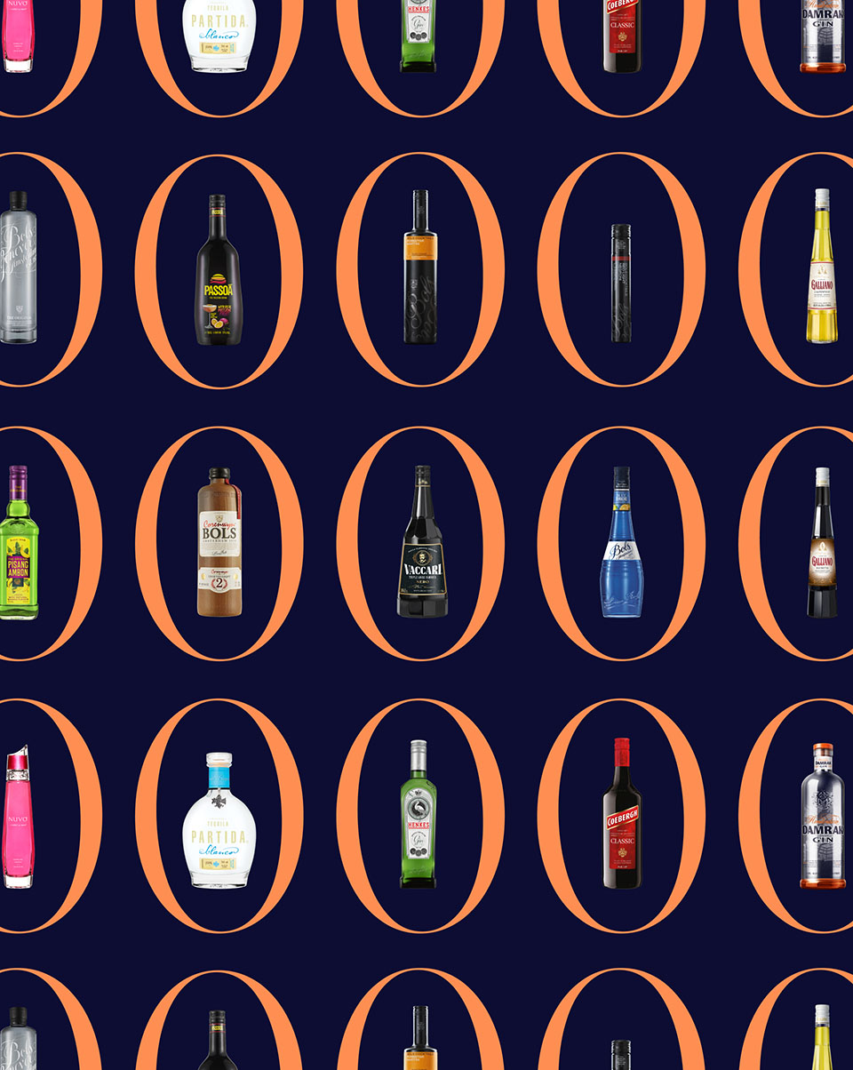

Triton POS Catalog
Updated: 2025

Slide 2
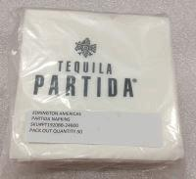
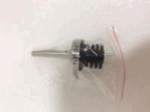


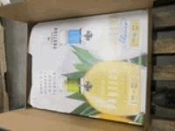
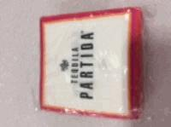
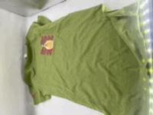
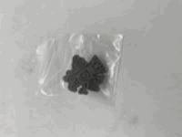
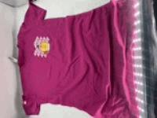
Partida
TEQUILA PARTIDA NAPKINS WHITE WITH GREY LOGO, 25PK
Item #LB-00331
PARTIDA TEQUILA POURER, 10PK
Item #LB-00354
PARTIDA PAPER STRAWS
25PK
Item #LB-00360
TEQUILA PARTIDA SAMPLING CUPS, 20PK
Item #LB-00385
TEQUILA PARTIDA DISPLAY
Item #LB-00606
TEQUILA PARTIDA NAPKINS WHITE WHITE BLACK LOGO
Item #LB-00334
TEQUILA PARTIDA - HEATHER GREEN LADIES T-SHIRT S, M, L
Item #LB-00673, LB-00674, LB-00675
PARTIDA TRQUILA LAPEL PIN
Item #LB-00668
TEQUILA PARTIDA BELLA BERRY LADIES T-SHIRT SM
Item #LB-00670

Slide 3
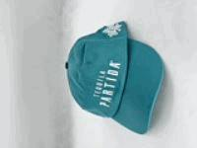
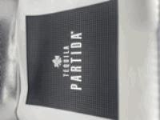
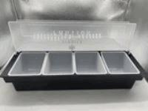
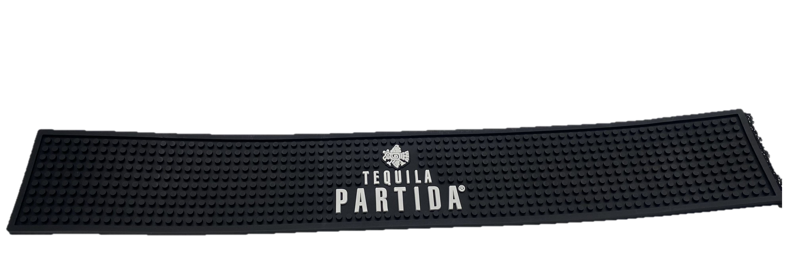
Partida
PARTIDA TEQUILA CAP TEAL WITH WHITE LOGO
Item #LB-00682
TEQUILA PARTIDA SQUARE BAR MAT
Item # LB-00690
TEQUILA PARTIDA 4 CONPARTMENT CONDIMENT TRAY
Item #LB-00689
TEQUILA PARTIDA BAR RAIL MAT
Item # LB-00691

