Slide 1
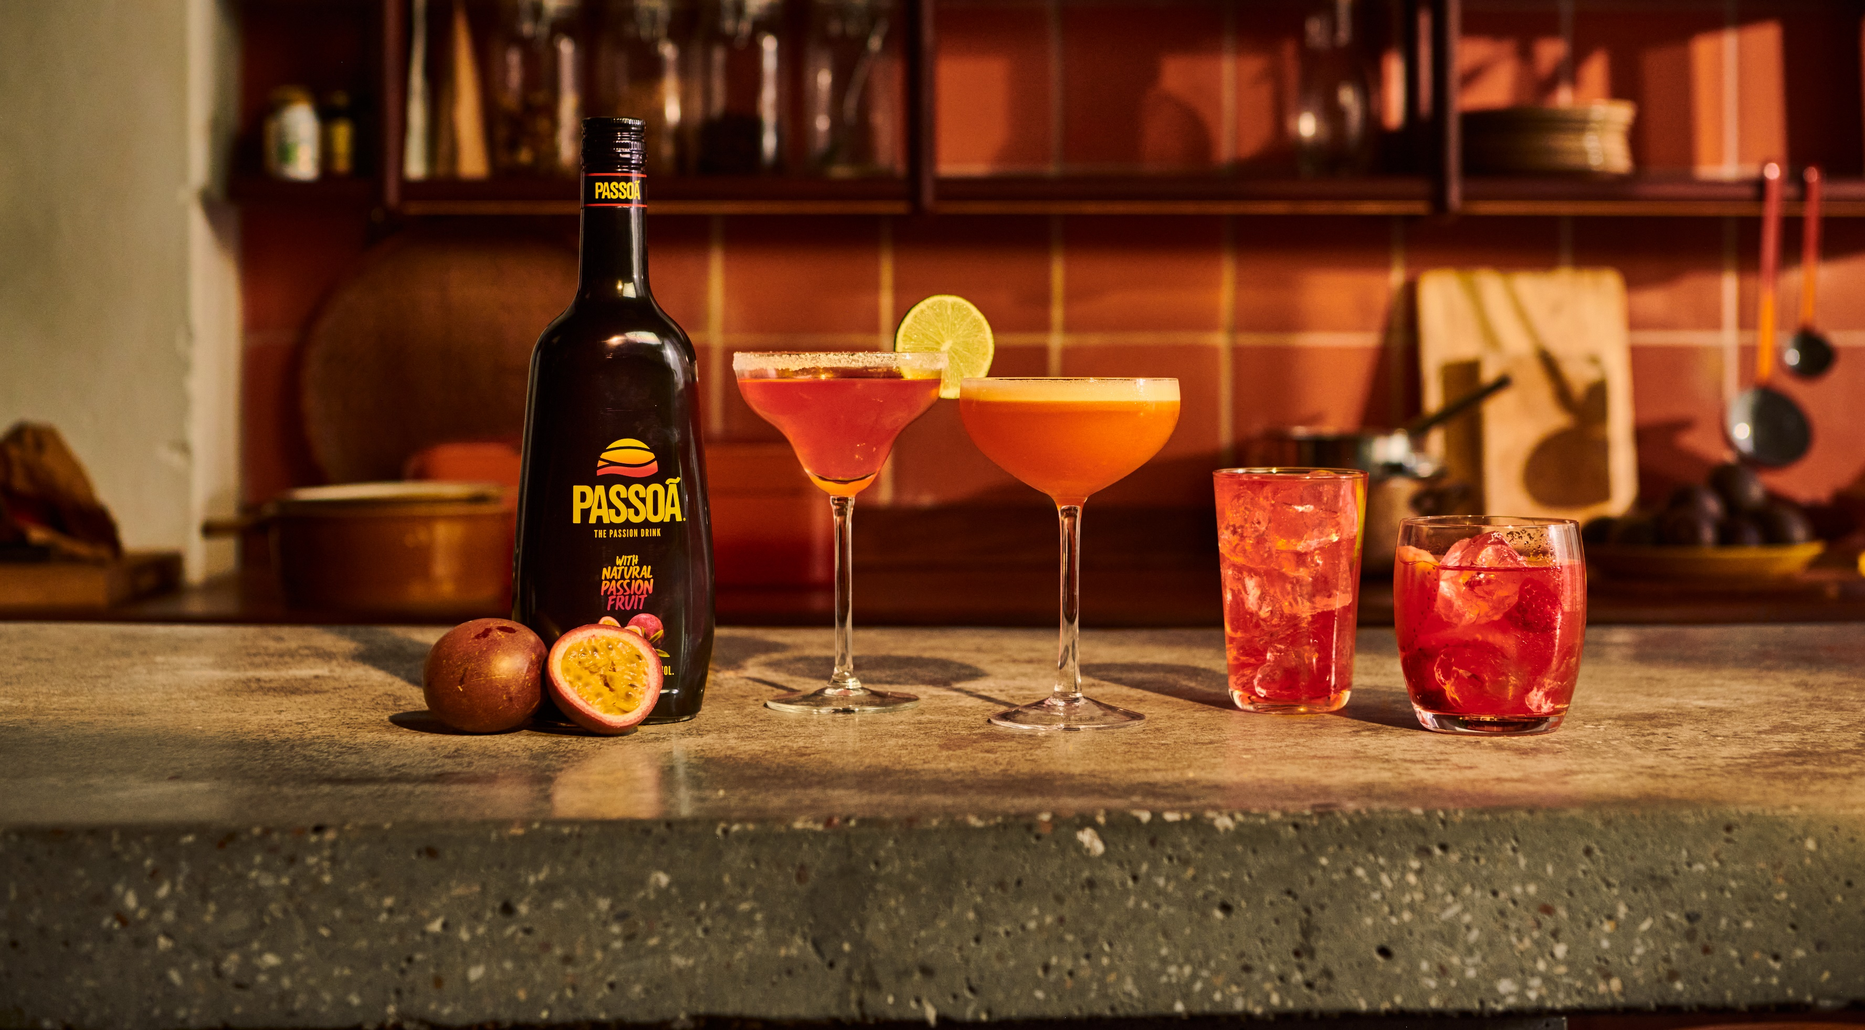
PASSOÃ
COCKTAIL CATALOGUE
Update - July 2024

Slide 2
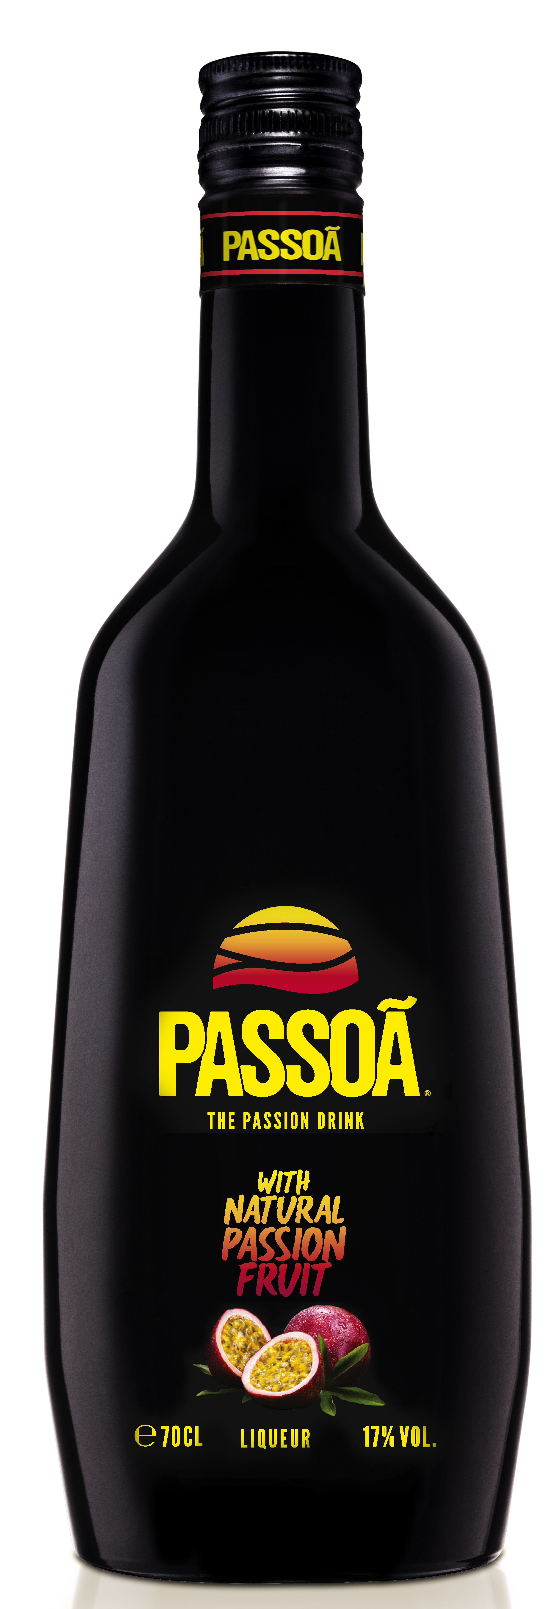
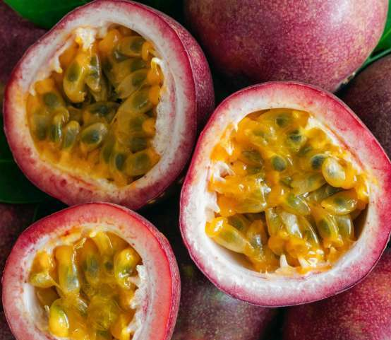
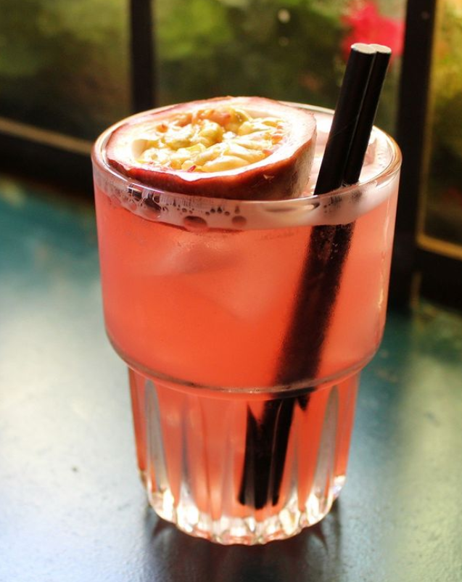
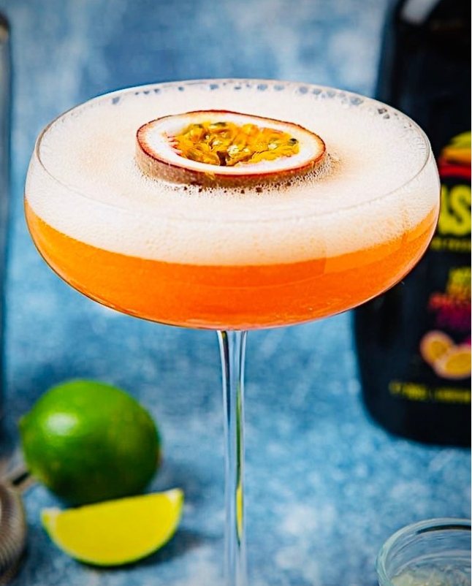
PASSOÃ IS THE PASSION FRUIT REFERENCE, WITH
LIMITLESS COCKTAIL VERSATILITY
The #1 passion fruit liqueur in the world
The Original Passion fruit liqueur (created over 35 years ago)
Made with natural passion fruit (passion fruit juice and natural passion fruit aromas) / No artificial flavors
Great cocktail versatilitY
Brings great flavor (fruity tropical taste, sweet and refreshing) and color to cocktails
Easy mixes and low ABV cocktails: Passoã & Tonic, Passoã Sangria,…
Elevates all classic cocktails with a passion fruit twist
KEY INGREDIENT OF THE ORIGINAL PORNSTAR MARTINI Douglas Ankrah used Passoã when he created the original PornStar Martini recipe in 2002.

Slide 3
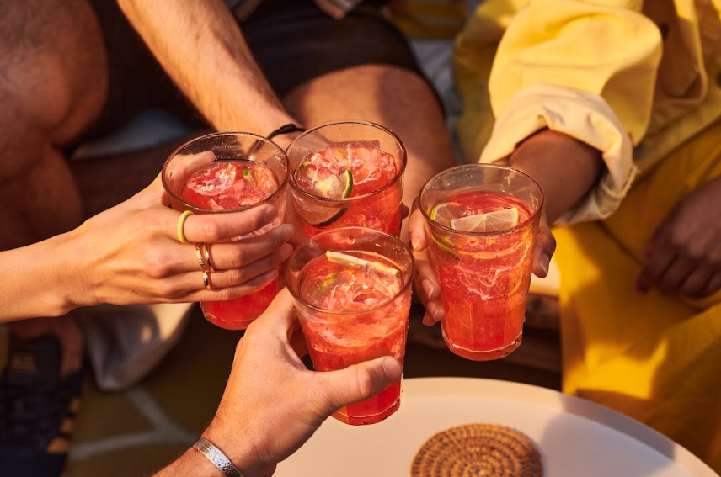
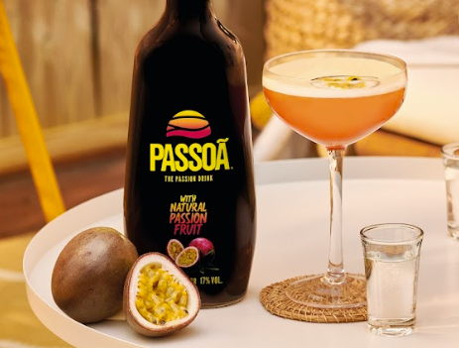
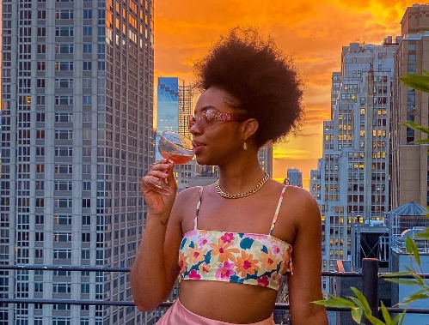
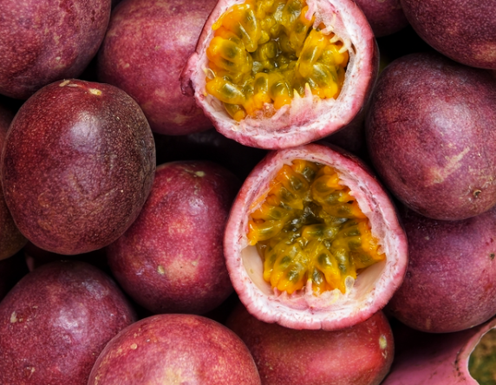
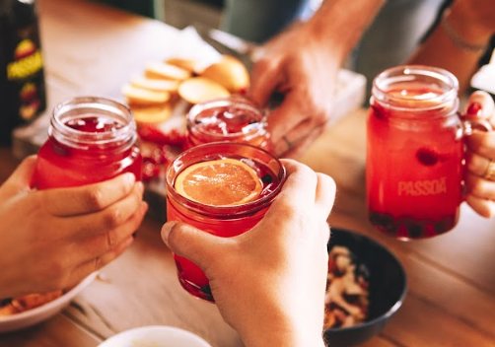
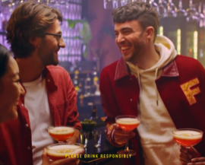
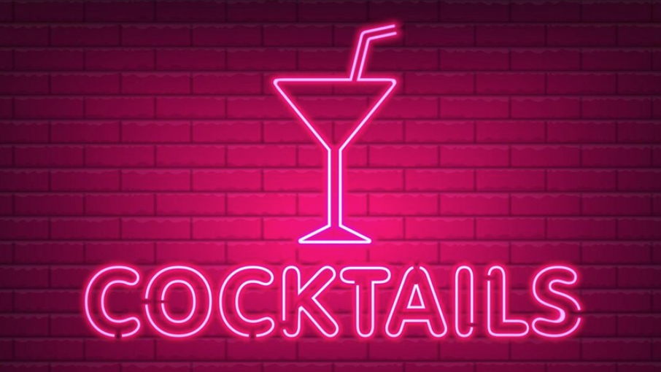
PASSOÃ COCKTAILS MEET CURRENT CONSUMER TRENDS
MODERATION
STRONG POPULARITY
OF PASSION FRUIT TASTe
Growing appeal of
Cocktails & pornstar martini
Low ABV
Less sugar than competition
Gluten free
Passion fruit is the #3 preferred flavor and fastest growing*
PornStar Martini: #1 search on Difford’s Guide and #2 on Google
Latest trends: Pink cocktails & Disco cocktails
*CGA Mixed Drink Report Q3 2022

Slide 4
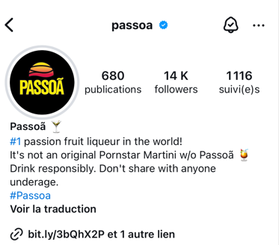
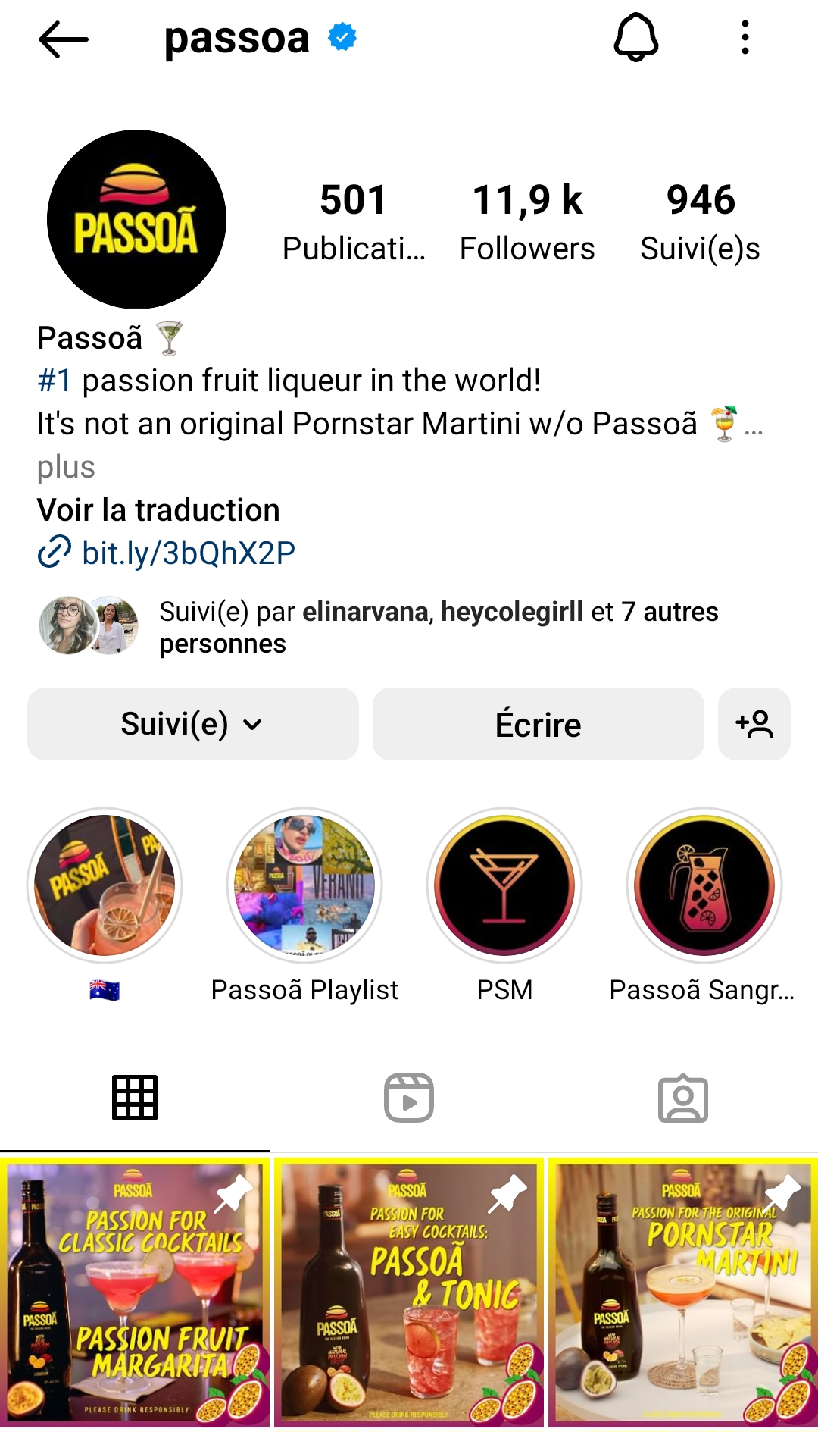
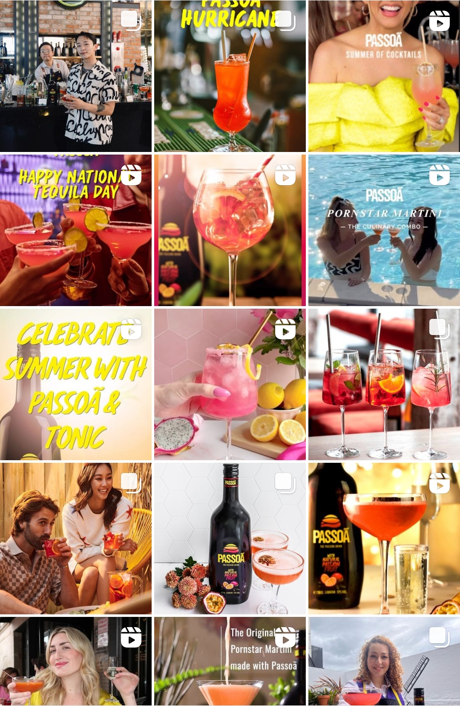
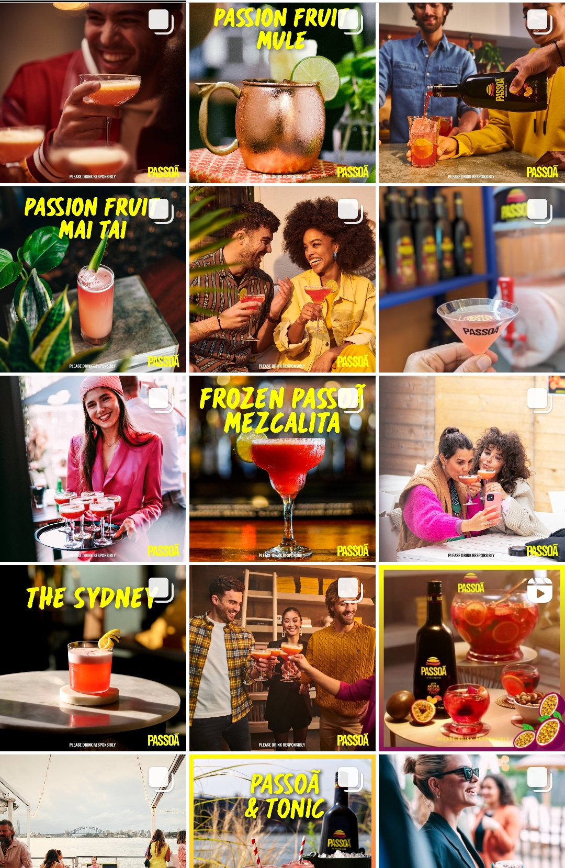
CONSUMERS LIKE INSTAGRAMABLE COCKTAILS

Slide 5
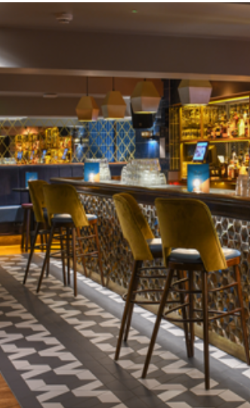
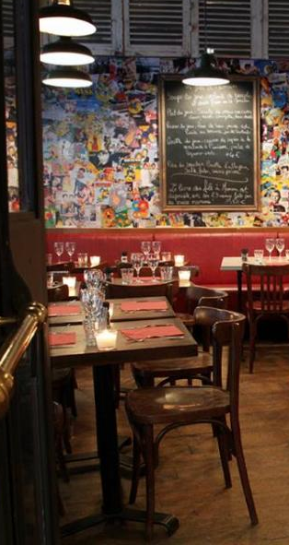
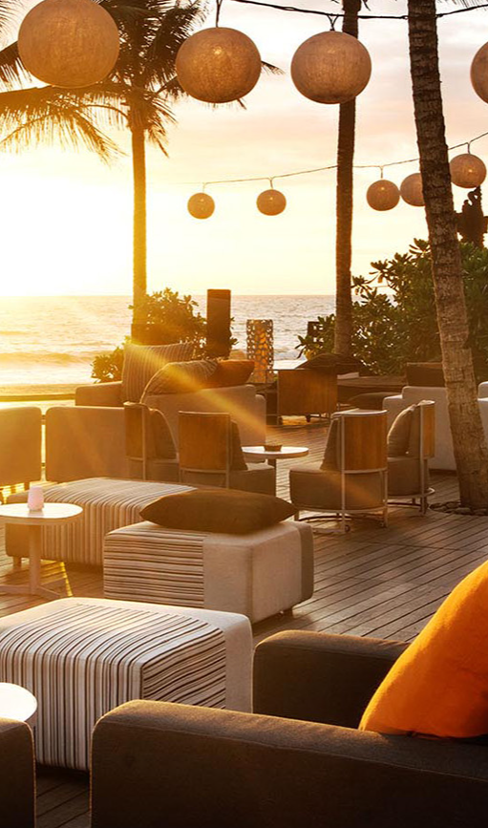
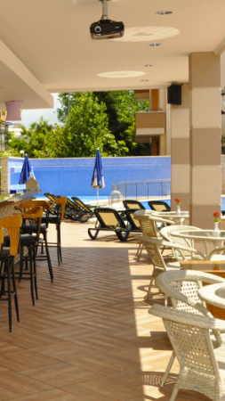

PASSOÃ COCKTAILS FOR A WIDE RANGE OF PREMIUM-MAINSTREAM ACCOUNTS
COCKTAIL BARS / NEIGHBORHOOD BARS
BRASSERIES/CASUAL DINING/PUBS
BEACH BAR/ POOL BAR /TIKI BAR / ROOFTOP BAR
HOTELS/ RESORTS /cruises

Slide 6
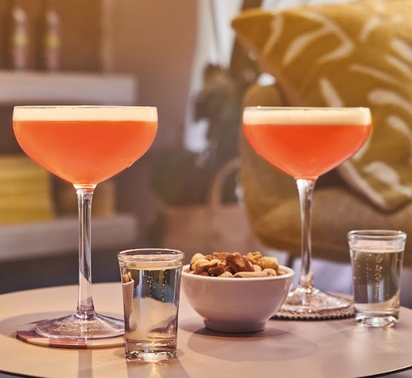
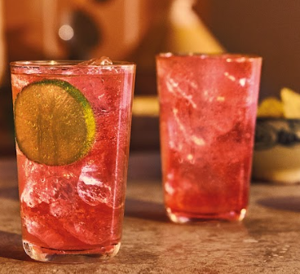
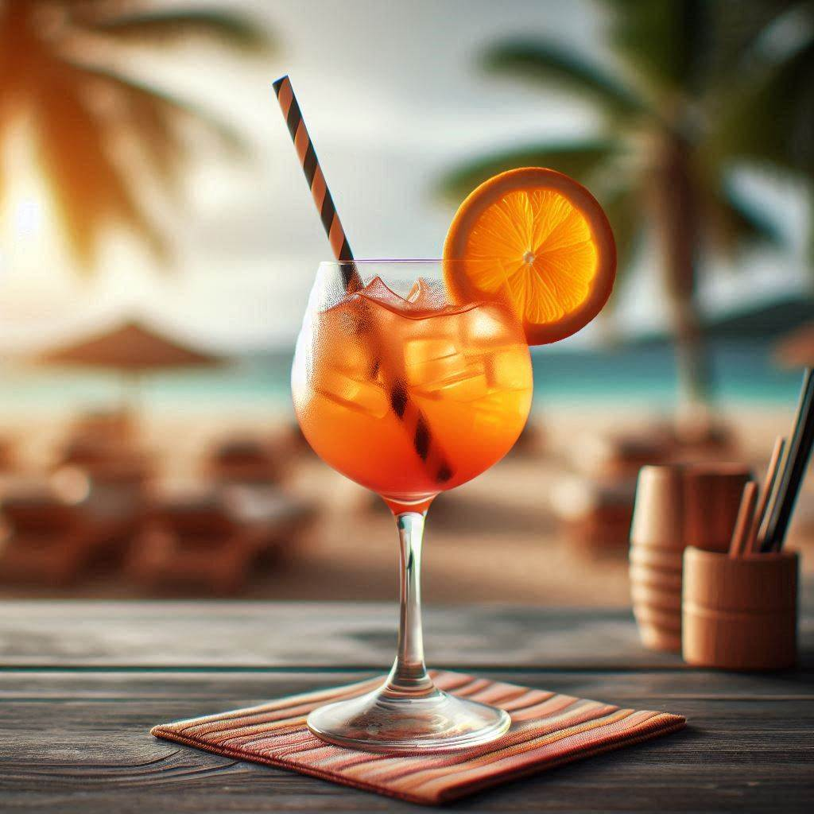
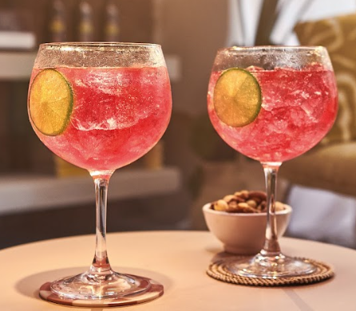
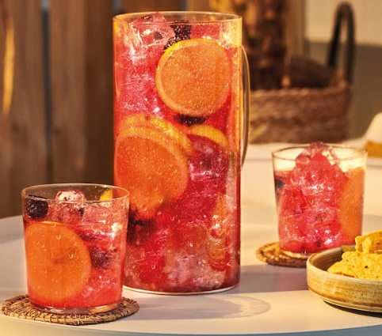
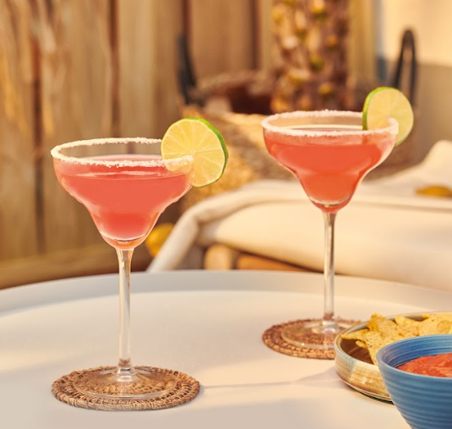
Passoã DRINK STRATEGY
Pornstar martini
Easy serves
THE ORIGINAL PORNSTAR MARTINI
Passoã & TONIC
Passoã & ORANGE
Passoã SPRITZ
Passoã SANGRIA
And MANY MORE OPTIONS
Elevate classic cocktails with a twist of passion fruit: Passoã Margarita, Passoã Mojito, Passoã Daiquiri,…
Frozen cocktails: Frozen Pornstar Martini, Frozé, Frozen margarita, …
Easy long drinks: Passoã Beer, Passoã Rosa, …
Seasonal cocktails: Passoã Coquito, Passoã Zombie, …
Twists on Pornstar Martinis: Spicy Pornstar Martini, White Chocolate Pornstar Martini

Slide 7
COCKTAIL OFFER COVERING ALL YEAR LONG NEEDS & OPPORTUNITIES (1/2)

Slide 8
COCKTAIL OFFER COVERING ALL YEAR LONG NEEDS & OPPORTUNITIES (2/2)

Slide 9
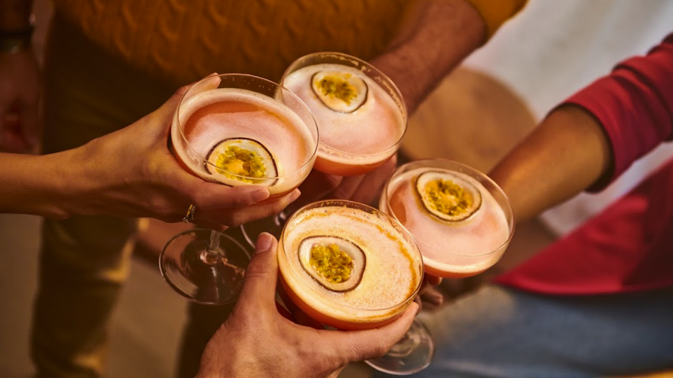
PASSOÃ original PORNSTAR MARTINI & TWISTs

Slide 10
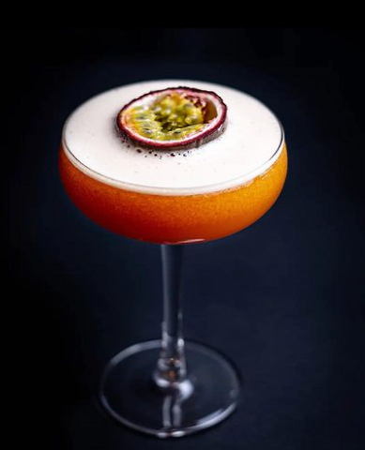
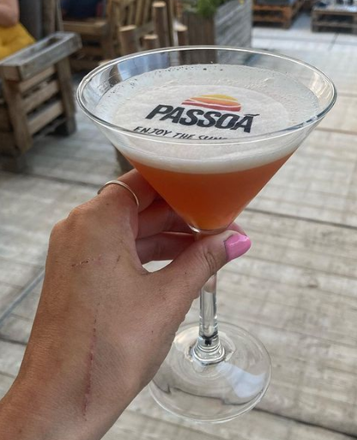
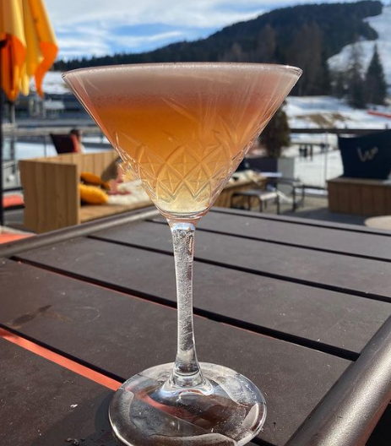
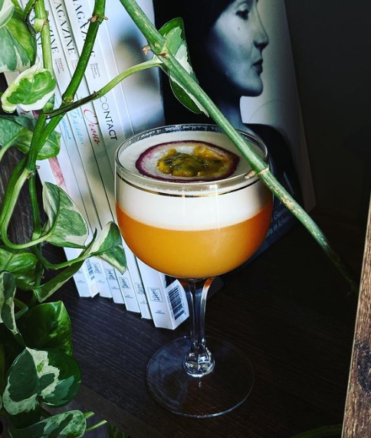
MAKE THE ORIGINAL PORNSTAR MARTINI WITH Passoã
The Pornstar Martini cocktail was created by Douglas Ankrah in London in the early 2000s, using Passoã is his original recipe.
Douglas Ankrah was one of the most London scene respected mixologist and founder of the legendary Lab cocktail bar.
“Passoã passion fruit liqueur is my little trick; it adds brightness to the cocktail” Douglas Ankrah
A winning recipe:
Intriguing name
Delicious sweet and sour taste with the combination of passionfruit and vanilla
Glamorous looks and ritual
Today, Pornstar Martini is the
#1 cocktail served in the UK
#1 cocktail search on Difford’s Guide
#2 cocktail search on Google

Slide 11
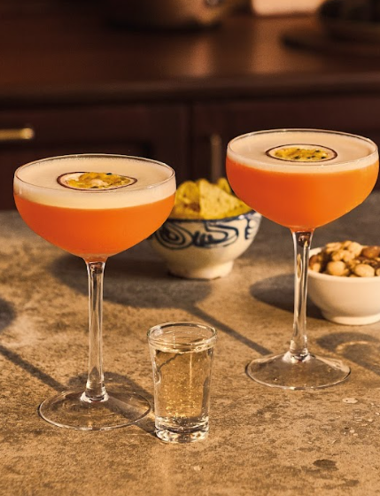




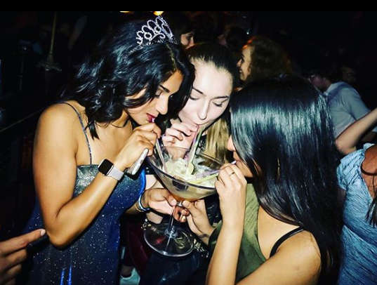
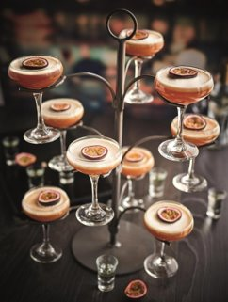
PASSOÃ ORIGINAL PORNSTAR MARTINI: THE #1 UK COCKTAIL
RECIPE
PREFERRED OCCASIONS
& PLACES
HAPPY HOUR/DINNEr/AFTER DINNER
Premium & mainstream bars/chains
Hotels/resorts
Brasseries/restaurants
RECOMMENDED RECIPE
40 ml / 1 ¼ oz. Passoã
30 ml / 1 OZ. vodka
15 ml / ½ OZ. vanilla syrup
30 ml / 1 OZ. unsweetened PF purée (20 ml/ ¾ OZ. when sweetened puree)
ALTERNATIVE RECIPE
40 ml / 1 ¼ oz. Passoã
30 ml / 1 OZ. vodka
10 ml / ¼ oz. vanilla syrup
15 ml / ½ OZ. lime or lemon juice
Pulp of 1 fresh PF
THEY LIKE
Skills
BARTENDERS
High rotations, loyalty potential & high margins
Impactful activations (trees, giant glass…)
CONSUMERS
Its name, taste and look
Its ritual(s)
/
PROFILE
EXCELLENT FRUITY LOW ACIDITY
BALANCE

Slide 12
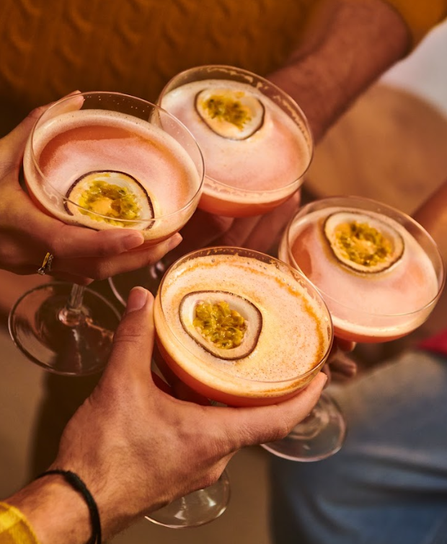
PRE-BATCH RECIPE OF PASSOÃ ORIGINAL PORNSTAR MARTINI
PRE-batch RECIPE
Pre-batch recipe #1 – conservation 24 hours:
You just take the recipe of the PSM and multiply the ingredients with the amount of serves you need. Shake before you serve. To be served within 24 hours and conserved in the fridge.
Pre-batch recipe #2 - conservation 7 days in the fridge:
Use the PSM recipe without the lime/lemon juice and multiply by the amount of serves. This preparation can be held good for 7 days in the fridge. Add the lime/lemon juice when shaking just before you serve it!
FULL RECIPE
40 ml / 1 ¼ oz. Passoã
30 ml / 1 OZ. vodka
10 ml / ¼ oz. vanilla syrup
Pulp of 1 fresh PF
15 ml / ½ OZ. lime or lemon juice

Slide 13
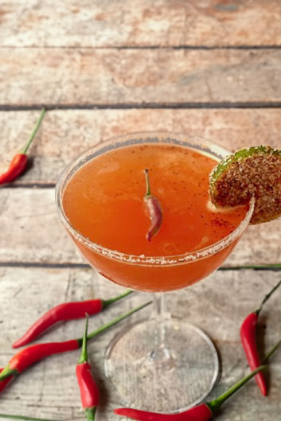
SPICY PORNSTAR MARTINI: SPICE UP YOUR HAPPY HOURS
RECIPE
PREFERRED OCCASIONS
& PLACES
30 ml / 1 OZ. Passoã
20 ml / ¾ OZ. Bols Vodka
10 ml / ⅓ oz. lime juice
20 ml / ¾ OZ. passion fruit puree
10 ml / ⅓ oz. cinnamon syrup
20 ml / ¾ OZ. egg white or 4 drops of foaming agent
HALLOWEEN/HAPPY HOURS
Premium & mainstream bars/chains
Hotels/resorts
Brasseries/restaurants
Skills
/
THEY LIKE
BARTENDERS
Nice twist for spicy lovers
CONSUMERS
A spicy twist on their favorite cocktail
PROFILE
BALANCE SPICY ORIGINAL

Slide 14
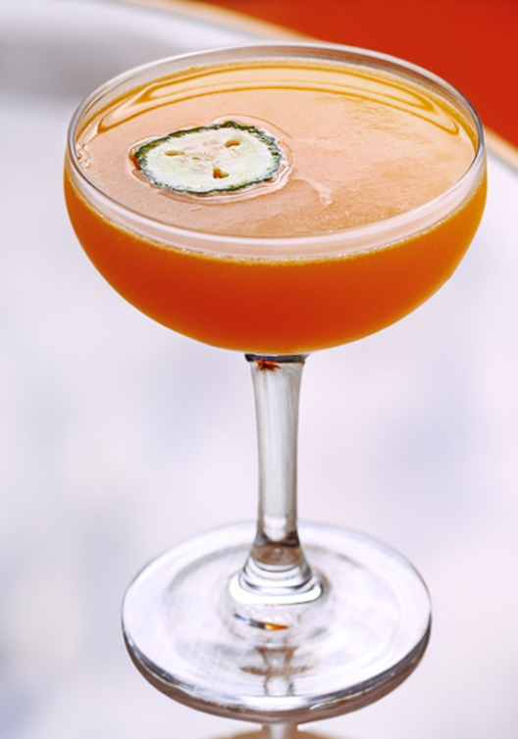
THE “FIT GIRL” PORNSTAR MARTINI: No more hesitation between a cocktail and a carrot juice
RECIPE
PREFERRED OCCASIONS
& PLACES
25 ml / ¾ oz. Passoã
30 ml / 1 oz. Tequila
25 ml / ¾ oz. Passion fruit puree
25 ml / ¾ oz. Carrot juice
2 Sage leaves
HALLOWEEN/THANKSGIVING
Premium & mainstream bars/chains
Hotels/resorts
Brasseries/restaurants
Skills
/
THEY LIKE
BARTENDERS
A fruit & vegetable option that can seduce a new target
CONSUMERS
Original and fun
PROFILE
original FRUIT & TEQUILA
VEGETABLE INTENSITY

Slide 15
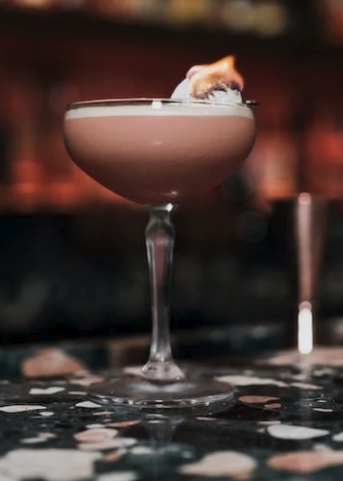
BISCOTTI PORN STAR MARTINI : IDEAL FOR AUTUMN DAYS
RECIPE
PREFERRED OCCASIONS
& PLACES
40 ml / 1 ¼ oz. Passoã
15 ml / ½ OZ. Bols Amaretto
20 ml / ¾ OZ. Bourbon whiskey
30 ml / 1 OZ. lemon juice
20 ml / ¾ OZ. egg white
CHRISTMAS/HALLOWEEN
Premium & mainstream bars/chains
Hotels/resorts
Brasseries/restaurants
Skills
/
THEY LIKE
BARTENDERS
Ideal for winter menu
CONSUMERS
Inspired by biscotti cake
For sweet tooth
PROFILE
balance BOLD sweet

Slide 16
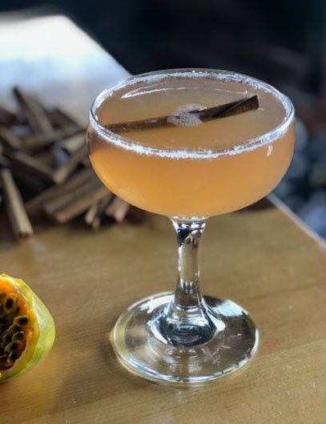
COZY PORNSTAR MARTINI: perfect cocktail for a dinner by the fire
RECIPE
PREFERRED OCCASIONS
& PLACES
30 ml / 1 OZ. Passoã
20 ml / ¾ OZ. Dark rum
15 ml / ½ OZ. lime juice
10 ml / ⅓ oz. cinnamon syrup
6 basil leaves
Autumn/thanksgiving/dinner
Premium & mainstream bars/chains
Hotels/resorts
Brasseries/restaurants
Skills
/
THEY LIKE
BARTENDERS
Nice twist for special winter period
CONSUMERS
An indulgent twist of their favorite cocktail
PROFILE
flavoring Indulgent sweet

Slide 17
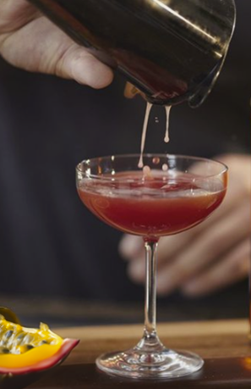
ENGLISH PORNSTAR MARTINI: IT’S TEA PORNSTAR MARTINI TIME!
RECIPE
PREFERRED OCCASIONS
& PLACES
30 ml / 1 oz. Passoã
20 ml / ¾ OZ. Passion fruit puree
15 ml / ½ oz. Black tea syrup
25 ml / ¾ oz. Cognac VSOP
15 ml / ½ oz. lime juice
Christmas/wintertime/AFTER DINNER
Premium & mainstream bars/chains
Hotels/resorts
Brasseries/restaurants
Skills
/
THEY LIKE
BARTENDERS
It’s originality
CONSUMERS
An original alternative to their teatime
PROFILE
aromatic bold creative

Slide 18
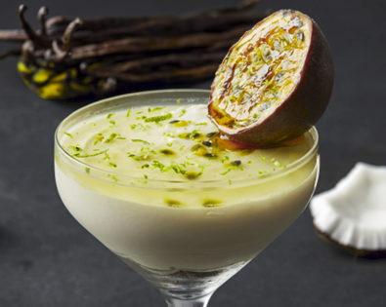
PORNSTAR MARTINI CHEESECAKE: YOUR FAVORITE DESSERT
RECIPE
PREFERRED OCCASIONS
& PLACES
20 ml / ¾ OZ. Passoã
40 ml / 1 ¼ oz. Bols Natural Yoghurt
20 ml / ¾ OZ. Passion fruit puree
10 ml / ⅓ oz. vanilla syrup
smooth
Christmas/wintertime/AFTER DINNER
Premium & mainstream bars/chains
Hotels/resorts
Brasseries/restaurants
Skills
/
THEY LIKE
BARTENDERS
Ideal for after dinner
CONSUMERS
Their new favorite dessert
PROFILE
Indulgent sweet

Slide 19
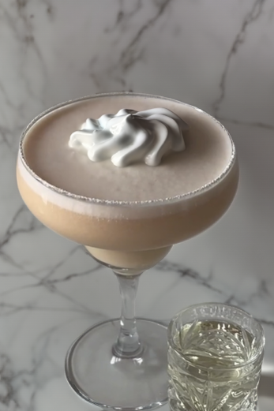
WHITE CHOCOLATE PORNSTAR MARTINI: For those with a sweet tooth
RECIPE
PREFERRED OCCASIONS
& PLACES
40 ml / 1 ¼ oz. Passoã
40 ml / 1 ¼ oz. vodka
40 ml / 1 ¼ oz. white chocolate liquor
10 ml/ ¼ oz. vanilla syrup
60 ml/ 2 oz. passionfruit juice
Christmas/wintertime/EASTER/AFTER DINNER
Premium & mainstream bars/chains
Hotels/resorts
Brasseries/restaurants
Skills
/
THEY LIKE
BARTENDERS
Ideal for winter period
CONSUMERS
An indulgent twist on their favorite cocktail
PROFILE
EXCELLENT Indulgent sweet
BALANCE

Slide 20
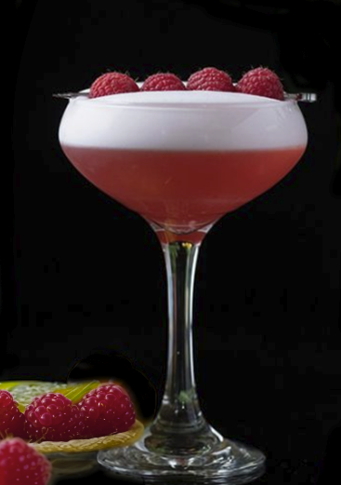
RASPBERRY PORNSTAR MARTINI: PINKY ONE FOR VALENTINE’S DAY
RECIPE
PREFERRED OCCASIONS
& PLACES
30 ml / 1 OZ. Passoã
20 ml / ¾ OZ. Vodka
10 ml / ⅓ oz. lime juice
20 ml / ¾ OZ. raspberry puree
10 ml / ⅓ oz. vanilla syrup
20 ml / ¾ OZ. egg white or 4 drops of foaming agent
valentine’S DAY/MOTHER DAY
Premium & mainstream bars/chains
Hotels/resorts
Brasseries/restaurants
Skills
/
THEY LIKE
BARTENDERS
Nice twist for Valentine’s day
CONSUMERS
It’s pink color
It’s raspberry/passion fruit taste
PROFILE
RASPBERRY Indulgent FRUITY
INTENSITY

Slide 21
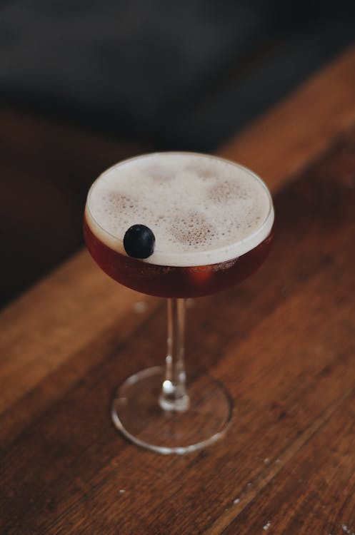
PORNSTAR MARTINI APERITIVO: FOR THOSE WHO PREFER IT BITTER
RECIPE
PREFERRED OCCASIONS
& PLACES
40 ml / 1 ¼ oz. Passoã
15 ml / ½ OZ. Galliano l’Aperitivo
20 ml / ¾ OZ. lime juice
20 ml / ¾ OZ. Passion fruit puree
10 ml / ⅓ oz. Ancho Reyes
Spring/summer focus
Premium & mainstream bars/chains
Hotels/resorts
Brasseries/restaurants
Skills
/
THEY LIKE
BARTENDERS
Nice twist for spring/summer edition
CONSUMERS
Pornstar Martini but make it more bitter
PROFILE
EXCELLENT BITTER COMPLEX
BALANCE

Slide 22
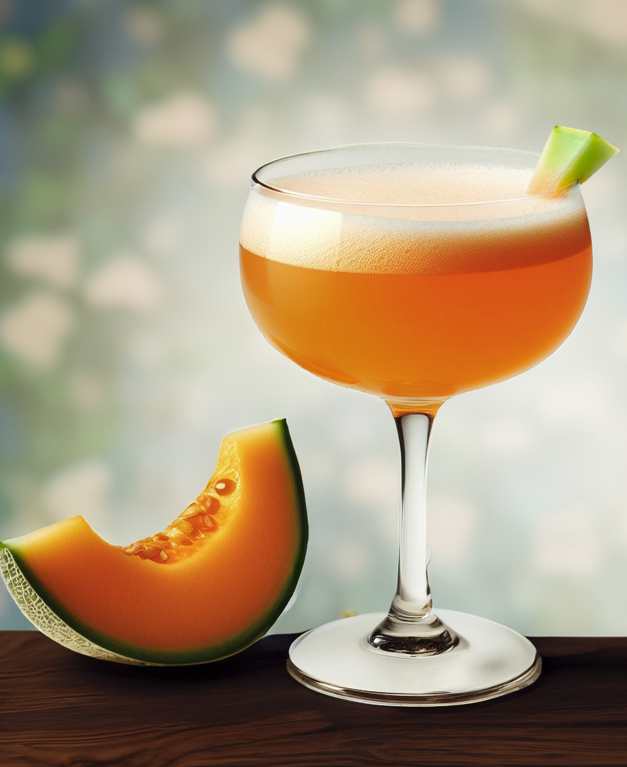
MELONIC PORNSTAR MARTINI : The sweetness of melon combined with our passionfruit liqueur
RECIPE
PREFERRED OCCASIONS
& PLACES
50 ml / 1 ¾ oz. Passoã
3-4 small of Canteloupe melon
2 basil leaves
10 ml / ⅓ oz. Lime juice
5 ml / 0,15 oz. Balsamic vinegar
10 ml / ⅓ oz. Sugar syrup
Spring/SUMMER FOCUS
Premium & mainstream bars/chains
Hotels/resorts
Brasseries/restaurants
Beach bars
Skills
/
THEY LIKE
BARTENDERS
Ideal for spring/summer activation
CONSUMERS
A melon/passion fruit original cocktail
PROFILE
Ideal for fruity sweet
summer

Slide 23
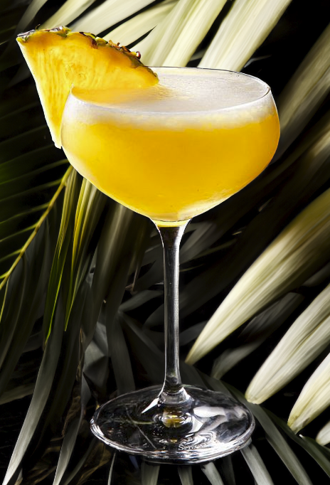
TROPICAL PORNSTAR MARTINI: A TRIP TO THE TROPICS
RECIPE
PREFERRED OCCASIONS
& PLACES
30 ml / 1 oz. Passoa
30 ml / 1 oz. Mango juice
15 ml / ½ oz. Lemon grass syrup
15 ml / ½ oz. lime juice
20 ml / ¾ OZ. egg whites
SUMMER FOCUS
Premium & mainstream bars/chains
Hotels/resorts
Brasseries/restaurants
Beach bars
Skills
/
THEY LIKE
BARTENDERS
A good tropical combination : mango and passion fruit which are trendy flavors for cocktail
CONSUMERS
It’s tropical taste!
PROFILE
tropical soft balance
intensity

Slide 24
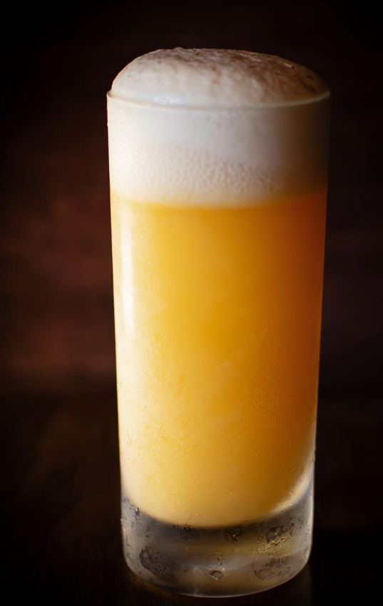
FEATHER BOA : IT’S FOAM PARTY
Winner Passoa x difford’s guide – 2023 competition
RECIPE
PREFERRED OCCASIONS
& PLACES
15 ml / ½ oz. Passion fruit liqueur
22.5 / ¾ oz. ml Lime juice
15 ml / ½ oz. Cream of coconut
45 ml / 1 ½ oz Tequila blanco
7.5 ml / ⅓ oz Sugar syrup 'rich' (2 sugar to 1 water, 65.0°Brix)
Premium & mainstream bars/chains
Hotels/resorts
Brasseries/restaurants
Beach bars
Skills
/
THEY LIKE
BARTENDERS
Very nice foam and color
CONSUMERS
This cocktail is your go-to cocktail, balance and tropical!
PROFILE
tropical foamy fresh
intensity

Slide 25
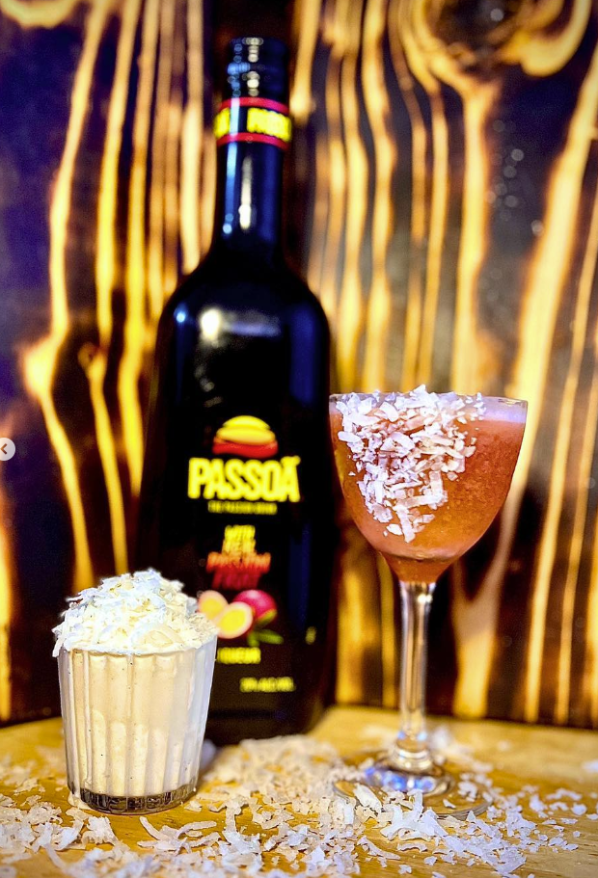
NICK AND NORA MAKE A PORNSTAR MARTINI : YOUR INDULGENT TREAT
1st runner-up Passoa x difford’s guide – 2023 competition
RECIPE
PREFERRED OCCASIONS
& PLACES
15 ml / ½ oz. Passion fruit liqueur
45 ml / 1 ½ oz Rum
7.5 ml / ⅓ oz Sherry – Amontillado
7.5 ml / ⅓ oz Passion fruit syrup
7.5 ml / ⅓ oz Cream of coconut
15 ml / ½ oz. Lime juice
30 ml / 1 OZ. Ice cream - Vanilla
Premium & mainstream bars/chains
Hotels/resorts
Brasseries/restaurants
Beach bars
Skills
THEY LIKE
/
BARTENDERS
Can be up for all season!
CONSUMERS
It’s original and sweet
PROFILE
bold indulgent sweet

Slide 26
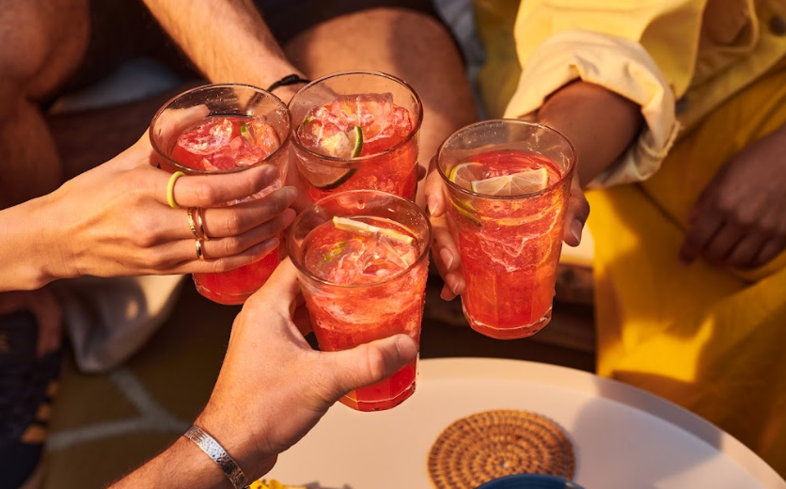
Long drinks & easy cocktails

Slide 27
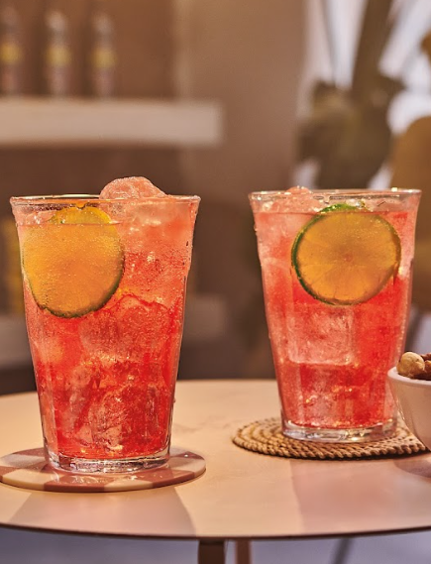



PASSOÃ & TONIC: THE SUPER EASY 1+1, AND IT IS LOW ABV
RECIPE
PREFERRED OCCASIONS
& PLACES
1 part PASSOã
2 parts tonic
SQUIZZ A LIME
PLENTY OF ICE CUBES
FRESH LIGHT FIZZY
DAY-TIME/Happy hour
Mainstream bars
Beach bars
Summer flagships
Festivals, fairs
Note: It is also possible to replace Tonic by lemonade: Passoã & Lemonade
Skills
THEY LIKE
BARTENDERS
Easy and quick preparation, simple service
CONSUMERs
Fruity & fresh
PROFILE
Comparison with white wine:
76 Kcal vs wine 82 Kcal (for 100mL)
ABV 5,7% vs wine 11,6% on average

Slide 28


PASSOÃ & ORANGE JUICE: THE OJ EASY MIX, POPULAR SINCE THE 1980s
RECIPEs
PREFERRED OCCASIONS
& PLACES
1 PART PASSOÃ
2 PARTS Orange juice
(preferably freshly squeezed)
Garnish with an orange slice
BRUNCH/DAY-time/HAPPY HOUR
Mainstream bars
Beach bars
Summer flagships
Festivals, fairs
THEY LIKE
BARTENDERS
Easy to prepare
Can be elevated with freshly squeezed orange juice
CONSUMERS
Refreshing, fruity & sweet
Low ABV
Skills
PROFILE
FRESH
fruity
SWEET

Slide 29



PASSOÃ SANGRIA: IDEAL FOR SHARING MOMENTS
RECIPE
PREFERRED OCCASIONS
& PLACES
1 part Passoã
2 parts rose dry wine
Handful of sliced oranges
and red fruits
BRUNCH/HAPPY HOUR/DINNEr
Mainstream bars/chains
Hotels/resorts/beach bars
Brasseries/restaurants
Summer flagships
Skills
THEY LIKE
BARTENDERS
Easy to mix and prepare
Its multiple occasions, as long as it is shared
CONSUMERS
Its generous and sharing format
Its fruity profile and lightness
PROFILE
FRESH FRUITY GENEROUS

Slide 30

PASSOÃ PASSION FRUIT SPRITZ:
A SWEET & FRUITY VERSION OF THE WELL-KNOWN COCKTAIL
RECIPEs
PREFERRED OCCASIONS
& PLACES
2 PARTS PASSOÃ
3 PARTS PROSECCO
1 PART SODA WATER
BRUNCH/DAY-time/HAPPY HOUR
Premium & mainstream bars/chains
Hotels/resorts/beach bars
Brasseries/restaurants
Skills
THEY LIKE
BARTENDERS
Versatility, different recipes according to consumer tastes
CONSUMERS
A fruity alternative to the famous bitter Spritz
Its eye catchy color
PROFILE
FRESH
LIGHT
SLIGHTLY
SWEET

Slide 31


PASSOÃ PASSION FRUIT BEER: HOW TO TWIST A PINT
RECIPE
PREFERRED OCCASIONS
& PLACES
1 part PASSOã
2 parts WHITE BEER
DASH OF LIME
DAY-TIME/Happy hour
Mainstream bars
Beach bars
Summer flagships
Festivals, fairs
Skills
THEY LIKE
BARTENDERS
Easy revisited version of Monaco/Panaché drink
CONSUMERS
Nice passion fruit twist to one of the most consumed drink during happy hour
PROFILE
REFRESHING
LIGHT
FRUITY

Slide 32

PASSOÃ ROSA: WINE ENTHUSIASTS WILL LIKE THIS ONE!
RECIPE
PREFERRED OCCASIONS
& PLACES
1/4 PASSOÃ
3/4 ROSÉ WINE
A LITTLE SPARKLING WATER
DAY-TIME/Happy hour
Premium & mainstream bars/chains
Hotels/resorts
Brasseries/restaurants
Beach bars
Skills
THEY LIKE
BARTENDERS
Like a spritz but easier and ideal for summer days
CONSUMERS
A good alternative to a Kir with less sugar
PROFILE
REFRESHING
LIGHT
FRUITY

Slide 33

PASSOÃ SPLASH: EASY AND FRUITY
RECIPE
PREFERRED OCCASIONS
& PLACES
1/3 PASSOÃ
1/3 SPARKLING WATER
1/3 CRANBERRY JUICE
DAY-TIME/Happy hour
Premium & mainstream bars/chains
Hotels/resorts
Brasseries/restaurants
Skills
THEY LIKE
BARTENDERS
Efficient quick drink
CONSUMERS
Instagrammable cocktail, fruity and fresh at the same time
PROFILE
REFRESHING
LIGHT
FRUITY

Slide 34

PASSOÃ GINGER (ALE/BEER): LET’S ADD SOFT SPICY NOTES!
RECIPE
PREFERRED OCCASIONS
& PLACES
1 part PASSOã
2 parts GINGER ALE/GINGER BEER
DASH OF LIME
FRESH LIGHT FIZZY
DAY-TIME/Happy hour
Mainstream bars
Beach bars
Summer flagships
Festivals, fairs
Skills
THEY LIKE
BARTENDERS
Easy and quick preparation, simple service
CONSUMERS
Ginger adding spicy notes well combined with passion fruit
PROFILE

Slide 35

PASSOÃ SUMMER BREEZE: THE NAME SAYS IT ALL
RECIPE
PREFERRED OCCASIONS
& PLACES
30 ML / 1 oz. PASSOÃ 30 ML / 1 oz. Grapefruit juice 30 ML / 1 oz. cranberry juice TOP WITH GINGER ALE/BEER
DAY-TIME/Happy hour
Mainstream bars
Beach bars
Summer flagships
Festivals, fairs
Skills
THEY LIKE
BARTENDERS
Easy and quick preparation
Simple service
CONSUMERS
Spicy and fruity cocktail that bring summer feeling
PROFILE
SPICY
NOTES
RICH IN
FRUITY
FLAVOURS
REFRESHING

Slide 36

TwistS on classic cocktails

Slide 37


PASSOÃ PASSION FRUIT MARGARITA:
EVEN MORE DELICIOUS THAN THE CLASSIC ONE!
RECIPE
PREFERRED OCCASIONS
& PLACES
20 ML / ¾ oz. PASSOÃ
50 ML / 1 ½ oz. TEQUILA
15 ML / ½ oz. TRIPLE SEC
20 ML / ¾ oz. FRESH LIME JUICE
BRUNCH/HAPPY HOUR/AFTER DINNER
Premium & mainstream bars/chains
Hotels/resorts
Brasseries/restaurants
Skills
THEY LIKE
BARTENDERS
Possibility to turn it frozen
Perfect promo with starters for happy hour
CONSUMERS
Passion fruit twist to the iconic cocktail
Its look
PROFILE
refreshing
FRUITY
SLIGHLTY
STRONG

Slide 38

PASSOÃ PASSION FRUIT MARTINI: THE NON-VANILLA OPTION OF THE FAMOUS PORNSTAR MARTINI
RECIPE
PREFERRED OCCASIONS
& PLACES
30 ml / 1 oz. PassoÃ
40 ml / 1 ¼ oz. Vodka
20 ml / ¾ oz. passionfruit puree
10 ml / ¼ oz. lime juice
DAY-TIME/Happy hour
Premium & mainstream bars/chains
Hotels/resorts
Brasseries/restaurants
Skills
THEY LIKE
BARTENDERS
Almost as famous as its twin the Pornstar Martini
CONSUMERS
An option for non-vanilla lovers
PROFILE
Passion fruit
intensity
balance
LIGHT

Slide 39

PASSOÃ COLLINS: SUPER TASTY, SUPER SUMMERY
RECIPE
PREFERRED OCCASIONS
& PLACES
20 ML / ¾ oz. PASSOÃ 50 ML / 1 ½ oz. GIN 25 ML / ¾ oz. LIME JUICE Splash of SODA
DAY-TIME/Happy hour
Premium & mainstream bars/chains
Hotels/resorts
Brasseries/restaurants
Skills
THEY LIKE
BARTENDERS
Easy and quick preparation
Simple service
CONSUMERS
Any combination with gin is always appreciated
Lightness feeling with fizzy touch
PROFILE
REFRESHING
FIZZY
CITRUS
NOTES

Slide 40


PASSOÃ PASSION FRUIT MOJITO: THE MOST EXOTIC OF ALL
RECIPE
PREFERRED OCCASIONS
& PLACES
15 ML / ½ oz. PASSOÃ
50 ML / 1 ½ oz. dark rum
20 ML / ¾ oz. FRESH LIME JUICE
15 ML / ½ oz. SUGAR SYRUP
6 mint leaves
HAPPY HOUR/AFTER DINNER
Mainstreams bars/chains
Hotels/resorts
Brasseries/restaurants
Beach bar
Skills
THEY LIKE
BARTENDERS
Even more simple and profitable version
of Bajan mojito
CONSUMERS
Exotism ++
Its eye-catchy color
PROFILE
FRESH
LAID
BACK
SLIGHTLY
SWEET

Slide 41


PASSOÃ PASSION FRUIT CAIPIRINHA:
A TROPICAL BRAZILIAN BREEZE
RECIPE
PREFERRED OCCASIONS
& PLACES
20ML/ ¾ oz. PASSOÃ
60ML/ 2 oz. CACHAçA
20ML/ ¾ oz. FRESH LIME JUICE
3 spoons SUGARCANE
CRUSHED ICE
HAPPY HOUR/AFTER DINNER
Premium & mainstream bars/chains
Hotels/resorts
Brasseries/restaurants
Beach bar
Skills
THEY LIKE
BARTENDERS&CONSUMERS
Passion fruit twist and additional exotic flavours to the most Brazilian cocktail
PROFILE
SWEET
ACIDULOUS
INTENSE

Slide 42


PASSOÃ PASSION FRUIT DAIQUIRI:
THE EXPRESSION OF TROPICALISM REVEALED
RECIPE
PREFERRED OCCASIONS
& PLACES
15 ML / ½ oz. PASSOÃ
50 ML / 1 ¾ oz oz. white rum
15 ML / ½ oz. sugar syrup
20 ML / ¾ oz. FRESH LIME JUICE
BRUNCH/HAPPY HOUR/AFTER DINNER
Premium & mainstream bars/chains
Hotels/resorts
Brasseries/restaurants
Skills
THEY LIKE
BARTENDERS
Possibility to turn it frozen
Perfect promo with starters for happy hour
CONSUMERS
Passion fruit twist to the iconic cocktail
PROFILE
CLASSIC BUT DIFFERENT
BALANCE
TROPICAL INTENSITY

Slide 43

PASSION FRUIT PALOMA : THE PERFECT SWEET AND SOUR
RECIPE
PREFERRED OCCASIONS
& PLACES
15 ml / ½ oz. Passoã
30 ml / 1 oz. Tequila silver
15 ml / ½ oz. lime juice
Pulp of 1 passion fruit
Grapefruit soda
BRUNCH/DAY-TIME/Happy hour
Premium & mainstream bars/chains
Hotels/resorts
Brasseries/restaurants
Beach bar
Skills
THEY LIKE
BARTENDERS
Revisited twist of Paloma cocktail, very trendy currently
CONSUMERS
Nice color and sweet and sour taste
PROFILE
Sweet
&
sour
REFRESHING
FRUITY

Slide 44


PASSOÃ HURRICANE: BOLD & PERFECT FOR SUMMER!
RECIPE
PREFERRED OCCASIONS
& PLACES
30 ml / 3 OZ PASSOÃ
30 ml / 3 OZ ORANGE JUICE
20 ml / 2 OZ DARK RUM
20ml / 2 OZ LIGHT RUM
10 ml / 1 OZ LIME JUICE
2 TBSP GRENADINE SYRUP
BRUNCH/DAY-TIME/Happy hour
Premium & mainstream bars/chains
Hotels/resorts
Brasseries/restaurants
Beach bar
Skills
THEY LIKE
BARTENDERS
Recognizable, eye catching
CONSUMERS
Bold and sweet at the same time
PROFILE
sweet
fresh
bold

Slide 45

PASSIONFRUIT MULE : STILL SPICY BUT WITH PASSIONFRUIT !
RECIPE
PREFERRED OCCASIONS
& PLACES
25 ml / ¾ oz. Passoã
35 ml / 1 ¼ oz. Bols Vodka
10 ml / ⅓ oz. fresh lime juice
Top up with Ginger beer
DAY-TIME/Happy hour
Premium & mainstream bars/chains
Hotels/resorts
Brasseries/restaurants
Beach bar
Skills
THEY LIKE
BARTENDERS
Easy revisited version of the Moscow Mule
CONSUMERS
Nice passion fruit twist on this classic cocktail
PROFILE
spicy
FRESH
intense

Slide 46

PASSOÃ BAY BREEZE: A FRUITY MIX THAT EVERYONE WILL LIKE!
RECIPE
PREFERRED OCCASIONS
& PLACES
25 ml / ¾ oz. Passoã
25 ml / ¾ oz. Bols Vodka
Pineapple juice
Cranberry juice
DAY-TIME/Happy hour
Mainstream bars
Beach bars
Summer flagships
Festivals, fairs
Skills
THEY LIKE
BARTENDERS
A way to reinvent Bay Breeze cocktail
CONSUMERS
Light and tropical cocktail
PROFILE
REFRESHING
LIGHT
FRUITY

Slide 47

PASSOÃ SOUR: A CLASSIC REINVENTED WITH PASSOÃ
RECIPE
PREFERRED OCCASIONS
& PLACES
60 ml / 2 oz. Passoã
30 ml / 1 oz. fresh lemon juice
15 ml / ½ oz. sugar syrup
2 dashes orange bitters
DAY-TIME/Happy hour
Premium & mainstream bars/chains
Hotels/resorts
Brasseries/restaurants
Skills
THEY LIKE
BARTENDERS
An original type of sour cocktail
CONSUMERS
For the true passion fruit lovers
PROFILE
fresh
PINKY
acidulous

Slide 48

PASSOÃ BRAMBLE: CLASSIC & FANTASTIC GIN COCKTAIL
RECIPE
PREFERRED OCCASIONS
& PLACES
20 ML / ¾ oz. PASSOÃ
50 ML / 1 ¾ oz. GIN
20 ML / ¾ oz. LEMON JUICE
10 ML/ ¼ oz. SUGAR SYRUP
DAY-TIME/Happy hour
Premium & mainstream bars/chains
Hotels/resorts
Brasseries/restaurants
Skills
THEY LIKE
BARTENDERS
A way to modernize the classic Bramble
CONSUMERS
A new gin cocktail option
PROFILE
BALANCE
LIGHT
FRUITY

Slide 49



PASSOÃ FIZZ: FIZZY AND FRESH FOR SUMMER
RECIPE
PREFERRED OCCASIONS
& PLACES
35 ml / 1 ¼ oz. Gin
25 ml / ¾ oz. fresh lemon juice
10 ml / ¼ oz. sugar syrup
Pulp of ½ passion fruit
Tonic water
Float 15 ml / ½ oz. Passoã
DAY-TIME/Happy hour
Premium & mainstream bars/chains
Hotels/resorts
Brasseries/restaurants
*
Skills
THEY LIKE
BARTENDERS
Like a gin fizz but with Passoã
CONSUMERS
Nice balance
Gin based-cocktail
PROFILE
REFRESHING
LIGHT
FIZZY
* Shake all ingredients, except tonic water and Passoã with ice. Top up with tonic water a float Passoã on top

Slide 50

PASSOÃ MIMOSA: FOR YOUR BEST BRUNCH
RECIPE
PREFERRED OCCASIONS
& PLACES
1 part PASSOã
2 PARTS PROSECCO
DAY-TIME/Happy hour
Premium & mainstream bars/chains
Hotels/resorts
Brasseries/restaurants
Skills
THEY LIKE
BARTENDERS
Easy revisited version of Mimosa
CONSUMERS
Nice passion fruit twist to one of the most consumed drink during brunches
PROFILE
FANCY
LIGHT
FRUITY

Slide 51

PASSOÃ PASSION FRUIT MAI TAI: EVEN BETTER WITH PASSOÃ
RECIPE
PREFERRED OCCASIONS
& PLACES
15 ml / ½ oz. PASSOÃ
30 ml / 1 oz. White Rum
15 ml / ½ oz. Dry Orange
30 ml / 1 oz. fresh lime juice
10 ml / ¼ oz. Orgeat syrup
10 ml / ¼ oz. Sugar syrup
BRUNCH/HAPPY HOUR/AFTER DINNER
Premium & mainstream bars/chains
Hotels/resorts
Brasseries/restaurants
Skills
THEY LIKE
BARTENDERS
Classic cocktail reinvented with Passoa
CONSUMERS
Passion fruit twist to the iconic cocktail
PROFILE
colorful
EXOTISM
bold

Slide 52

PASSOÃ FROZEN cocktails

Slide 53


PASSOÃ FROZEN ORIGINAL PORNSTAR MARTINI:
THE FROZEN VERSION OF UK #1 COCKTAIL
RECIPE
PREFERRED OCCASIONS
& PLACES
In a frozen machine (10 liters):
800 ml / 28 oz Passoã
1600 ml / 56 oz Vodka
300 ml / 10,5 oz passionfruit juice
600 ml / 21 oz lime juice
800 ml / 28 oz Vanilla Syrup
300 ml / 10,5 oz water
DAY-TIME/HAPPY HOUR
Mainstream bars/chains
Hotels/resorts/beach bars
Brasseries/restaurants
Summer flagships
THEY LIKE
Skills
BARTENDERS
Great volume maker, best-seller when listed*
CONSUMERS
Its name, fun ritual
/
PROFILE
FROZEN
BALANCED
FIZZY

Slide 54

PASSOÃ FROZEN MARGARITA:
HOT & COLD AT THE SAME TIME
RECIPE
PREFERRED OCCASIONS
& PLACES
DAY-TIME/HAPPY HOUR
Mainstream bars/chains
Hotels/resorts/beach bars
Brasseries/restaurants
Summer flagships
IN A FROZEN MACHINE (10 liters): :
700 ml / 24,5 OZ Passoã
1150 ml / 40 OZ Tequila silver
300 ml / 10,5 OZ Bols Triple Sec
700 ml / 24,5 OZ lime juice
600 ml / 21 OZ sugar syrup
1550 ml / 52 OZ cold water
Skills
THEY LIKE
BARTENDERS
Volume maker
CONSUMERS
Even more refreshing and yummy version to classic Margarita
PROFILE
FROZEN
FRUITY
BOLD

Slide 55

PASSOÃ FROZEN DAIQUIRI:
TWISTED WITH PASSOÃ, PERFECT FOR COOLING DOWN
RECIPE
PREFERRED OCCASIONS
& PLACES
DAY-TIME/HAPPY HOUR
Mainstream bars/chains
Hotels/resorts/beach bars
Brasseries/restaurants
Summer flagships
IN A FROZEN MACHINE (10 liters):
900 ml / 31 OZ Passoã
1300 ml / 44 OZ white Rum
800 ml / 28 OZ lime juice
800 ml / 28 OZ sugar syrup
1200 ml / 41 OZ cold water
Skills
THEY LIKE
BARTENDERS
Volume maker
CONSUMERS
Even more refreshing and yummy version to classic Daiquiri
PROFILE
FROZEN
SPICY
NOTES
TROPICAL
INTENSITY

Slide 56

PASSOÃ FROZEN SUMMER BREEZE:
OUR FRUITY & EASY FROZEN COCKTAIL
RECIPE
PREFERRED OCCASIONS
& PLACES
iN A FROZEN MACHINE (10 liters): :
1500 ML / 50 OZ Passoã
1250 ML / 42 OZ Grapefruit juice
1250 ML / 42 OZ Cranberry juicE
1000 ML / 34 OZ Water
DAY-TIME/HAPPY HOUR
Mainstream bars/chains
Hotels/resorts/beach bars
Brasseries/restaurants
Summer flagships
Skills
THEY LIKE
BARTENDERS
Volume maker
Ideal for Happy Hour promotion
CONSUMERS
Easy to drink, fresh berry flavor
PROFILE
FROZEN
LIGHT
fruity

Slide 57

PASSOÃ FROZÉ:
Passoã + ROSE IS ALWAYS A GOOD IDEA
RECIPE
PREFERRED OCCASIONS
& PLACES
DAY-TIME/HAPPY HOUR
Mainstream bars/chains
Hotels/resorts/beach bars
Brasseries/restaurants
Summer flagships
iN A FROZEN MACHINE (10 liters): :
1100 ml Passoã
3200 ml Rose Wine
700 ml Sparkling Wine*
Skills
THEY LIKE
BARTENDERS
Volume maker
CONSUMERS
Trendy for summer
PROFILE
FROZEN
fresh
balance
* Sparkling wine doesn’t freeze sparkling. You can replace it with non sparkling white wine as well

Slide 58

PASSOÃ SEASONAL GREETINGS

Slide 59


HALLOWEEN: LET’S BE WICKED!
PASSOÃ ZOMBIE
RECIPE
PREFERRED OCCASIONS
& PLACES
15 ml / ½ oz. PASSOÃ
50 ml / 1 ½ oz. RUM
(suggestion: Mix of dark, white, overproof*)
20 ml / ¾ oz. pineapple juice
15 ML / ½ oz. LIME JUICE
1 FRESH PASSION FRUIT
HAPPY HOUR/AFTER DINNEr
Premium & mainstream bars/chains
Hotels/resorts
Skills
THEY LIKE
BARTENDERS
Spectacular aspect of service
Extended activations during Summer (Hawai party)
CONSUMERS
Powerful aromatic profile, fun of ritual
General look and typical glassware
PROFILE
FRUITY
SPICY
INTENSE,
COMPLEX
* A lower version in ABV taking out OVERPROOF RUM CAN BE OFFERED

Slide 60

HALLOWEEN: LET’S BE WICKED!
PASSOÃ LADY KILLER
RECIPE
PREFERRED OCCASIONS
& PLACES
15 ML / ½ oz. PASSOÃ
50 ML / 1 ½ oz. GIN
15 ML / ½ oz. TRIPLE SEC
20 ML / ¾ oz. PINEAPPLE JUICE
FRESH SQUeezED PASSION FRUIT
HAPPY HOUR/AFTER DINNEr
Premium & mainstream bars/chains
Hotels/resorts
Brasseries/Restaurants
Skills
THEY LIKE
BARTENDERS
Multiple occasions from brunch to late night
CONSUMERS
Combination with gin is always highly appreciated
Its elegance when served in a coupe glass, more festive
PROFILE
RICH
IN FRUITY FLAVOURS
FRESH
LIGHT

Slide 61

HALLOWEEN: LET’S BE WICKED!
PASSOÃ CRIME PASSIONELE
RECIPE
PREFERRED OCCASIONS
& PLACES
20 ml / ¾ oz. PASSOÃ
20 ML / ¾ oz. bOLS VODKA
40 ML / 1 ¼ oz. ORANGE JUICE
Top up with champagne or prosecco
BRUNCH/HAPPY HOUR/AFTER DINNEr
Premium & mainstream bars/chains
Hotels/resorts
Brasseries/restaurants
Skills
THEY LIKE
BARTENDERS
Brunch table, at the beach — and pretty much anywhere consumer want a cocktail with a kick.
CONSUMERS
Combination of herbal and fruity flavours
PROFILE
FRESH
LIGHT
FESTIVE

Slide 62

THANKSGIVING: IT’S ALL ABOUT SHARING
PASSOÃ PASSION PUNCH BOWL
RECIPES
PREFERRED OCCASIONS
& PLACES
15 ml / ½ oz. PASSOÃ
50 ml / 1 ½ oz. vodka
20 ml / ¾ oz. pear juice
15 ML / ½ oz. LIME JUICE
1 FRESH PASSION FRUIT
top with champagne
Optional seasonals: spices, cinnamon, nutmeg
BRUNCH/HAPPY HOUR/DINNEr
Premium & mainstream bars/chains
Hotels/resorts
Brasseries/restaurants
THEY LIKE
Skills
BARTENDERS
Easy to make and prepare. Versatility of flavours, depending on consumer tastes. Adapted to the season and celebration in groups
CONSUMERS
A more complex version of the passion fruit sangria.
PROFILE
RICH IN
FRUITY FLAVOURS
FRESH
GENEROUS
*Inspired by Autumn punch recipe from Difford’s Guide

Slide 63


XMAS SPECIALS: WHEN TWO CLASSICS MEET
PASSOÃ PASSION PINK
RECIPE*
PREFERRED OCCASIONS
& PLACES
15 ml / ½ oz. PASSOÃ
50 ml / 1 ½ oz. tequila/vodka/gin
15 ml / ½ oz. triple sec
20 ml / ¾ oz. cranberry juice
Optional seasonals: spices, cinnamon, nutmeg
BRUNCH/HAPPY HOUR/DINNEr
Premium & mainstream bars/chains
Hotels/resorts
Brasseries/restaurants
Skills
THEY LIKE
BARTENDERS
Cosmopolitan and Margarita cocktails meeting around passion fruit twist and flavor
CONSUMERS
A pink cocktail, very trendy and catching attention
PROFILE
REFRESHING
FRUITY
BALANCED
*Inspired by Christmas margarita recipe from Difford’s Guide

Slide 64

XMAS SPECIALS: TIME TO REVISIT TRADITION!
PASSOÃ SNOWBALL (PASSION FRUIT EGGNOG)
RECIPEs
PREFERRED OCCASIONS
& PLACES
DINNEr/AFTER DINNER
Brasseries/restaurants
Mainstream bars/chains
Hotels/resorts
EGGNOG
20 ml / ¾ oz. PASSOÃ
20 ml / ¾ oz. bols advocaat
20 ML / ¾ oz. bols yoghurt
10 ml / ¼ oz. BOLS VANILLA
EGGNOG WITH A TWIST
30 ml / 1 oz. PASSOÃ
10 ml / ¼ oz. bols advocaat
30 ML / 1 oz. bols yoghurt
50 ML / 1 ½ oz. prosecco
Skills
THEY WILL LIKE
BARTENDERS
Twist to a very traditional and family drink to be served during/after dinner
CONSUMERS
A eggnog version freshened with passion fruit, lime and invigorated with champagne/prosecco
PROFILE
RICH
CREAMY
generous

Slide 65


XMAS SPECIALS:
PASSOÃ COQUITO
RECIPE
PREFERRED OCCASIONS
& PLACES
120 ml/ 4 oz. PASSOÃ
120 ml / 4 oz, condensed milk
180 ml / 6 oz. coconut cream
240 ml / 8 oz. white rum
1 tsp vanilla extract
Optional seasonal: cinnamon
X-MAS/AFTER-DINNER
Brasseries/restaurants
Mainstream bars/chains
Hotels/resorts
Skills
THEY LIKE
BARTENDERS
A new listing on their menu for X-mas season
CONSUMERS
A dessert alternative
PROFILE
INDULGENT
cocktail
REFRESHING
SPICY

Slide 66

NEW YEAR’S EVE + SAINT VALENTINE’S: LET’S SPARKLE
PASSOÃ BELLINI
RECIPE
PREFERRED OCCASIONS
& PLACES
1 part PASSOÃ
2 parts prosecco
Squeeze fresh lime juice
add passion fruit puree
HAPPY HOUR/AFTER DINNER
Mainstream bars/chains
Hotels/resorts
Brasseries/restaurants
Skills
THEYS LIKE
BARTENDERS
Easy sparkling alternative to classic Peach Bellini
CONSUMERS
Eye-catching color
PROFILE
FRESH
SPARKLING
FESTIVE

Slide 67

SAINT VALENTINE’S + MOTHER’S DAY: BRING THE GLAMOUROUS
PASSOÃ COSMOPOLITAN
RECIPE
PREFERRED OCCASIONS
& PLACES
15 ml / ½ oz. PASSOÃ
50 ml / 1 ½ oz. vodka
15 ml / ½ oz. triple sec
20 ml / ¾ oz. lime juice
(15ml cranberry juice)
BRUNCH/HAPPY HOUR/AFTER DINNER
Mainstream bars/chains
Hotels/resorts
Brasseries/restaurants
Skills
THEY LIKE
BARTENDERS
Passion twist to iconic New Yorker classic
CONSUMERS
Pink color appealing to consumers
PROFILE
FRUITY
BALANCED
ELEGANT

Slide 68

A PASSIONATE sourCE OF CREATION

Slide 69



LET YOURSELF BE INSPIRED AND CREATE YOUR OWN RECIPES!

Slide 70







GET VISIBILITY ON PASSOÃ SOCIAL NETWORK!
Get your chance to get new visibility by sharing your content with us!
Our followers are constantly seeking for places recommendations, making it the perfect partnership to boost your reach and promote Passoa ̃cocktails!
Tag @Passoa on Instagram and use #Passoa and #PassoaxBar, we will share our favorites creations directly on our account!
We can’t wait to see your creations!
Our social network:
165 K

