Slide 1


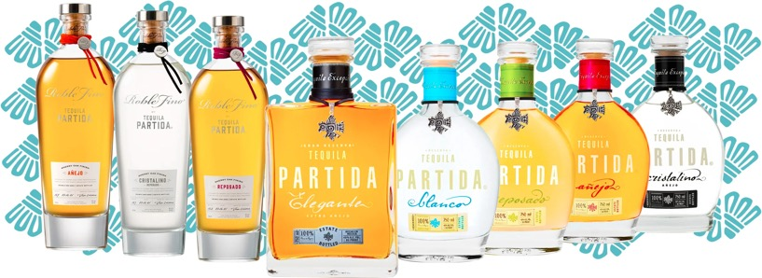
THE ORIGINAL ADDITIVE FREE TEQUILA
100% Agave Tequila Made in Mexico
“SIMPLY THE FINEST LINE OF TEQUILAS MONEY CAN BUY”
-PAUL PACULT
ADDITIVE FREE
TEQUILA
+87%
$ Sales vs PY

Slide 2

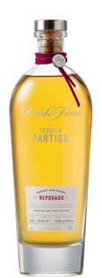
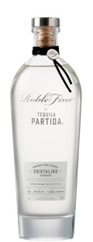
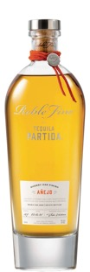

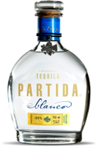
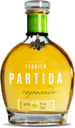
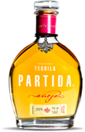
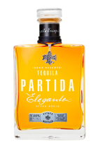
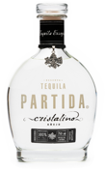
THE SINGLE MALT OF TEQUILA
DOUBLE AGED IN EX-SINGLE MALT SHERRY OAK CASKS
ROBLE FINO REPOSADO
Age: 6 + 2 Months
Appearance:
Intense and brilliant amber
Aromas:
Toasted oak, dry fruits, whisky, and agave
Flavor profile:
Presence of cooked agave, maple syrup, anise, quince, and dried fruits
ROBLE FINO REPOSADO-CRISTALINO
Age: 6 + 2 Months
Appearance:
Transparent, crystal clear
Aromas:
Hazelnuts, green olives, wood, and sweetness
Flavor profile:
Exploding flavors of dried fruits, cooked agave, toasted oak, vanilla, and nuts
ROBLE FINO AÑEJO
Age: 18 + 5 Months
Appearance:
Gold color with reddish shimmer & brilliance
Aromas:
Sweet & woody denote a prolonged maturation, notes of pear & dill
Flavor profile:
Clean & smooth, notes of dried fruits, oak, cooked agave & chocolate
BLANC O
Age: Unaged
Appearance:
Crystal clear
Aromas:
Earth & citrus notes
Flavor profile:
The freshest expression of 100% Blue Weber Agave
Red ruby grapefruit
Mint
REPOSADO
Age: 6 months
Appearance: Natural light amber with golden tones; transparent & clean
Aromas:
Earth & citrus notes
Flavor profile:
Brilliant & full-bodied
Vanilla
Caramel & butter
Charred oak
AÑEJO
Age: 18 months
Appearance: Intensely golden with bronze tones
Aromas:
Oak, dry fruits, & butter
Flavor profile:
Clean & full-bodied with a hint of spice
Banana
Maple honey
Chocolate
AÑEJO CRISTALINO
ELEGANTE EXTRA AÑEJO
Age: 48 months
Appearance: Dark amber color and high- density body denote the long aging process
Aromas:
Deep toasted oak notes, dark chocolate and coffee
Flavor profile:
Slightly toasty, peppery
Gentle spice
Agave, maple, almonds
Age: 18 months
Appearance: Clear with light golden highlights
Aromas:
Toasted oak, maple syrup, vanilla, quince, & figs
Flavor profile:
Intense, rich & full-bodied
Dry & tart
High-density fruit
TEQUILA PARTIDA. C OM @TEQUILA PARTIDA

Slide 3





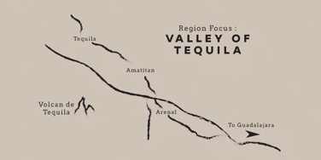

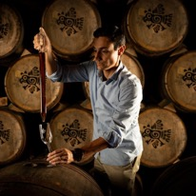
TEQUILA PARTIDA
CRAFT & CULTURE
Named in honor of 3rd generation agave farmer Enrique Partida, Partida is committed to preserving the fresh agave flavor at each step of the tequila - making process. The result is a tequila that is truly from field to glass.
PRIME MATURE AGAVE
P r o d u c e s ripe,
Ful l – flavored agave
24 HOUR FIELD TO FERMENTATION
Preserves fresh
agave flavor
STAINLESS STEEL DISTILLATION
Preserves agave
purity
AGED BEYOND EXPECTATIONS
E n h a n c es natural
agave flavor and color
THE PRISTINE SERVE
To savor the world’s
highest - rated tequila
THE VALLEY OF TEQUILA
Sometimes called “El Valle” or “The Lowlands” the Valley of Tequila is home to some of the oldest brands in the Tequila world. In the town of Tequila, you’ll find industry giants as well as the boutique brands of sipping Tequilas.
Just outside of Tequila in the town of Amatitán we find the Partida family, NOM 1502
MAESTRO TEQUILERO JOSÉ VALDEZ
José Valdez is a distinguished Maestro Tequilero and the Master Distiller for Partida Tequila, a highly regarded premium tequila brand. With a deep passion for the art of tequila making, Valdez has become a key figure in the industry, renowned for his expertise in crafting high-quality tequila that respects traditional methods while incorporating modern techniques.

Slide 4
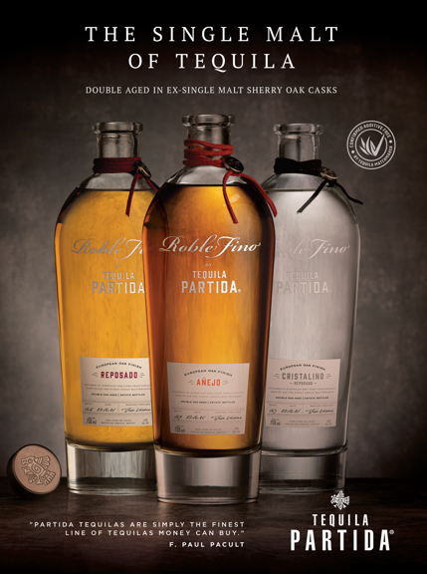

WIN THE HEART OF NEW ACCOUNTS,
Buyers and bar managers first experience of Partida moving forward needs to be,
The Roble Fino Line
EVERY ON & OFF-PREMISE Don Julio 1942 ACCOUNTS NEED Partida Roble Fino
ADDITIVE FREE
AND
RATED MUCH HIGHER
“DOUBLE AGED IN EX-SINGLE SHERRY OAK CASK”

Slide 5
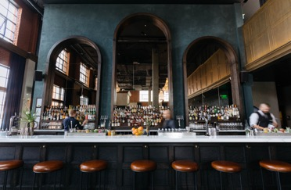



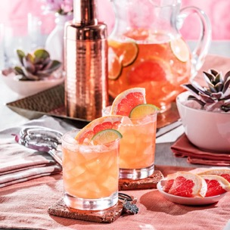




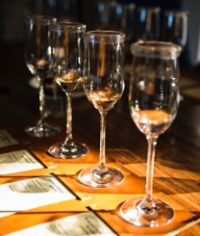
STRATEGY
ON-PREMISE
For the Familia range, your competitive set pricing wise is, Mijenta, Ocho, Lalo
Focus on high-end accounts and tequila specialty accounts
COCKTAIL MENU priority SKUs by order of Priority
SIGNATURE COCKTAIL
PINK PALOMA
2 oz Partida Reposado
1 oz Ruby red grapefruit juice
0.5 oz Fresh lime juice
0.5 oz Simple syrup
1.5 oz Grapefruit soda
BACK BAR placement by SKUs
priority
TEQUILA FLIGHT

Slide 6

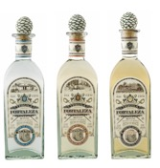
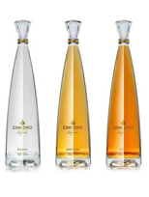
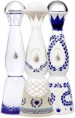



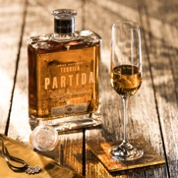

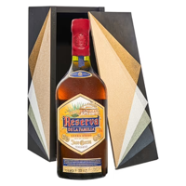

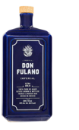
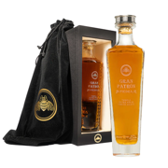
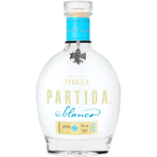
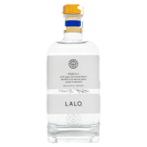
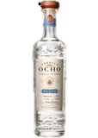
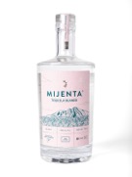
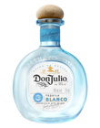


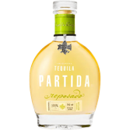
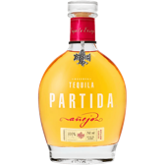

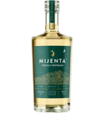

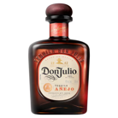
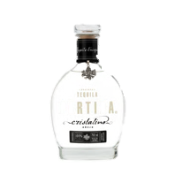


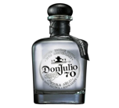
PARTIDA ROBLE FINO/ELEGANTE/FAMILIA
COMPETITIVE SET
$119
$129
$149
$399
$43
$47
$55
$60

Slide 7






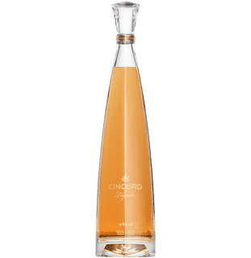



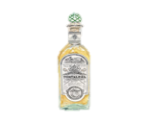

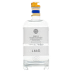





BRAND STANDARDS OFF-PREMISE
Roble Fino + Elegante
TOP SHELF STRATEGY
Priority #1 Roble Fino line
$100+ tequila section
Top shelf-level, marques blocked together
Adjacent to Clase azul, Cincoro, 1942 or Komos
Reason to Believe
Partida Roble Fino is one of the only $100+ tequila that is Additive Free
Roble Fino Cristalino is the only Double aged Cristalino on the market
BRAND STANDARDS OFF-PREMISE
Familia range
1
2
SHELF STRATEGY Two options
Option Uno: (The current broad option)
$40+ tequila section
Eye-level, marques blocked together
Adjacent to Don Julio
Option Dos: ( The big opportunity)
$40+ Additive Free section
Adjacent to Lalo, Fortaleza or Ocho

Slide 8

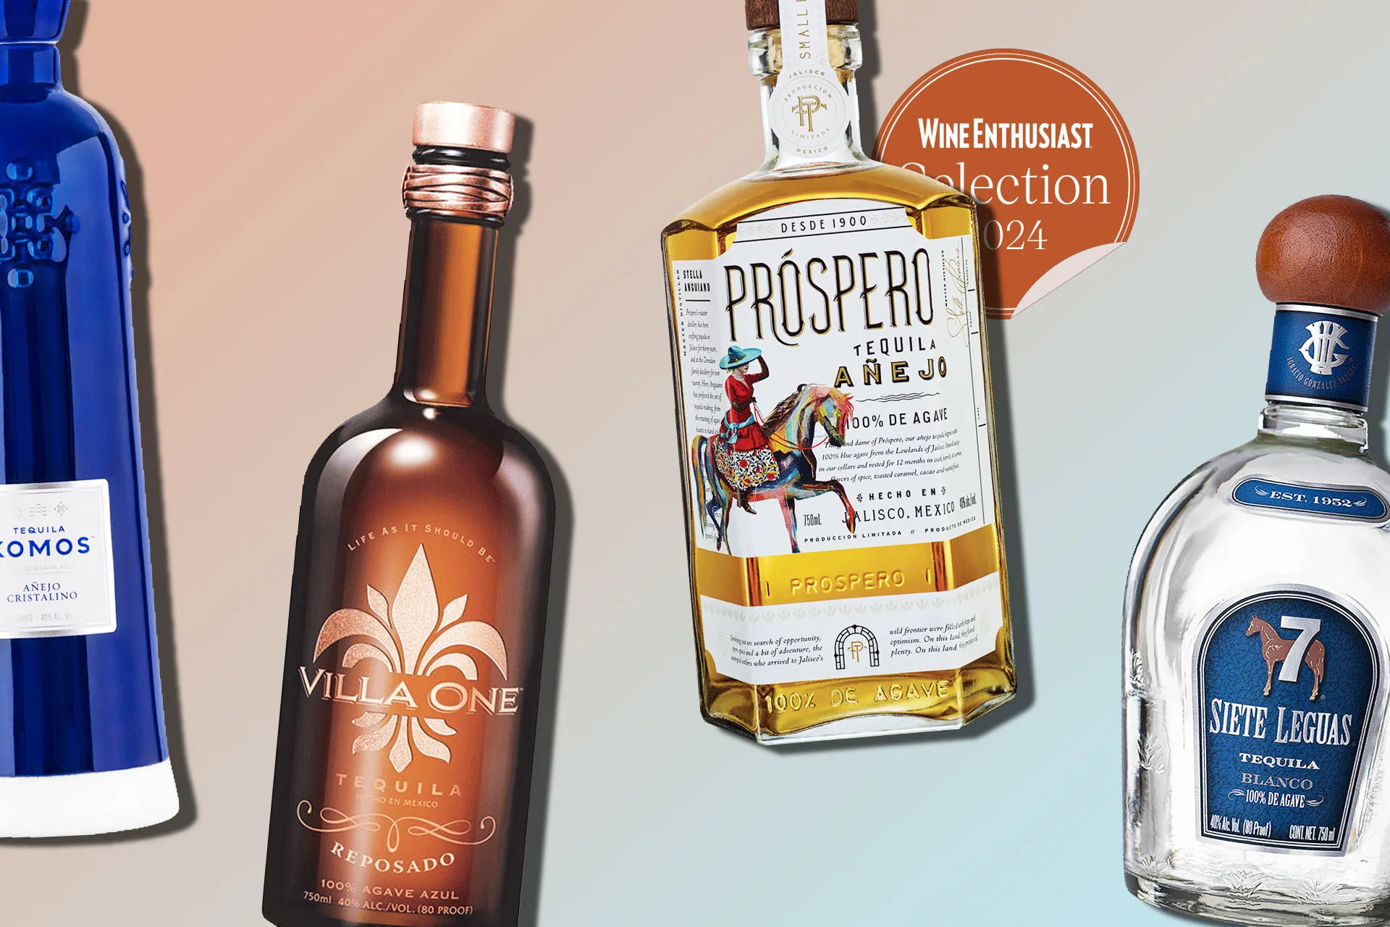
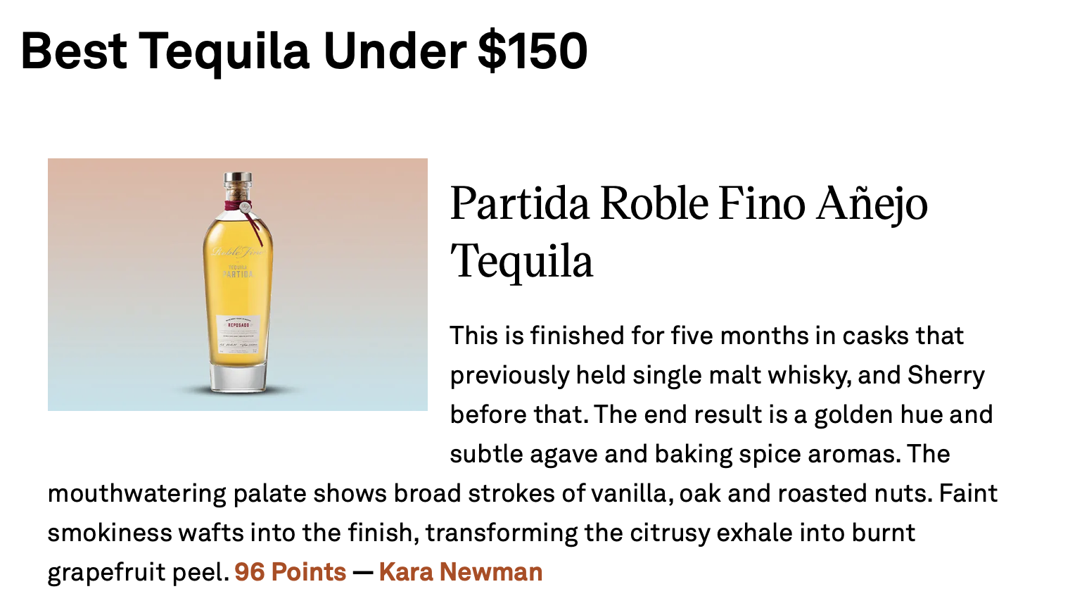

The Best Tequilas at Every Price Point
Scan me for the full article

