Slide 1



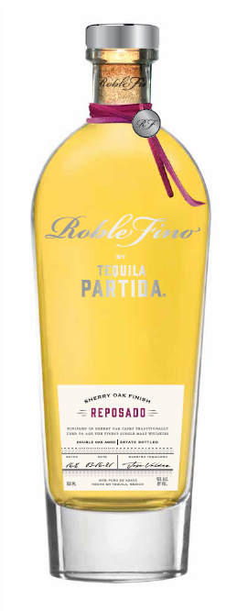

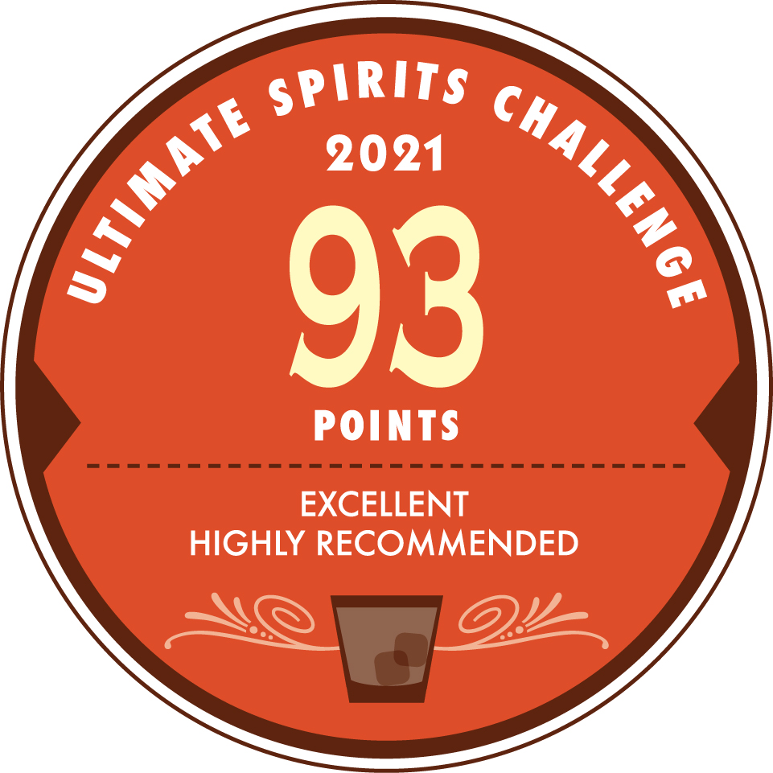
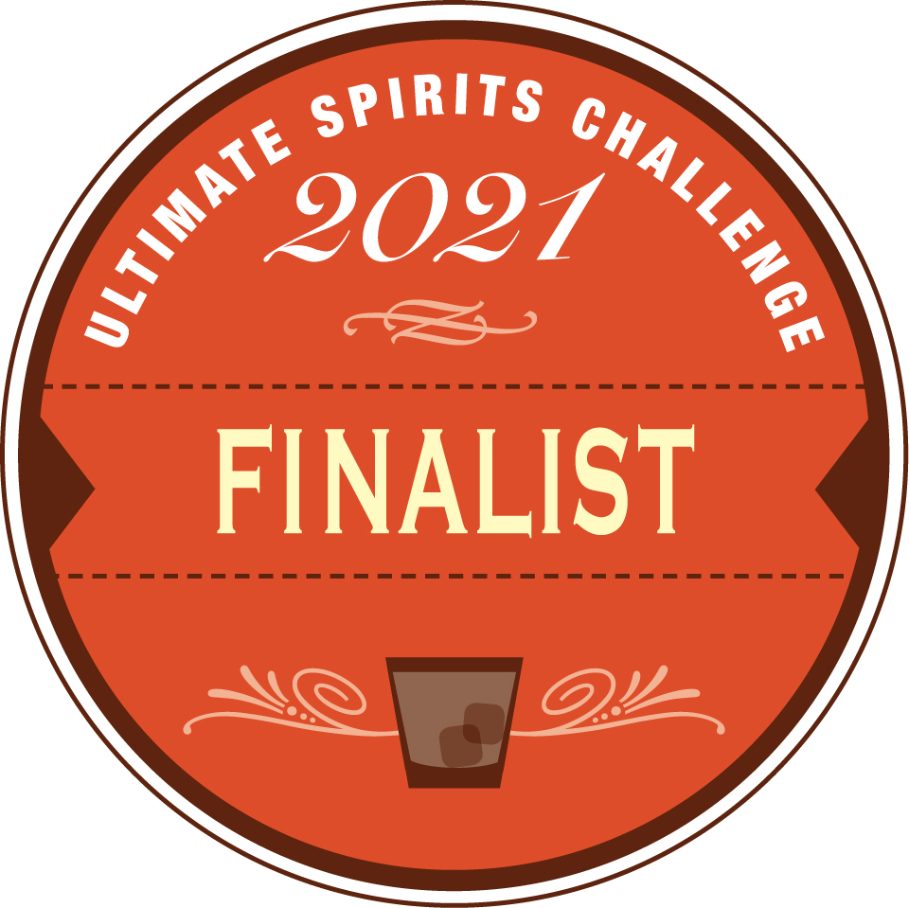
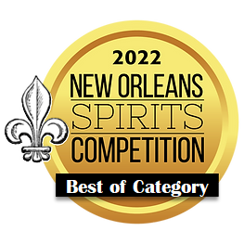
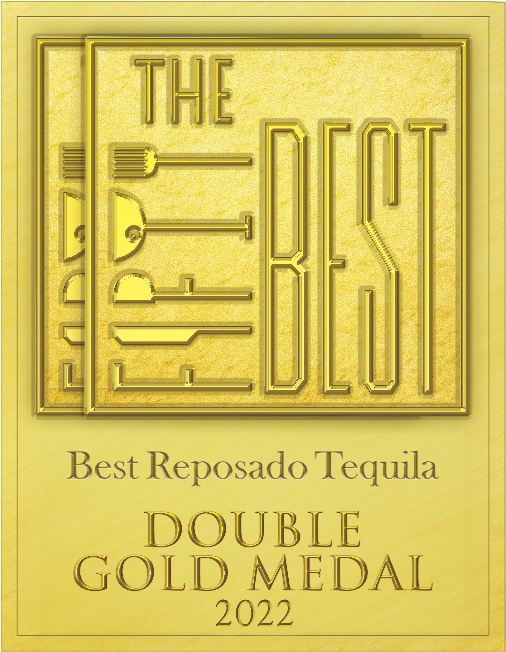
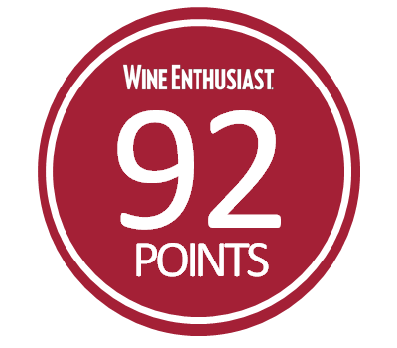

introducing
PARTIDA
ROBLE FINO REPOSADO
Double Aged in Ex-Single Malt Sherry Oask Casks
When Partida's Maestro Tequilero, José Valdez, visited Scotland for the first time, he immediately felt the connection to the homeland of the world's finest Single Malts. He envisioned an amazingly rich product that combines Single Malts Best in Cask Management and the World's Highest-Rated Tequila. From this vision came Roble Fino, meaning Fine Oak.
1st Aged for a minimum of 6 months in ex-bourbon barrels to develop a brilliant, full body with notes of caramel, vanilla and charred oak.
2nd continues its aging for an additional 2 months in ex-single malt, sherry seasoned casks from the most sought-after Scotch Whisky. The result is an intense and complex spirit that is bottled at 43% ABV for optimal flavor and body.
COLOR
Intense and brilliant amber
AROMA
Toasted oak, dry fruits, whisky, and agave
PALATE
Presence of cooked agave with hints of vanilla, maple syrup, anise, quince, and dried fruits
FINISH
Long finish with a final dry and sweet touch of Sherry
ABV
43%
Notes:
Roble Fino Partida Reposado Sherry Oak Finish 100% de Agave Tequila (Mexico) 43% abv, $110.
Excellent clarity; citron color. Wow, I immediately like this laser focused opening aromas that features keenly herbal scents of sage, fennel, anise, savory, and bay leaf (laurel), as well as green chili pepper, leather, and green tomato vine; secondary inhalations pick up subtler notes of road tar, quince, casaba melon, hard boiled egg, brown butter, and black peppercorn. Entry flavors are grapy, winey, and berry-like and that fruitiness dominates the early stage, except for the foundational agave vegetal/herbaceous taste; midpalate highlights the sherry cask/agave plant marriage via the succulent, semisweet flavor that’s not short on agave syrup richness and tanginess; in fact, the agave presence is found mostly in the lush texture. Concludes long in the throat, moderately peppery/spicy, not as sweet as the midpalate and therefore more herbal and green vegetable-like. This is the dawn of a promising new era for 100% agave tequila, one that’s been needed for at least a decade. Note the abv level.
Spirit Journal 2019:
FIVE STARS/Highest Recommendation

Slide 2
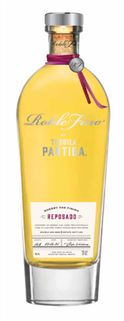
PARTIDA
ROBLE FINO REPOSADO
SHERRY OAK FINISH
CALL TO ACTION
Give your Don Julio 1942 and Clase Azul fans an upgrade
to a higher quality additive-free tequila in same price range
KEY SELLING POINTS
Luxury tequilas are the 1st largest and fastest growing prestige+ spirits segment*
Tequila is the fastest growing spirit On & Off Premise**
The Original Additive Free Tequila since 2005
PRIME MATURE AGAVE
Produces ripe, full-flavored agave
24 HOUR FIELD
TO FERMENTATION
Preserves fresh agave flavor
STAINLESS STEEL
DISTILLATION
Preserves agave purity
AGED BEYONG EXPECTATION
Enhances natural agave flavor & color
THE PRISTINE
SERVE
To savor the world’s highest-rated tequila
TRADE POSITIONING
Focus: Off-Premise:
Key chain accounts
Luxury, high-end independent accounts
Top-shelf, eye-level placement, adjacent to Cincoro and Clase Azul
On-Premise
Top existing Partida accounts
Premium Mexican and tequila “A” accounts
Premium cocktail bars
Target Consumer: Spirit Evangelists
30 to 55 years old, educated, affluent $100k+ HHI
Quality-seeking individuals who like to experience & share premium products with friends that reflect their lifestyle
UPC | 7503022413344
SCC | 17503022413341
Volume/Bottle (L): | .750
ABV% | 43
Cases per Layer | 18
Cases per Pallet | 72
Layers per Pallet | 4
Bottles per Case | 6
Bottles per Layer | 108
Bottles per Pallet | 432
Case Length (in) | 10.315
Case Width (in) | 8.898
Case Height (in) | 12.795
Bottle Weight (in) | 4.78
DRINK STRATEGY
Served neat in Tequila stemware
*IWSR, $ VALUE ‘19-’23 CAGR ** Nielsen ***Ultimate Spirits Challenge

