Slide 1




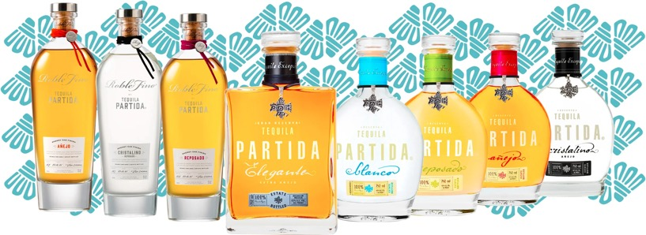






THE ORIGINAL ADDITIVE FREE TEQUILA
“SIMPLY THE FINEST LINE OF TEQUILAS MONEY CAN BUY”
-PAUL PACULT
Tequila Partida crafted the world’s highest rated tequila by honoring the blue weber agave. Named in honor of 3rd generation agave farmer Enrique Partida, Partida is committed to preserving the fresh agave flavor at each step of the tequila - making process. The result is a tequila that is truly from field to glass.
PARTIDA IS 100% ADDITIVE-FREE AND PRODUCED ONLY WITH 3 INGREDIENTS:
100% BLUE WEBER AGAVE
NATURAL YEAST
ESTATE WATER
PRIME MATURE AGAVE
Produces ripe, Fully flavored agave
24 HOUR FIELD TO FERMENTATION
Preserves fresh agave flavor
STAINLESS STEEL DISTILLATION
Preserves agave purity
AGED BEYOND EXPECTATIONS
Enhances natural agave flavor & color
THE PRISTINE SERVE
“Simply the finest line of tequilas money can buy” – Paul Pacult

Slide 2
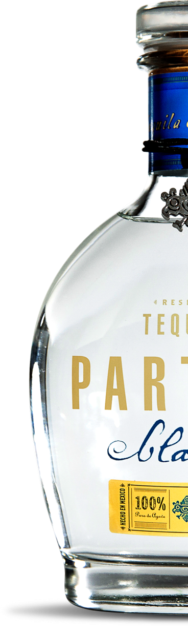
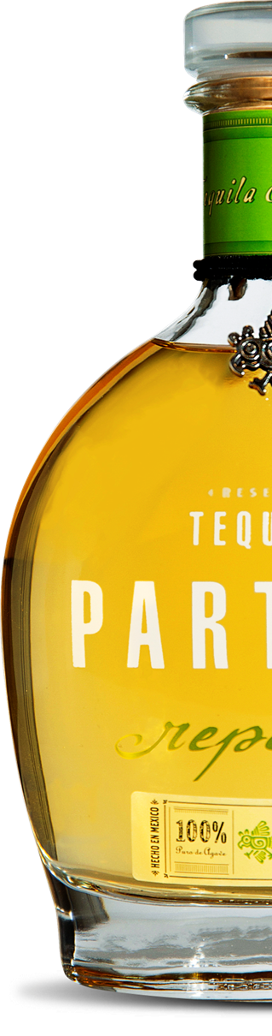
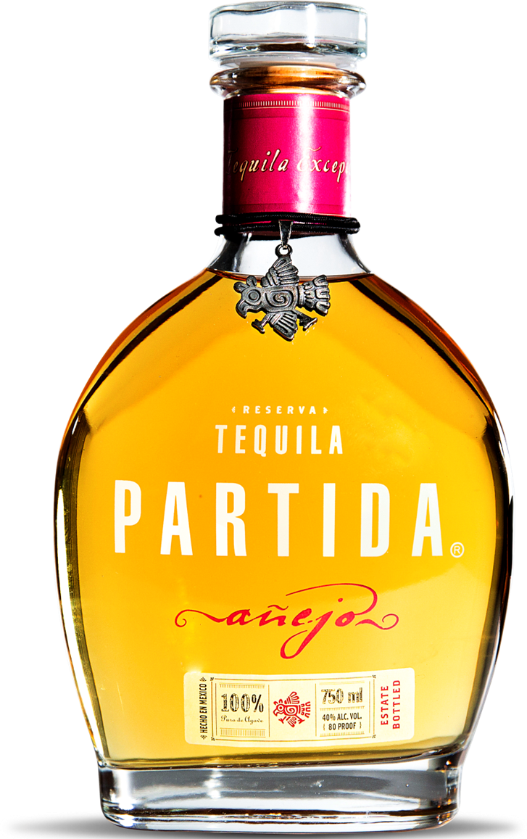
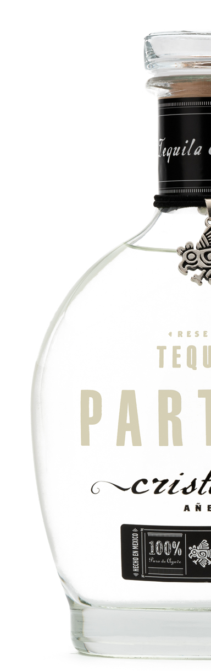
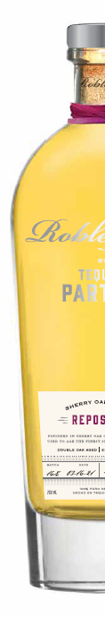
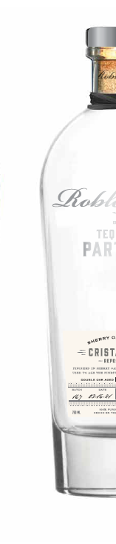
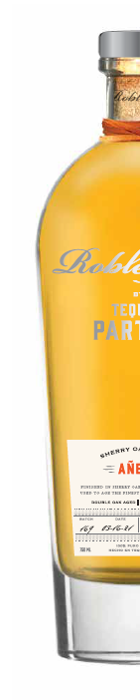
THE ORIGINAL ADDITIVE FREE TEQUILA
BLANCO
REPOSADO
AÑEJO
Age: Unaged
Appearance:
Crystal clear
Aromas:
Agave & cooked yams
Flavor profile:
True and fresh expression of blue agave
Red ruby grapefruit
Mint
Age: 6 months
Appearance:
Light amber with golden tones; transparent & clean
Aromas:
Honey & citrus
Flavor profile:
Brilliant & full-bodied
Vanilla
Caramel & butter
Charred oak
Age: 18 months
Appearance:
Intensely golden with bronze tones
Aromas:
Oak, dry fruits, & butter
Flavor profile:
Clean And full-bodied with a hint of spice
Banana, Maple honey
Chocolate
CRISTALINO AÑEJO
ELEGANTE
Age: 18 months
Appearance:
Clear with light yellow highlights
Aromas:
Toasted oak, maple syrup, vanilla, quince, & figs
Flavor profile:
Intense, Gentle spice
Sweet high-density fruit
Age: 40+ months
Appearance:
Dark amber
Aromas:
Toasted oak, dark chocolate, & honey
Flavor profile:
Intensely rich and full bodied with spices
Coffee
Dark chocolate
Roasted nuts
ROBLE FINO
REPOSADO
ROBLE FINO
CRISTALINO
ROBLE FINO
AÑEJO
Age: 6 + 2 months
Appearance:
Intense and brilliant amber
Aromas:
Toasted oak, dry fruits, whisky, and agave
Flavor profile:
Presence of cooked agave with hints of vanilla, maple syrup, anise, quince, and dried fruits
Age: 6 + 2 months
Appearance:
Transparent, crystal clear
Aromas:
Hazelnuts, green olives, wood, and sweetness
Flavor profile:
Exploding flavors of dried fruits, cooked agave, toasted oak, vanilla, and nuts
Age: 18 + 5 months
Appearance:
Gold color with reddish shimmer & brilliance
Aromas:
Sweet & woody, denote with notes of pear & dill
Flavor profile:
Clean & smooth with notes of dried fruits, oak, chocolate, & cooked agave
TEQUILA PARTIDA. C OM @TEQUILA PARTIDA

