Slide 1



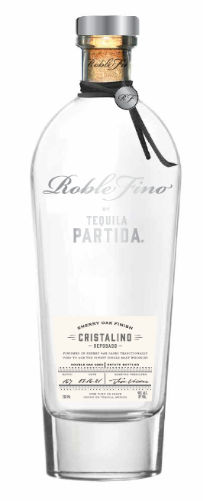



introducing
PARTIDA
ROBLE FINO CRISTALINO
the first ever Reposado Cristalino finished in ex-single malt, sherry oak casks
When Partida's Maestro Tequilero, José Valdez, visited Scotland for the first time, he immediately felt the connection to the homeland of the world's finest Single Malts. He envisioned an amazingly rich product that combines Single Malts Best in Cask Management and the World's Highest-Rated Tequila. From this vision came Roble Fino, meaning Fine Oak.
1st Aged for 6 months in ex-bourbon barrels to develop a brilliant, full body with notes of caramel, vanilla and charred oak.
2nd Continues its aging and is finished for 2 months in ex-single malt, sherry seasoned casks from the most sought-after Scotch Whisky.
The Reposado Cristalino is then naturally filtered to remove all color while retaining its defined body and the complex flavors and aromas achieved through the double aging process.
COLOR
Transparent, crystal clear
AROMA
Hazelnuts, green olives, wood, and sweetness
PALATE
Exploding flavors of dried fruits, cooked agave, toasted oak, vanilla, and nuts
FINISH
Tannic and dry with a hint of black peppercorn
ABV
40%
Notes:
Roble Fino Partida Cristalino Sherry Oak Finish 100% de Agave Tequila (Mexico) 40% abv, $110.
Crystalline, sediment free appearance; pewter-like silvery color. Upfront, I find distinctive aromatic notes of toasted hazelnut, salted butter, carob, and green tobacco leaves; after more aeration, the fragrances pick up earthy, mineral-like scents of terra cotta, coriander, sage, lead pencil, tin can, and dill. Entry showcases more agave character than the bouquet, as dry, slightly bittersweet flavors of carbon/charcoal, black tea, caramelized onion, green olive, and grilled pineapple cover the palate; midpalate stage is where the inclusion of sherry cask emerges and it’s this pivotal addition of gentle, winey sweetness that accentuates the agave elements that last deep into the near-succulent, pleasingly pruny aftertaste.
Spirit Journal 2019:
FOUR STARS/Highly Recommended

Slide 2

PARTIDA
ROBLE FINO CRISTALINO
SHERRY OAK FINISH
CALL TO ACTION
Give your Don Julio 1942 and Clase Azul fans an upgrade
to a higher quality additive-free tequila in same price range
KEY SELLING POINTS
Luxury tequilas are the 1st largest and fastest growing prestige+ spirits segment*
Tequila is the fastest growing spirit On & Off Premise**
The Original Additive Free Tequila since 2005
the first ever Reposado Cristalino finished in ex-single malt, sherry oak casks
PRIME MATURE AGAVE
Produces ripe, full-flavored agave
24 HOUR FIELD
TO FERMENTATION
Preserves fresh agave flavor
STAINLESS STEEL
DISTILLATION
Preserves agave purity
AGED BEYONG EXPECTATION
Enhances natural agave flavor & color
THE PRISTINE
SERVE
To savor the world’s highest-rated tequila
TRADE POSITIONING
Focus: Off-Premise:
Key chain accounts
Luxury, high-end independent accounts
Top-shelf, eye-level placement, adjacent to Cincoro and Clase Azul
On-Premise
Top existing Partida accounts
Premium Mexican and tequila “A” accounts
Premium cocktail bars
Target Consumer: Spirit Evangelists
30 to 55 years old, educated, affluent $100k+ HHI
Quality-seeking individuals who like to experience & share premium products with friends that reflect their lifestyle
UPC | 7503022413337
SCC | 17503022413334
Volume/Bottle (L): | .750
ABV% | 40
Cases per Layer | 18
Cases per Pallet | 72
Layers per Pallet | 4
Bottles per Case | 6
Bottles per Layer | 108
Bottles per Pallet | 432
Case Length (in) | 10.315
Case Width (in) | 8.898
Case Height (in) | 12.795
Bottle Weight (in) | 4.78
DRINK STRATEGY
Served neat in Tequila stemware
*IWSR, $ VALUE ‘19-’23 CAGR ** Nielsen ***Ultimate Spirits Challenge

