Slide 1



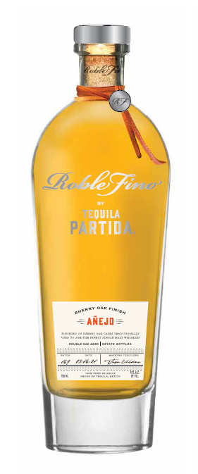


introducing
PARTIDA
ROBLE FINO AÑEJO
“2024
BEST TEQUILA under $150”
Double Aged in Ex-Single Malt Sherry Oask Casks.
When Partida's Maestro Tequilero, José Valdez, visited Scotland for the first time, he immediately felt the connection to the homeland of the world's finest Single Malts. He envisioned an amazingly rich product that combines Single Malts Best in Cask Management and the Finest-Rated Tequila. From this vision came Roble Fino, meaning Fine Oak.
1st Aged for an extensive 18 months in ex-bourbon barrels to develop a full-bodied Tequila with hints of spice, maple and chocolate.
2nd Continues its finishing for an additional 5 months in ex-single malt, sherry seasoned casks from the most sought-after Scotch Whisky.
To appreciate the complexity and depth in flavor, the tequila is finished at 45% ABV, bringing together the two worlds in perfect harmony.
COLOR
Outstanding gold color with reddish shimmer & a beautiful brilliance
AROMA
Sweet & woody aromas denote a prolonged maturation with notes of pear & dill.
PALATE
Clean & smooth with sweet notes of dried fruits, toasted oak, chocolate, & cooked agave.
FINISH
Sweet and woody finish with hints of whisky & sherry.
ABV
45%
ABV 45%
Notes:
Roble Fino Partida Anejo Sherry Oak Finish 100% de Agave Tequila (Mexico) 45% abv, $125.
Goldenrod/harvest gold color; impeccably clear and clean. Oh yeah, now we’re talking burnt matches, smoldering campfire embers, egg yolks/hard boiled egg, bacon fat, lard, and shallot-like aromas that all echo earthy agave; secondary whiffs detect baked scents of pear, nectarine, and white grapes/raisins that now dominate the bouquet as the herbal/vegetal/smoky aspects recede a bit. Entry owns an impactful, multilevel flavor of pickle brine/dill and baked orchard and vineyard fruits that together present the taste buds with a dramatically exciting and piquant 100% agave flavor experience unlike and better than any other; midpalate mirrors the entry stage, adding a larger portion of mince meat-like sherry cask flavor without sacrificing the earthy agave core taste. Finishes long, ripe, semisweet, vegetal, and dill-like. I believe that it’s the 45% abv that makes this tequila so memorable as much as it is the sherry cask finishing.
Spirit Journal 2019:
FIVE STARS/Highest Recommendation

Slide 2

CALL TO ACTION
Give your Don Julio 1942 and Clase Azul fans an upgrade
to a higher quality additive-free tequila in same price range
KEY SELLING POINTS
Luxury tequilas are the 1st largest and fastest growing prestige+ spirits segment*
Tequila is the fastest growing spirit On & Off Premise**
The Original Additive Free Tequila since 2005
PRIME MATURE AGAVE
Produces ripe, full-flavored agave
24 HOUR FIELD
TO FERMENTATION
Preserves fresh agave flavor
STAINLESS STEEL
DISTILLATION
Preserves agave purity
AGED BEYONG EXPECTATION
Enhances natural agave flavor & color
THE PRISTINE
SERVE
To savor the world’s highest-rated tequila
TRADE POSITIONING
Focus: Off-Premise:
Key chain accounts
Luxury, high-end independent accounts
Top-shelf, eye-level placement, adjacent to Cincoro and Clase Azul
On-Premise
Top existing Partida accounts
Premium tequila “A” accounts
Premium cocktail bars
Target Consumer: Spirit Evangelists
30 to 55 years old, educated, affluent $100k+ HHI
Quality-seeking individuals who like to experience & share premium products with friends that reflect their lifestyle
UPC | 7503022413351
SCC | 17503022413358
Volume/Bottle (L): | .750
ABV% | 45
Cases per Layer | 18
Cases per Pallet | 72
Layers per Pallet | 4
Bottles per Case | 6
Bottles per Layer | 108
Bottles per Pallet | 432
Case Length (in) | 10.315
Case Width (in) | 8.898
Case Height (in) | 12.795
Bottle Weight (in) | 4.78
DRINK STRATEGY
Served neat in Tequila stemware
*IWSR, $ VALUE ‘19-’23 CAGR ** Nielsen ***Ultimate Spirits Challenge

