Slide 1

HALLOWEEN & DIA DE MUERTOS
Program will run from October 15th to November 15th

Slide 2

Halloween and Día de Muertos create a powerful seasonal window where high-energy celebration, tequila cocktail demand, and authentic Mexican cultural relevance come together—an opportunity to further grow Partida’s cocktail strategy, supported by pricing adjustments designed to better fit bar program ounce-cost needs.

Slide 3
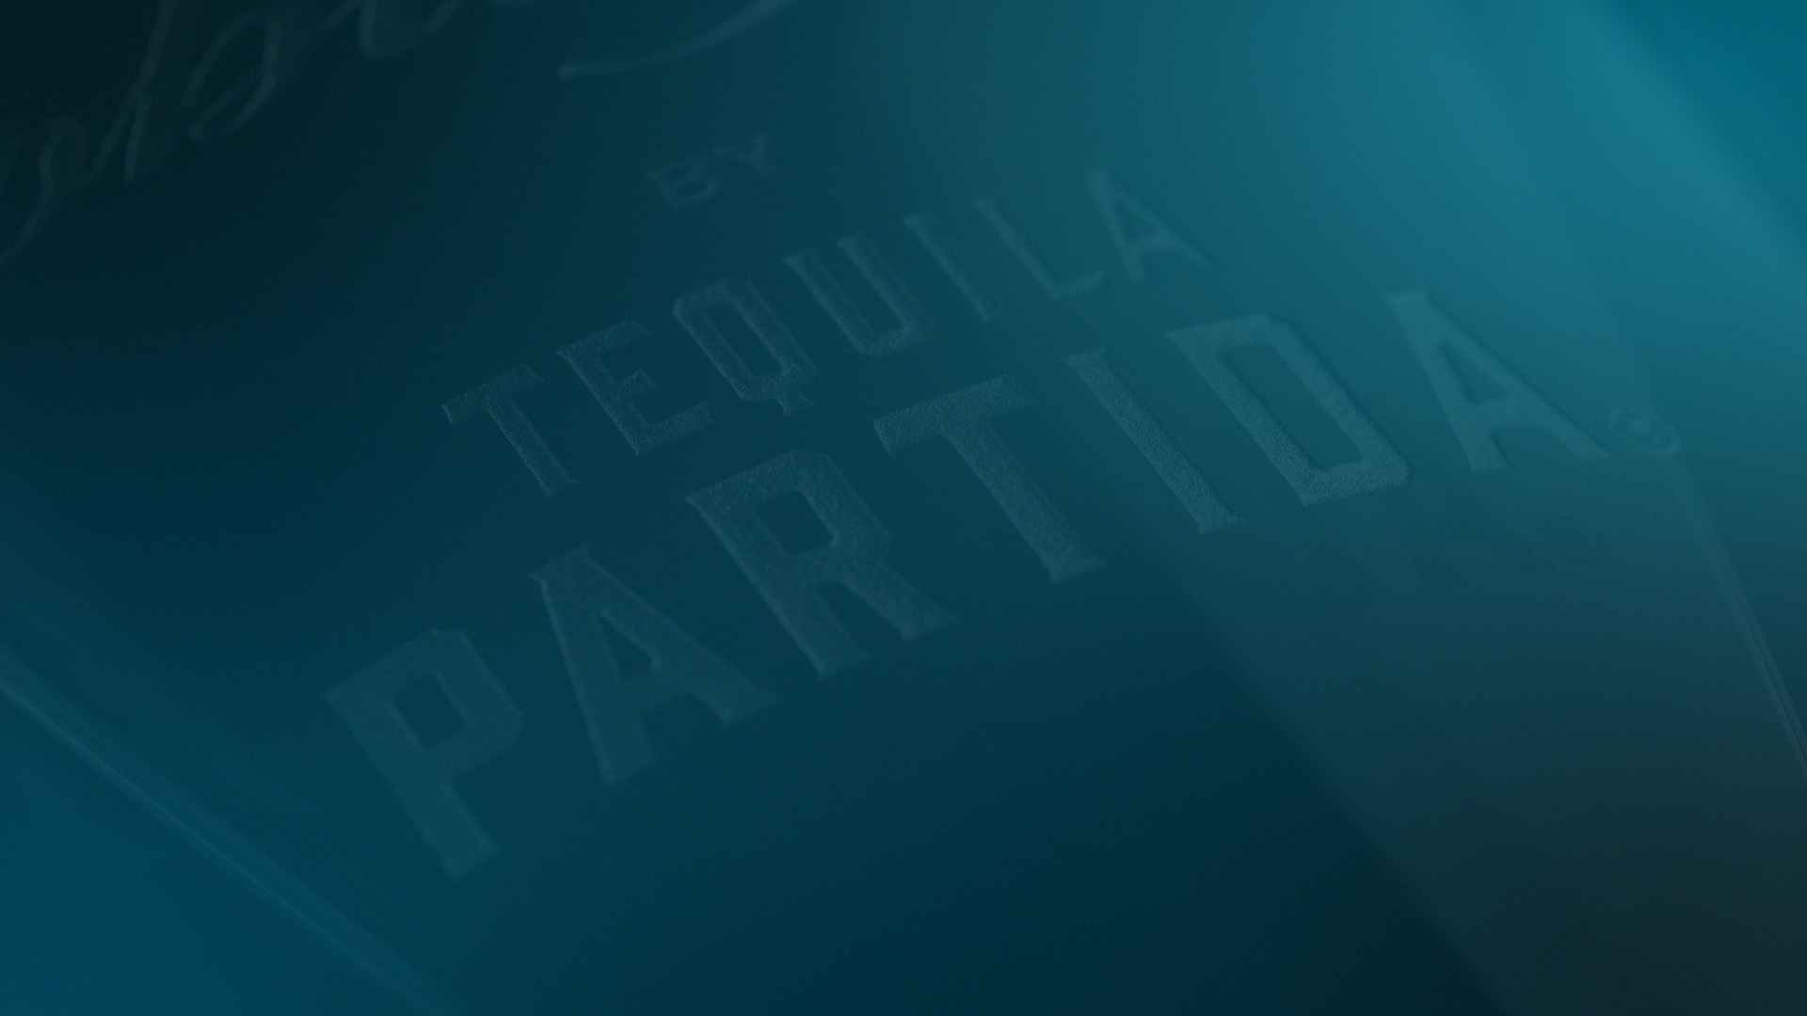
PROGRAM
AMBITION & KEY DRIVERS
AMBITION
KEY DRIVERS
TIPS ON US COCKTAIL TABLE TENT PROGRAM FOR 400 ACCOUNTS
PARTIDA ACCOUNT KITS FOR 400 ACCOUNTS
COMBO DEALS INCLUDING CROSS PORTFOLIO SKU’s
ACTIVATE 200 ACCOUNTS, DEPLET 200 9ltr CASES EAST
ACTIVATE 200 ACCOUNTS, DEPLET 200 9ltr CASES WEST
FOCUS STATES: FLORIDA, TEXAS AND CALIFORNIA

Slide 4
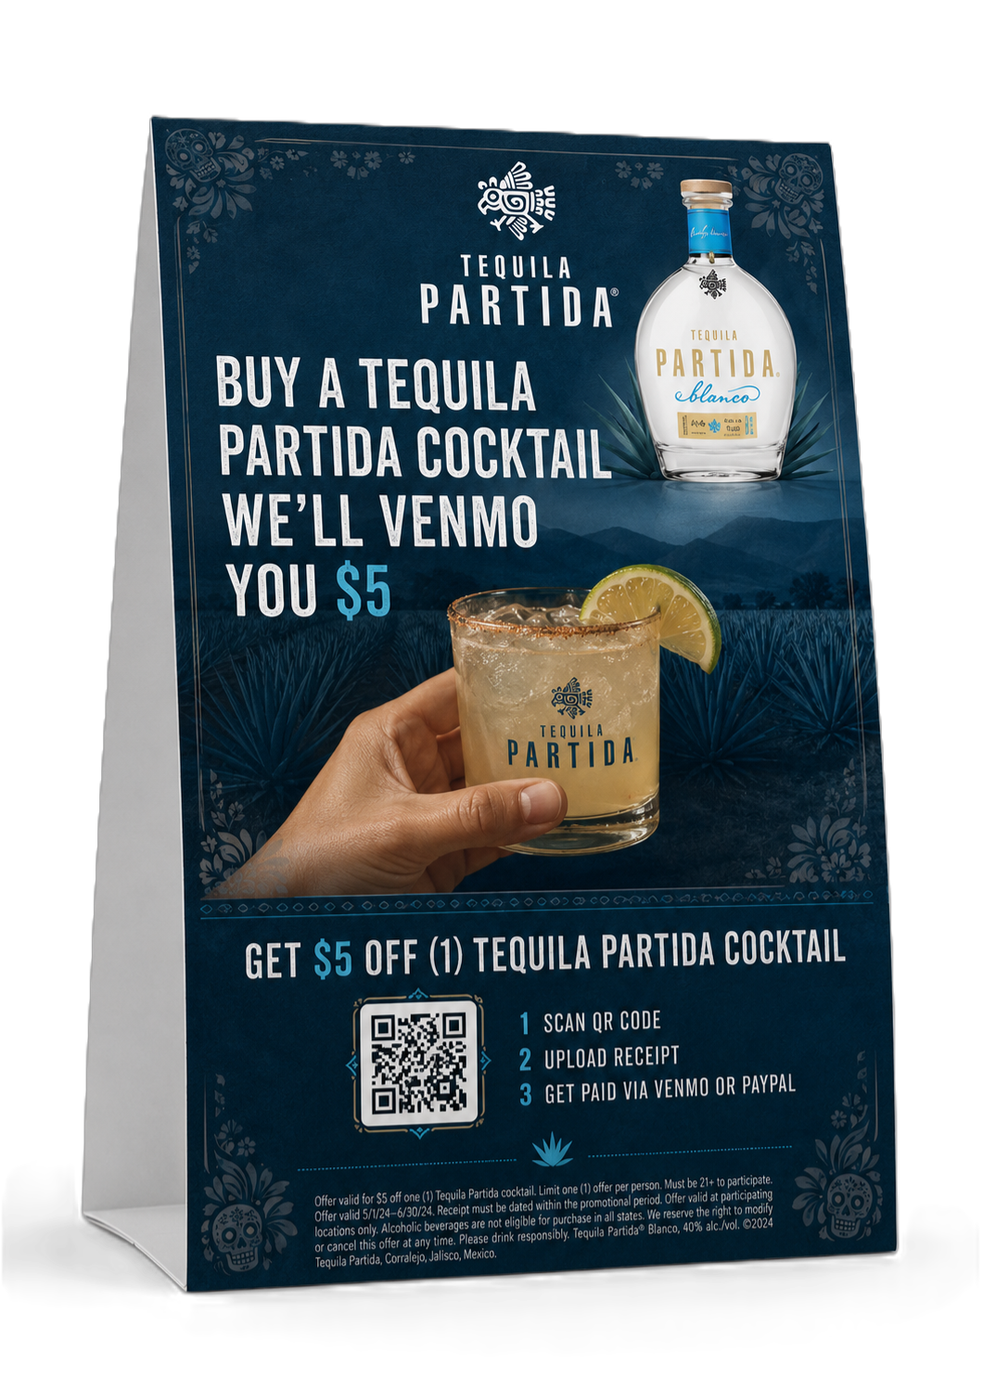
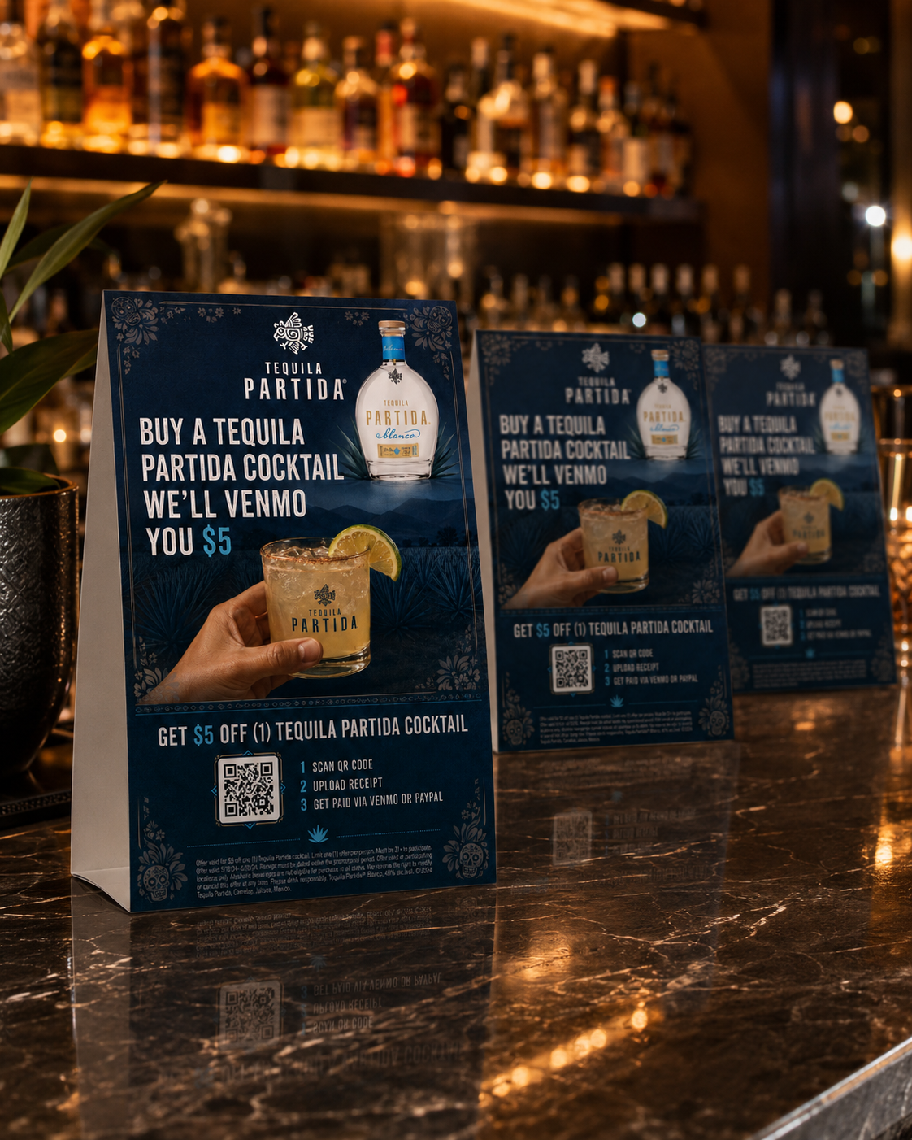
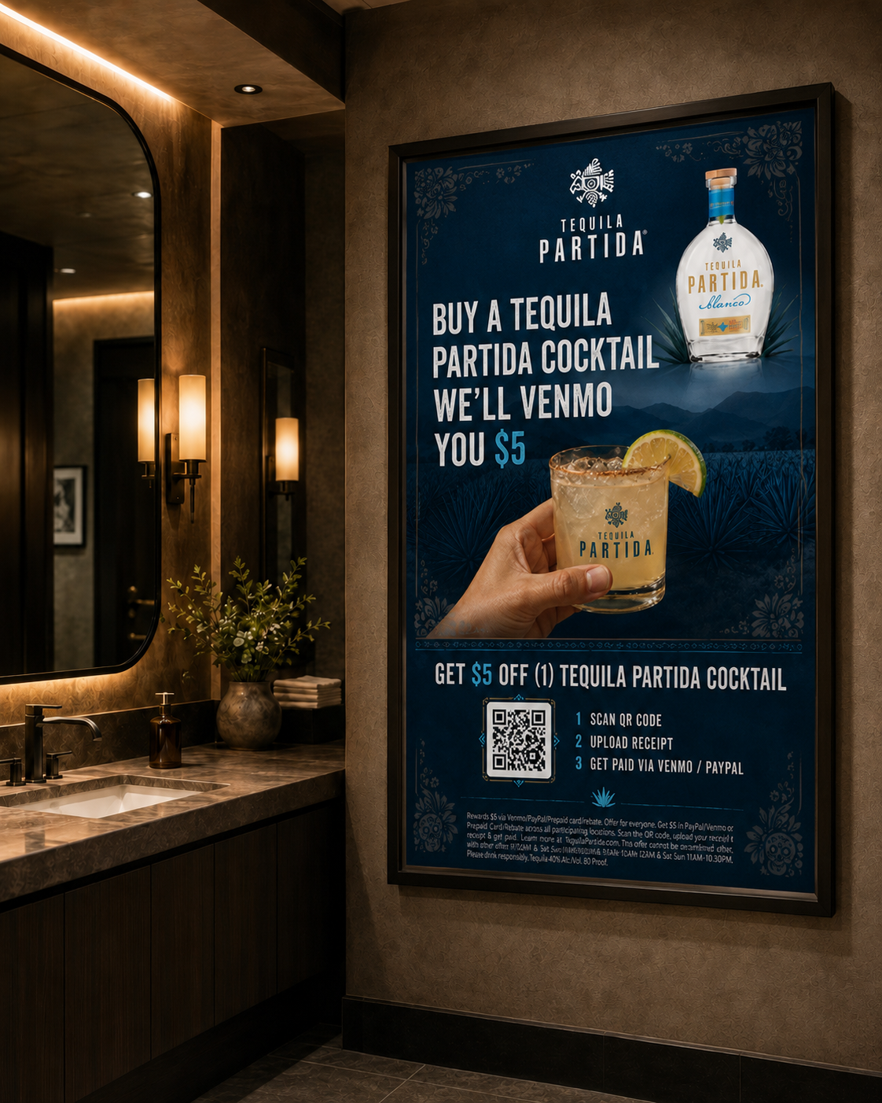
TIPS ON US COCKTAIL PROGRAM
HALLOWEEN / DIA DE MUERTOS
TABLE TENT & POSTERS
Program will run from October 15th to November 15th
To cover both Halloween and Dia De Muertos celebrations
Customers will be able to redeem Tip on us (up to $5)
To receive TIP on US, provide image proof of Purchasing Partida cocktail and Tip your bartender

Slide 5
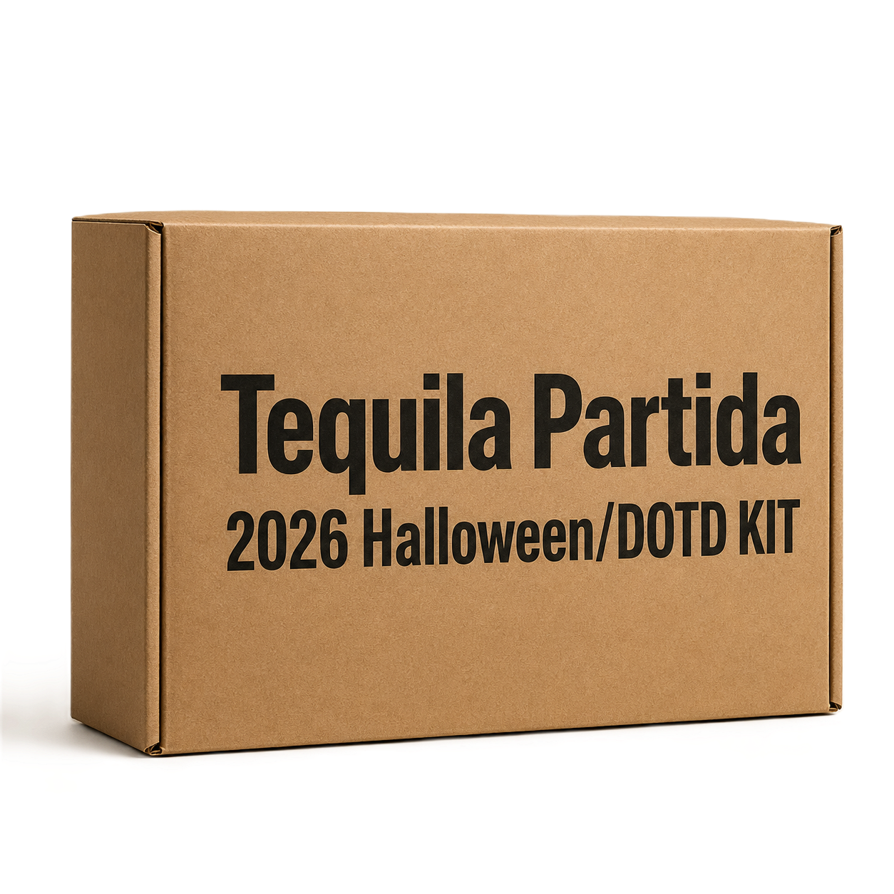
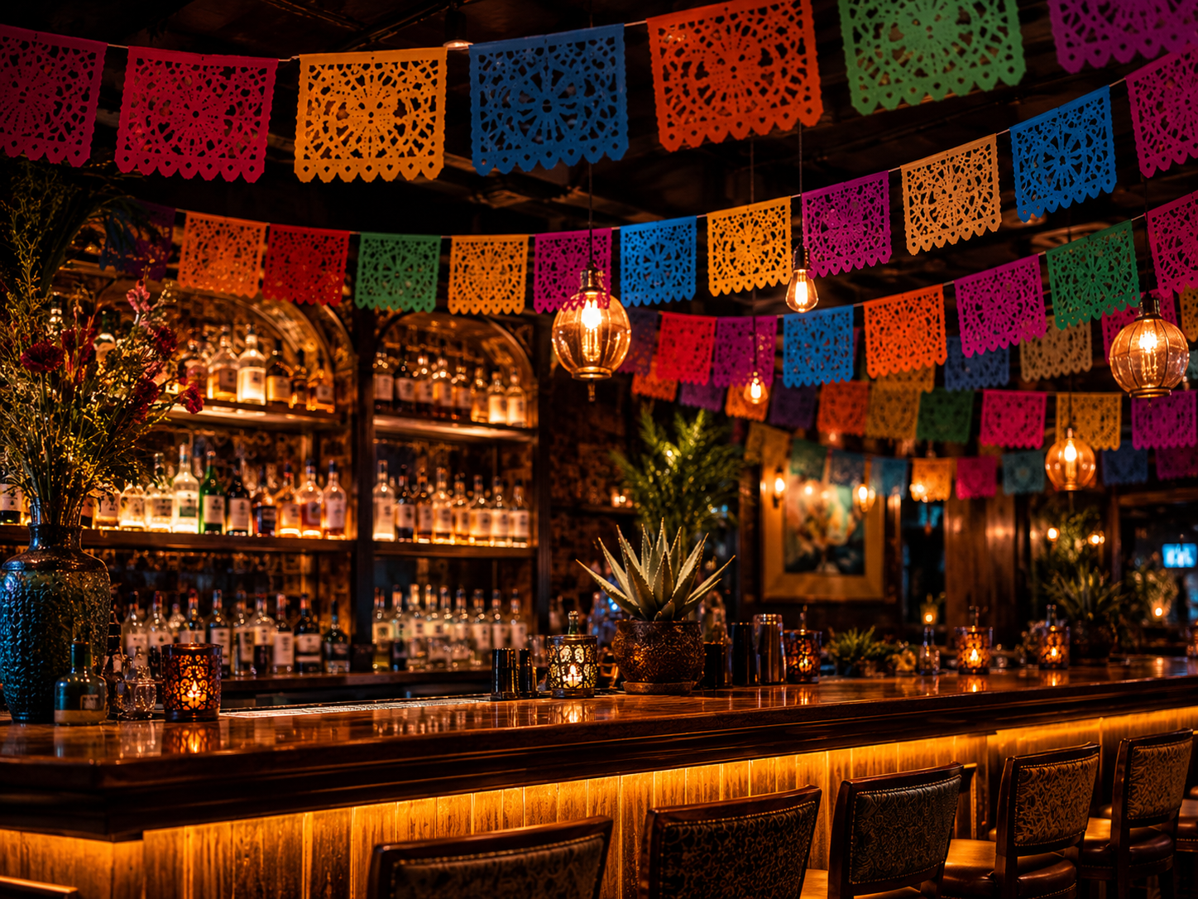
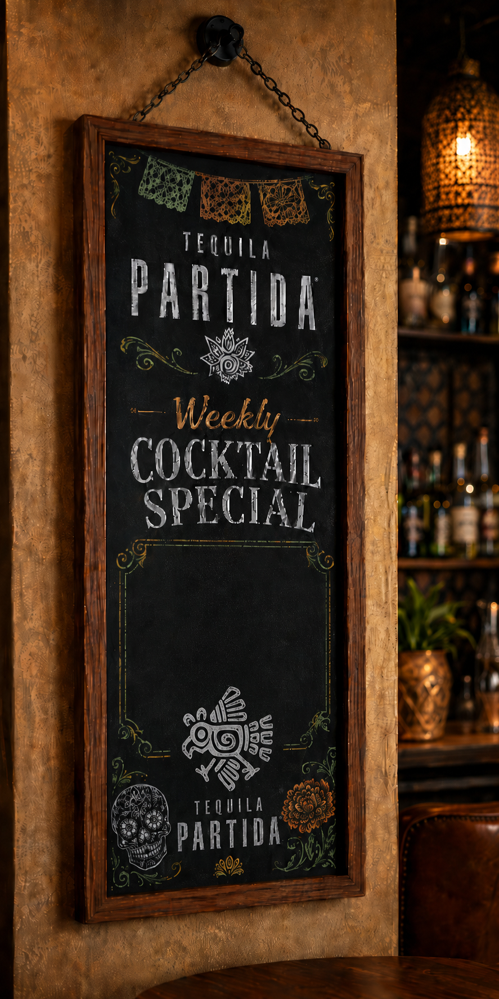
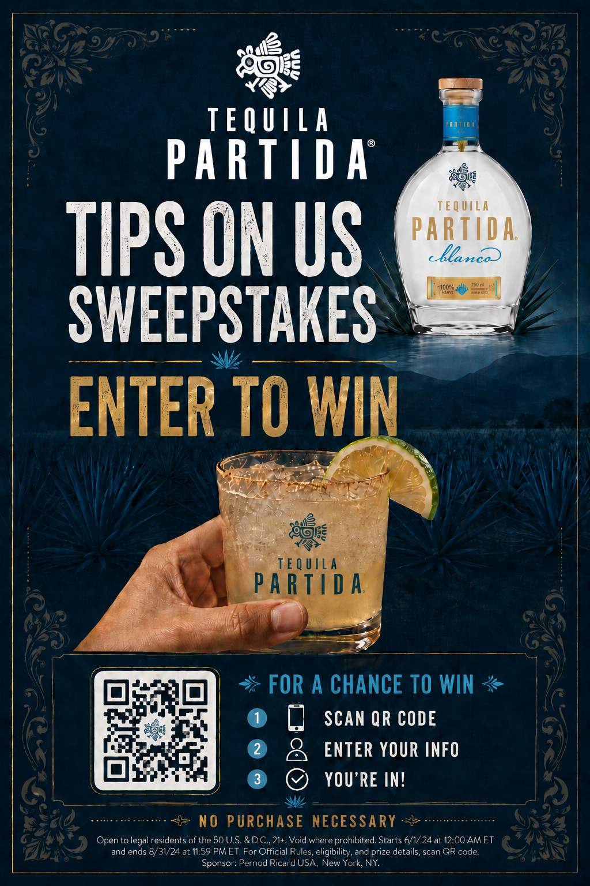
PARTIDA KITS
HALLOWEEN/DIA DE MUERTOS
400 KITS Nationwide
INCLUDED IN KIT:
1 Partida Chalkboard 1’ X 2’
2 pack 12ft long each Papel Picado/Tissue Paper
24 table tents
2 posters to display in restaurants & Bars
Papel Picado/Tissue Paper
Chalk Board
table tents
posters

Slide 6
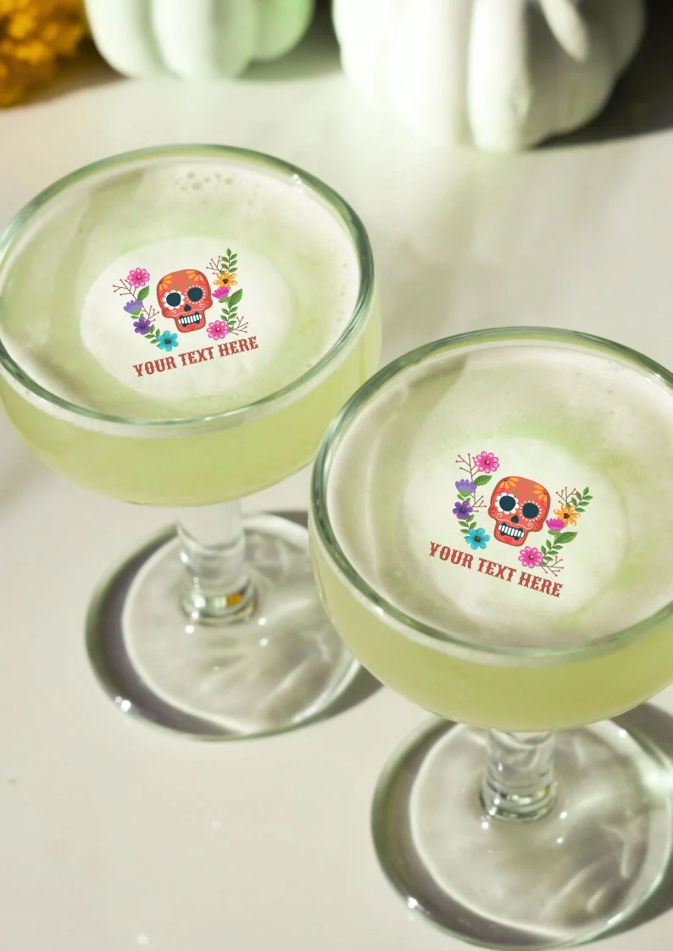
PARTIDA KITS
HALLOWEEN/DIA DE MUERTOS
400 KITS
INCLUDED IN KIT:
1 Partida Chalkboard 1’ X 2’
2 sets of edible cocktail toppers (total of 100)
3 pack 12ft long each Papel Picado/Tissue Paper
24 table tents
2 posters to display in restaurants & Bars
Notes: Total budget 40K from Brand A&P (including rebate)
posters
table tents

Slide 7
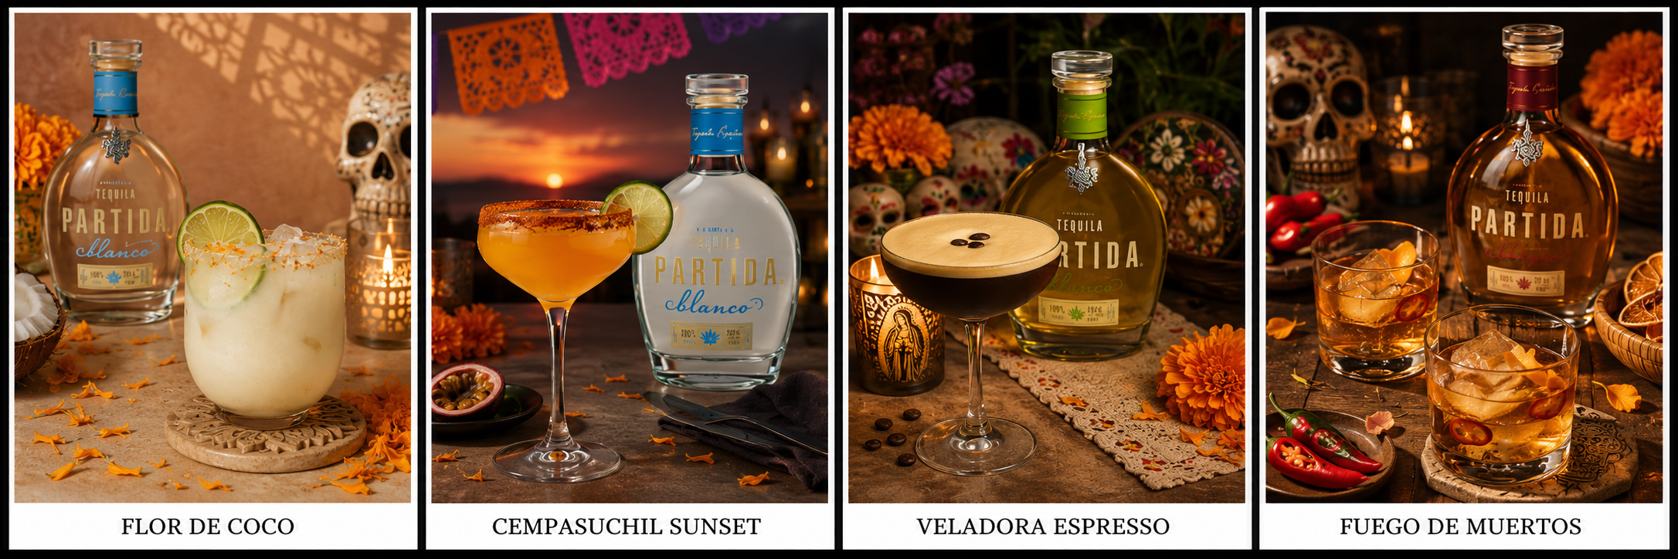
COCKTAIL SPECIAL
To Display on custom Chalkboard

Slide 8


CAMPAIGN CALENDAR
HALLOWEEN & DDM
JAN | FEB | MAR | APR | MAY | JUN | JUL | AUG | SEP | OCT | NOV | DEC
AWARENESS
MEDIA, PR, EVENTS
PR & MEDIA COVERAGE
SOCIAL MEDIA CONTENT & ADS
TRIAL
ON PREMISE
POS DELIVERY
1st week Sept
TIP ON US COCKTAIL MENUS
PURCHASE
OFF PREMISE
LOYALTY
EMAIL, DTC, SOCIAL
EMAIL MARKETING

Slide 9
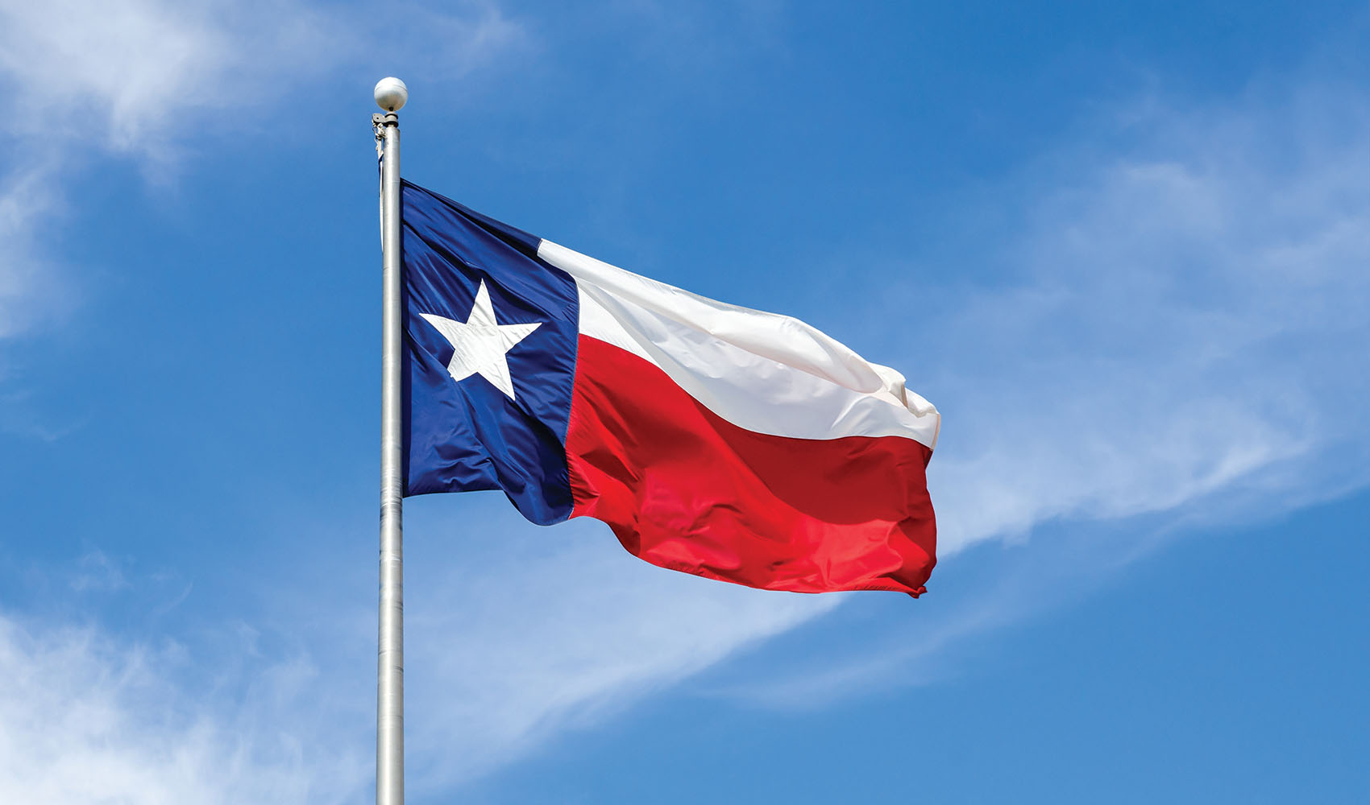
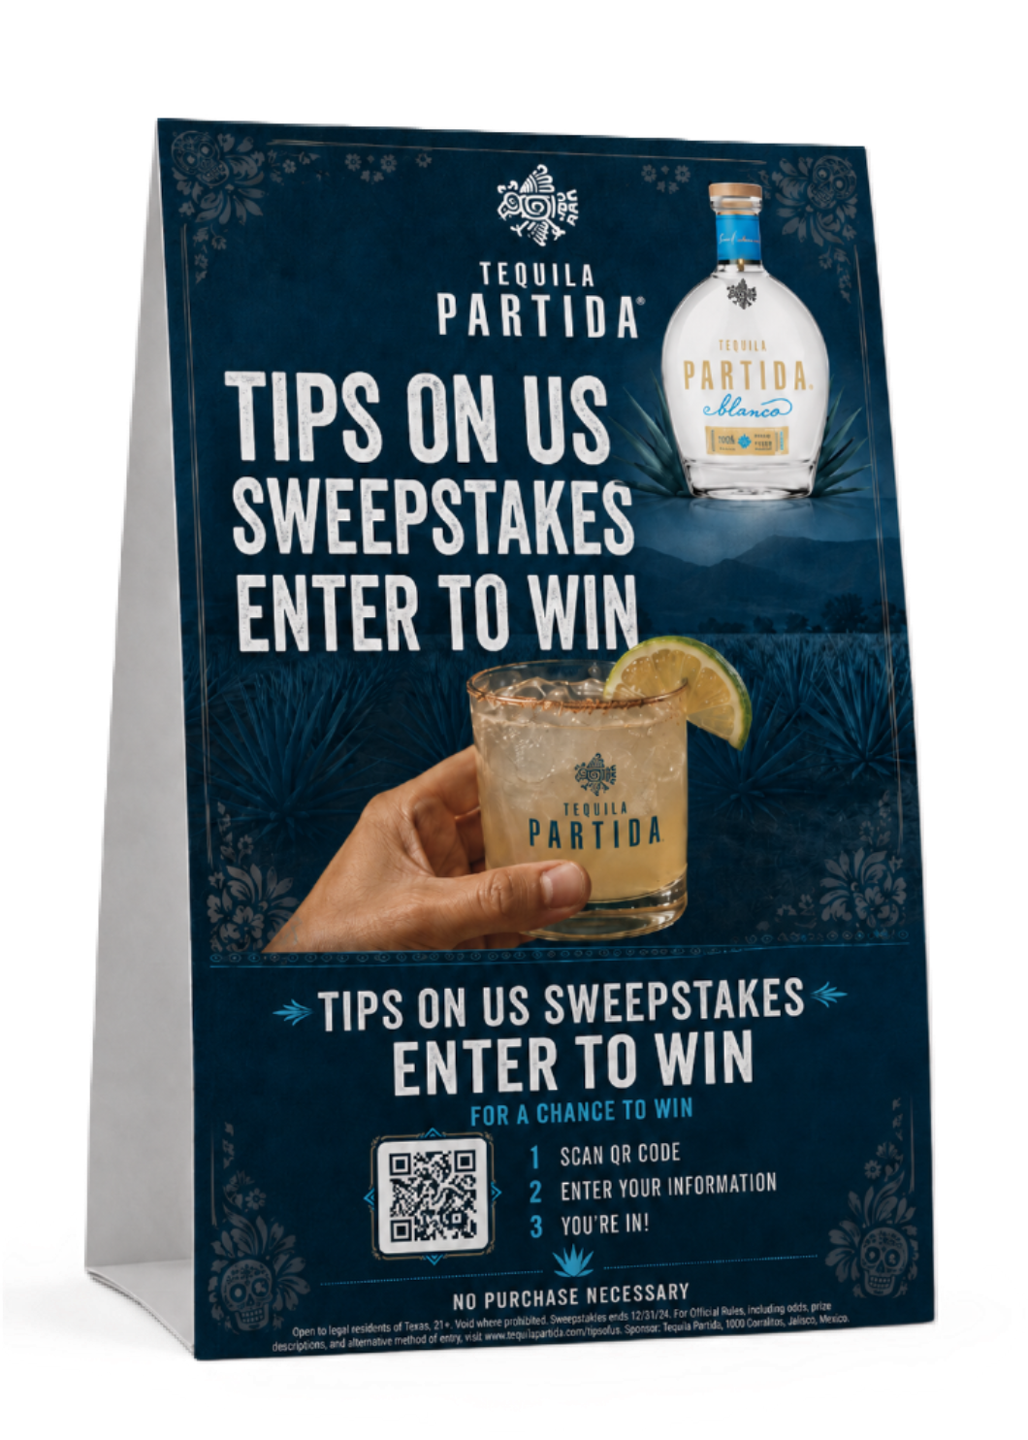
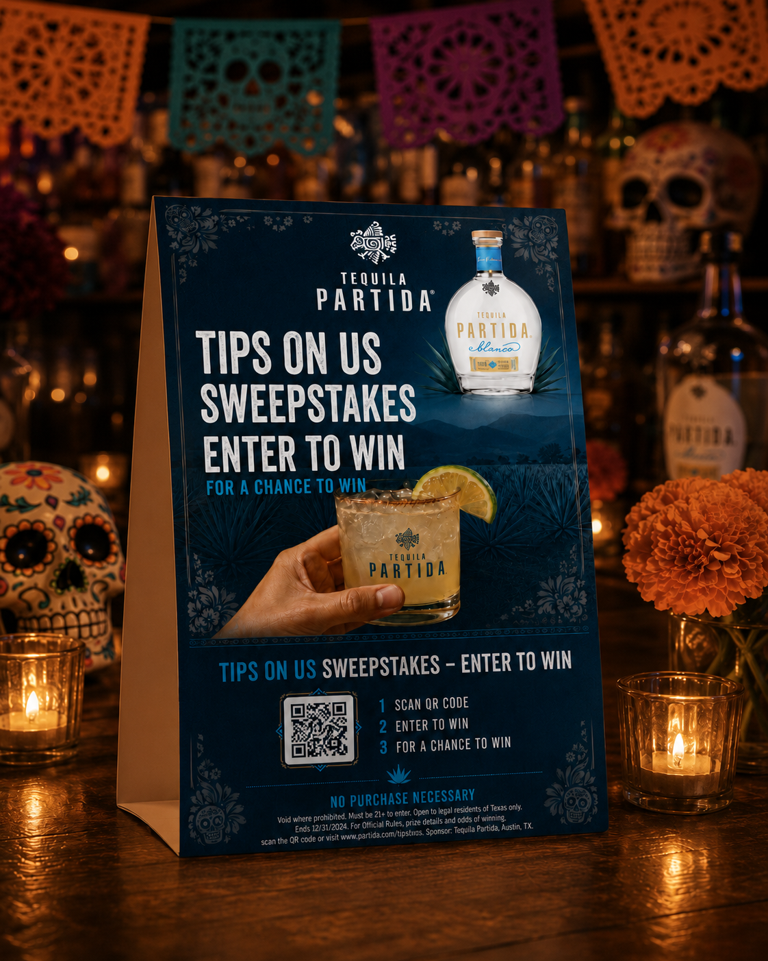
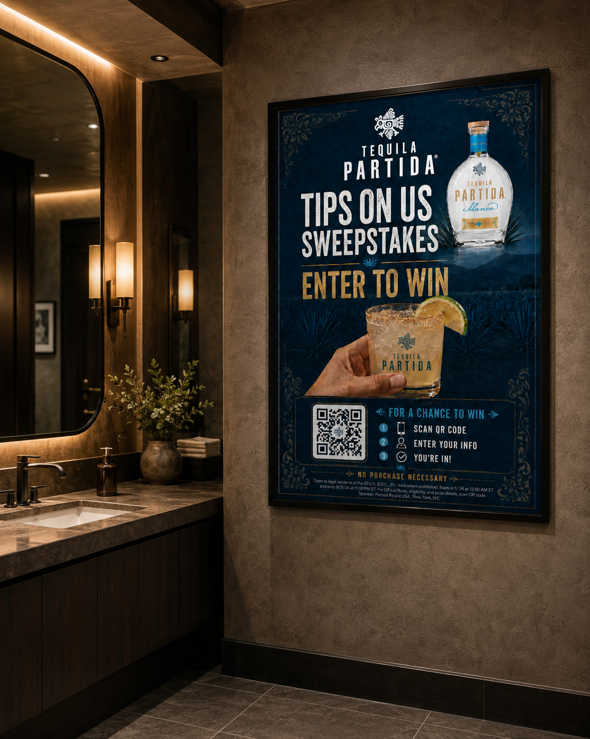
SWEEPSTAKE
TIPS ON US COCKTAIL PROGRAM
FOR TEXAS
HALLOWEEN / DIA DE MUERTOS
TABLE TENT & POSTERS
Program will run from October 15th to November 15th
To cover both Halloween and Dia De Muertos celebrations
Customers will enter to win up to $10
No Purchase Necessary

