Slide 1

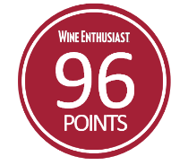





PARTIDA ELEGANTE
Tequila Partida crafted the world’s highest-rated tequila by honoring the agave. Named in honor of 3rd generation agave farmer Enrique Partida, Partida is committed to preserving the fresh agave flavor at each step of the tequila making process. The result is a tequila that is truly from field to glass.
Age: 48 months Appearance: Dark Amber Aromas: Honey & citrus Flavor Profile:
Intensely rich and full-bodied with spices
Coffee, dark chocolate, & roasted nuts
“THE BENTLEY OF TEQUILA AND, IN MY MIND, THE NEW BENCHMARK.”
- F. Paul Pacult, The Spirit Journal -
“ELEGANTE IS A FITTING JEWEL IN THE CROWN FOR THE PARTIDA LINE OF ULTRA PREMIUM TEQUILAS.”
- Anthony Dias Blue, The Robb Report -
FROM FIELD TO GLASS
PRIME MATURE
AGAVE
Produces ripe, full-flavored agave
24 HOUR FIELD TO FERMENTATION
Preserves fresh agave flavor
STAINLESS STEEL DISTILLATION
Preserves agave
purity
AGED BEYOND EXPECTATIONS
Enhances natural agave flavor & color
THE PRISTINE SERVE
To savor the world’s highest-rated tequila

Slide 2
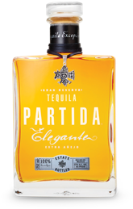

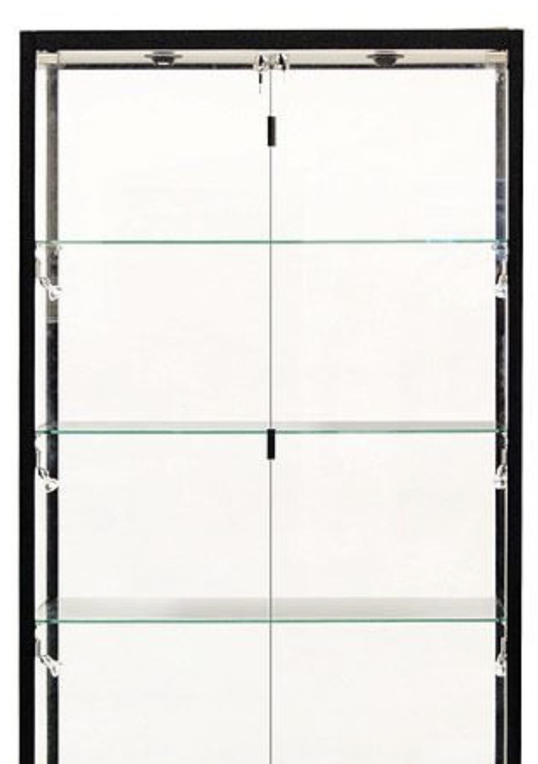
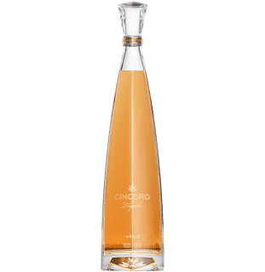

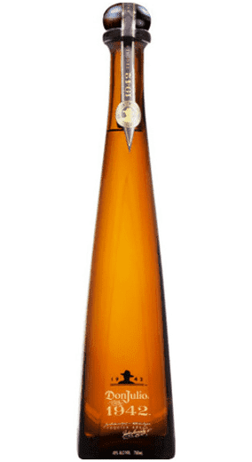




SERVE STRATEGIES
Neat in stemware
TARGET CONSUMER
35 – 55 years old Male & female High income
SHELF STRATEGY
Premier lockbox placement
PACK | Elegante 750 ML
Bottle UPC: | 701530557506
Case SCC: | 10701530557503
ABV (Alcohol %): | 40%
Volme (L): | 750 mL
Bottles per Case: | 2
Cases per Layer: | 25
Layers per Pallet: | 5
Cases per Pallet: | 125
Case Length (in.): | 13.6
Case Width (in.): | 10.1
Case Height (in.): | 7.9
Case Weight (lbs.): | 12.8
@TEQUILAPARTIDA

