Slide 1

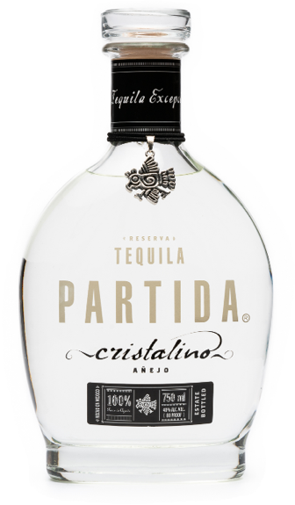


introducing
PARTIDA
AÑEJO CRISTALINO
Partida’s newest gem, Añejo Cristalino, honors the 15th Anniversary of Jose Valdez, Tequila Partida’s Maestro Tequilero who has combined innovative, modern practices with time-honored tequila making traditions. His dedication to purity and perfection for Tequila Partida is reflected in this new flawless, crisp, and clear Añejo Cristalino.
Partida Añejo Cristalino begins with Partida’s highly acclaimed Añejo Tequila which is aged for a minimum of 18 months in ex-bourbon barrels to develop a full-bodied Tequila with hints of spice, maple syrup and chocolate.
This intensely flavored Añejo is then transformed through a natural filtration process that removes color and heaviness from oak aging while retaining and enhancing the liquid’s defined body, aromas and complex flavors. Before bottling, this clear, complex and crisp Añejo rests quietly to ensure it retains its flawless clarity, like a brilliant diamond.
Tequila Partida has perfected an all-natural charcoal filtration process in order to eliminate the need for additives that are often used to help soften the liquid and enhance the flavor. This results in a 100% all natural, complex, crisp yet surprisingly clear and smooth 18-month-old Añejo. Enjoy this flawless gem in classic cocktails to enhance their flavors or neat to savor the complex characters of the crystal-clear liquid.
COLOR Clear with light golden highlights
PALATE Intense, sweet high-density fruit
FINISH Prolonged & gentle while pleasantly dry & tart
AROMA Toasted oak, maple syrup, vanilla, quince, & figs
ABV 40%
Notes:
Roble Fino Partida Reposado Sherry Oak Finish 100% de Agave Tequila (Mexico) 43% abv, $110.
Excellent clarity; citron color. Wow, I immediately like this laser focused opening aromas that features keenly herbal scents of sage, fennel, anise, savory, and bay leaf (laurel), as well as green chili pepper, leather, and green tomato vine; secondary inhalations pick up subtler notes of road tar, quince, casaba melon, hard boiled egg, brown butter, and black peppercorn. Entry flavors are grapy, winey, and berry-like and that fruitiness dominates the early stage, except for the foundational agave vegetal/herbaceous taste; midpalate highlights the sherry cask/agave plant marriage via the succulent, semisweet flavor that’s not short on agave syrup richness and tanginess; in fact, the agave presence is found mostly in the lush texture. Concludes long in the throat, moderately peppery/spicy, not as sweet as the midpalate and therefore more herbal and green vegetable-like. This is the dawn of a promising new era for 100% agave tequila, one that’s been needed for at least a decade. Note the abv level.
Spirit Journal 2019:
FIVE STARS/Highest Recommendation

Slide 2
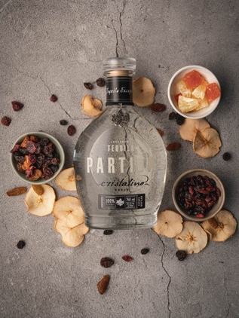
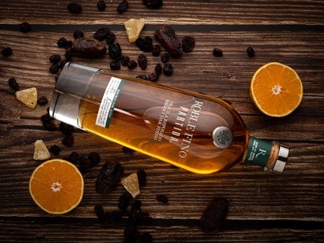
introducing
PARTIDA
AÑEJO CRISTALINO
KEY SELLING POINTS
US Cristalino Market exploding with double-digit growth* (Nielsen 52WE 9.5.20)
Cristalino is the fastest-growing segment of tequila in Mexico
Cristalino category has grown over 60% in last 5 years US
Partida Cristalino is 100% natural with no artificial flavoring or coloring
Partida Cristalino starts with award-winning Añejo**
PRIME MATURE AGAVE
Produces ripe, full-flavored agave
24 HOUR FIELD
TO COOKING
Preserves fresh agave flavor
STAINLESS STEEL
DISTILLATION
Preserves agave purity
AGED BEYONG EXPECTATION
Enhances natural agave flavor & color
THE PRISTINE
SERVE
To savor the world’s highest-rated tequila
TRADE POSITIONING
Focus: On-Premise
Key existing Partida accounts
Premium Mexican and tequila “A” accounts
Premium cocktail bars
Off-Premise:
Eye-level placement to the left of Partida Añejo and/or secondary placement in Cristalino Section
Independent accounts in key Latino neighborhoods
Key Partida accounts with current Añejo listing
Target Consumer: Tequila Tastemakers
20 to 40+ years old, educated
SKUs Latino/Mexican Heritage (familiar with Cristalinos from travels to Mexico
Like discovering new things and quality tequilas
UPC | 7503022413368
SCC | 17503022413365
Volume/Bottle (L): | .750
ABV% | 40
Cases per Layer | 12
Cases per Pallet | 96
Layers per Pallet | 8
Bottles per Case | 6
Bottles per Layer | 72
Bottles per Pallet | 576
Case Length (in) | 11.4
Case Width (in) | 12.6
Case Height (in) | 9.5
Case Weight (lbs) | 22.2
DRINK STRATEGY
Partida Cristalino Margarita served up in Martini Glass
Upgrade cocktails with this complex & crystal-clear liquid
*(Nielsen 52WE 9.5.20) ** (USC 94 - 2017; 93 - 2019)

