Slide 1
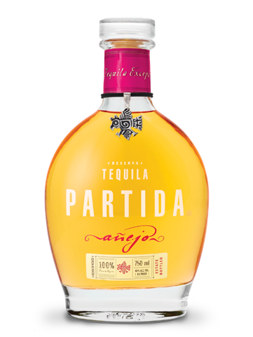


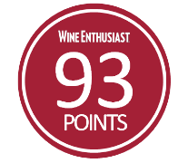





Tequila Partida crafted the world’s highest-rated tequila by honoring the agave. Named in honor of 3rd generation agave farmer Enrique Partida, Partida is committed to preserving the fresh agave flavor at each step of the tequila making process. The result is a tequila that is truly from field to glass.
PARTIDA AÑEJO
Age: 18 months
Appearance: Intensely golden with bronze tones
Aromas: Oak, dry fruits, & butter
Flavor Profile:
Clean and full-bodied with a hint of spice
Banana, maple honey, & chocolate
“PARTIDA TEQUILAS ARE SIMPLY THE FINEST LINE OF TEQUILAS
THAT MONEY CAN BUY.”
- F. PAUL PACULT, THE SPIRIT JOURNAL -
FROM FIELD TO GLASS
PRIME
MATURE AGAVE
Produces ripe,
full-flavored agave
24 HOUR FIELD TO FERMENTATION
Preserves
fresh agave flavor
STAINLESS STEEL DISTILLATION
Preserves
agave purity
AGED BEYOND EXPECTATIONS
Enhances natural agave
flavor & color
THE PRISTINE SERVE
To savor the world’s
highest-rated tequila

Slide 2
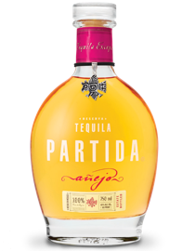









SERVE STRATEGIES
Neat in stemware
Elevated tequila or whisky-centric cocktails
TARGET CONSUMER
25 – 34 years old
Male & female
High income
SHELF STRATEGY
Super premium tequila section
Eye-level, marques blocked together
Adjacent to Don Julio
PACK | Añejo 750 mL
Bottle UPC: | 701530512505
Case SCC: | 10701530512502
ABV (Alcohol %): | 40%
Volme (L): | 750 mL
Bottles per Case: | 6
Cases per Layer: | 12
Layers per Pallet: | 8
Cases per Pallet: | 96
Case Length (in.): | 11.4
Case Width (in.): | 12.6
Case Height (in.): | 9.5
Case Weight (lbs.): | 22.20
@TEQUILAPARTIDA

