Slide 1

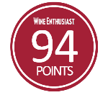





PARTIDA REPOSADO
Tequila Partida crafted the world’s highest-rated tequila by honoring the agave. Named in honor of 3rd generation agave farmer Enrique Partida, Partida is committed to preserving the fresh agave flavor at each step of the tequila making process. The result is a tequila that is truly from field to glass.
Age: 6 months
Appearance: Light amber with golden tones
Aromas: Honey & citrus
Flavor Profile:
Brilliant & full-bodied
Caramel, butter, vanilla, & charred oak
“PARTIDA TEQUILAS ARE SIMPLY THE FINEST LINE OF TEQUILAS
THAT MONEY CAN BUY.”
- F. PAUL PACULT, THE SPIRIT JOURNAL -
“SOFT AGAVE NOSE; SMOOTH AND RICH, WITH CONSIDERABLE FINESSE AND A BALANCE BETWEEN ELEGANCE AND EARTHINESS.”
- TASTING PANEL -
FROM FIELD TO GLASS
PRIME MATURE
AGAVE
Produces ripe, full-flavored agave
24 HOUR FIELD TO FERMENTATION
Preserves fresh agave flavor
STAINLESS STEEL DISTILLATION
Preserves agave purity
AGED BEYOND EXPECTATIONS
Enhances natural agave flavor & color
THE PRISTINE SERVE
To savor the world’s highest-rated tequila

Slide 2
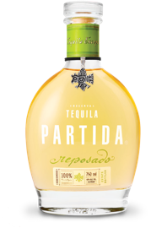









SERVE STRATEGIES
Neat in stemware
Tequila soda
Elevated tequila cocktails
TARGET CONSUMER
25 – 34 years old
Male & female
High income
SHELF STRATEGY
Super premium tequila section
Eye-level, marques blocked together
Adjacent to Don Julio
PACK | Reposado 750 mL
Bottle UPC: | 701530511508
Case SCC: | 10701530511505
ABV (Alcohol %): | 40%
Volme (L): | 750 mL
Bottles per Case: | 6
Cases per Layer: | 12
Layers per Pallet: | 8
Cases per Pallet: | 96
Case Length (in.): Case Width (in.): | 10.8 9.8
Case Height (in.): | 9.5
Case Weight (lbs.): | 22.2
@TEQUILAPARTIDA

