Slide 1
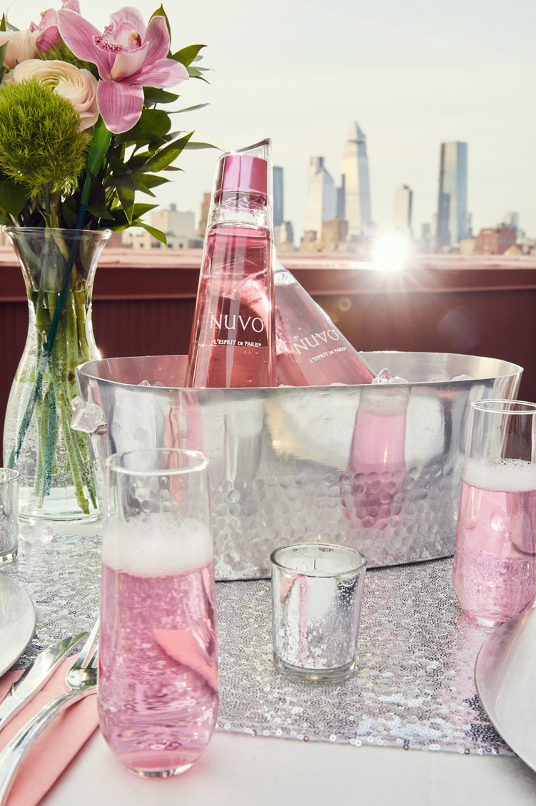


Slide 2
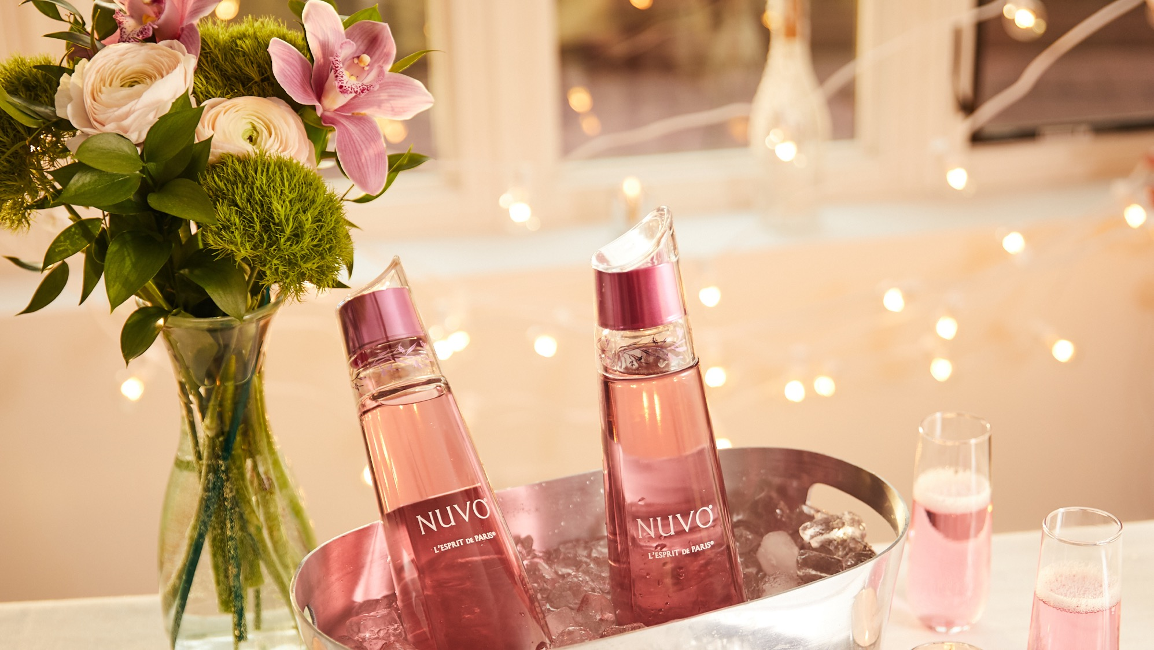
What is NUVO??
95% French Premium vodka, 5% sparkling white wine, blend of fruit nectar & five bars of pressure just like champagne
Best consumed chilled or mixed with other base spirits

Slide 3
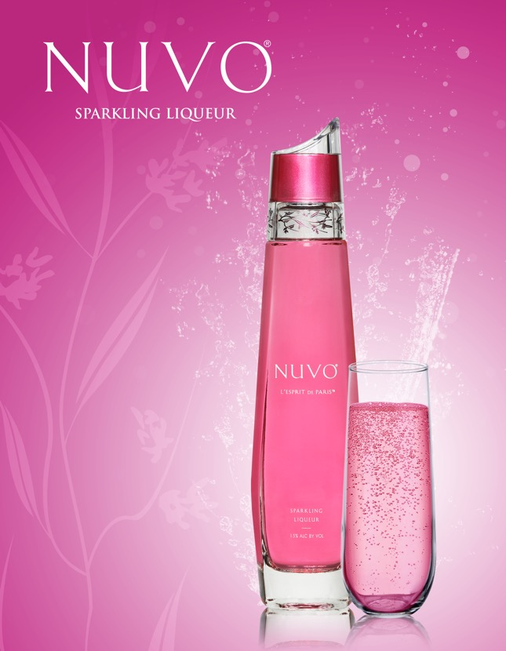
KEY SELLING POINTS
It’s like champagne, but it’s a sparkling vodka with fruit nectars
Super premium packaging, which makes it’s perfect for key gifting occasions
Low ABV aligns well with current cocktail trends
Cross over opportunity aligning with Champagne & Trendy Rosé wines

Slide 4
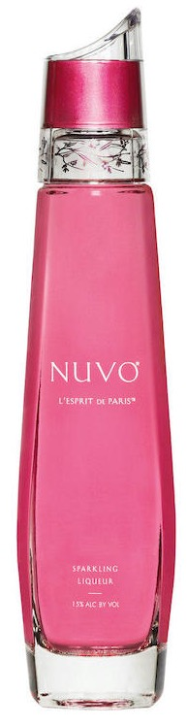
SUPER PREMIUM PACKAGING
Custom Designed Oversize Closure with Flowers Screen Printed
First squared off bottle
to hold carbonation.
Three years to develop.
Approx. 700g glass
Weighted Bottom

Slide 5
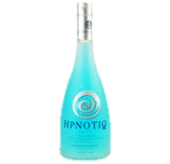
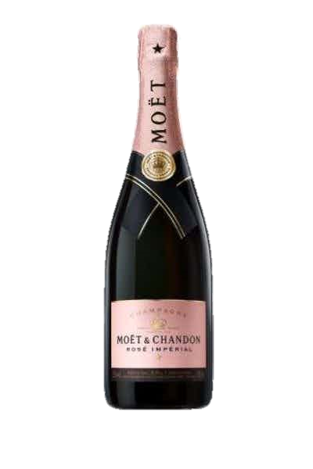
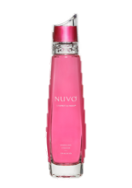

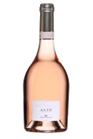
category &&- Consumer focus
Focus on accounts with parody brands
Target audience, General Market, woman 25 to 55 years young, looking for glamorous and chic accessory
Bottle shape, perfume bottle or luxurious lipstick, drives impulse purchase

Slide 6
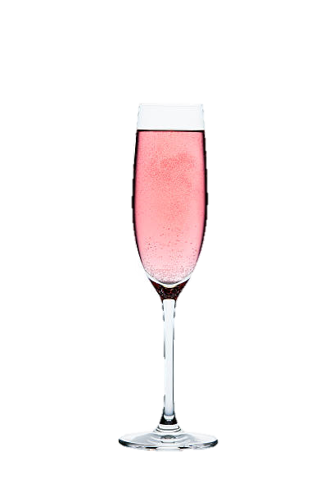
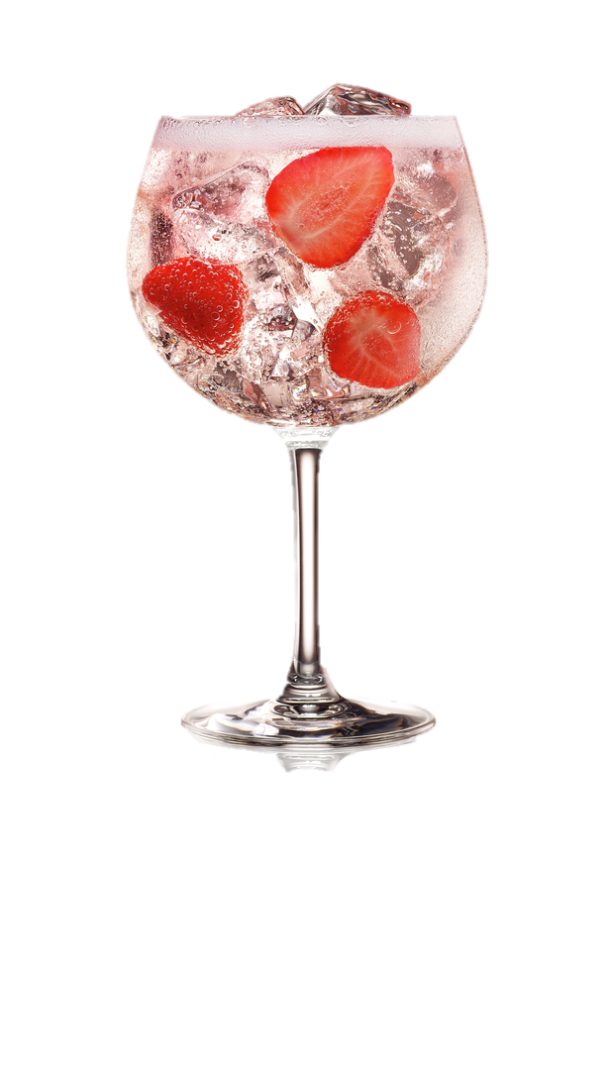

Signature serve
NUVO CLASSIC
6oz of NUVO
Serve in a flute or rocks glass over ice
NUVO SPRITZ
4 oz of NUVO
1 oz bitter liqueur
Serve in wine glass over ice
@sparklingnuvo 300K followers
@@@sparklingnuvo 20K followers

Slide 7
Nuvo Strategy house
celebratory occasions
VIP treatment
Off-Premise
Brand collaboration
E-Commerce/Social Media
Store footprint
POS
Sampling
Celebrity collaboration
Strategic E-Commerce Social media conversion campaign
Notes:
Display – High –End
WOW POS – assets visuals
Need to invest more A&P to keep growing at that rate

Slide 8
Nuvo Store display strategy
“key gifting periods”

Slide 9
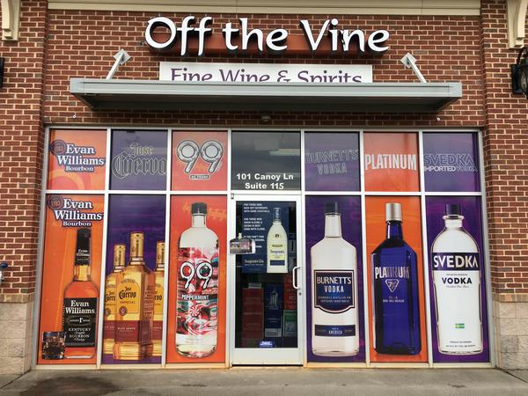
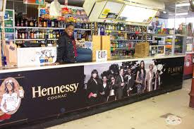
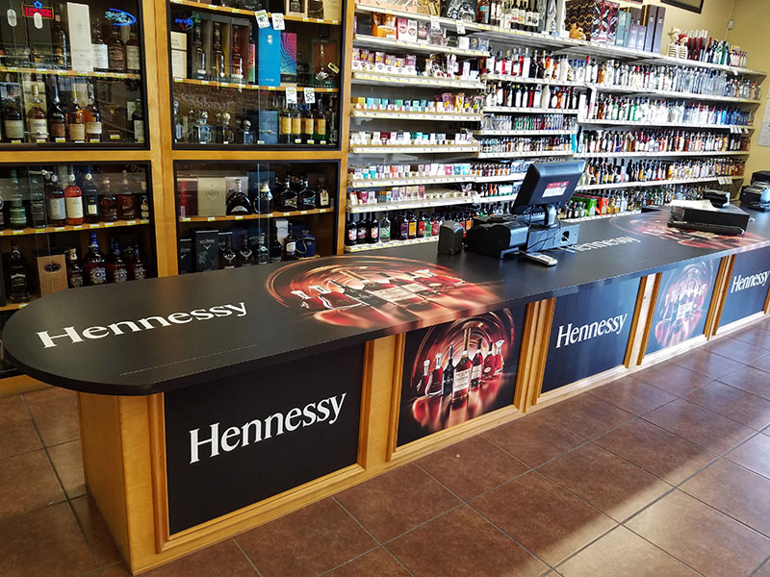
Nuvo WOW store VISUALS
“Let’s cover our stores in PINK”

Slide 10
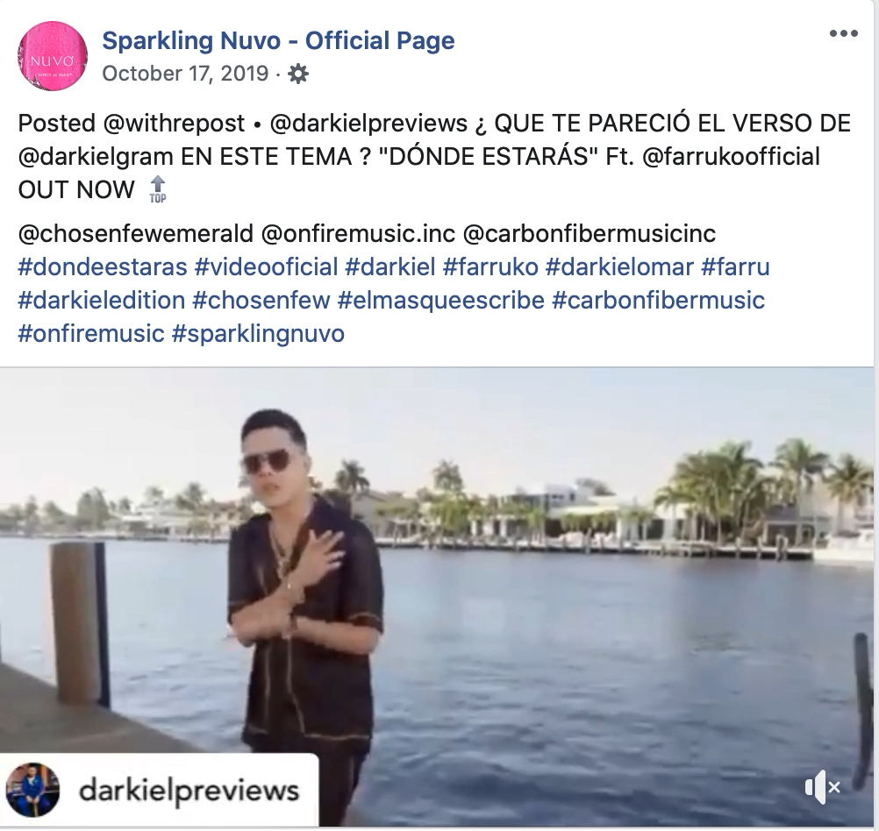
Nuvo brand collaboration
NUVO will BE signing new music acts in 2021 with a shift to
POP-MUSIC artist
Our 2020 videos have generated over 700 Millions views

Slide 11
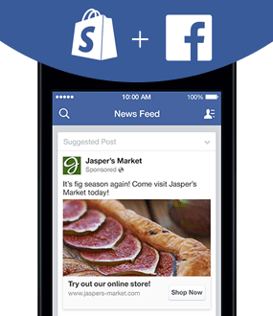
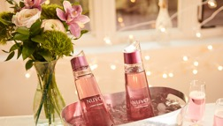
Social Media / E-commerce
“conversion campaign”
Dedicated budget to inspire and convert consumers
GEO targeted campaign
Direct click &&and shop action to National accounts dedicated NUVO page
E-Commerce partnership with independent and regional accounts
@sparklingnuvo 300K followers
@@@sparklingnuvo 20K followers

Slide 12
Key facts ==- growth
Lucas BOLS USA Fiscal YTD-April through July 2020 Depletions
NIELSEN DATA
(52-week period ending 06/13/2020)
 | CM Depletions |  |  | FYTD Performance
Brand | CM 9L Depl | CM 9L Depl +/- | CM % Chg vs LY | FYTD 9L Depl | FYTD 9L Depl +/- | FYTD % Chg
Nuvo | 1,119 | 599 | 115% | 3,858 | 1,174 | 44%
Market | Sales Dollars | Sales Dollars LY | Sales Dollar % Chg
MEIJER TOTAL CTA FD SPIRITS | $28,645 | $12,596 | 127.41%
TOTAL WINE & MORE TOTAL US SPIRITS | $82,359 | $41,172 | 100.03%
TTL US XAOC SPIRITS | $65,795 | $34,333 | 91.64%
NUVO Grew +115% in CM (July) and have grown +44% in the first four months of our USA FY
NUVO sales at Meijer and Total W&M are growing at +127% and +100% 52-week period ending 06/13/20 Nielsen data

