Slide 1


MEDIA COVERAGE
2024-2025

Slide 2

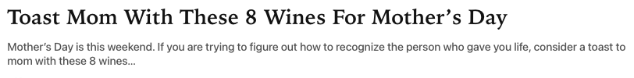


May 6, 2025
Online Visits: 14,336
Click to view article

Slide 3


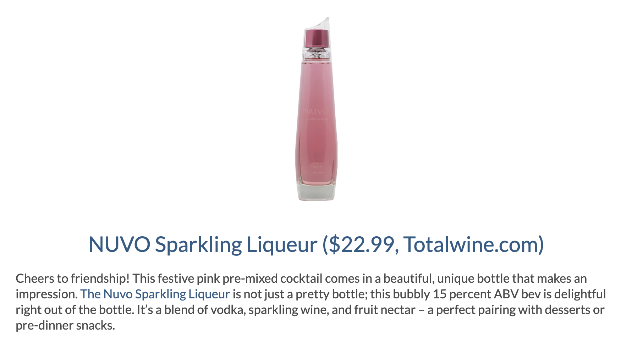
January 31, 2025
Online Visits: 5,000
Click to view article

Slide 4

 | January 31, 2025 Online Visits: 123,209,368 Click to view article
Syndication from Truetrae.com

Slide 5

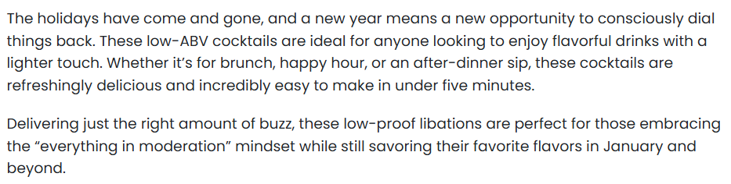
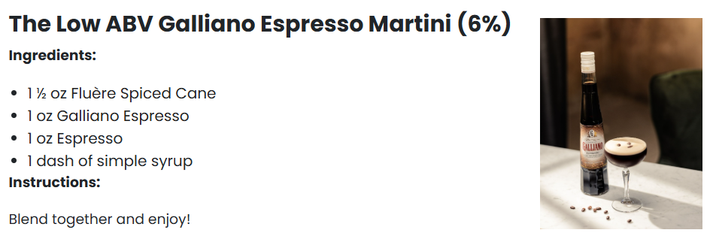
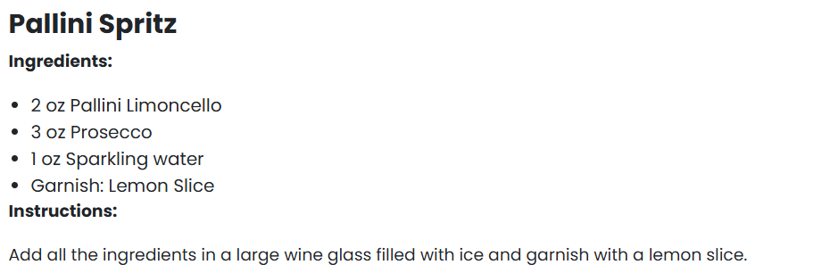

January 22, 2025
Online Visits: 1,567,783
Click to view article

Slide 6

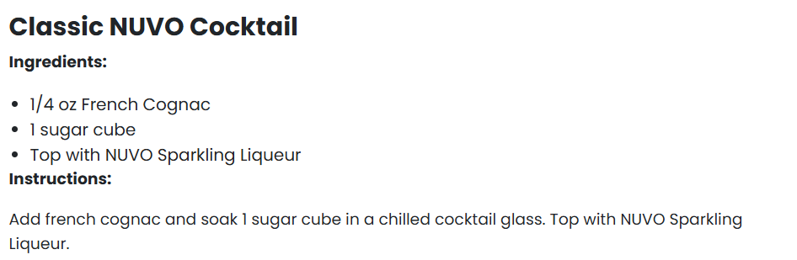
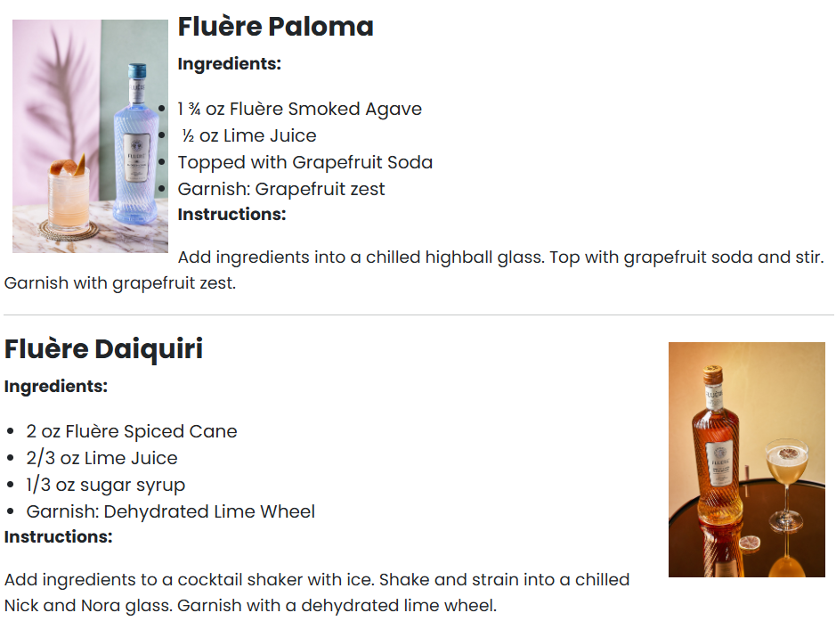

Slide 7

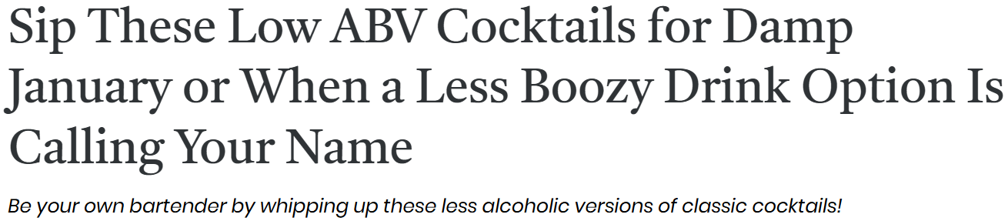


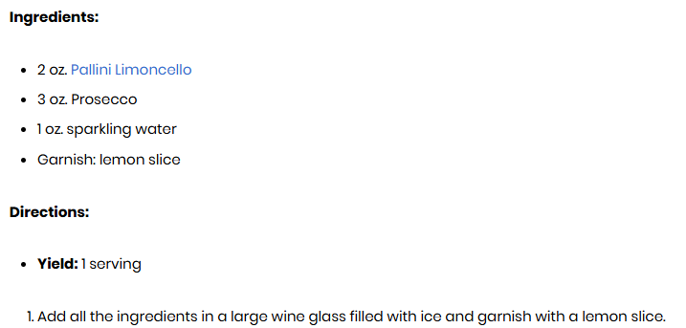
January 17, 2025
Online Visits: 693,695
Click to view article

Slide 8
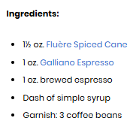

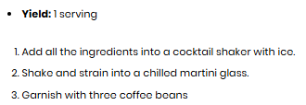


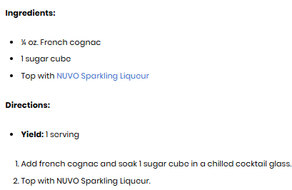

Slide 9







 | January 17, 2025 Online Visits: 975,948 Click to view article
 | January 17, 2025 Online Visits: 70,867 Click to view article
 | January 17, 2025 Online Visits: 737,081 Click to view article
 | January 17, 2025 Online Visits: 445,392 Click to view article
 | January 17, 2025 Online Visits: 136,939 Click to view article
 | January 17, 2025 Online Visits: 1,275,976 Click to view article
 | January 17, 2025 Online Visits: 1,437,841 Click to view article
Syndications from First For Women

Slide 10

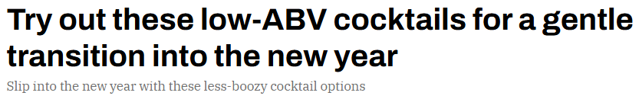

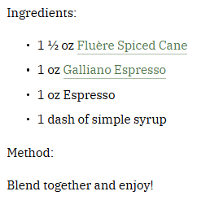
January 15, 2025
Online Visits: 480,560
Click to view article

Slide 11
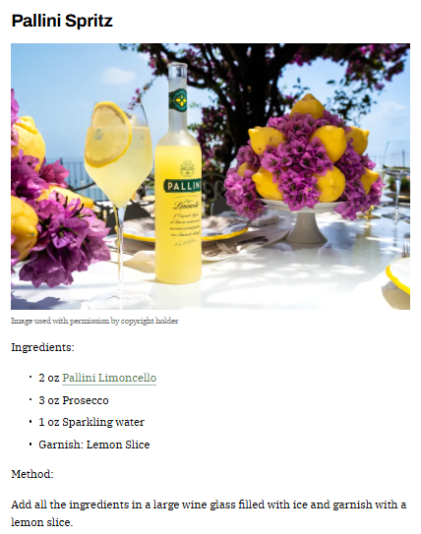

Slide 12

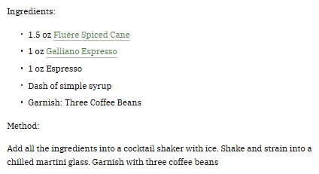


Slide 13

 | January 15, 2025 Online Visits: 413,750,923 Click to view article
Syndications from The Manual

