Slide 1
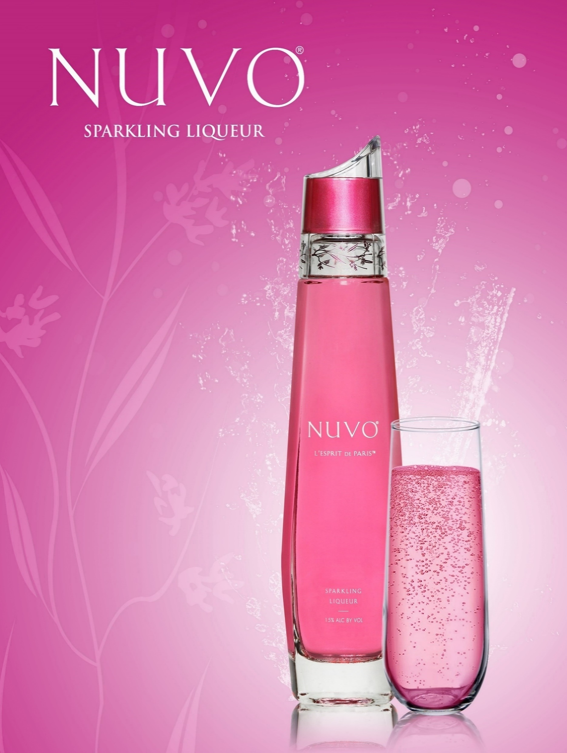


Join us in the fight against cancer
By supporting a breast cancer awareness organization, Nuvo Sparkling Liqueur contributes to a meaningful cause, strengthens its brand, fosters community engagement, and builds lasting consumer relationships.

Slide 2
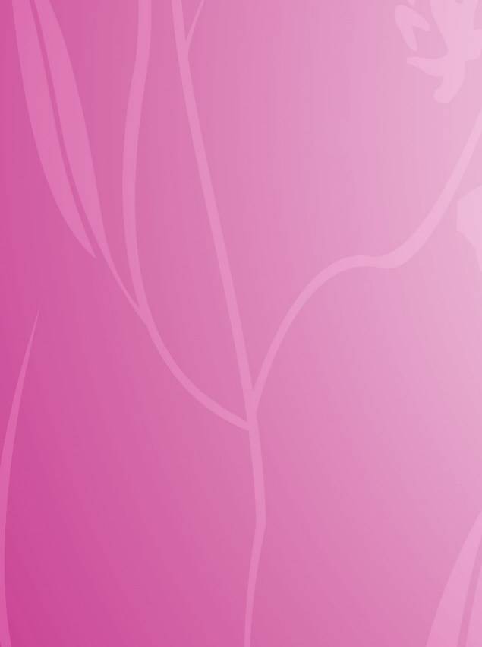
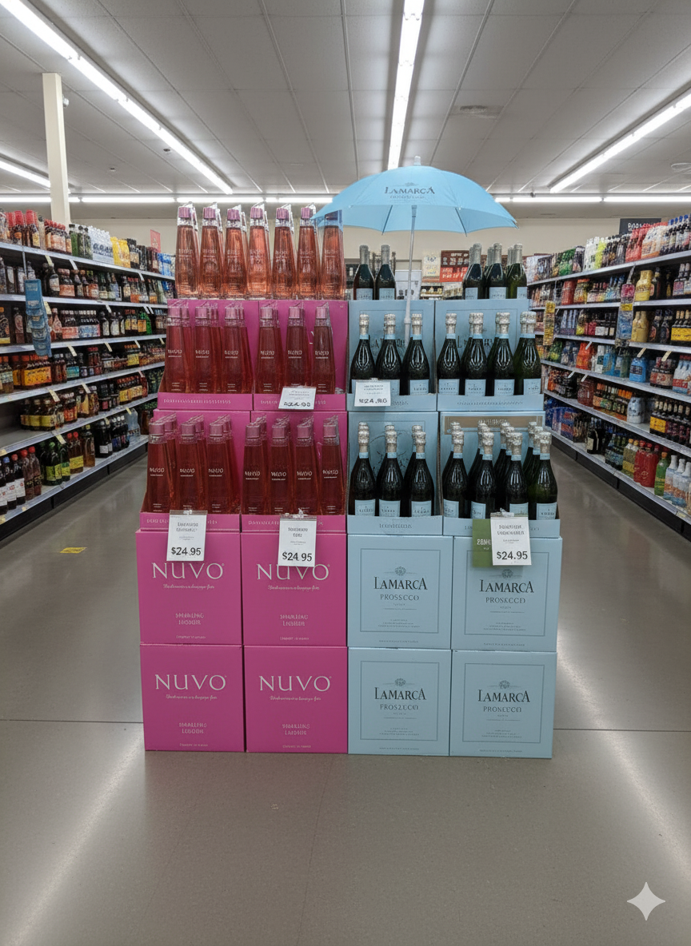
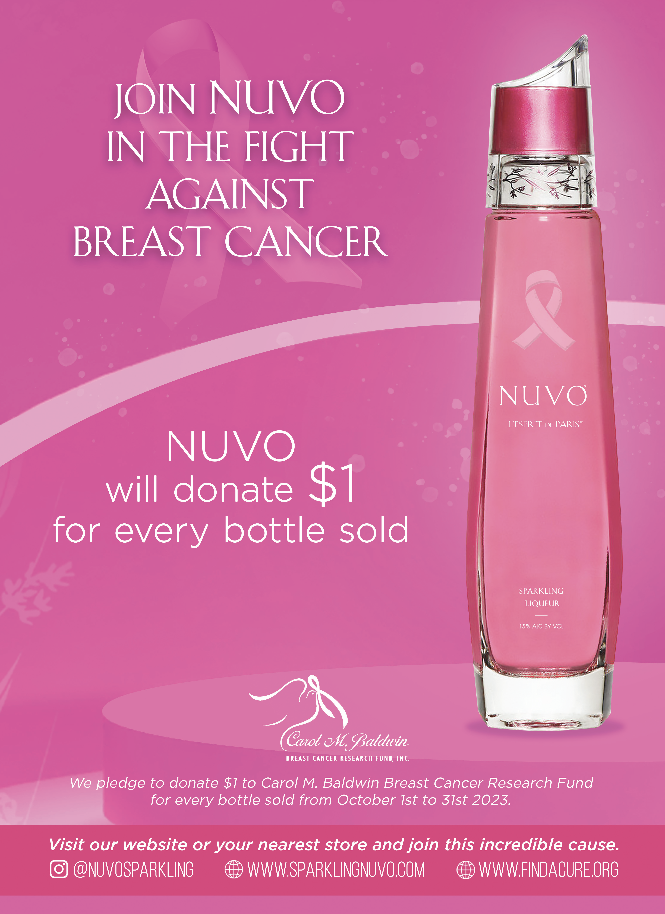
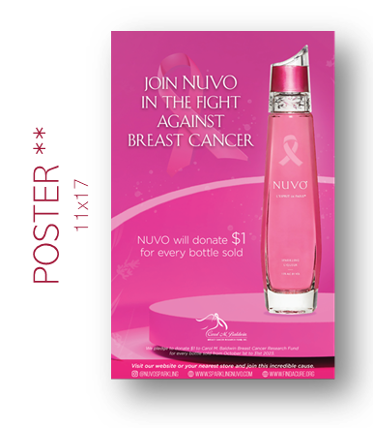


STRATEGY
October 1st to December 31st
Strengthen connection with our core consumers. Female-Centric
Ensure visibility through case displays next to Sparkling Wines
NUVO will donate $1 for every bottle sold
OFF-PREMISE TOOLS
nuvosparkling
sparklingnuvo

