Slide 1

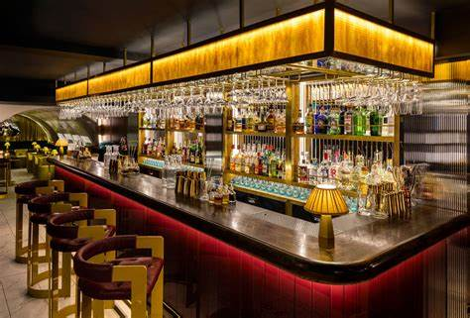
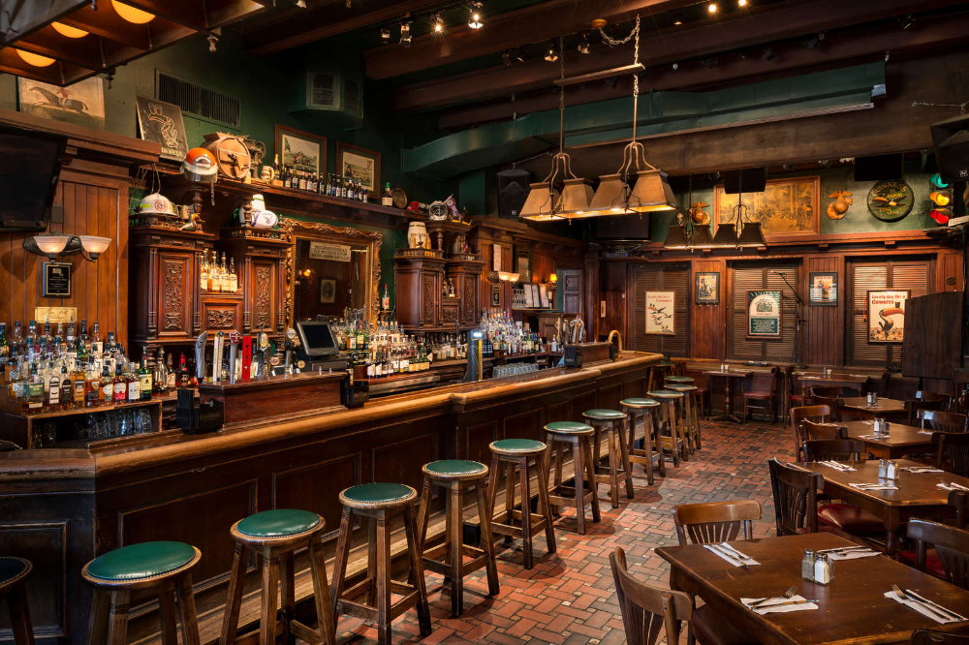
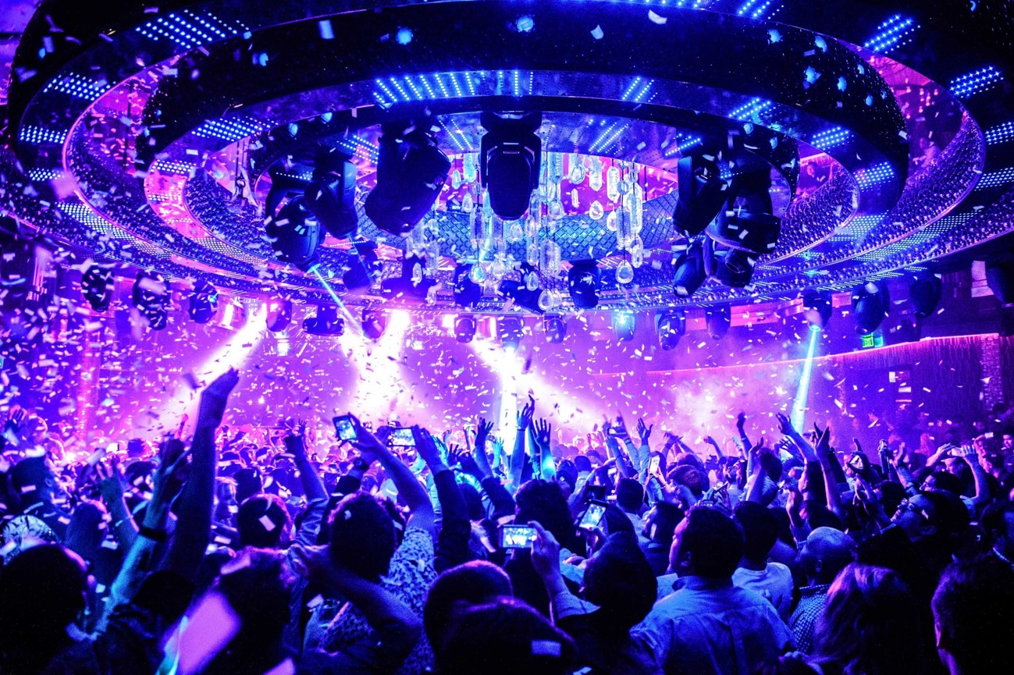
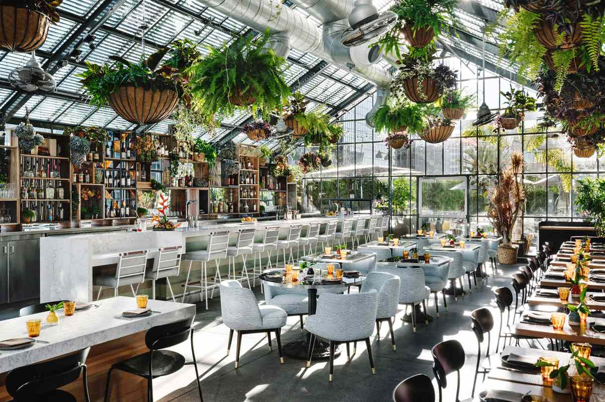
TRIAL
ON PREMISE
CHANNEL SEGMENTATION
Craft Cocktail Bars
Irish Pubs & Restaurants
Muff Irish Coffee
Muff Whiskey Ginger
Irish Whiskey Sour
Muff Gin and Tonic
Nightclub & Dance Venue
Brunch Spots
Muff Vodka Red Bull
Muff Gin Fizz
Muff Vodka Bloody Mary
Gin Mimosa

