Slide 1

Top Media
Hits Recap
2024 - 2026

Slide 2

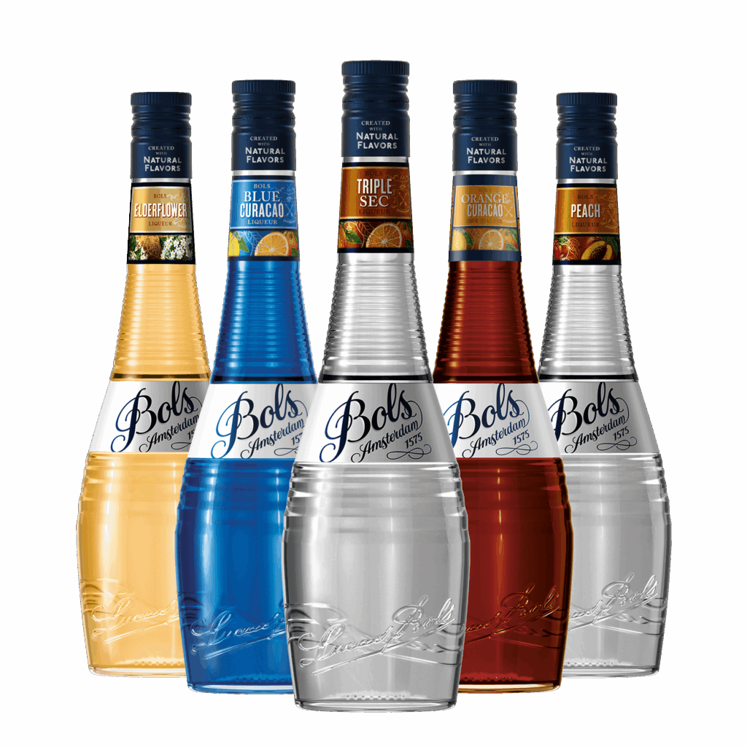
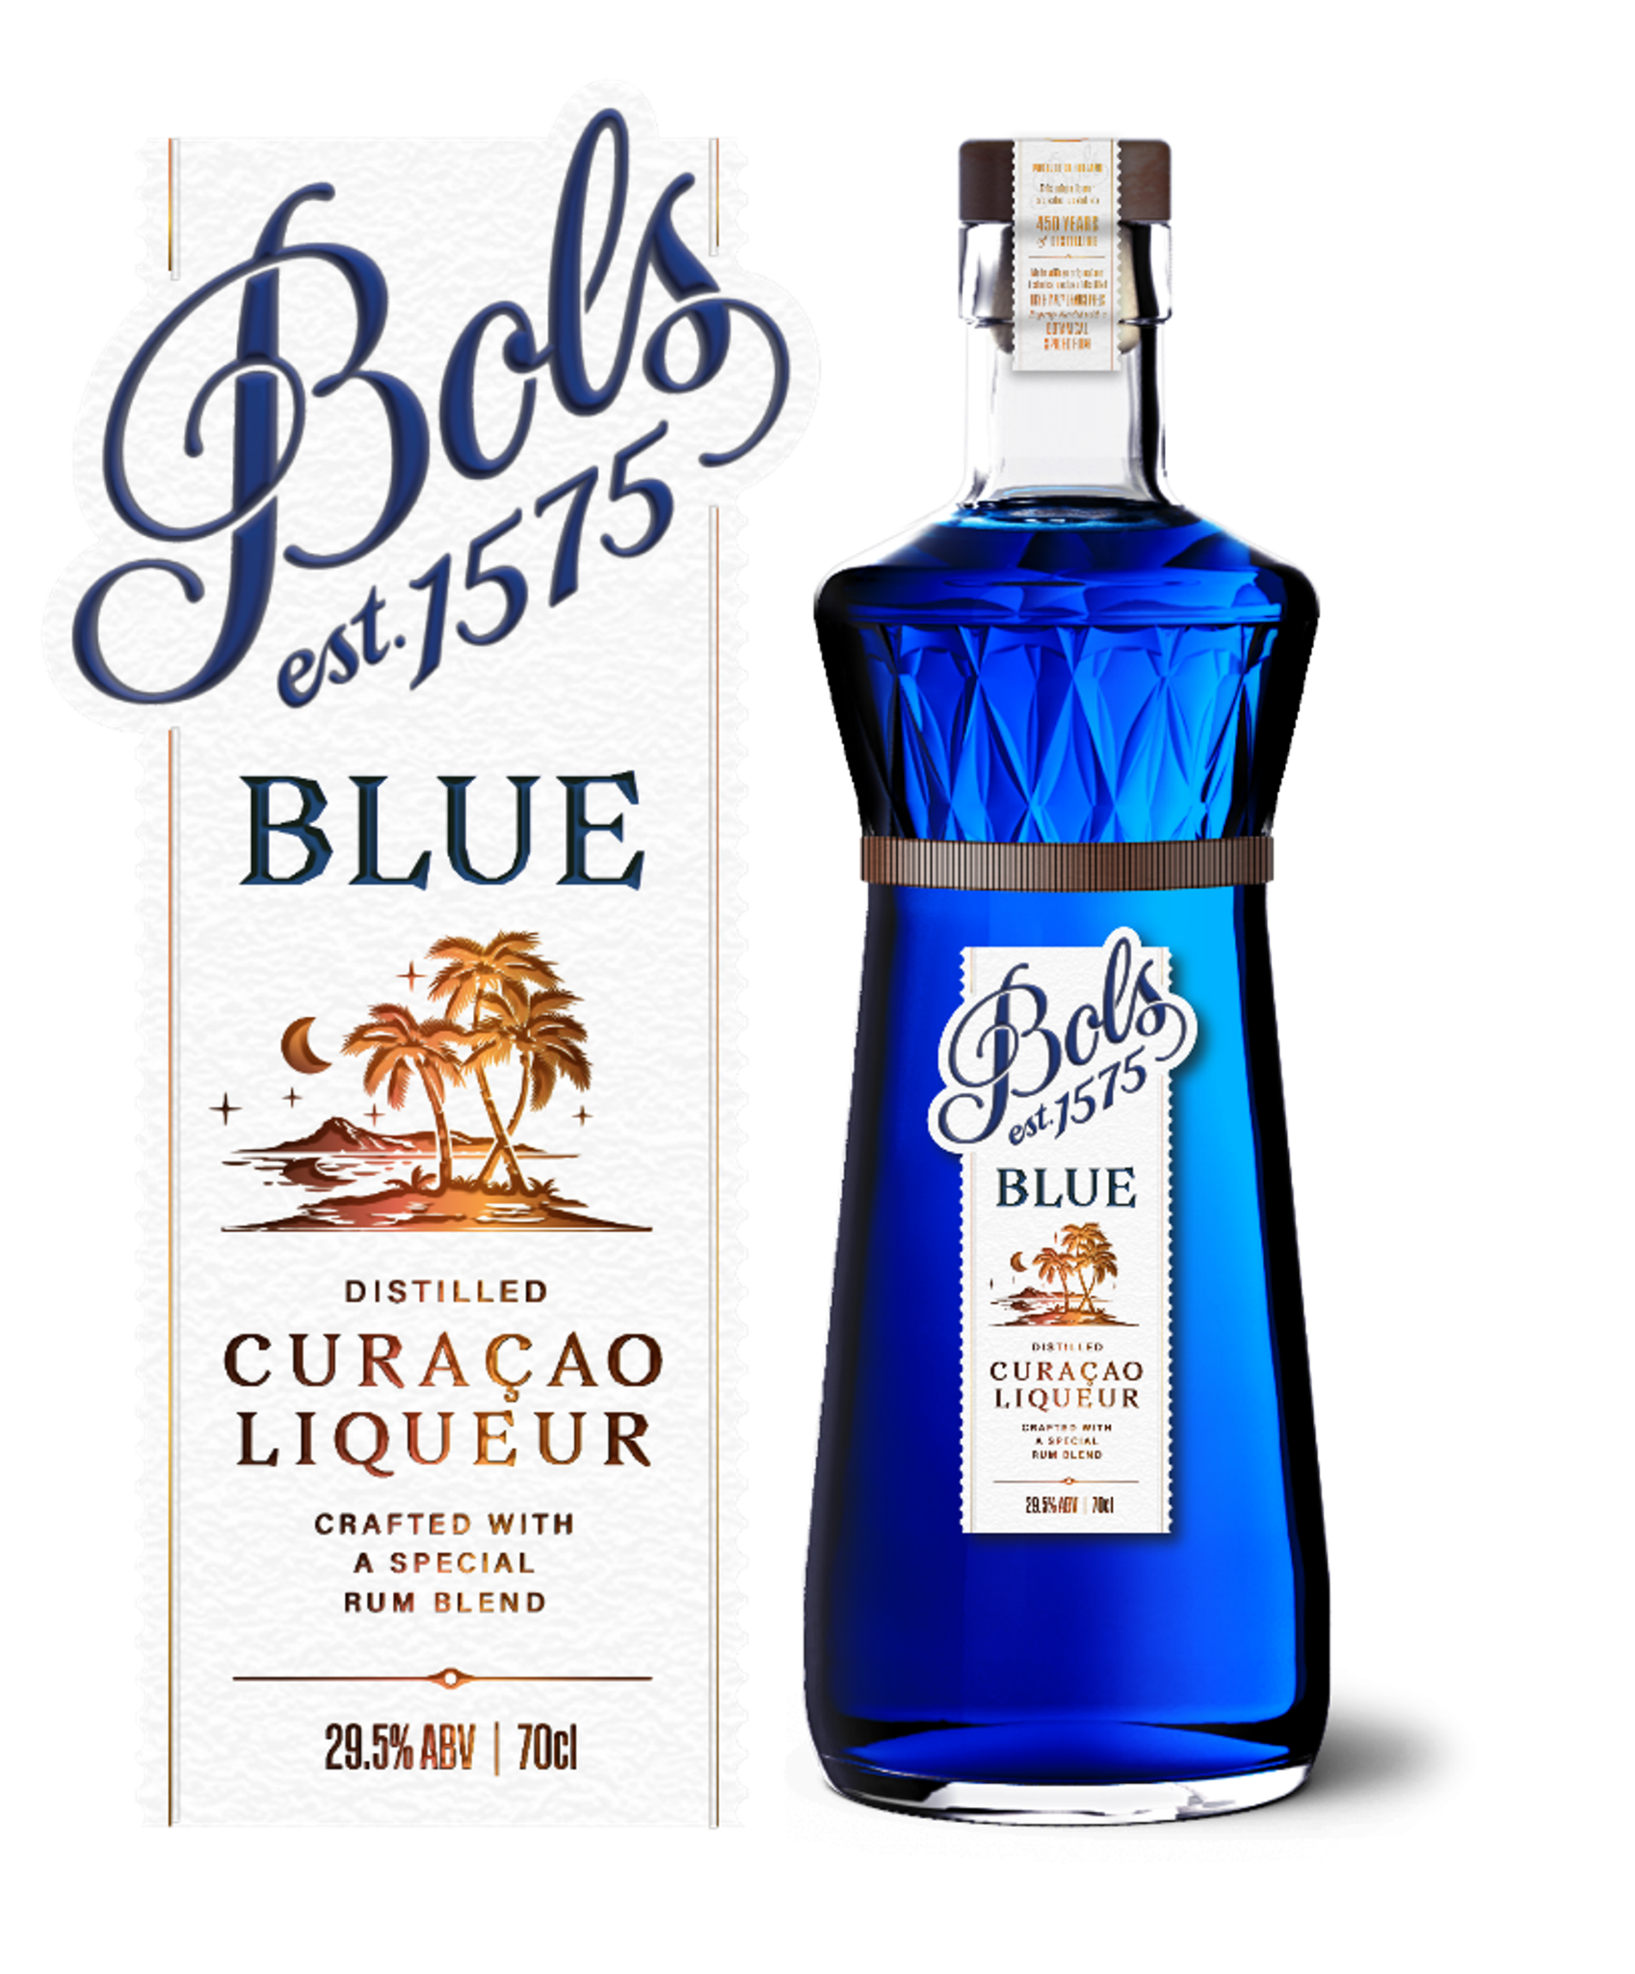
Top Media
Hits Recap

Slide 3



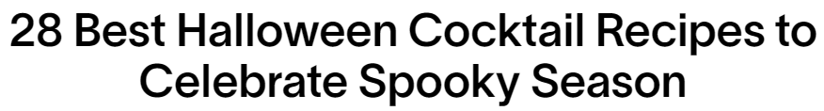
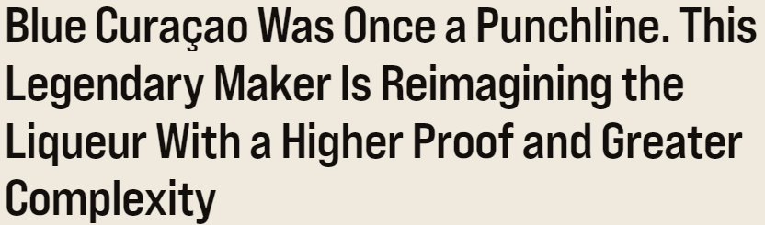
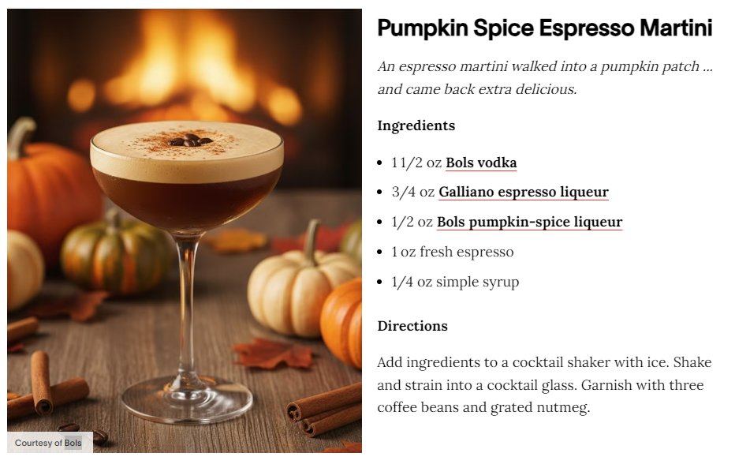
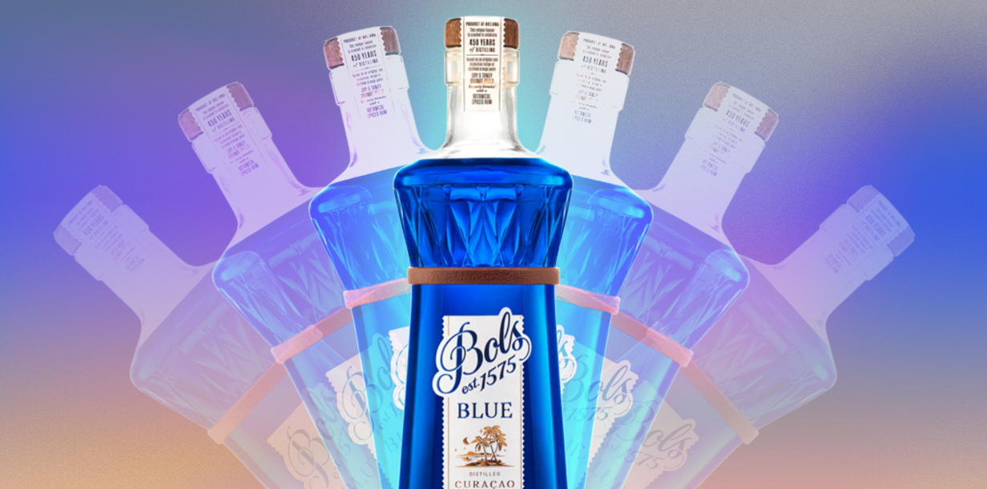
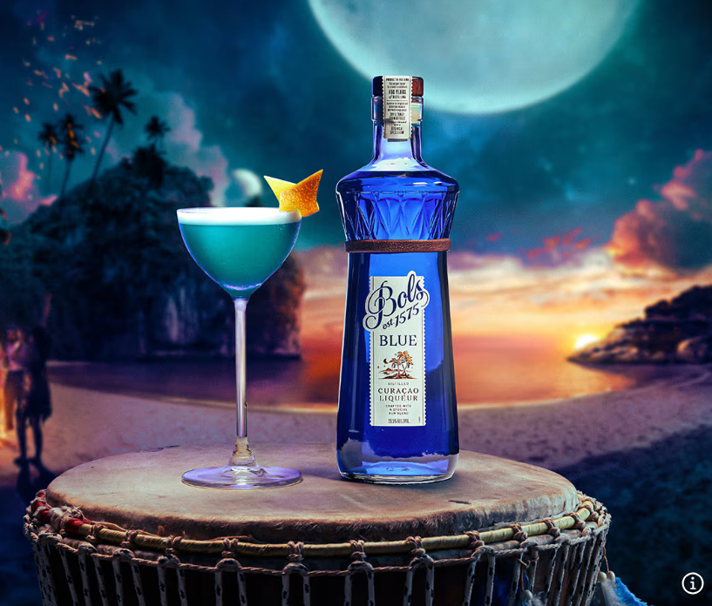

Top Media Highlights - Liqueurs
Date: 11/25/2025
Online Visits: 829,906
Link
Date: 10/24/2025
Online Visits: 12,883,348
Link
Date: 9/30/2025
Online Visits: 15,082,382
Link

Slide 4





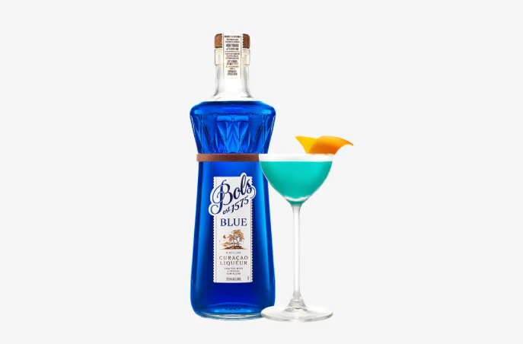

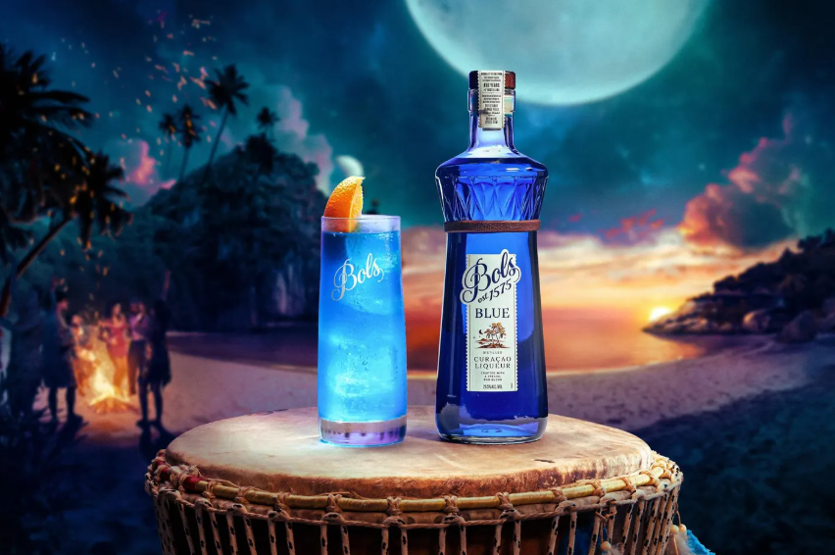
Top Media Highlights - Liqueurs
Date: 10/15/2025
Online Visits: 785,423
Link
Date: 3/14/2025
Online Visits: 50,739,115
Link
Date: 2/22/2026
Online Visits: 9,147,567
Link
Notes:
https://www.insidehook.com/spirits/muff-liquor-company-gin-vodka-irish-whiskey-review
https://robbreport.com/food-drink/spirits/gallery/best-irish-whiskey-brands-1235509136/redbreast_15/
https://www.wineenthusiast.com/toplists/100-best-spirits-of-2025/?srsltid=AfmBOorO2sIB5ICAsSpSH8R0rSM6ojZibx92BKoWPOGcl7b1v1JXbVt9
https://www.forbes.com/sites/hudsonlindenberger/2025/12/05/the-relentless-rise-of-muff-liquor-and-the-founder-who-refused-to-quit/
https://www.drinkhacker.com/2025/04/10/review-the-muff-irish-vodka-gin-and-whiskey/
https://ftw.usatoday.com/story/entertainment/pop-culture/2025/03/14/best-irish-whiskeys-st-patricks-day-guide-jameson-natterjack/81960562007/#
https://www.themanual.com/food-and-drink/muff-liquor-company/#dt-heading-where-can-i-buy-them

Slide 5





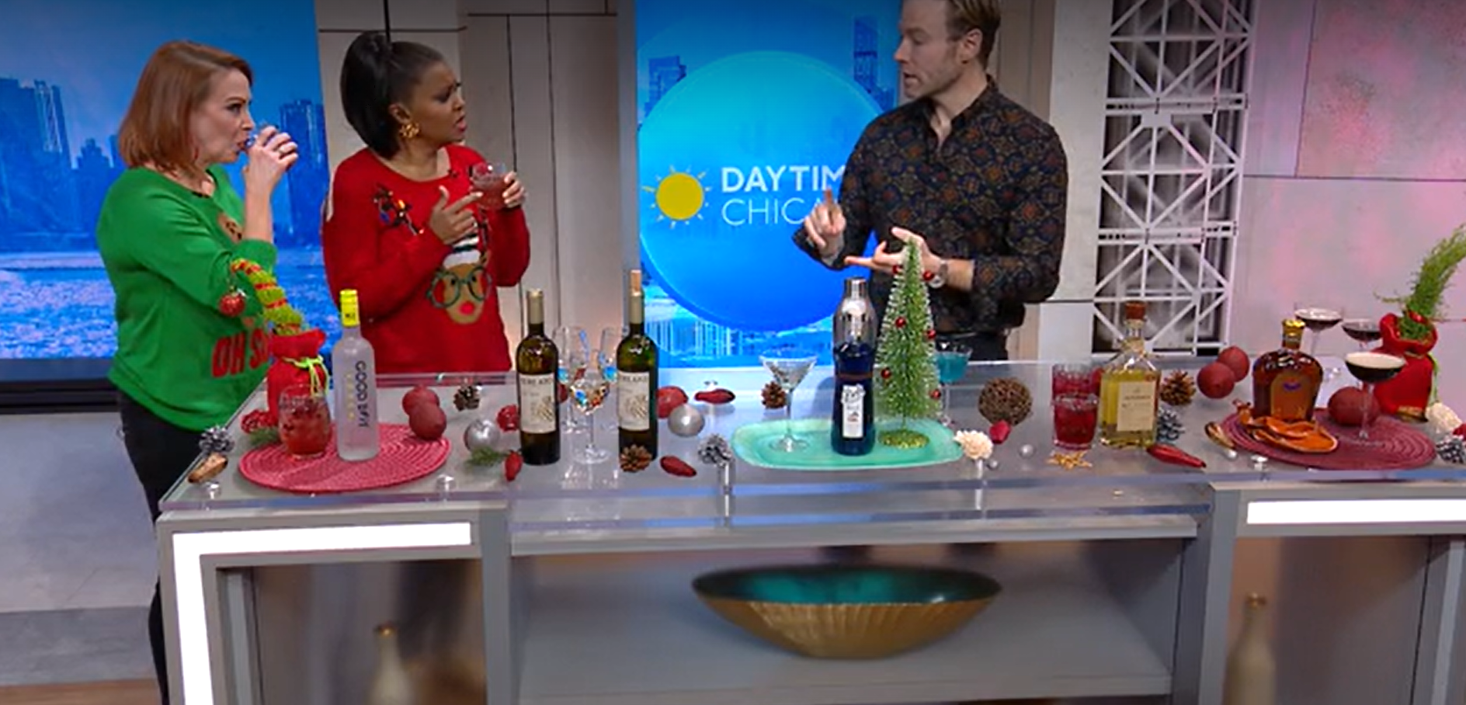
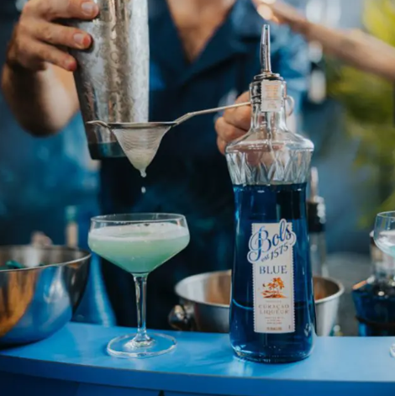
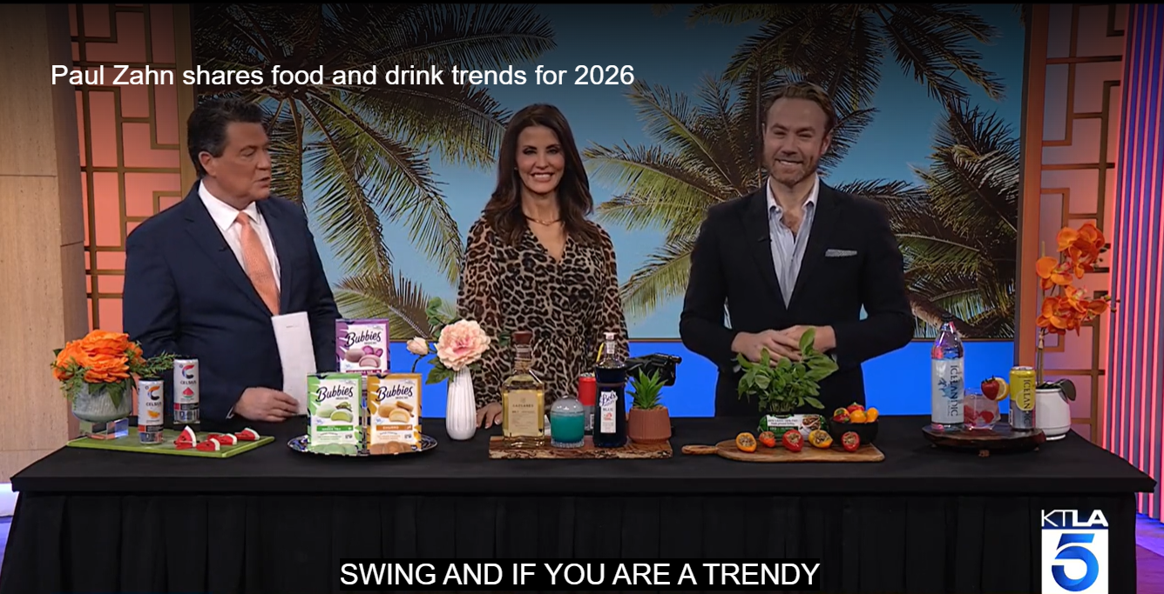
Top Media Highlights - Liqueurs
Date: 3/18/2026
Online Visits: 215,994
Link
Date: 1/16/2026
Online Visits: 5,150,657
Link
Date: 12/19/2025
Online Visits: 1,650,448
Link
Notes:
https://www.insidehook.com/spirits/muff-liquor-company-gin-vodka-irish-whiskey-review
https://robbreport.com/food-drink/spirits/gallery/best-irish-whiskey-brands-1235509136/redbreast_15/
https://www.wineenthusiast.com/toplists/100-best-spirits-of-2025/?srsltid=AfmBOorO2sIB5ICAsSpSH8R0rSM6ojZibx92BKoWPOGcl7b1v1JXbVt9
https://www.forbes.com/sites/hudsonlindenberger/2025/12/05/the-relentless-rise-of-muff-liquor-and-the-founder-who-refused-to-quit/
https://www.drinkhacker.com/2025/04/10/review-the-muff-irish-vodka-gin-and-whiskey/
https://ftw.usatoday.com/story/entertainment/pop-culture/2025/03/14/best-irish-whiskeys-st-patricks-day-guide-jameson-natterjack/81960562007/#
https://www.themanual.com/food-and-drink/muff-liquor-company/#dt-heading-where-can-i-buy-them

Slide 6


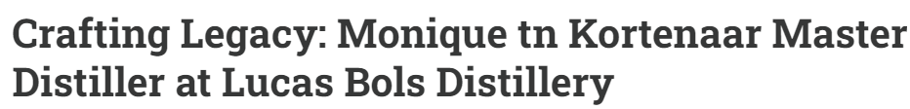

Top Media Highlights (Podcasts)
Date: 6/24/2025
Listenership: 20,000
Link
Date: 6/6/2025
Listenership: 5,000
Link
Notes:
https://www.insidehook.com/spirits/muff-liquor-company-gin-vodka-irish-whiskey-review
https://robbreport.com/food-drink/spirits/gallery/best-irish-whiskey-brands-1235509136/redbreast_15/
https://www.wineenthusiast.com/toplists/100-best-spirits-of-2025/?srsltid=AfmBOorO2sIB5ICAsSpSH8R0rSM6ojZibx92BKoWPOGcl7b1v1JXbVt9
https://www.forbes.com/sites/hudsonlindenberger/2025/12/05/the-relentless-rise-of-muff-liquor-and-the-founder-who-refused-to-quit/
https://www.drinkhacker.com/2025/04/10/review-the-muff-irish-vodka-gin-and-whiskey/
https://ftw.usatoday.com/story/entertainment/pop-culture/2025/03/14/best-irish-whiskeys-st-patricks-day-guide-jameson-natterjack/81960562007/#
https://www.themanual.com/food-and-drink/muff-liquor-company/#dt-heading-where-can-i-buy-them

Slide 7



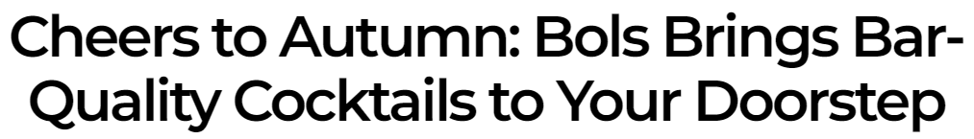
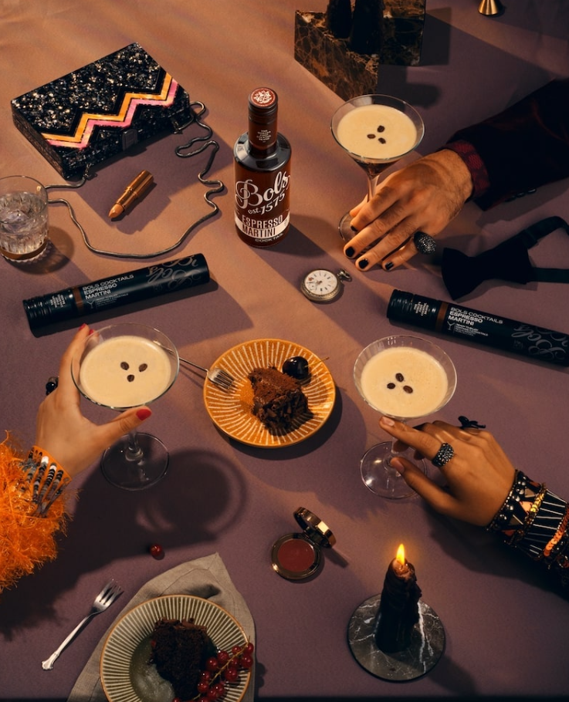

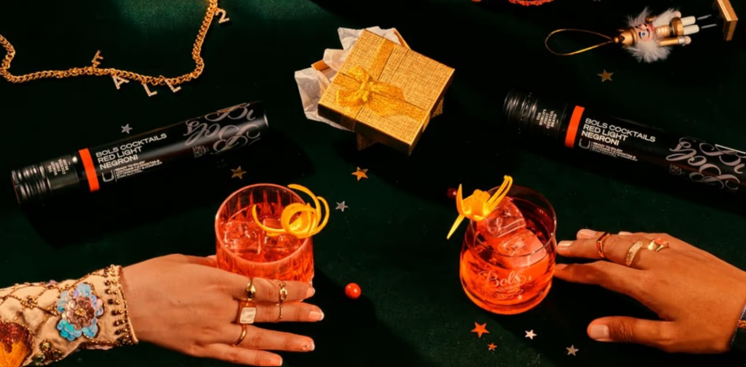
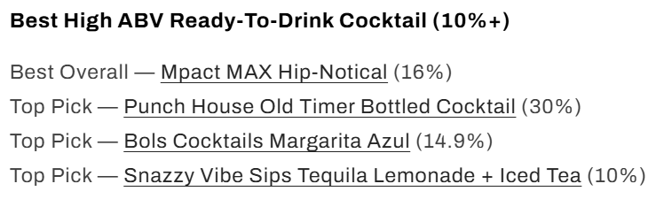
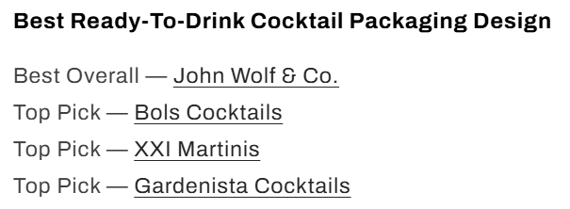
Top Media Highlights – RTE's
Date: 9/14/2024
Online Visits: 1,450,675
Link
Date: 10/28/2024
Online Visits: 212,241
Link
Date: 3/5/2026
Online Visits: 23,605
Link
Notes:
https://www.insidehook.com/spirits/muff-liquor-company-gin-vodka-irish-whiskey-review
https://robbreport.com/food-drink/spirits/gallery/best-irish-whiskey-brands-1235509136/redbreast_15/
https://www.wineenthusiast.com/toplists/100-best-spirits-of-2025/?srsltid=AfmBOorO2sIB5ICAsSpSH8R0rSM6ojZibx92BKoWPOGcl7b1v1JXbVt9
https://www.forbes.com/sites/hudsonlindenberger/2025/12/05/the-relentless-rise-of-muff-liquor-and-the-founder-who-refused-to-quit/
https://www.drinkhacker.com/2025/04/10/review-the-muff-irish-vodka-gin-and-whiskey/
https://ftw.usatoday.com/story/entertainment/pop-culture/2025/03/14/best-irish-whiskeys-st-patricks-day-guide-jameson-natterjack/81960562007/#
https://www.themanual.com/food-and-drink/muff-liquor-company/#dt-heading-where-can-i-buy-them

Slide 8
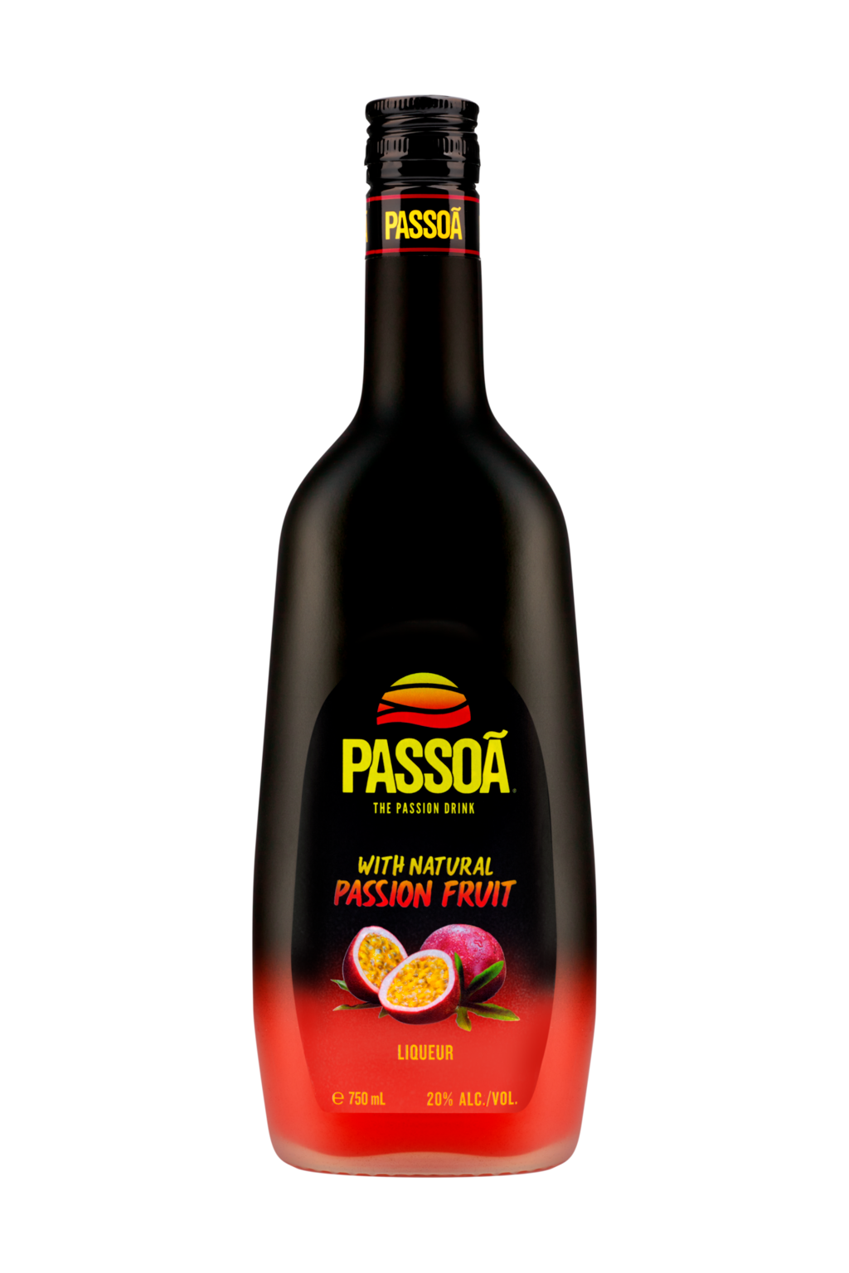

Top Media
Hits Recap

Slide 9



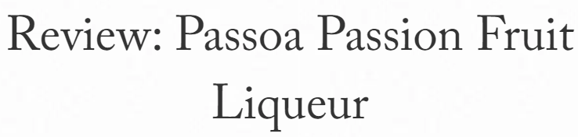
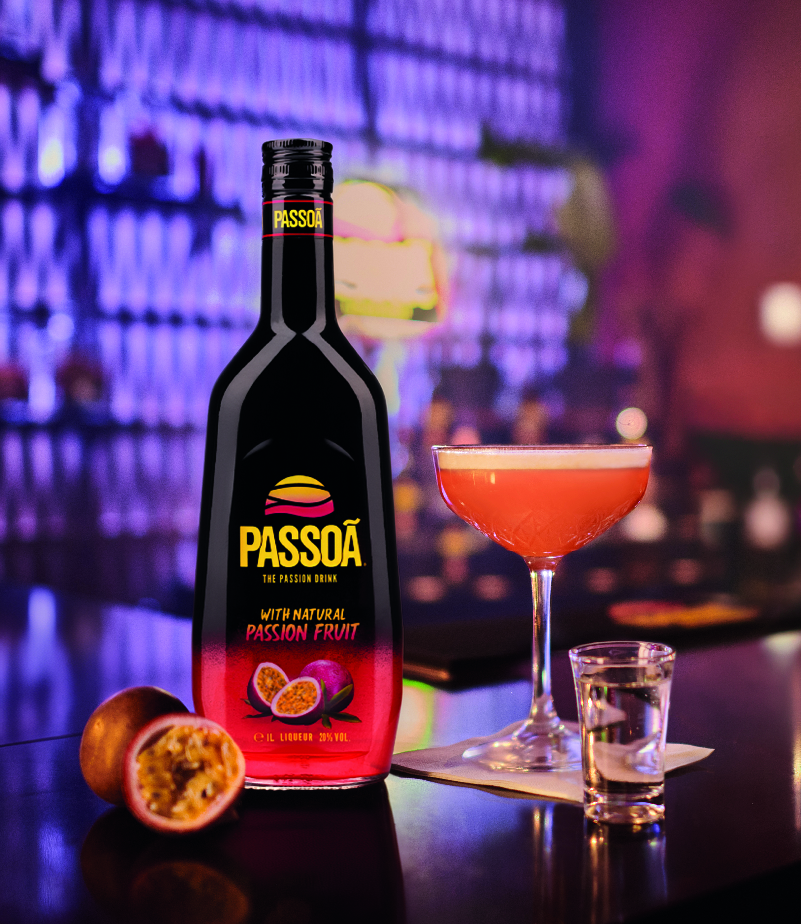
Top Media Highlights
Date: 2/12/2026
Online Visits: 2,690,996
Link
Date: 3/16/2026
Online Visits: 782,202
Link
Date: 4/30/2026
Online Visits: 273,017
Link

Slide 10





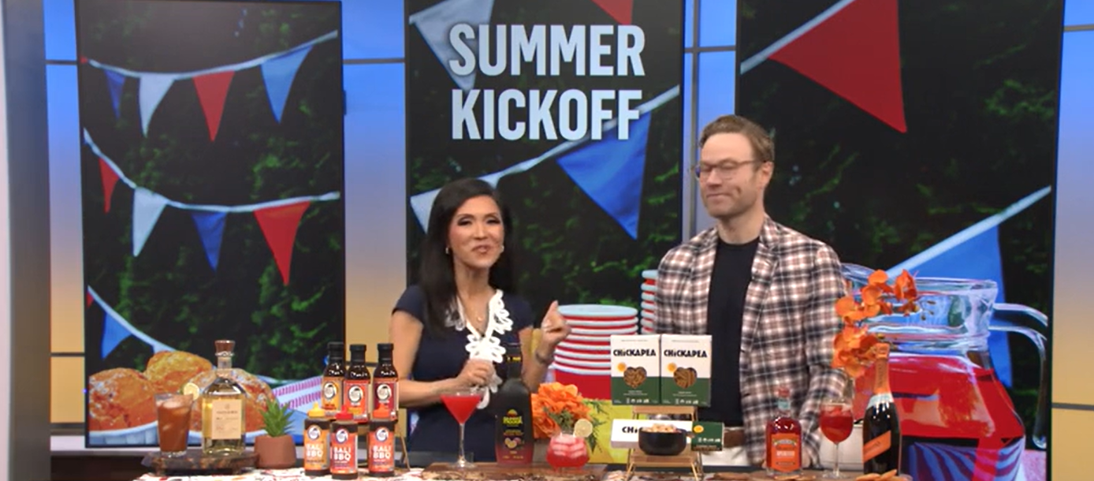

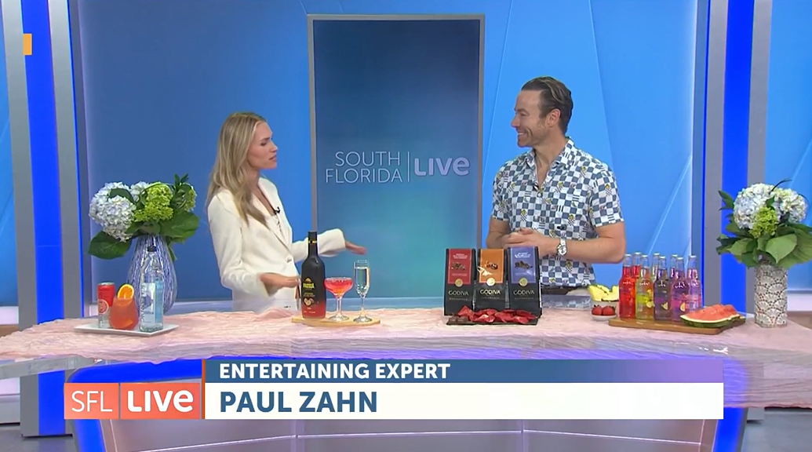
Top Media Highlights
Date: 5/6/2026
Online Visits: 10,030,000
Link
Date: 5/17/2026
Online Visits: 44,828,867
Link
Date: 5/26/2026
Online Visits: 7,465,000
Link

Slide 11

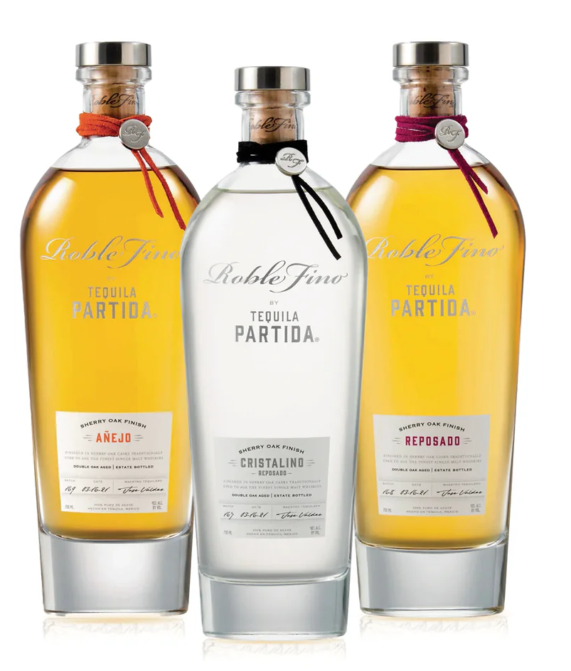
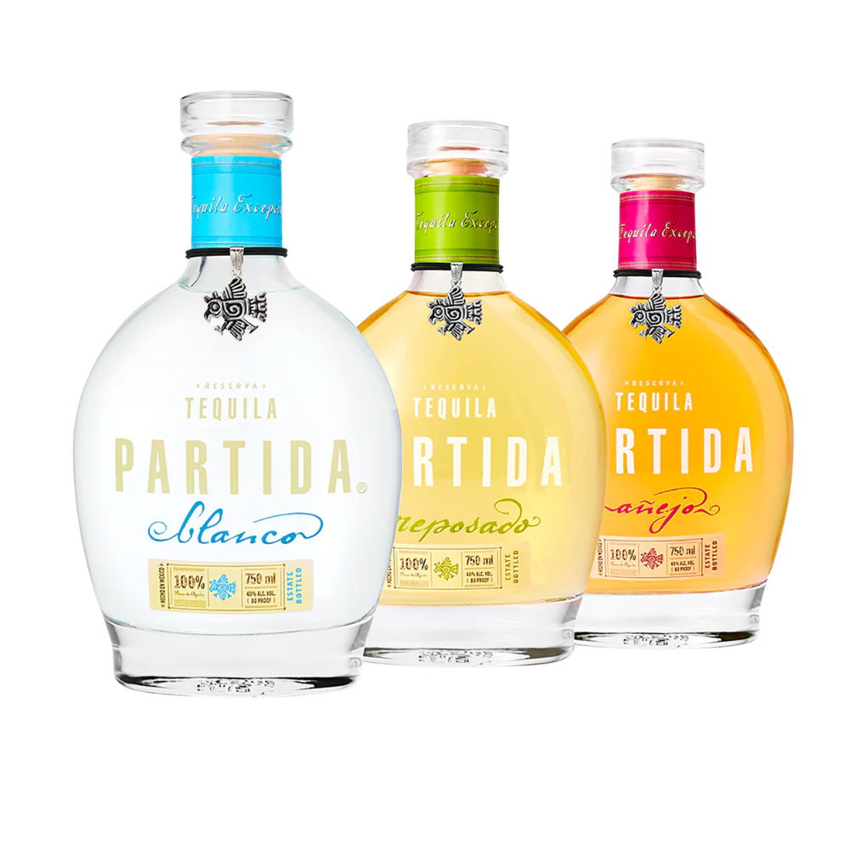
Top Media
Hits Recap

Slide 12



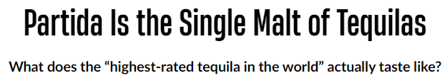

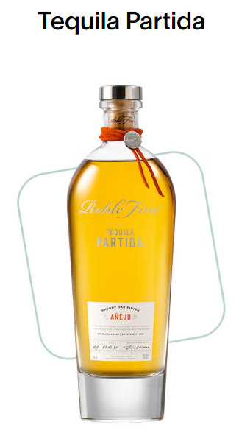

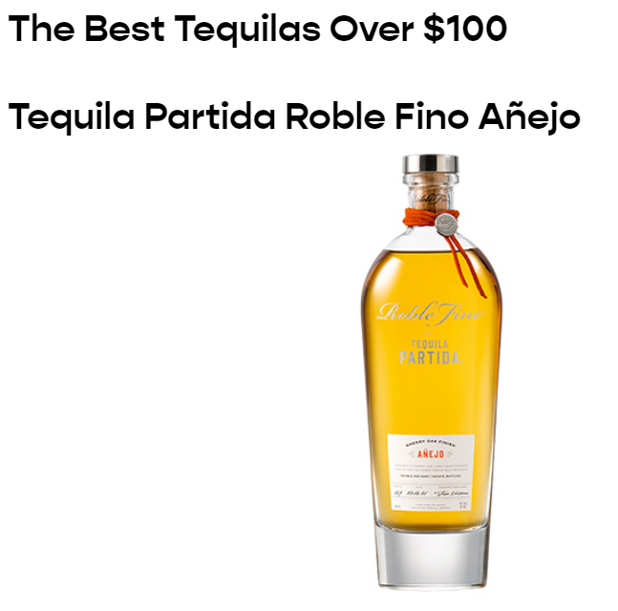
Top Media Highlights
Date: 3/21/2025
Online Visits: 12,883,348
Link
Date: 5/1/2025
Online Visits: 829,906
Link
Date: 4/30/2025
Online Visits: 785,423
Link

Slide 13



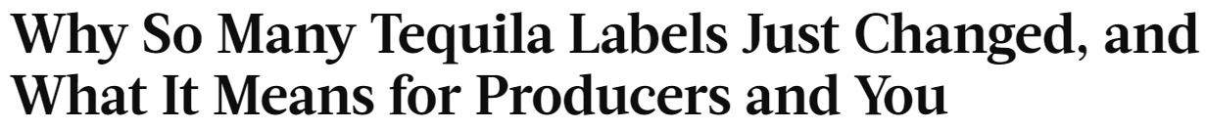

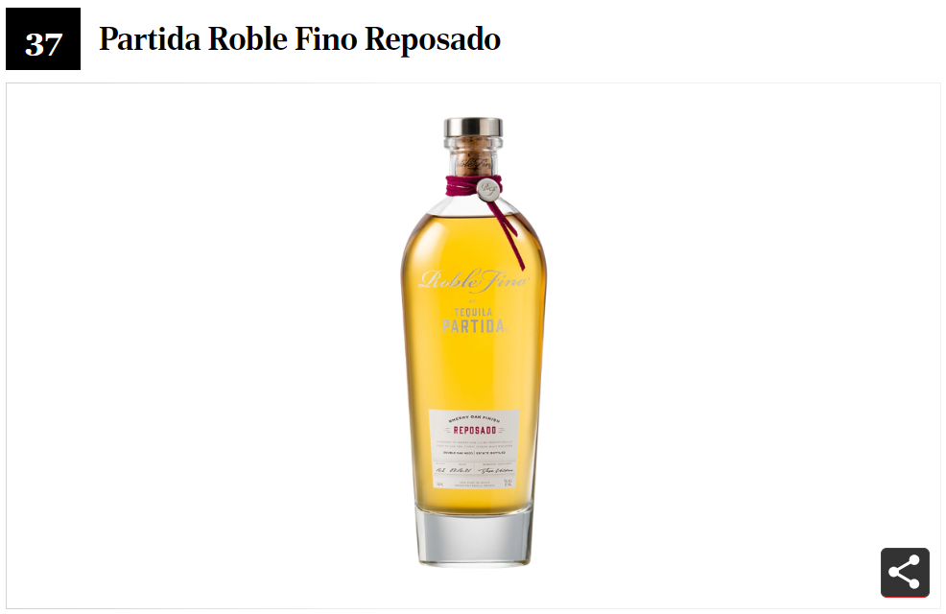
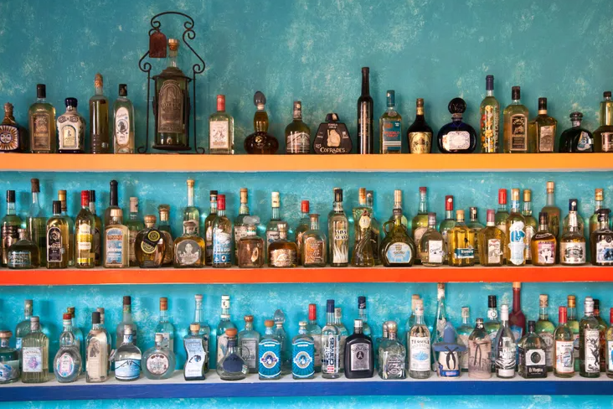
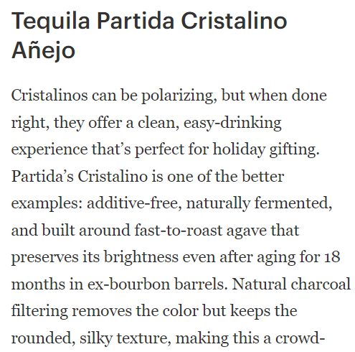
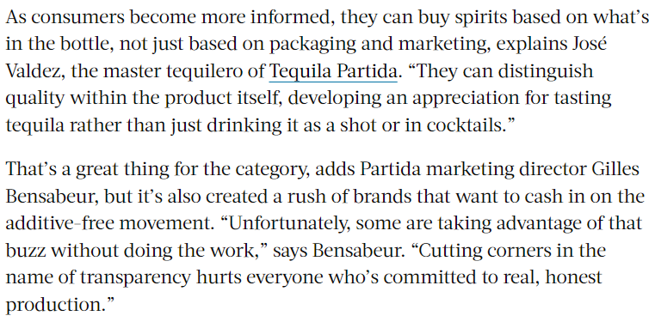
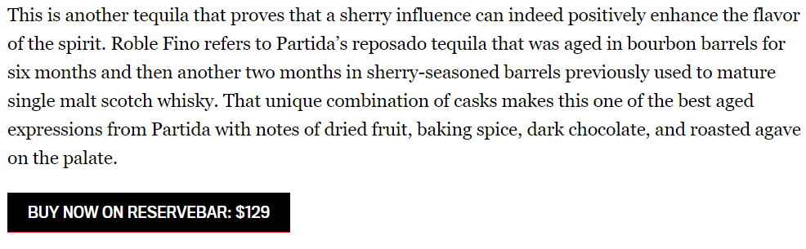
Top Media Highlights
Date: 12/9/2025
Online Visits: 50,739,115
Link
Date: 4/29/2025
Online Visits: 1,861,181
Link
Date: 11/13/2025
Online Visits: 10,093,996
Link

Slide 14


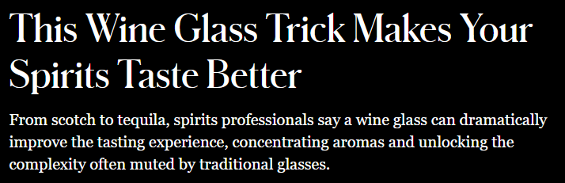


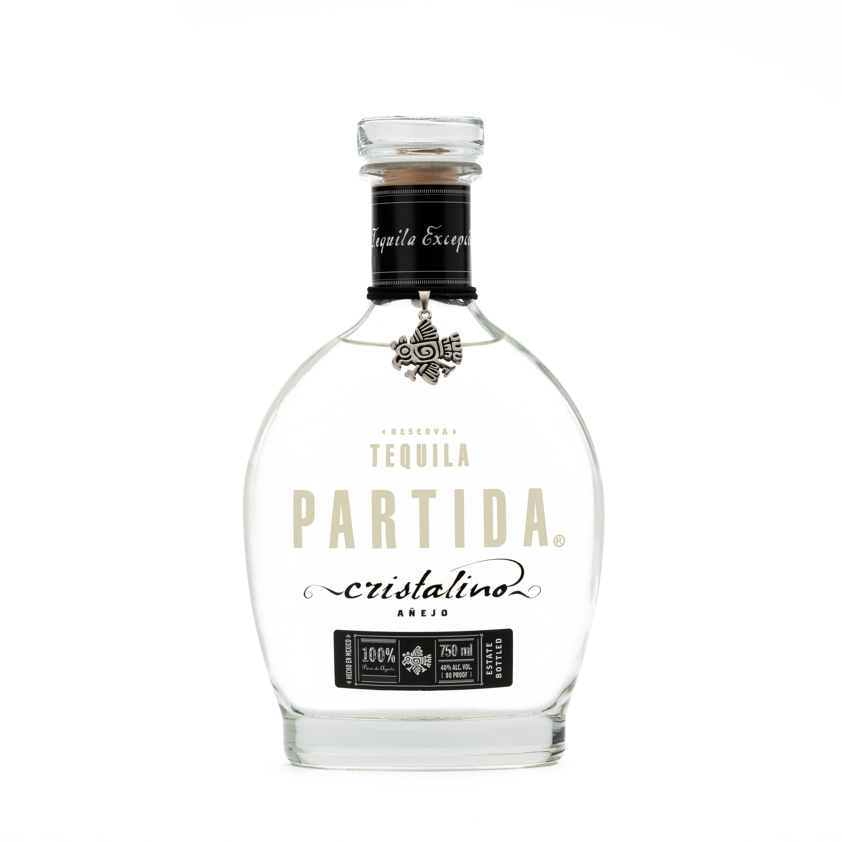
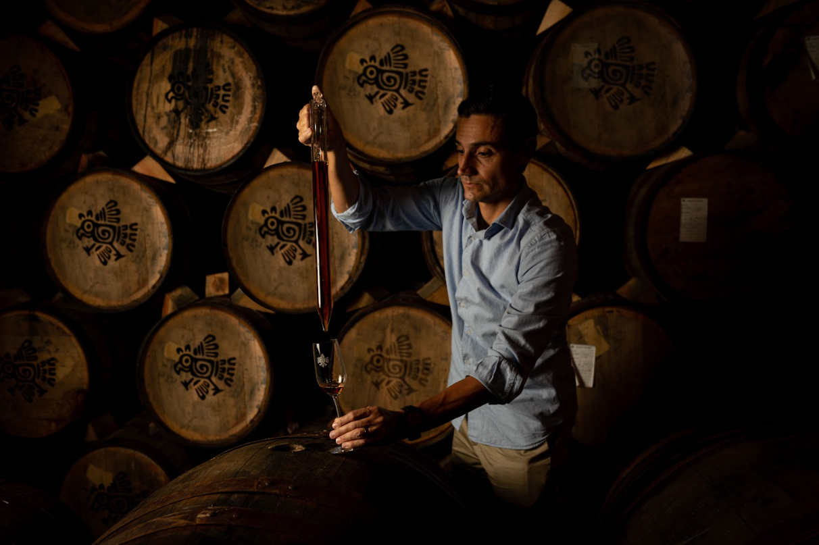
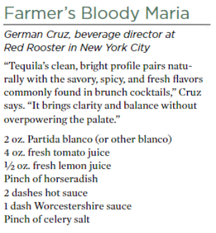
Top Media Highlights
Date: 4/29/2026
Online Visits: 627,074
Link
Date: 3/7/2026
Online Visits: 58,739,060
Link
Date: Spring 2026 Issue
Circulation: 1,065,000
Link

Slide 15



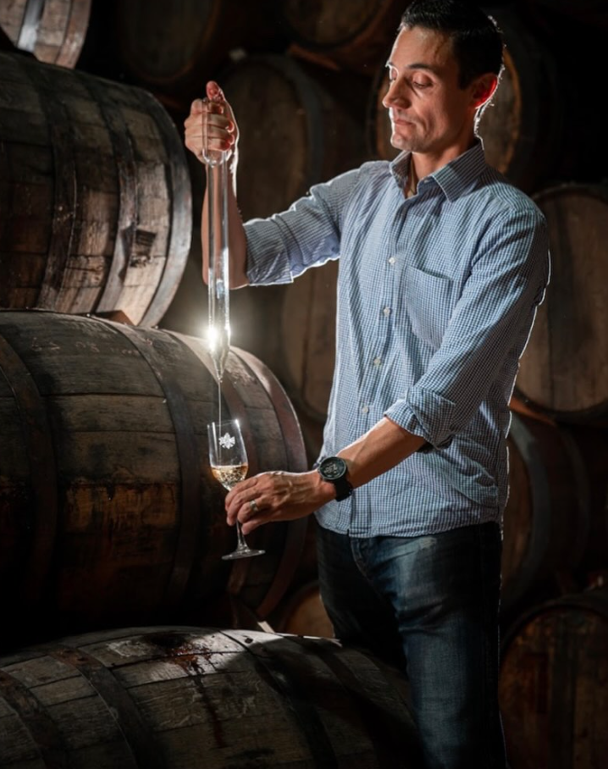
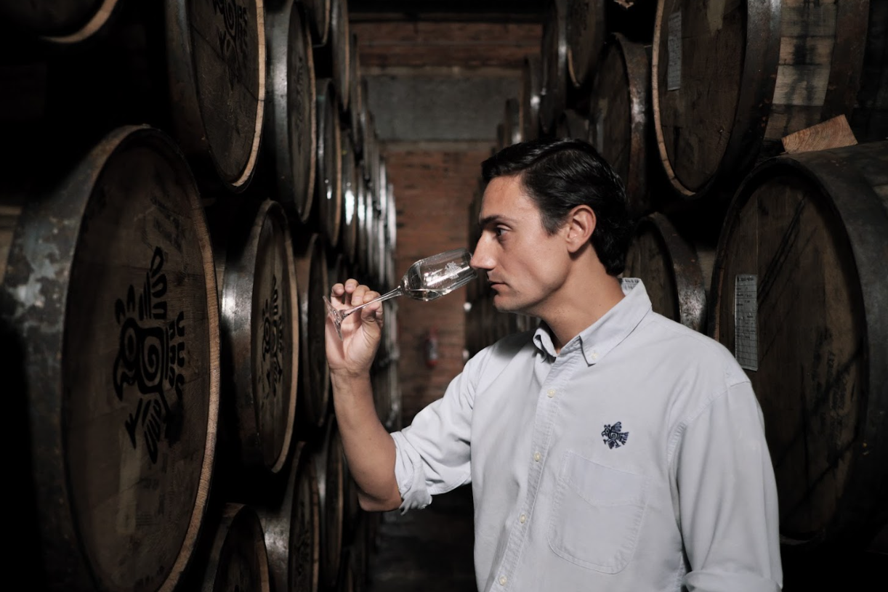
Top Media Highlights (Podcasts)
Date: 6/9/2025
Listenership: 5,000
Link
Date: 5/8/2025
Followers: 437
Link
Date: 12/12/2024
Listenership: 20,000
Link
Notes:
https://www.insidehook.com/spirits/muff-liquor-company-gin-vodka-irish-whiskey-review
https://robbreport.com/food-drink/spirits/gallery/best-irish-whiskey-brands-1235509136/redbreast_15/
https://www.wineenthusiast.com/toplists/100-best-spirits-of-2025/?srsltid=AfmBOorO2sIB5ICAsSpSH8R0rSM6ojZibx92BKoWPOGcl7b1v1JXbVt9
https://www.forbes.com/sites/hudsonlindenberger/2025/12/05/the-relentless-rise-of-muff-liquor-and-the-founder-who-refused-to-quit/
https://www.drinkhacker.com/2025/04/10/review-the-muff-irish-vodka-gin-and-whiskey/
https://ftw.usatoday.com/story/entertainment/pop-culture/2025/03/14/best-irish-whiskeys-st-patricks-day-guide-jameson-natterjack/81960562007/#
https://www.themanual.com/food-and-drink/muff-liquor-company/#dt-heading-where-can-i-buy-them

Slide 16
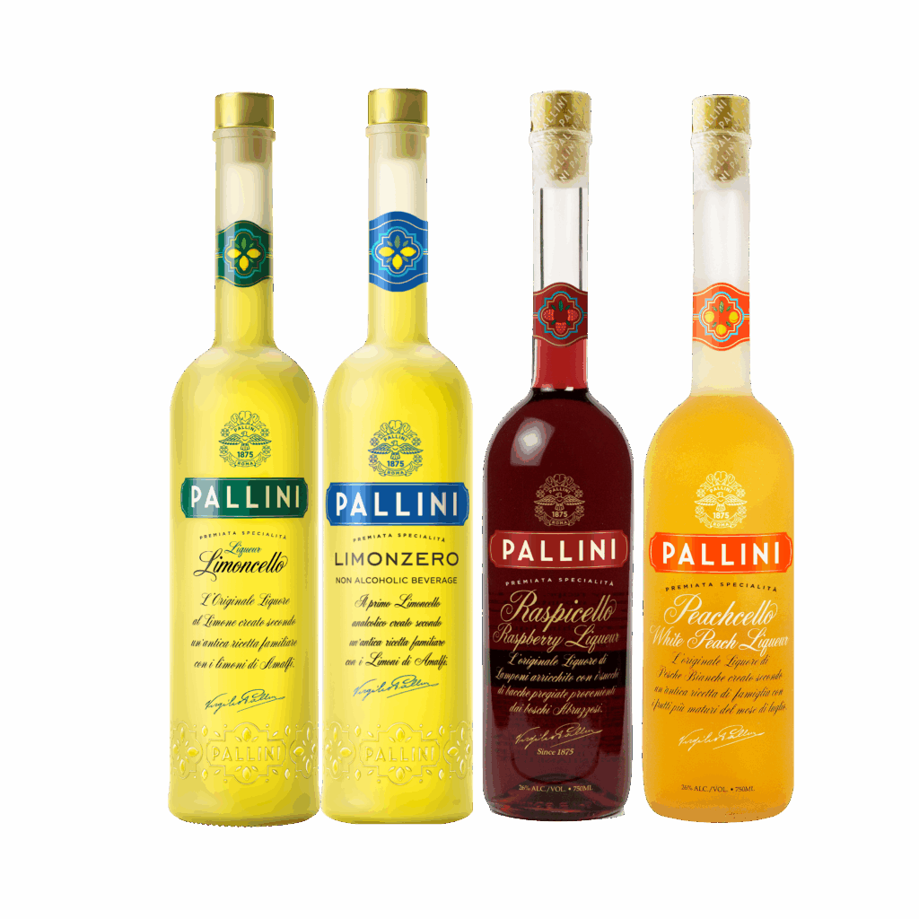
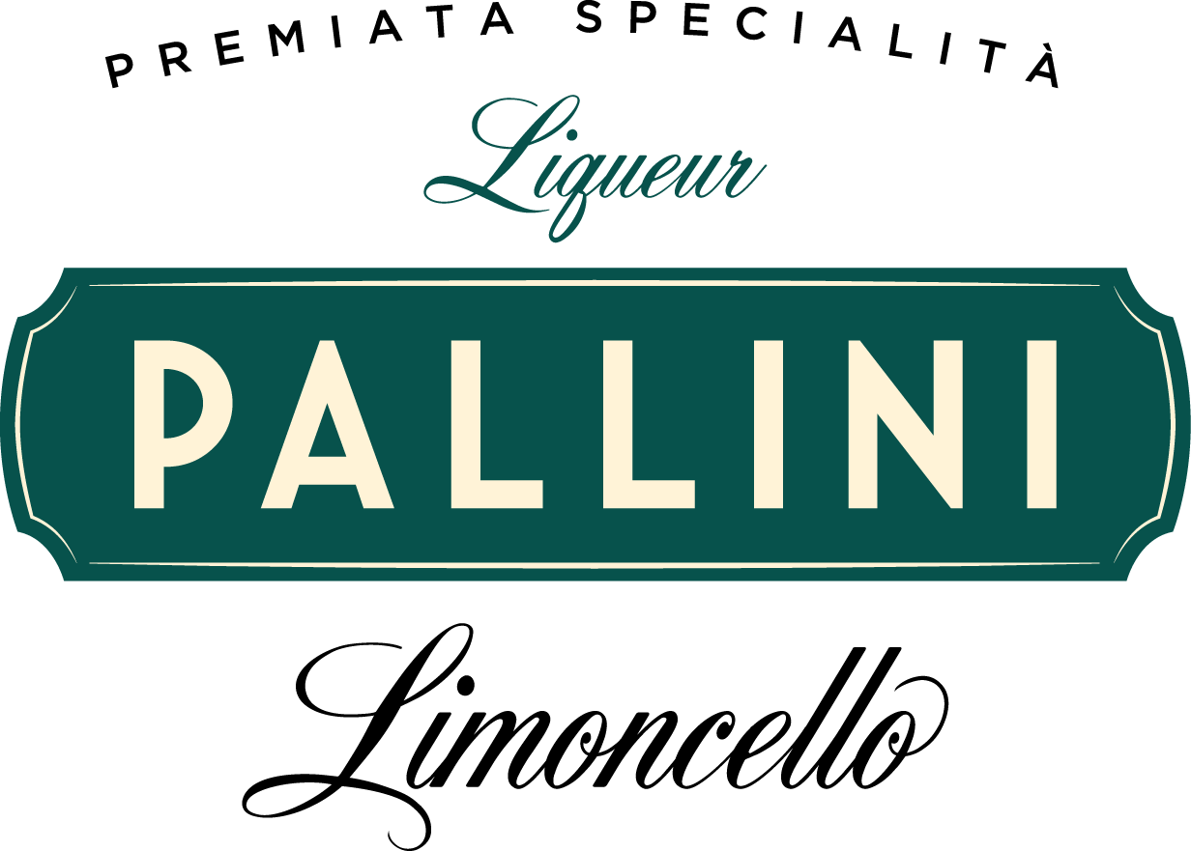
Top Media
Hits Recap

Slide 17



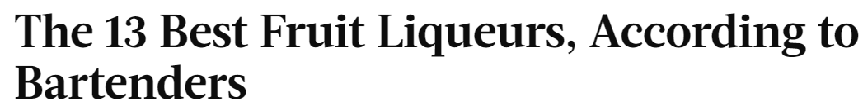
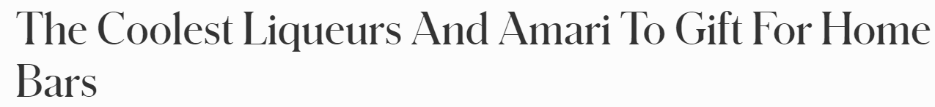

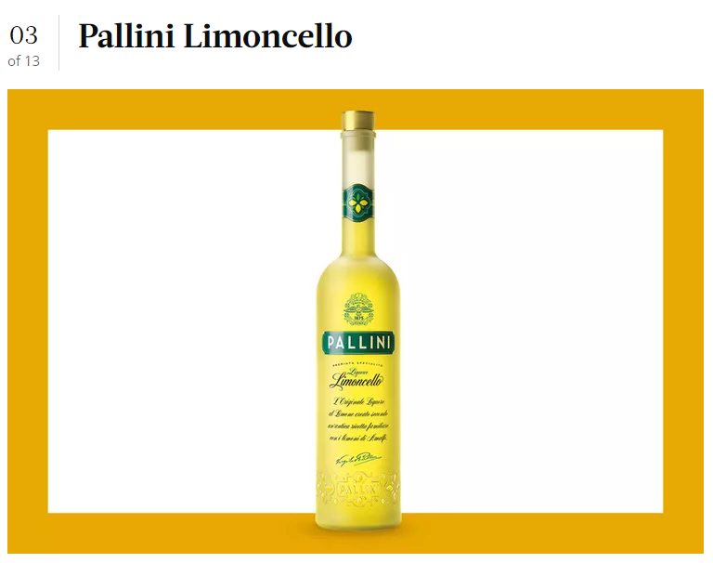
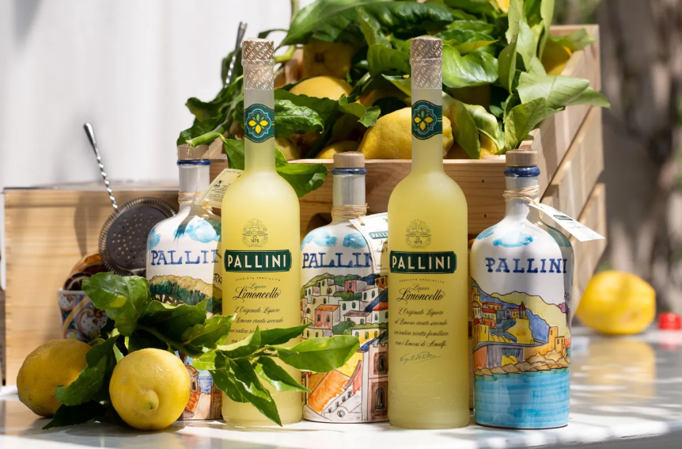
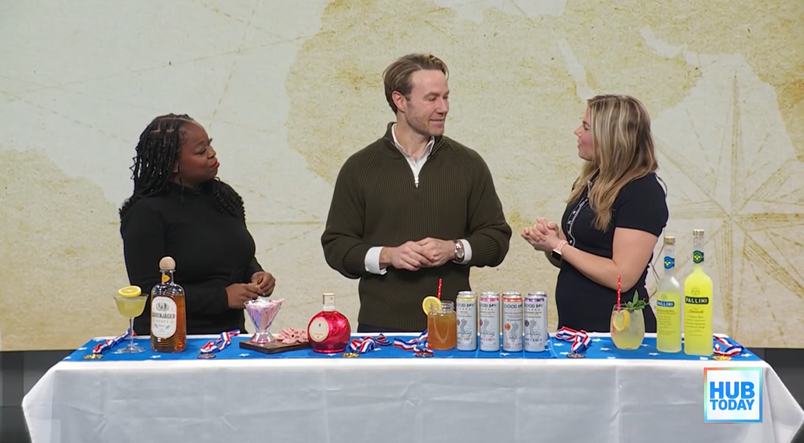
Top Media Highlights
Date: 11/23/2025
Online Visits: 50,739,115
Link
Date: 5/13/2025
Online Visits: 10,093,996
Link
Date: 2/25/2026
Online Visits: 2,087,000
Link

Slide 18




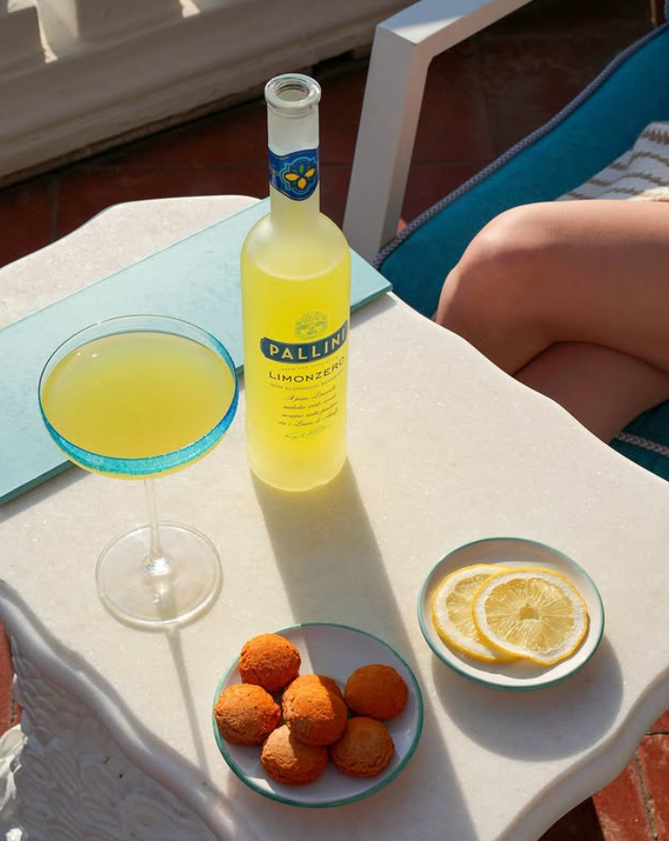
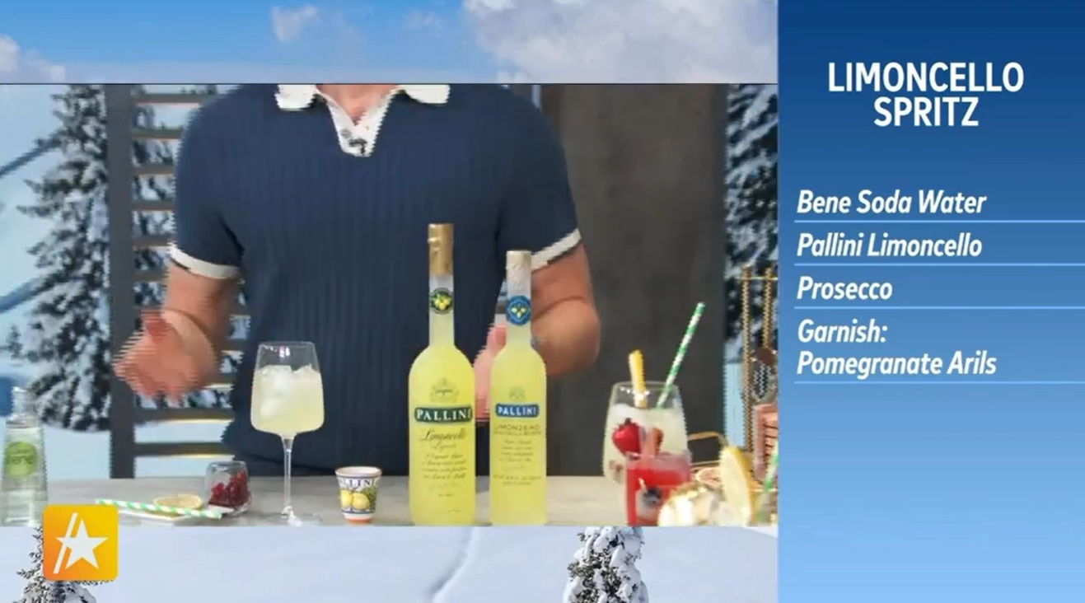
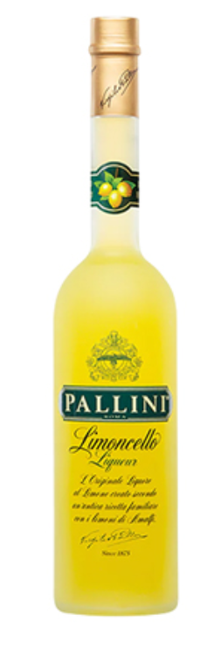
Top Media Highlights
Date: 12/24/2024
Online Visits: 829,906
Link
Date: 12/30/2024
Online Visits: 21,636,585
Link
Date: 2/6/2026
Viewership: 1,500,000
Link

Slide 19








Top Media Highlights
Date: 2/5/2026
Online Visits: 1,500,000
Link
Date: 4/27/2026
Online Visits: 273,017
Link
Date: 4/16/2025
Online Visits: 50,739,115
Link

Slide 20


Top Media
Hits Recap

Slide 21









Top Media Highlights
Date: 10/24/2025
Online Visits: 12,883,348
Link
Date: 12/9/2025
Online Visits: 10,093,996
Link
Date: 11/13/2025
Online Visits: 50,739,115
Link

Slide 22








Top Media Highlights
Date: 3/18/2025
Online Visits: 5,514,941
Link
Date: 2/25/2026
Online Visits: 622,975
Link
Date: 4/23/2026
Online Visits: 14,920,166
Link

Slide 23






Top Media Highlights
Date: 12/24/2024
Online Visits: 829,906
Link
Date: 10/1/2024
Online Visits: 58,739,060
Link
Date: 2/5/2026
Online Visits: 829,906
Link

Slide 24


Top Media
Hits Recap

Slide 25







Top Media Highlights
Date: 12/31/2025
Online Visits: 50,739,115
Link
Date: 12/30/2024
Online Visits: 21,636,585
Link
Date: 2/23/2026
Online Visits: 78,566
Link

Slide 26






Top Media Highlights
Date: 5/1/2026
Online Visits: 92,566
Link
Date: 6/22/2026
Online Visits: 2,421,138
Link
Date: February 2026 Issue
Circulation: 50,000
Link

Slide 27


Top Media
Hits Recap

Slide 28









Top Media Highlights
Date: 11/23/2025
Online Visits: 50,739,115
Link
Date: 1/29/2026
Circulation: 66,000
Link
Date: 2/11/2026
Online Visits: 52,784
Link

Slide 29


Top Media
Hits Recap

Slide 30







Top Media Highlights
Date: 2/25/2025
Online Visits: 1,861,181
Link
Date: December 2025
Online Visits: 782,202
Link
Date: 12/5/2025
Online Visits: 50,739,115
Link

Slide 31








Top Media Highlights
Date: 2/12/2025
Online Visits: 785,423
Link
Date: 12/1/2024
Online Visits: 156,188
Link
Date: 2/20/2026
Online Visits: 58,739,060
Link
Notes:
https://www.insidehook.com/spirits/muff-liquor-company-gin-vodka-irish-whiskey-review
https://robbreport.com/food-drink/spirits/gallery/best-irish-whiskey-brands-1235509136/redbreast_15/
https://www.wineenthusiast.com/toplists/100-best-spirits-of-2025/?srsltid=AfmBOorO2sIB5ICAsSpSH8R0rSM6ojZibx92BKoWPOGcl7b1v1JXbVt9
https://www.forbes.com/sites/hudsonlindenberger/2025/12/05/the-relentless-rise-of-muff-liquor-and-the-founder-who-refused-to-quit/
https://www.drinkhacker.com/2025/04/10/review-the-muff-irish-vodka-gin-and-whiskey/
https://ftw.usatoday.com/story/entertainment/pop-culture/2025/03/14/best-irish-whiskeys-st-patricks-day-guide-jameson-natterjack/81960562007/#
https://www.themanual.com/food-and-drink/muff-liquor-company/#dt-heading-where-can-i-buy-them

Slide 32






Top Media Highlights
Date: 3/7/2026
Online Visits: 1,659,513
Link
Date: 3/6/2026
Online Visits: 738,236
Link
Date: 3/11/2026
Online Visits: 627,074
Link
Notes:
https://www.insidehook.com/spirits/muff-liquor-company-gin-vodka-irish-whiskey-review
https://robbreport.com/food-drink/spirits/gallery/best-irish-whiskey-brands-1235509136/redbreast_15/
https://www.wineenthusiast.com/toplists/100-best-spirits-of-2025/?srsltid=AfmBOorO2sIB5ICAsSpSH8R0rSM6ojZibx92BKoWPOGcl7b1v1JXbVt9
https://www.forbes.com/sites/hudsonlindenberger/2025/12/05/the-relentless-rise-of-muff-liquor-and-the-founder-who-refused-to-quit/
https://www.drinkhacker.com/2025/04/10/review-the-muff-irish-vodka-gin-and-whiskey/
https://ftw.usatoday.com/story/entertainment/pop-culture/2025/03/14/best-irish-whiskeys-st-patricks-day-guide-jameson-natterjack/81960562007/#
https://www.themanual.com/food-and-drink/muff-liquor-company/#dt-heading-where-can-i-buy-them

