Slide 1



SALES ONBOARDING
TOOLKIT
2026

Slide 2



CREATING GREAT COCKTAIL EXPERIENCES AROUND THE WORLD
FOR 450 YEARS, SINCE 1575

Slide 3
LIMONCELLO
SALES ONBOARDING TOOLKIT
CONTEXT & PURPOSE
The following slides bring together the most impactful LBUSA sales tools designed to help distributor teams win more placements, activate faster, and drive incremental growth across priority brands.
This toolkit is built to:
Onboard new distributor teams quickly and confidently
Equip current teams with the right tools to win in market
Provide access to best-in-class tools that drive execution and growth
All thumbnails are hyperlinked to live files on the LBUSA Trade Portal for immediate use in presentations, planning, and customer conversations.

Slide 4
LIMONCELLO
SALES ONBOARDING TOOLKIT
HOW TO USE THIS TOOLKIT
1. BUILD THE STORY (SELL)
→ BRANDS & PLANNING
Start here to build a strong, confident selling story and prepare for customer conversations.
Brand Catalog → Build compelling brand stories
JBP Template → Structure strategic customer proposals
Trade Portal → Access the tools and assets you need before any meeting
👉 Outcome: Walk in prepared with a clear story and plan
2. WIN THE MENU (PLACE & ACTIVATE)
→ ON PREMISE CHANNEL
Use these tools to secure menu placements, build cocktail programs, and activate in bar and restaurant accounts.
On Premise Strategy → Build compelling cocktail programs
Top 100 Cocktails → Sell into proven, high-demand serves
Ansira POS Portal / POS Tools → Support activation and drive visibility in account
👉 Outcome: Win placements and bring programs to life on-premise
3. WIN THE SHELF (PLACE & ACTIVATE)
→ OFF PREMISE CHANNEL
Use these tools to secure shelf space, displays, and retail activation in priority accounts.
Off Premise Strategy → Build compelling retail programs
Retail Standards → Strengthen shelf and display execution
Portfolio Retail Program → Unlock features and displays
👉 Outcome: Win the shelf, secure displays, and drive retail execution
4. PROVE & TRADE UP (CLOSE)
→ MEDIA & ACCOLADES
Use these tools to build credibility, justify price, and strengthen premium selling conversations.
Media Coverage → Reinforce your selling story with third-party validation
Media Highlights → Use high-impact proof points in presentations
Brand Accolades → Support trade-up and premium positioning
👉 Outcome: Strengthen your pitch and close with confidence

Slide 5
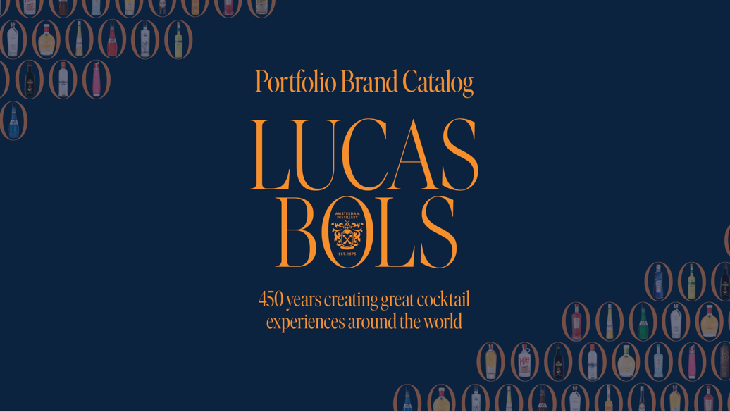
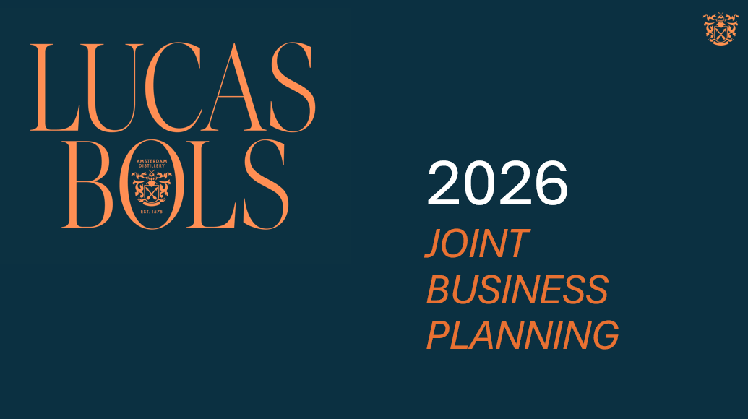
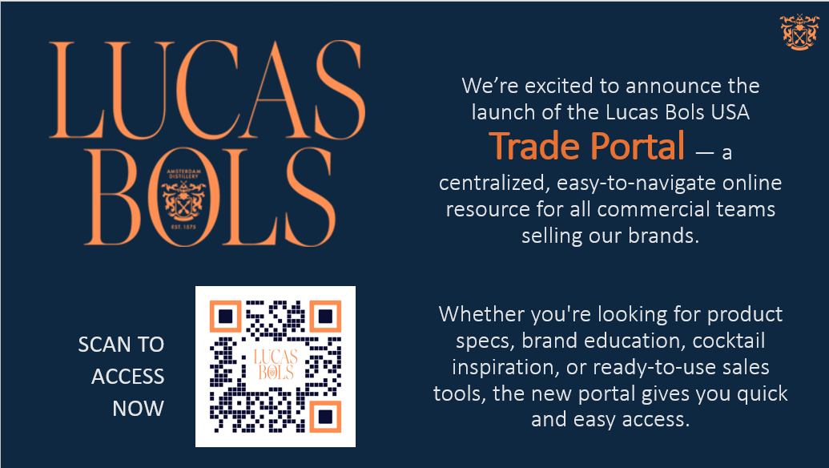
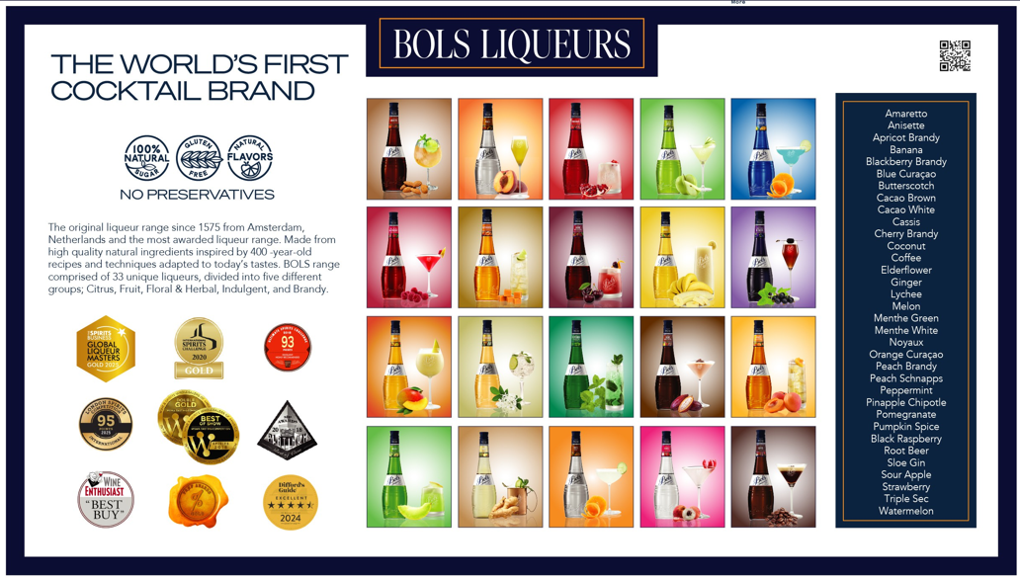
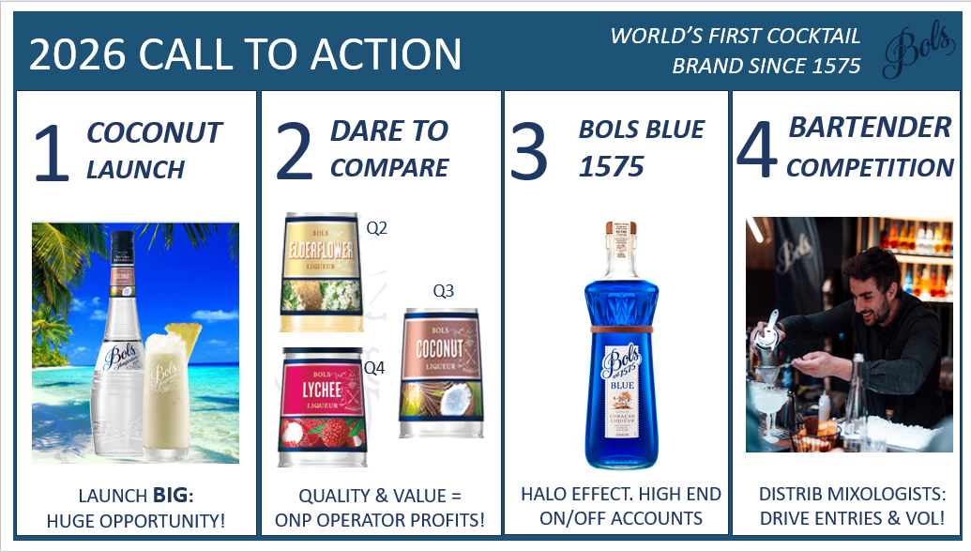
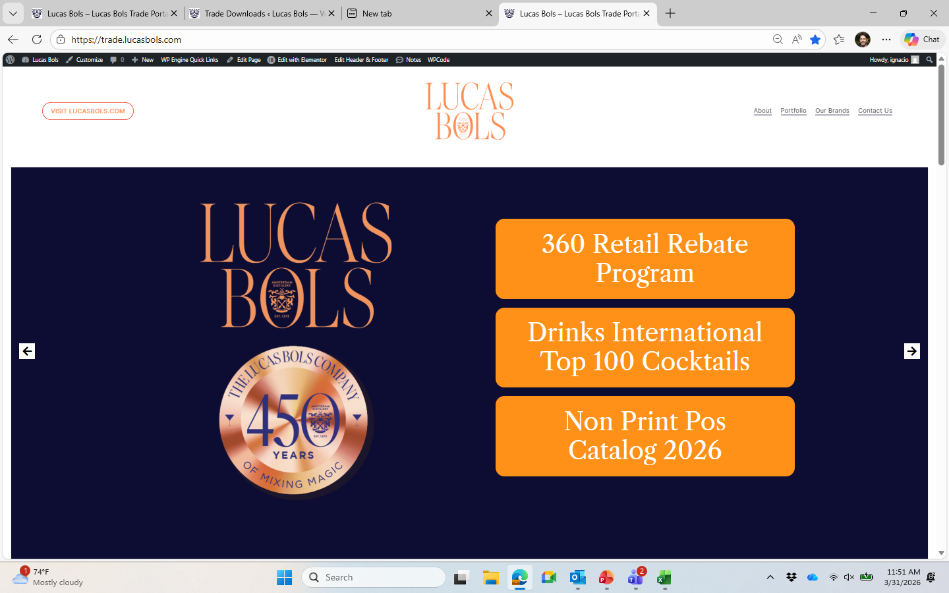
LIMONCELLO
BRANDS & PLANNING
Use these tools to build stronger selling stories, structure customer proposals, and anchor your plans in clear brand strategy
LBUSA BRAND CATALOG
Concise brand overviews with key selling points, credentials, and portfolio roles
→ Use to build compelling brand stories and confidently present the portfolio
LBUSA JBP TEMPLATE
Comprehensive 40-slide framework to develop local Joint Business Plans
→ Use to structure strategic, insight-led proposals that align with customers and unlock growth
LBUSA TRADE PORTAL
Central hub for all LBUSA selling tools, assets, and resources
→ Start here to access all tools and prepare for any customer interaction

Slide 6
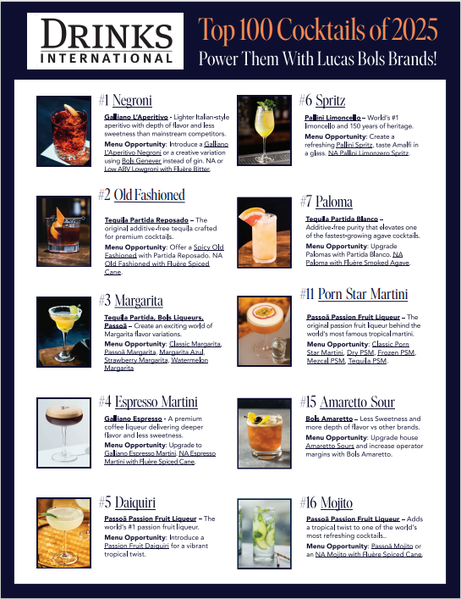
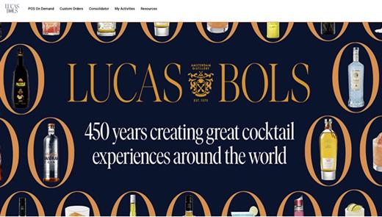
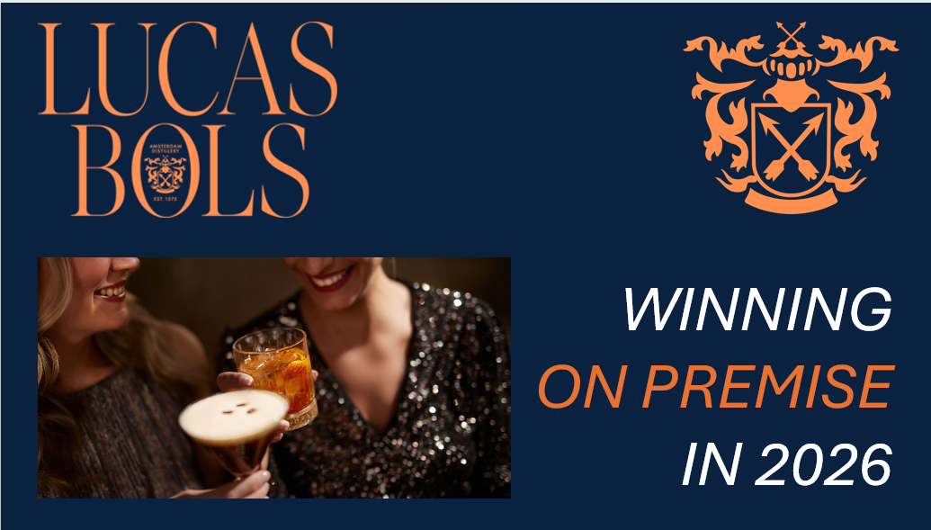
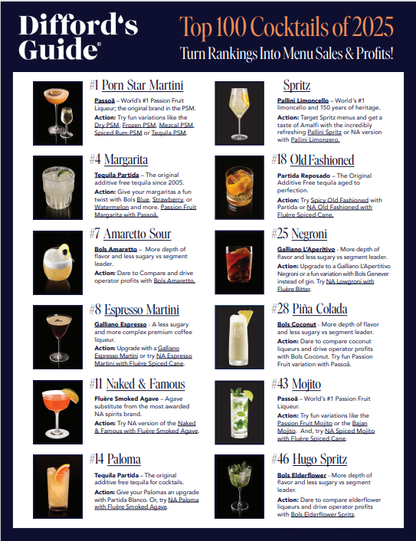
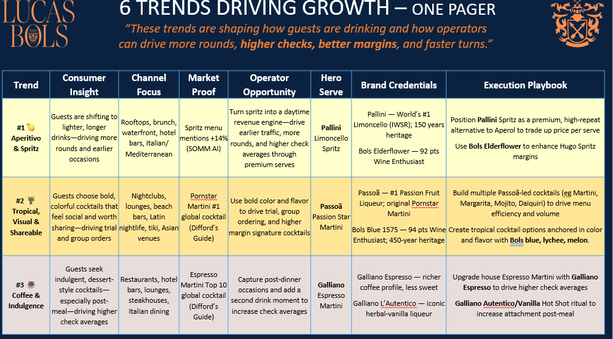
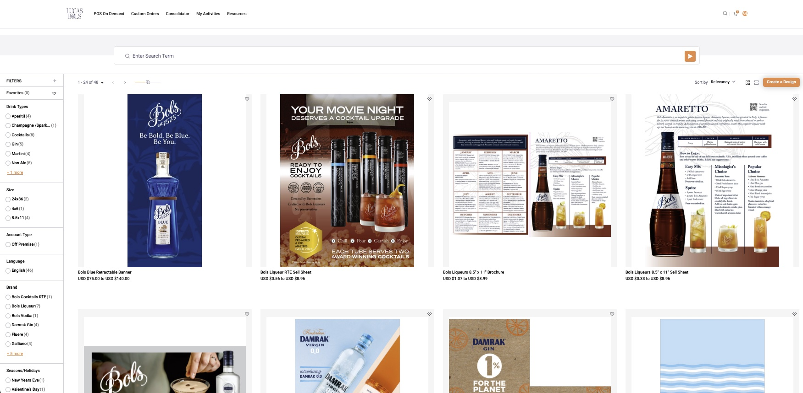
LIMONCELLO
ON PREMISE CHANNEL
Use these tools to win menu placements, build stronger cocktail programs, and drive rate of sale in bar & restaurant accounts
LBUSA ON PREMISE STRATEGY
Category opportunity + channel execution playbook
→ Use to build compelling cocktail programs and secure menu placements across priority accounts
TOP 100 COCKTAILS
Globally recognized cocktails (Difford’s Guide & Drinks International) with LBUSA brand recommendations
→ Use to sell into proven, high-demand cocktails with credibility and speed decision-making with buyers
ANSIRA POS PORTAL
Central platform to access and order POS materials across all brands
→ Use to activate displays, enhance visibility in-store, and convert shopper attention into purchase

Slide 7
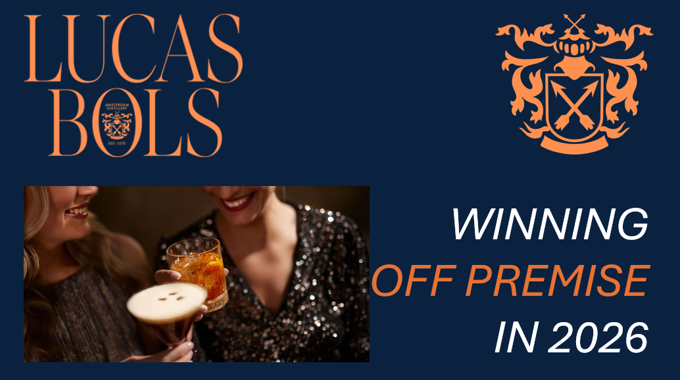
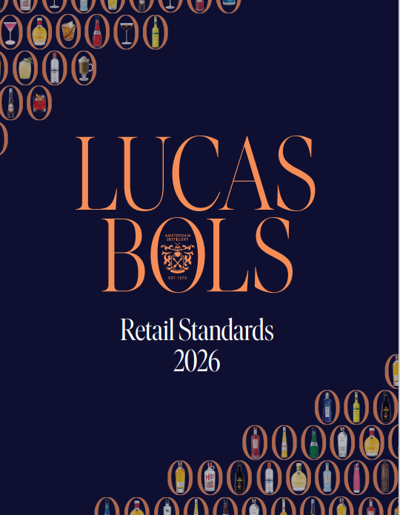
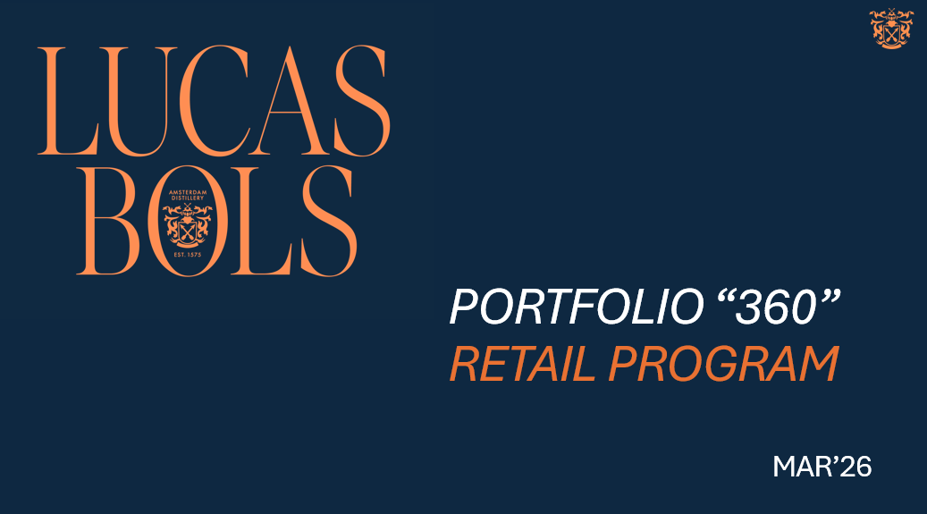
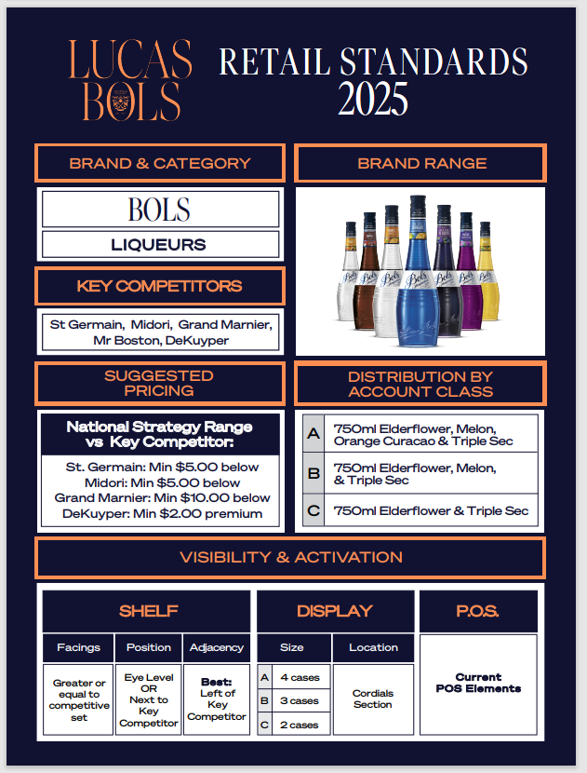
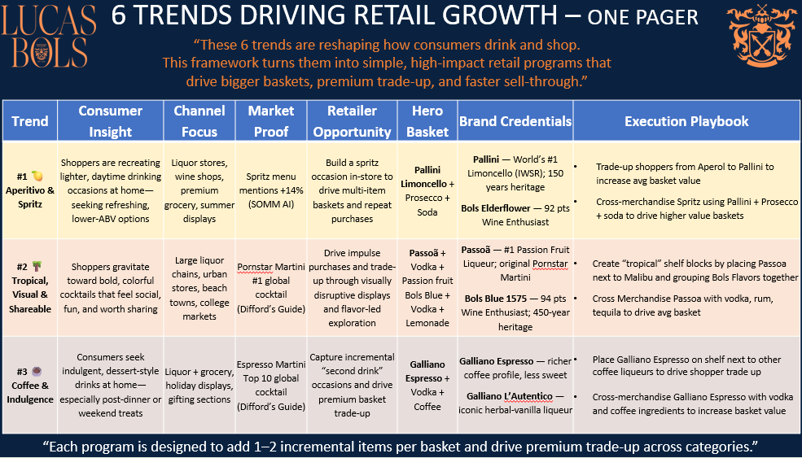
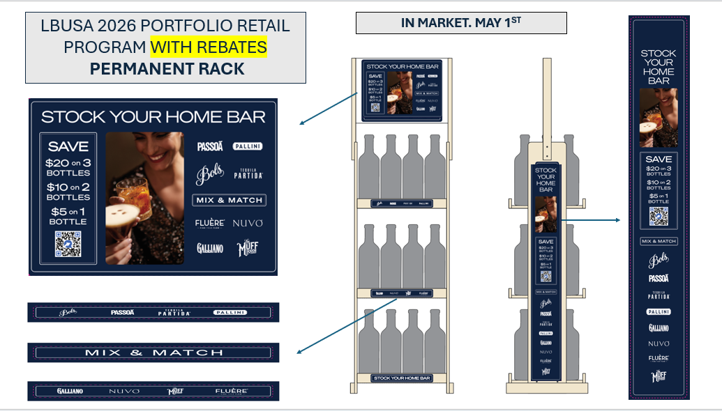
LIMONCELLO
OFF PREMISE CHANNEL
Use these tools to secure displays, improve shelf execution, and drive incremental volume across retail accounts
LBUSA OFF PREMISE STRATEGY
Category opportunity + channel execution playbook
→ Use to build compelling retail programs and secure placements & activation in priority accounts
LBUSA RETAIL STANDARDS
Guidelines for shelf, display, and pricing excellence across brands
→ Use to improve shelf presence, justify space, and ensure best-in-class execution in-store
LBUSA 360 RETAIL PROGRAM
Portfolio rebate program running through Dec 31, 2026
→ Use to unlock displays, secure features, and drive incremental volume

Slide 8
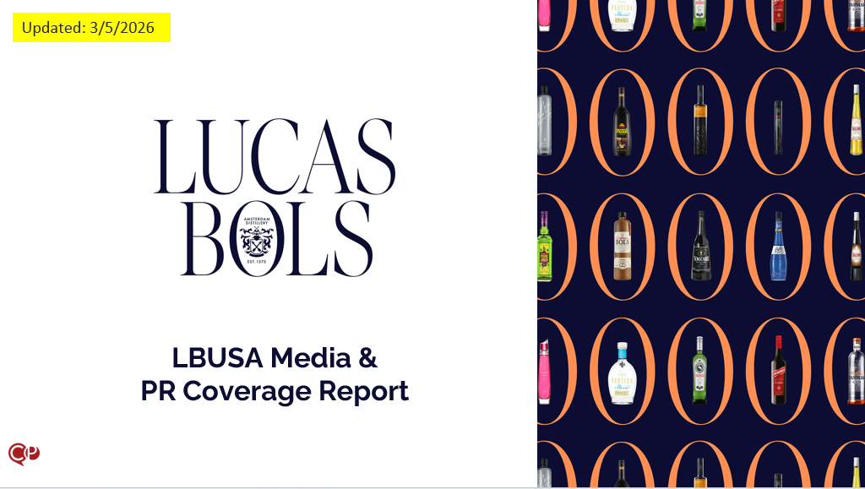
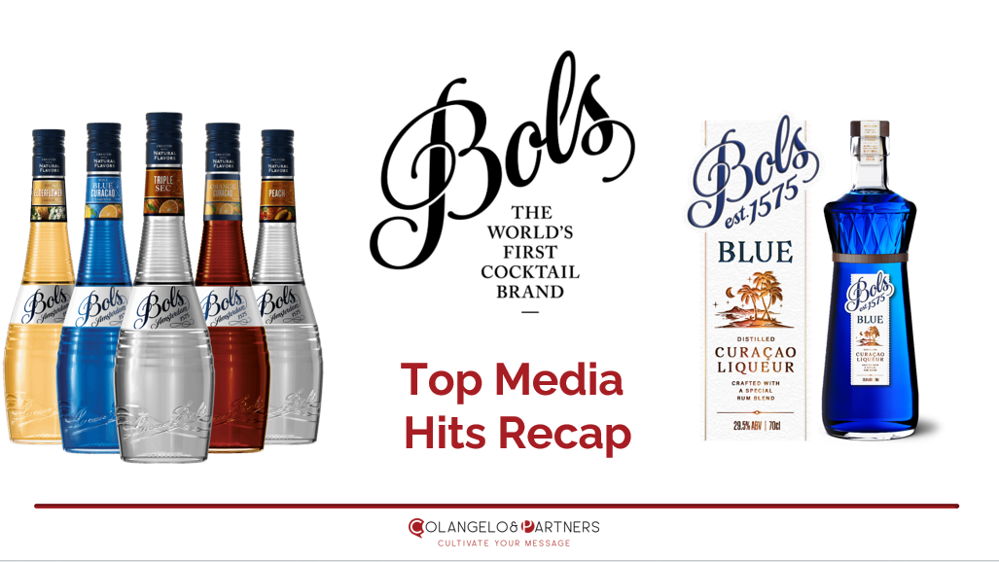
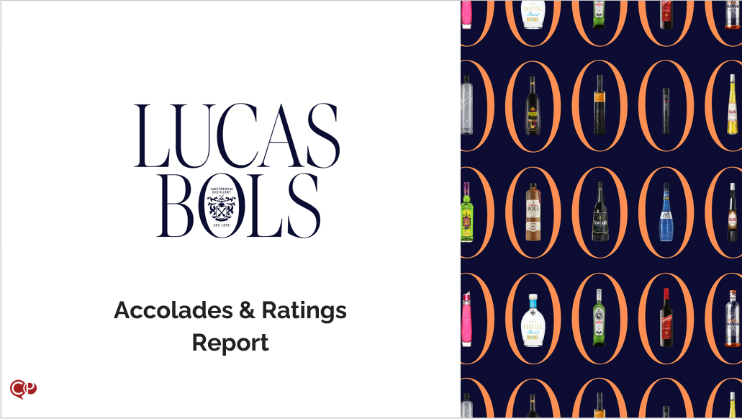
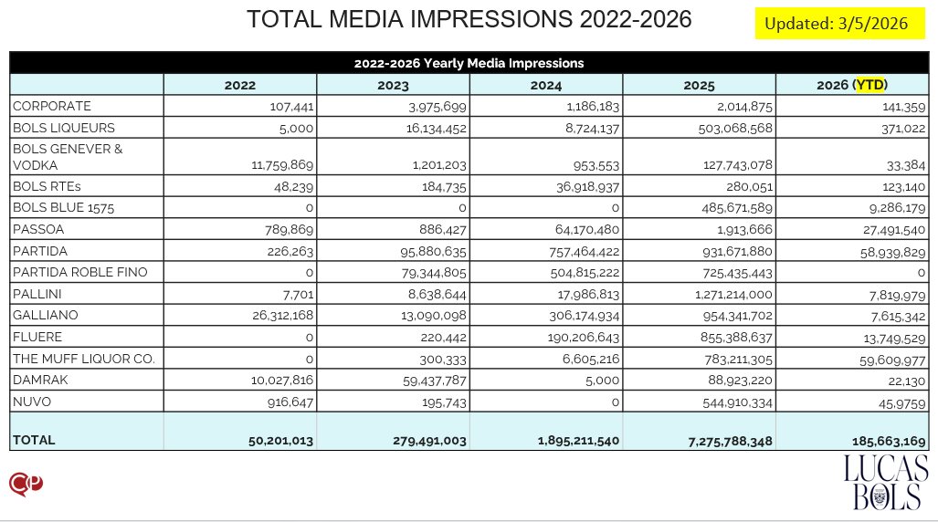
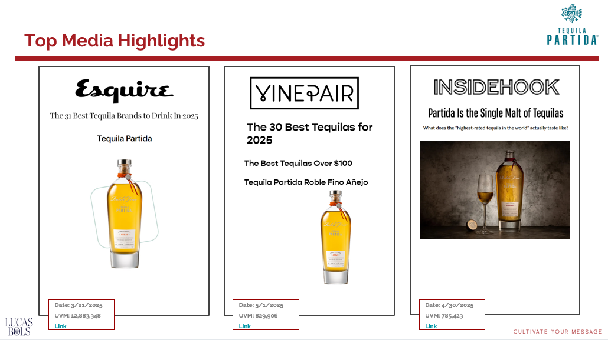
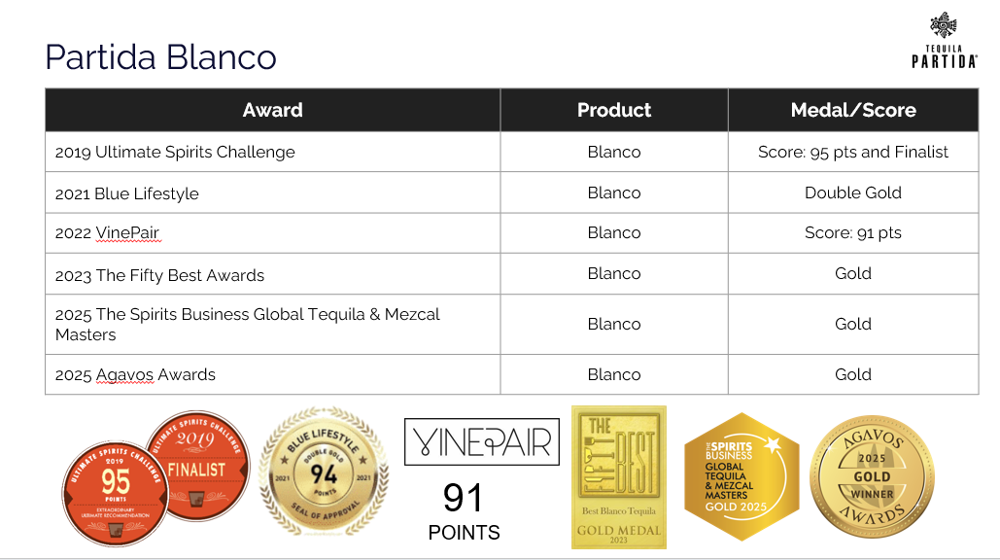
LIMONCELLO
MEDIA & ACCOLADES
Use these tools to build credibility, justify premium positioning, and win trade-up conversations with buyers and operators
LBUSA MEDIA COVERAGE
Comprehensive recap with links to all brand press features
→ Use to reinforce brand credibility and support your selling story with trusted third-party validation
LBUSA MEDIA HIGHLIGHTS
Curated selection of top-tier media wins across the portfolio
→ Use to strengthen your pitch with high-impact proof points from top-tier media
LBUSA BRAND ACCOLADES
Awards and ratings across the portfolio
→ Use to justify price, support trade-up, and position brands as best-in-class within their category

Slide 9

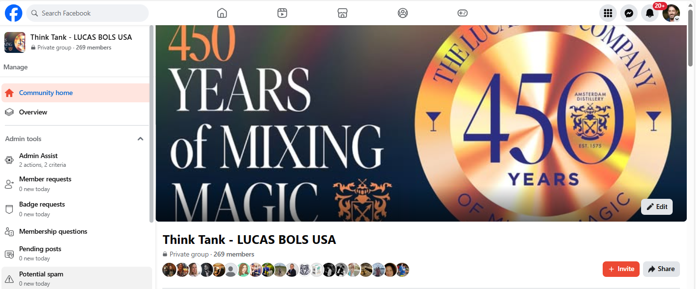
LIMONCELLO
JOIN US ON FACEBOOK!
Lucas Bols USA internal team group.
Here we share important news, activities and success stories for our brands by each team member.

Slide 10
CREATING GREAT COCKTAIL EXPERIENCES AROUND THE WORLD
FOR 450 YEARS, SINCE 1575

