Slide 1


LIMONCELLO
Lean into profitable trends - powered by Lucas Bols
“These six trends aren’t just shaping what guests drink—they define how operators grow revenue, increase margins, and win across every daypart.”
Trend | Consumer Insight | Channel Focus | Market Proof | How to Win | Hero Serve | Brand Credentials | Menu Strategy
🍋 Aperitivo & Spritz | Guests are shifting to lighter, longer drinks—unlocking more rounds, earlier occasions, and higher total spend per visit | Rooftops, brunch, waterfront, hotel bars, Italian/ Mediterranean | Spritz menu mentions +14% (Somm AI) | Build a high-margin spritz program to drive daytime traffic, increase rounds, and extend dwell time | Pallini Limoncello Spritz | Pallini Limoncello— World’s #1 Limoncello (IWSR); 150 years heritage Bols Elderflower – 92 pts “Best Buy” Wine Enthusiast | Start with Pallini Spritz as the anchor. Add peach & berry variants to drive repeat orders Bols Elderflower to improve Hugo Spritz margins
🌴 Tropical, Visual & Shareable | Guests choose bold, colorful cocktails that feel social, photogenic, and worth sharing—driving trial and group ordering | Nightclubs, lounges, beach bars, Latin nightlife, tiki, Asian venues | Pornstar Martini world’s #1 cocktail (Difford’s Guide) | Build a visually-driven cocktail section that turns color and flavor into trial and repeat orders | Passoã Passion Star Martini | Passoã — #1 Passion Fruit Liqueur; original Pornstar Martini Bols Blue 1575 — 94 pts Wine Enthusiast; 450-year heritage | Leverage Passoã versatility across serves like Martini, Mojito, Margarita. Expand tropical cocktail menu with Bols flavors blue curacao, coconut, lychee, melon
☕ Coffee & Indulgence | Consumers seek indulgent, dessert-style cocktails—especially post-meal—driving higher check averages | Restaurants, hotel bars, lounges, steakhouses, Italian dining | Espresso Martini remains a top 10 global cocktail (Difford’s Guide) | Extend into dessert and after-dinner cocktails to capture incremental spend and increase check size | Galliano Espresso Martini | Galliano Espresso — richer coffee, less sweet profile for cocktails Galliano L’Autentico — iconic herbal-vanilla liqueur | Build Espresso Martini section with variations Extend into dessert/affogato serves Add Hot Shot ritual for late-night occasions
🥃 Drink Better (Craft & Transparency) | Guests drink less but trade up—seeking authenticity, transparency, and higher-quality ingredients | Cocktail bars, premium casual, steakhouses, Mexican restaurants | Additive free tequila +15% Dollar Sales (AC Nielsen) | Trade guests up within familiar cocktails by upgrading base spirits and emphasizing quality | Partida Margarita & Old Fashioned | Tequila Partida — additive-free purity & precision since 2005 Roble Fino —double-aged, award-winning innovation | Build premium Margarita & Paloma variations Drive trade up and margins with Roble Fino Use Bols liqueurs to modify & elevate classics
🌿 Lo & No Alcohol | More guests are moderating but still want full cocktail experiences and inclusive occasions | Restaurants, hotel bars, wellness venues, premium casual | Non-alcoholic menu mentions +300% (Somm AI) | Serve more guests and occasions with premium alcohol-free cocktails alongside full-strength options | Fluère Spritz/ NA Margarita | Fluère — award-winning non-alcoholic distilled spirits Pallini Limonzero — world’s first non-alcoholic limoncello | Build dedicated lo & no menu section Mirror classic cocktails with NA versions Add Limonzero Spritz to extend aperitivo
⚡ Quality Cocktails at Scale (RTS) | Guests expect bar-quality cocktails with speed and consistency in high-volume environments | Stadiums, arenas, festivals, casinos, high-volume bars | RTS cocktails +19% Dollar Sales (AC Nielsen) | Add premium ready-to-serve cocktails to increase speed, reduce labor, maintain quality | Bols RTS Margarita / Espresso Martini | Bols RTS Cocktails — bartender-crafted with real spirits; 450-year expertise | Start with basics like Margarita & Espresso Martini Expand to Negroni, Old Fashioned, Pornstar Martini

Slide 2
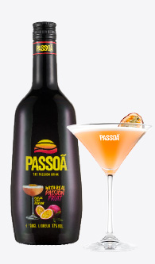
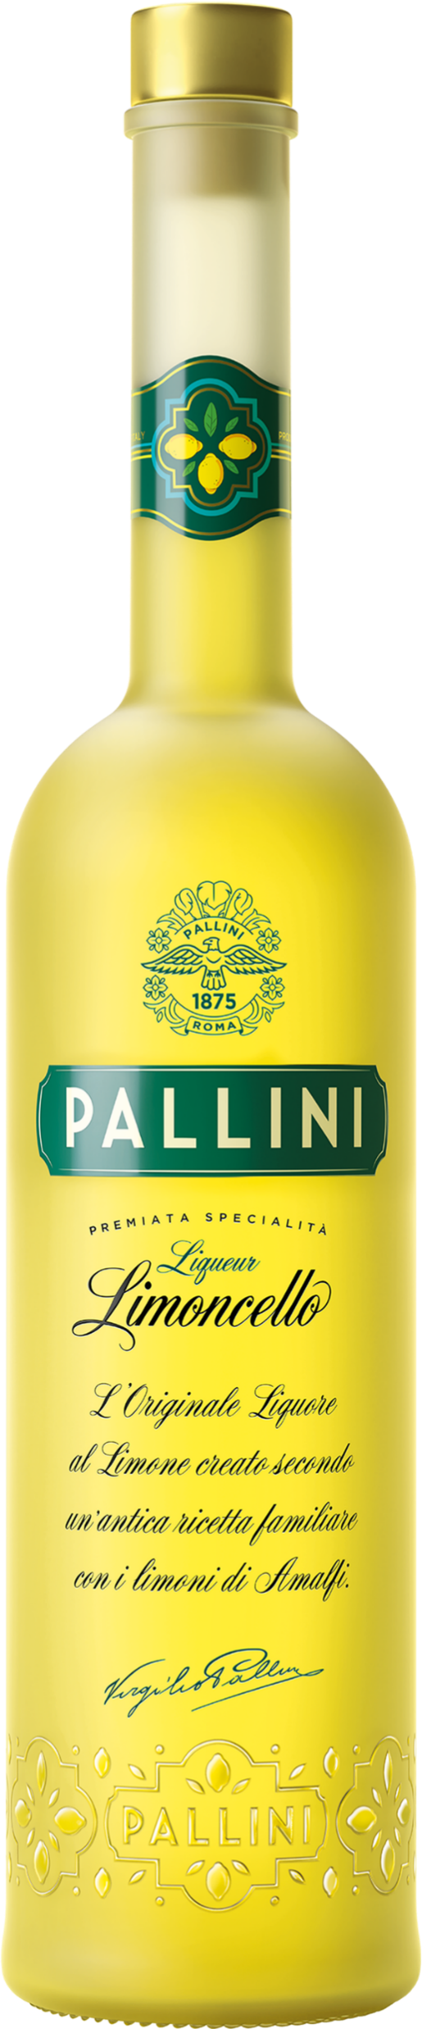
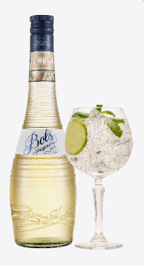
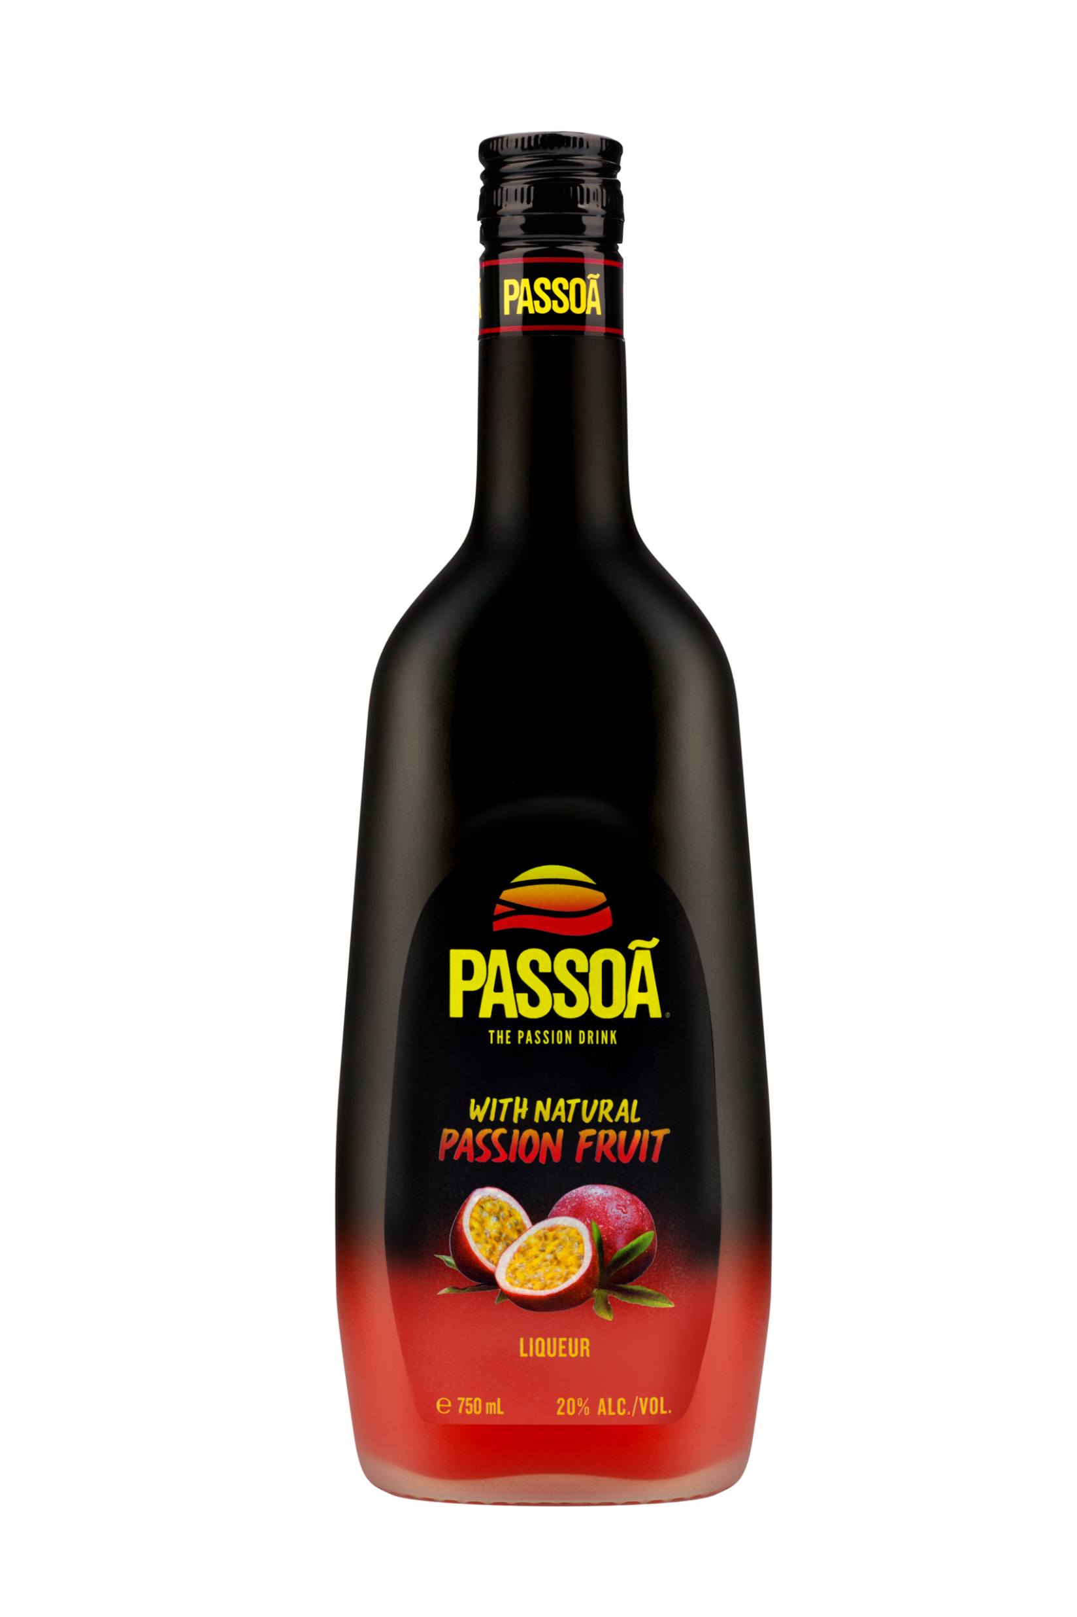
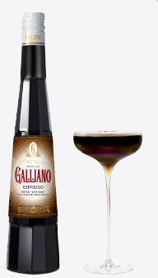
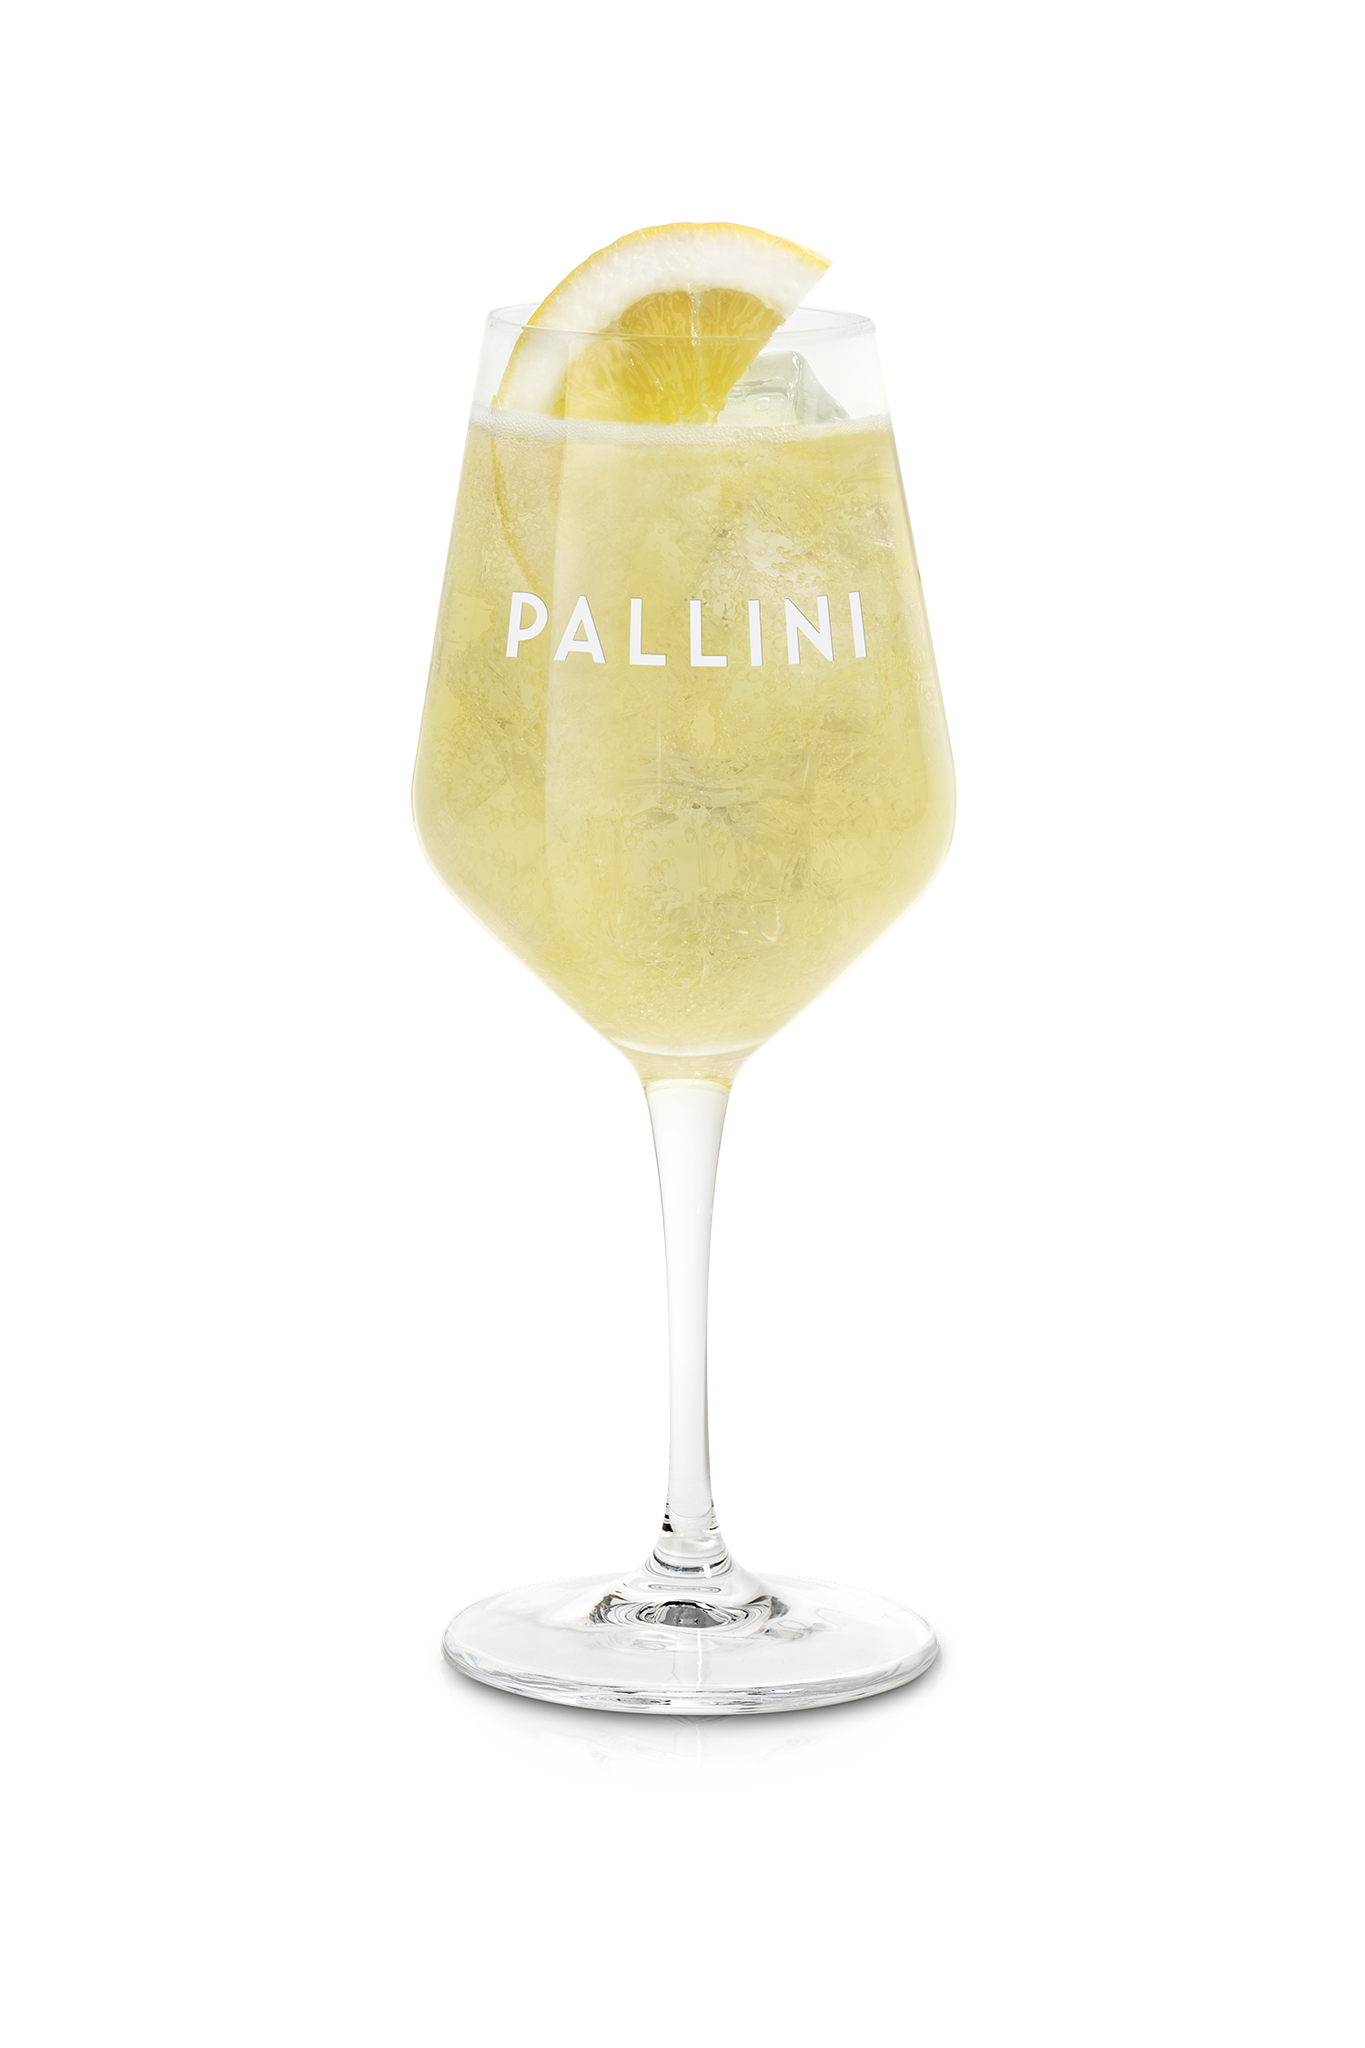
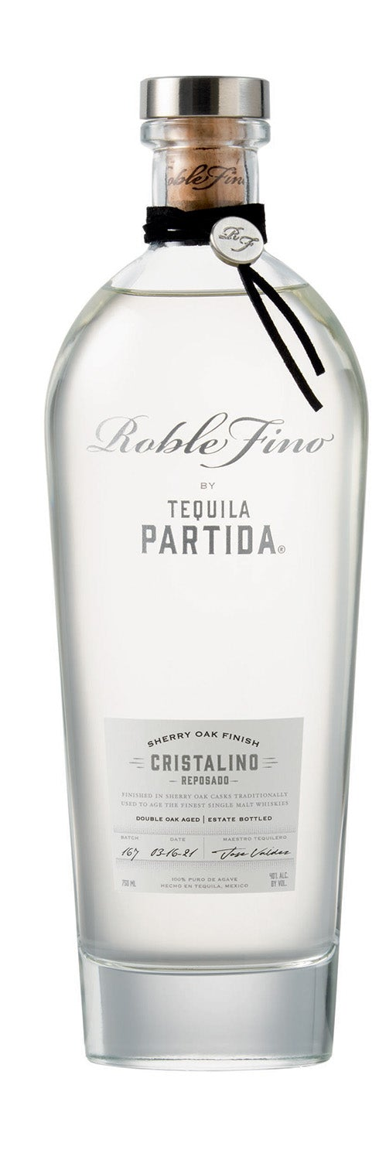
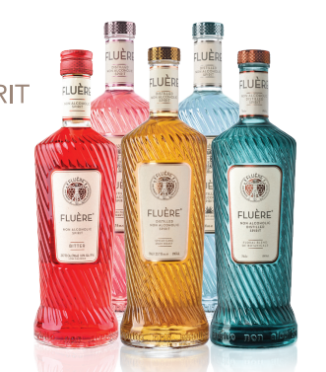
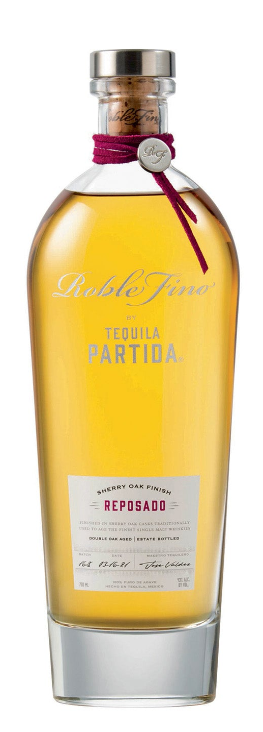
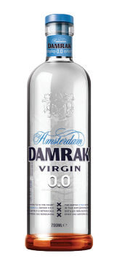
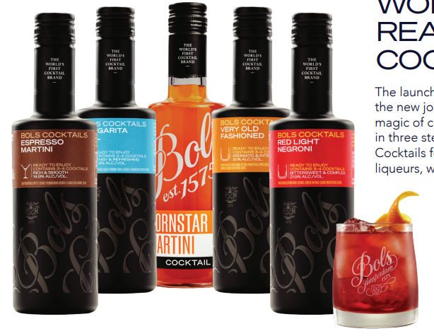
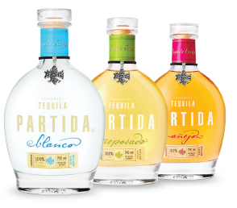
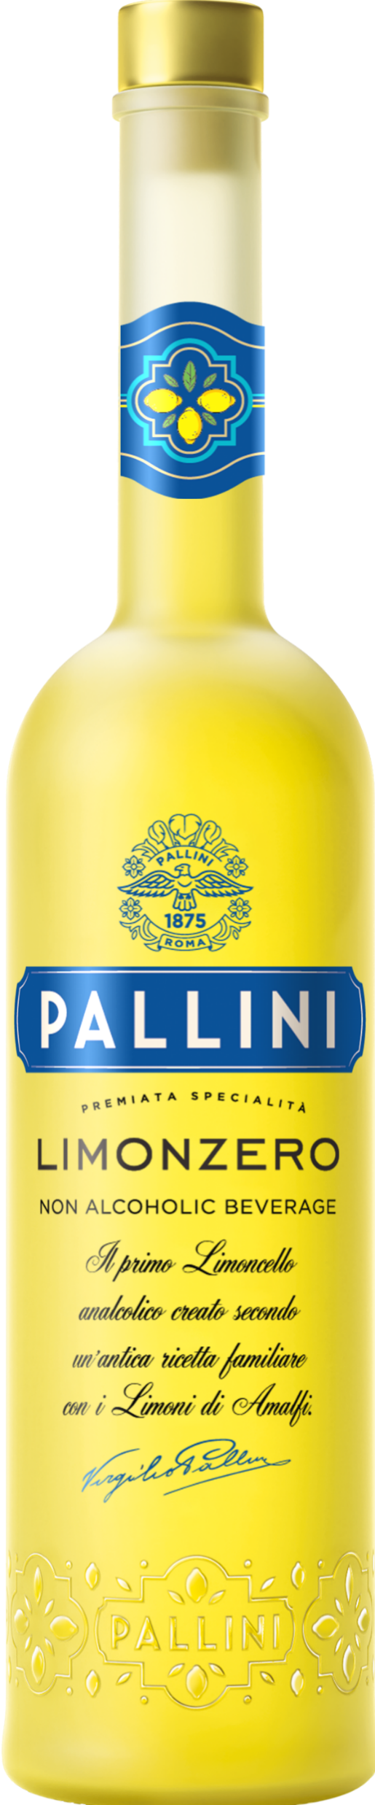
LIMONCELLO
Lean into profitable trends - powered by Lucas Bols
“These six trends aren’t just shaping what guests drink—they define how operators grow revenue, increase margins, and win across every daypart.”
🍋 APERITIVO & SPRITZ
🌴 TROPICAL & VISUAL
☕ COFFEE/INDULGENCE
PALLINI LIMONCELLO
+6%
ELDERFLOWER
LIQUEUR
PASSION FRUIT
LIQUEUR
PREMIUM COFFEE
LIQUEUR
+30%
Dollar Sales*
+8%
Dollar
Sales*
+79%
in menu mentions to 52k in 2025
DEPLETIONS
+14%
“Spritz” menu mentions to 40k in 2025
*Nielsen 52wks 12/22/25
+14%
“Spritz” menu mentions to 40k in 2025
*Nielsen 52wks 12/22/25
Source: SOMM AI
Source: SOMM AI
Source: SOMM AI
🥃 DRINK BETTER/ TRANSPARENCY
🌿 LO & NO ALCOHOL
⚡ QUALITY COCKTAILS AT SCALE
ADDITIVE-FREE TEQUILA
+15% Dollar Sales*
NON ALC SPIRITS +300% Menu Mentions*
RTS COCKTAILS +19%
Dollar Sales*
*Nielsen 52wks 12/22/25
*Nielsen 52wks 12/22/25
Source: SOMM AI

