Slide 1


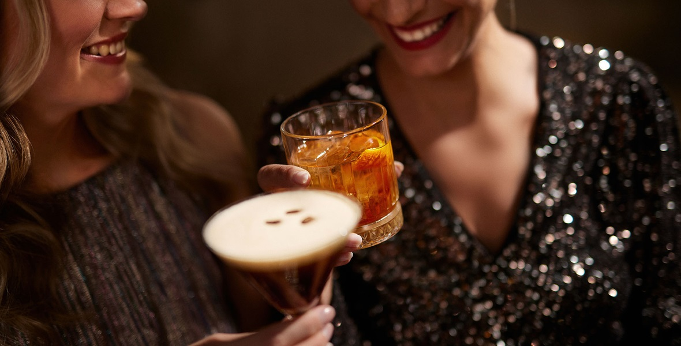
WINNING THE MOMENT OF DECISION ON-PREMISE

Slide 2
LIMONCELLO
Winning on-premise today means winning the moment of decision — where bartenders influence choice, visibility drives trial, and experiences convert into repeat purchases.
On-premise is no longer just a sales channel — it’s a media channel where the right drink gets chosen.

Slide 3
LIMONCELLO
WINNING ON PREMISE IN 2026
CONTEXT & PURPOSE
The way CONSUMERS drink is evolving:
Fewer drinks — but higher expectations for quality and experience
More occasions beyond nightlife — from aperitivo to post-meal to moderation
Greater influence of visibility, presentation, and bartender recommendation on what gets ordered
The OPPORTUNITY for accounts is clear:
Increase spend per guest through premiumization and trade-up
Drive more rounds through sessionable, occasion-led cocktails
Unlock incremental visits across new dayparts
Accelerate order velocity in high-volume moments
The CALL TO ACTION for our teams is simple:
Help accounts sell more drinks, at higher value, more often— by activating cocktail programs that are easy to execute and built to scale.
THIS DECK turns these shifts into clear, high-profit cocktail programs your accounts can execute immediately — designed to drive depletions, simplify execution, and win the moment of decision.

Slide 4
LIMONCELLO
6 TRENDS DRIVING ON PREMISE GROWTH IN 2026
“These trends are shaping how guests drink and how operators can drive more rounds, higher checks, better margins, and faster turns.”
#1 APERITIVO & SPRITZ
“Spritz-style drinks continue to dominate as consumers seek lighter, lower-ABV options that fit daytime and early evening occasions.” — SevenFifty Daily
“The Spritz has evolved into a global drinking ritual, driven by its sessionability and strong appeal across multiple dayparts.” — Drinks International
#2 TROPICAL, VISUAL
“The Pornstar Martini remains one of the most ordered cocktails globally, reflecting sustained demand for bold, fruit-forward flavors.” — Difford’s Guide
“Colorful, visually striking cocktails are increasingly driving consumer choice, particularly among younger drinkers seeking shareable experiences.” — Liquor.com
#3 COFFEE & INDULGENCE
“The Espresso Martini shows no signs of slowing, consistently ranking among the most popular cocktails worldwide.” — Drinks International
“Coffee cocktails are thriving as consumers look for indulgent, dessert-like drinks that extend the drinking occasion.” — Imbibe Magazine
#4 DRINK BETTER
“Consumers are increasingly prioritizing transparency and authenticity, particularly in tequila, where additive-free claims are gaining traction.” — SevenFifty Daily
“Premiumization continues to shape spirits consumption, with drinkers opting for fewer but higher-quality cocktails.” — The Spirits Business
#5 LO & NO ALCOHOL
“No- and low-alcohol cocktails are moving from niche to mainstream, with bars expanding offerings to meet growing consumer demand.” — Drinks International
“Guests increasingly expect alcohol-free options that deliver the same experience and complexity as full-strength cocktails.” — SevenFifty Daily
#6 COCKTAILS AT SCALE
“Ready-to-drink and ready-to-serve cocktails continue to surge as consumers and operators prioritize convenience without sacrificing quality.” — Beverage Information Group
“High-volume venues are increasingly turning to batched and pre-made cocktails to improve speed of service and consistency.” — Bar & Restaurant

Slide 5
LIMONCELLO
And here’s why and how to turn these trends into high-impact cocktail programs your accounts can execute today

Slide 6
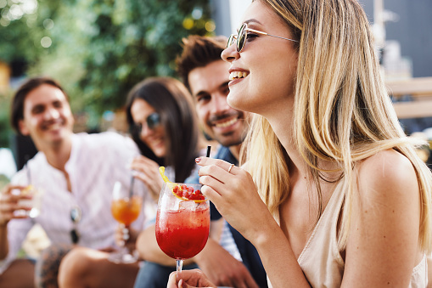
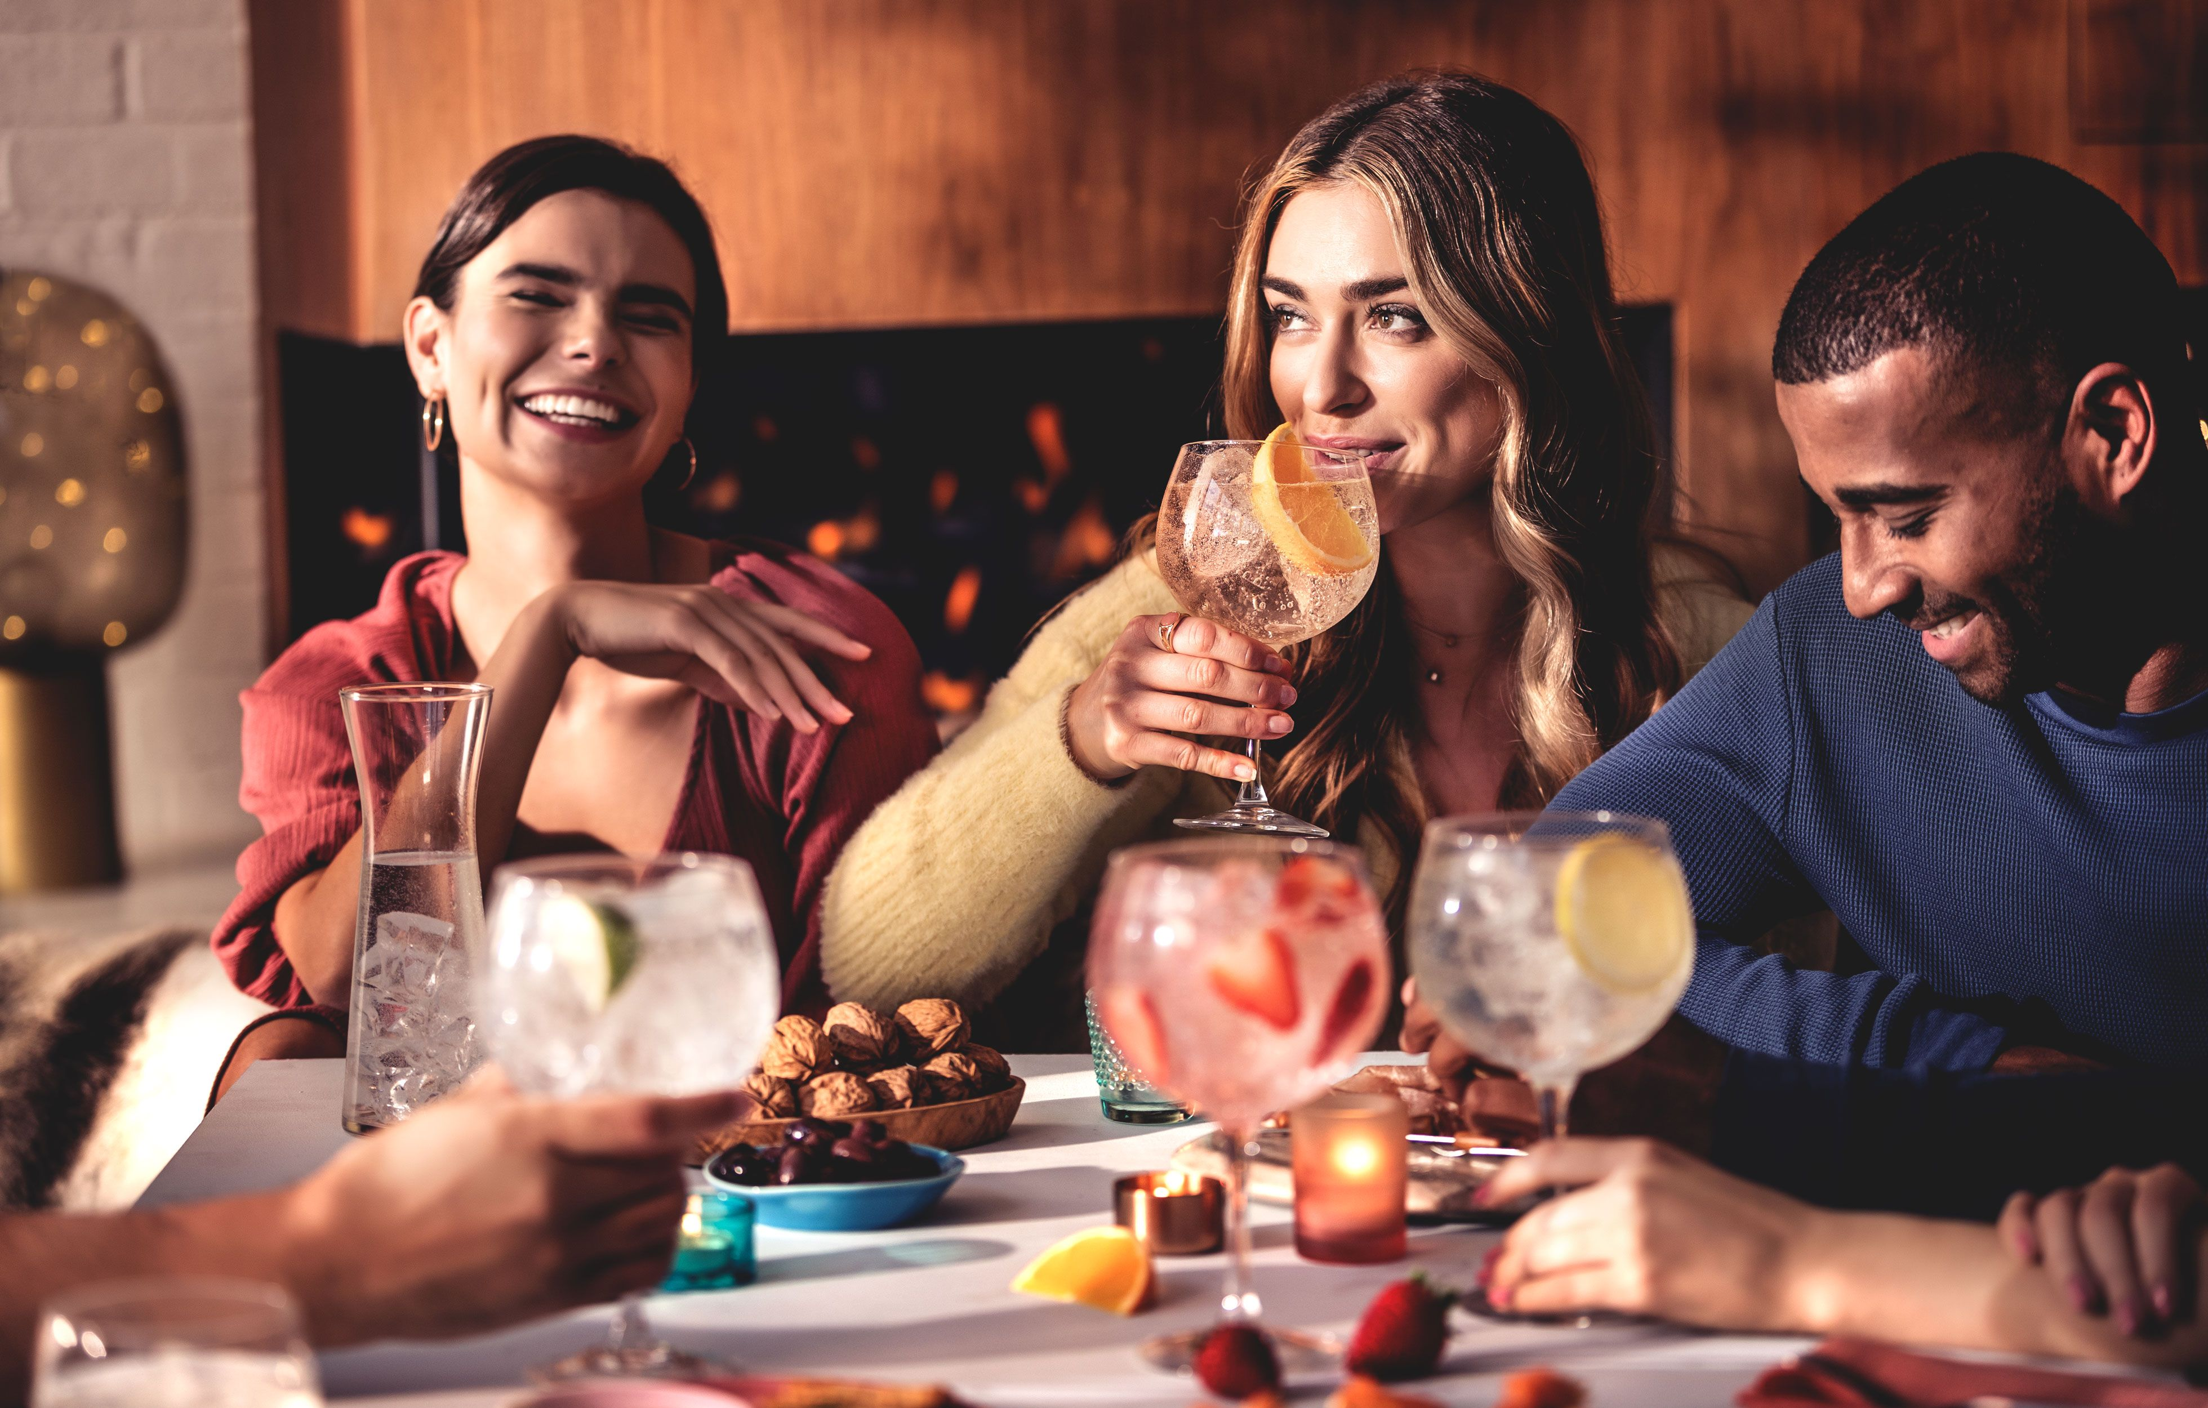
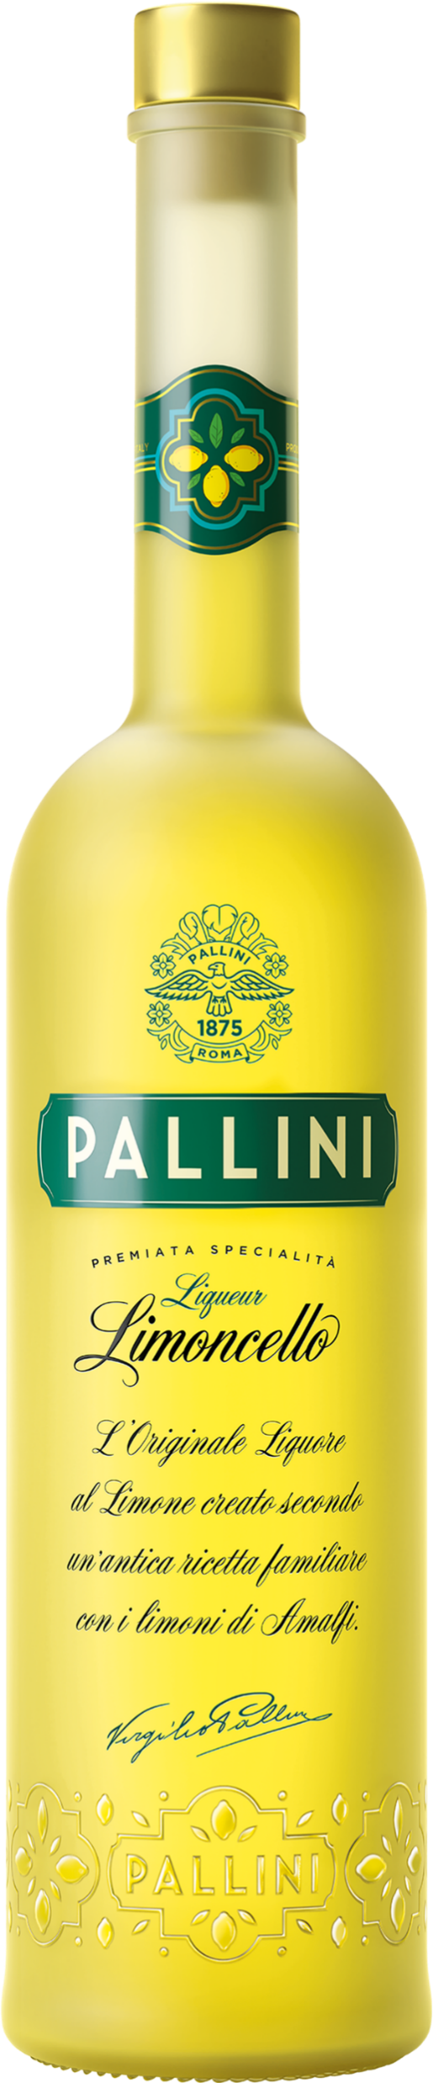
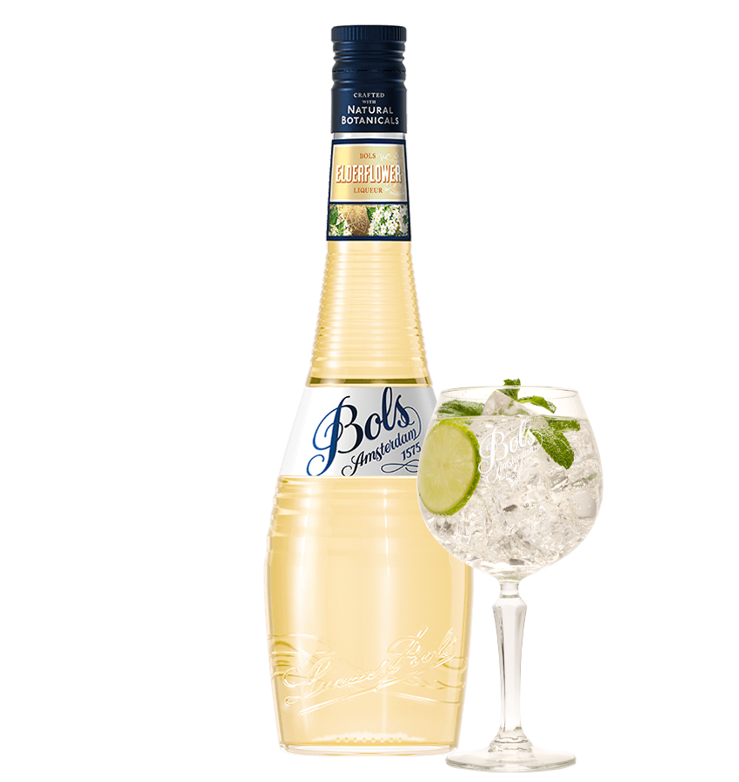
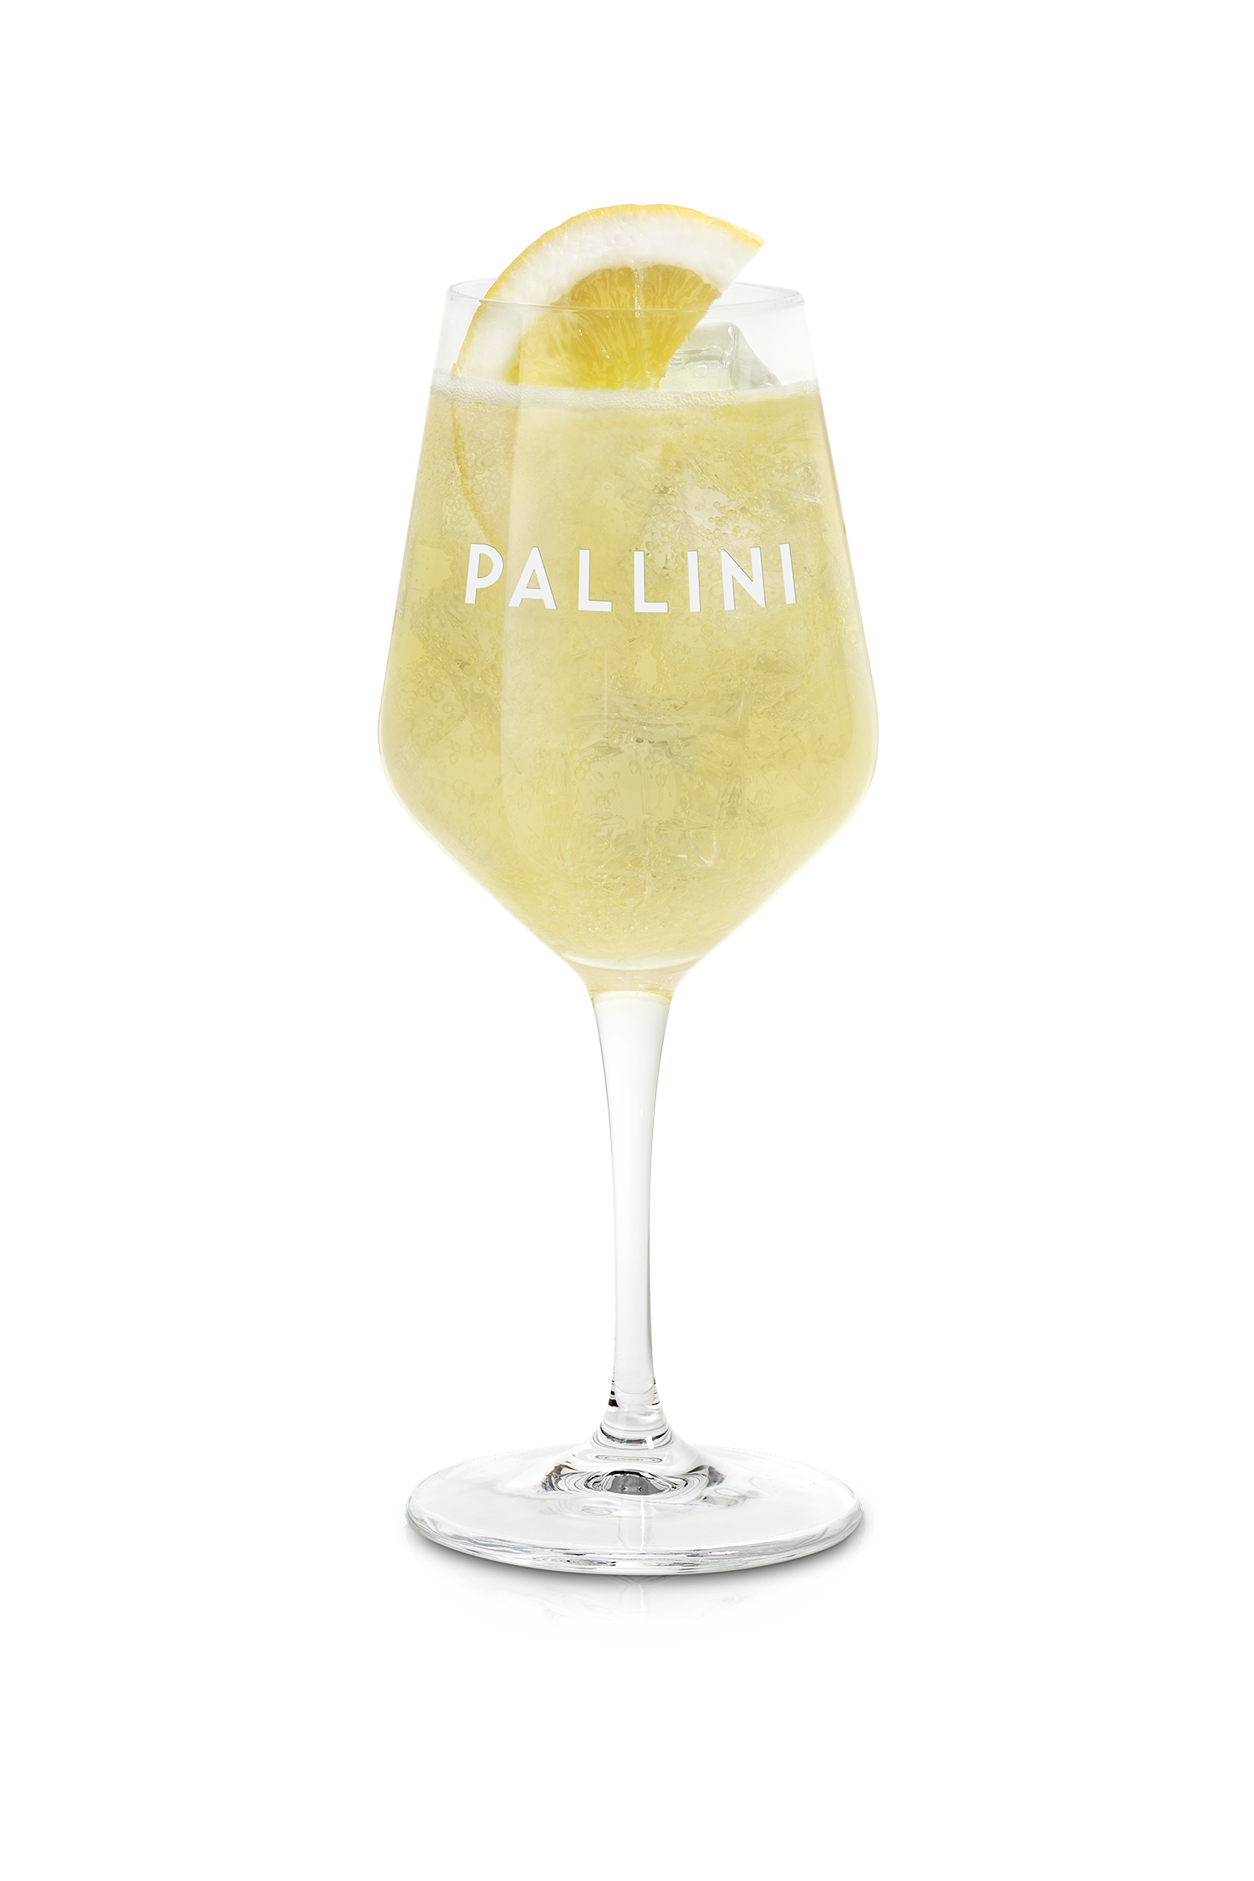
TREND #1 APERITIVO & SPRITZ
CONSUMER INSIGHT Guests are shifting to lighter, longer drinks—driving more rounds, earlier occasions, and higher frequency visits
MARKET PROOF
Spritz menu mentions +14% (SOMM AI)
CHANNEL FOCUS
Rooftops, brunch, waterfront, hotel bars, Italian/Mediterranean
OPERATOR OPPORTUNITY: Turn spritz into a daytime revenue engine—driving earlier traffic, more rounds, and higher check averages by owning the first drink decision and setting the pace for the occasion
BRAND CREDENTIALS
Pallini — World’s #1 Limoncello (IWSR); 150 years heritage
Bols Elderflower — 92 pts Wine Enthusiast
HERO SERVES
Pallini Spritz
Bols Elderflower Spritz
EXECUTION PLAYBOOK
Position Pallini Spritz as a premium, high-repeat alternative to Aperol to trade up price per serve and increase rounds per guest
Use Bols Elderflower to enhance Hugo Spritz margins while expanding menu variety without adding complexity
Build a dedicated spritz section to anchor the aperitivo moment and drive consistent, high-visibility orders

Slide 7
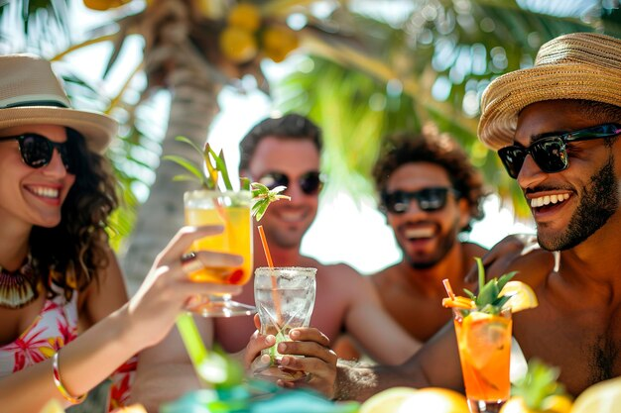
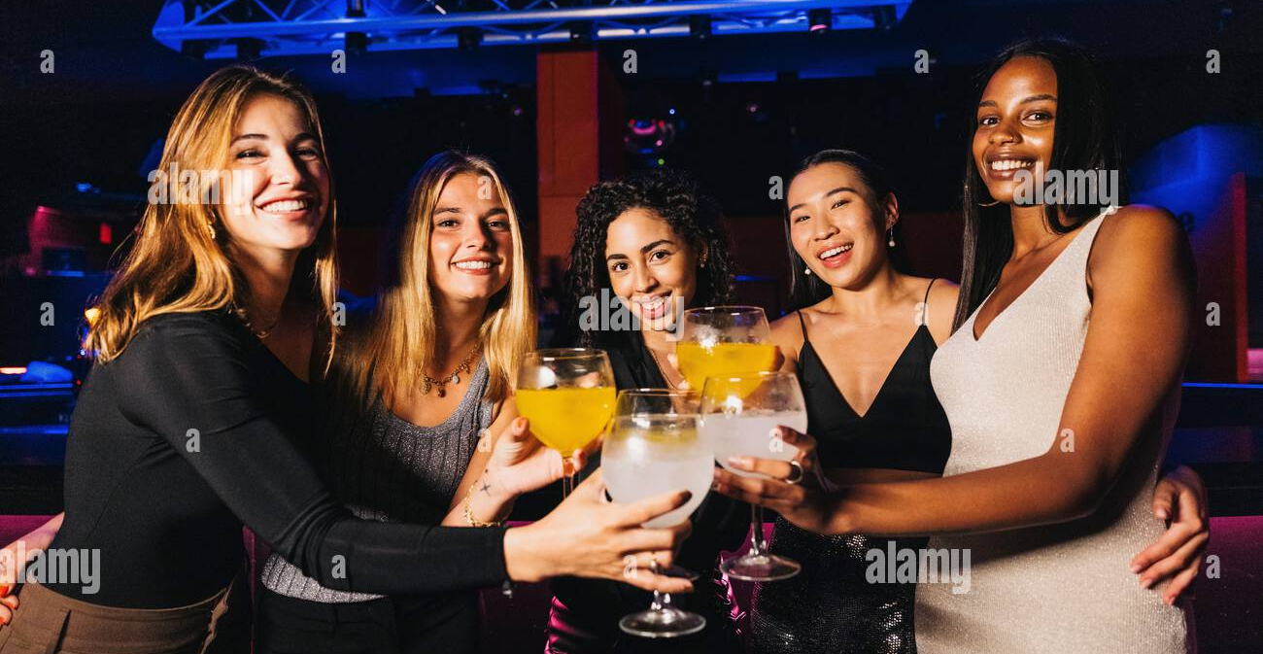
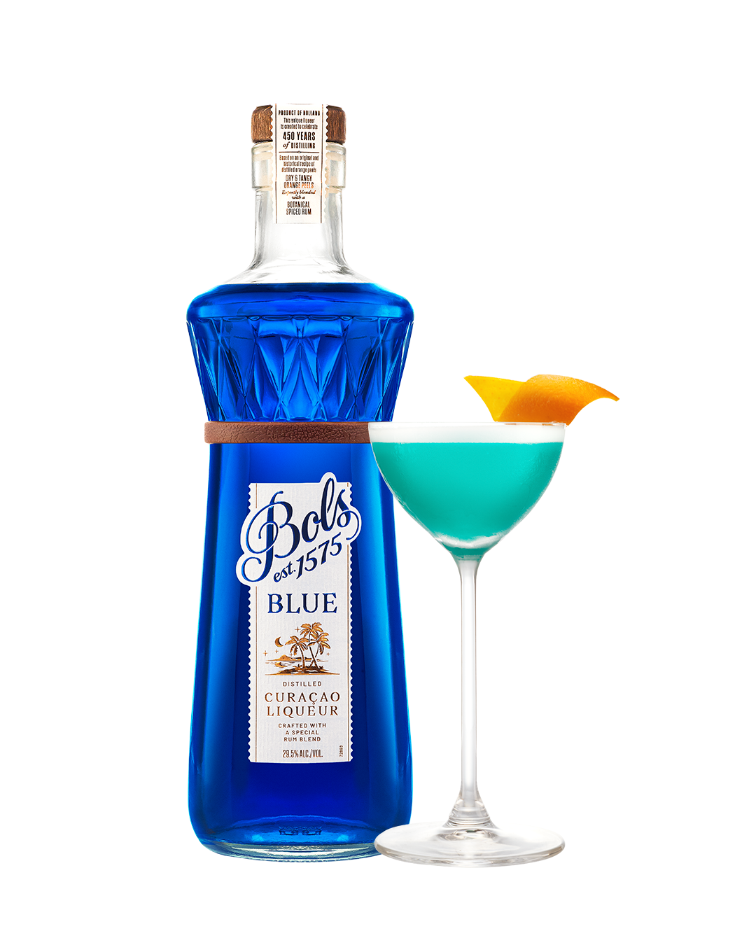
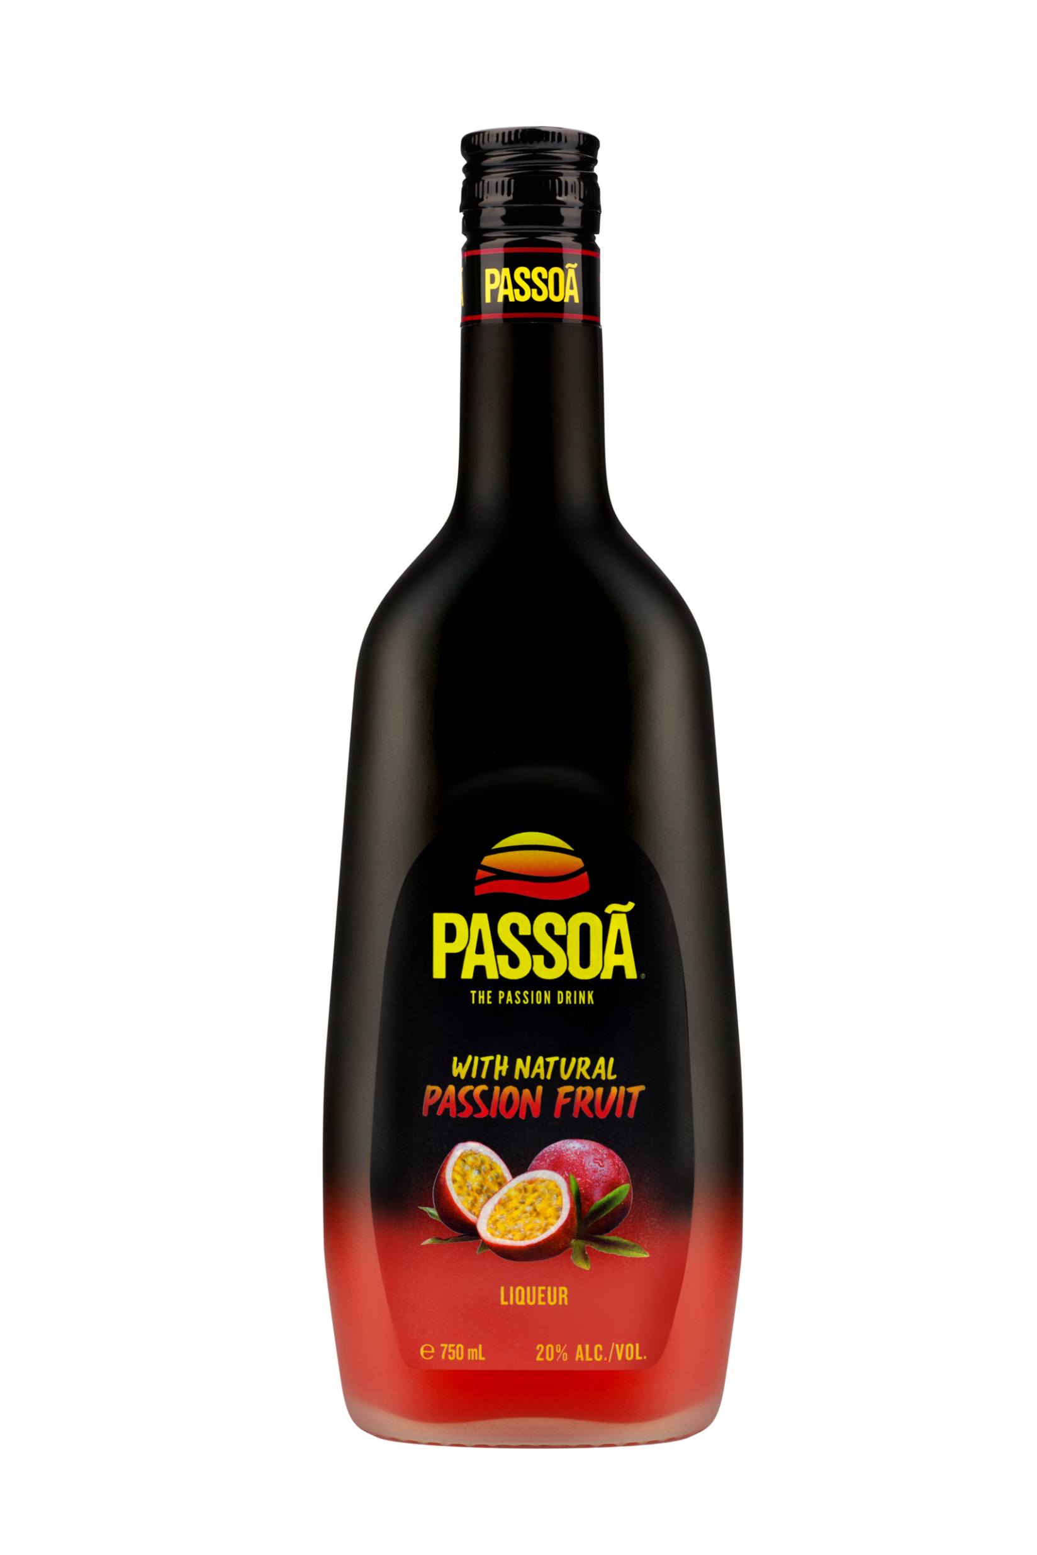
TREND #2 TROPICAL & SHAREABLE
CONSUMER INSIGHT Guests choose bold, colorful cocktails that feel social and worth sharing—driving trial, group ordering, and repeat occasions
MARKET PROOF Pornstar Martini #1 global cocktail (Difford’s Guide)
CHANNEL FOCUS Nightclubs, lounges, beach bars, Latin nightlife, tiki, Asian venues
OPERATOR OPPORTUNITY: Use bold color and flavor to drive trial and group ordering—winning the moment of decision through visual impact and social appeal that accelerates high-margin cocktail sales
BRAND CREDENTIALS
Passoã — #1 Passion Fruit Liqueur; original Pornstar Martini
Bols Blue 1575 — 94 pts Wine Enthusiast; 450-year heritage
HERO SERVES
Passoã Passion Star Martini
Bols Blue 1575 Martini
EXECUTION PLAYBOOK
Build a multi-serve Passoã program (Martini, Margarita, Mojito, Daiquiri) to drive menu efficiency, repeat orders, and higher volume per SKU
Expand tropical offerings anchored in Bols Blue, Lychee, and Melon to increase visibility and menu standout
Prioritize glassware, garnish, and presentation to turn each cocktail into a shareable experience that drives incremental orders

Slide 8
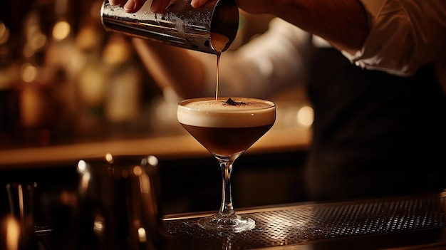
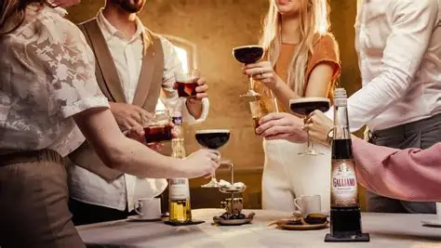
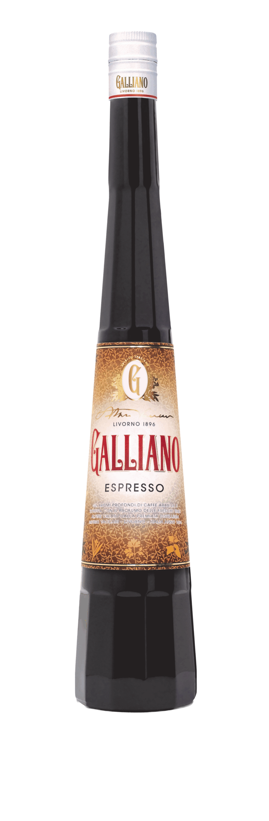
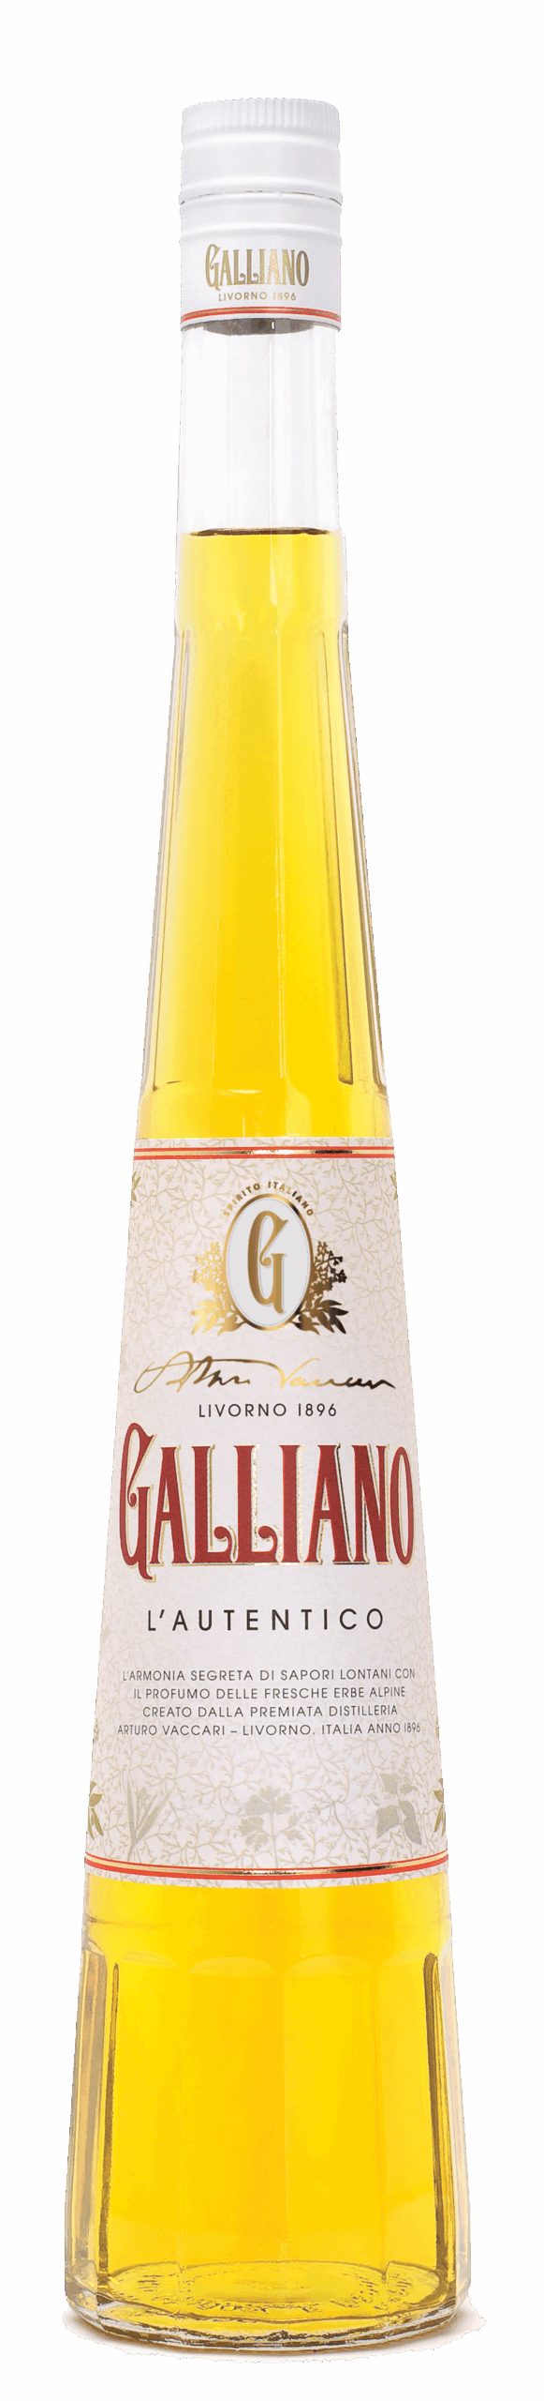
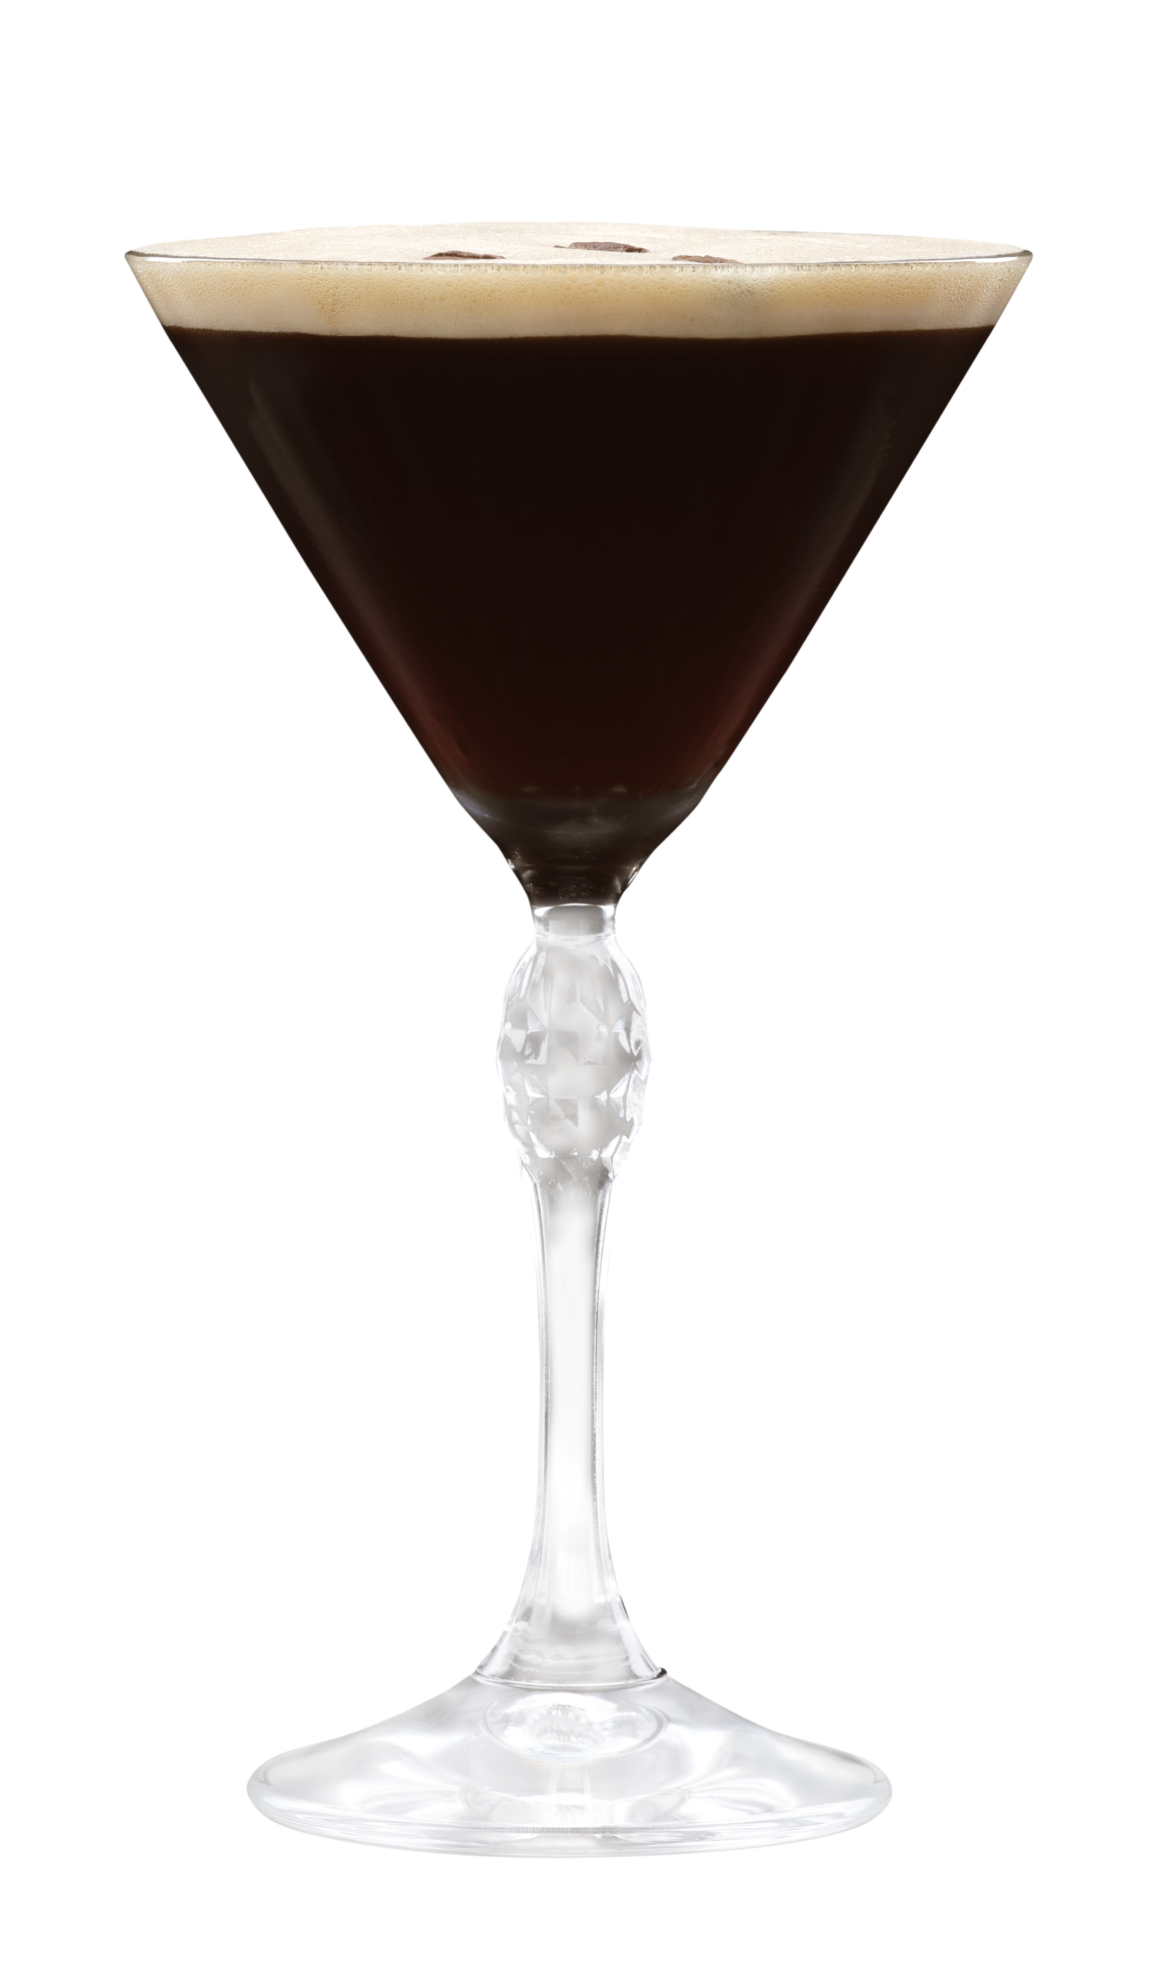
TREND #3 COFFEE & INDULGENCE
CONSUMER INSIGHT
Guests seek indulgent, dessert-style cocktails—especially post-meal—driving higher check averages and incremental drink occasions
MARKET PROOF
Espresso Martini Top 10 global cocktail (Difford’s Guide)
CHANNEL FOCUS
Restaurants, hotel bars, lounges, steakhouses, Italian dining
OPERATOR OPPORTUNITY: Capture post-dinner occasions and add a second drink moment—extending the guest experience and increasing total check through high-margin indulgent serves
BRAND CREDENTIALS
Galliano Espresso — richer coffee profile, less sweet
Galliano L’Autentico — iconic herbal-vanilla liqueur
HERO SERVES
Galliano Espresso Martini
Galliano Vanilla Hot Shot
EXECUTION PLAYBOOK
Upgrade house Espresso Martini with Galliano Espresso to increase check averages and differentiate from standard builds
Introduce Hot Shot ritual (Autentico/Vanilla) to drive attachment post-meal and create a signature experience
Position coffee cocktails as a dedicated menu section to capture incremental second-drink occasions

Slide 9
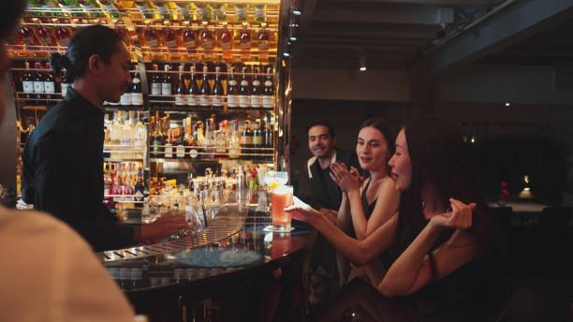
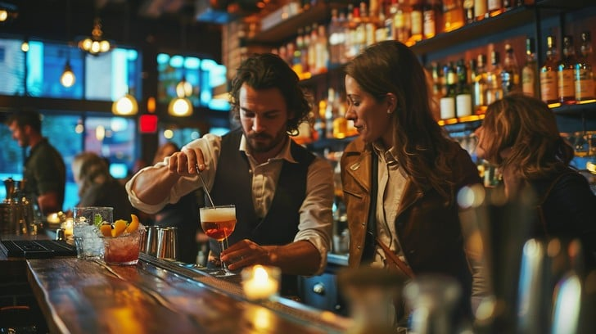
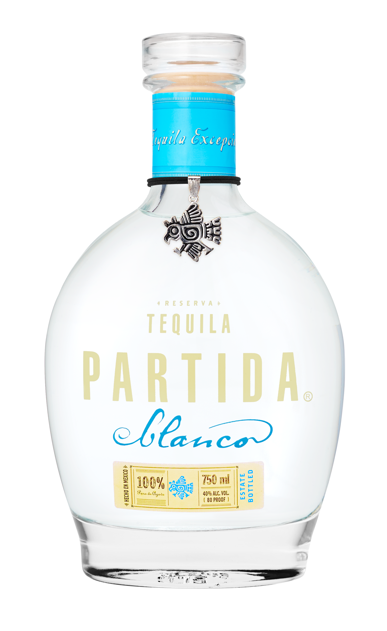
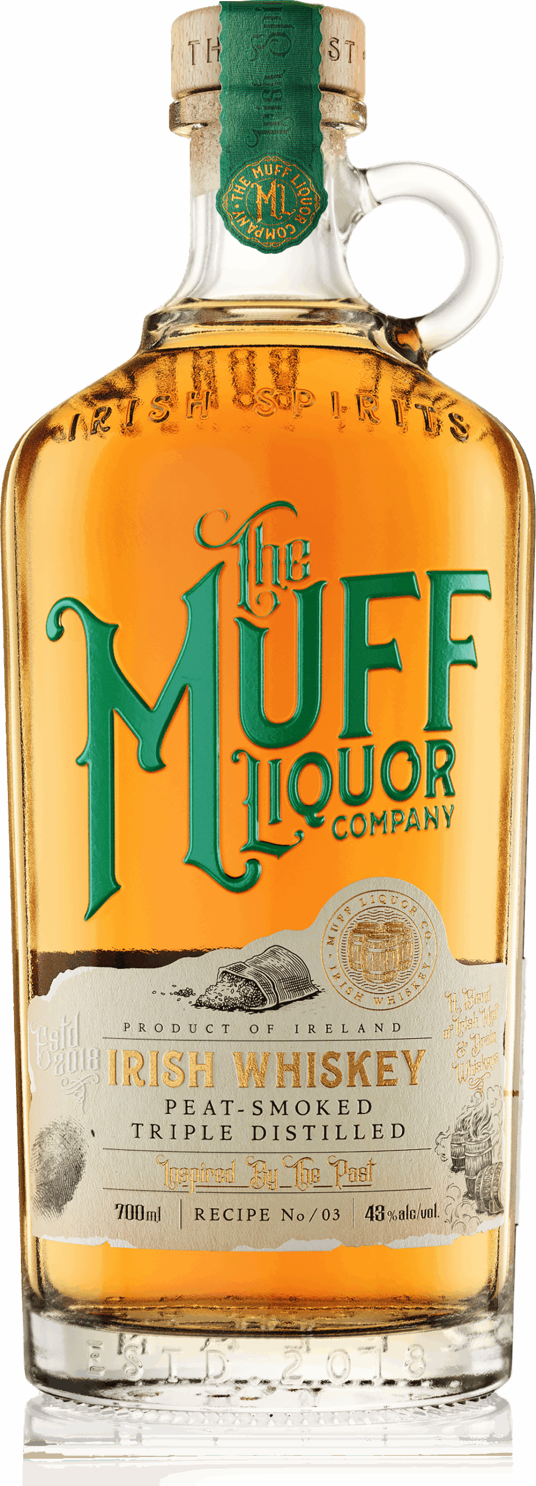
TREND #4 DRINK BETTER
CONSUMER INSIGHT
Guests drink less but trade up—seeking authenticity, quality ingredients, and trusted recommendations
MARKET PROOF
Additive-free tequila +15% dollar sales (Nielsen)
CHANNEL FOCUS
Cocktail bars, premium casual, steakhouses, Mexican restaurants
OPERATOR OPPORTUNITY: Trade guests up within familiar cocktails—leveraging bartender recommendations to influence the final purchase decision and increase price per serve
BRAND CREDENTIALS
Tequila Partida — award winning additive-free tequila since 2005
Muff Irish Whiskey — best Irish whiskey for cocktails, Robb Report 2026
HERO SERVES
Partida Margarita
Muff Old Fashioned
EXECUTION PLAYBOOK
Upgrade house Margaritas with Partida to drive premium pricing while maintaining familiarity for guests
Use Bols Triple Sec to enhance margins without compromising quality
Position Muff as a trade-up whiskey option to encourage bartender-led upsell and premium substitution

Slide 10
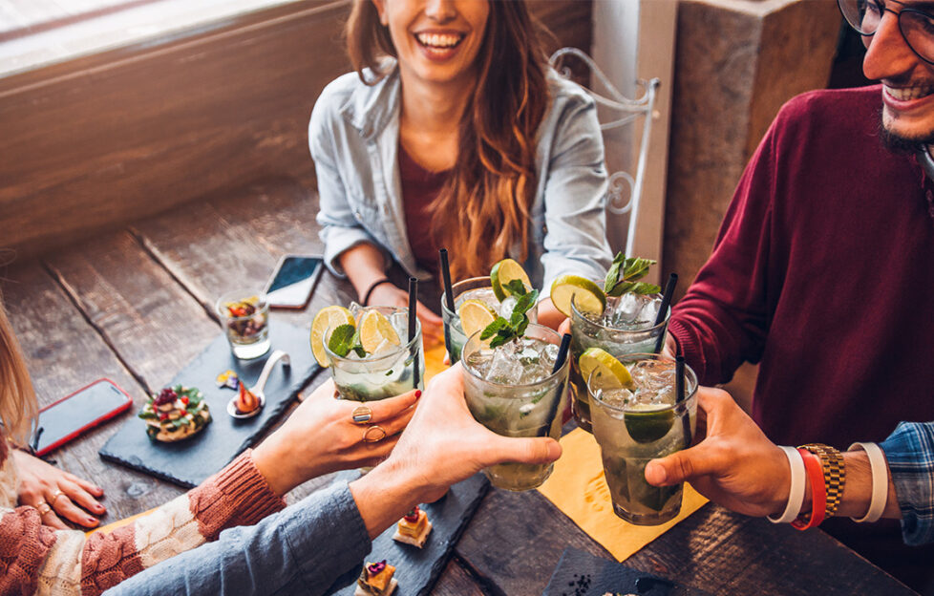
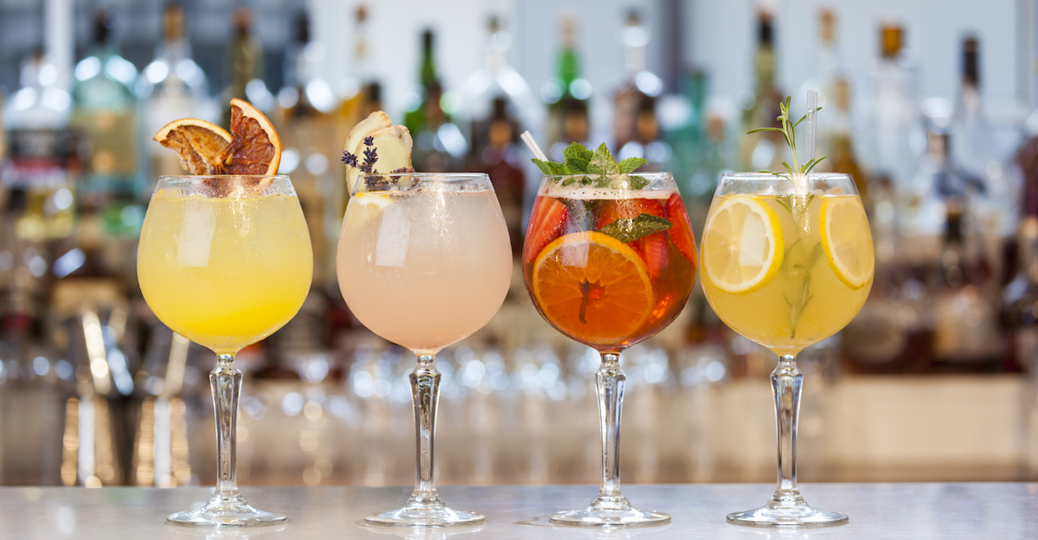
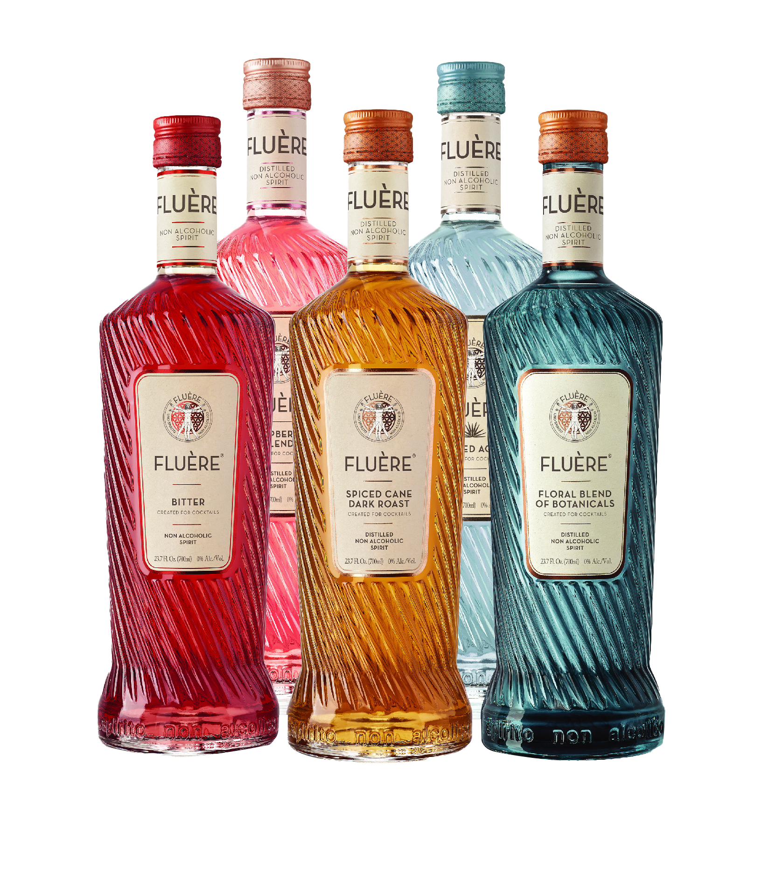
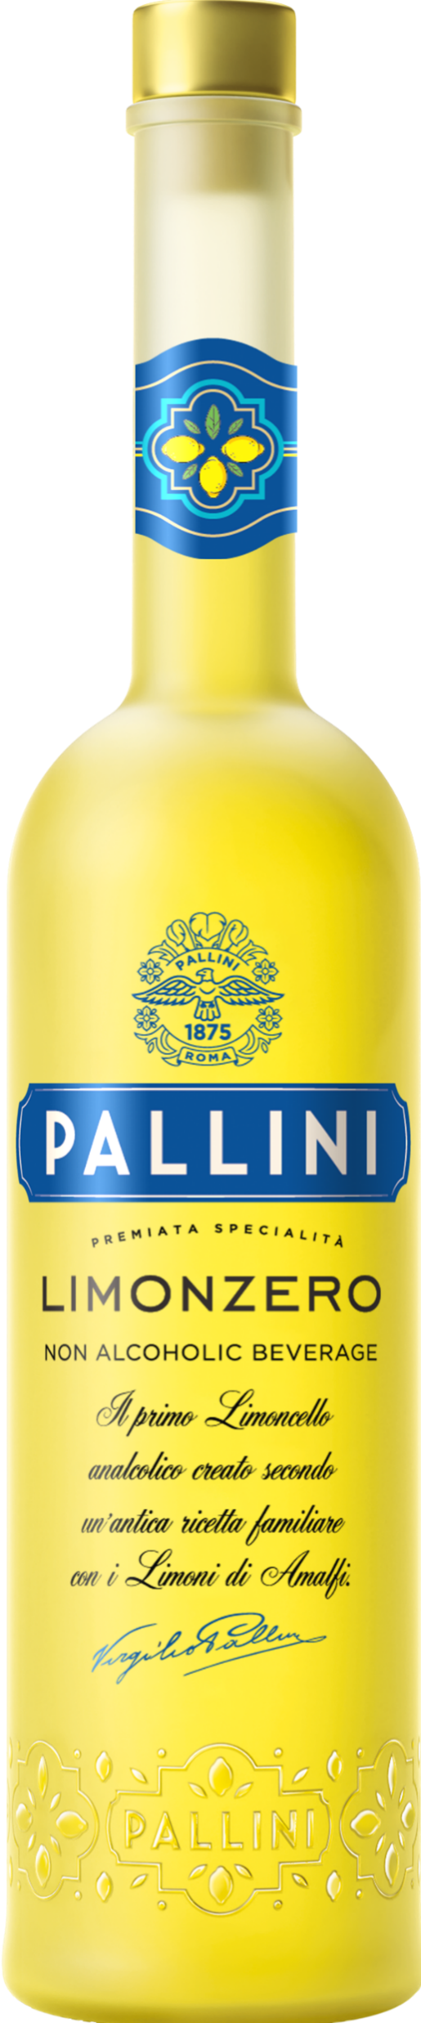
TREND #5 LO & NO ALCOHOL
CONSUMER INSIGHT
More guests are moderating but still want full cocktail experiences and inclusive social occasions
MARKET PROOF
Non-alcoholic menu mentions +300% (SOMM AI)
CHANNEL FOCUS
Restaurants, hotel bars, wellness venues, premium casual
OPERATOR OPPORTUNITY: Capture incremental visits and group occasions—winning the decision for non-drinkers without sacrificing revenue or experience quality
BRAND CREDENTIALS
Fluère — award-winning non-alcoholic spirits
Pallini Limonzero — first non-alcoholic limoncello
HERO SERVES
Fluère Bitter Spritz / NA Margarita
Pallini Limonzero Spritz
EXECUTION PLAYBOOK
Build a dedicated no/low cocktail section with Fluère that mirrors top-selling full-proof cocktails to maintain price integrity
Add Pallini Limonzero Spritz to extend aperitivo occasions and increase inclusivity across groups
Integrate no/low options into core menus to normalize ordering and drive consistent volume

Slide 11
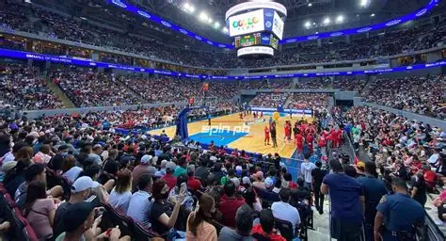
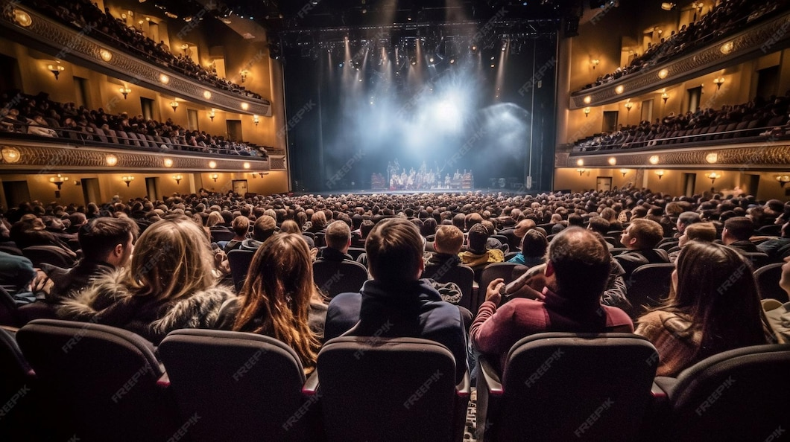
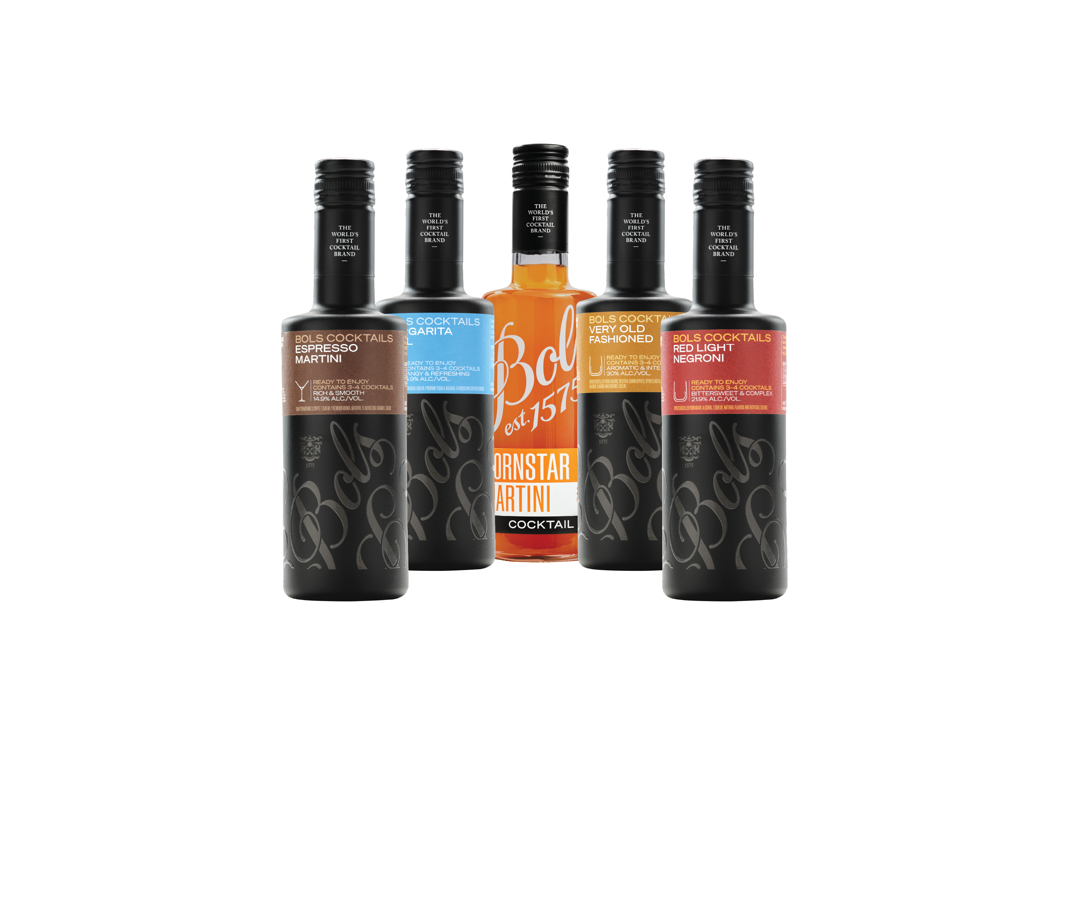
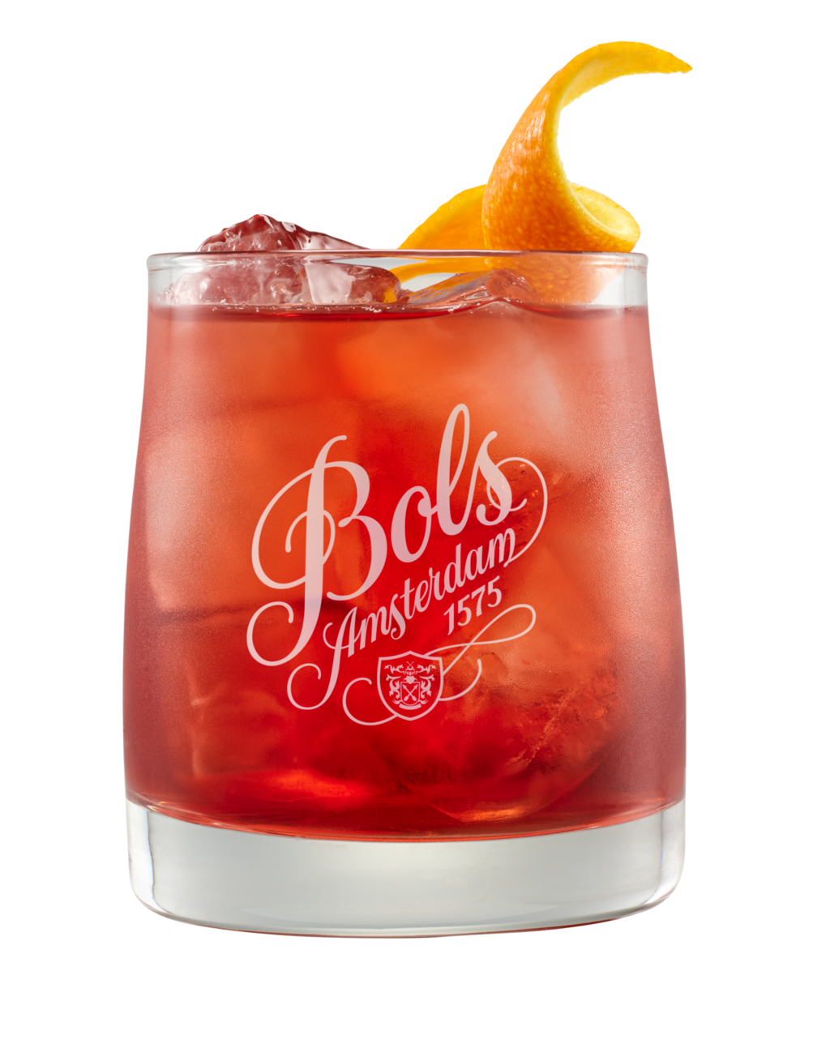
TREND #6 QUALITY AT SCALE
CONSUMER INSIGHT
Guests expect bar-quality cocktails with speed, consistency, and minimal wait time in high-volume environments
MARKET PROOF
RTS cocktails +19% dollar sales (Nielsen)
CHANNEL FOCUS
Stadiums, festivals, casinos, high-volume bars
OPERATOR OPPORTUNITY: Increase speed of service and sales per hour—capturing more orders in peak moments while maintaining cocktail quality and consistency
BRAND CREDENTIALS
Bols RTS — bartender-crafted cocktails with real spirits; 450-year expertise
HERO SERVES
Bols RTS Margarita / Espresso Martini
EXECUTION PLAYBOOK
Lead with Margarita & Espresso Martini as high-velocity SKUs to maximize throughput and revenue per hour
Expand to Negroni and Old Fashioned to scale cocktail programs without adding labor or complexity
Position RTS as a solution for peak periods to convert demand into sales rather than lost orders

Slide 12
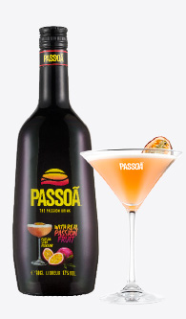
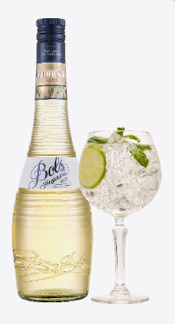
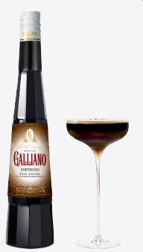
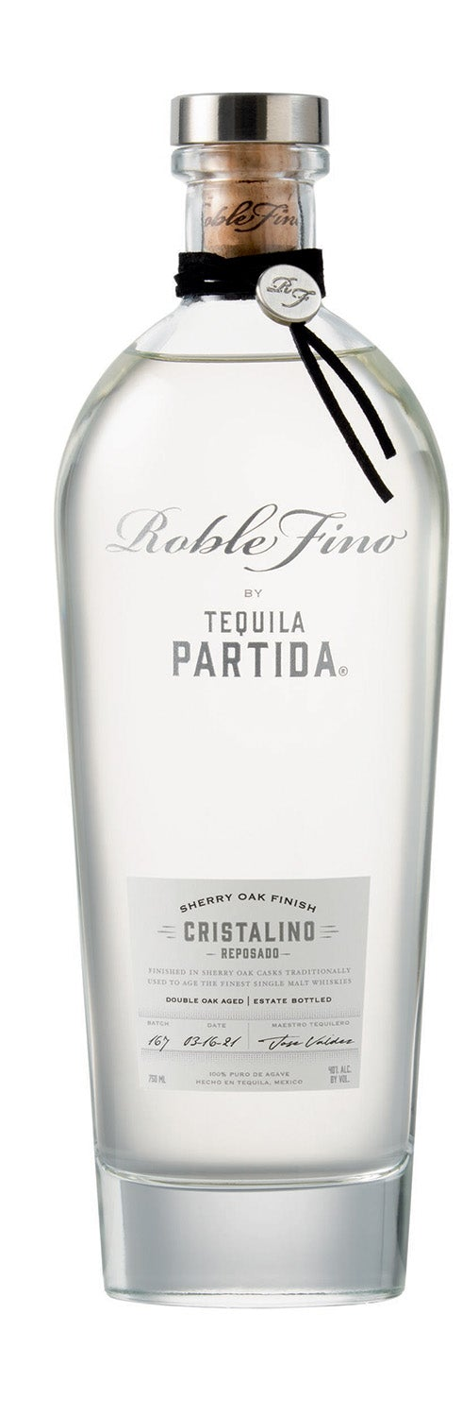
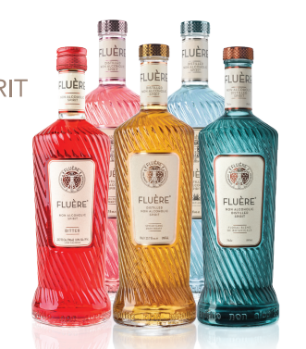
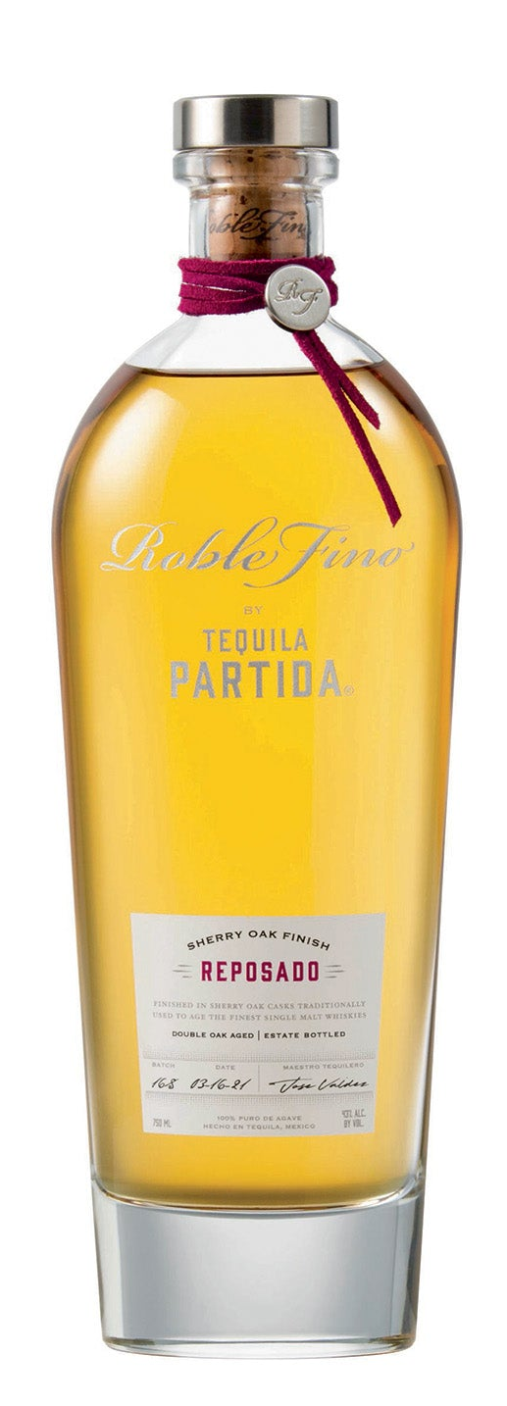
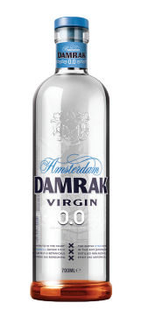
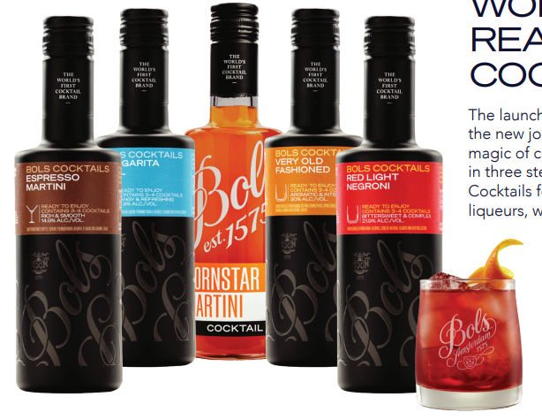
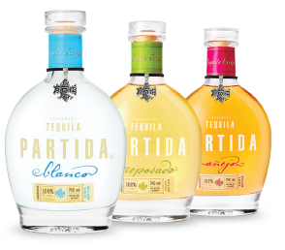
LIMONCELLO
WINNING ON PREMISE WITH LUCAS BOLS
Leading brands in high growth category segments aligned with trends
APERITIVO & SPRITZ
TROPICAL & VISUAL
COFFEE/INDULGENCE
PALLINI LIMONCELLO
+6%
ELDERFLOWER
LIQUEUR
PASSION FRUIT
LIQUEUR
PREMIUM COFFEE
LIQUEUR
+30%
Dollar Sales*
+8%
Dollar
Sales*
+79%
in menu mentions to 52k in 2025
DEPLETIONS
+14%
“Spritz” menu mentions to 40k in 2025
*Nielsen 52wks 12/22/25
+14%
“Spritz” menu mentions to 40k in 2025
*Nielsen 52wks 12/22/25
Source: SOMM AI
Source: SOMM AI
Source: SOMM AI
DRINK BETTER/ TRANSPARENCY
LO & NO ALCOHOL
QUALITY COCKTAILS AT SCALE
ADDITIVE-FREE TEQUILA
+15% Dollar Sales*
NON ALC SPIRITS +300% Menu Mentions*
RTS COCKTAILS +19%
Dollar Sales*
*Nielsen 52wks 12/22/25
*Nielsen 52wks 12/22/25
Source: SOMM AI

Slide 13
WHY LUCAS BOLS WINS
Proven Cocktail Expertise Since 1575 450 years of cocktail craftsmanship and bartender credibility
Complete Portfolio Across All 6 Programs From spritz to tropical, coffee to no/low, premium to RTS—one partner, total solution
Built for Operators, Not Just Brands Programs designed to drive revenue, simplify execution, and improve margins
Drives Incremental Revenue More rounds, higher checks, faster turns, and new occasions
“Let’s activate these programs now— and drive immediate growth across your accounts”

Slide 14
LIMONCELLO
TURN ON PREMISE TRENDS INTO OPERATOR PROFITS
PRINTABLE ONE PAGER FOR SALES TEAMS
TREND | CONSUMER INSIGHT | CHANNEL FOCUS | MARKET PROOF | OPERATOR OPPORTUNITY | HERO SERVE | BRAND CREDENTIALS | EXECUTION PLAYBOOK
#1🍋 Aperitivo & Spritz | Guests are shifting to lighter, longer drinks—driving more rounds, earlier occasions, and higher frequency visits | Rooftops, brunch, waterfront, hotel bars, Italian/ Mediterranean | Spritz menu mentions +14% (SOMM AI) | Turn spritz into a daytime revenue engine—driving earlier traffic, more rounds, and higher check averages by owning the first drink decision and setting the pace for the occasion | Pallini Limoncello Spritz | Pallini — World’s #1 Limoncello (IWSR); 150 years heritage Bols Elderflower — 92 pts Wine Enthusiast | Position Pallini Spritz as a premium, high-repeat alternative to Aperol to trade up price per serve and increase rounds per guest Use Bols Elderflower to enhance Hugo Spritz margins while expanding menu variety without adding complexity Build a dedicated spritz section to anchor the aperitivo moment and drive consistent, high-visibility orders
#2 🌴 Tropical, Visual & Shareable | Guests choose bold, colorful cocktails that feel social and worth sharing—driving trial, group ordering, and repeat occasions | Nightclubs, lounges, beach bars, Latin nightlife, tiki, Asian venues | Pornstar Martini #1 global cocktail (Difford’s Guide) | Use bold color and flavor to drive trial and group ordering—winning the moment of decision through visual impact and social appeal that accelerates high-margin cocktail sales | Passoã Passion Star Martini | Passoã — #1 Passion Fruit Liqueur; original Pornstar Martini Bols Blue 1575 — 94 pts Wine Enthusiast; 450-year heritage | Build a multi-serve Passoã program (Martini, Margarita, Mojito, Daiquiri) to drive menu efficiency, repeat orders, and higher volume per SKU Expand tropical offerings anchored in Bols Blue, Lychee, and Melon to increase visibility and menu standout Prioritize glassware, garnish, and presentation to turn each cocktail into a shareable experience that drives incremental orders
#3 ☕ Coffee & Indulgence | Guests seek indulgent, dessert-style cocktails—especially post-meal—driving higher check averages and incremental drink occasions | Restaurants, hotel bars, lounges, steakhouses, Italian dining | Espresso Martini Top 10 global cocktail (Difford’s Guide) | Capture post-dinner occasions and add a second drink moment—extending the guest experience and increasing total check through high-margin indulgent serves | Galliano Espresso Martini | Galliano Espresso — richer coffee profile, less sweet Galliano L’Autentico — iconic herbal-vanilla liqueur | Upgrade house Espresso Martini with Galliano Espresso to increase check averages and differentiate from standard builds Introduce Hot Shot ritual (Autentico/Vanilla) to drive attachment post-meal and create a signature experience Position coffee cocktails as a dedicated menu section to capture incremental second-drink occasions

Slide 15
LIMONCELLO
TURN ON PREMISE TRENDS INTO OPERATOR PROFITS
PRINTABLE ONE PAGER FOR SALES TEAMS
TREND | CONSUMER INSIGHT | CHANNEL FOCUS | MARKET PROOF | OPERATOR OPPORTUNITY | HERO SERVE | BRAND CREDENTIALS | EXECUTION PLAYBOOK
#4🥃 Drink Better (Craft & Transparency) | Guests drink less but trade up—seeking authenticity, quality ingredients, and trusted recommendations | Cocktail bars, premium casual, steakhouses, Mexican restaurants | Additive-free tequila +15% dollar sales (Nielsen) | Trade guests up within familiar cocktails—leveraging bartender recommendations to influence the final purchase decision and increase price per serve | Partida Margarita / Old Fashioned | Tequila Partida — award winning additive-free since 2005 Muff Irish Whiskey — best Irish whiskey for cocktails, Robb Report | Upgrade house Margaritas with Partida to drive premium pricing while maintaining familiarity for guests Use Bols Triple Sec to enhance margins without compromising quality Position Muff as a trade-up whiskey option to encourage bartender-led upsell and premium substitution
#5 🌿 Lo & No Alcohol | More guests are moderating but still want full cocktail experiences and inclusive social occasions | Restaurants, hotel bars, wellness venues, premium casual | Non-alcoholic menu mentions +300% (SOMM AI) | Capture incremental visits and group occasions—winning the decision for non-drinkers without sacrificing revenue or experience quality | Fluère Bitter Spritz / NA Margarita | Fluère — award-winning non-alcoholic spirits Pallini Limonzero — first non-alcoholic limoncello | Build a dedicated no/low cocktail section with Fluère that mirrors top-selling full-proof cocktails to maintain price integrity Add Pallini Limonzero Spritz to extend aperitivo occasions and increase inclusivity across groups Integrate no/low options into core menus to normalize ordering and drive consistent volume
#6⚡ Quality Cocktails at Scale (RTS) | Guests expect bar-quality cocktails with speed, consistency, and minimal wait time in high-volume environments | Stadiums, festivals, casinos, high-volume bars | RTS cocktails +19% dollar sales (Nielsen) | Increase speed of service and sales per hour—capturing more orders in peak moments while maintaining cocktail quality and consistency | Bols RTS Margarita / Espresso Martini | Bols RTS — bartender-crafted cocktails with real spirits; 450-year expertise | Lead with Margarita & Espresso Martini as high-velocity SKUs to maximize throughput and revenue per hour Expand to Negroni and Old Fashioned to scale cocktail programs without adding labor or complexity Position RTS as a solution for peak periods to convert demand into sales rather than lost orders

Slide 16
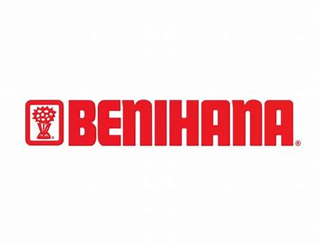
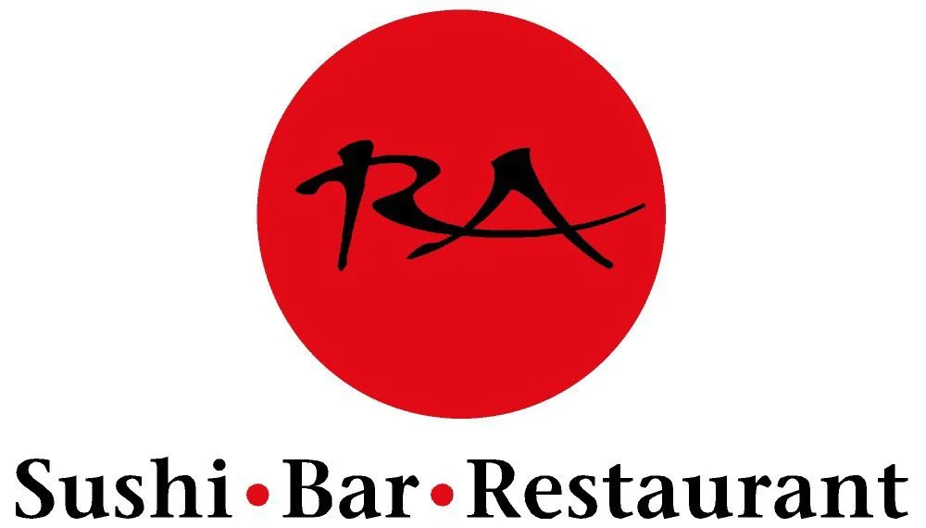

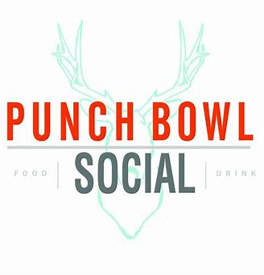
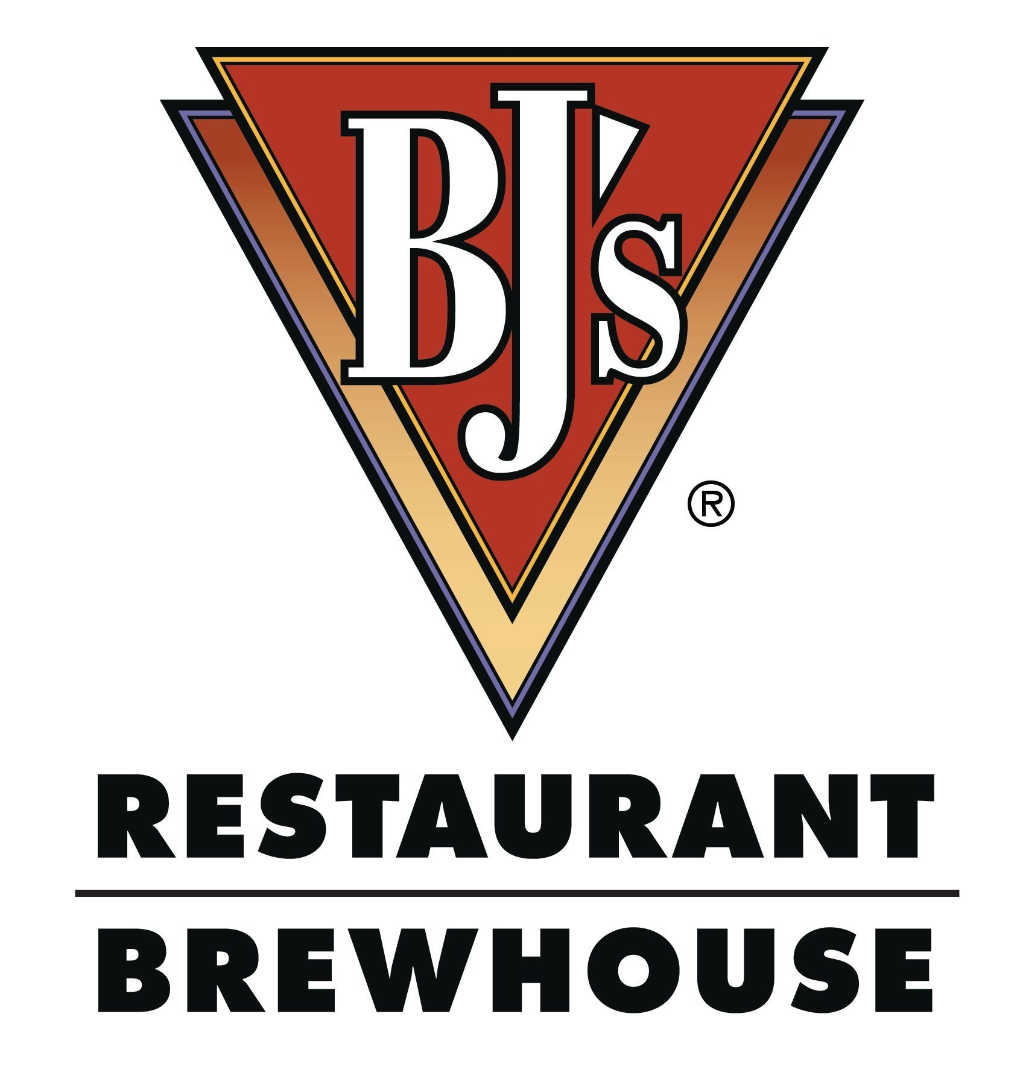
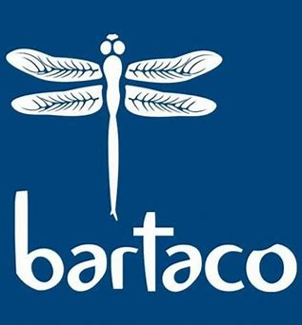
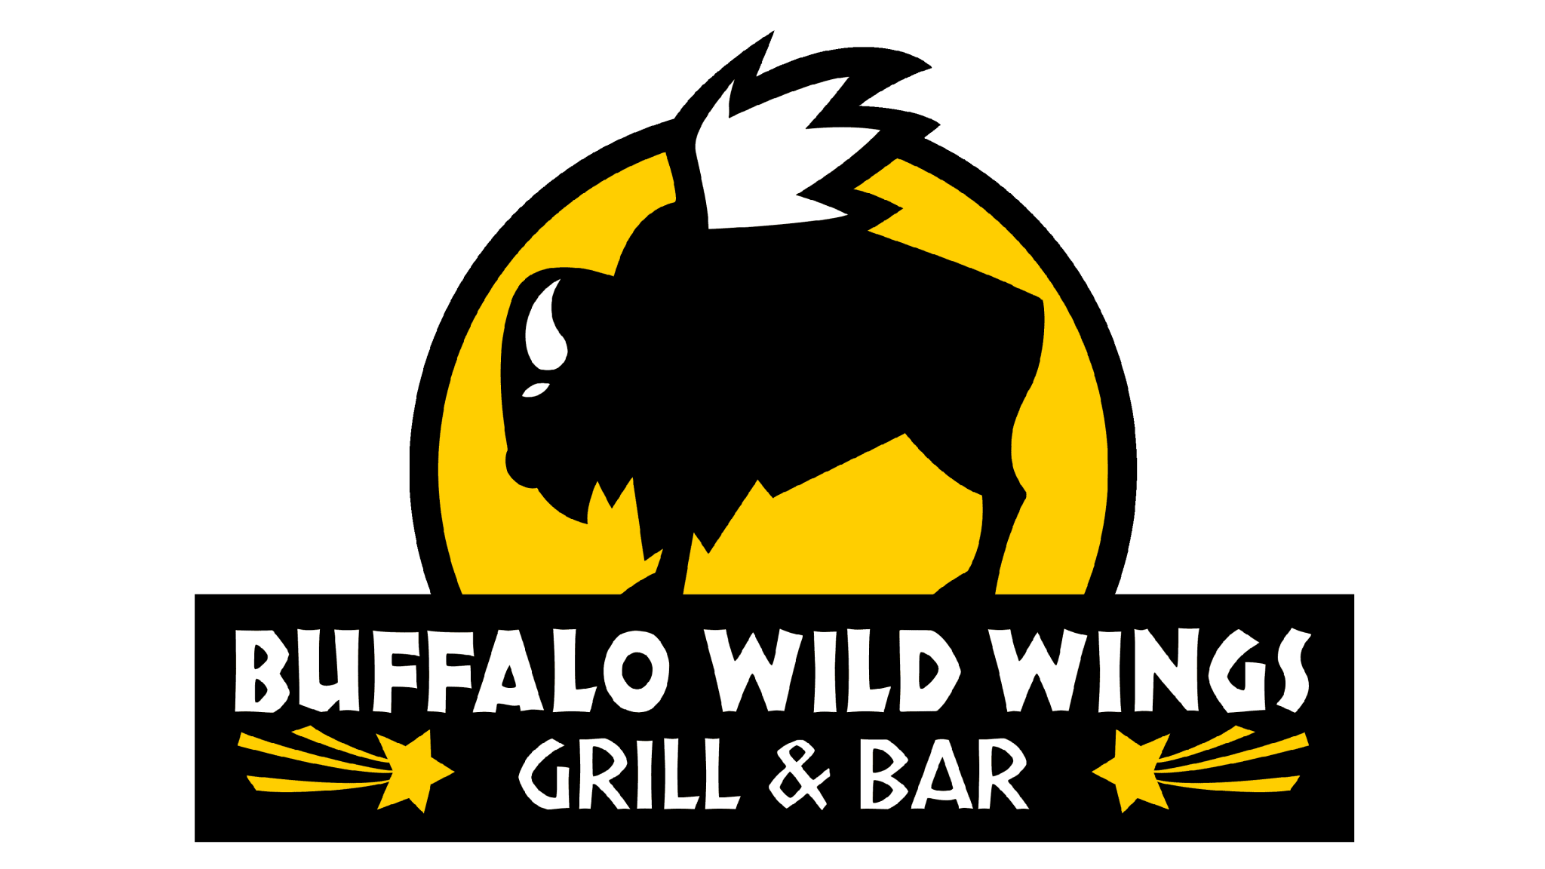
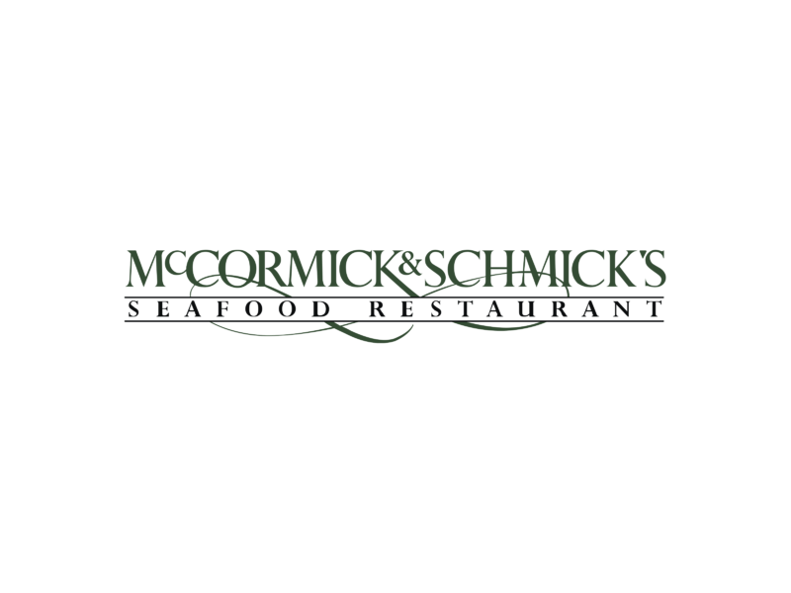


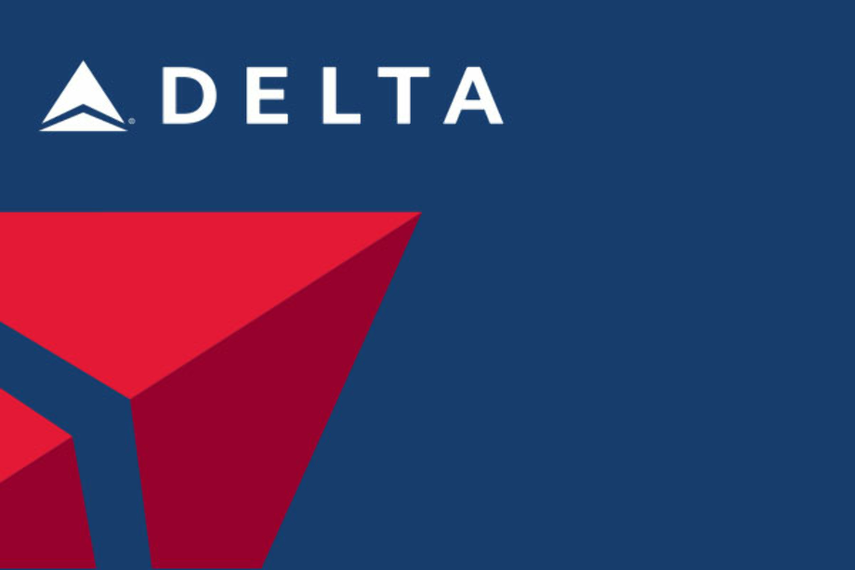
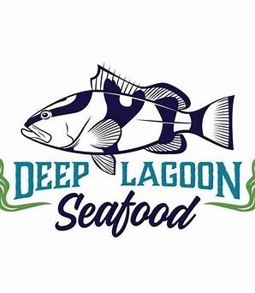

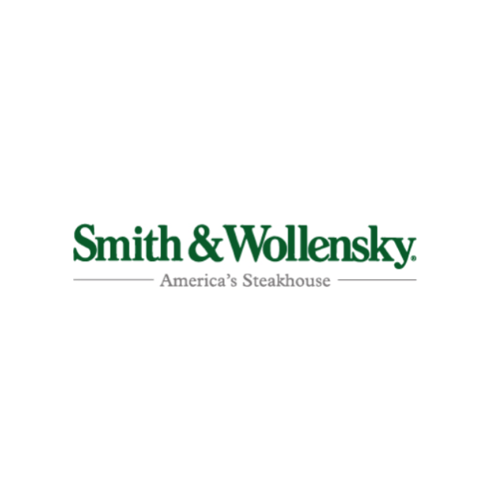

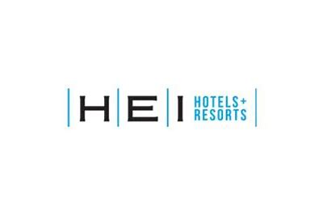

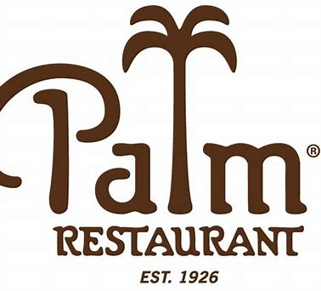
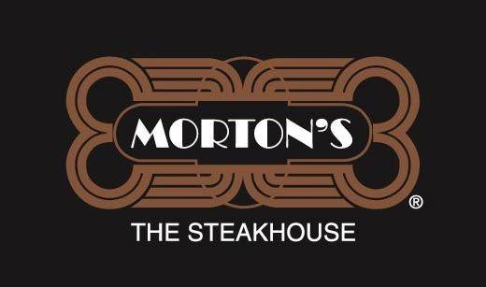
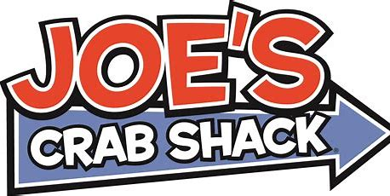










NATIONAL ACCOUNTS ON-PREMISE

Slide 17



CREATING GREAT COCKTAIL EXPERIENCES AROUND THE WORLD
FOR 450 YEARS, SINCE 1575

