Slide 1


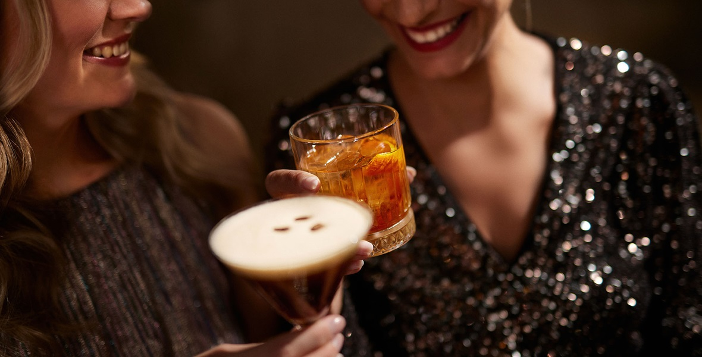
WINNING OFF PREMISE IN 2026

Slide 2
LIMONCELLO
WINNING OFF PREMISE IN 2026
CONTEXT & PURPOSE
The CALL TO ACTION for sales teams is clear:
Help retailers sell more bottles,
build bigger baskets, and trade shoppers up—more often
The way CONSUMERS drink is evolving:
Fewer drinks, but higher quality and higher expectations
More occasions beyond traditional nightlife (aperitivo, daytime, post-meal, moderation)
Greater demand for experience, flavor, and
visual appeal
This shift is creating clear opportunities for RETAILERS:
Drive bigger baskets per trip
Trade shoppers up to higher value bottles
Increase purchase frequency across occasions
THIS DECK turns these shifts into simple, high-profit RETAIL PROGRAMS that your teams can sell, and retailers can implement immediately.
Simple to execute. Built to scale. Designed to drive depletions.

Slide 3
LIMONCELLO
6 TRENDS DRIVING ON PREMISE GROWTH IN 2026
“These 6 trends are reshaping how consumers drink and shop. They also create opportunity for simple, high-impact retail programs that drive bigger baskets, premium trade-up, and faster sell-through.”
#1 APERITIVO & SPRITZ
“Spritz-style drinks continue to dominate as consumers seek lighter, lower-ABV options that fit daytime and early evening occasions.”
— SevenFifty Daily
“The Spritz has evolved into a global drinking ritual, driven by its sessionability and strong appeal across multiple dayparts.”
— Drinks International
#2 TROPICAL, VISUAL
“The Pornstar Martini remains one of the most ordered cocktails globally, reflecting sustained demand for bold, fruit-forward flavors.”
— Difford’s Guide
“Colorful, visually striking cocktails are increasingly driving consumer choice, particularly among younger drinkers seeking shareable experiences.” — Liquor.com
#3 COFFEE & INDULGENCE
“The Espresso Martini shows no signs of slowing, consistently ranking among the most popular cocktails worldwide.”
— Drinks International
“Coffee cocktails are thriving as consumers look for indulgent, dessert-like drinks that extend the drinking occasion.”
— Imbibe Magazine
#4 DRINK BETTER
“Consumers are increasingly prioritizing transparency and authenticity, particularly in tequila, where additive-free
claims are gaining traction.”
— SevenFifty Daily
“Premiumization continues to shape spirits consumption,
with drinkers opting for fewer but higher-quality cocktails.”
— The Spirits Business
#5 LO & NO ALCOHOL
“No- and low-alcohol cocktails are moving from niche
to mainstream, with bars expanding offerings to meet growing consumer demand.”
— Drinks International
“Guests increasingly expect alcohol-free options that deliver the same experience and complexity as full-strength cocktails.”
— SevenFifty Daily
#6 COCKTAILS AT SCALE
“Ready-to-drink and ready-to-serve cocktails continue to surge as consumers and operators prioritize convenience without sacrificing quality.”
— Beverage Information Group
“High-volume venues are increasingly turning to batched and pre-made cocktails to improve speed of service and consistency.”
— Bar & Restaurant

Slide 4
LIMONCELLO
And here’s why and how to turn these trends into high-impact cocktail programs your accounts can execute today

Slide 5
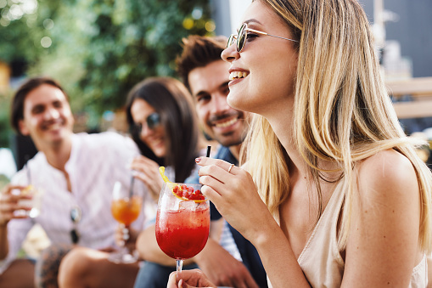
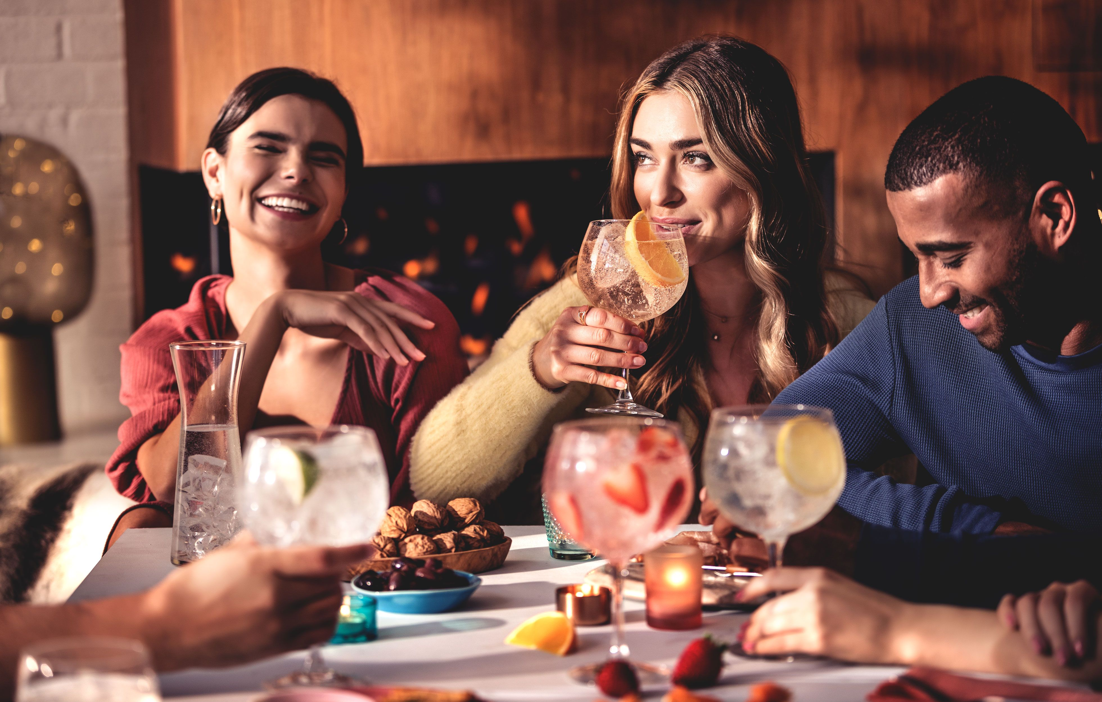
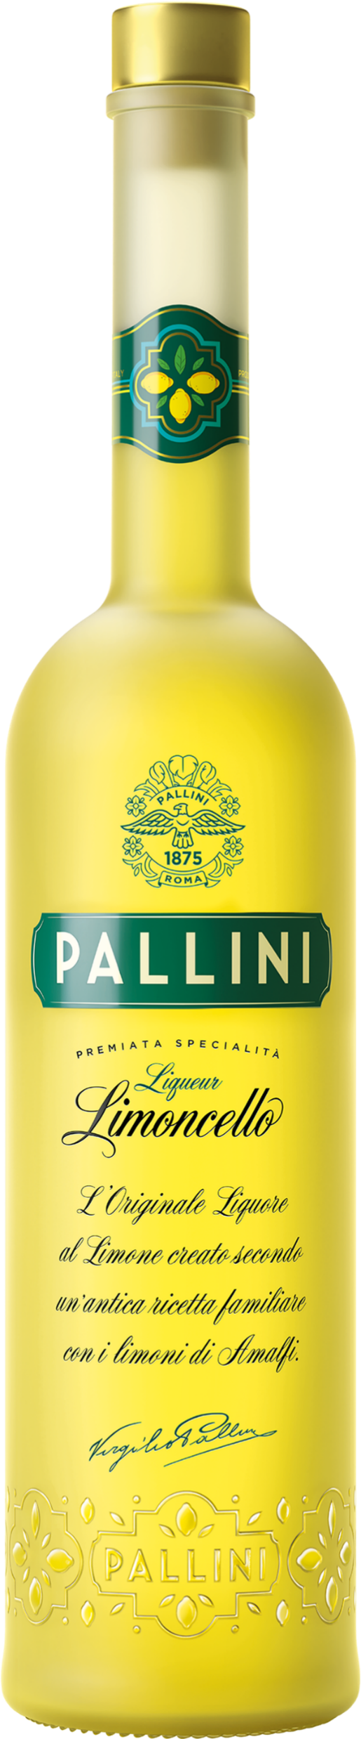
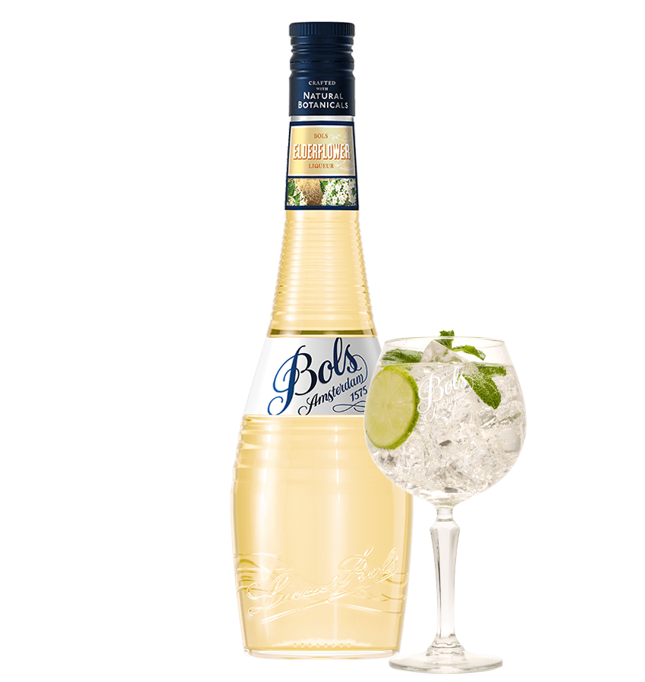
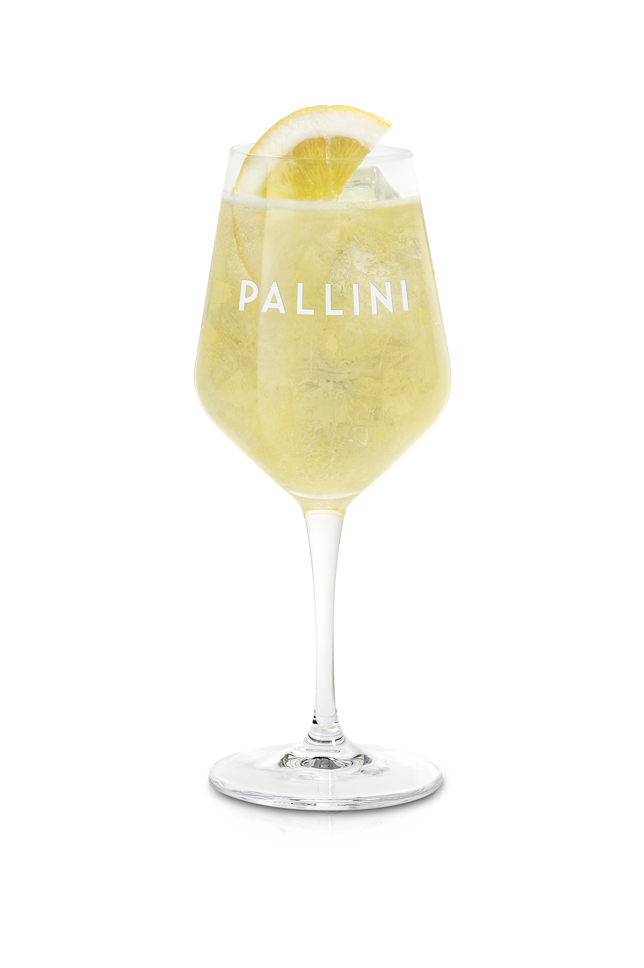
TREND #1
APERITIVO & SPRITZ
SHOPPER INSIGHT Shoppers are recreating lighter, daytime drinking occasions at home—seeking refreshing, lower-ABV options
MARKET PROOF
Spritz menu mentions +14% (SOMM AI)
CHANNEL FOCUS Liquor stores, wine shops, premium grocery, summer displays
RETAILER OPPORTUNITY: Turn Spritz into a multi-item basket engine—driving 2–3 item attachments and repeat purchase.
BRAND CREDENTIALS
Pallini — World’s #1 Limoncello (IWSR); 150 years heritage
Bols Elderflower — 92 pts . Wine Enthusiast
HERO BASKET Pallini Limoncello + Prosecco + Soda
EXECUTION PLAYBOOK
Trade-up shoppers from Aperol to Pallini to increase avg basket value
Cross-merchandise Spritz using Pallini + Prosecco + soda to drive higher value baskets

Slide 6
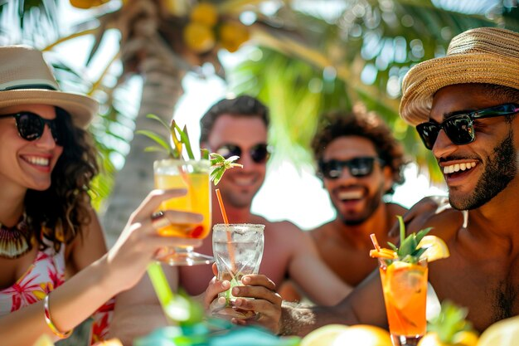
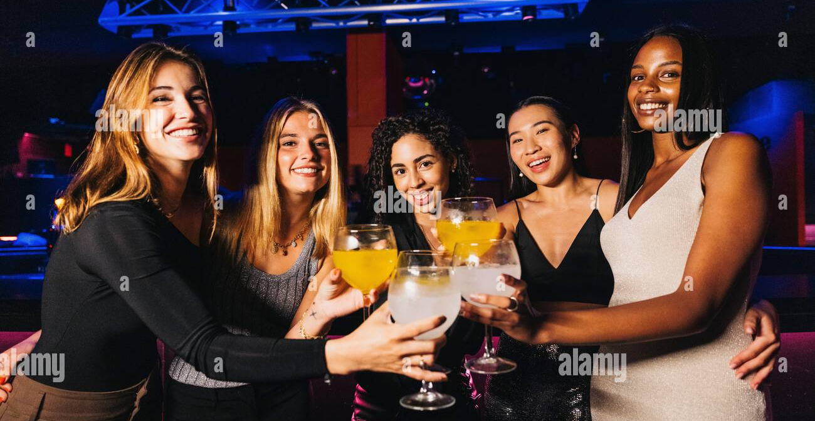
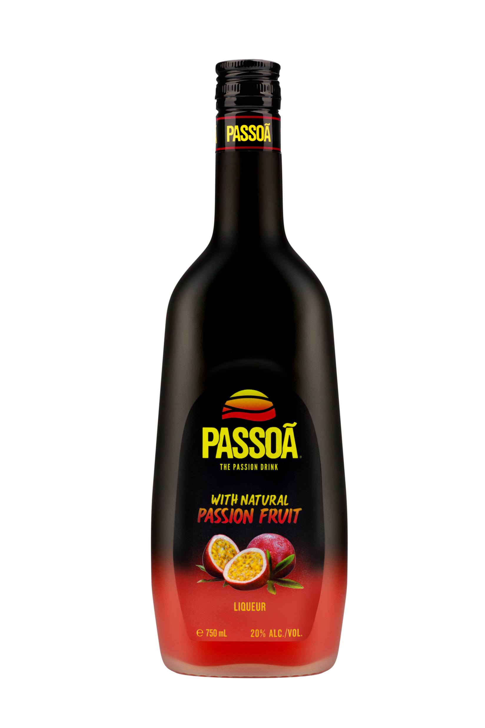
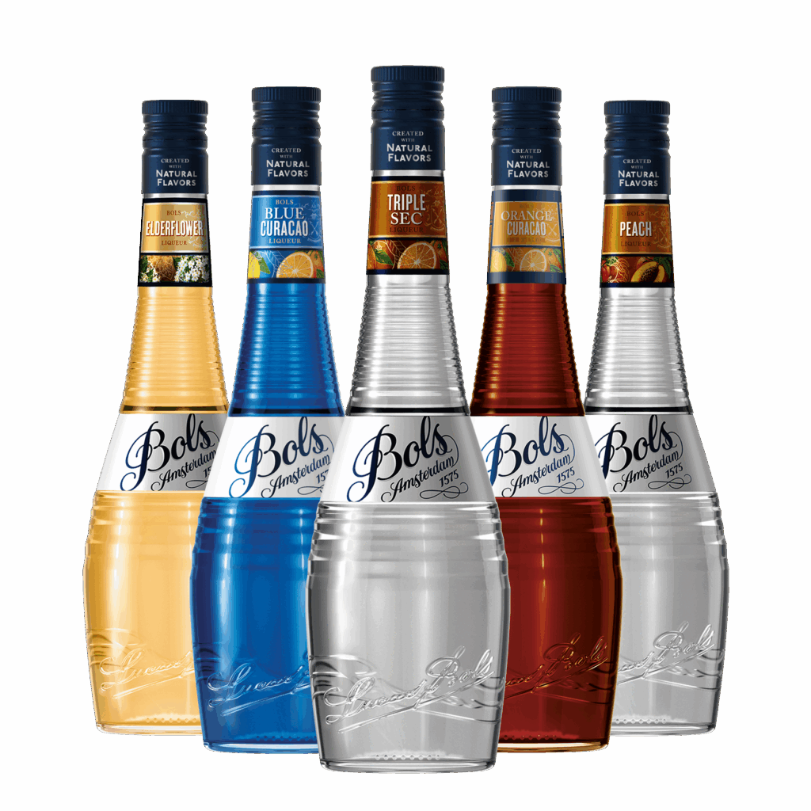
TREND #2
TROPICAL & SHAREABLE
SHOPPER INSIGHT Shoppers gravitate toward bold, colorful cocktails that feel social, fun, and worth sharing
MARKET PROOF
Pornstar Martini #1 global cocktail (Difford’s Guide)
CHANNEL FOCUS Large liquor chains, urban stores, beach towns, college markets
RETAILER OPPORTUNITY: Turn color into conversion—using bold, visual displays to stop shoppers and drive impulse baskets.
BRAND CREDENTIALS
Passoã — #1 Passion Fruit Liqueur; original Pornstar Martini; great cocktail versatility across Margarita, Mojito, Martini
HERO BASKET
Passoã or Bols Liqueurs + Vodka, Rum or Tequila
EXECUTION PLAYBOOK
Create “tropical” shelf blocks by placing Passoa next to Malibu and grouping Bols Flavors together
Cross Merchandise Passoa with vodka, rum, tequila to drive avg basket

Slide 7
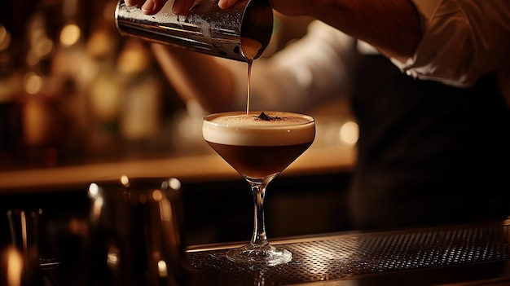
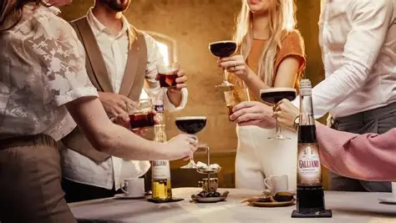
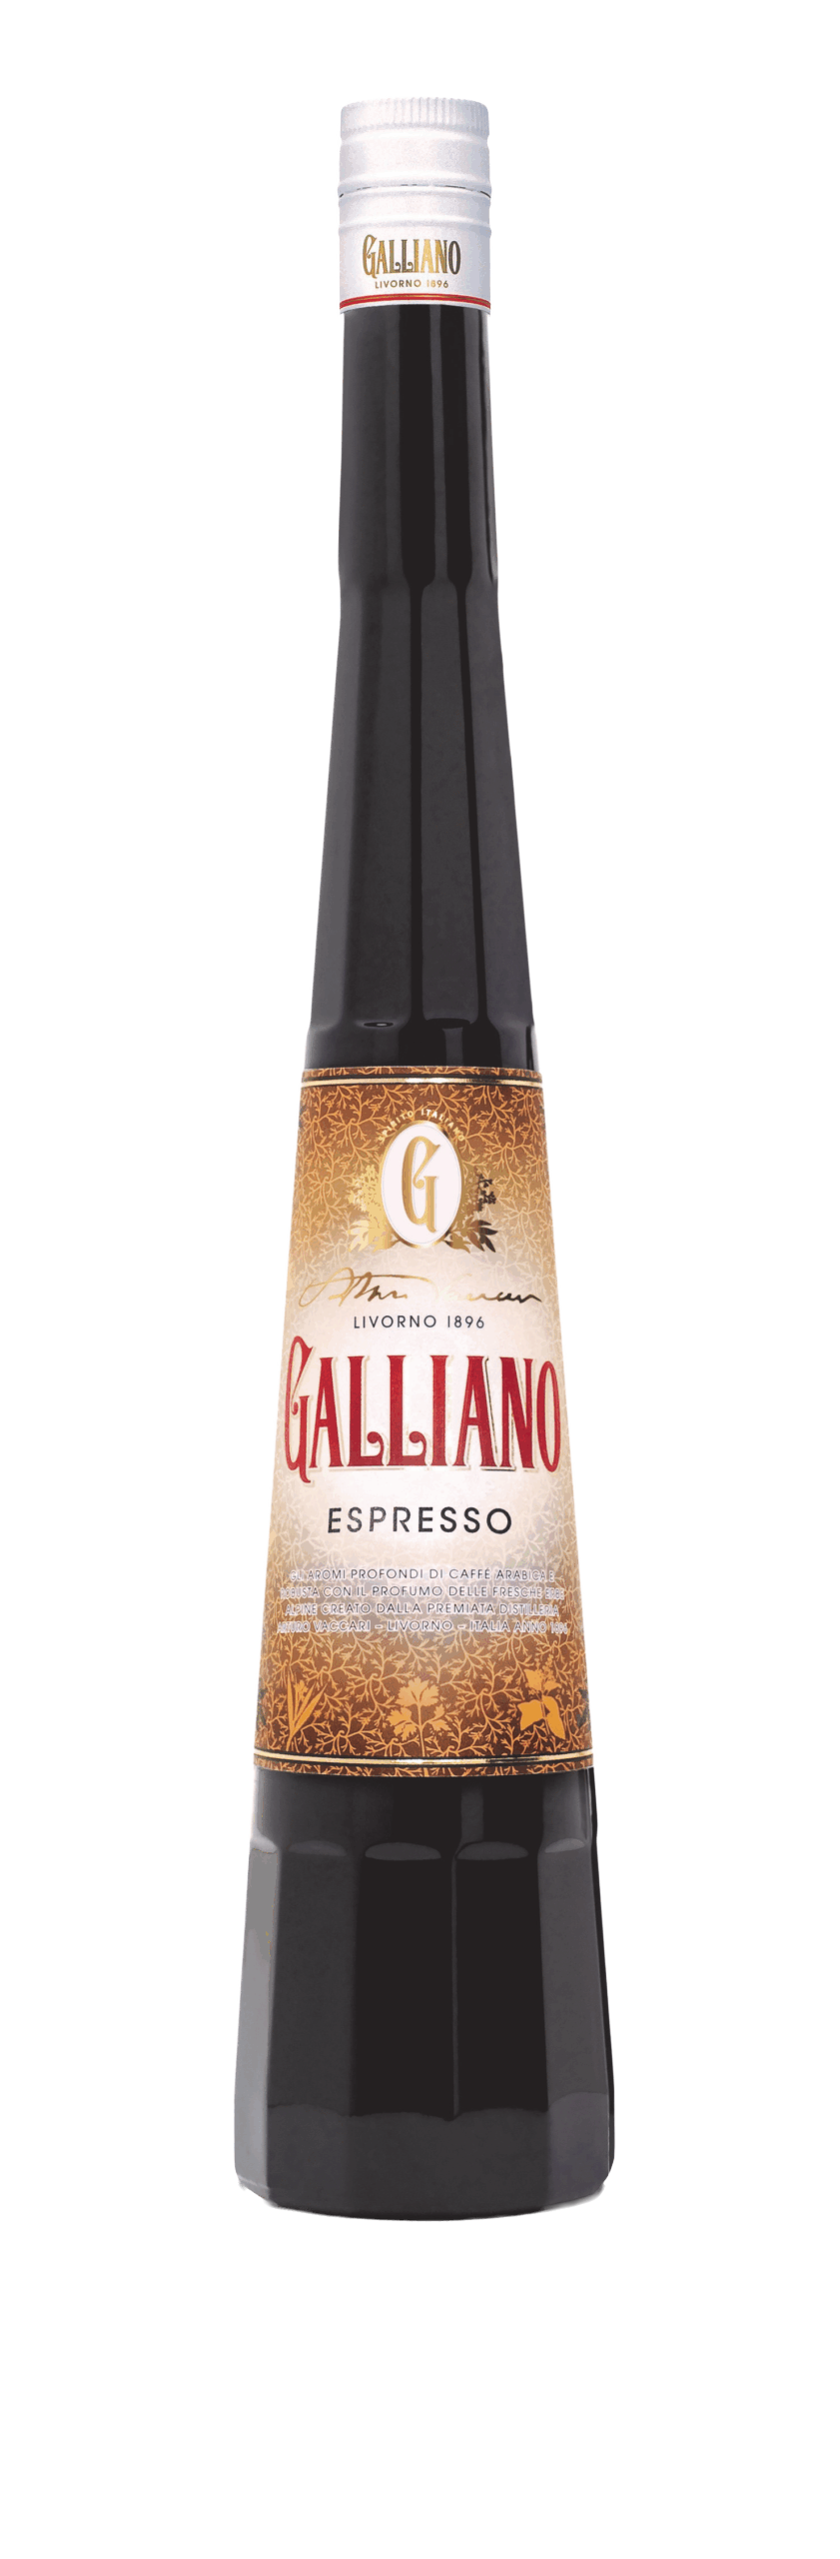
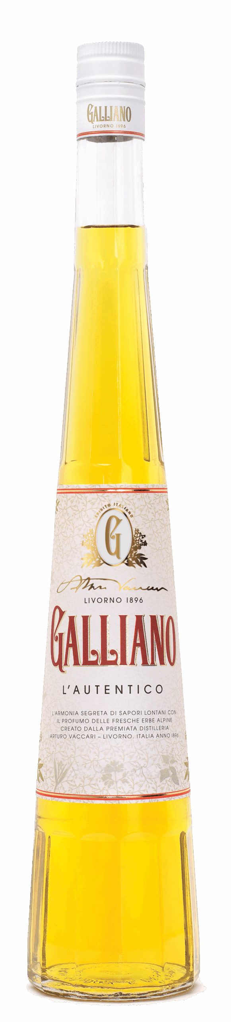
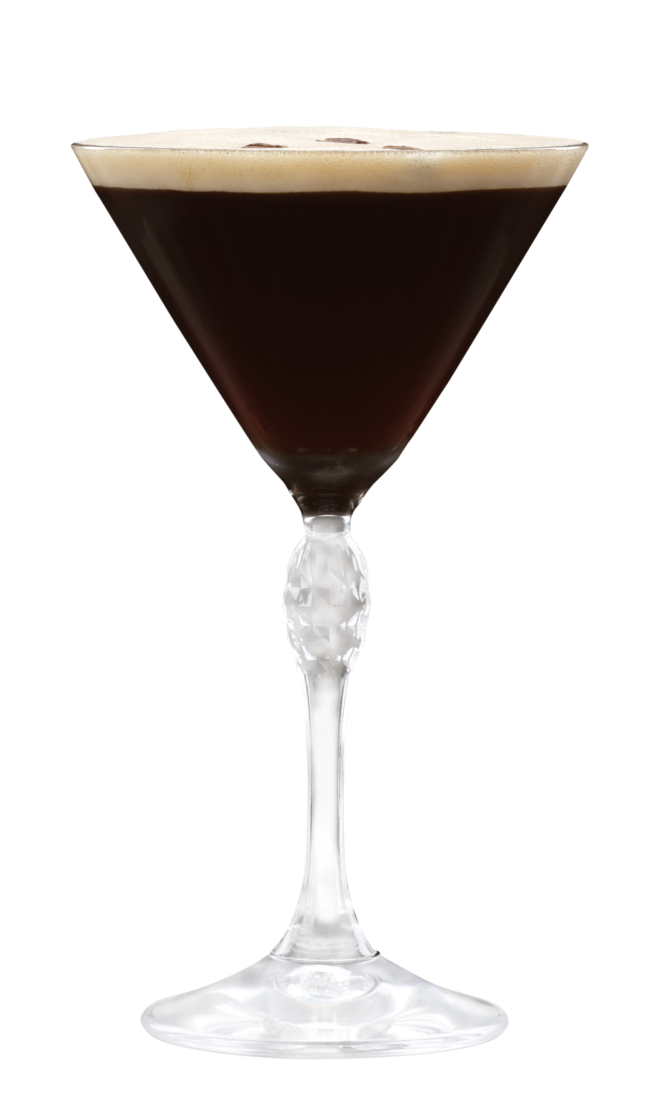
TREND #3
COFFEE & INDULGENCE
SHOPPER INSIGHT Consumers seek indulgent, dessert-style drinks at home—especially post-dinner or weekend treats
MARKET PROOF
Espresso Martini Top 10 global cocktail (Difford’s Guide)
CHANNEL FOCUS Liquor + grocery, holiday displays, gifting sections
RETAILER OPPORTUNITY: Turn one-bottle occasions into two-drink moments and drive premium basket trade-up
BRAND CREDENTIALS
Galliano Espresso — richer coffee profile, less sweet
Galliano L’Autentico — iconic herbal-vanilla liqueur
HERO BASKET
Galliano Espresso + Vodka + Coffee
EXECUTION PLAYBOOK
Place Galliano Espresso on shelf next to other coffee liqueurs to drive shopper trade up
Cross-merchandise Galliano Espresso with vodka and coffee ingredients to increase basket value

Slide 8
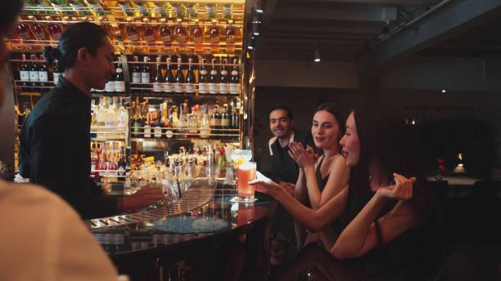
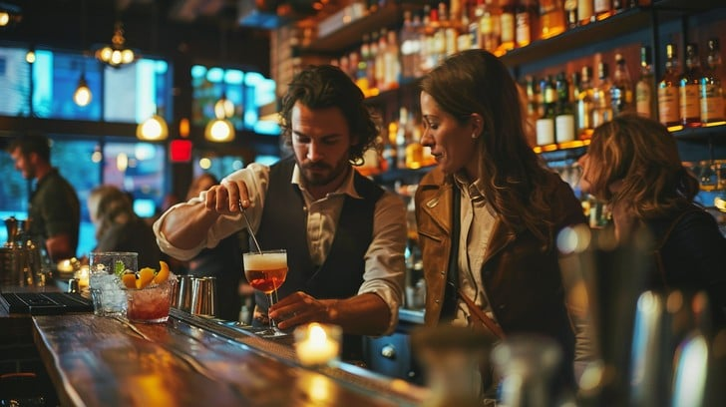
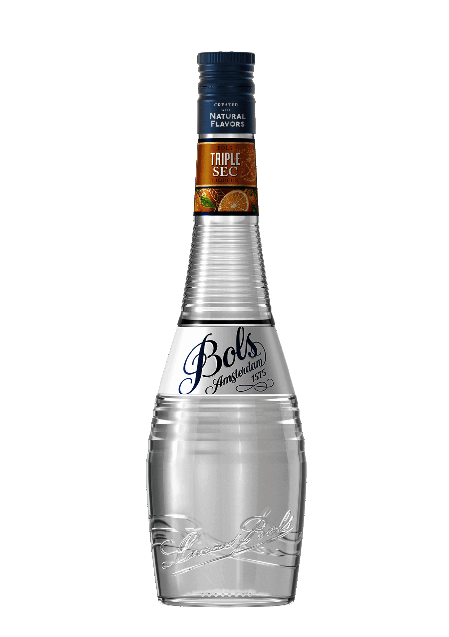
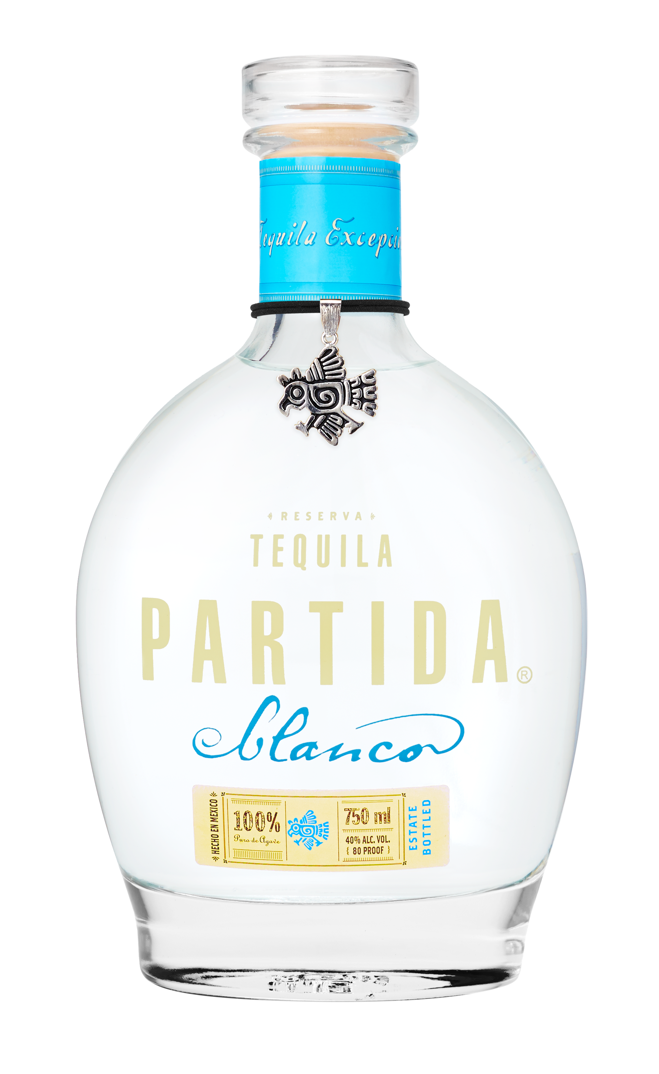
TREND #4
DRINK BETTER
SHOPPER INSIGHT
Shoppers are buying fewer bottles but trading up for quality, authenticity, and transparency
MARKET PROOF
Additive-free tequila +15% dollar sales (Nielsen)
CHANNEL FOCUS
Premium liquor stores, tequila sections, high-income trade areas
RETAILER OPPORTUNITY: Drive trade-up and premium margin expansion through clear quality cues and upgrade messaging
BRAND CREDENTIALS
Tequila Partida — award winning additive-free tequila since 2005
Bols Triple Sec – 93 pts. Ultimate Spirits Challenge
HERO BASKET
Partida Tequila + Bols Triple Sec + Lime
EXECUTION PLAYBOOK
Build “upgrade your cocktail” shelf communication (e.g., Margarita trade-up)
Create good-better-best ladders to guide shopper decisions
Trade up with Partida and Roble Fino to increase price per bottle

Slide 9
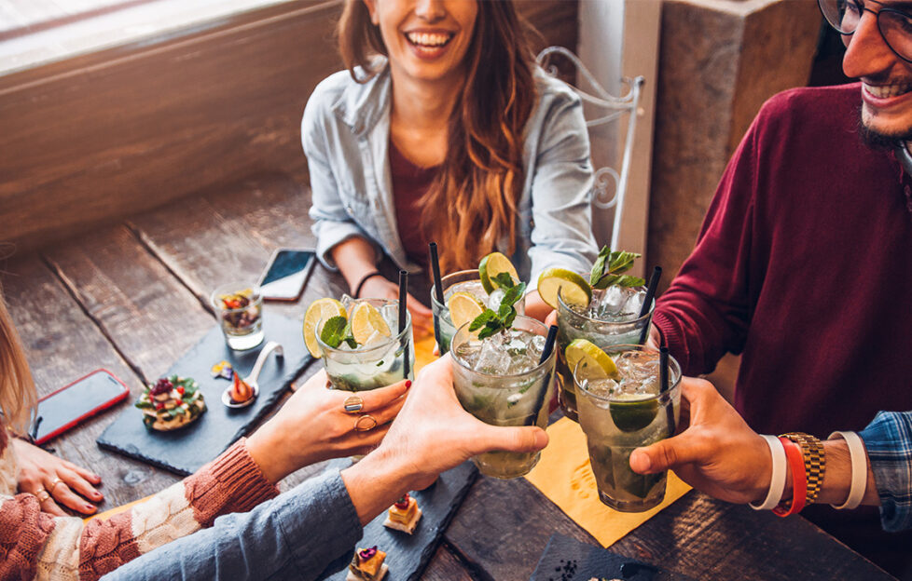
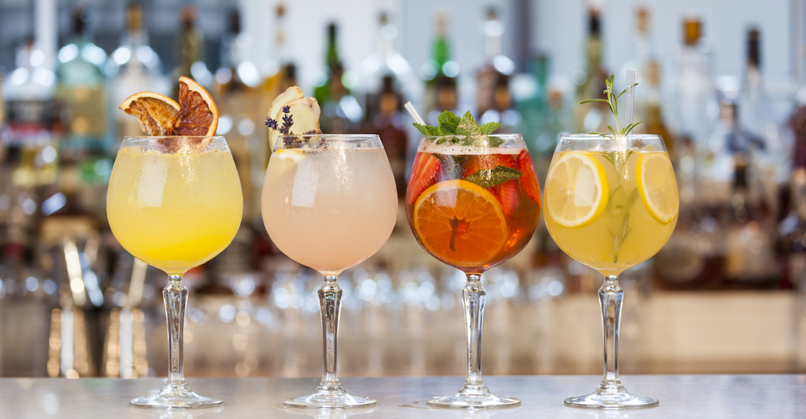
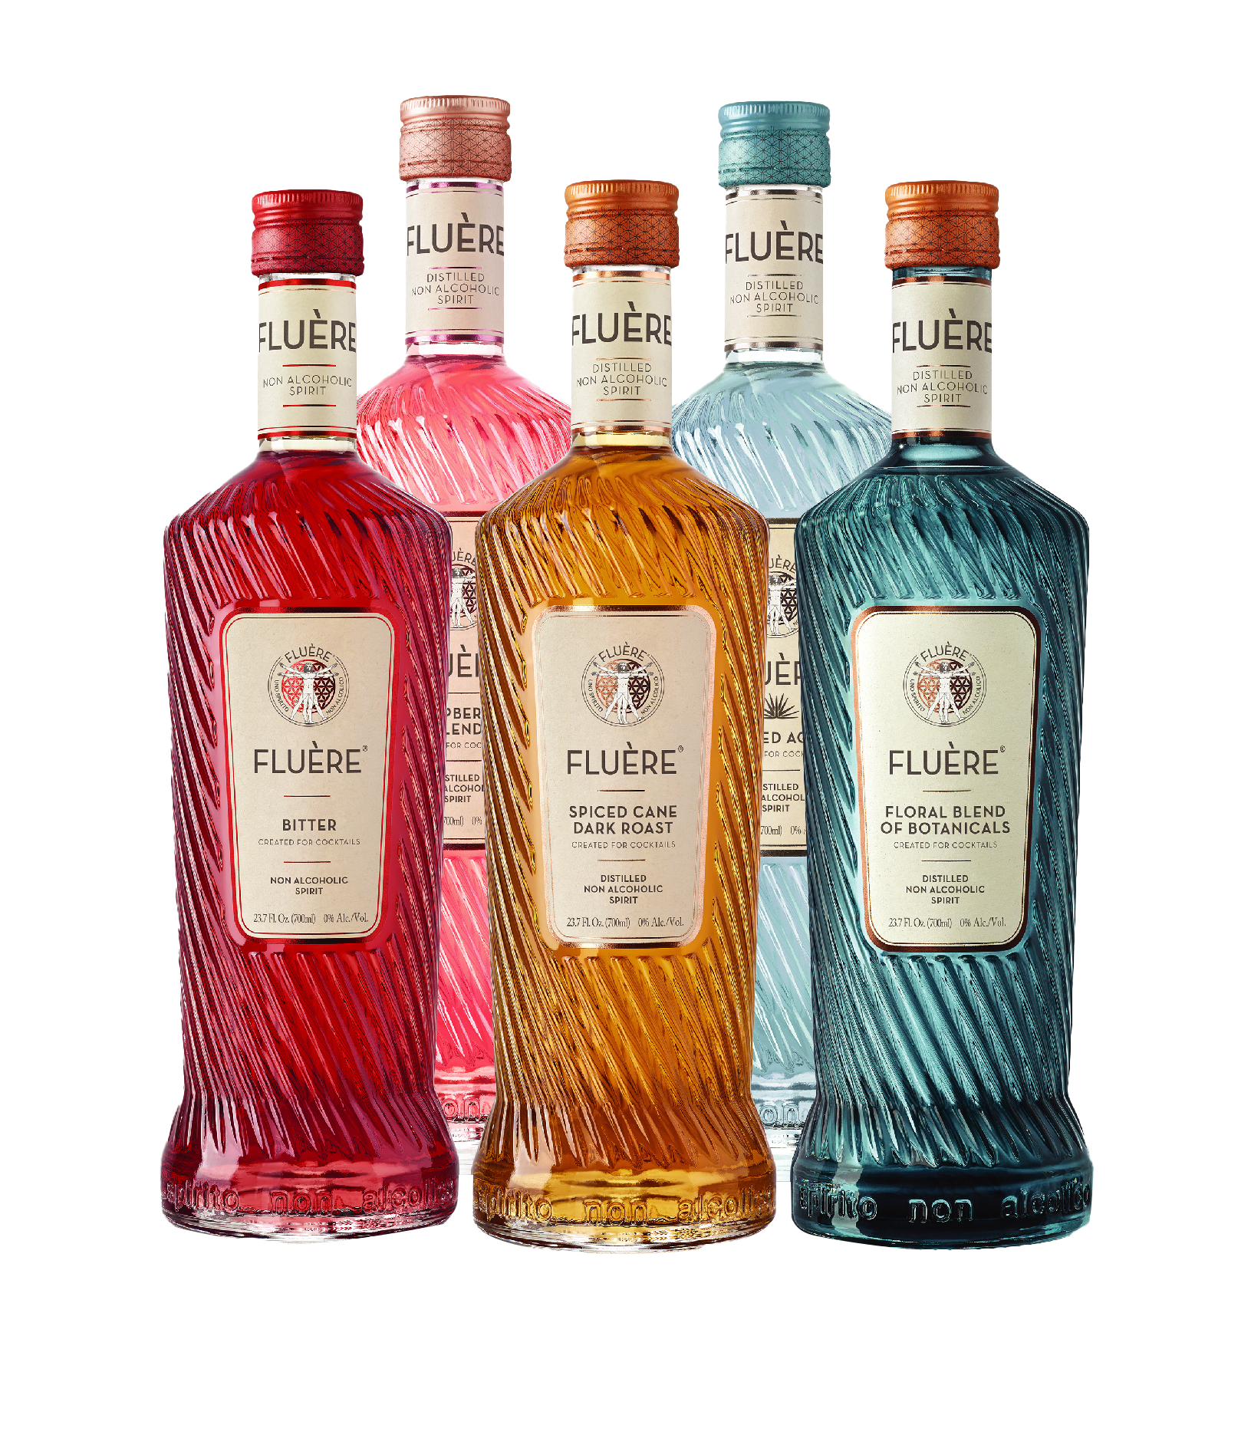
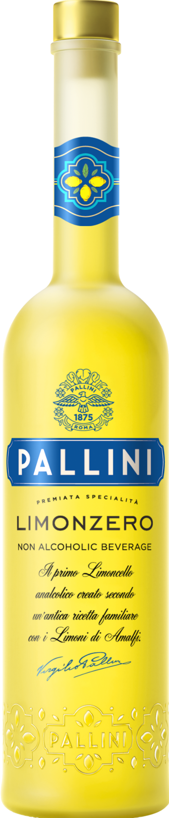
TREND #5
LO & NO ALCOHOL
SHOPPER INSIGHT
Moderation is expanding occasions—shoppers want full cocktail experiences without alcohol
MARKET PROOF
Non-alcoholic menu mentions +300% (SOMM AI)
CHANNEL FOCUS
Premium grocery, wellness retailers, urban liquor, moderation-forward sets
RETAILER OPPORTUNITY: Capture incremental occasions and shoppers without losing basket value.
BRAND CREDENTIALS
Fluère — award-winning non-alcoholic spirits
Pallini Limonzero — first non-alcoholic limoncello
HERO BASKET
Fluère + Mixer
Pallini
Limonzero + Soda
EXECUTION PLAYBOOK
Widen no/low offerings across shelf with clear signage
Build “same cocktail, no alcohol” solutions to drive adoption
Cross merchandise with cocktail mixers (e.g. Prosecco for Spritz) to drive basket value

Slide 10
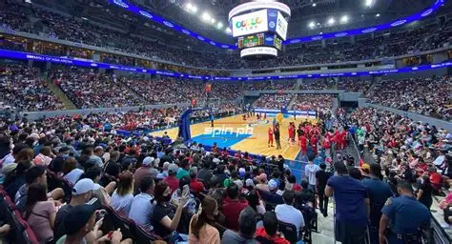
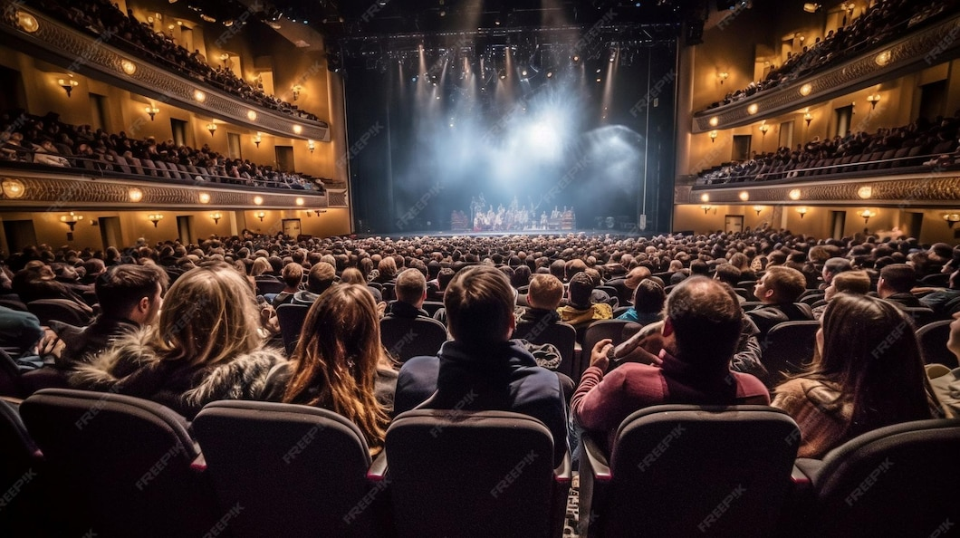
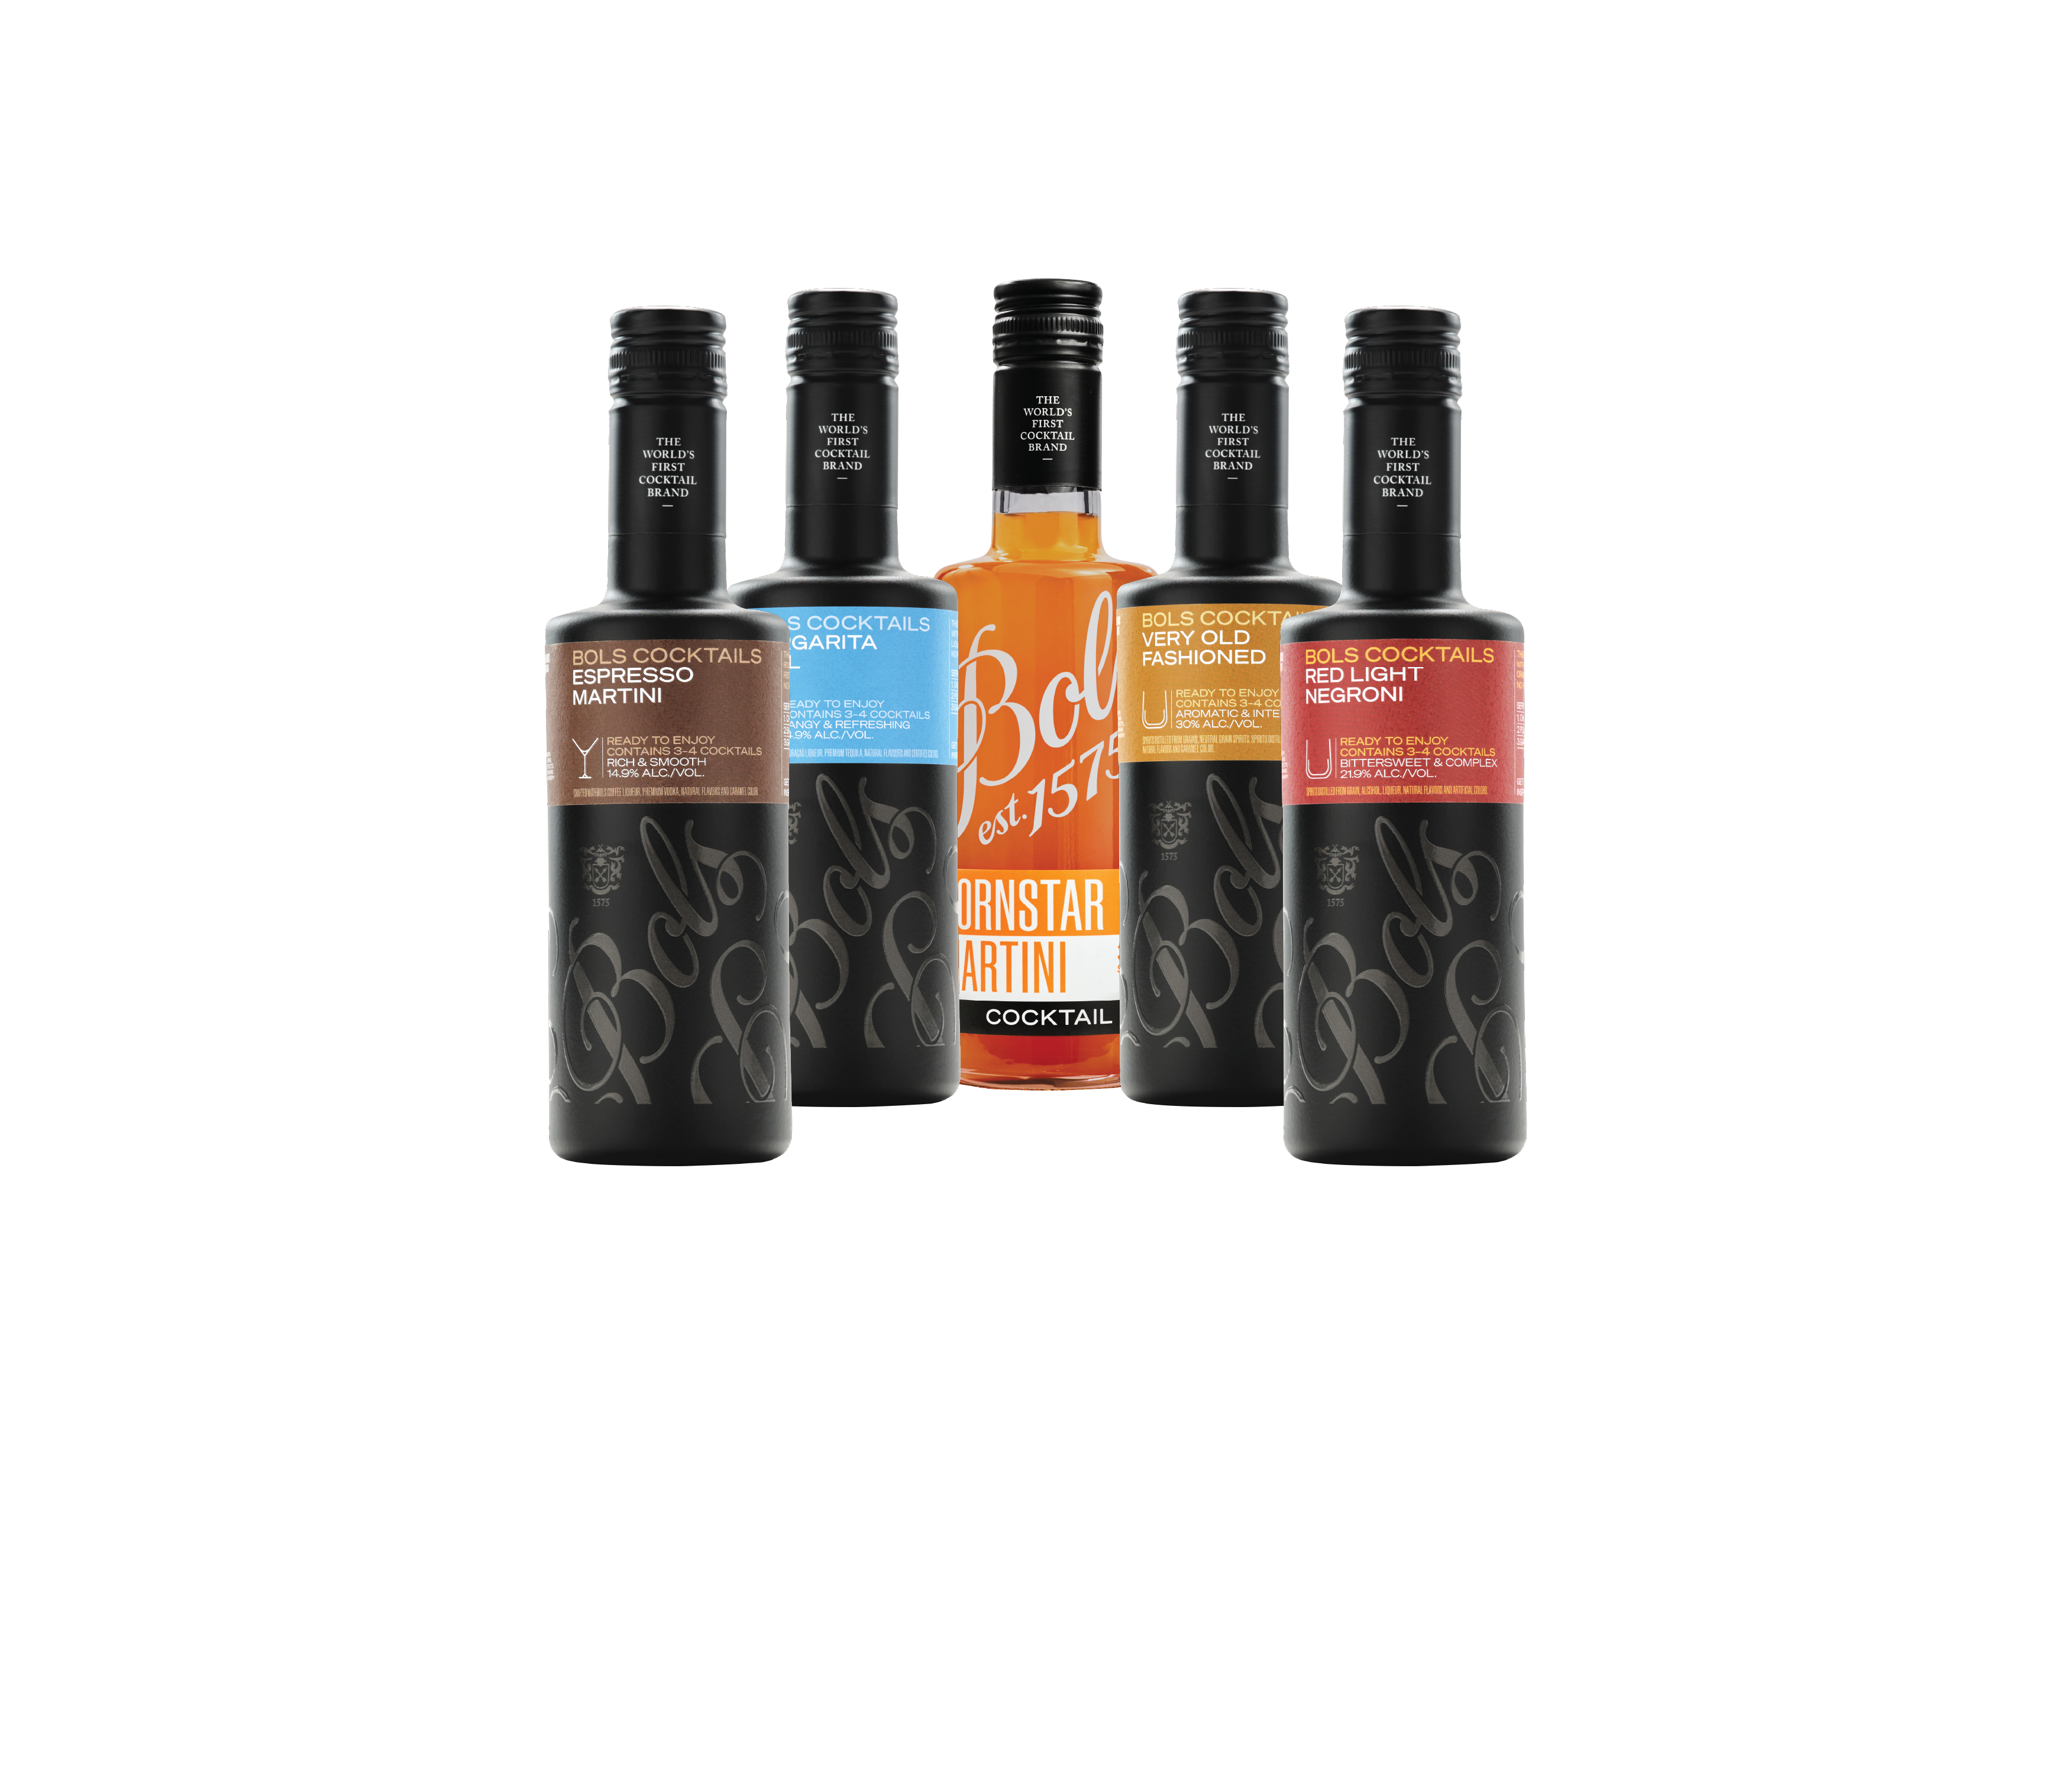
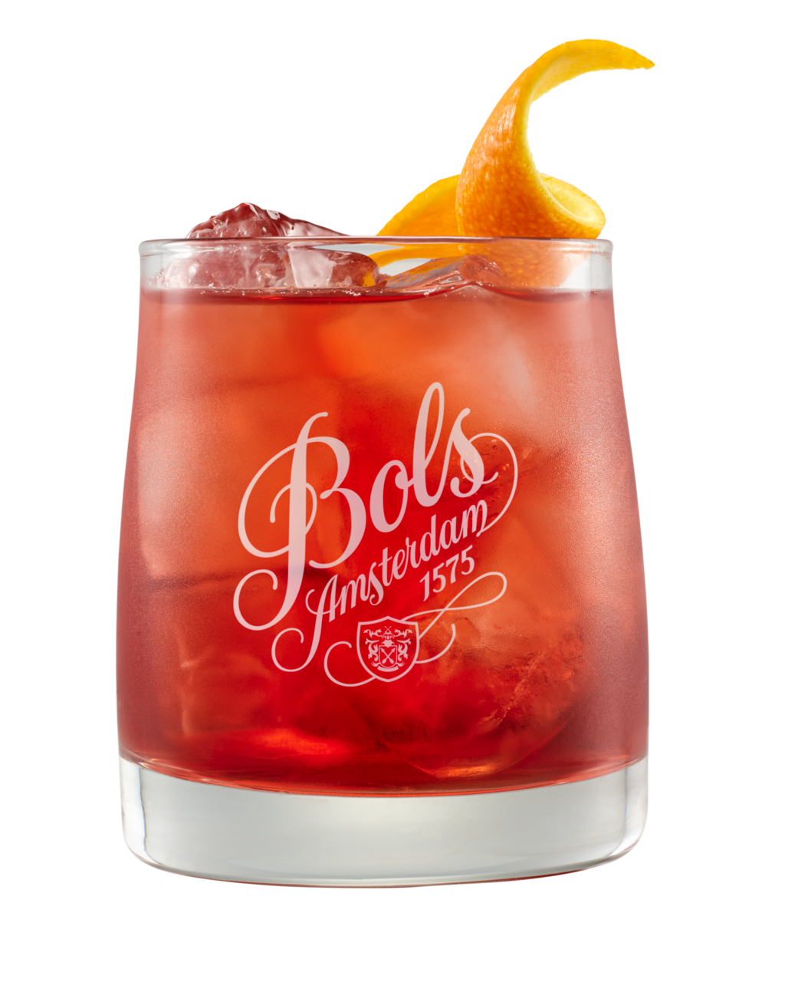
TREND #6
QUALITY AT SCALE
CONSUMER INSIGHT
Shoppers want bar-quality cocktails with zero effort—especially for hosting and social occasions
MARKET PROOF
RTS cocktails +19% dollar sales (Nielsen)
CHANNEL FOCUS
End caps, front-of-store displays, convenience-driven retail
RETAILER OPPORTUNITY: Win the convenience & hosting occasion— driving impulse purchases and high-velocity sales
BRAND CREDENTIALS
Bols RTS — bartender-crafted cocktails with real spirits; 450-year expertise
EXECUTION PLAYBOOK
Offer 5 cocktails set to drive multiple purchases
Position as already chilled or “pour over ice” cocktail solution to remove friction
Prioritize secondary placement (front of store / end caps) — critical to conversion
HERO BASKET
Bols RTS Margarita / Espresso Martini

Slide 11
LIMONCELLO
HOW TO WIN IN STORE
“The 6 trends are reshaping how consumers drink and shop. This framework turns them into simple, high-impact retail programs that drive bigger baskets, premium trade-up, and faster sell-through.”
Build Occasions, Not Just Shelves
Spritz / Tropical / Coffee / No & Low / Hosting
2. Drive the Basket, Not the Bottle
Every display = 2–3 item attachment minimum
3. Remove Friction
“3 ingredients”
“Pour over ice”
“Same cocktail, no alcohol”

Slide 12
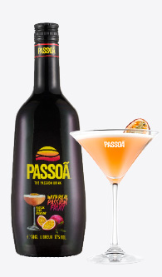
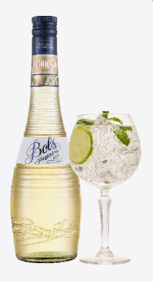
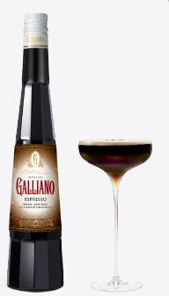
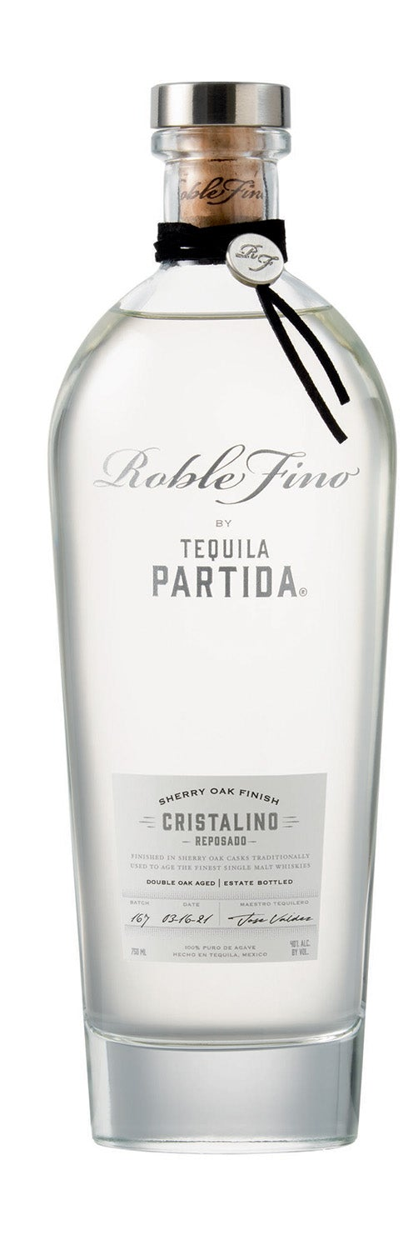
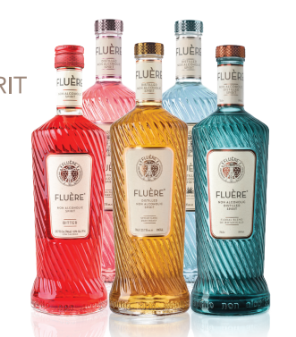
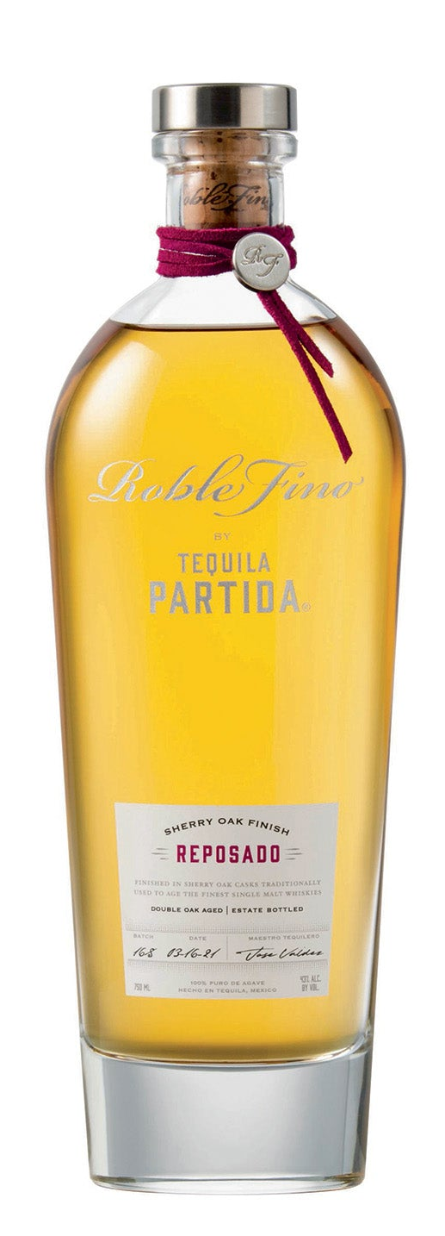
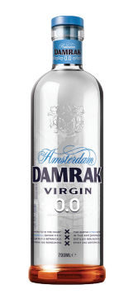
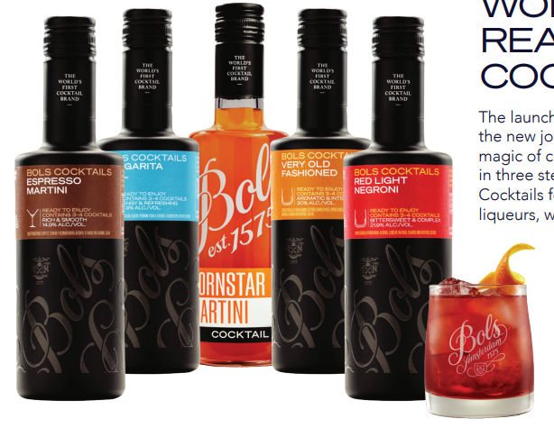
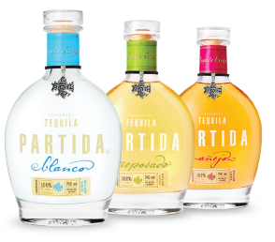
LIMONCELLO
WINNING ON PREMISE WITH LUCAS BOLS
Leading brands in high growth category segments aligned with trends
APERITIVO & SPRITZ
TROPICAL & VISUAL
COFFEE/INDULGENCE
PALLINI LIMONCELLO
+6%
ELDERFLOWER
LIQUEUR
PASSION FRUIT
LIQUEUR
PREMIUM COFFEE
LIQUEUR
+30%
Dollar Sales*
+8%
Dollar
Sales*
+79%
in menu mentions to 52k in 2025
DEPLETIONS
+14%
“Spritz” menu mentions to 40k in 2025
*Nielsen 52wks 12/22/25
+14%
“Spritz” menu mentions to 40k in 2025
*Nielsen 52wks 12/22/25
Source: SOMM AI
Source: SOMM AI
Source: SOMM AI
DRINK BETTER/ TRANSPARENCY
LO & NO ALCOHOL
QUALITY COCKTAILS AT SCALE
ADDITIVE-FREE TEQUILA
+15% Dollar Sales*
NON ALC SPIRITS +300% Menu Mentions*
RTS COCKTAILS +19%
Dollar Sales*
*Nielsen 52wks 12/22/25
*Nielsen 52wks 12/22/25
Source: SOMM AI

Slide 13
WHY LUCAS BOLS WINS
“From shelf to basket, from bottle to occasion—this is how we win off-premise.”
Proven Cocktail Expertise Since 1575
450 years of cocktail craftsmanship and bartender credibility
Complete Portfolio Across All 6 Programs
From spritz to tropical, coffee to no/low, premium to RTS—one partner, total solution
Built for Retailers, Not Just Brands
Programs designed to drive revenue, simplify execution, and improve margins
Drives Incremental Revenue
Higher average baskets, shopper trade-up, and more frequent purchases
“Let’s activate these programs now— and drive immediate growth across your accounts”

Slide 14
LIMONCELLO
6 TRENDS DRIVING RETAIL GROWTH – ONE PAGER
“These 6 trends are reshaping how consumers drink and shop. This framework turns them into simple, high-impact retail programs that drive bigger baskets, premium trade-up, and faster sell-through.”
Trend | Consumer Insight | Channel Focus | Market Proof | Retailer Opportunity | Hero Basket | Brand Credentials | Execution Playbook
#1 🍋 Aperitivo & Spritz | Shoppers are recreating lighter, daytime drinking occasions at home—seeking refreshing, lower-ABV options | Liquor stores, wine shops, premium grocery, summer displays | Spritz menu mentions +14% (SOMM AI) | Build a spritz occasion in-store to drive multi-item baskets and repeat purchases | Pallini Limoncello + Prosecco + Soda | Pallini — World’s #1 Limoncello (IWSR); 150 years heritage Bols Elderflower — 92 pts Wine Enthusiast | Trade-up shoppers from Aperol to Pallini to increase avg basket value Cross-merchandise Spritz using Pallini + Prosecco + soda to drive higher value baskets
#2 🌴 Tropical, Visual & Shareable | Shoppers gravitate toward bold, colorful cocktails that feel social, fun, and worth sharing | Large liquor chains, urban stores, beach towns, college markets | Pornstar Martini #1 global cocktail (Difford’s Guide) | Drive impulse purchases and trade-up through visually disruptive displays and flavor-led exploration | Passoã + Vodka + Passion fruit Bols Blue + Vodka + Lemonade | Passoã — #1 Passion Fruit Liqueur; original Pornstar Martini Bols Blue 1575 — 94 pts Wine Enthusiast; 450-year heritage | Create “tropical” shelf blocks by placing Passoa next to Malibu and grouping Bols Flavors together Cross Merchandise Passoa with vodka, rum, tequila to drive avg basket
#3 ☕ Coffee & Indulgence | Consumers seek indulgent, dessert-style drinks at home—especially post-dinner or weekend treats | Liquor + grocery, holiday displays, gifting sections | Espresso Martini Top 10 global cocktail (Difford’s Guide) | Capture incremental “second drink” occasions and drive premium basket trade-up | Galliano Espresso + Vodka + Coffee | Galliano Espresso — richer coffee profile, less sweet Galliano L’Autentico — iconic herbal-vanilla liqueur | Place Galliano Espresso on shelf next to other coffee liqueurs to drive shopper trade up Cross-merchandise Galliano Espresso with vodka and coffee ingredients to increase basket value
“Each program is designed to add 1–2 incremental items per basket and drive premium trade-up across categories.”

Slide 15
LIMONCELLO
6 TRENDS DRIVING RETAIL GROWTH – ONE PAGER
“These 6 trends are reshaping how consumers drink and shop. This framework turns them into simple, high-impact retail programs that drive bigger baskets, premium trade-up, and faster sell-through.”
Trend | Consumer Insight | Channel Focus | Market Proof | Retailer Opportunity | Hero Basket | Brand Credentials | Execution Playbook
#4 🥃 Drink Better (Craft & Transparency) | Shoppers are buying fewer bottles but trading up for quality, authenticity, and transparency | Premium liquor stores, tequila sections, high-income trade areas | Additive-free tequila +15% dollar sales (Nielsen) | Drive trade-up and premium margin expansion through clear quality cues and upgrade messaging | Partida Tequila + Bols Triple Sec + Lime | Tequila Partida — additive-free since 2005; award-winning Muff Irish Whiskey — Robb Report recognition | Build “upgrade your cocktail” shelf communication (e.g., Margarita trade-up) Create good-better-best ladders to guide shopper decisions Trade up with Partida and Roble Fino to increase price per bottle
#5 🌿 Lo & No Alcohol | Moderation is expanding occasions—shoppers want full cocktail experiences without alcohol | Premium grocery, wellness retailers, urban liquor stores | Non-alcoholic menu mentions +300% (SOMM AI) | Capture incremental shoppers and occasions without sacrificing basket value | Fluère + Mixer Pallini Limonzero + Soda | Fluère — award-winning non-alcoholic spirits Pallini Limonzero — first non-alcoholic limoncello | Widen no/low offerings across shelf with clear signage Build “same cocktail, no alcohol” solutions to drive adoption Cross merchandise with cocktail mixers to drive basket value
#6 ⚡ Quality Cocktails at Scale (RTS) | Shoppers want bar-quality cocktails with zero effort—especially for hosting and social occasions | End caps, front-of-store displays, convenience-driven retail | RTS cocktails +19% dollar sales (Nielsen) | Drive high-velocity sales, impulse purchases, and larger baskets through convenience-led solutions | Bols RTS Margarita / Espresso Martini + Ice | Bols RTS — bartender-crafted with real spirits; 450-year expertise | Position as already chilled or “pour over ice” cocktail solution to remove friction Prioritize secondary placement (front of store / end caps) — critical to conversion
“Each program is designed to add 1–2 incremental items per basket and drive premium trade-up across categories.”

Slide 16

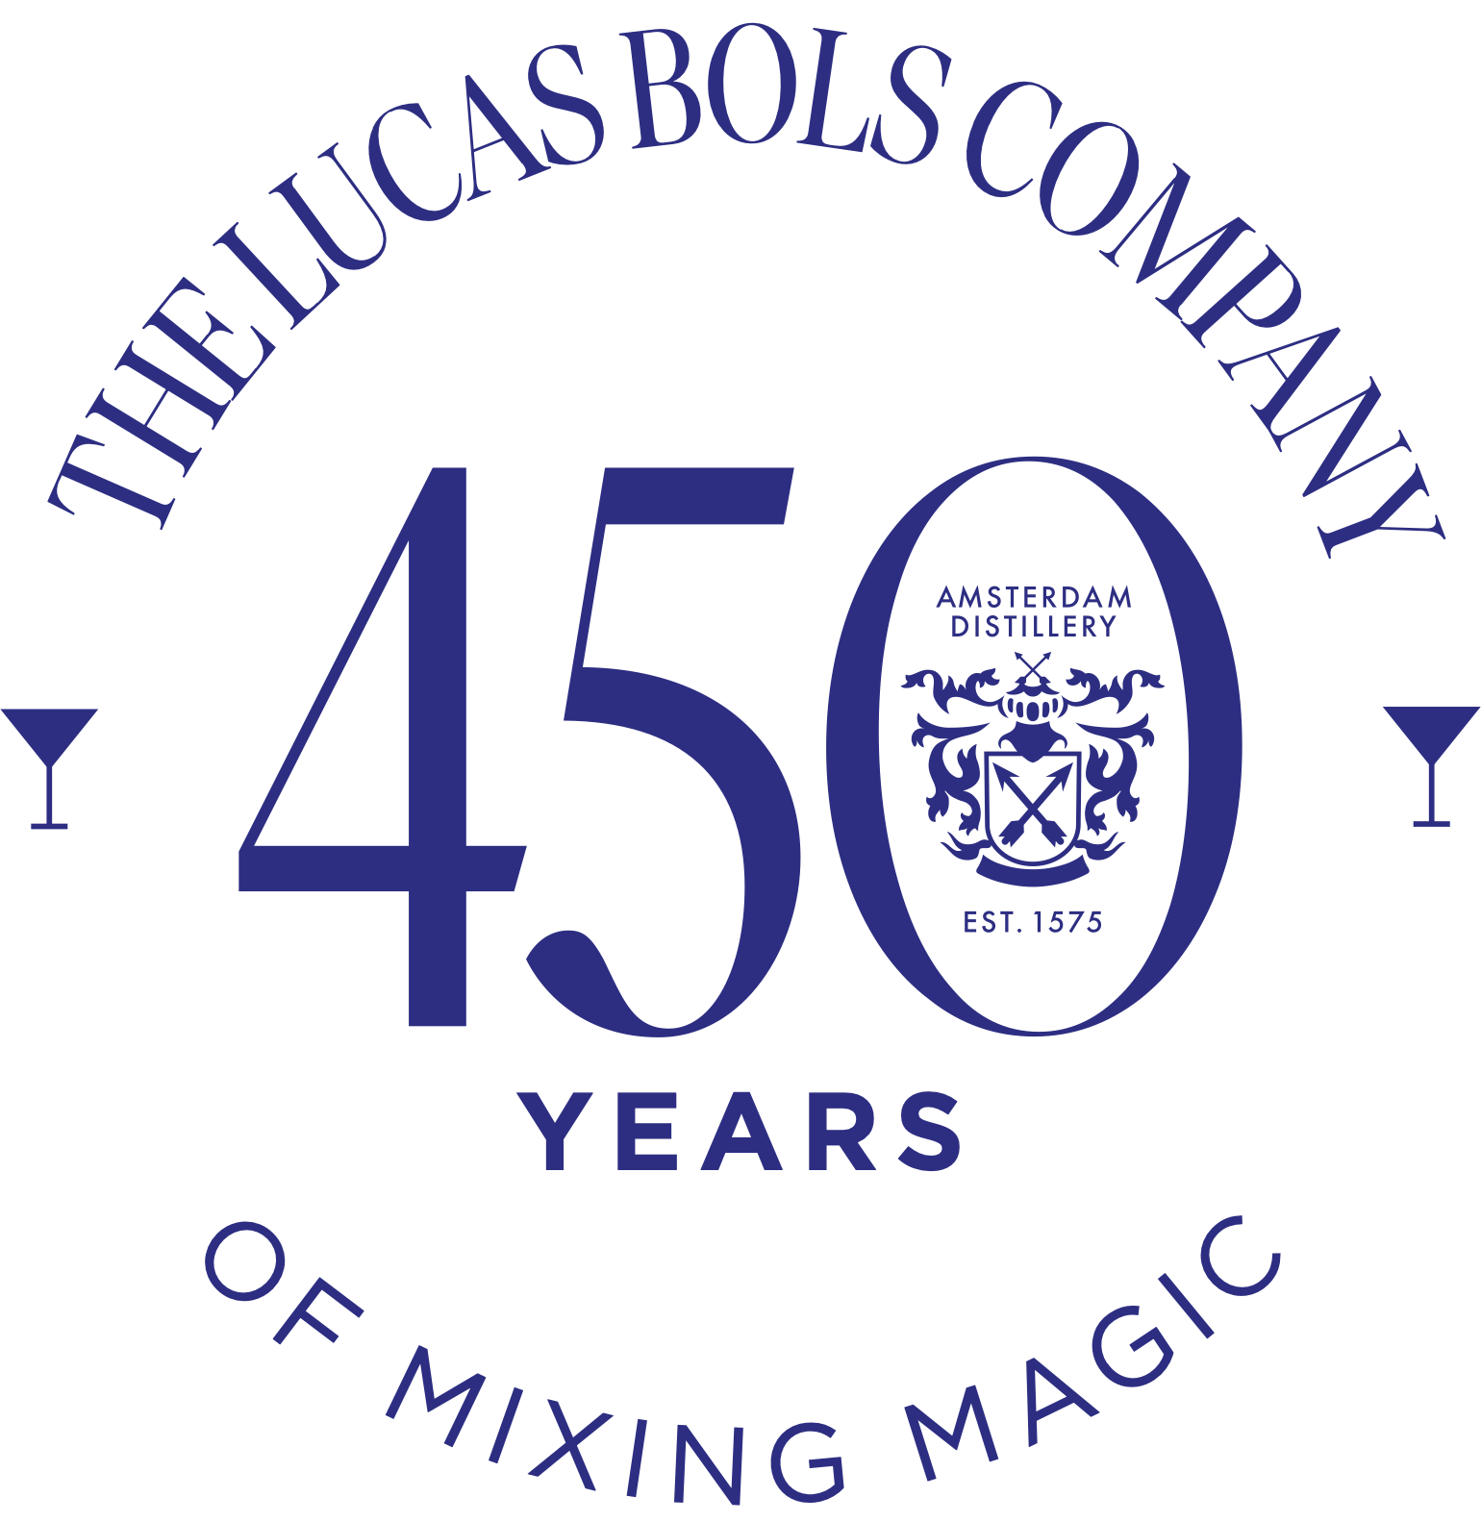

CREATING GREAT COCKTAIL EXPERIENCES AROUND THE WORLD
FOR 450 YEARS, SINCE 1575

