Slide 1
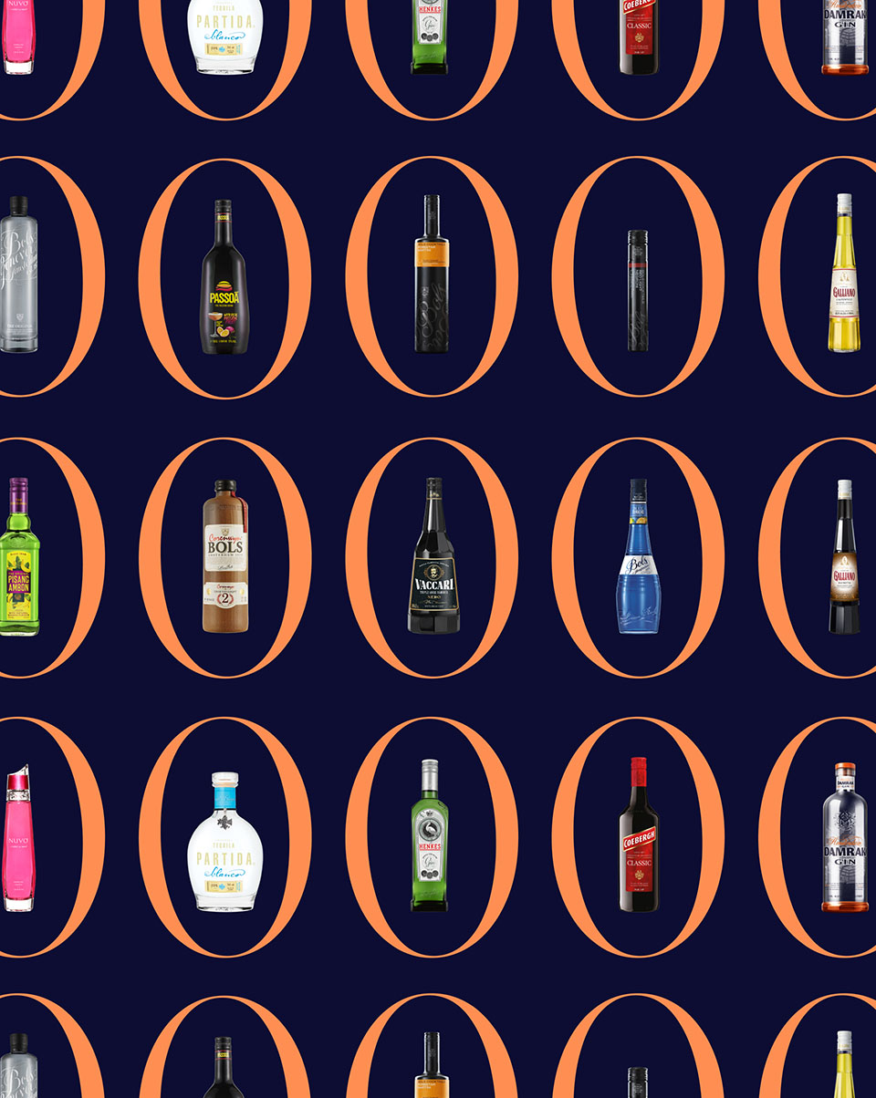


Accolades & Ratings Report

Slide 2
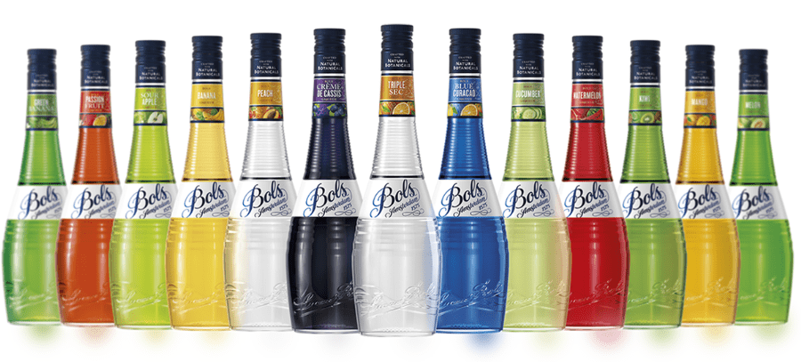

Slide 3


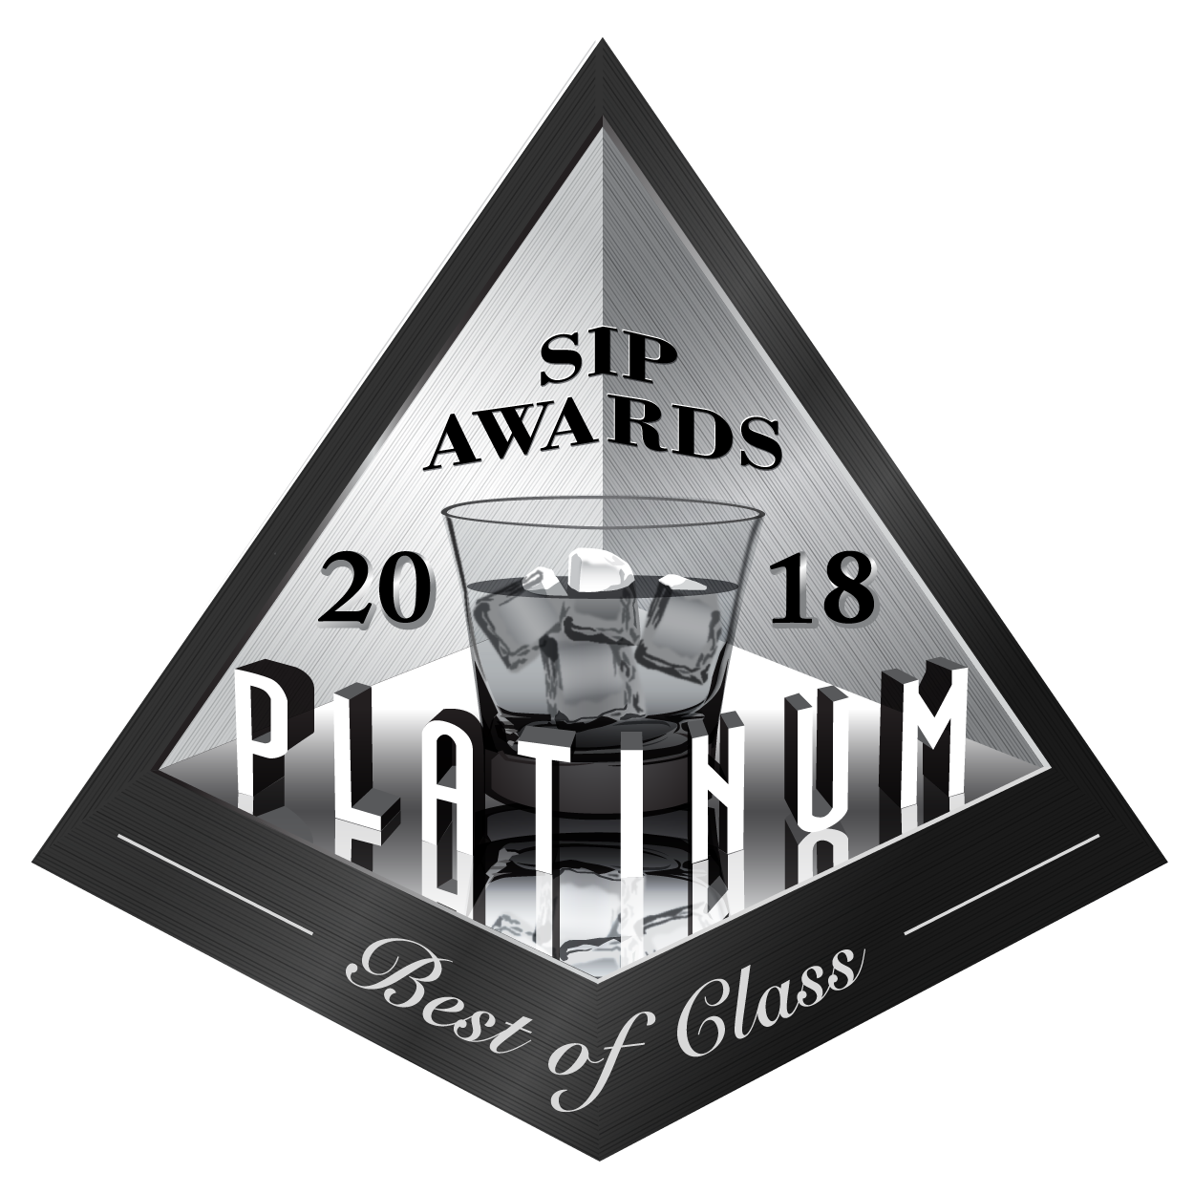





Bols Liqueurs
Award | Product | Medal/Score
2018 SIP Awards | Ginger | Platinum – Best of Class
2018 Wine & Spirits Wholesalers of America (WSWA) | Ginger | Double Gold Best of Show
2014 Wine Enthusiast | Elderflower | Best Buy
2023 The Spirits Business Global Liqueur Masters | Elderflower | Gold
2025 London Spirits Competition | Elderflower | 95 pts
2025 IWSC | Amaretto | 92 pts

Slide 4
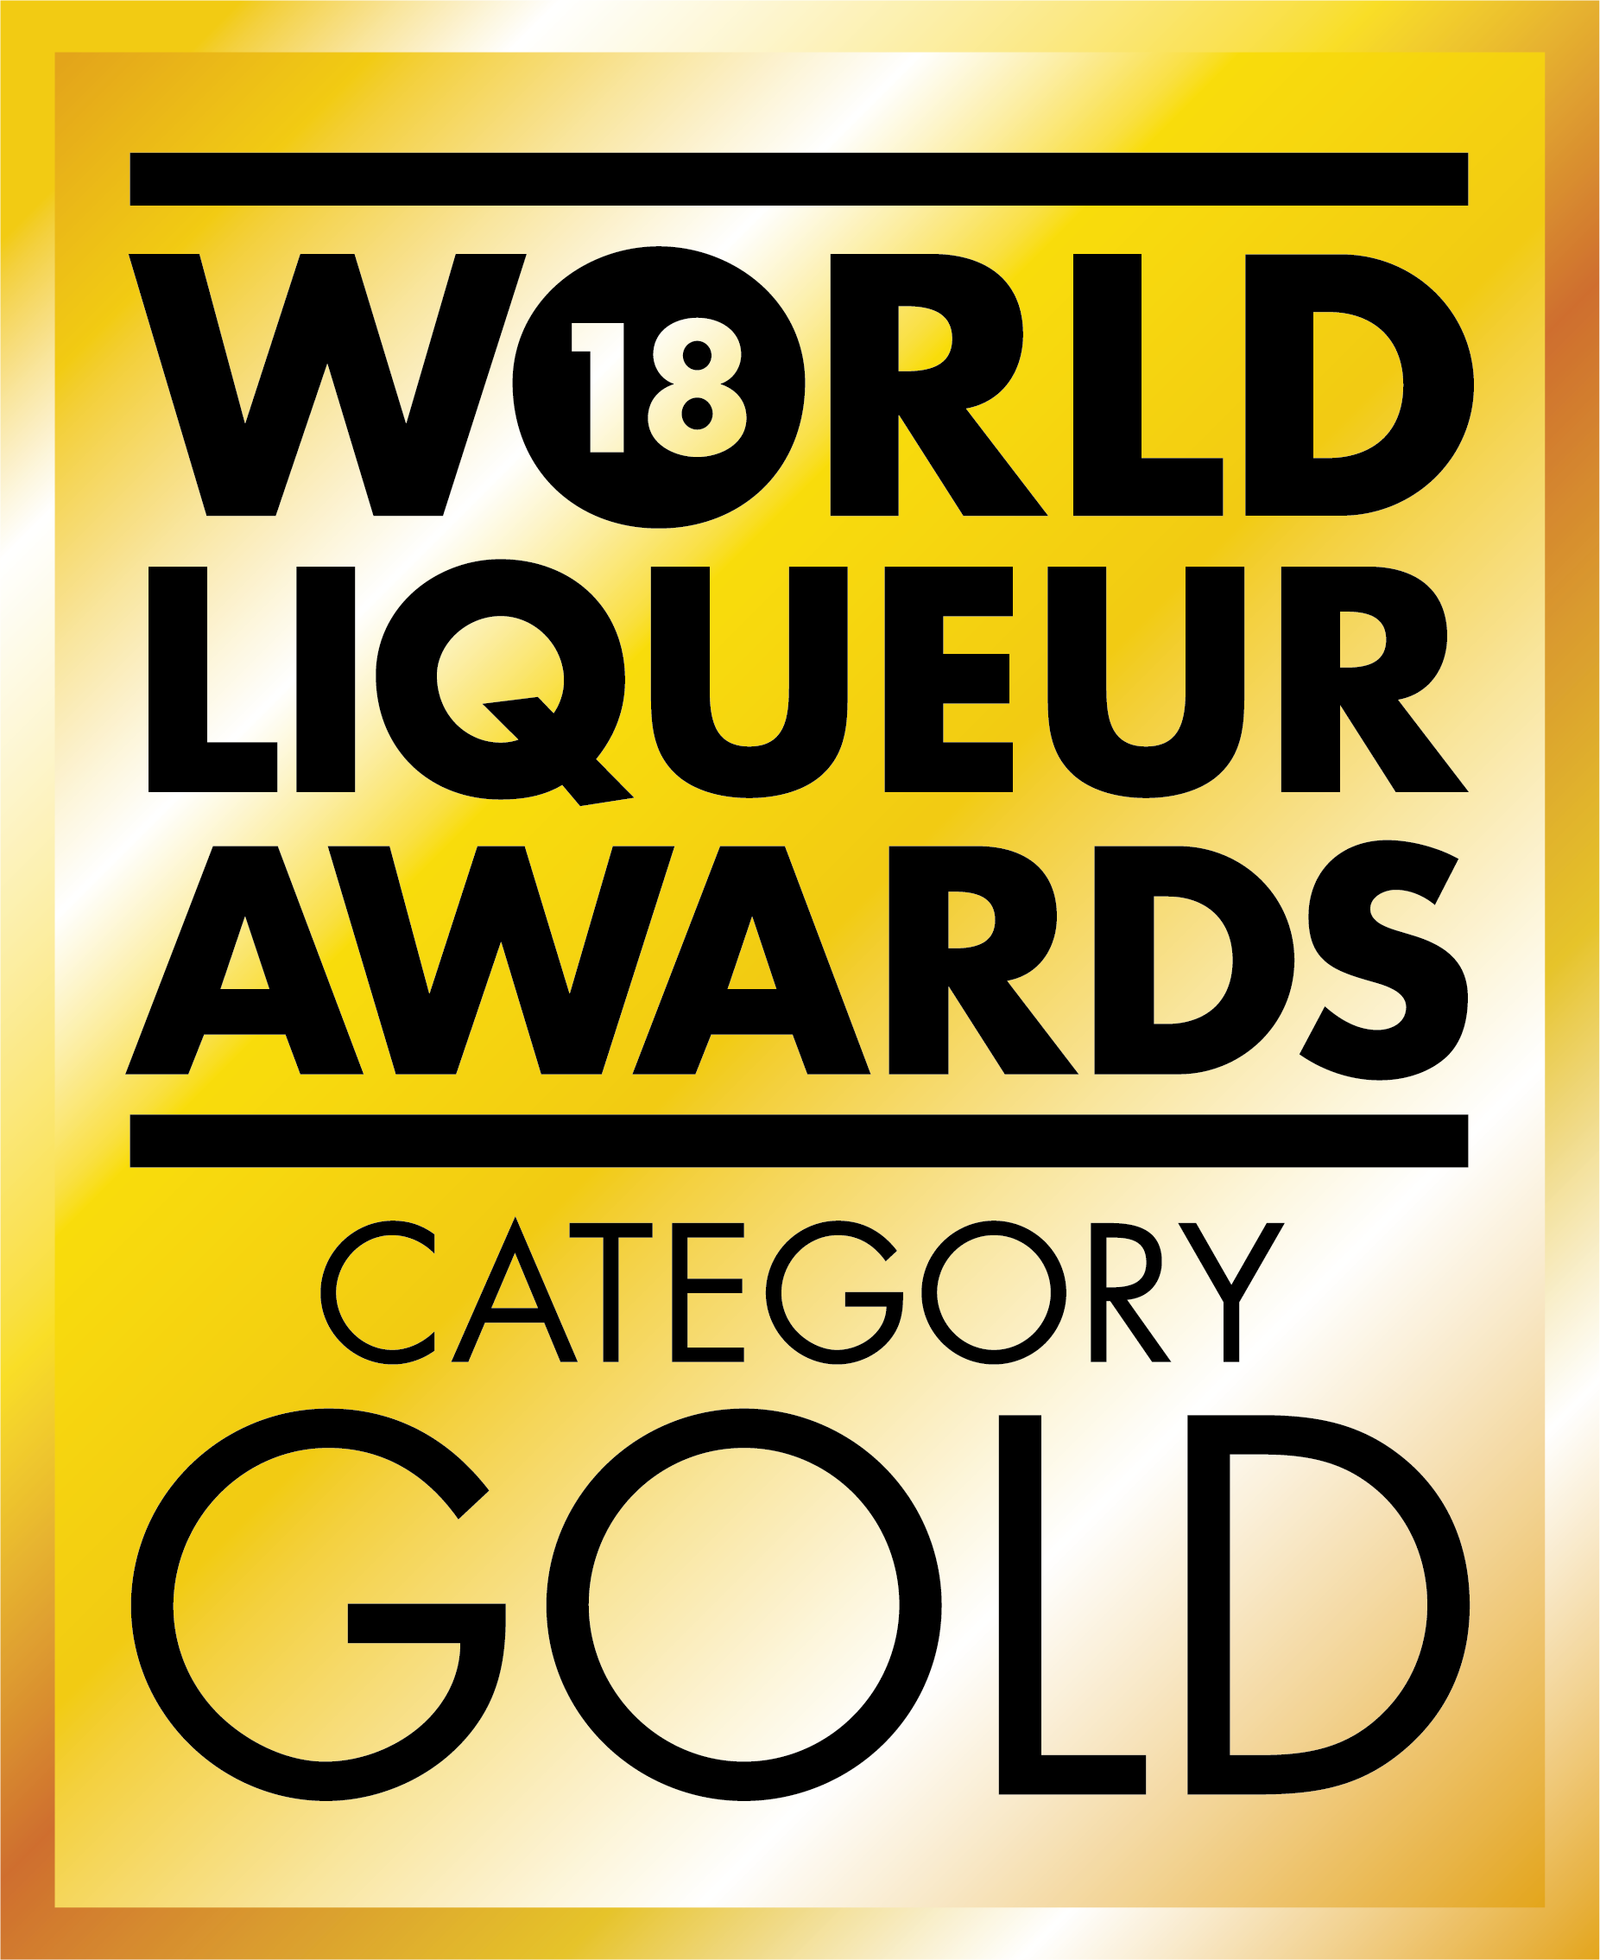
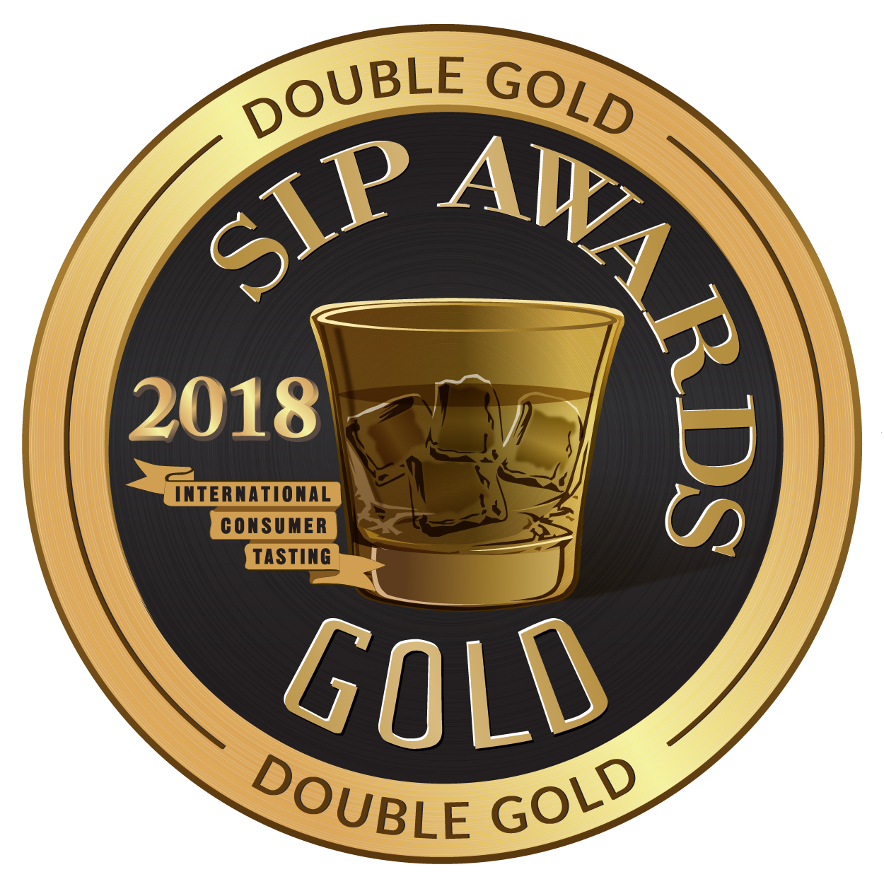
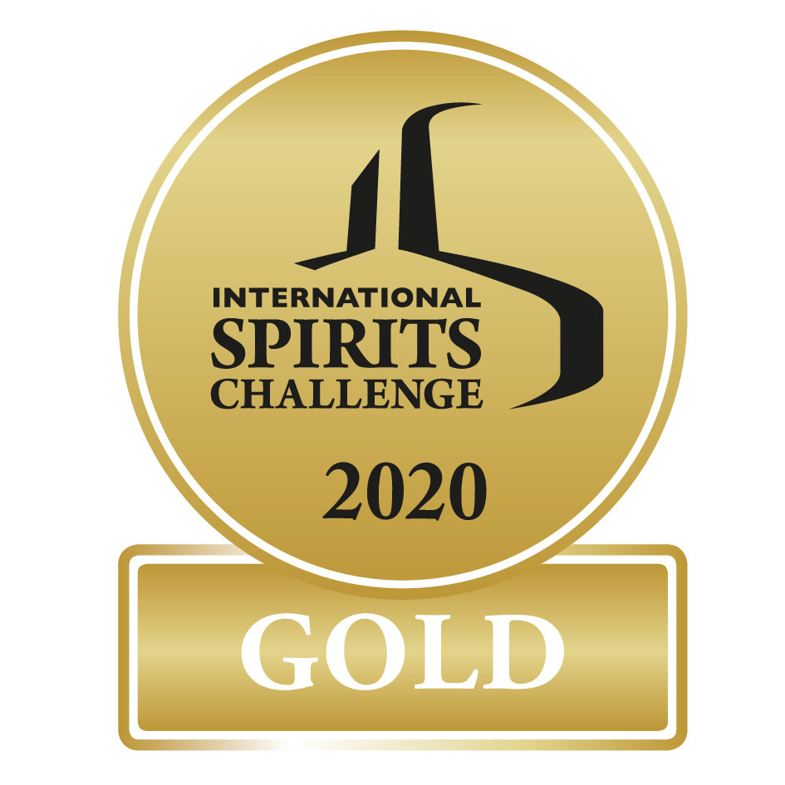
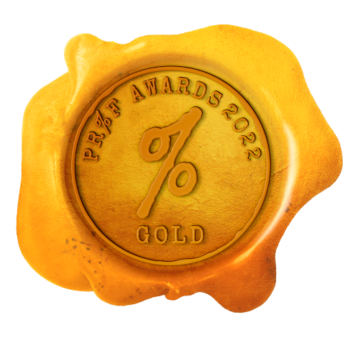

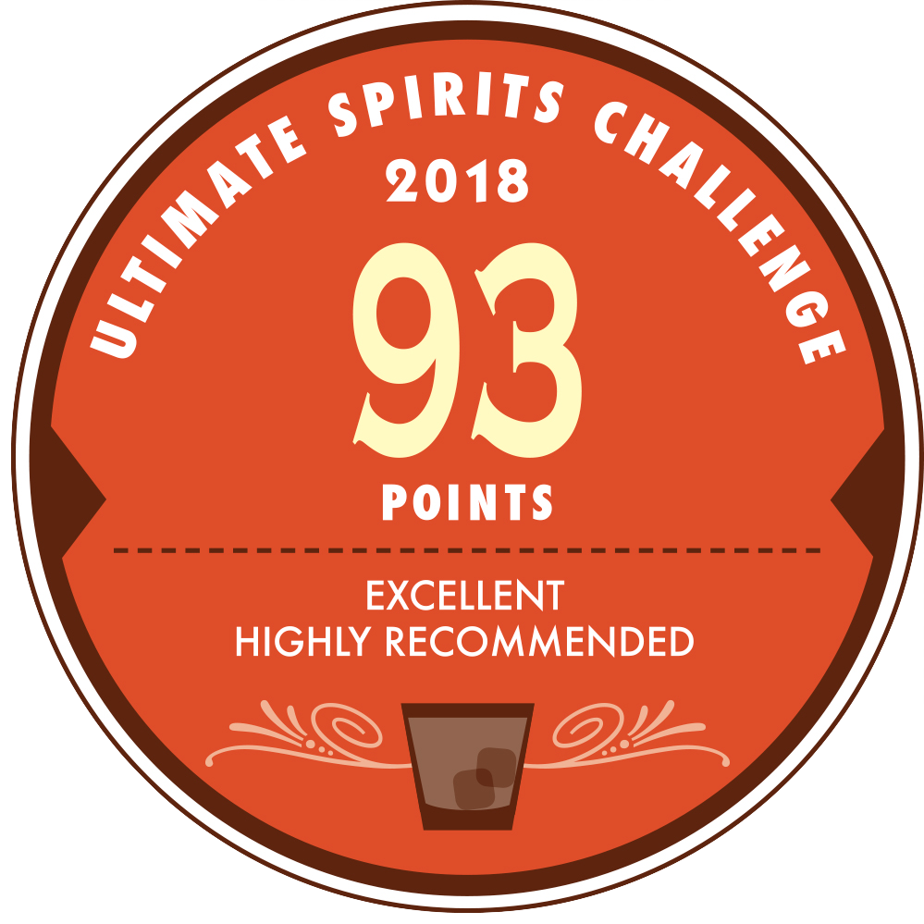
Bols Liqueurs
Award | Product | Medal/Score
2018 World Liqueur Awards | Cucumber | Gold
2018 SIP Awards | Pineapple Chipotle | Gold
2020 International Spirits Challenge | Crème de Cassis | Gold
2020 PROOF Awards | Orange Curacao | Gold
2023 Ultimate Spirits Challenge | Triple Sec | 93 pts
2023 Wine Enthusiast | Triple Sec | Best Buy
2025 IWSC | Peach | 98 pts

Slide 5
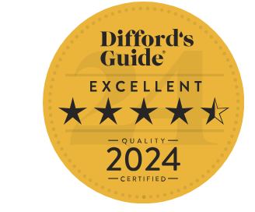
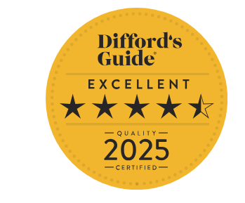
Bols Liqueurs
Award | Product | Medal/Score
Difford’s Guide 2024 | Apricot Brandy | Excellent/4.5 Stars
Difford’s Guide 2025 | Blue | Excellent/4.5 Stars

Slide 6
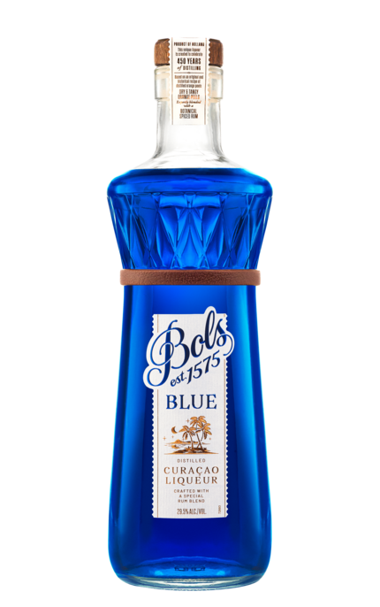

BLUE 1575

Slide 7
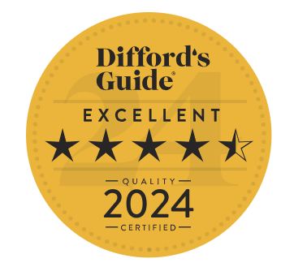

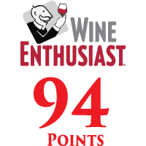
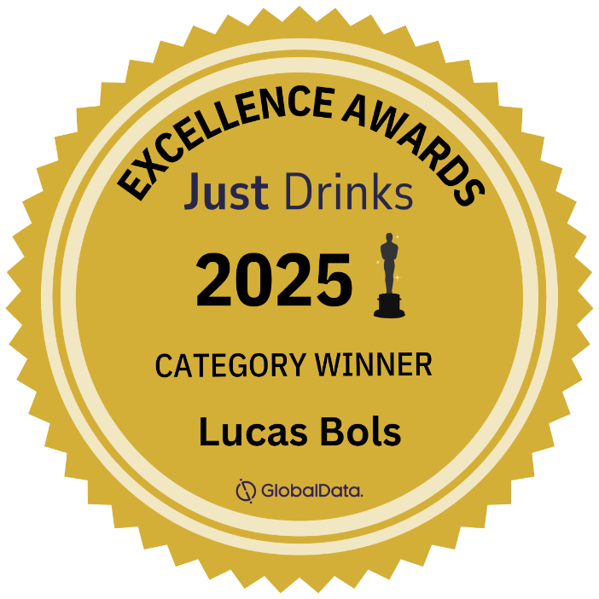
Bols Blue 1575
Award | Product | Medal/Score
2024 Difford’s Guide | Bols Blue 1575 | Excellent 4.5 Stars
2025 Just Drinks Awards | Bols Blue 1575 | Category Winner
2025 Wine Enthusiast | Bols Blue 1575 | 94 pts
“One of the best 6 new liqueurs at Berlin Bar Convent 2024”

Slide 8
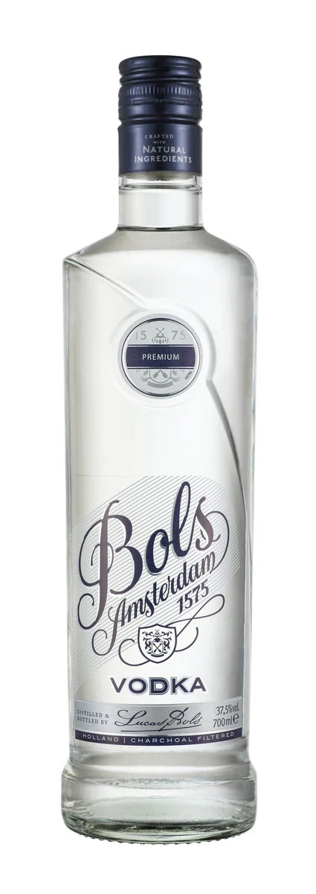
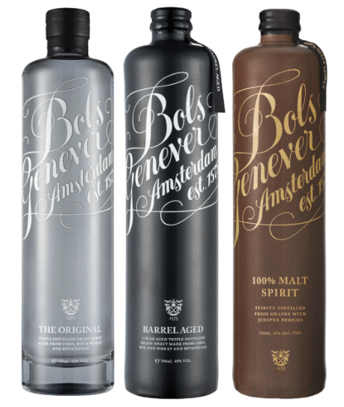
GENEVER & VODKA

Slide 9
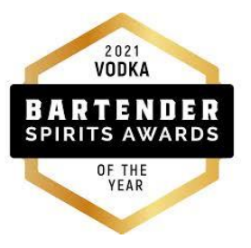

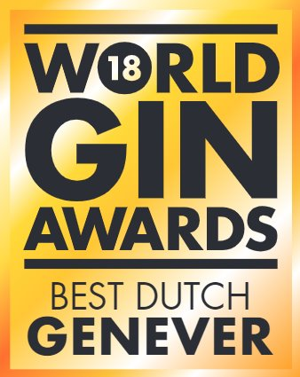
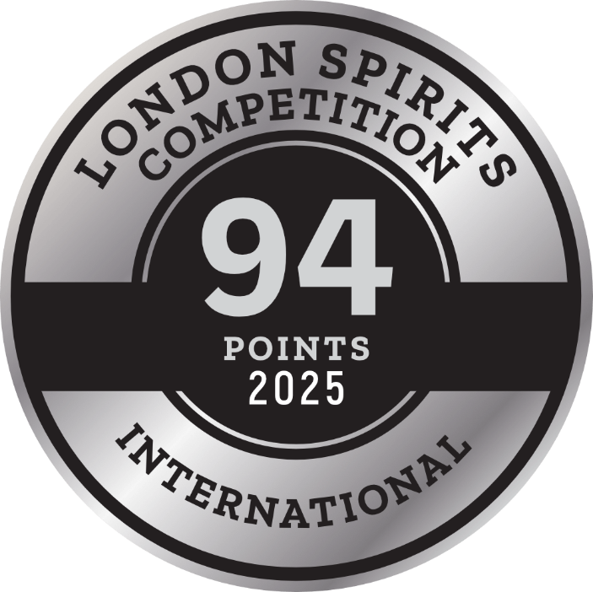
Bols Genever & Vodka
Award | Product | Medal/Score
2018 World Gin Awards | Bols Genever Original | Best of Class
2018 Wine & Spirits Wholesalers of America (WSWA) | Bols Genever Original | Best of Show
2018 Wine & Spirits Wholesalers of America (WSWA) | Bols Genever Original | Double Gold
2021 Bartender Spirits Award | Bols Vodka | Vodka of the Year
2025 The Spirits Business Gin Masters | Bols Genever Barrel Aged | MASTER
2025 London Spirits Competition | Bols Genever Barrel Aged | 94 pts

Slide 10
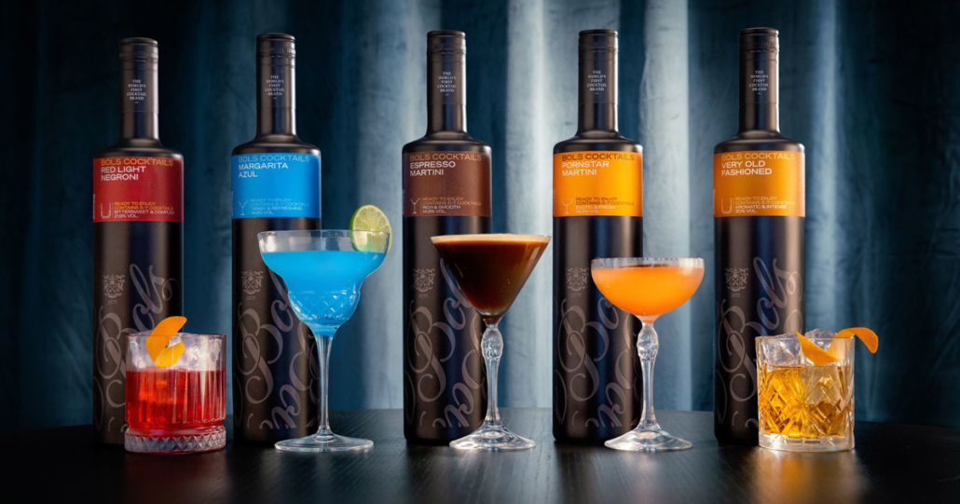
RTE
COCKTAILS

Slide 11




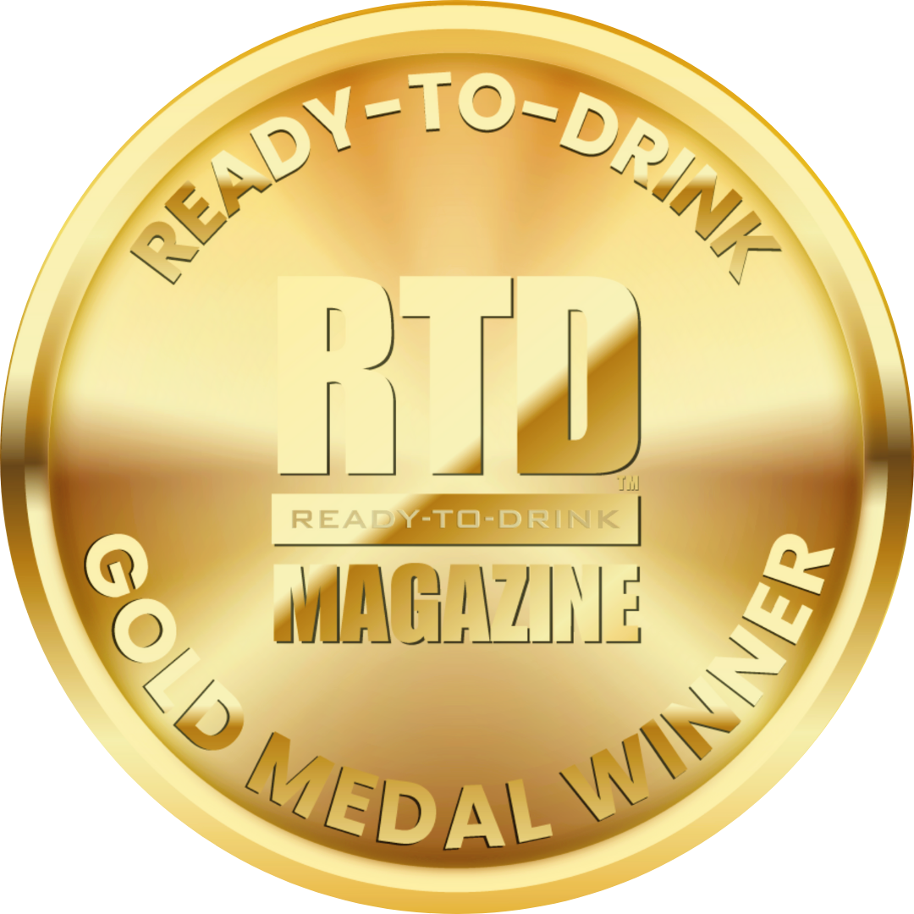
Bols RTEs
Award | Product | Medal/Score
2023 The Spirits Business RTD Masters | Pornstar Martini, Espresso Martini | Gold
2025 The Spirits Business RTD Masters | Bols Red Light Negroni | MASTER
2025 The Spirits Business RTD Masters | Bols Very Old Fashioned, Bols Margarita Azul | Gold
2025 International Spirits Challenge | Bols Margarita Azul | Gold
2025 RTD Magazine | Espresso Martini, Margarita Azul, Red Light Negroni, Pornstar Martini | Gold

Slide 12
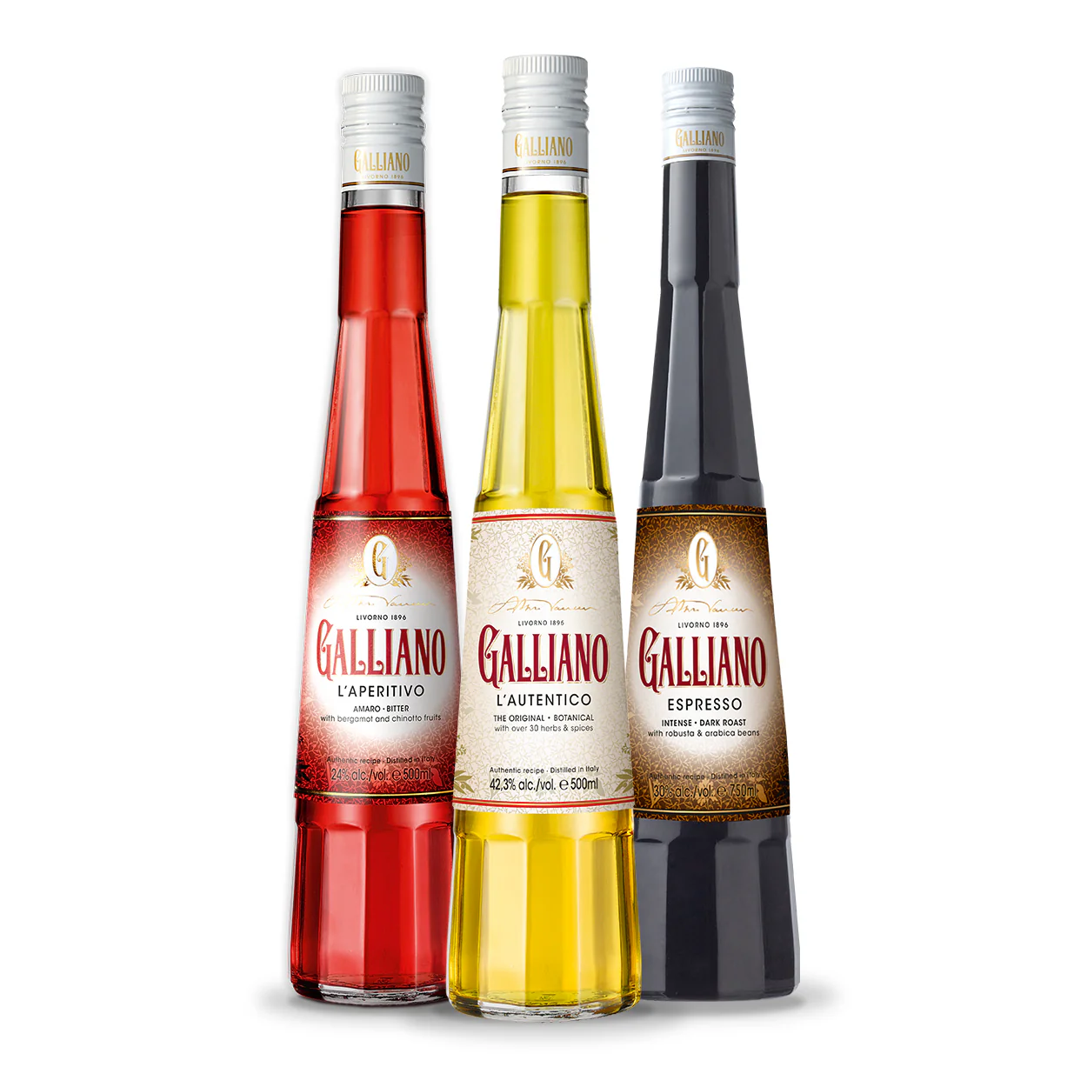
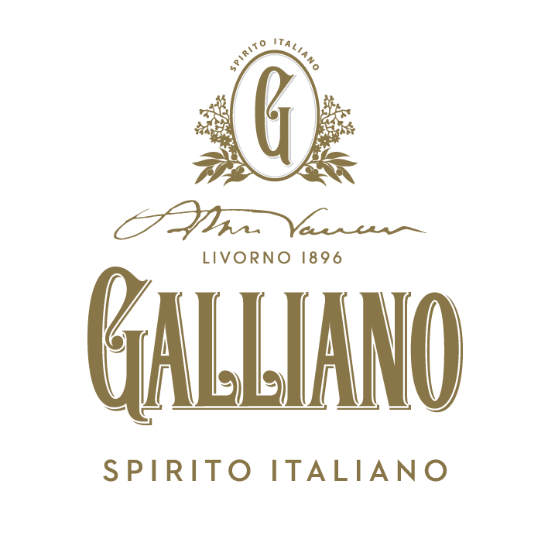

Slide 13


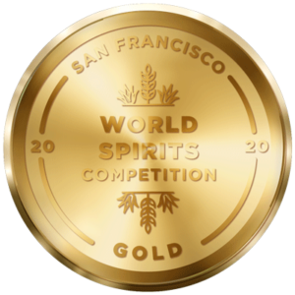

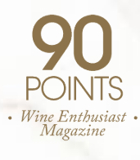
Galliano L'Autentico
Award | Product | Medal/Score
2020 San Francisco World Spirits Competition | L’Autentico | Gold
2022 International Wine & Spirit Competition | L’Autentico | Score: 95
2022 Difford’s Guide | L’Autentico | Exceptional/5 Stars
2022 Wine Enthusiast Magazine | L’Autentico | Score: 90

Slide 14
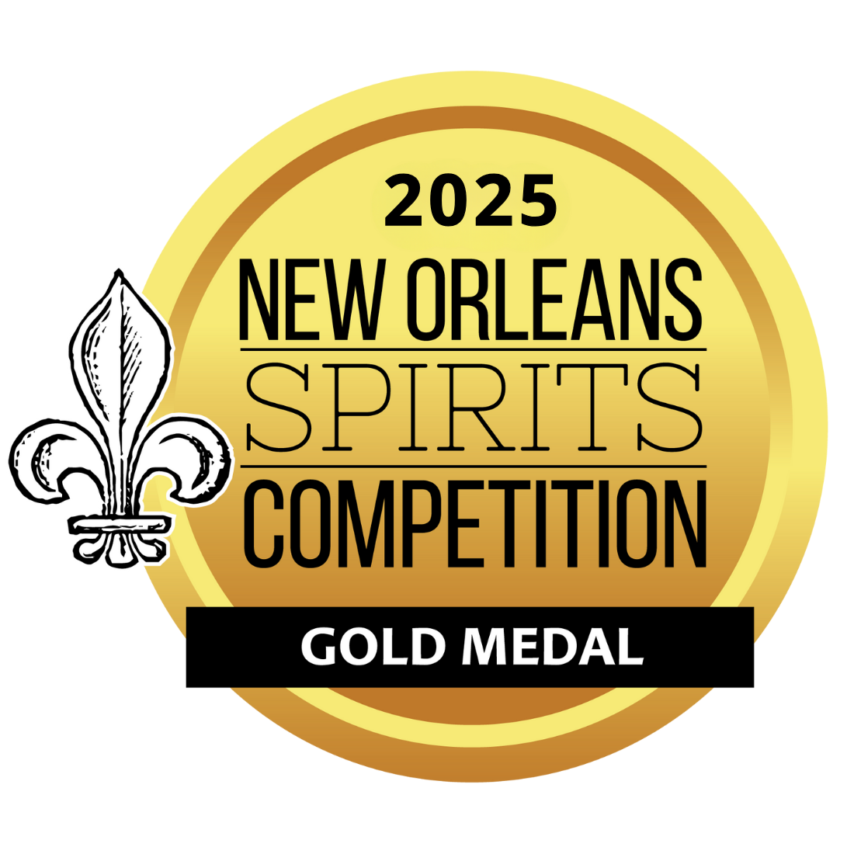
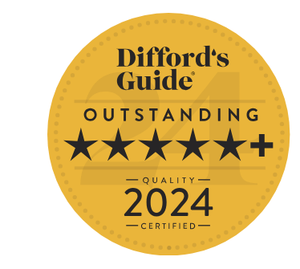

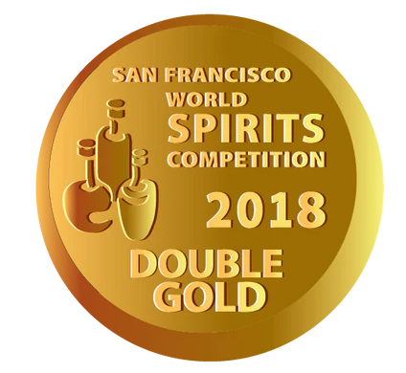
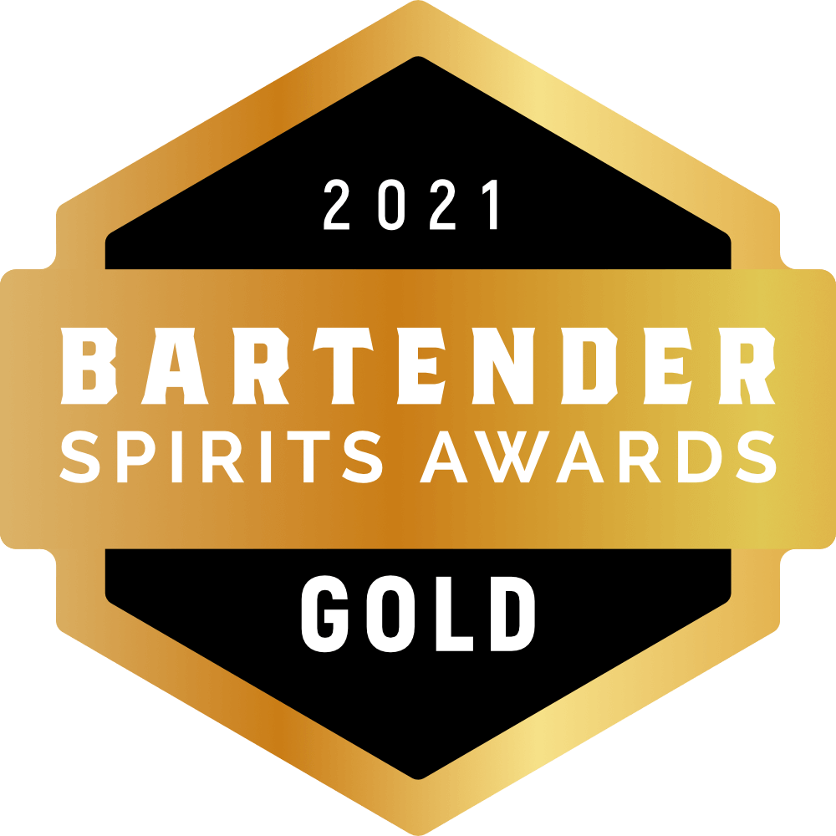
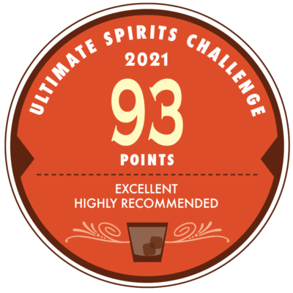
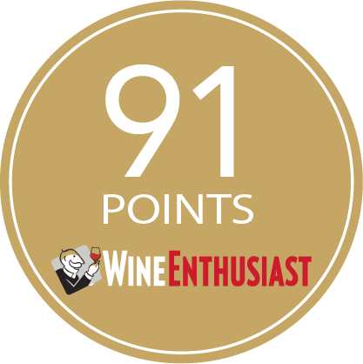
Galliano Espresso
Award | Product | Medal/Score
2017 Wine Enthusiast | Espresso | Score: 91
2018 San Francisco World Spirits Competition | Espresso | Double Gold
2021 Bartender Spirits Awards | Espresso | Gold
2021 Beverage Tasting Institute | Espresso | Gold
2021 Ultimate Spirits Challenge | Espresso | Score: 93
2024 Difford’s Guide | Espresso | Outstanding/5+ stars
2025 New Orleans Spirits Competition | Espresso | Gold

Slide 15

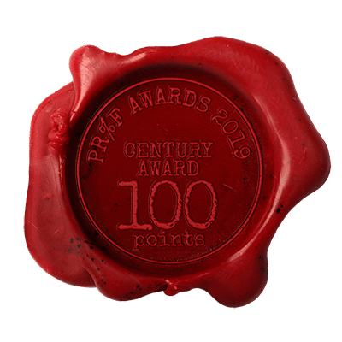
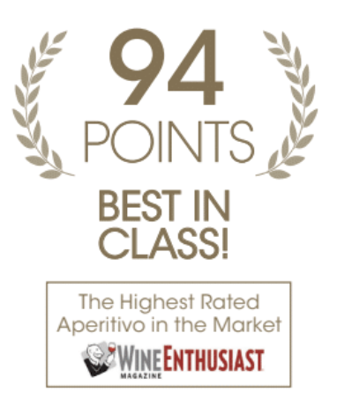
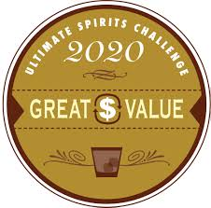

Galliano L'Aperitivo
Award | Product | Medal/Score
2018 International Spirits Challenge | L'Aperitivo | Gold
2018 Wine Enthusiast | L'Aperitivo | Score: 94, Crowned Century Award
2019 PROOF Award | L'Aperitivo | Score: 100
2020 Ultimate Beverage Challenge | L'Aperitivo | Great Value
2023 Alberta Beverage Awards | L'Aperitivo | Judges Selection

Slide 16

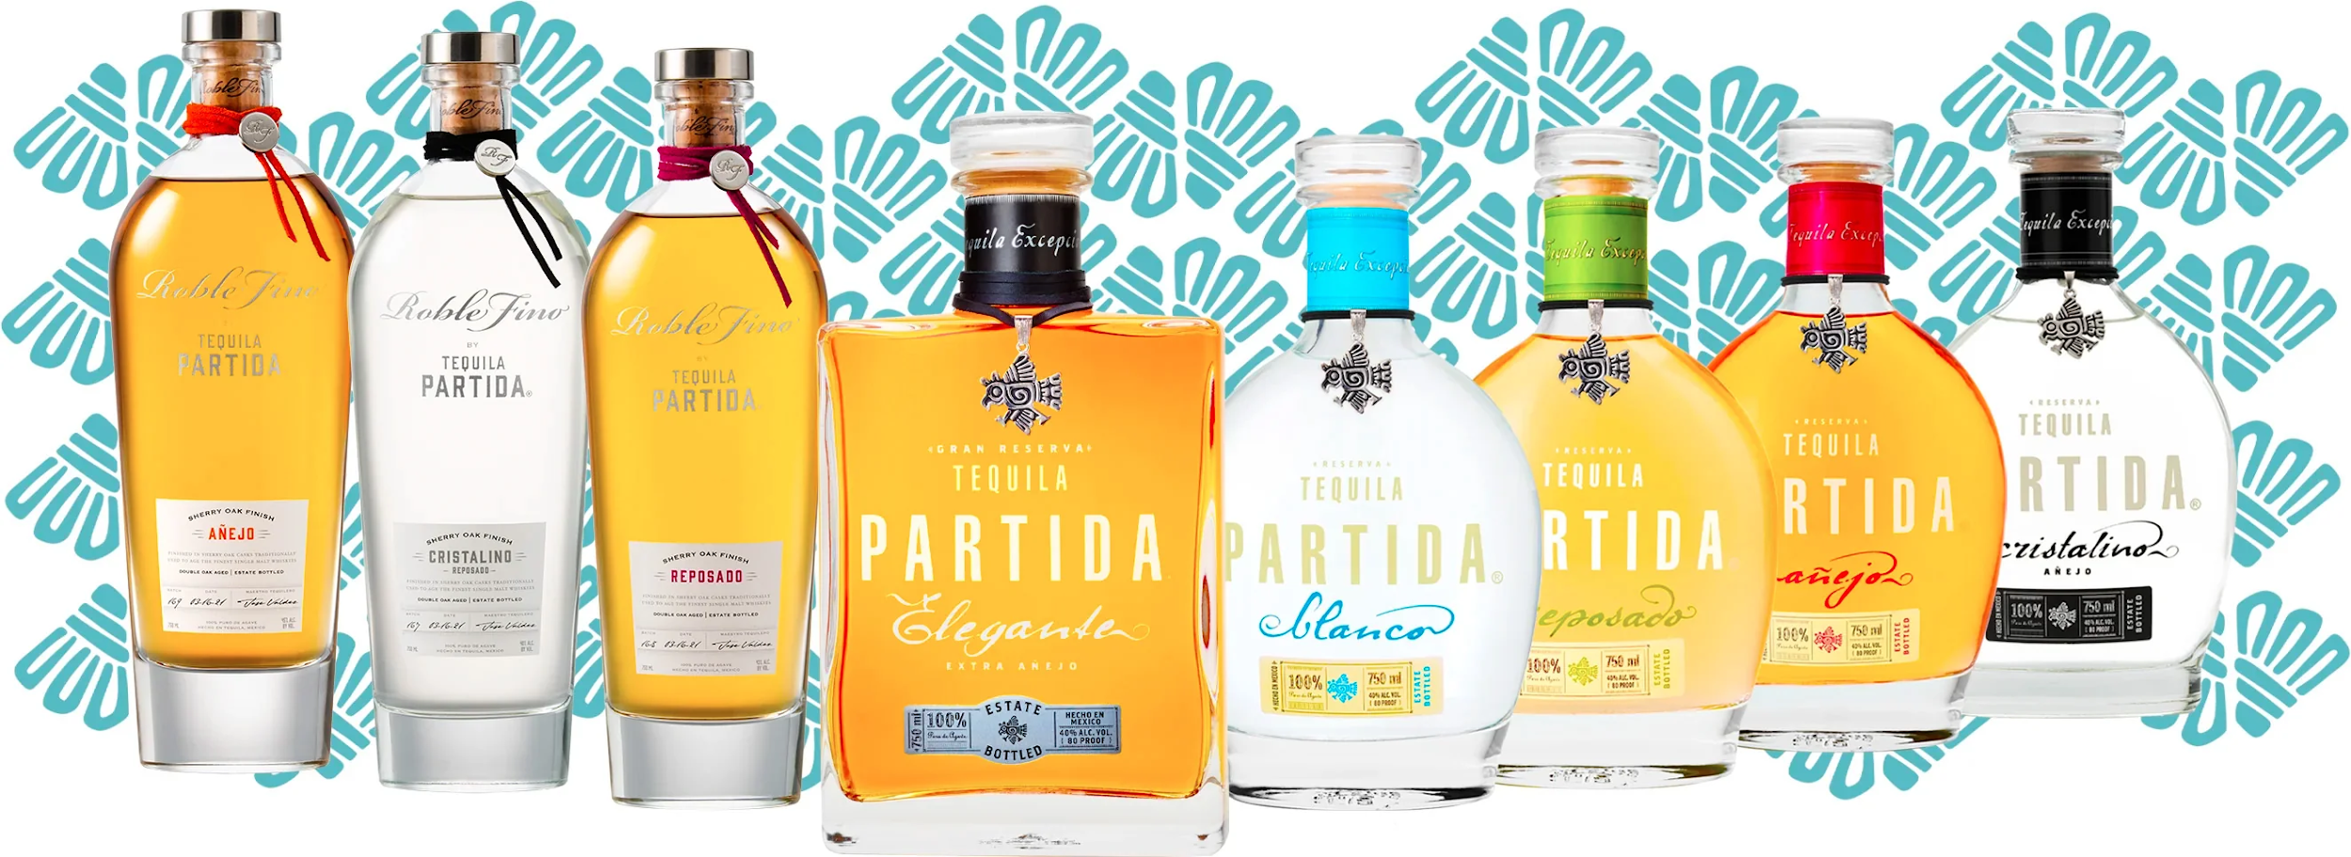
FAMILIA

Slide 17





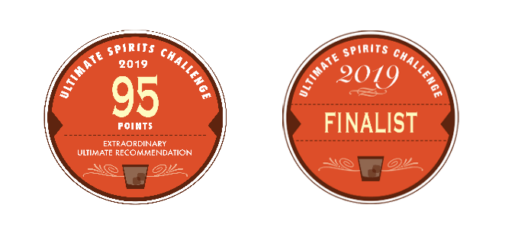
Partida Blanco
Award | Product | Medal/Score
2019 Ultimate Spirits Challenge | Blanco | Score: 95 pts and Finalist
2021 Blue Lifestyle | Blanco | Double Gold
2022 VINEPAIR | Blanco | Score: 91 pts
2023 The Fifty Best Awards | Blanco | Gold
2025 The Spirits Business | Blanco | Gold
2025 Agavos Awards | Blanco | Gold
91 POINTS

Slide 18
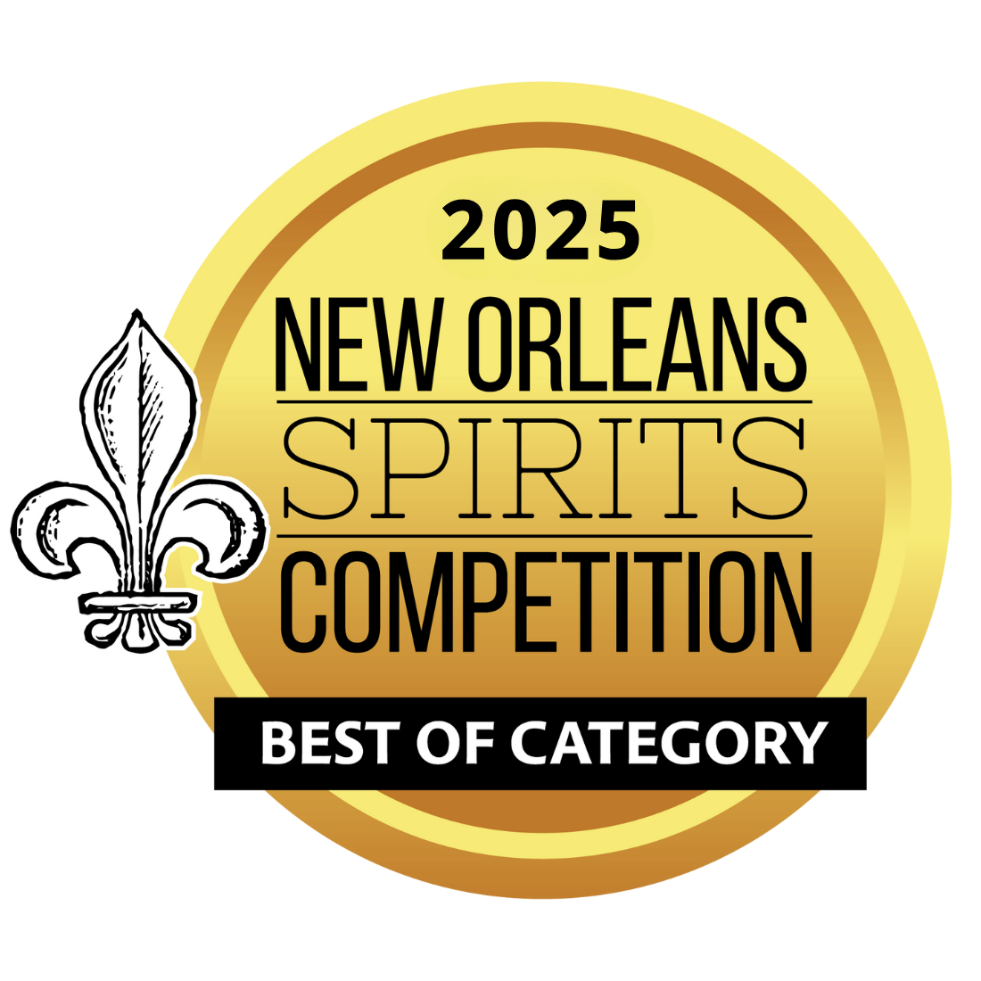


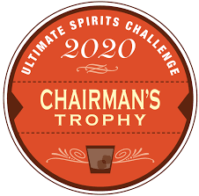
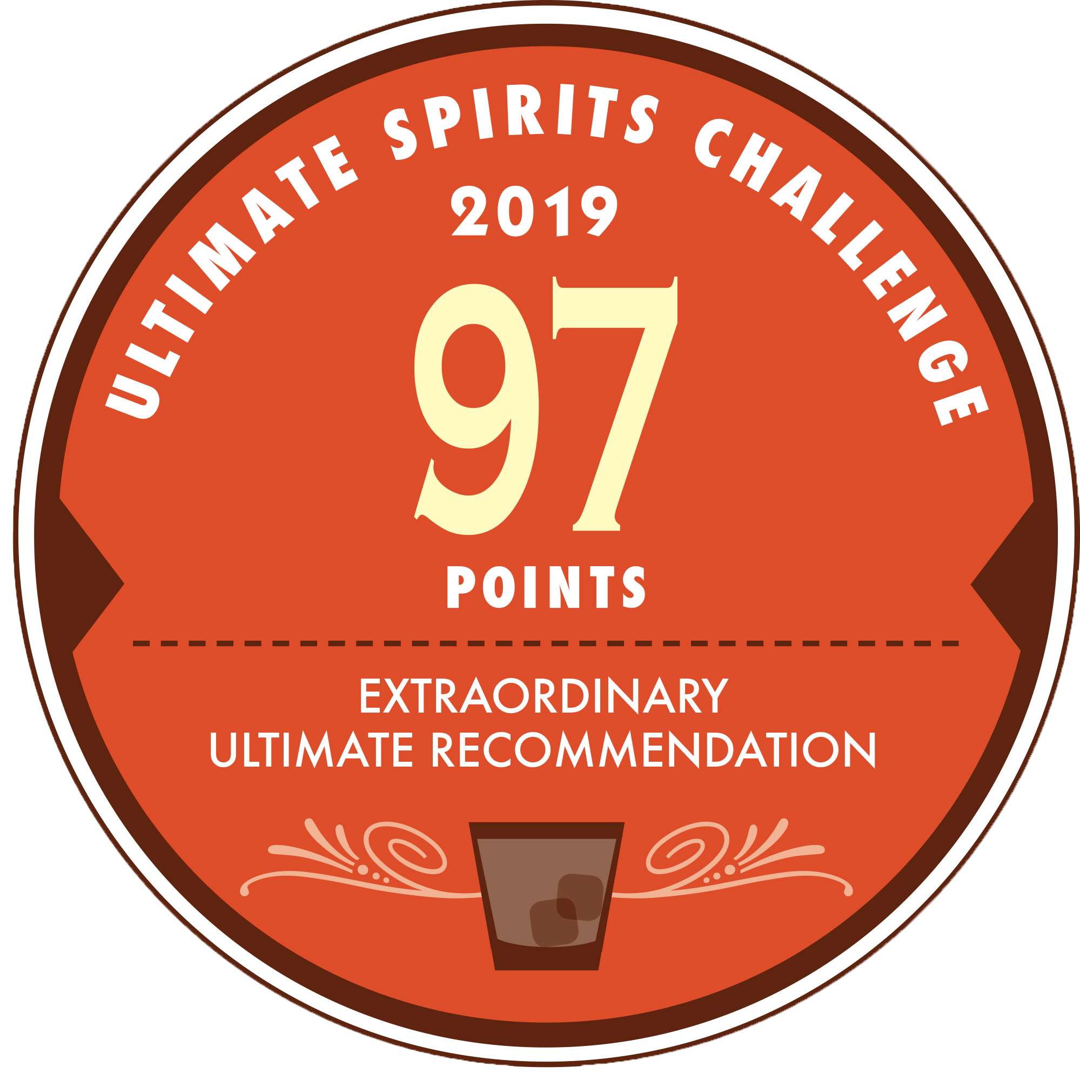
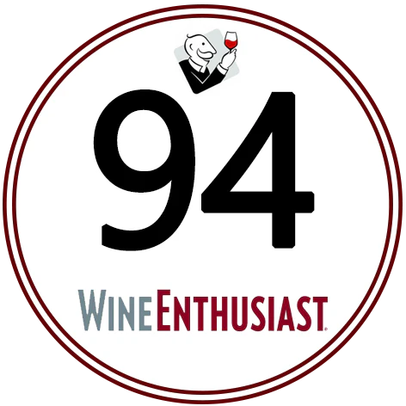

Partida Reposado
Award | Product | Medal/Score
2019 Ultimate Spirits Challenge | Reposado | Score: 97 Chairman’s Trophy
2020 International Spirits Challenge | Reposado | Gold
2021 Blue Lifestyle | Reposado | Double Gold
2021 Wine Enthusiast | Reposado | Score: 94
2022 The Fifty Best Awards | Reposado | Gold
2025 International Spirits Challenge | Reposado | Gold
2025 New Orleans Spirits Competition | Reposado | Gold/Best in Reposado Tequila Category

Slide 19

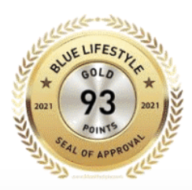
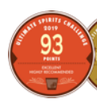
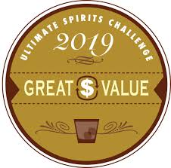
Partida Añejo
Award | Product | Medal/Score
2019 Ultimate Spirits Challenge | Añejo | Score: 93 pts/Great Value
2021 Blue Lifestyle | Añejo | Gold
2022 Wine Enthusiast | Añejo | Score: 93 pts
2022 VINEPAIR | Añejo | Score: 93 pts
2024 The Spirits Business Tequila & Mezcal Masters | Añejo | Gold
93 POINTS

Slide 20
Partida Single Barrel #11 Añejo
Award | Product | Medal/Score
2025 Agavos Awards | Single Barrel #11 Añejo | Gold

Slide 21
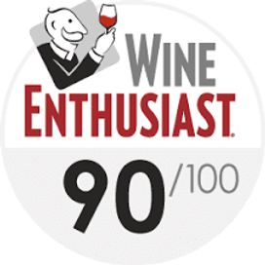
Partida Cristalino Anejo
Award | Product | Medal/Score
2021 Blue Lifestyle | Cristalino Añejo | Double Gold
2022 Wine Enthusiast | Cristalino Añejo | Score: 90 pts
2022 VinePair | Cristalino Añejo | Score: 94 pts
2025 The Spirits Business | Cristalino Añejo | Gold
94 POINTS

Slide 22
ROBLE FINO

Slide 23
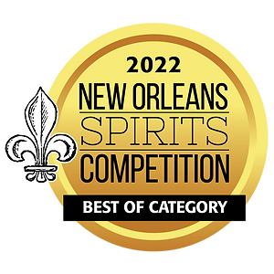
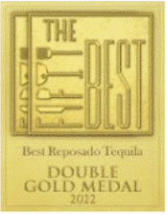

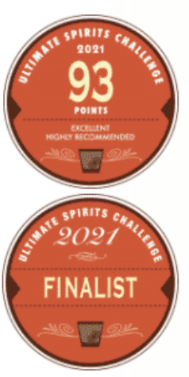
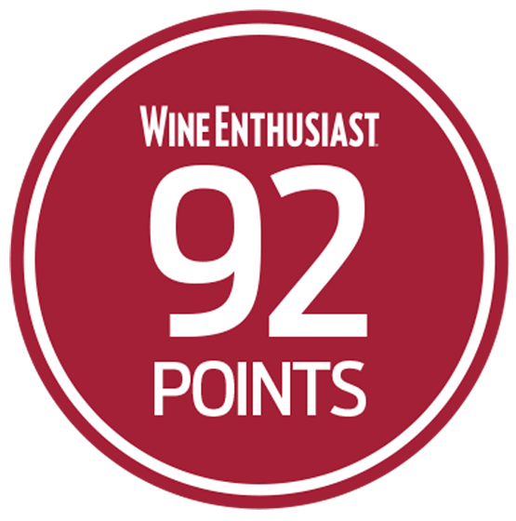
Roble Fino Reposado
Award | Product | Medal/Score
2021 Blue Lifestyle | Roble Fino Reposado | Double Gold
2021 Ultimate Spirits Challenge | Roble Fino Reposado | Finalist
2021 Ultimate Spirits Challenge | Roble Fino Reposado | Score: 93
2021 Wine Enthusiast | Roble Fino Reposado | Score: 92
2022 New Orleans Spirits Competition | Roble Fino Reposado | Best of Category
2022 The Fifty Award | Roble Fino Reposado | Double Gold

Slide 24
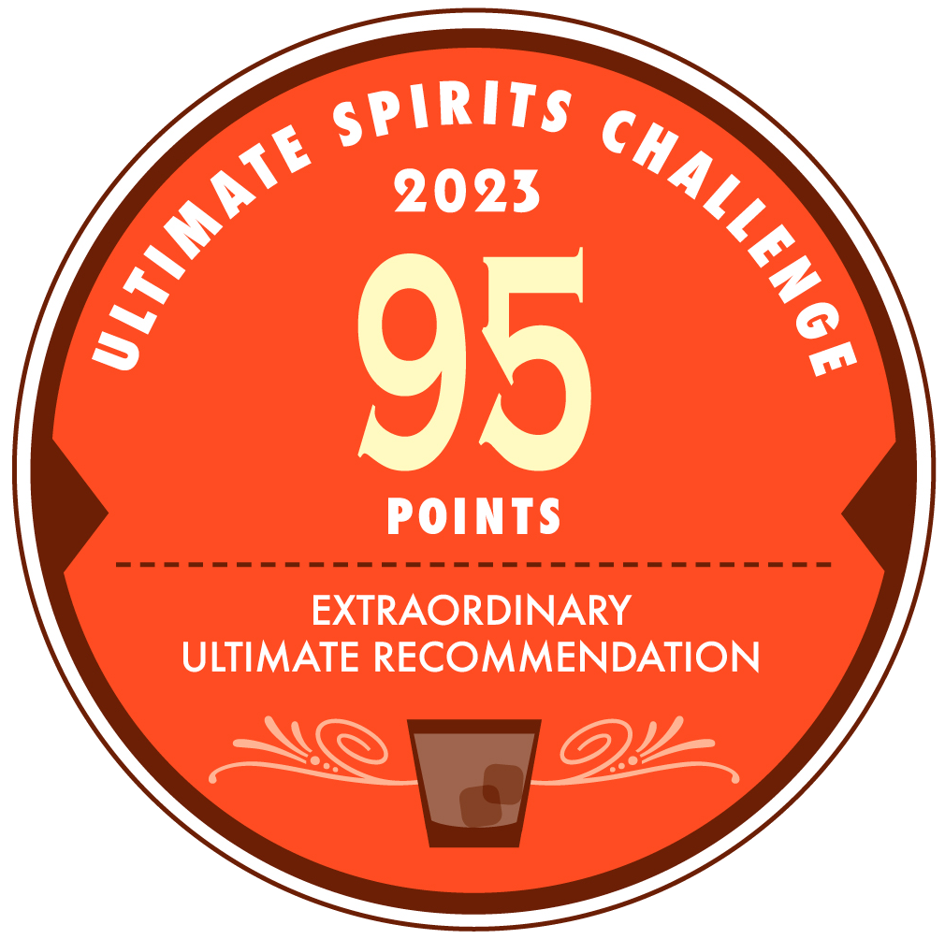
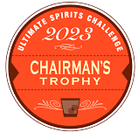

Roble Fino Cristalino
Award | Product | Medal/Score
2021 Blue Lifestyle | Roble Fino Cristalino | Double Gold
2022 VinePair | Roble Fino Cristalino | Score: 96 pts
2023 Ultimate Spirits Challenge | Roble Fino Cristalino | Score: 95 pts
2023 Ultimate Spirits Challenge | Roble Fino Cristalino | Chairman's Trophy
2023 Ultimate Spirits Challenge | Roble Fino Cristalino | Top 100 Spirits
96 POINTS

Slide 25





Roble Fino Anejo
Award | Product | Medal/Score
2021 Ultimate Spirits Challenge | Roble Fino Añejo | Finalist/ Score: 93 pts
2022 Wine Enthusiast | Roble Fino Añejo | Top 100 Spirits/Score: 96 pts
2024 WSWA Access Live | Roble Fino Añejo | Best of Show/Double Gold
2024 Wine Enthusiast | Roble Fino Añejo | Best Tequila Under $150
2025 Agavos Awards | Roble Fino Añejo | Gold
2025 VinePair | Roble Fino Añejo | Score: 93
2025 The Spirits Business | Roble Fino Añejo | Master Medal

Slide 26
ELEGANTE

Slide 27



Partida Elegante
Award | Product | Medal/Score
2019 Ultimate Spirits Challenge | Elegante | Top 100 Spirits
2019 Ultimate Spirits Challenge | Elegante | Score: 96
2022 Wine Enthusiast | Elegante | Score: 96 Top 100 Spirits
2025 Agavos Awards | Elegante | Double Gold

Slide 28






Slide 29






Pallini Limoncelllo
Award | Product | Medal/Score
2019 Sip Award | Limoncello | Platinum
2021 Ultimate Spirits Challenge | Limoncello | Score: 93
2023 Quality Award | Limoncello | Quality Award
2023 WSWA Access Live | Limoncello | Best of Show
2023 WSWA Access Live | Limoncello | Double Gold
2023 Concours Mondial de Bruxelles | Limoncello | Gold
2025 IWSC | Limoncello | 95 Points/Gold

Slide 30







Pallini Limonzero & Peachello
Award | Product | Medal/Score
2023 International Wine & Spirit Competition | Limonzero | Gold
2023 World Alcohol Free Award | Limonzero | Gold
2023 The Low & No Masters Competition | Limonzero | Master
2023 Ultimate Spirits Challenge | Limonzero | Great Value
2023 Ultimate Spirits Challenge | Limonzero | Finalist/Score; 93
2024 Beverage Testing Institute | Peachcello | Gold/Score: 92
2024 WSWA Access Live | Limonzero | Double Gold

Slide 31




Slide 32




Damrak Gin & Virgin Gin
Award | Product | Medal/Score
2012 The Fifty Best Awards | Gin | Gold
2014 Wine Enthusiast | Gin | Score: 94
2014 Wine Enthusiast | Gin | Best Buy
2020 Ultimate Spirits Challenge | Virgin Gin | Best in Class
2025 New York International Spirits Competition | Virgin Gin | Gold/95 Points

Slide 33



Slide 34


Fluère Spiced Cane
Award | Product | Medal/Score
2023 WSWA Access Live | Spiced Cane | Best of Show
2023 WSWA Access Live | Spiced Cane | Double Gold
2022 The Fifty Best Awards | Spiced Cane | Gold
2023 Ultimate Spirits Challenge | Spiced Cane | Chairman’s Trophy, Top 100 Spirits, Great Value
2025 New Orleans Spirits Competition | Spiced Cane | Best No & Low Elixir Category, No & Low Elixir of the Year, Gold

Slide 35



Fluère Bitter
Award | Product | Medal/Score
2023 WSWA Access Live | Bitter | Best of Show
2023 WSWA Access Live | Bitter | Double Gold
2023 The Low & No Masters Competition | Bitter | Gold
2024 New Orleans Spirits Competition | Bitter | Best of Show
2025 Beverage Testing Institute | Bitter | Gold/94 Points

Slide 36



Fluère Raspberry, Smoked Agave, Botanical
Award | Product | Medal/Score
2021 Luxury Report Award | Original Blend | Top distilled non-alcoholic spirit of the year
2021 The Low & No Masters Competition | Raspberry Blend | Master Award
2021 The Low & No Masters Competition | Smoked Agave | Gold
2024 The Low & No Masters Competition | Smoked Agave | Gold
2025 Beverage Testing Institute | Smoked Agave | Gold/90 Points
2025 New York International Spirits Competition | Smoked Agave | Silver/93 Points

Slide 37



Slide 38



TMLC Irish Whiskey
Award | Product | Medal/Score
2024 The Tasting Panel | Muff Irish Whiskey | Score: 92
2024 The Fifty Best Awards | Muff Irish Whiskey | Double Gold
2024 Whisky Advocate | Muff Irish Whiskey | Score: 89
89 POINTS

Slide 39




TMLC Irish Vodka
Award | Product | Medal/Score
2020 The Spirits Business Vodka Master | Muff Irish Vodka | Gold
2022 London Spirits Competition | Muff Irish Vodka | Gold
2023 New York World Wine & Spirits Competition (NYWSC) | Muff Irish Vodka | Double Gold
2023 The Spirits Business Vodka Masters | Muff Irish Vodka | Gold
2024 The Tasting Panel | Muff Irish Vodka | Score: 92
2025 New Orleans Spirits Competition | Muff Irish Vodka | Best in Vodka Category, Vodka of the Year, Gold Medal

Slide 40






TMLC Irish Gin
Award | Product | Medal/Score
2018 The Drinks Business Hong Kong Gin Masters | Muff Irish Gin | Gold
2018 The Wine & Spirits Wholesalers of America | Muff Irish Gin | Gold/Spirit Of The Year
2019 The Gin Guide Award | Muff Irish Gin | Best in Ireland
2019 The Irish Gin Award | Muff Irish Gin | Gold
2024 The Tasting Panel | Muff Irish Gin | Score: 91
2025 Wine Enthusiast | Muff Irish Gin | Best Buy/Score: 93
93 POINTS

Slide 41
Accolades & Ratings Report

