Slide 1


2026
PORTFOLIO
“360” RETAIL PROGRAM
MAR’26

Slide 2
PROGRAM OVERVIEW
GOAL
DRIVE VELOCITY ACROSS THE PORTFOLIO
BOLS, PASSOA, PARTIDA, PALLINI, GALLIANO, FLUERE. MUFF, NUVO
REBATE STRUCTURE
SAVE $5 ON 1 BOTTLE, SAVE $10 ON 2 BOTTLES, SAVE $20 ON 3 BOTTLES
ACTIVATION
AT SHELF: BOTTLE NECKERS, SHELFT TALKERS
ON THE FLOOR: PORTFOLIO RACKS, CASE CARDS, CASE TUCKERS
TIMELINE
MAY 1ST – DEC 31ST 2026

Slide 3
2026
PORTFOLIO
“360” RETAIL PROGRAM
WITH REBATES
MAR’26

Slide 4

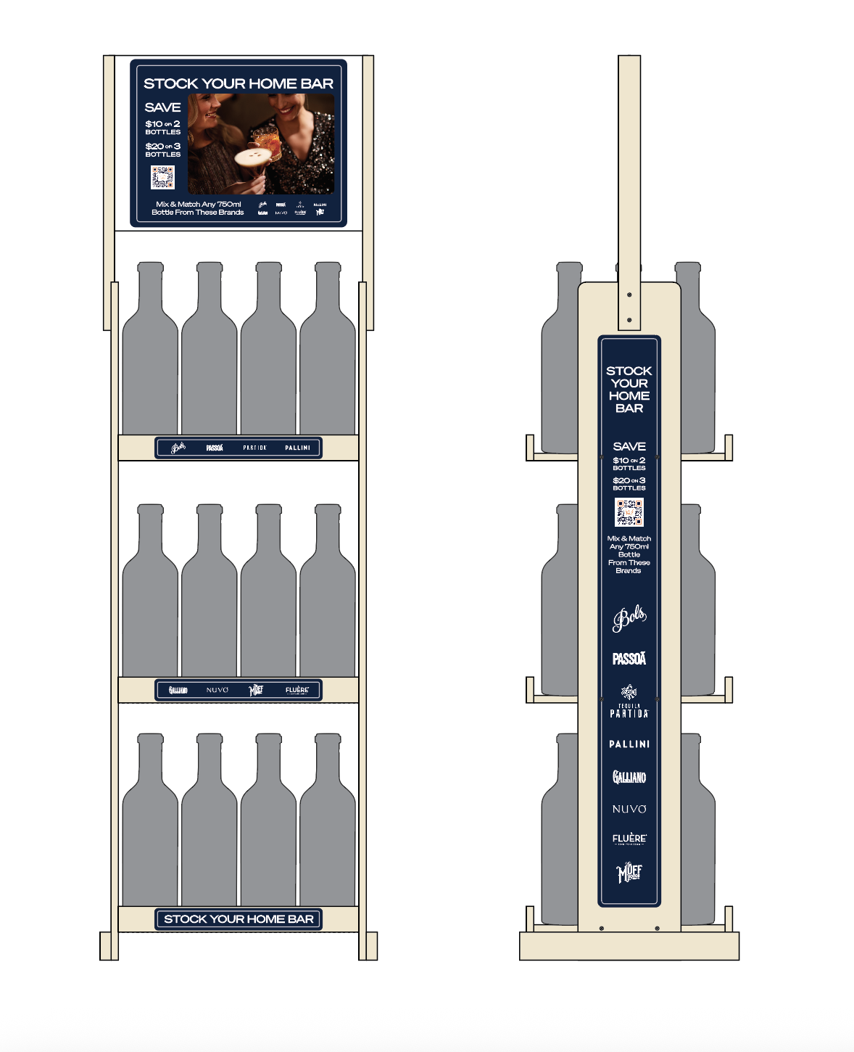


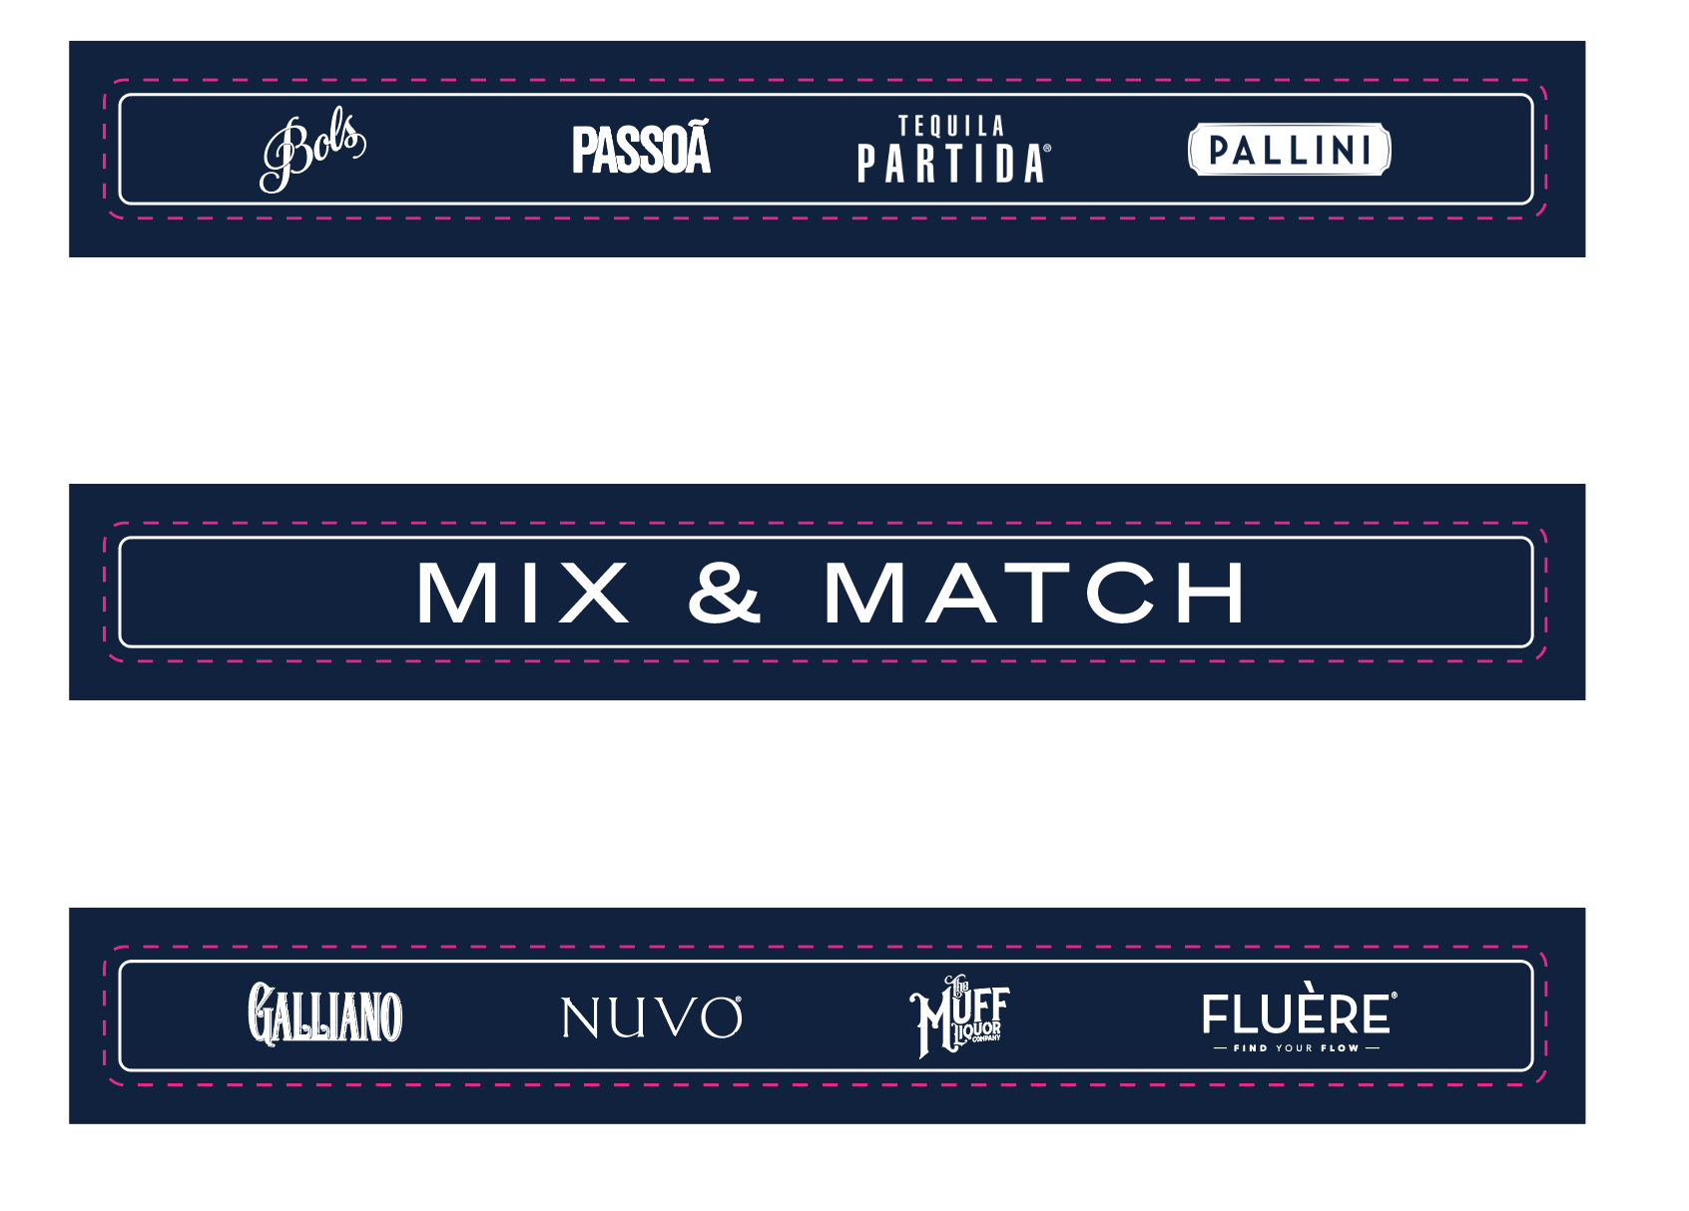
LBUSA 2026 PORTFOLIO RETAIL PROGRAM WITH REBATES
PERMANENT RACK
IN MARKET. MAY 1ST

Slide 6
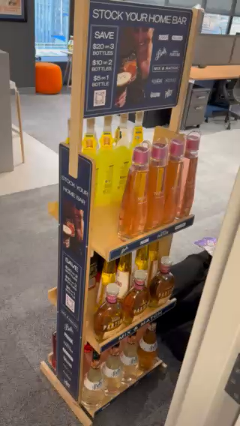

Slide 7
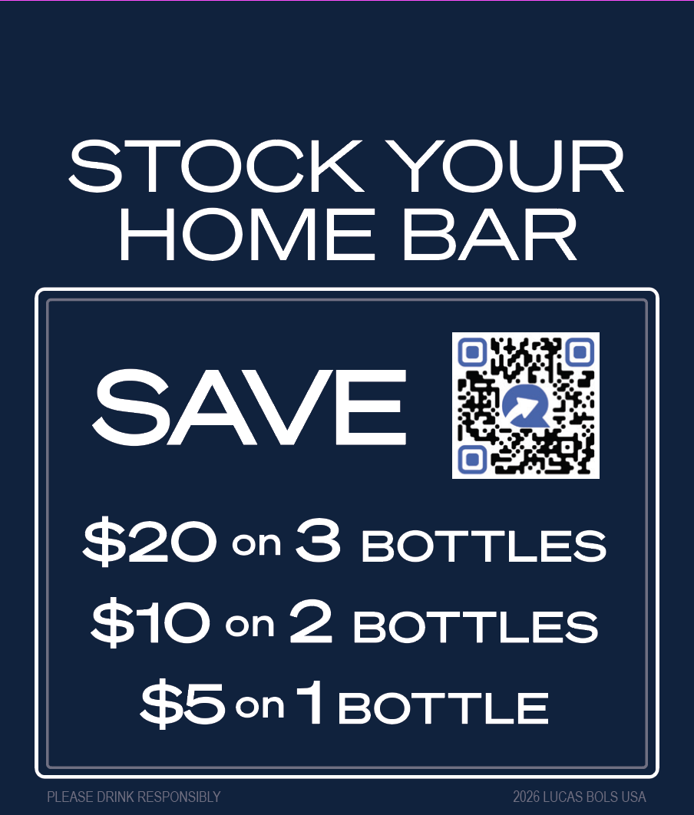
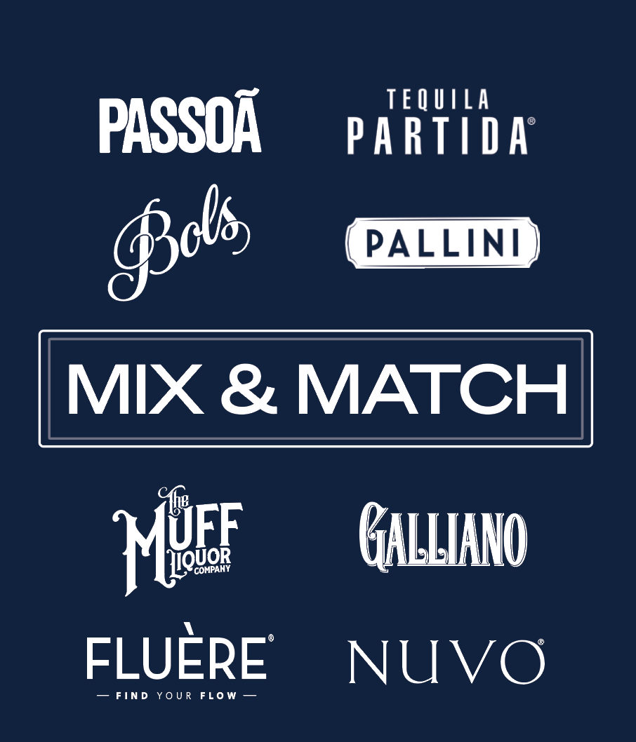
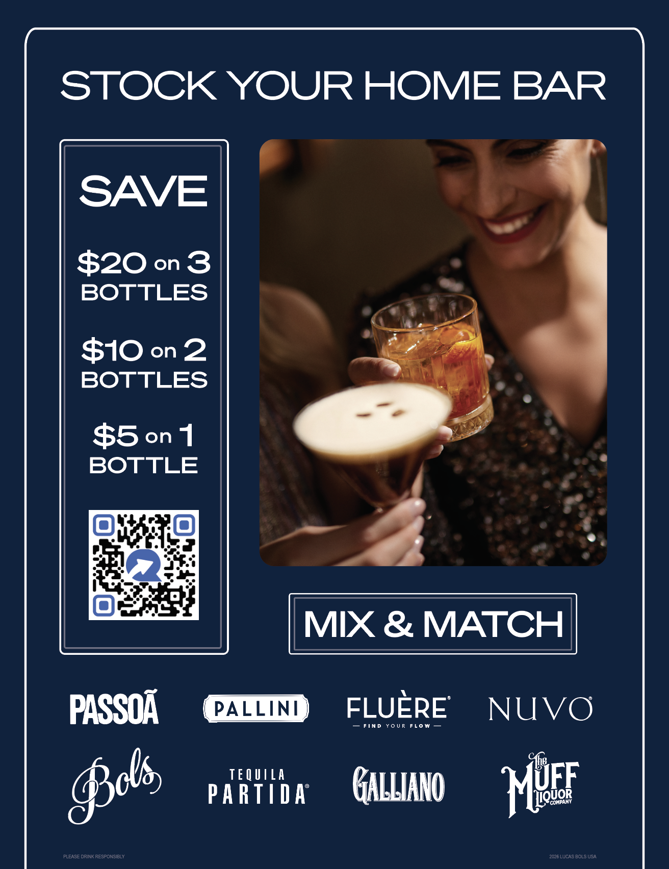
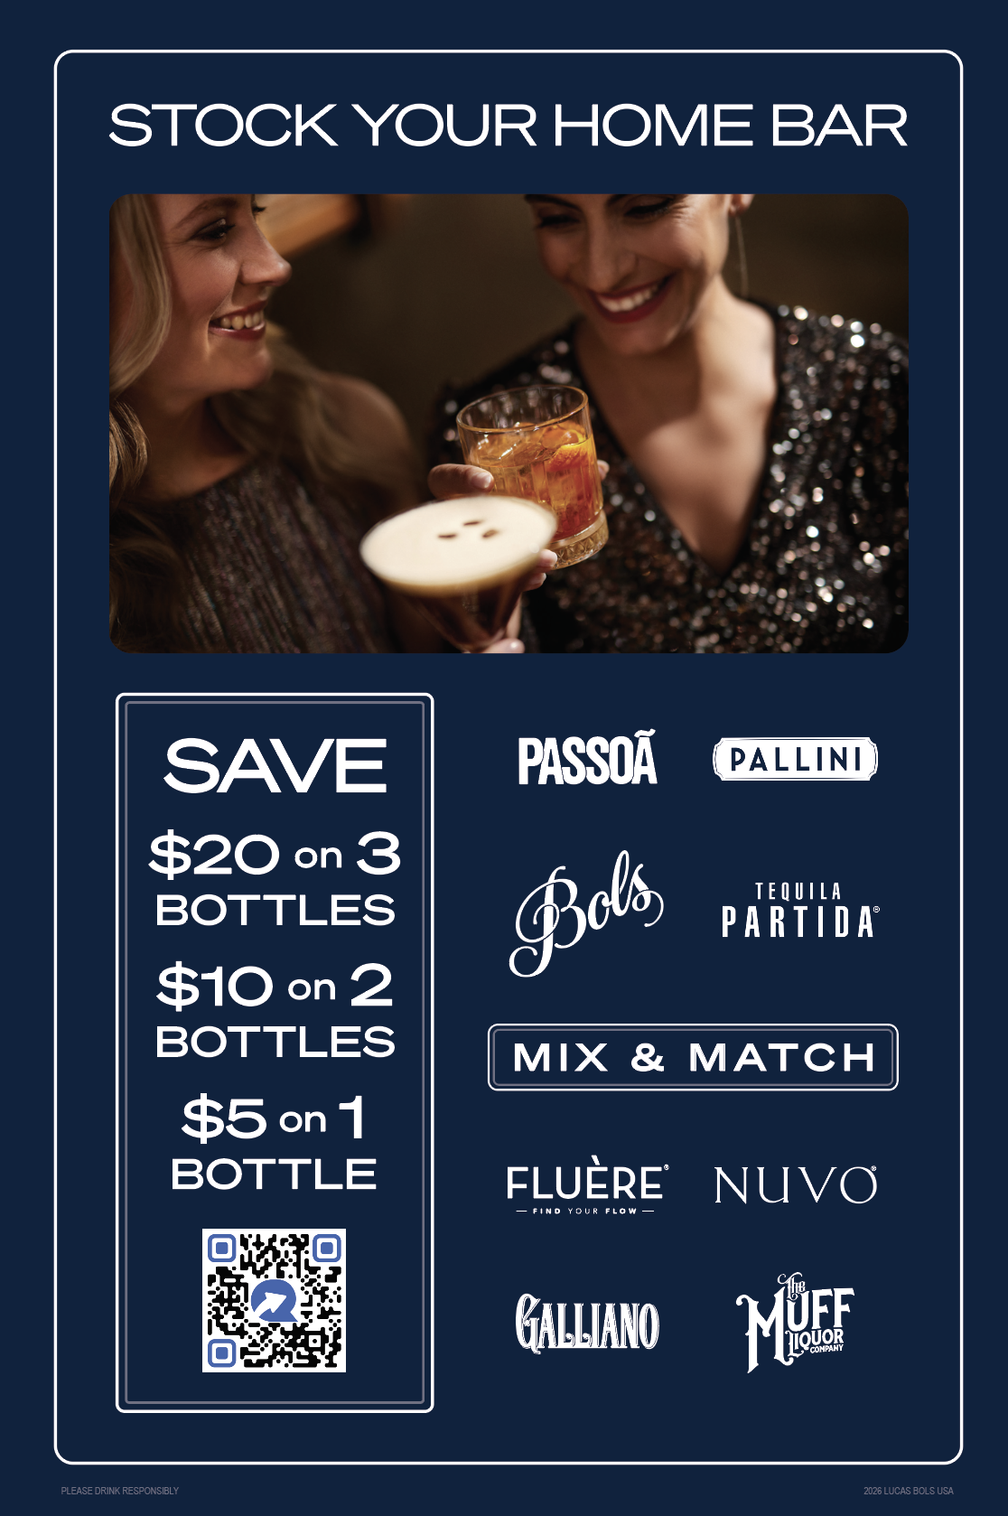
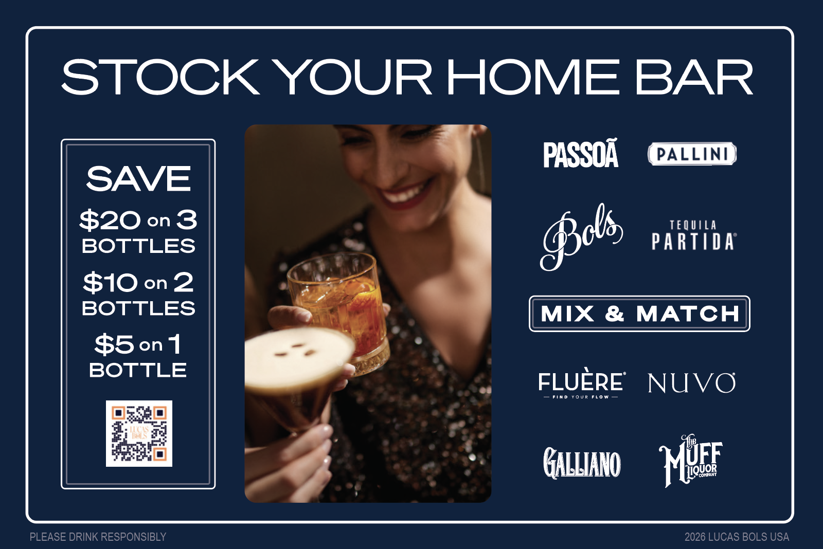
LBUSA 2026 PORTFOLIO RETAIL PROGRAM WITH REBATES
PRINT POS
STRINGED BOTTLE NECKER
(FRONT & BACK)
CASE CARD
CASE TUCKER
SHELF TALKER
IN MARKET. APRIL 15th

Slide 8
LUCAS BOLS USA POS ORDERS – RETAIL 360
ITEM NAME | TOTAL
Racks - WITH REBATE | 183
Case Cards - WITH REBATE | 425
Case Tuckers - WITH REBATE | 435
Shelf Talkers - WITH REBATE | 1,907
Bottle Neckers (packs of 25) - WITH REBATE | 307
ITEM NAME | TOTAL
Racks - NO REBATE | 31
Case Cards - NO REBATE | 95
Case Tuckers - NO REBATE | 20
Shelf Talkers - NO REBATE | 415
Bottle Neckers (packs of 25) - NO REBATE | 139

Slide 9
2026
PORTFOLIO
“360” RETAIL PROGRAM
NO REBATES
MAR’26

Slide 10
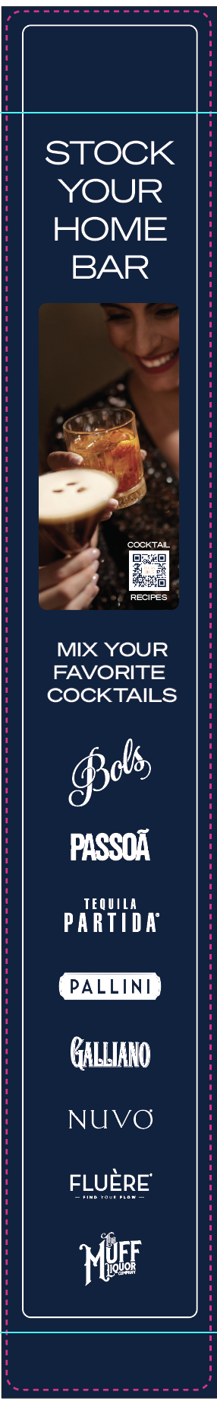

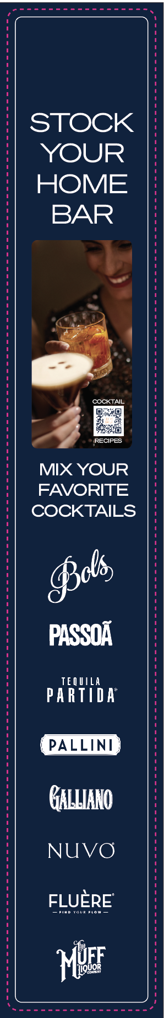
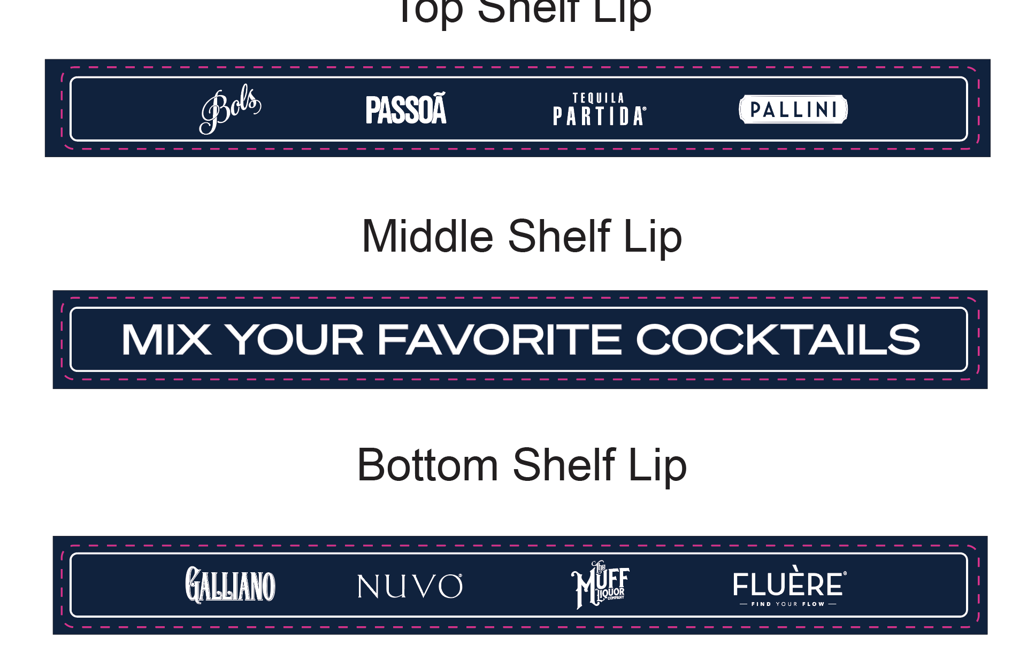
LBUSA 2026 PORTFOLIO RETAIL PROGRAM NO REBATES PERMANENT RACK
IN MARKET. MAY 1ST

Slide 11
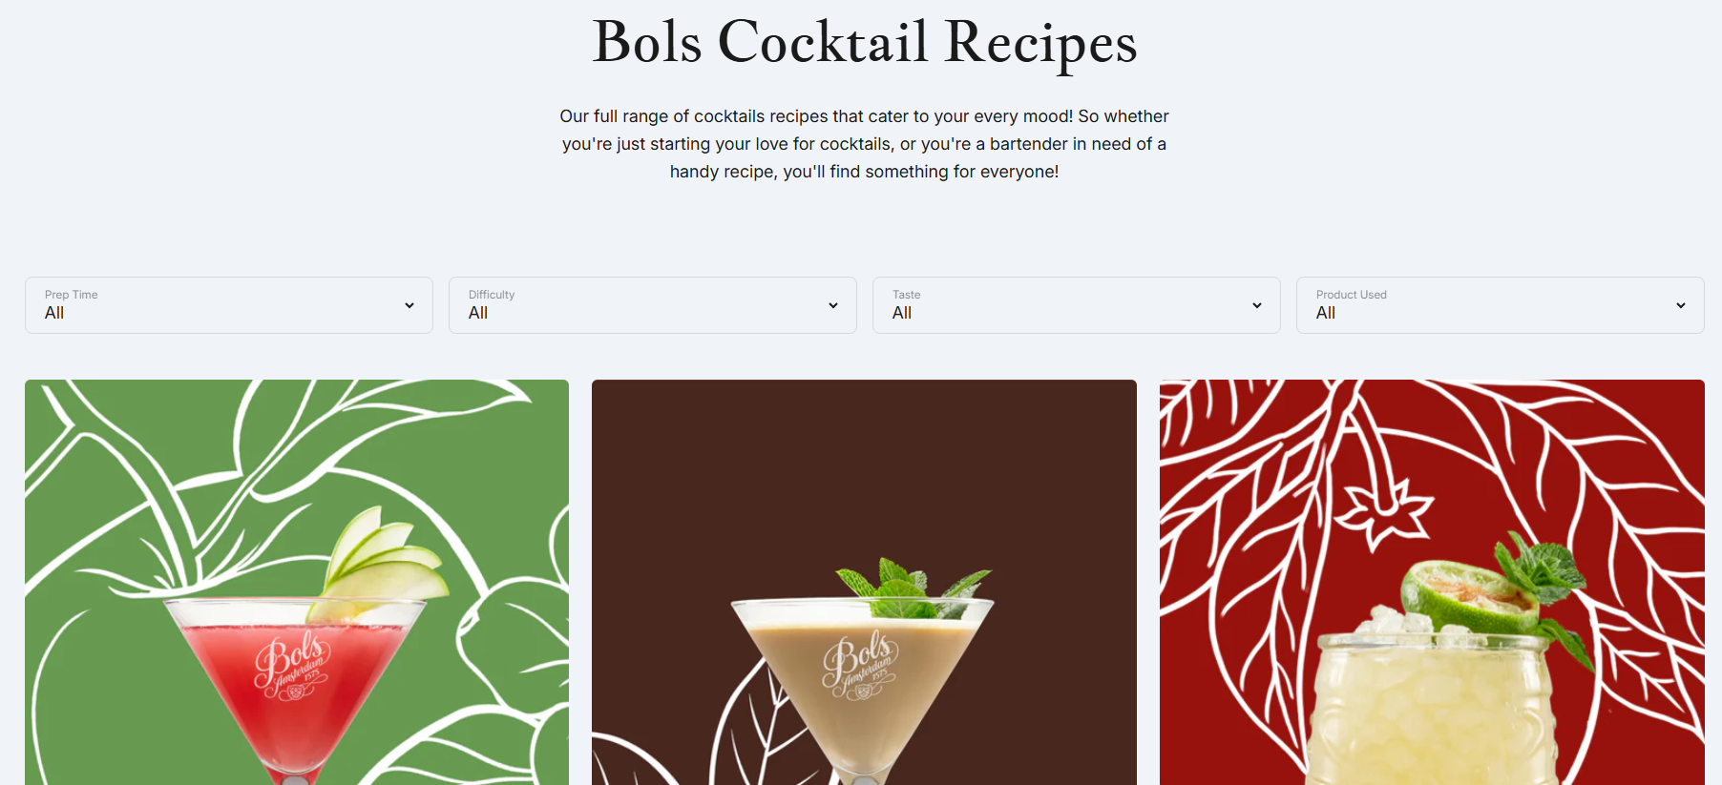
The Best Bols Cocktail Recipes USA | Create cocktails at home

Slide 12

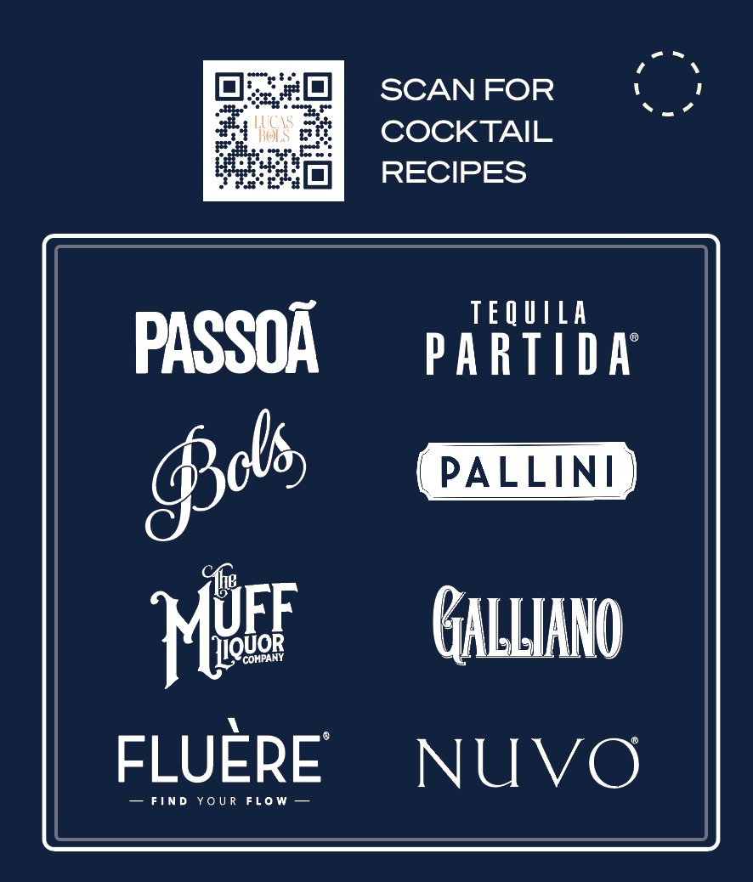
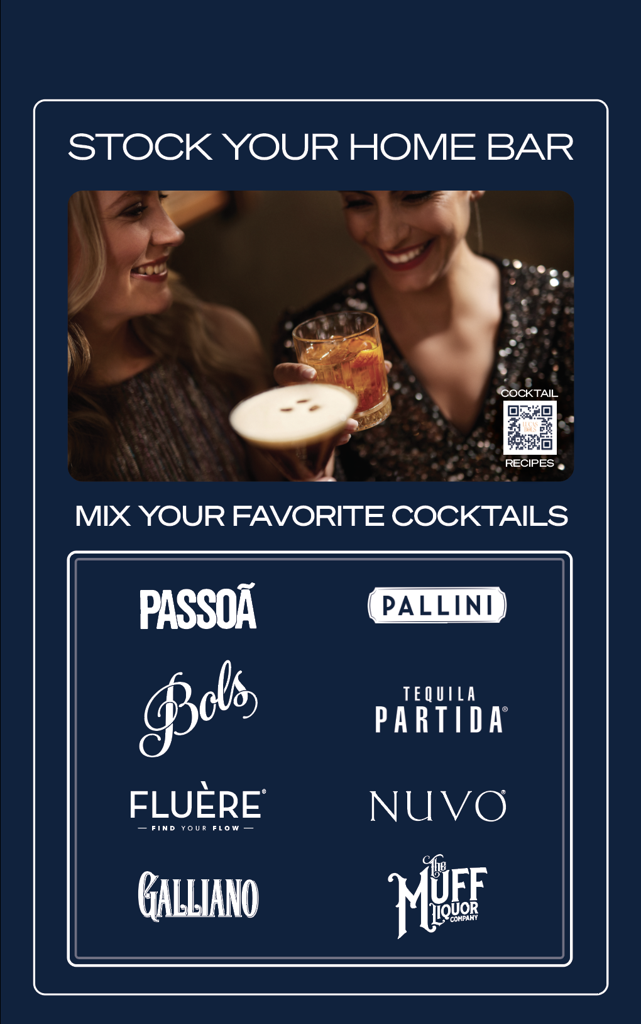
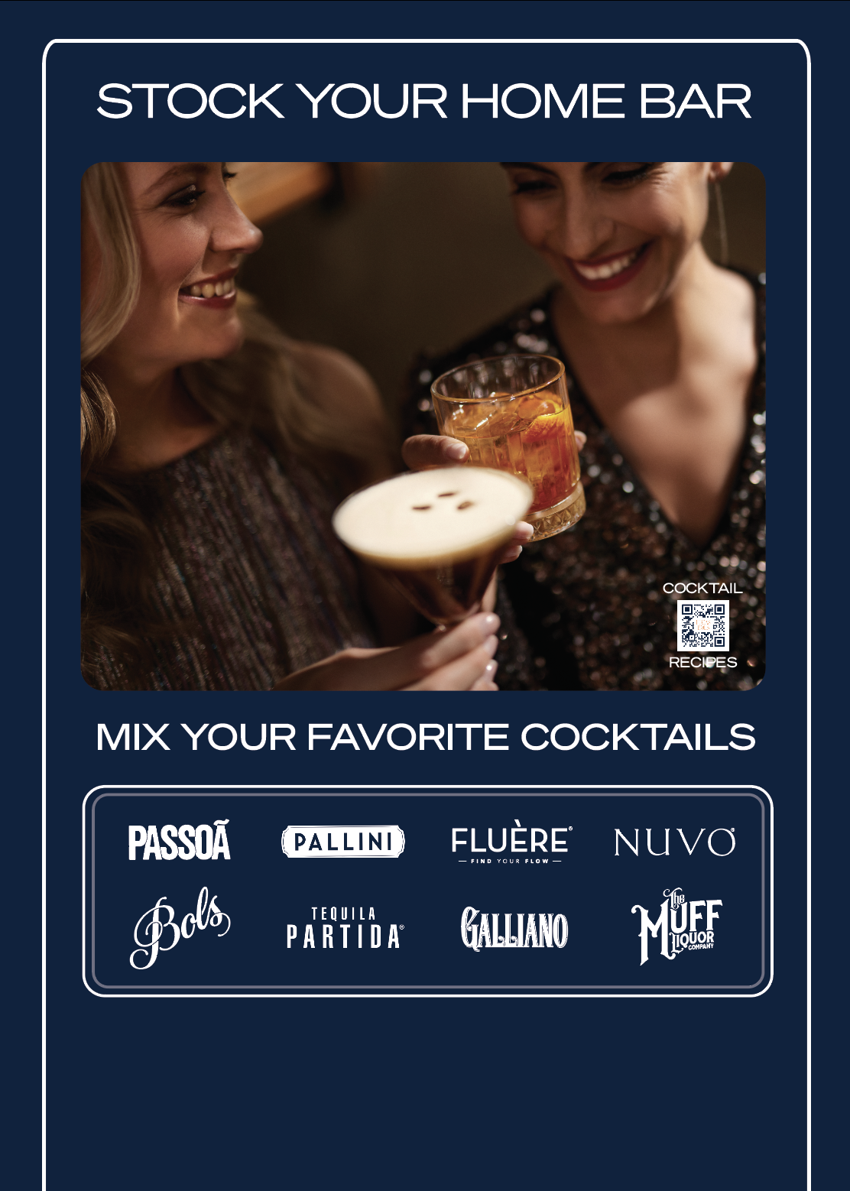

LBUSA 2026 PORTFOLIO RETAIL PROGRAM NO REBATES
PRINT POS
STRINGED BOTTLE NECKER
(FRONT & BACK)
CASE CARD
CASE TUCKER
SHELF TALKER
IN MARKET. APRIL 15th

Slide 13


2026 PORTFOLIO “360” RETAIL PROGRAM
NEXT STEPS & TIMELINE
Collect print POS allocations – MARCH 13th
Print POS in market – APRIL 15th
Racks in Market – MAY 1st

Slide 14




OUR MISSION IS TO CREATE GREAT COCKTAIL EXPERIENCES AROUND THE WORLD
FOR 450 YEARS SINCE 1575

