Slide 1




THE ORIGINAL ADDITIVE FREE TEQUILA since 2005

Slide 2


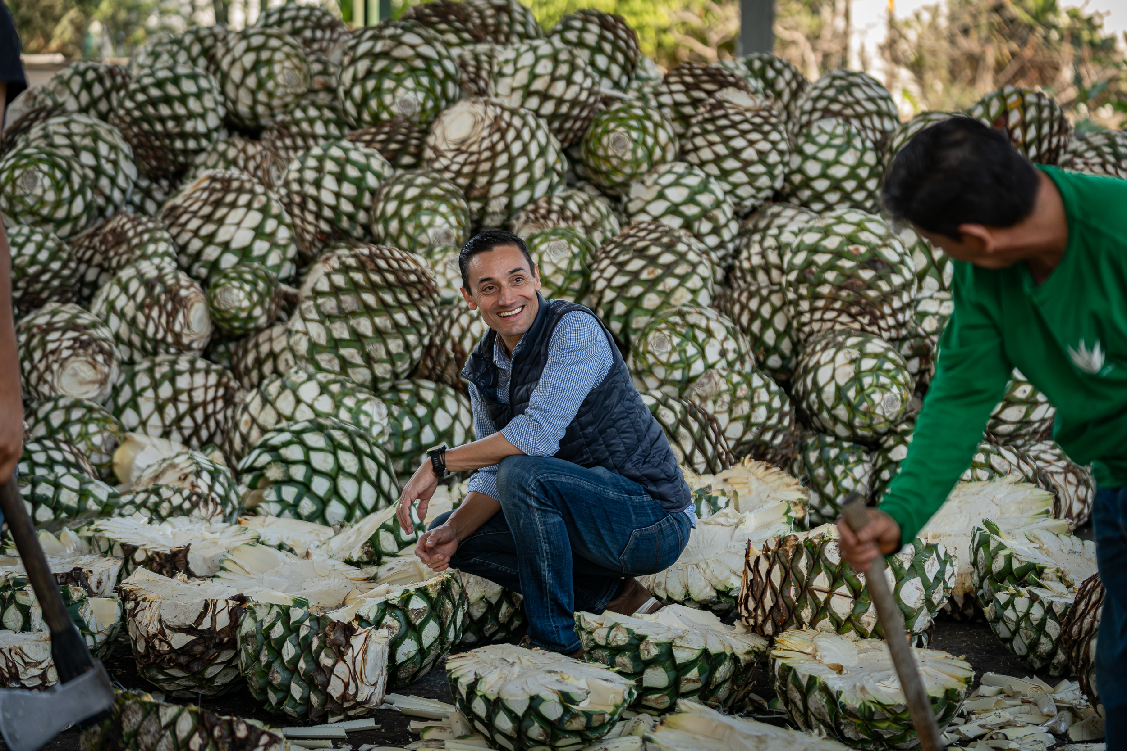
TEQUILA PARTIDA MAESTRO TEQUILERO JOSÉ VALDEZ
José Valdez is a distinguished Maestro Tequilero and the Master Distiller for Partida Tequila, a highly regarded premium tequila brand. With a deep passion for the art of tequila making, Valdez has become a key figure in the industry, renowned for his expertise in crafting high-quality tequila that respects traditional methods while incorporating modern techniques.

Slide 3
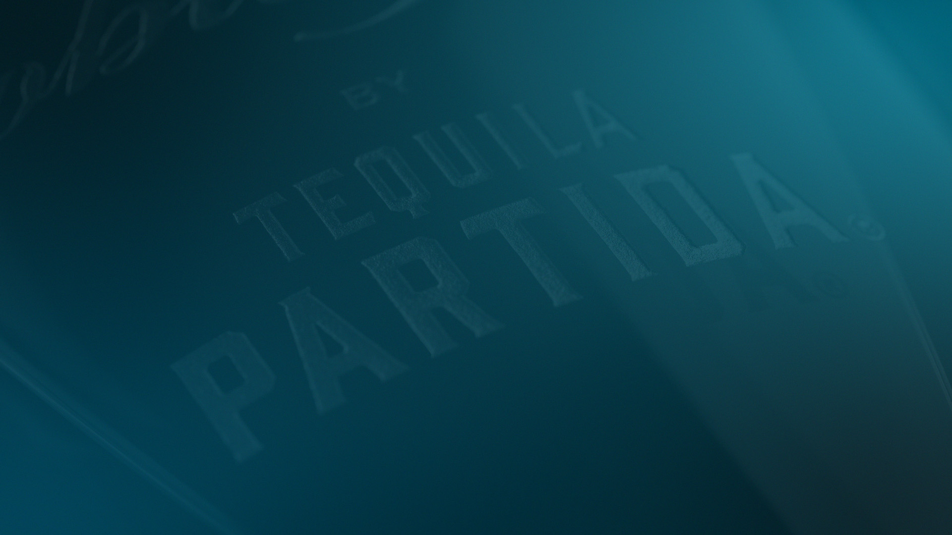

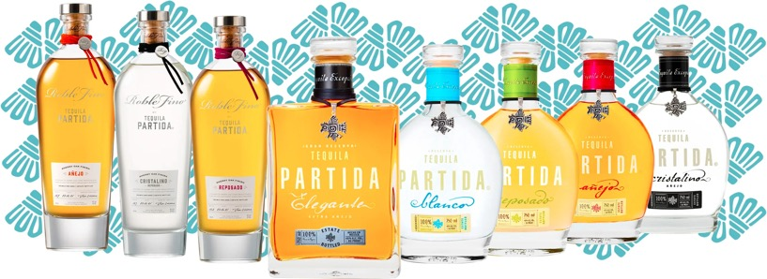
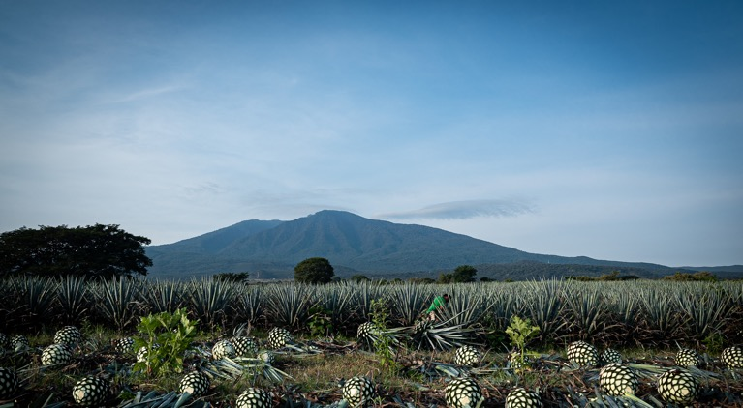

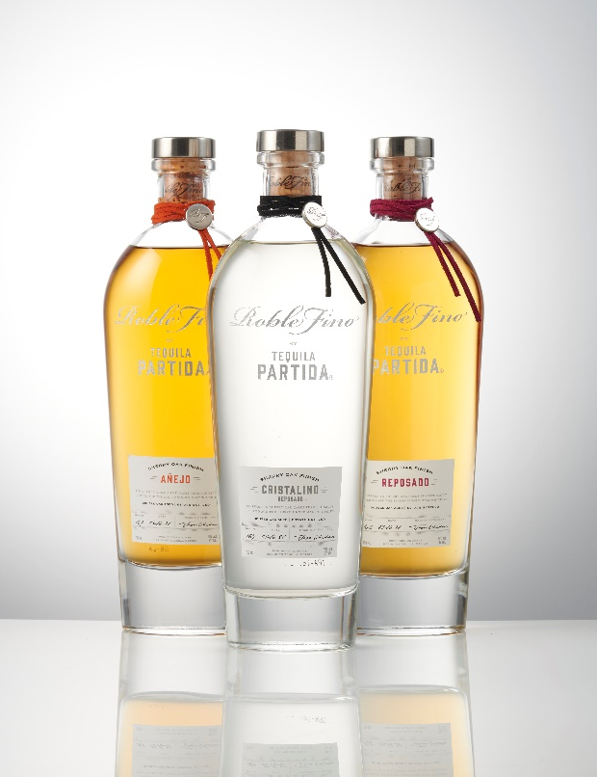
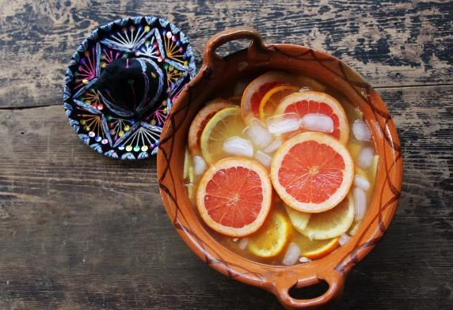
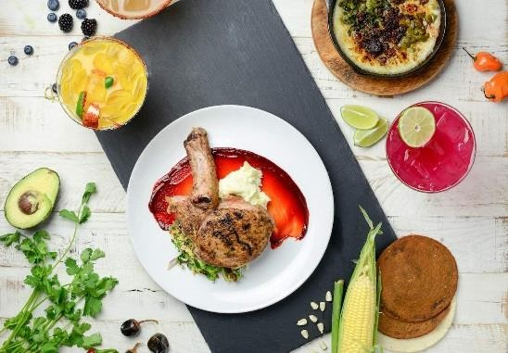
TEQUILA PARTIDA VISION
iPARTIDA!
100% NATURAL, 100% MEXICAN
“
The authentic Luxury tequila that embraces the true flavors of Agave with no compromise*
“
AUTHENTIC
Production & sourcing • The Spirit Bird • The Pristine Serve
CONTEMPORARY
Packaging • Colors
* Tequila Maestro, José Valdez

Slide 4
THE SPIRIT BIRD
Legend has it that when a Mexican village was suffering, a woman watched a bird struggling to perch on an agave.
The bird pierced the heart of the sacred plant, revealing its nectar, which restored her village.
Today, a spirit bird charm graces each Tequila Partida bottle to symbolize the how the precious agave nectar was discovered.

Slide 5






TEQUILA PARTIDA PRODUCTION
FROM FIELD TO GLASS
MATURE PRIME BLUE WEBER AGAVE
24 HOUR FIELD TO COOKING
NATURAL YEAST FERMENTATION
STAINLESS STEEL DISTILATION
AGE BEYOND EXPECTATIONS
100% ADDITIVE FREE
We rely on natural yeast fermentation and steer clear of any artificial additives
Utilizing stainless steel distillation preserves the purity of agave
Aged longer than industry standards in ex-bourbon American White Oak barrels
“Simply the finest line of tequilas money can buy” – Paul Pacult
To ensure the perfect sugar content, our plants must mature for a minimum of 6 years
To achieve the fresh agave flavor, we commence the slow-cooking process within just 24 hours of harvesting
Partida water source is proprietary, naturally filtered through volcanic soil

Slide 6
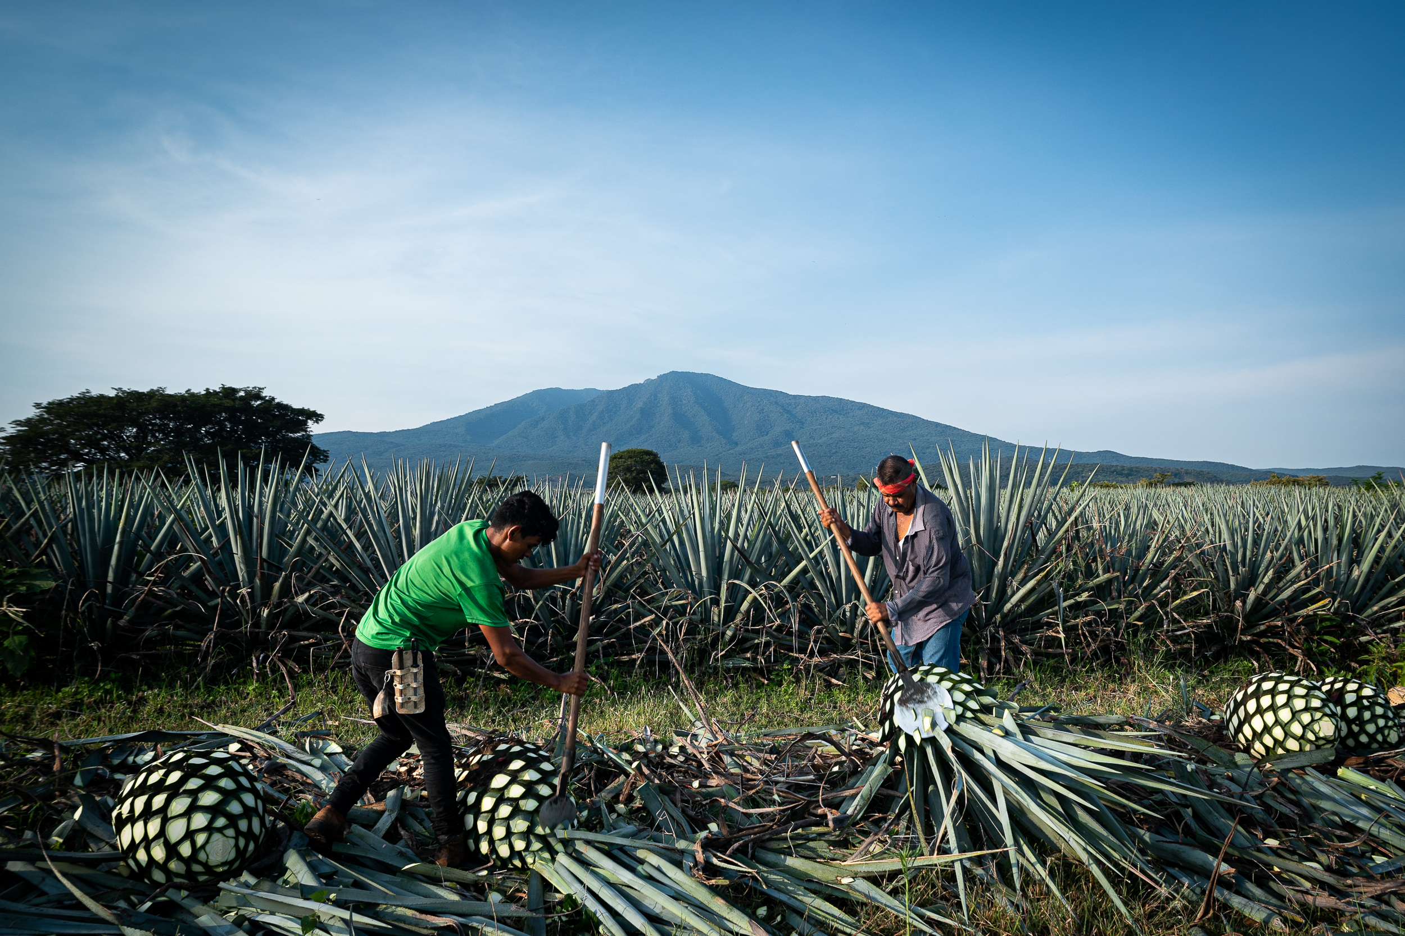
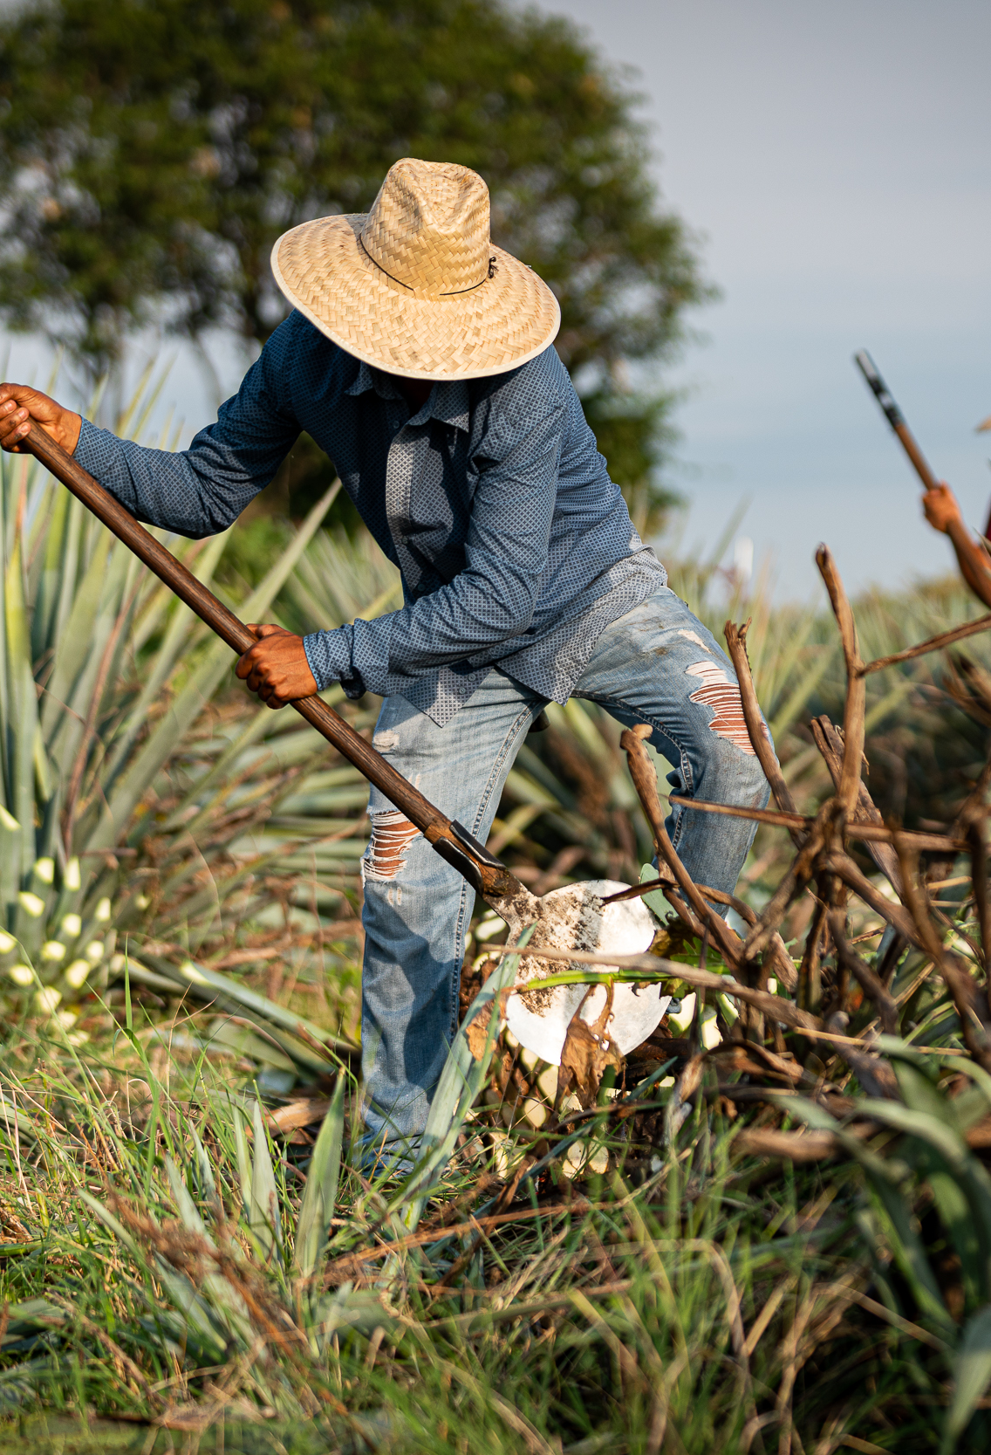
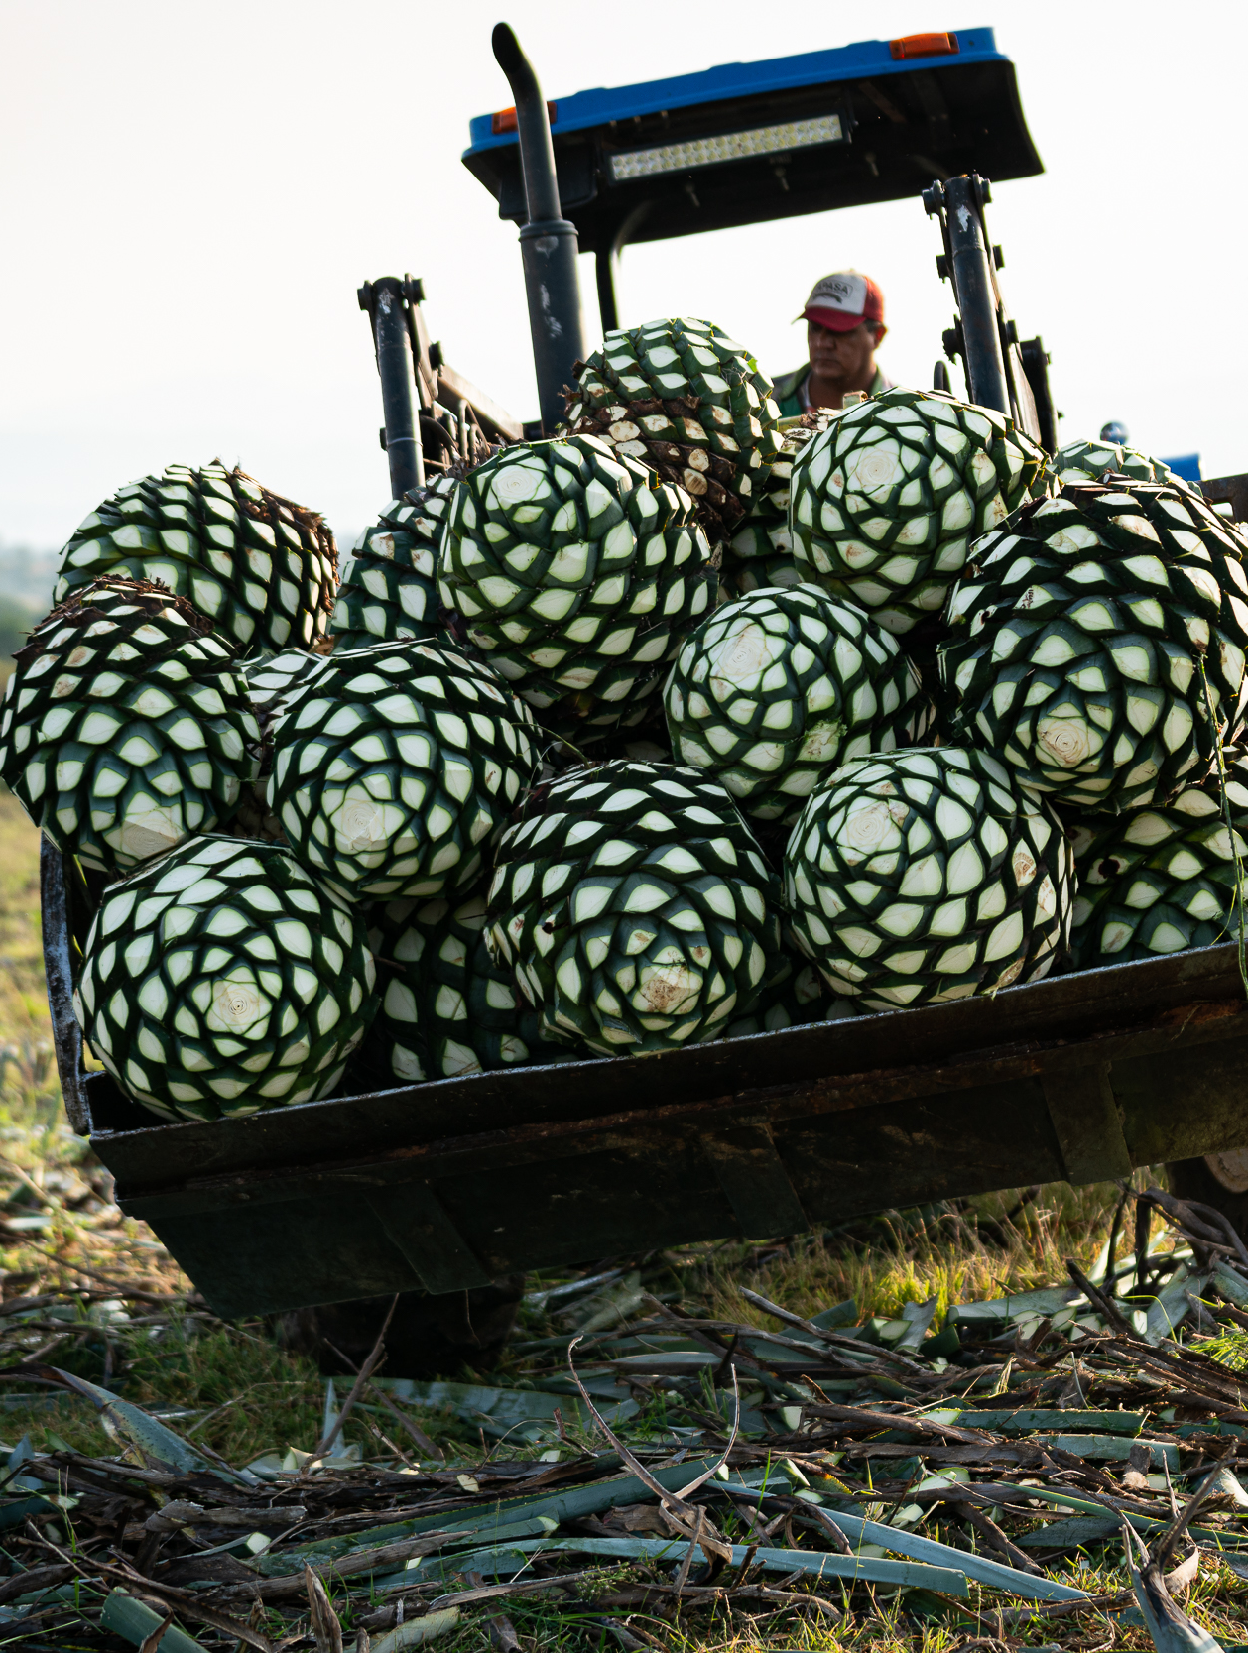
TEQUILA PARTIDA PRODUCTION
WHAT MAKES US SPECIAL?
THE AGAVE
PRIME MATURE AGAVE
Produces ripe, full-flavored agave
Harvested in the Tequila Valley
Prime Mature agave
High in sugar content = Minimum 24% ART
Close harvesting = No longer than 2 cm
Fresh = Cooked within 24 hours after harvesting

Slide 7

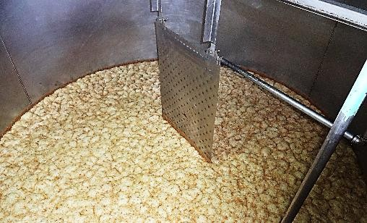
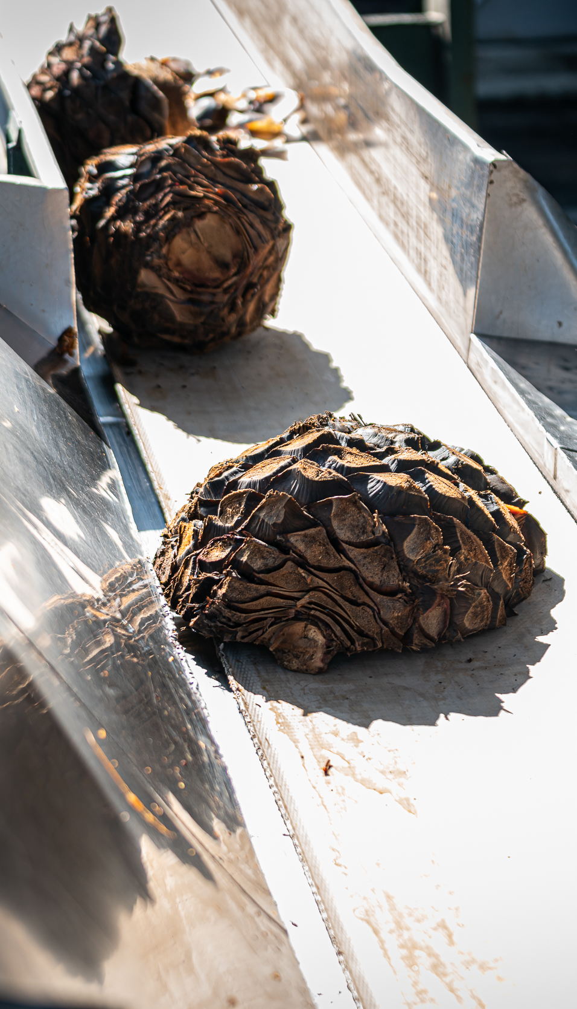
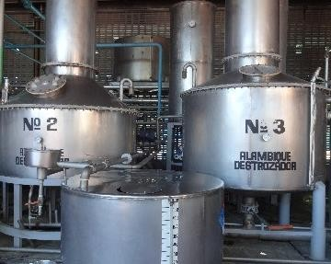
TEQUILA PARTIDA PRODUCTION
WHAT MAKES US SPECIAL?
THE PROCESS
Mix of Traditional & Contemporary
24 HOUR FIELD TO COOKING
Preserves fresh agave flavor
NATURAL YEAST FERMENTATION
STAINLESS STEEL DISTILLATION
Preserves agave purity
Slow and natural fermentation
Additive Free = 100% Natural
Liquid produced in one distillery NOM 1502
Clean and slow
Artisanal with consistency
Estate water, naturally filtered through volcanic soil

Slide 8
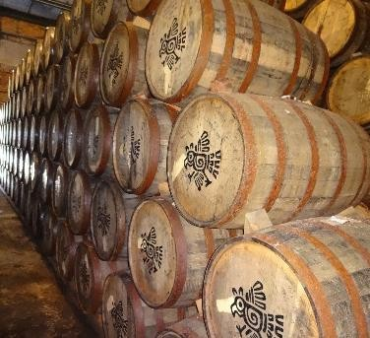

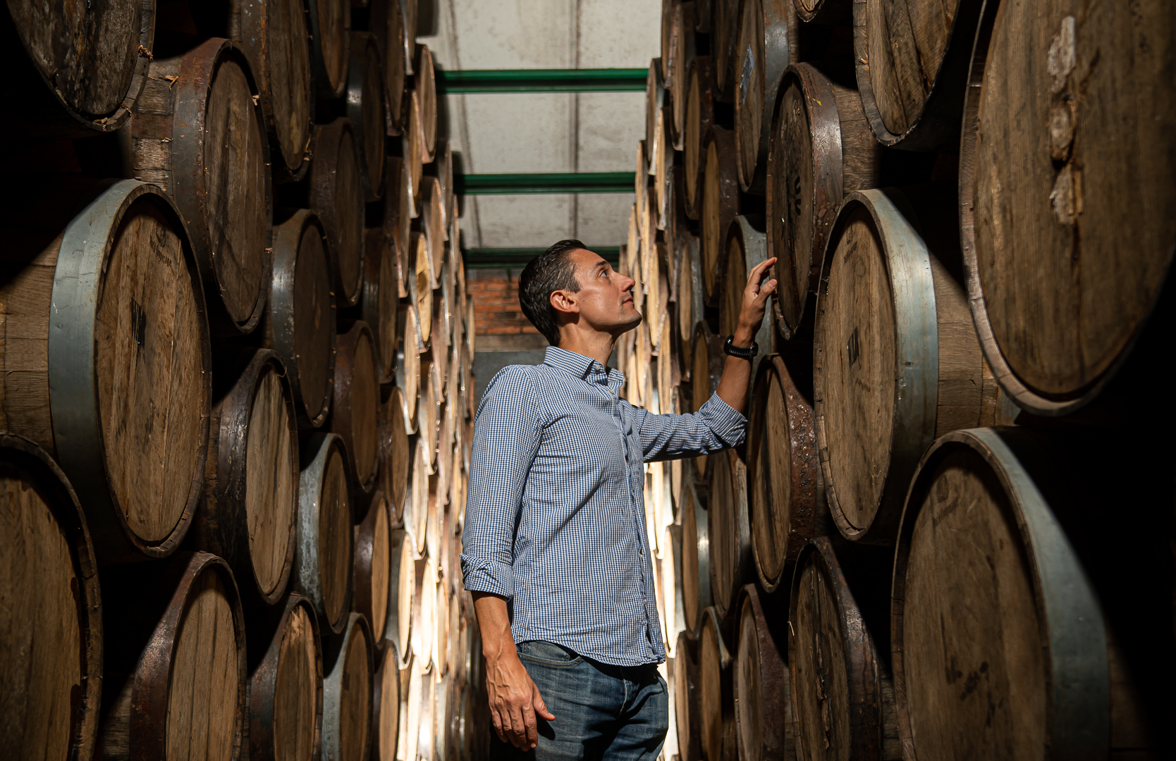
TEQUILA PARTIDA PRODUCTION
WHAT MAKES US SPECIAL?
THE AGING
AGED BEYOND EXPECTATIONS
Enhances natural agave flavor & color
Ex-Bourbon white American Oak, medium toast
Fresh Barrels directly from the source
Aged beyond the minimum required
6 Months Vs 2 months (industry standarsd = Reposado
18 Months instead of 12 months = Añejo
48 Months instead of 36 months = E. Añejo
Aged in smaller containers than the Mexican Law states. Use the barrels only for 3 years

Slide 9
TEQUILA PARTIDA PRODUCTION
WHAT MAKES US SPECIAL?
THE PROCESS
Mix of Traditional & Contemporary
THE AGAVE
THE AGING

Slide 10
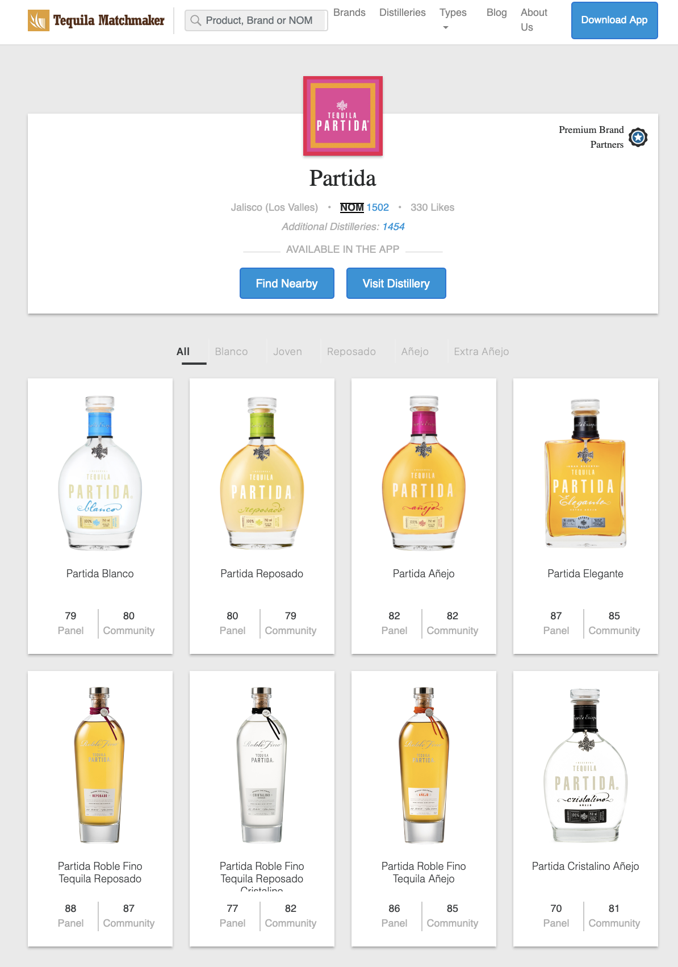
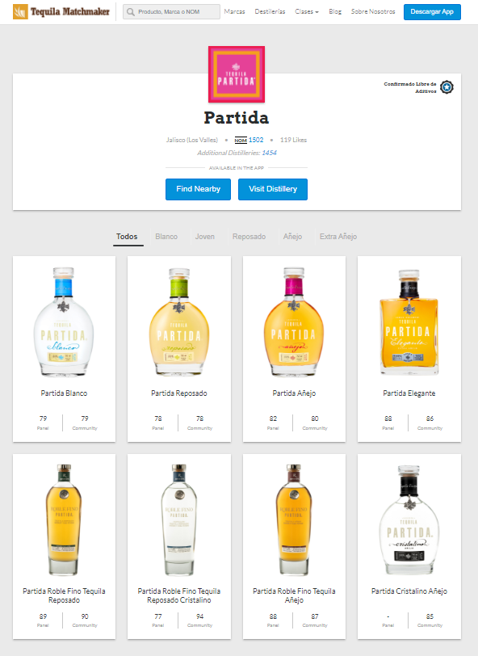



TEQUILA PARTIDA PRODUCTION
THE ORIGINAL ADDITIVE FREE TEQUILA
https://tequilamatchmaker.com/es/brands/69-partida

Slide 11
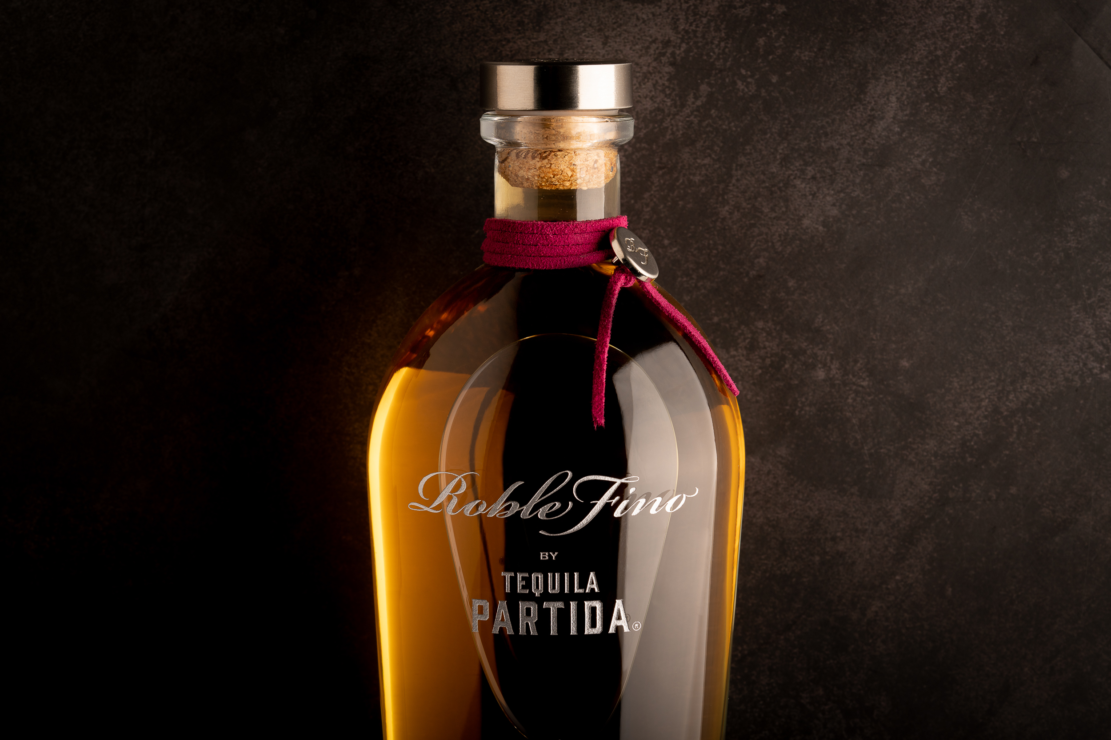

DOUBLE AGED IN EX-SINGLE MALT SHERRY OAK CASK
2024 BEST LUXURY TEQUILA

Slide 12

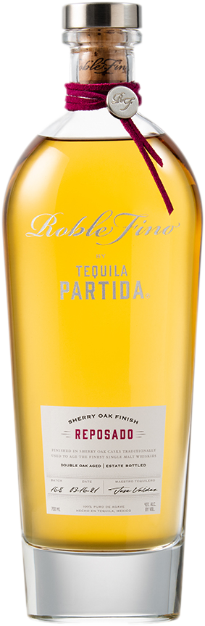
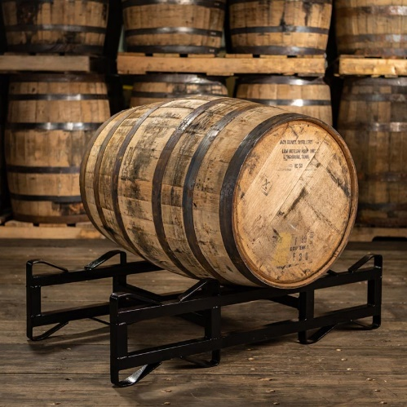
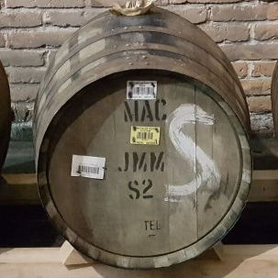
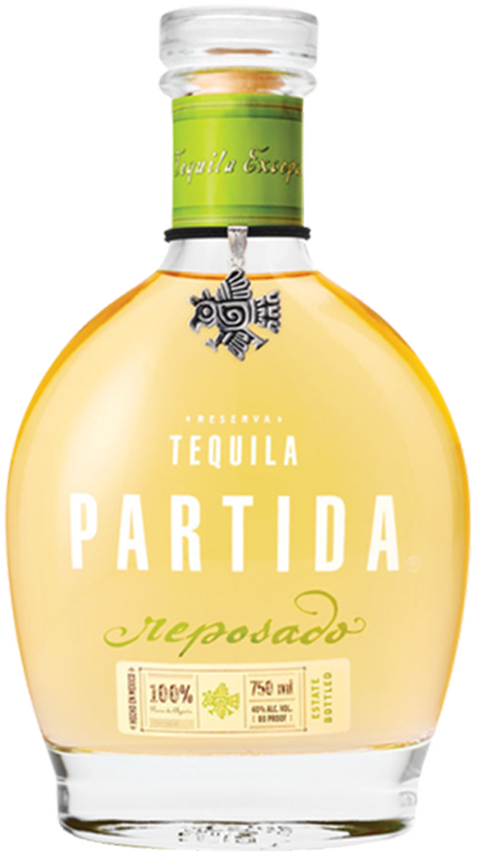
TEQUILA PARTIDA PRODUCTION
ROBLE FINO REPOSADO
6 MONTHS
+
2 MONTHS
DOUBLE AGED IN EX-SINGLE MALT
SHERRY OAK CASK
43% ABV

Slide 13
TEQUILA PARTIDA PRODUCTION
ROBLE FINO REPOSADO
TASTING DESCRIPTION
Excellent clarity; citron color. Wow, I immediately like this laser focused opening aromas that features keenly herbal scents of sage, fennel, anise, savory, and bay leaf (laurel), as well as green chili pepper, leather, and green tomato vine; secondary inhalations pick up subtler notes of road tar, quince, casaba melon, hard boiled egg, brown butter, and black peppercorn. Entry flavors are grapy, winey, and berry-like and that fruitiness dominates the early stage, except for the foundational agave vegetal/herbaceous taste; midpalate highlights the sherry cask/agave plant marriage via the succulent, semisweet flavor that’s not short on agave syrup richness and tanginess; in fact, the agave presence is found mostly in the lush texture. Concludes long in the throat, moderately peppery/spicy, not as sweet as the midpalate and therefore more herbal and green vegetable-like. This is the dawn of a promising new era for 100% agave tequila, one that’s been needed for at least a decade. Note the abv level.
Spirit Journal 2019: Paul Pacult FIVE STARS/Highest Recommendation
PALATE
Presence of cooked agave with hints of vanilla, maple syrup, anise, quince, and dried fruits

Slide 14
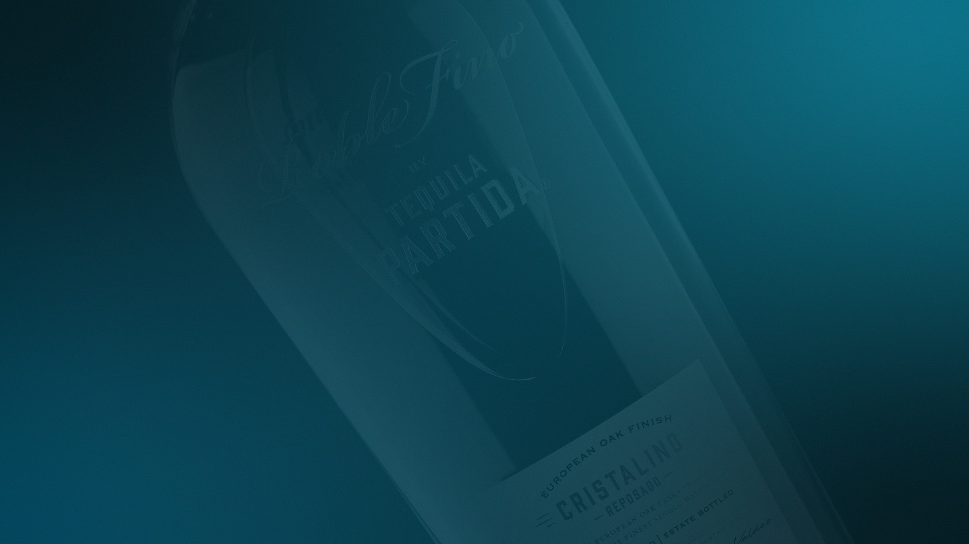
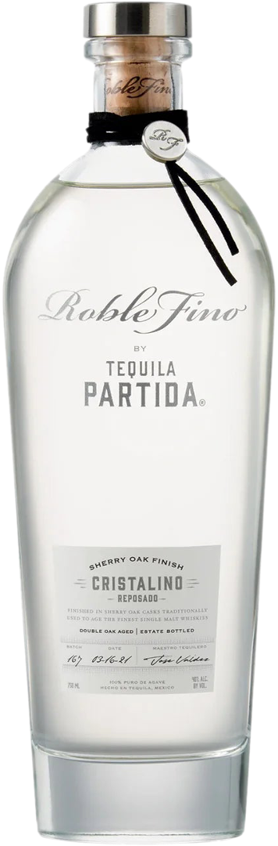
TEQUILA PARTIDA PRODUCTION
ROBLE FINO REPOSADO CRISTALINO
6 MONTHS
+
2 MONTHS
+
FILTERED
DOUBLE AGED IN EX-SINGLE MALT
SHERRY OAK CASK
40% ABV

Slide 15
TEQUILA PARTIDA PRODUCTION
ROBLE FINO REPOSADO CRISTALINO
TASTING DESCRIPTION
Crystalline, sediment free appearance; pewter-like silvery color. Upfront, I find distinctive aromatic notes of toasted hazelnut, salted butter, carob, and green tobacco leaves; after more aeration, the fragrances pick up earthy, mineral-like scents of terra cotta, coriander, sage, lead pencil, tin can, and dill. Entry showcases more agave character than the bouquet, as dry, slightly bittersweet flavors of carbon/charcoal, black tea, caramelized onion, green olive, and grilled pineapple cover the palate; midpalate stage is where the inclusion of sherry cask emerges and it’s this pivotal addition of gentle, winey sweetness that accentuates the agave elements that last deep into the near-succulent, pleasingly pruny aftertaste.
Spirit Journal 2019: Paul Pacult FOUR STARS/Highly Recommended
PALATE
Exploding flavors of dried fruits, cooked agave, toasted oak, vanilla, and nuts

Slide 16
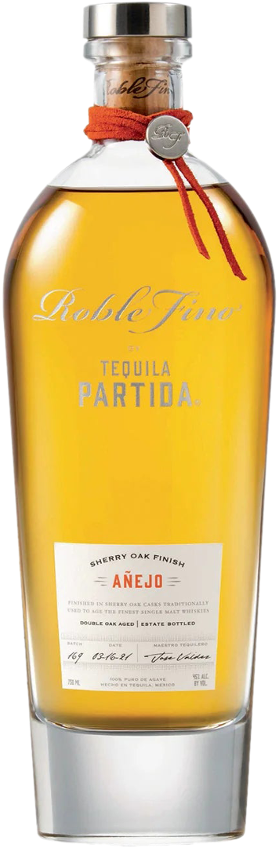
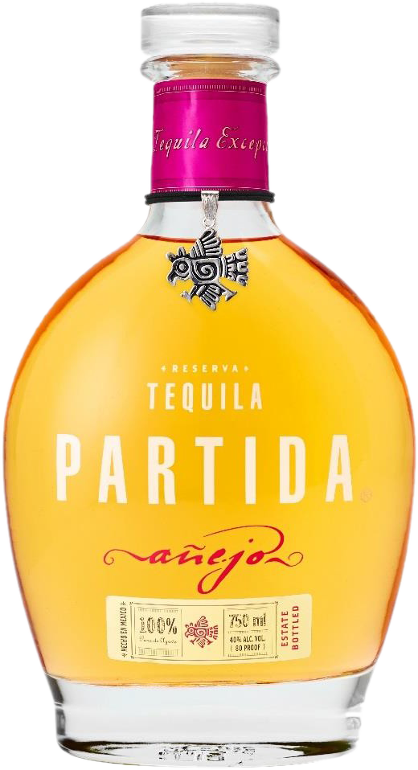
TEQUILA PARTIDA PRODUCTION
ROBLE FINO AÑEJO
18 MONTHS
+
5 MONTHS
DOUBLE AGED IN EX-SINGLE MALT
SHERRY OAK CASK
45% ABV

Slide 17

TEQUILA PARTIDA PRODUCTION
ROBLE FINO AÑEJO
TASTING DESCRIPTION
Goldenrod/harvest gold color; impeccably clear and clean. Oh yeah, now we’re talking burnt matches, smoldering campfire embers, egg yolks/hard boiled egg, bacon fat, lard, and shallot-like aromas that all echo earthy agave; secondary whiffs detect baked scents of pear, nectarine, and white grapes/raisins that now dominate the bouquet as the herbal/vegetal/smoky aspects recede a bit. Entry owns an impactful, multilevel flavor of pickle brine/dill and baked orchard and vineyard fruits that together present the taste buds with a dramatically exciting and piquant 100% agave flavor experience unlike and better than any other; midpalate mirrors the entry stage, adding a larger portion of mince meat-like sherry cask flavor without sacrificing the earthy agave core taste. Finishes long, ripe, semisweet, vegetal, and dill-like. I believe that it’s the 45% abv that makes this tequila so memorable as much as it is the sherry cask finishing.
Spirit Journal 2019: Paul Pacult FIVE STARS/Highest Recommendation
PALATE
Clean & smooth with sweet notes of dried fruits, toasted oak, chocolate, & cooked agave
2024 BEST LUXURY TEQUILA

Slide 18

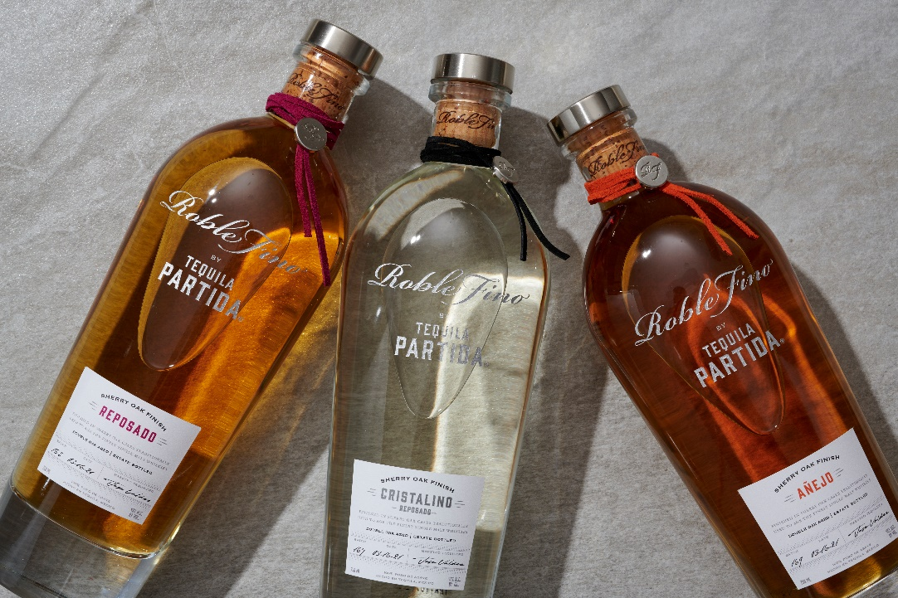
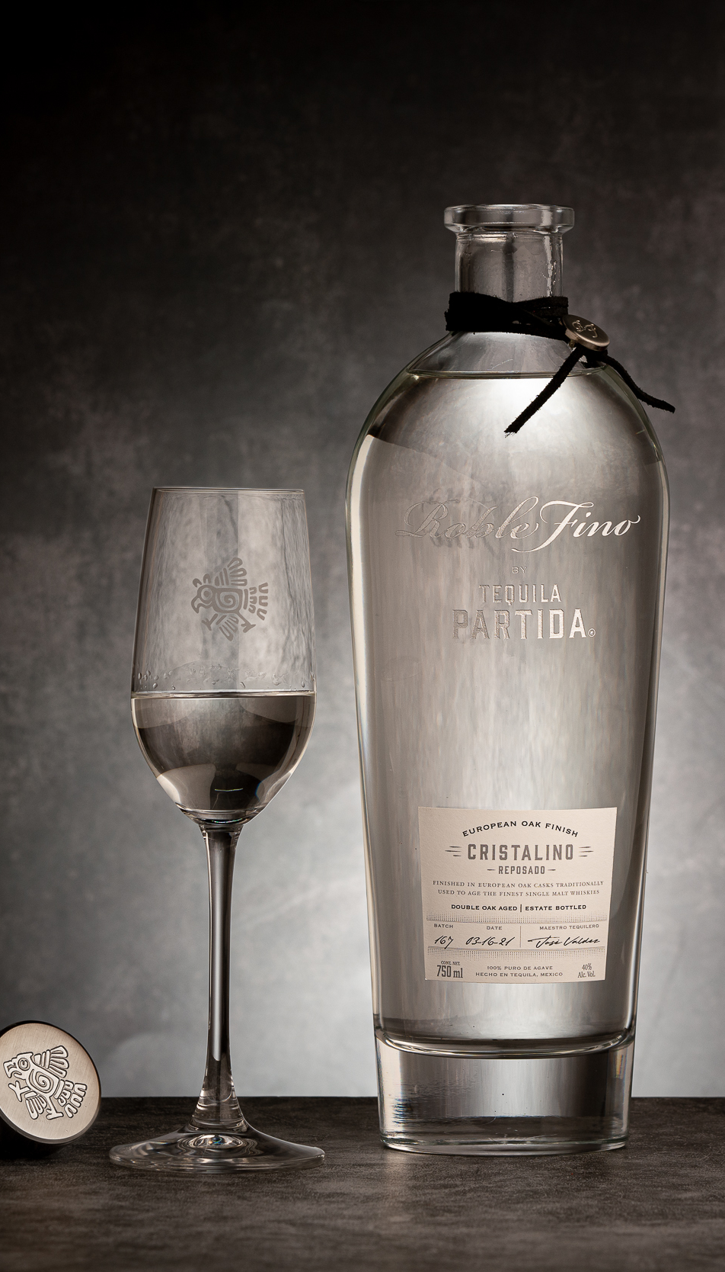
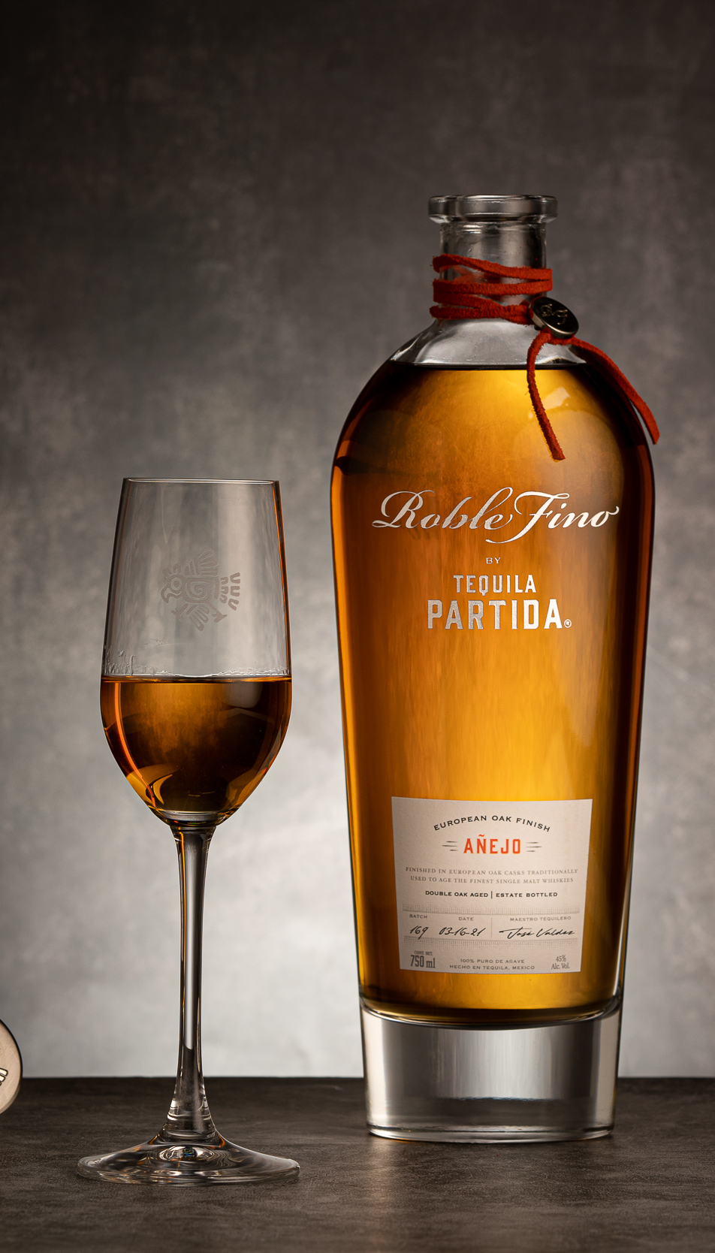
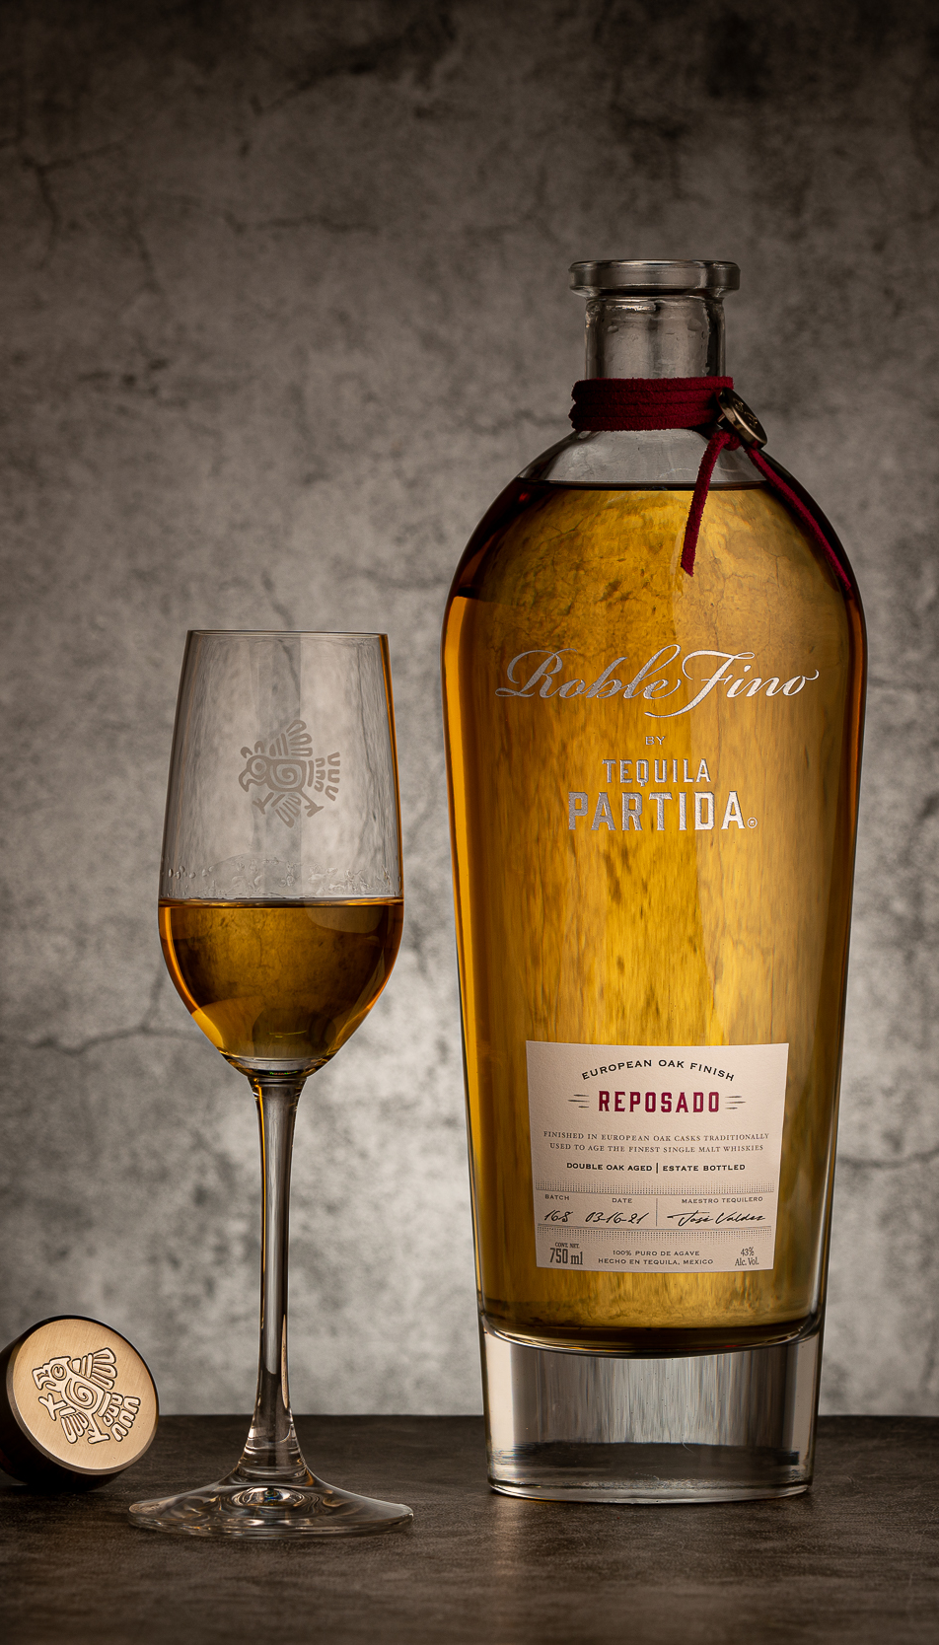
TEQUILA PARTIDA PRODUCTION
ROBLE FINO
“THIS IS THE DAWN OF A PROMISING NEW ERA FOR 100% AGAVE TEQUILA, ONE THAT’S BEEN NEEDED FOR AT LEAST A DECADE.” - F. PAUL PACULT

Slide 19

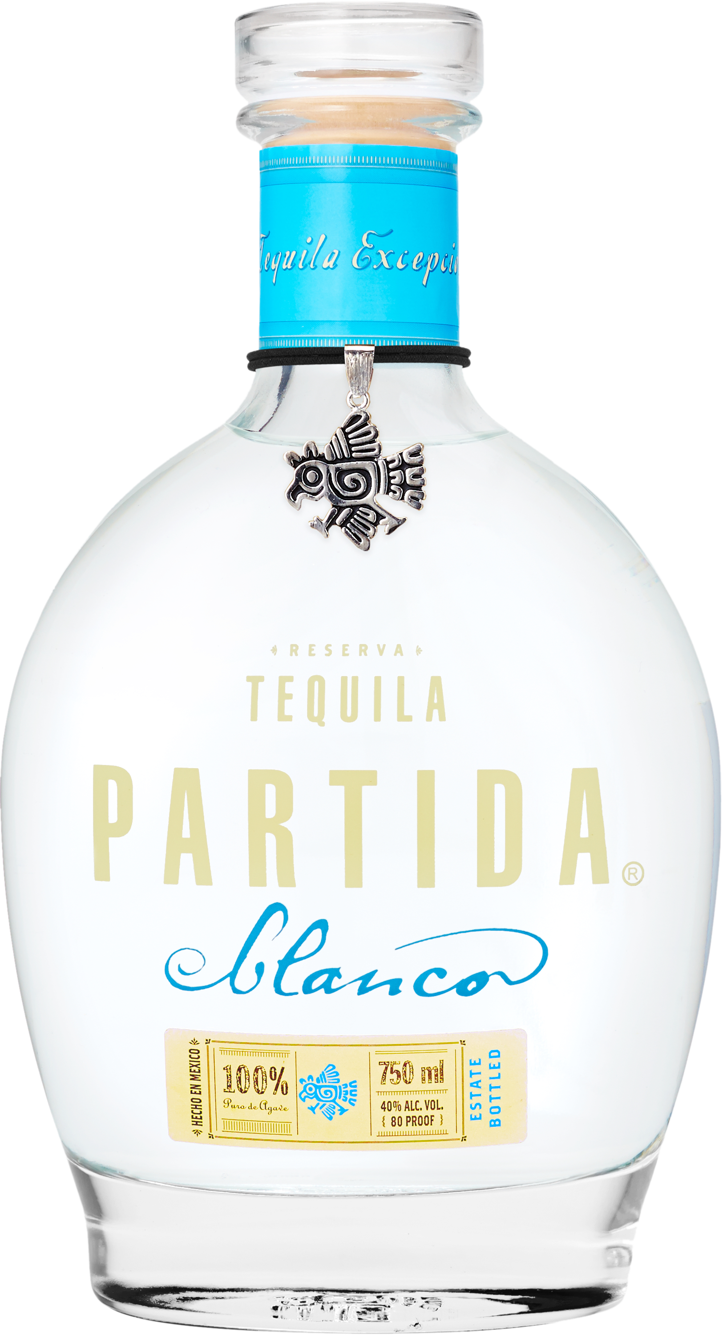
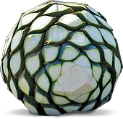
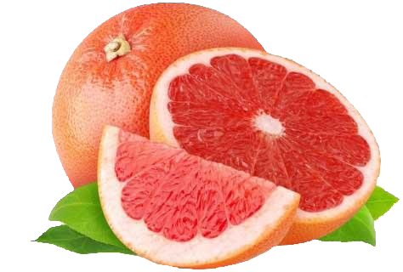
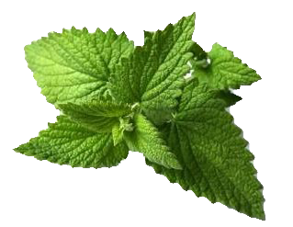
TEQUILA PARTIDA – BLANCO
(UNAGED)
APPEARANCE
Crystal clear
AROMAS
Ruby Red Grapefruit
Agave
Mint

Slide 20
TEQUILA PARTIDA – BLANCO
(UNAGED)
TASTING DESCRIPTION
Real and fresh expression of blue agave. Crystal clear appearance. Perfect harmony and balance between aromas and flavors. Wide and complex variety of notes where herbal, earthy and citrus dominate. Hints of tropical fruits and vanilla but overall cooked agave, sweet potatoes, black pepper, volcanic minerals and grapefruit.

Slide 21

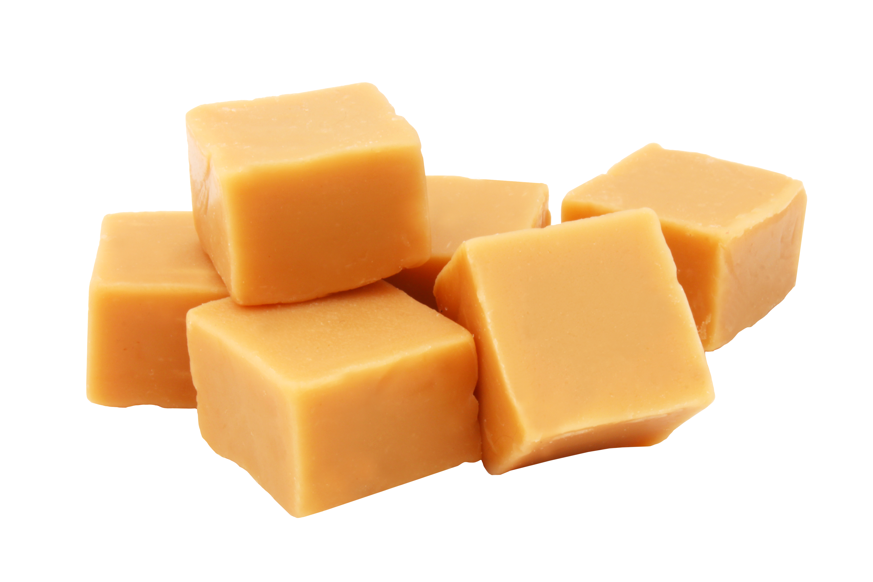
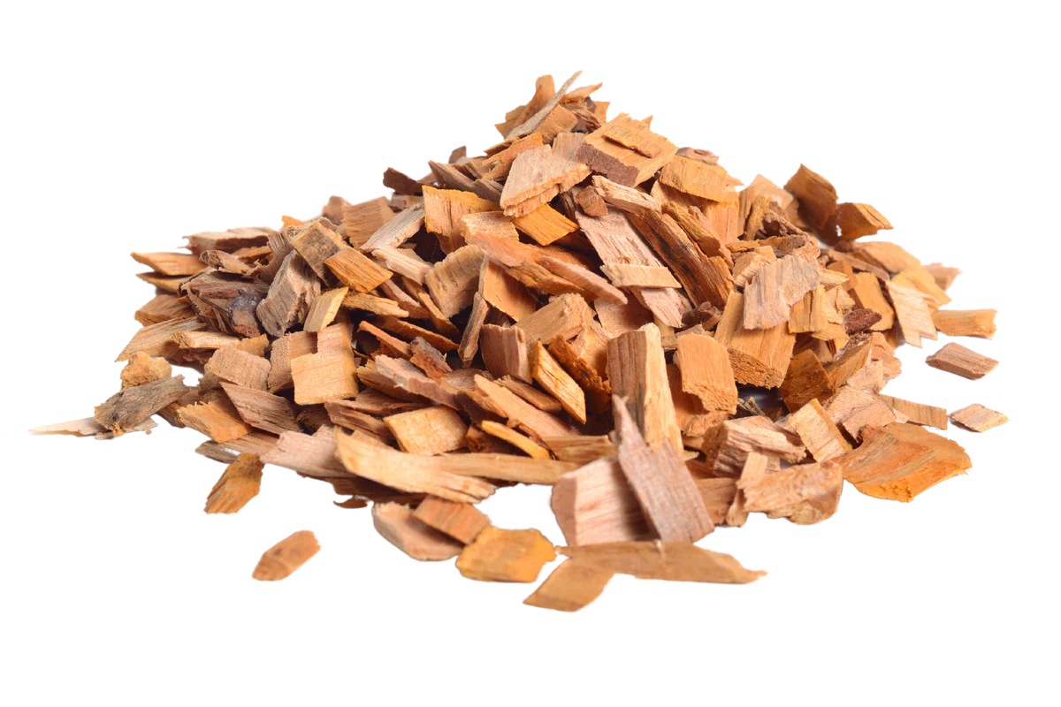
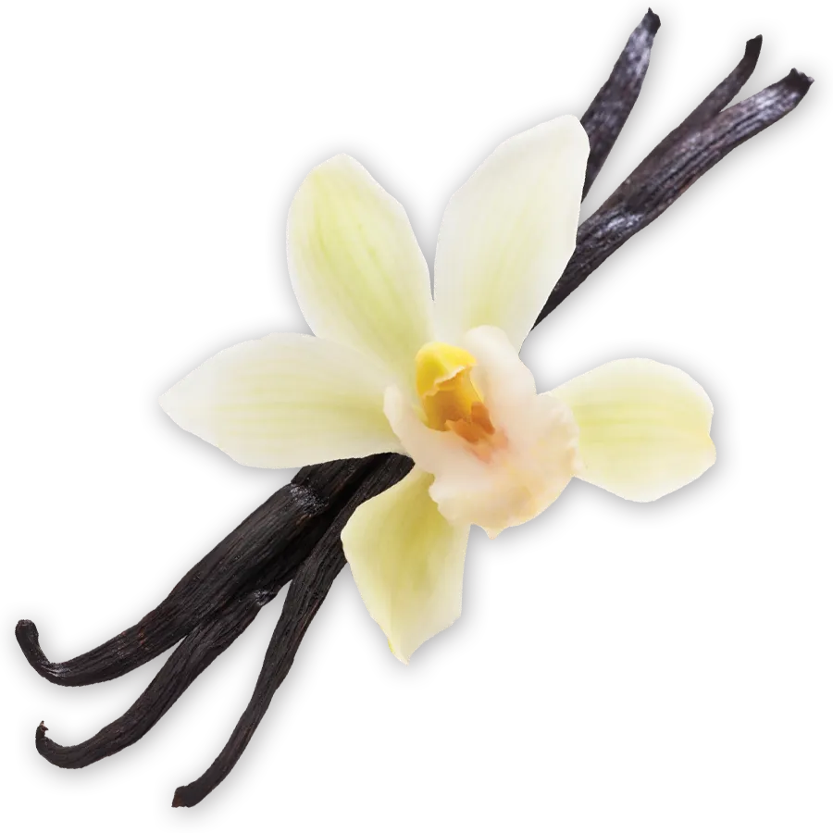
TEQUILA PARTIDA – REPOSADO
(RESTED MINIMUM OF 6 MONTHS)
APPEARANCE
Intense gold
AROMAS
Vanilla pods
Charred oak
Caramel

Slide 22
TEQUILA PARTIDA – REPOSADO
(RESTED MINIMUM OF 6 MONTHS)
TASTING DESCRIPTION
Natural and beautiful light amber color with golden tones, transparent and clean, brilliant and full bodied. Notable aromas of vanilla, cooked agave, caramel, butter, bourbon, hazelnut and almond. These aromas are confirmed in the mouth. This amazing Reposado is the result of a great base of Tequila Blanco, the right cask selection and the perfect age timing.

Slide 23

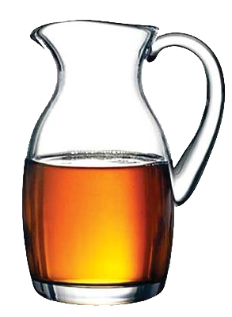
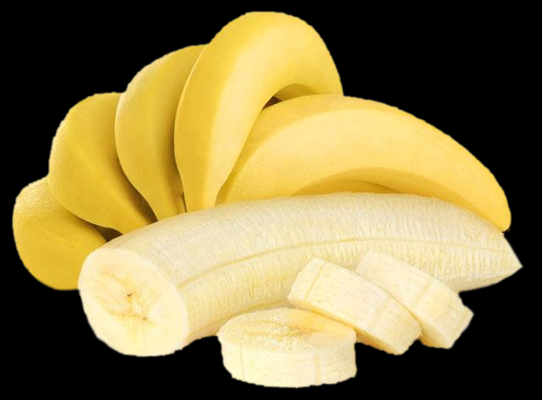
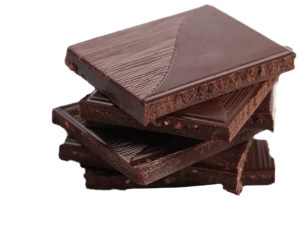
TEQUILA PARTIDA – AÑEJO
(RESTED MINIMUM OF 18 MONTHS)
APPEARANCE
Light amber
AROMAS
Dark Chocolate
Banana
Maple honey

Slide 24
TEQUILA PARTIDA – AÑEJO
(RESTED MINIMUM OF 18 MONTHS)
TASTING DESCRIPTION
Intense golden color with tones of bronze. Clean and full bodied. Refined aromas of oak, chocolate, dry fruits and butter. A pleasant spice at the tongue, with flavors of black and green pepper, white oak, vanilla, spices and maple honey. Although it has 18 months of aging the flavor of agave is still present.

Slide 25
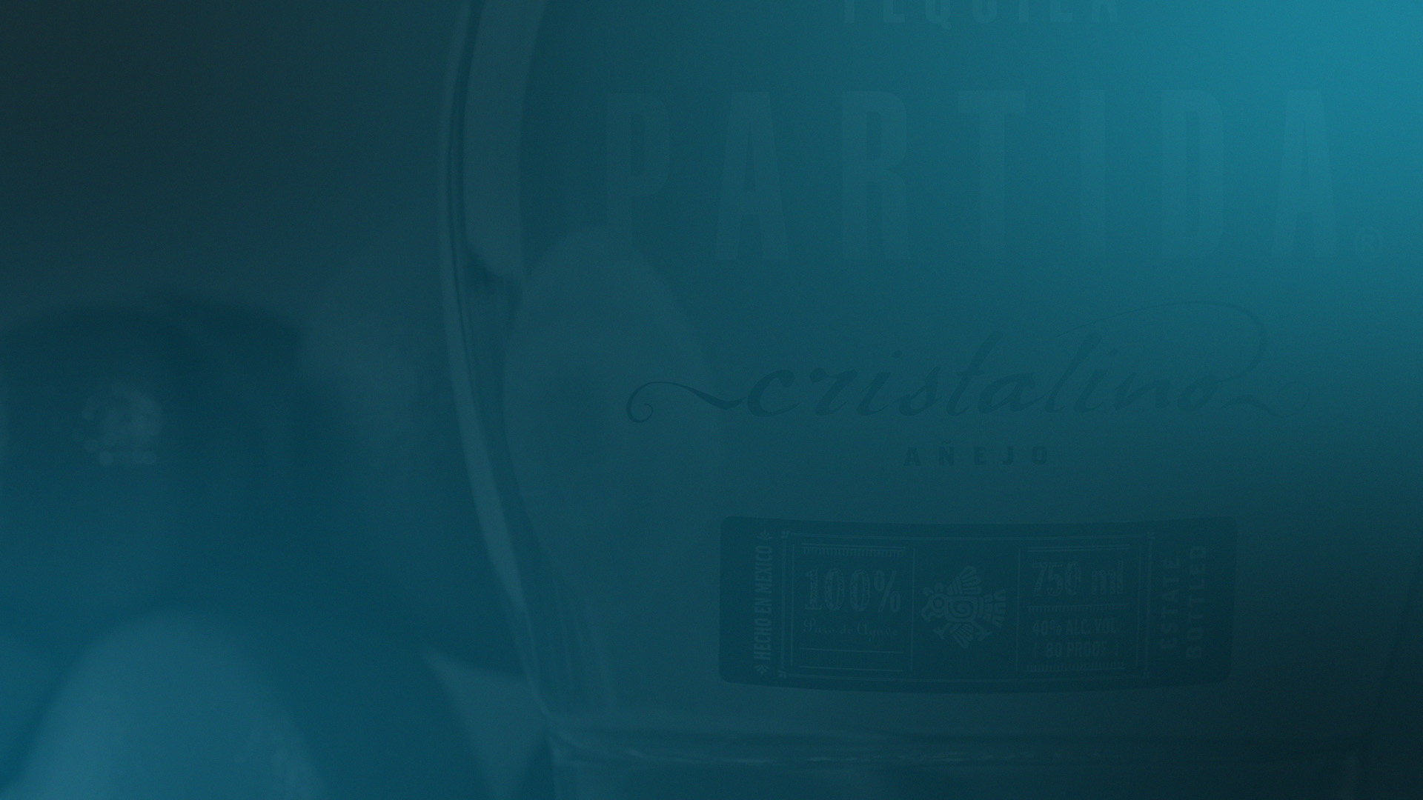
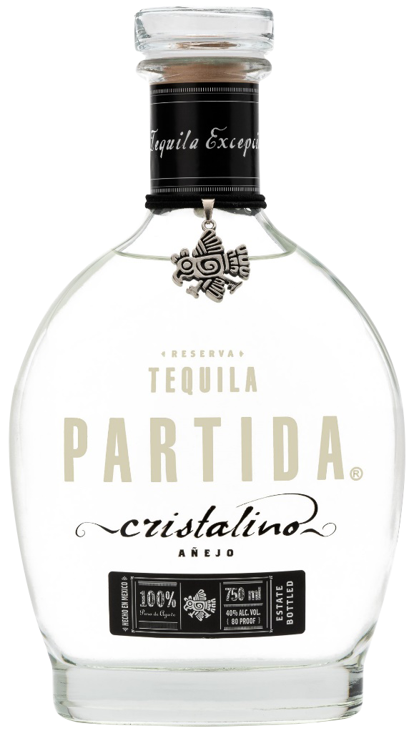
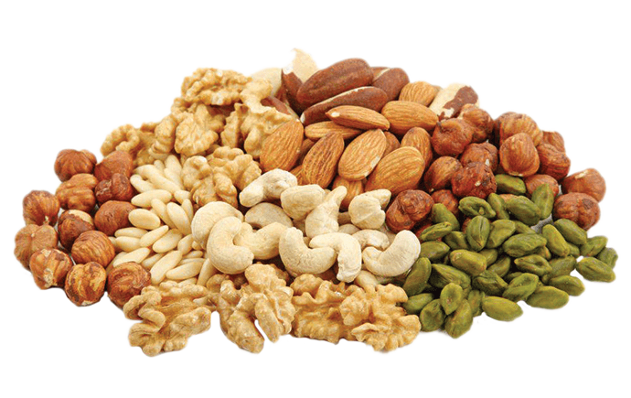
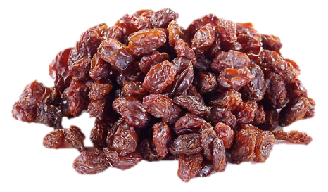
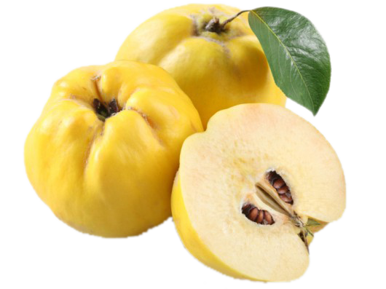
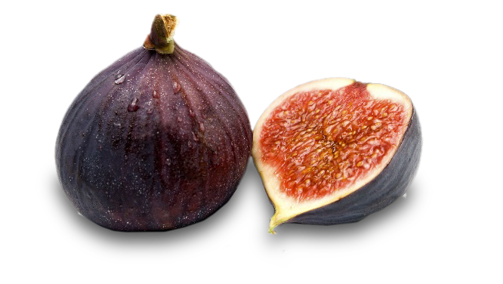
TEQUILA PARTIDA – AÑEJO CRISTALINO
(RESTED MINIMUM OF 18 MONTHS AND FILTERED OUT TO REMOVE COLOR)
APPEARANCE
Crystal
AROMAS
Raising
Dry fruits
Quince
Figs

Slide 26
TEQUILA PARTIDA – AÑEJO CRISTALINO
(RESTED MINIMUM OF 18 MONTHS AND FILTERED OUT TO REMOVE COLOR)
TASTING DESCRIPTION
Silky, delicate and transparent full body with very light-yellow shimmers. Sweet and woody aromas coming from a prolonged aging process. The palladate reaffirm the natural sweet and great intensity and personality of the Añejo Cristalino Tequila. The finishing is gently and pleasantly dry and astringent that balance with the sweet aromas and flavors of the first part of the tasting experience.

Slide 27
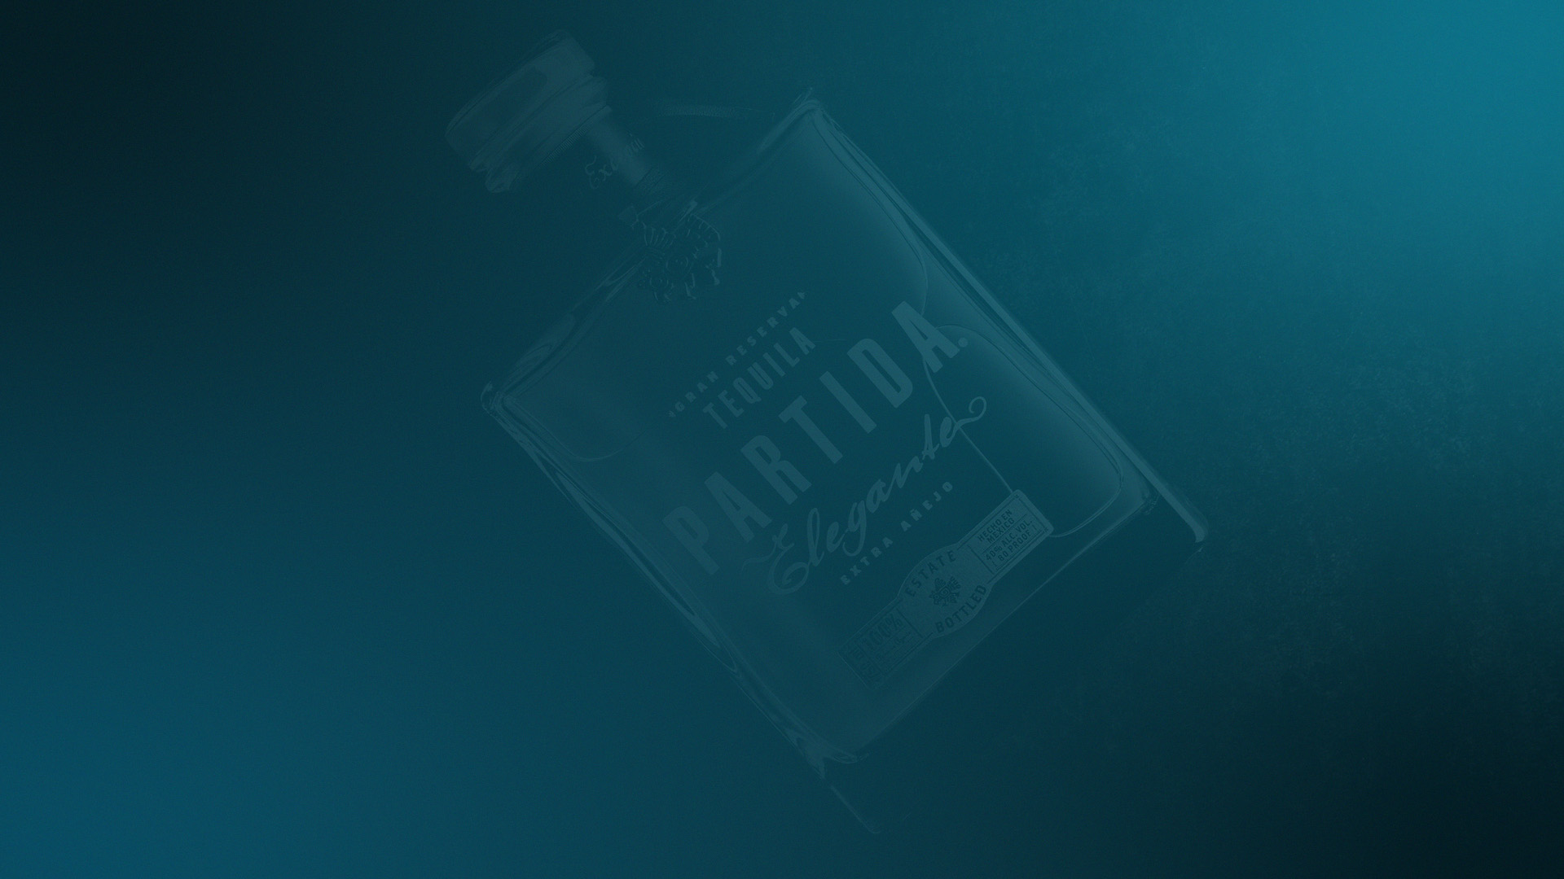
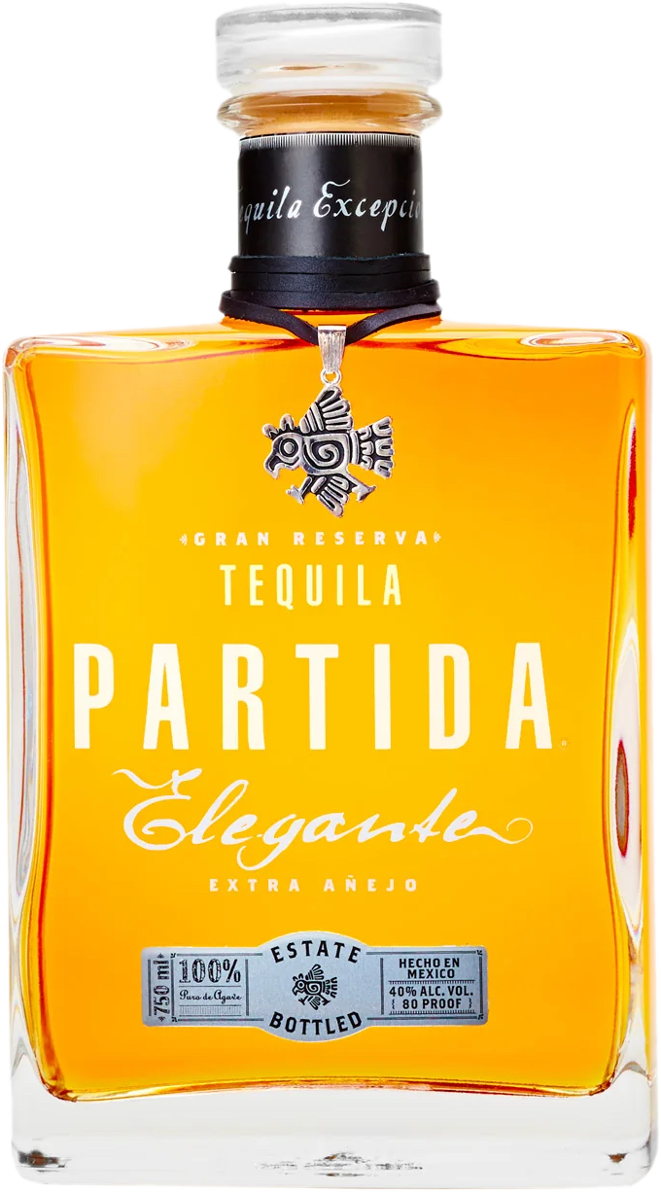

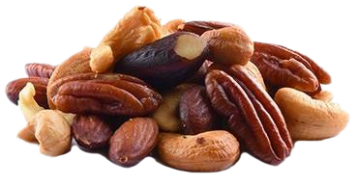
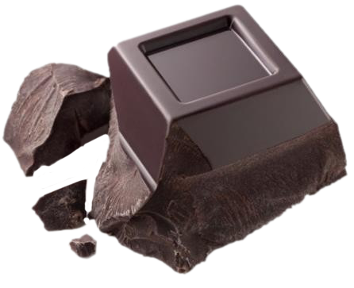
TEQUILA PARTIDA – ELEGANTE
(RESTED MINUMUM OF 48 MONTHS)
APPEARANCE
Dark Amber
AROMAS
Coffee
Roasted nuts
Darkest chocolate

Slide 28
TEQUILA PARTIDA – ELEGANTE
(RESTED MINUMUM OF 48 MONTHS)
TASTING DESCRIPTION
Dark amber color and high density body denote the long aging process. Complex aromas come with deep notes of toasted oak, dark chocolate, coffee and ripe banana. The palate entry is slightly toasty, peppery and spicy. Every sip confirms not only the initial aromas, but also new and different flavors such as agave, vanilla, caramel, bourbon, butter, maple, almonds, hazelnuts, black pepper, citrus flowers and more. This tequila lives up to its name; it is simply Elegant in every sense.

Slide 29







TEQUILA PARTIDA ACCLAIMS

Slide 30


TEQUILA PARTIDA PRODUCTION
WHAT IS PARTIDA?
“PARTIDA TEQUILAS ARE SIMPLY THE FINEST LINE OF TEQUILAS THAT MONEY CAN BUY.” - F. PAUL PACULT, THE SPIRIT JOURNAL

Slide 31

GRACIAS
“Life is too short to waste it drinking not good tequila: Sip Tequila Partida”
“Share some Partida love to America”

