Slide 1


Brand training deck

Slide 2
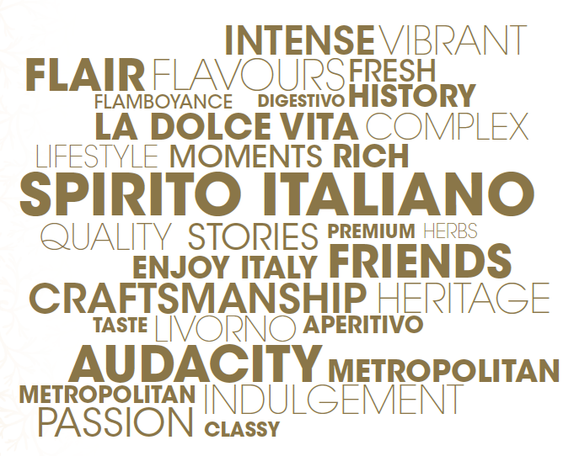
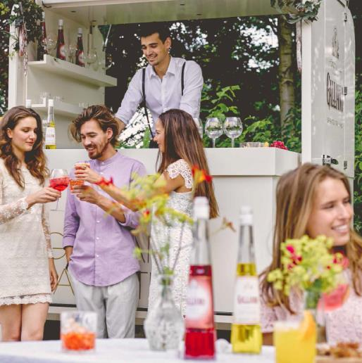
Galliano Brand Identity
Galliano is the premium range of Italian liqueurs which offers the richest and finest tastes of the Italian food and drink culture (Aperitivo & Digestivo Italiano).

Slide 3
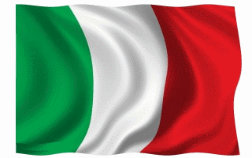
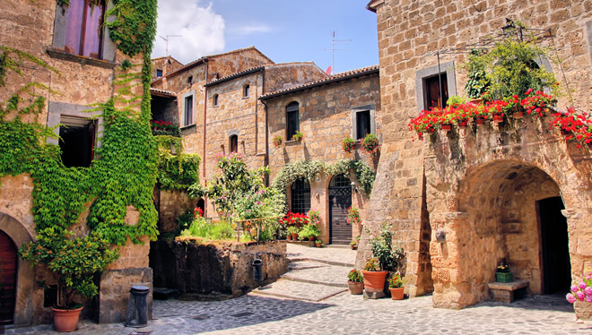
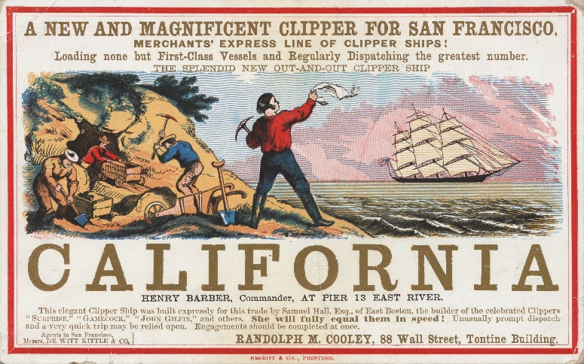
The History of Galliano
Picture 1896… Italy… Tuscany, specifically the port town of Livorno
Arturo Vaccari: The creator of Galliano, born in Livorno, Italy in 1854.
Galliano, the man: Inspiration behind the name - Italian war hero Maggiore Galliano in the late 1800s. Always described as a ‘dashing and commanding figure’
The Gold rush: Italian immigrants were given a bottle of Galliano as they boarded US-bound ships and began their quest for gold in California. Hence the golden yellow color.
Notes:
Galliano: Led 2,300 Italian troops against 80,000 Abyssinians and won. Shortly after was defeated and killed at the Battle of Adua (20,000 Italians were killed in this battle and his body was never recovered)

Slide 4
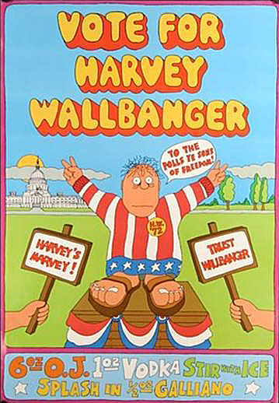
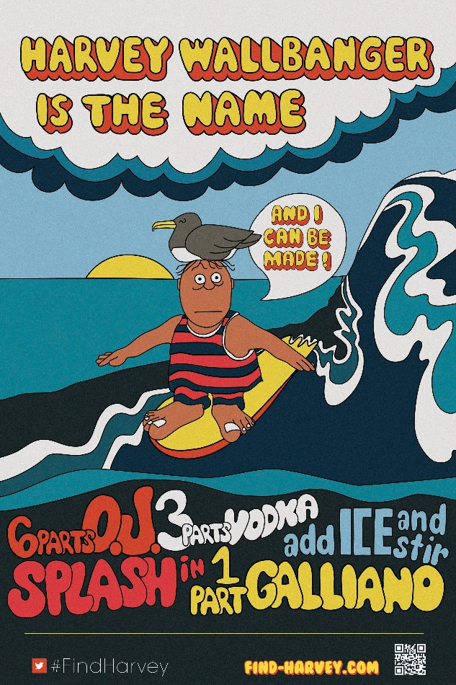
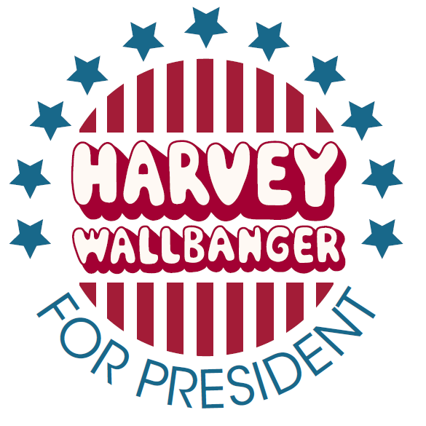
The Phenomenon of Harvey Wallbanger
The iconic cocktail was first mentioned in the late 60s
Named after a Californian surfer who had a few too many drink after loosing a competition
In the 70’s, the Harvey Wallbanger propels Galliano to a 500k brand in the USA!
In 1972 – got the most write-in votes in the presidential election
Earned himself his own National Holiday: November 8th – National Harvey Wallbanger Day

Slide 5
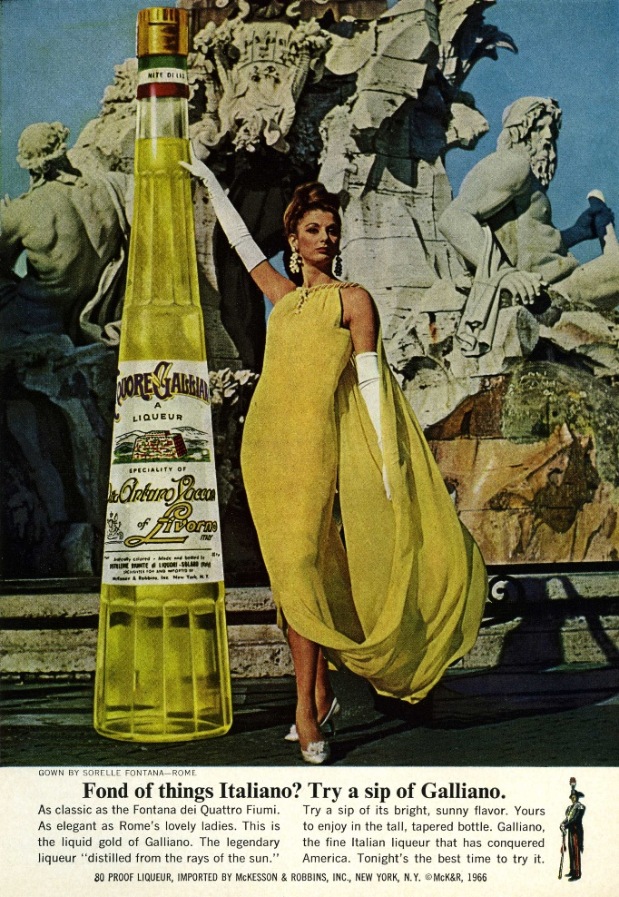
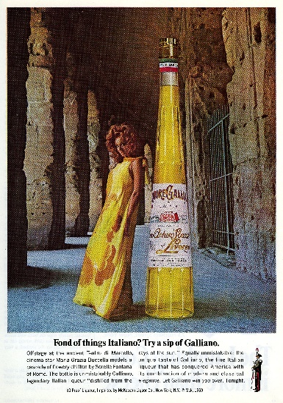
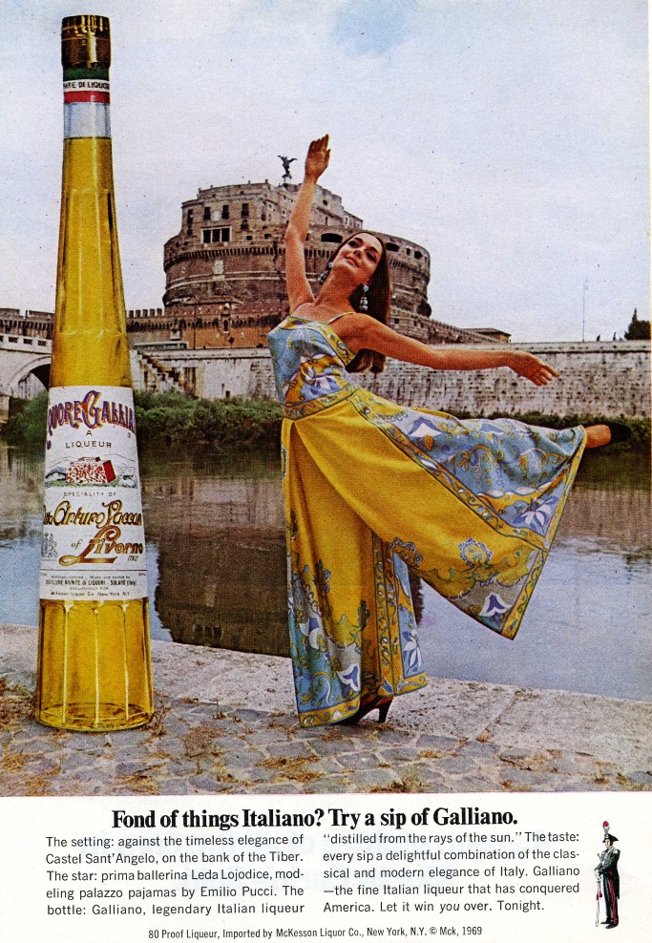
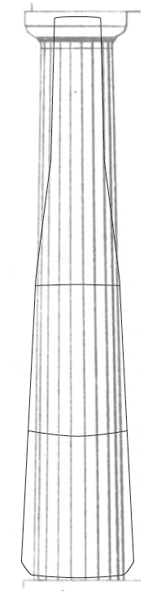
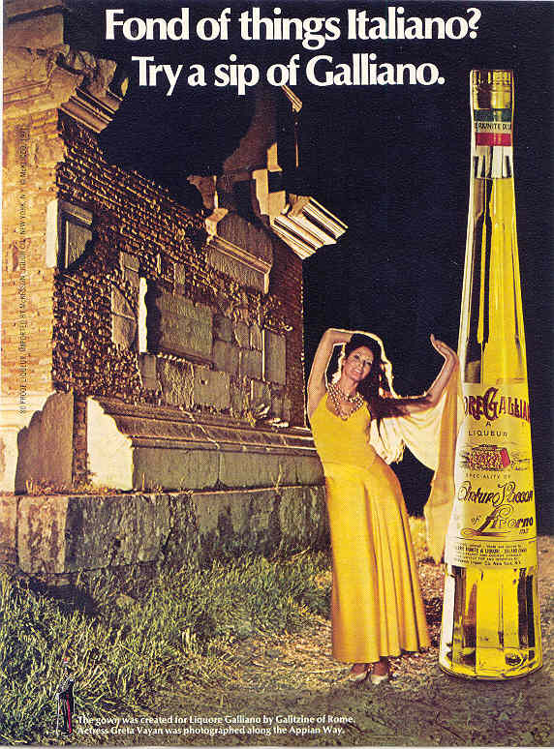
The bottle
Meant to symbolize greatness! The tall, slender shape with many tapered flat sides was inspired by the columns of the ancient temples of Rome and the mighty glory of the Roman empire.

Slide 6
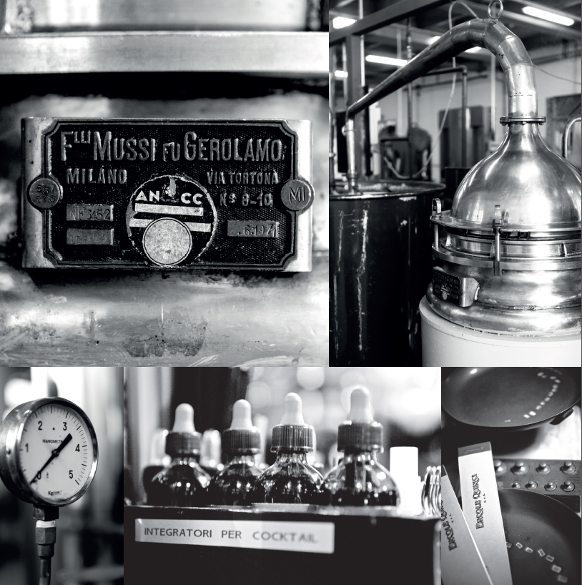
Made in Italy
To make Galliano, A. Vaccari turned to Fratelli Maraschi SPA, a company established in 1888 in Torino.
Today, Fratelli Maraschi is known as Maraschi & Quirici, situated in a small town high in the foothills of the Italian Alps just outside Torino, where so many of the herbs and spices used in Galliano grow.
Now in a pristine, modern factory, the standards of their founders prevail and they are world famous for the quality of their extracts.
To this day Maraschi & Quirici are the sole providers of the ingredients which are the essence of the incomparable taste and aroma of Galliano.
True Craftsmanship:
Galliano is made by the same distillers since 1896
Notes:
Famous for producing Prosecco, Vermouth and Aromatic Wine Piedmont – alpine region

Slide 7
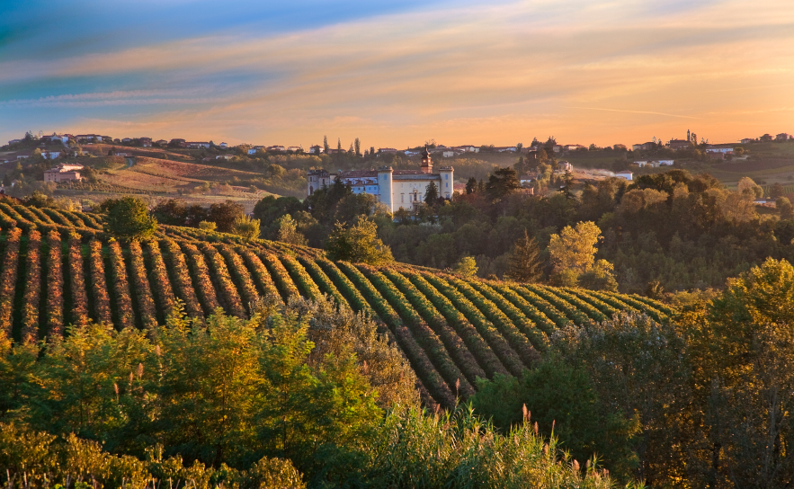


GALLIANO
Spirito Italiano
TORINO
MILANO
MARASCHI &
QUIRICI
VENEZIA
ROMA
Notes:
Q: Galliano is the true Italian liqueur. We make Galliano in the Torino area / North of Italy. Ago, can you explain a bit of the area?
AGO: Well, I’m from the North as well (lake Como)The area of Torino is famous for prosecco, vermouth and aromatic wines. Many of the herbs and spices used in the Galliano liqueurs grow here.
Ago: All the Galliano distillates are produced by Maraschi & Quirici, since the start of Galliano in 1896.

Slide 8
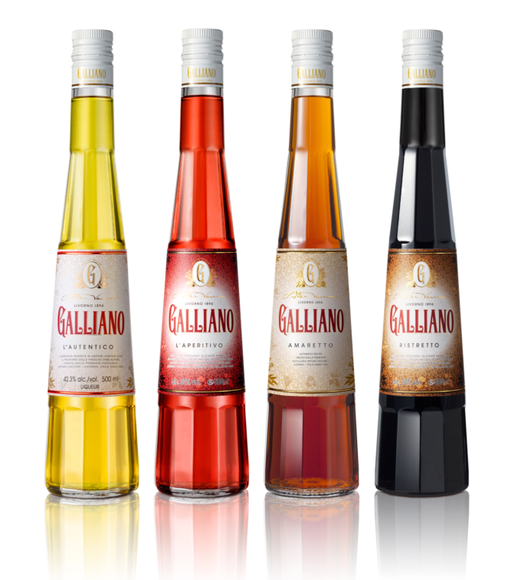
Galliano Famiglia
Family is the cornerstone of Italian culture. Therefore, it’s the cornerstone of Galliano. Together we’re so much better.
The only brand with the full Italian ‘artisanal famiglia’ for all typical Italian moments: pre- and after-dinner.
Galliano L’Autentico
Galliano L’Aperitivo
Galliano Espresso

Slide 9
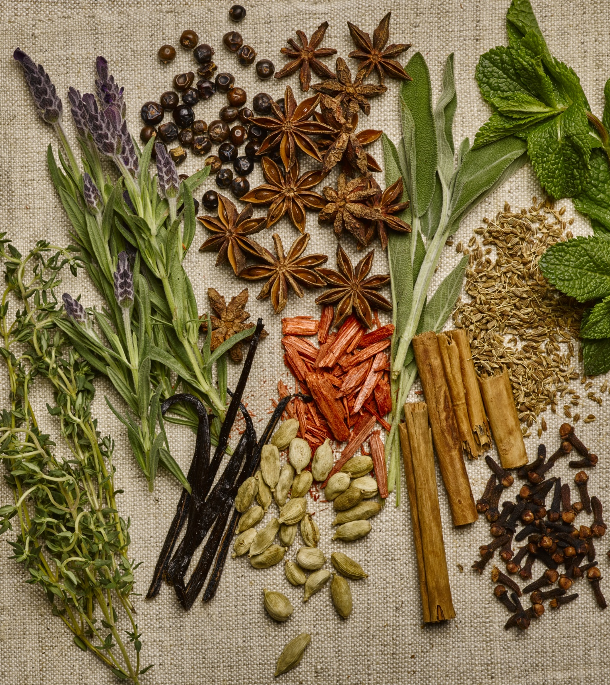
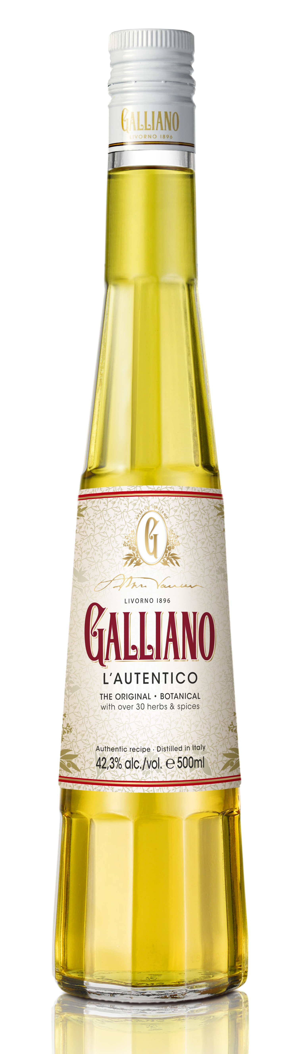
GALLIANO L’AUTENTICO
BOTANICAL • RICH • COMPLEX
Arturo Vaccari captured the spirit of his beloved Italy with a perfectly balanced blend of Mediterranean and exotic botanicals, all sourced and blended in their natural form.
After Vaccari’s experiments with countless combinations of ingredients, he settled on more than 30 herbs, plants, roots, flowers, barks and spices.
These include juniper berries, caraway seed cloves, cardamom, sandalwood, star anise, cinnamon, sage, thyme, mint, lavender and Madagascar vanilla.
Notes:
Note re recipe change in the 70s

Slide 10
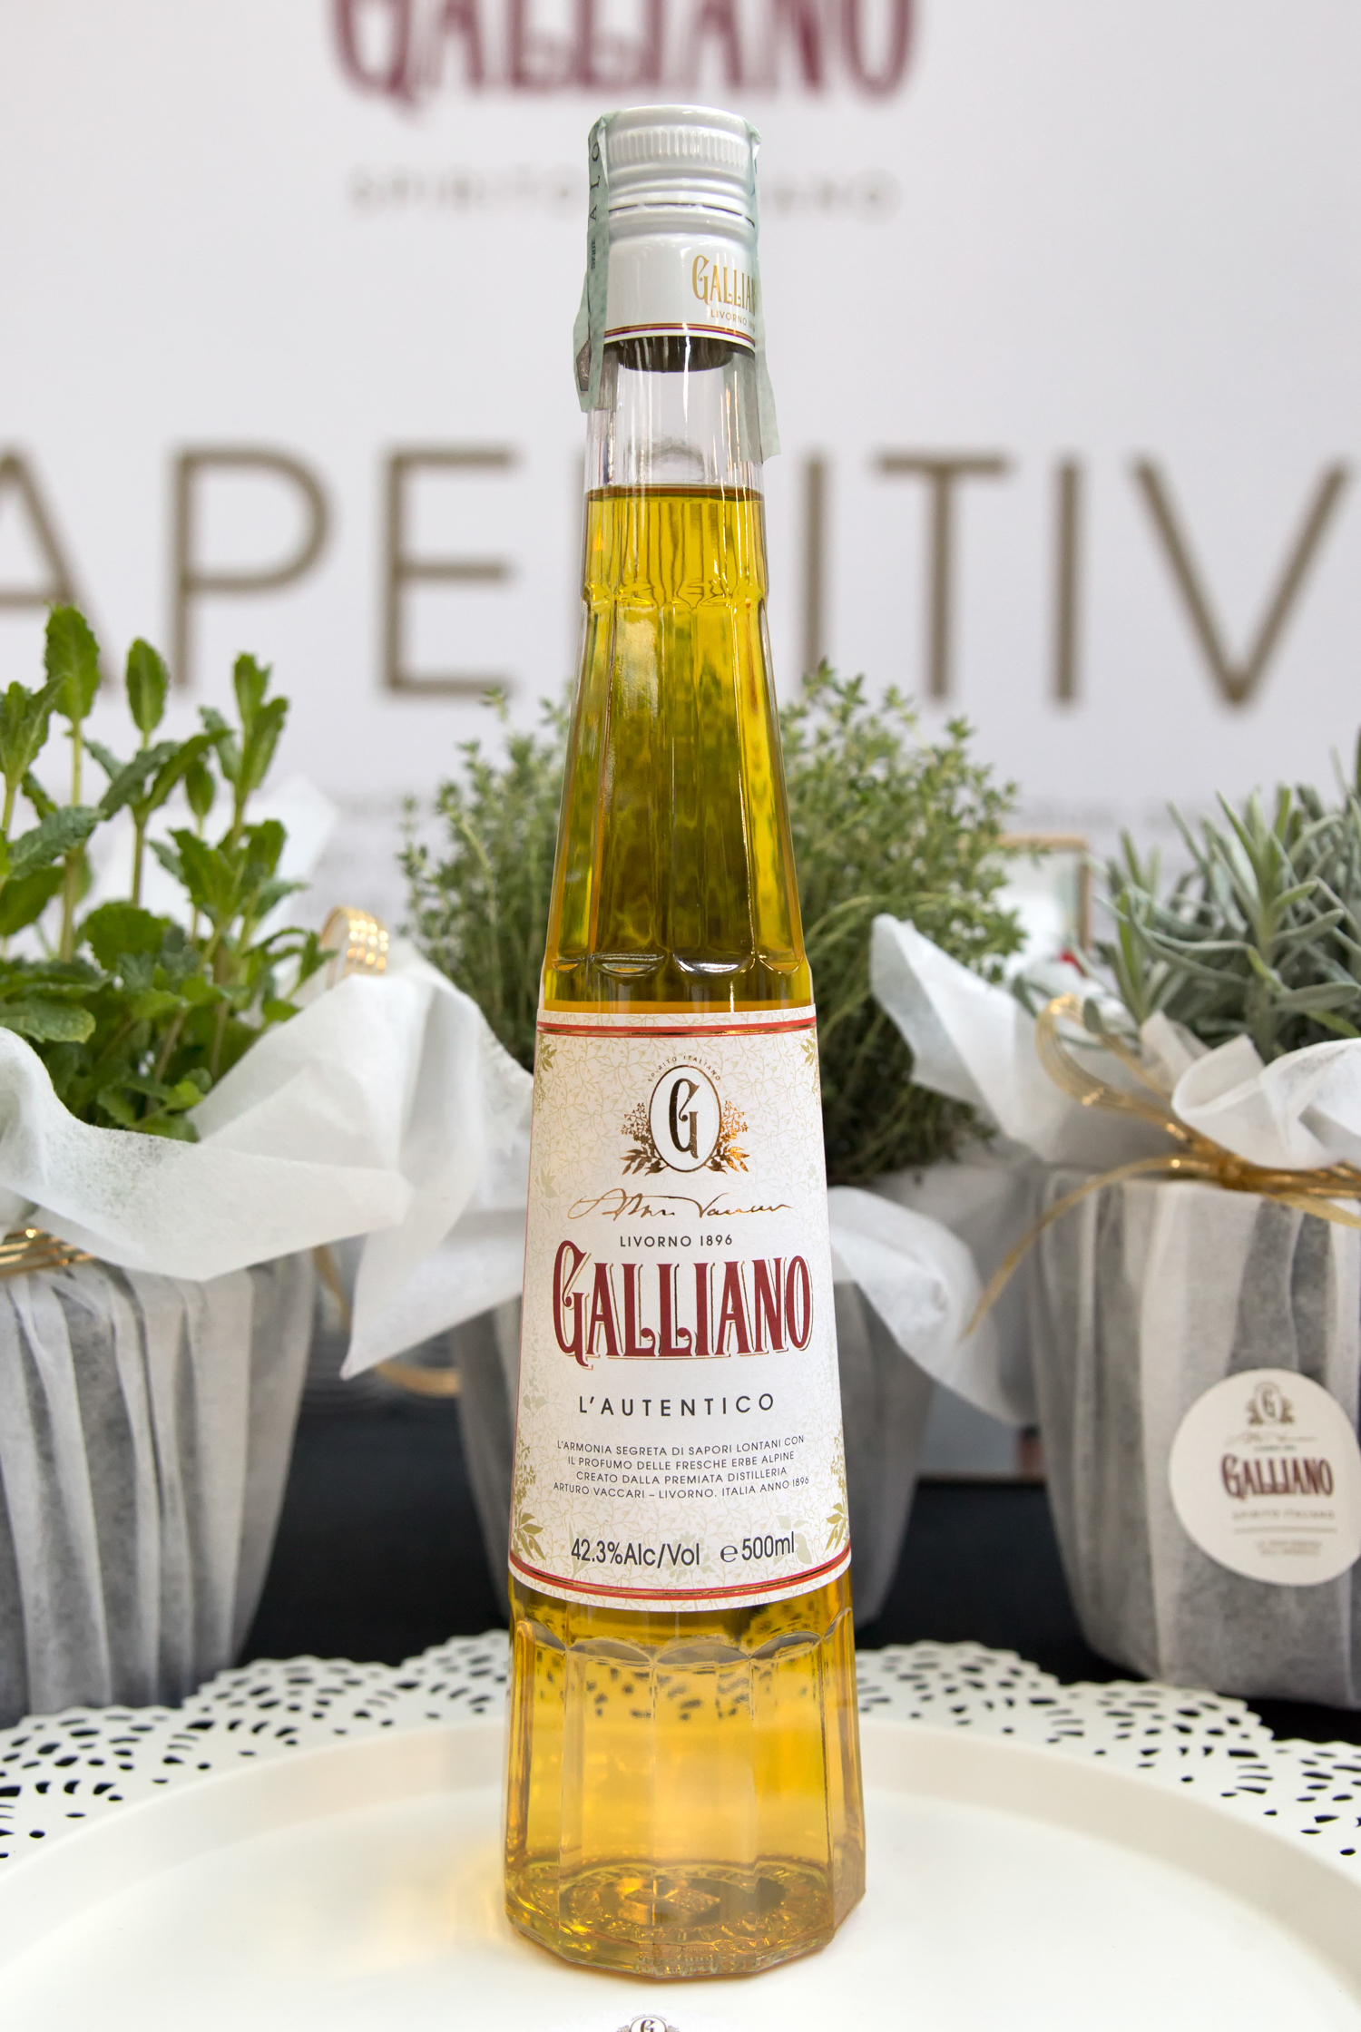
GALLIANO L’AUTENTICO
TASTING NOTES
Tasting Notes:
Anise and peppermint are most prominent on the palate when drinking Galliano L’Autentico.
An explosion of fresh herbs, cinnamon, ginger, nutmeg and citrus follows. The lingering taste of smooth vanilla, refreshing peppermint and spice remains.
42,3% ABV
Notes:
Q: SO it all started with Galliano L’autentico
Q: explain the different herbs (lavender, aniseed, vanilla, cinnamon, gloves)

Slide 11
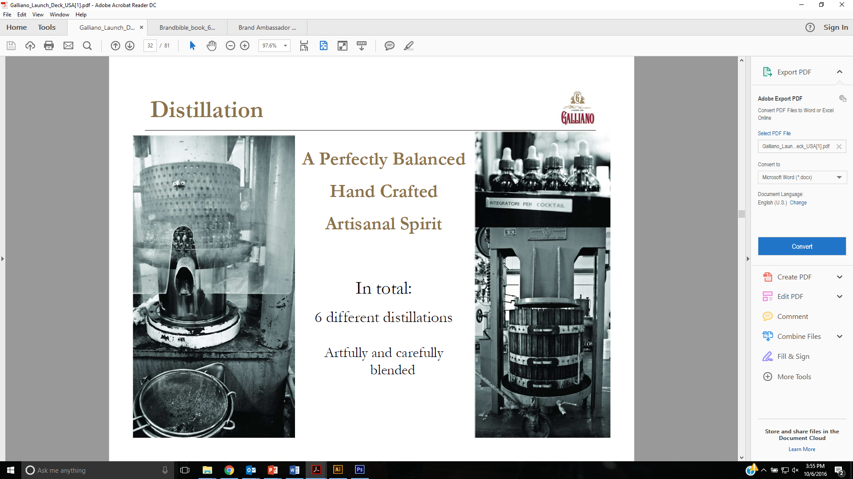
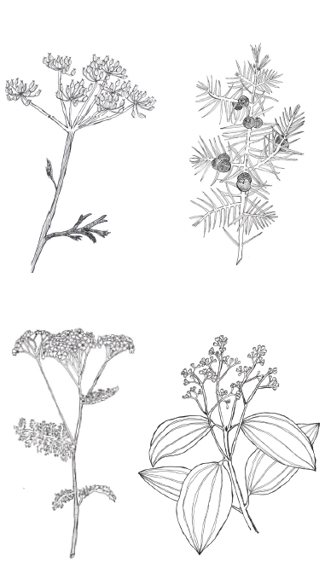
GALLIANO L’AUTENTICO
PRODUCTION NOTES
Galliano L’Autentico is created by using 7 infusions and distillations.
It’s blended from nine component parts, several being highly complex themselves.
The intricacy of the final recipe of Galliano L’Authentico remains a guarded secret to this day.
Notes:
each ingredients is treated differently, which makes the creation of Galliano very labor intensive:
• Vanilla: double infused for 3 days then
rested for several months
• Juniper: 2 distillations
• Anise and marrow musk: 1 infusion and 1 distillation each

Slide 12
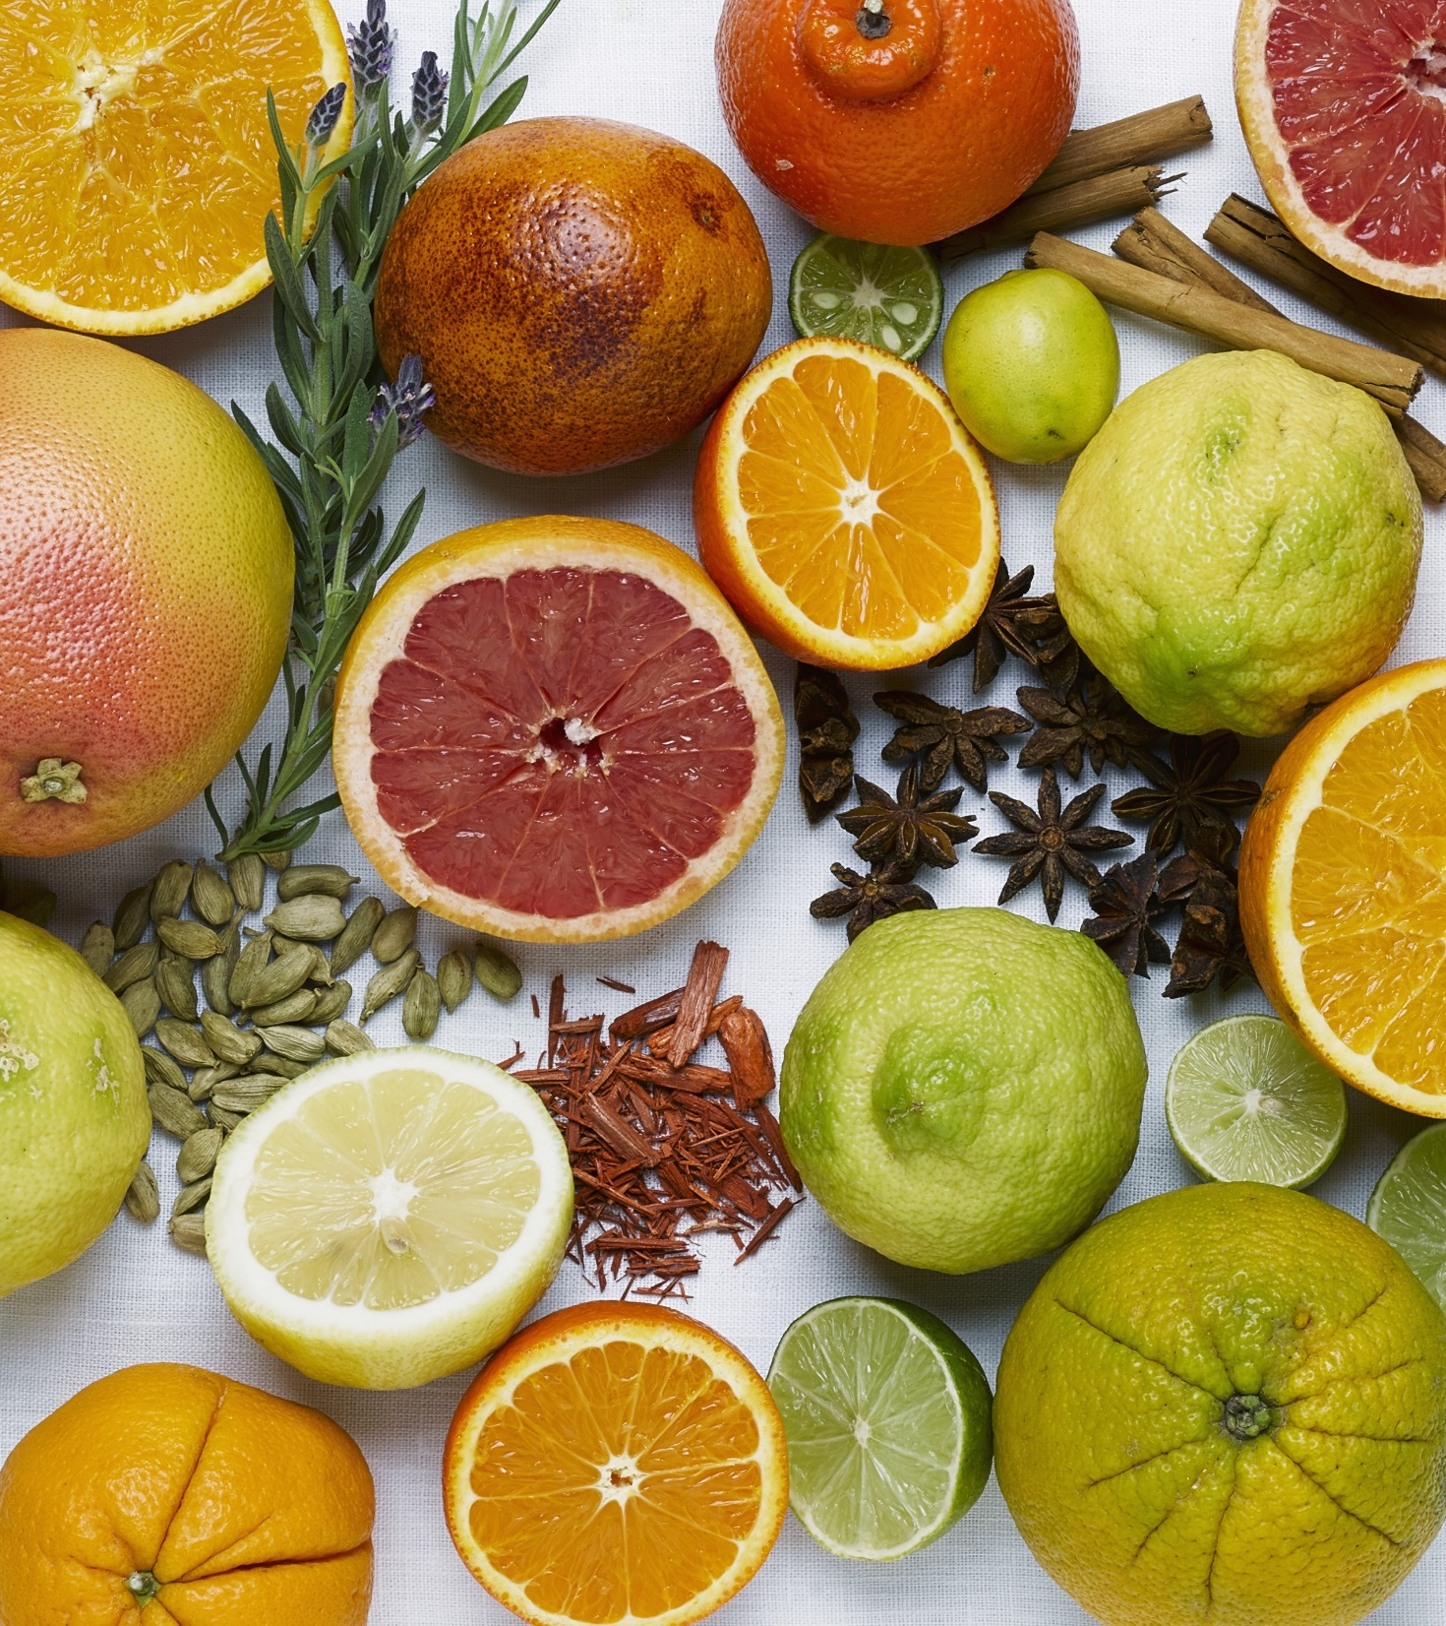
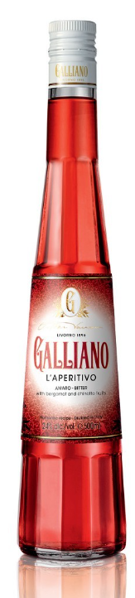
GALLIANO L’APERITIVO
FRESH • RICH • BITTERSWEET
Galliano L’Aperitivo is a bitter, or in Italian ‘Amaro’.
The unique recipe of Galliano L’Aperitivo includes many extracts and infusions of Mediterranean citruses such as oranges, bergamots, bitter oranges, chinotto, tangerines and grapefruits. This fresh blend of fruits makes Galliano L’Aperitivo stand out in freshness.
The ingredients of L’Aperitivo are macerated and rested at least two weeks to obtain the ultimate flavor composition of fruits, plants and herbs.
Overall – 50 ingredients, where 80% of them are sourced in the Northern Italy

Slide 13
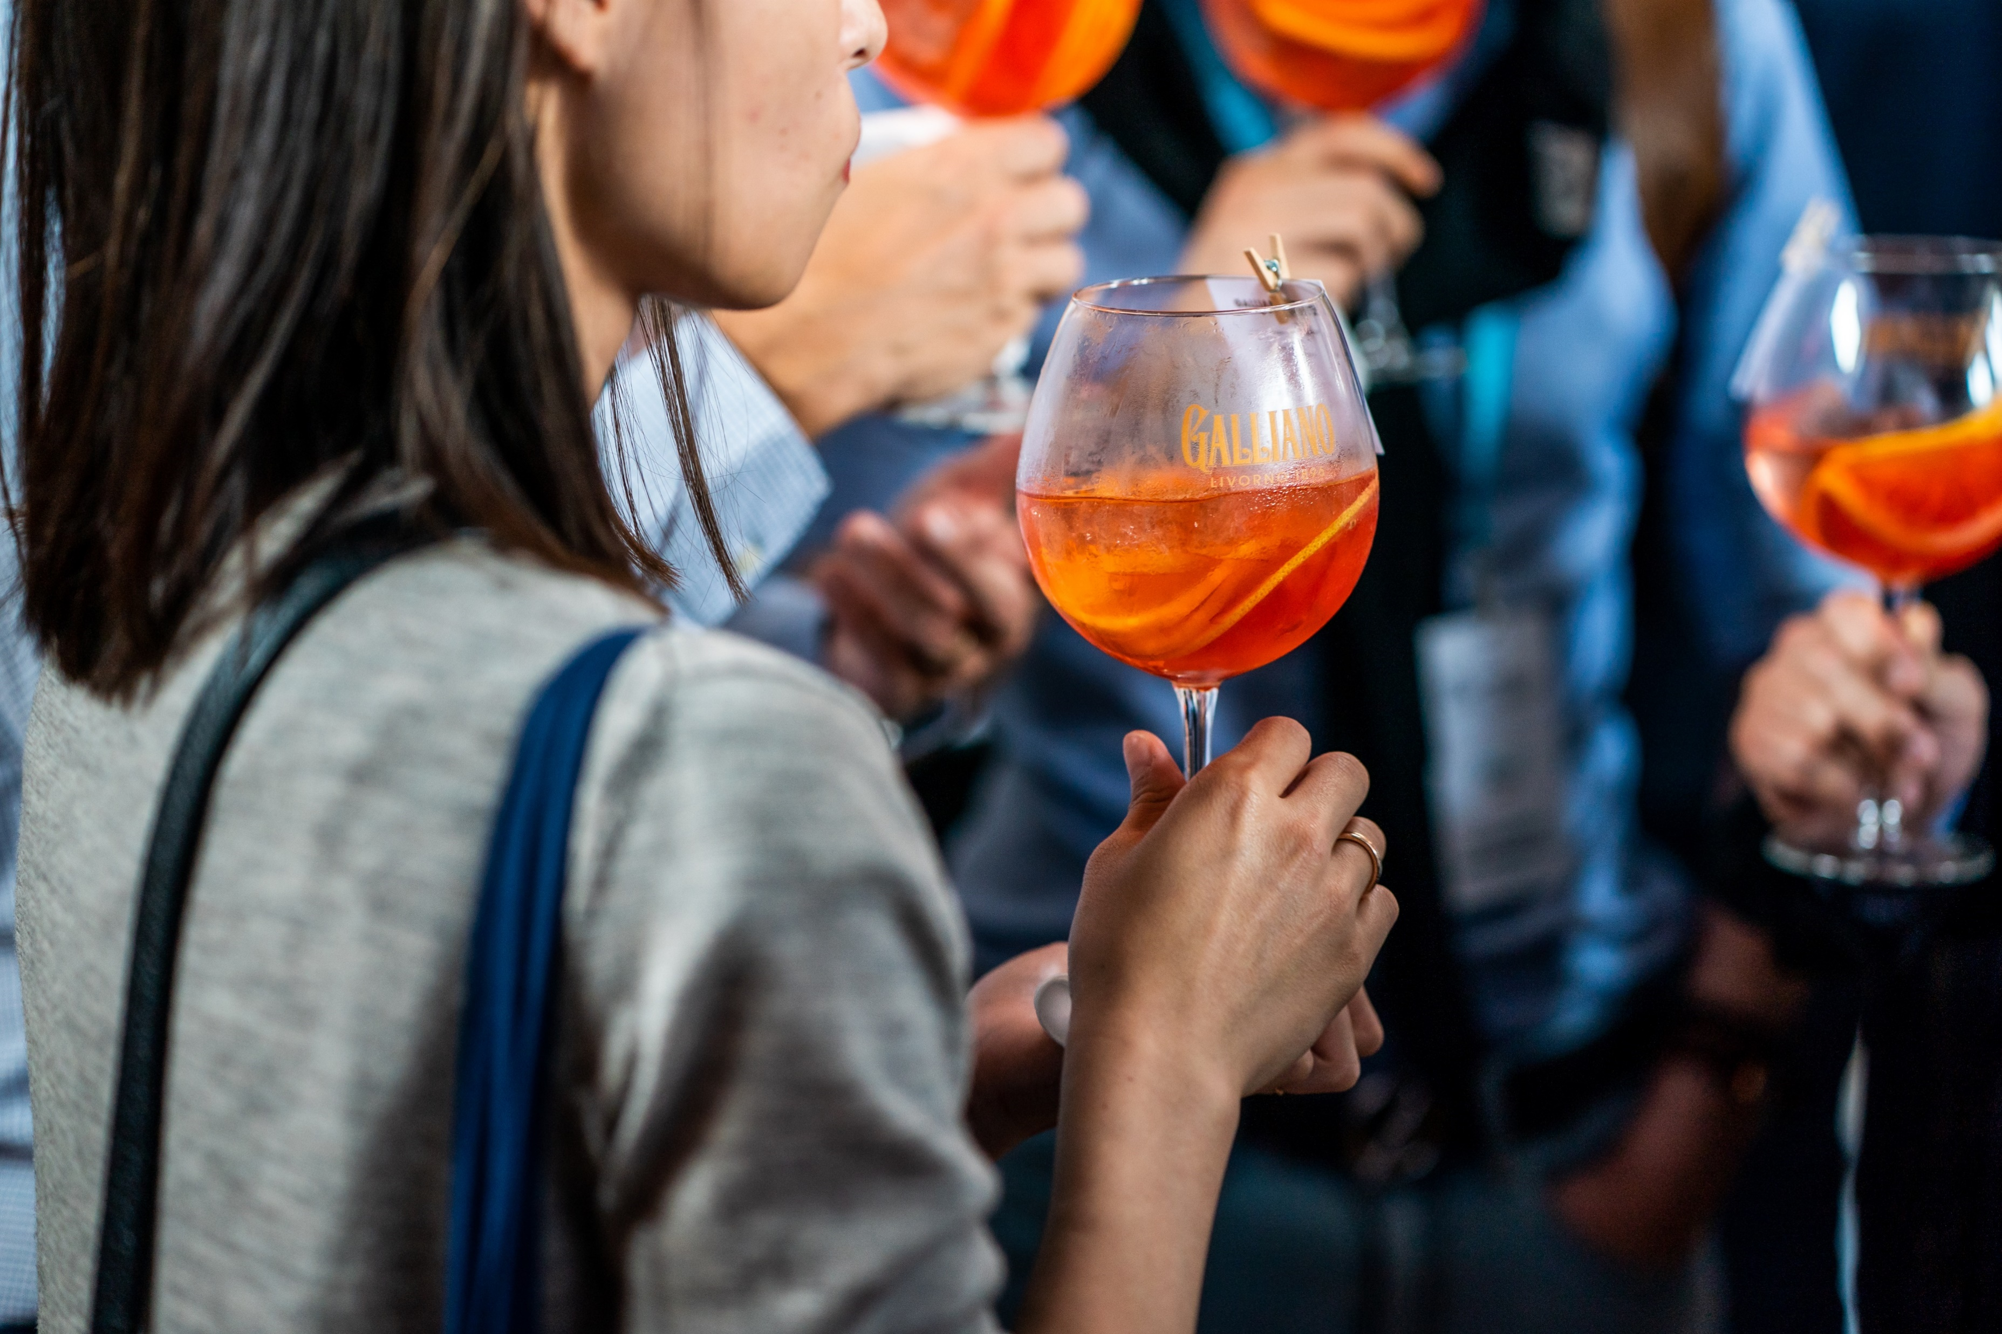
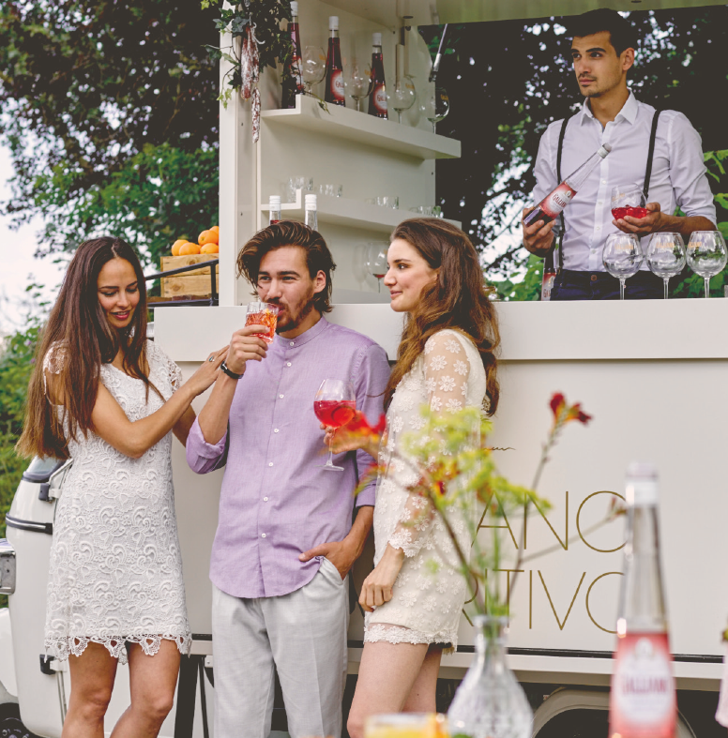
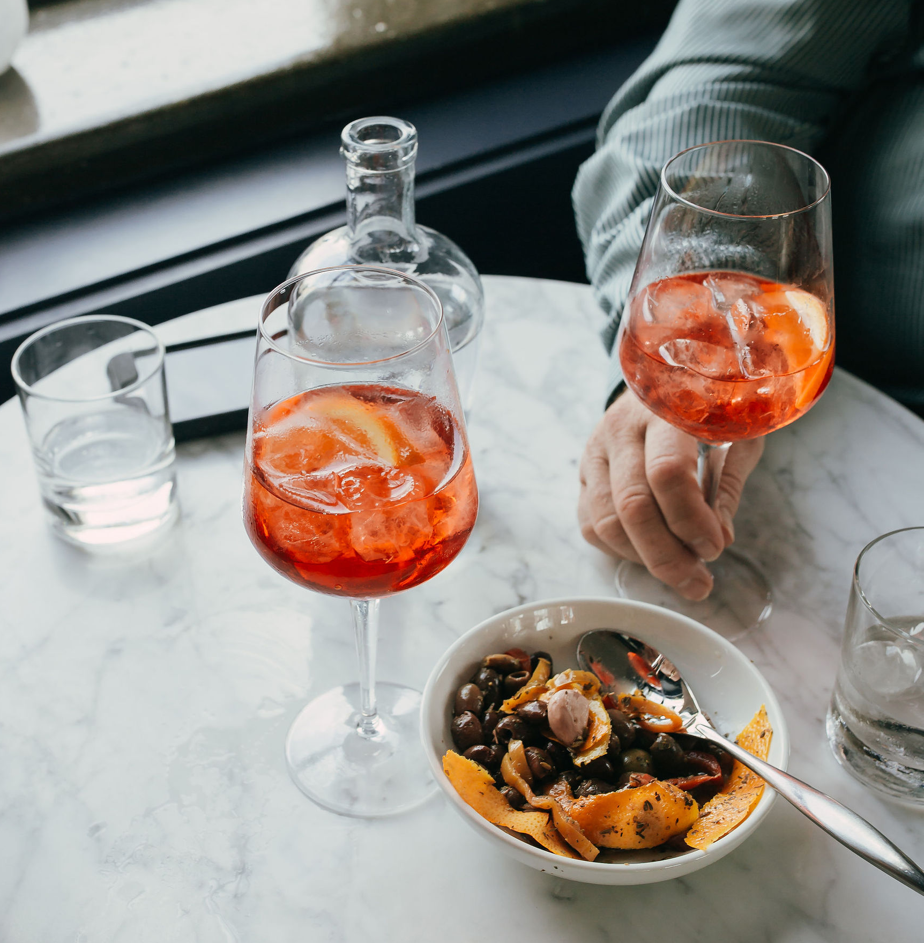
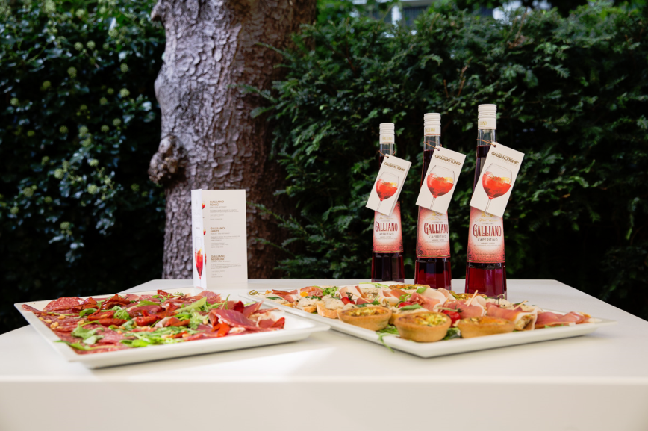
APERITIVO MOMENT
Key in brand presentation & image
The legendary Italian ‘Aperitivo’ is rapidly growing in popularity worldwide.
Aperitivo literally means to open the appetite, and the word refers to both the drink itself, and the ritual of going out for a pre-dinner drink.
This tradition of pre-dinner drinks (5-7pm) is often combined with small bites. Bittersweet liqueurs (Amari) are traditionally from Italy and are the ideal thirst quencher, as well as appetite stimulator. The aperitivo hour is where you want to interact with friends in a good place, sharing beautiful moments.
Galliano L’Aperitivo is claiming the Italian aperitivo tradition

Slide 14
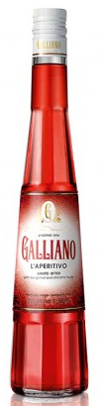
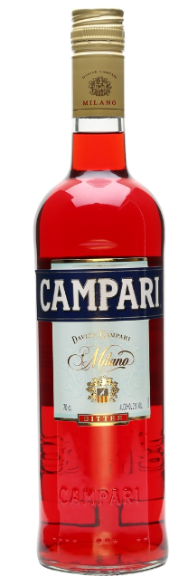
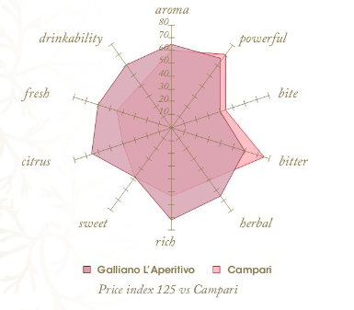
GALLIANO L’APERITIVO VS CAMPARI
VS
FRESH: many extracts and infusions of Mediterranean citrus: oranges, bergamots, bitter oranges, chinotto, tangerines and grapefruits.
RICH: variety of herbs that create layers of flavor (rhubarb, sage, cardamom, etc).
BITTERSWEET: A well balanced bitter, with a long gentle bitter finish.
Higher drinkability = mixes better in cocktails, wider application range, versatility
24% ABV

Slide 15



FLAVOUR GALLIANO VS KEY COMPETITION
SUBTLE BITTER FLAVOUR
Very light, singular, more sweet flavour, 11% ABV
Well balanced bittersweet palette with Mediterranean freshness & subtle herbal notes, 24% ABV
SIMPLE, LIGHT
FLAVOUR
RICH
FLAVOUR
Most bitter variant, 21% ABV
More licorice heavy taste,
30% ABV
STRONG BITTER FLAVOUR

Slide 16
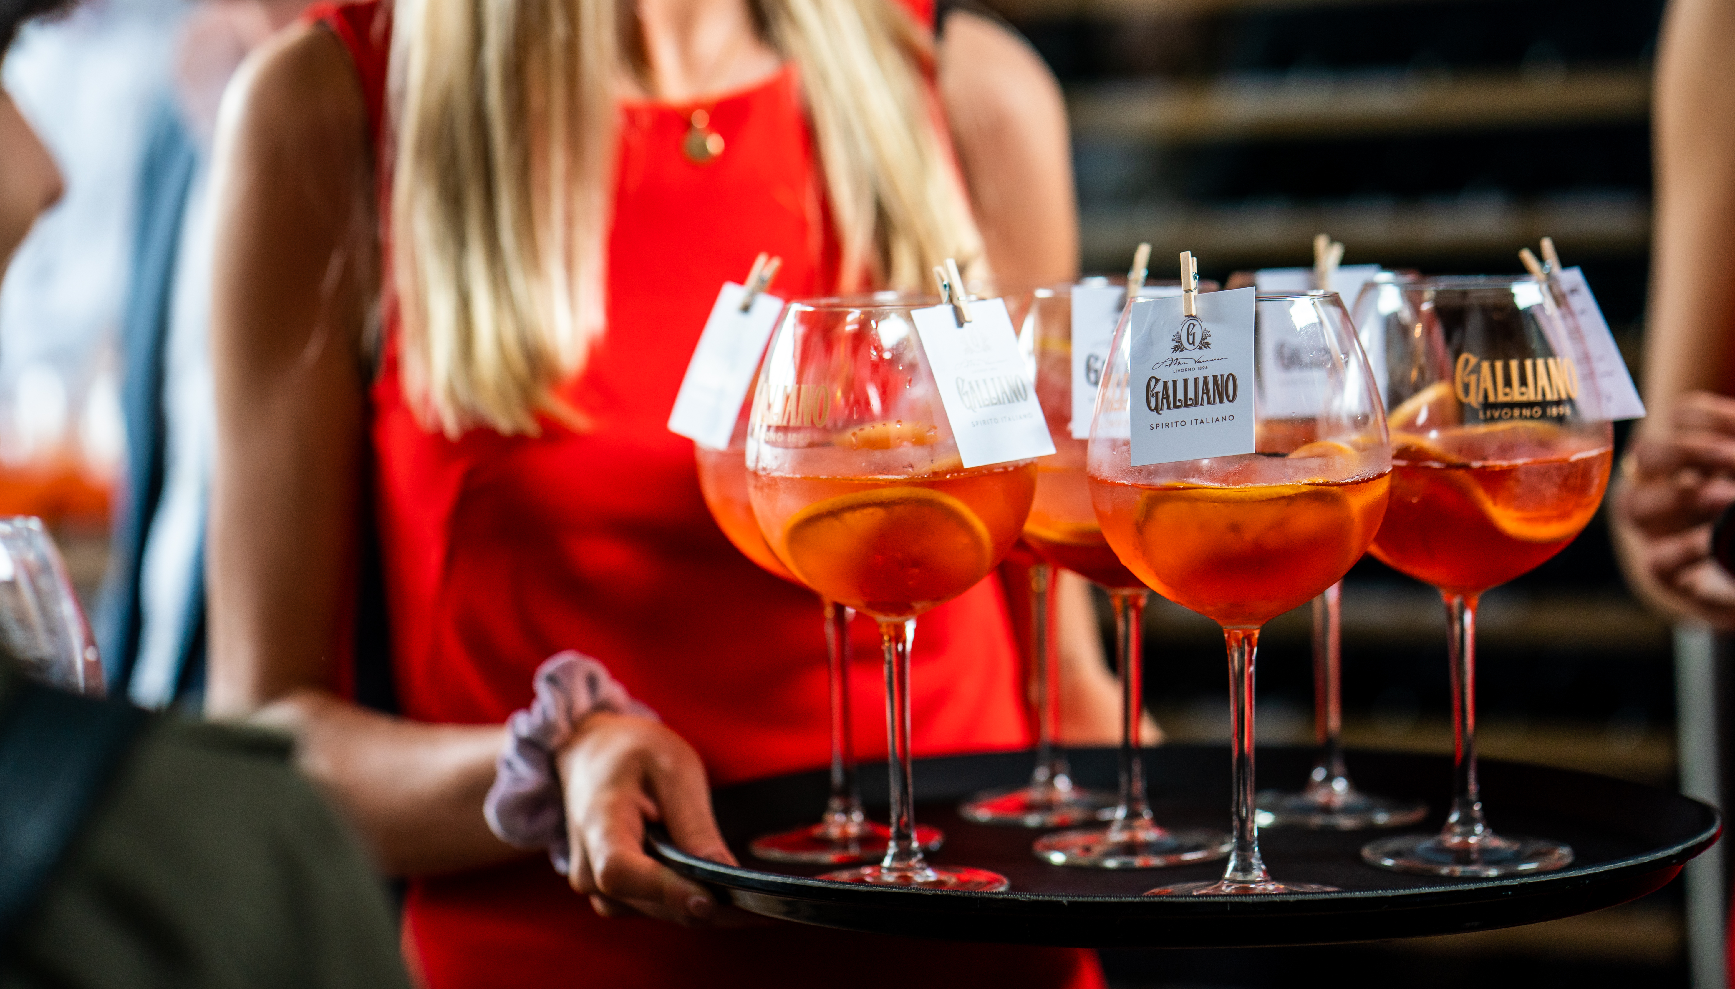
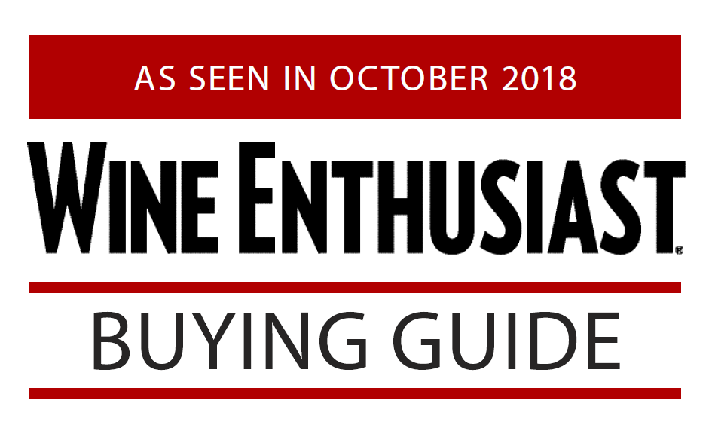
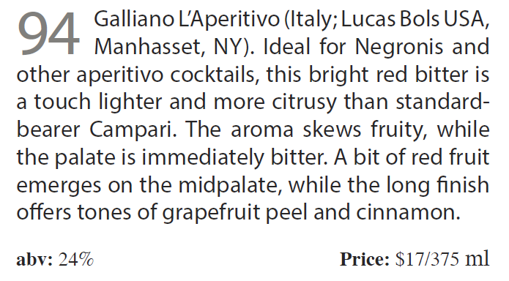
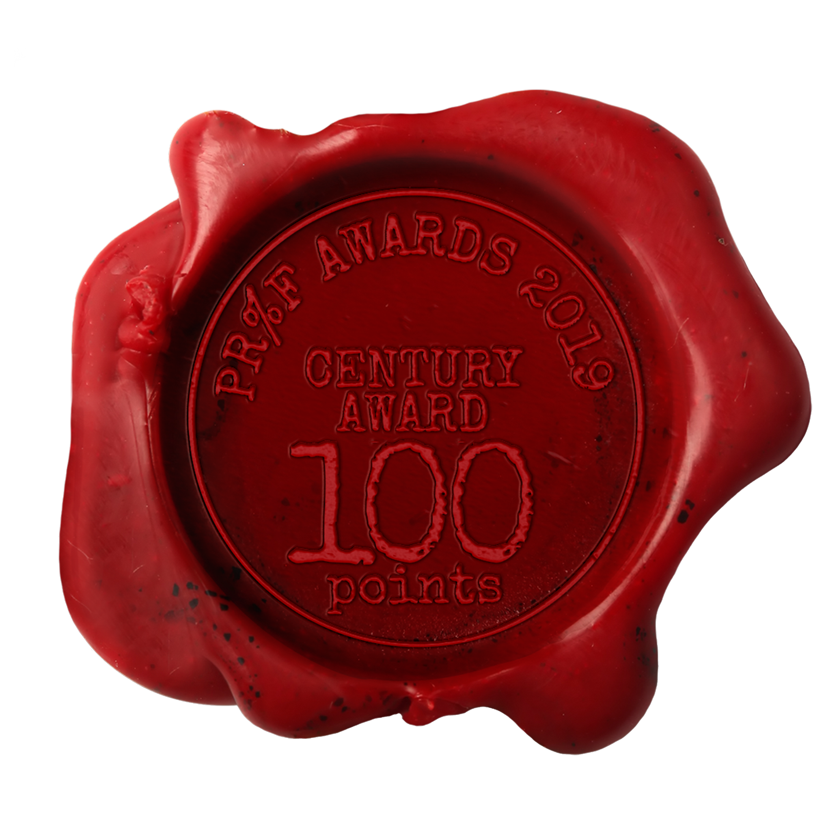
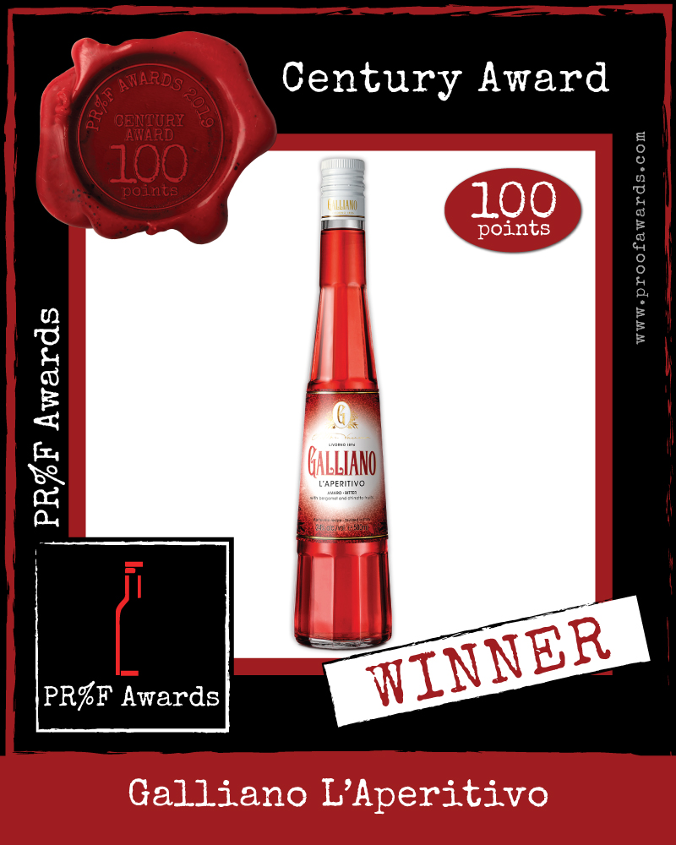
BEST IN CLASS
The Highest Rated Aperitivo Liqueur on the Market: 94 points
Wine Enthusiast Ratings:
Aperol: 90
Campari: 84
Cerasum Aperitivo: 90
Cinque Aperitivo: 90
Casoni Aperitivo: 92
Luxardo Aperitivo: 90
Mezzodi Aperitivo: 90
CENTURy award by proof awards with the absolute score of 100 points

Slide 17
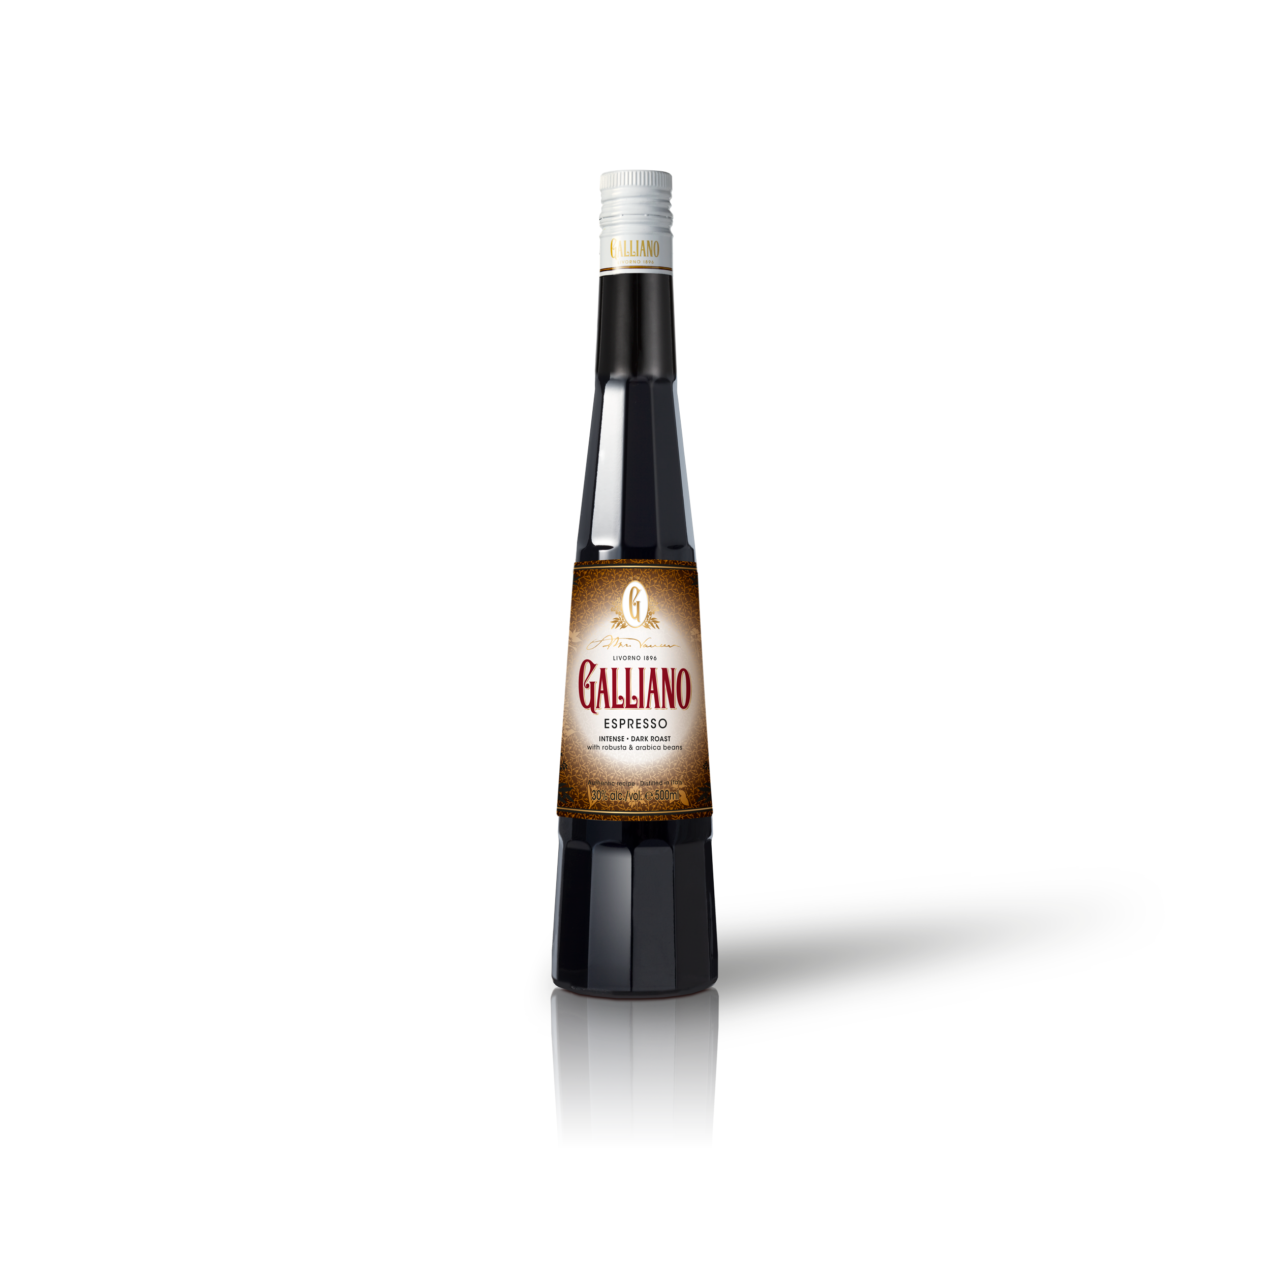
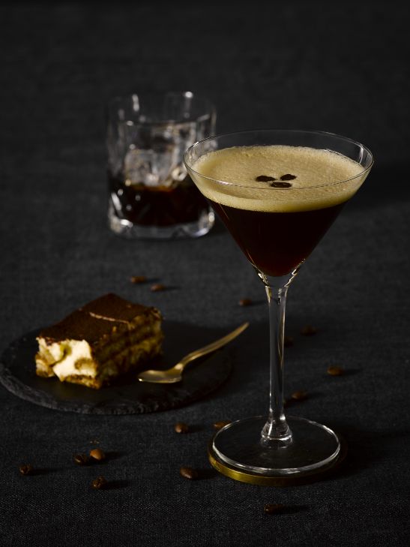
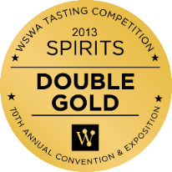
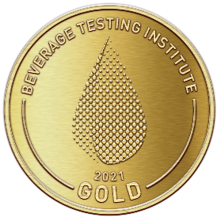
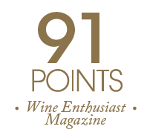
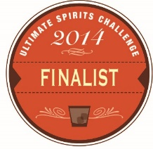
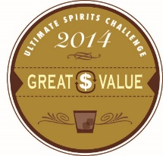
GALLIANO ESPRESSO
STRONG • INTENSE • DARK ROAST
The deepest and most intense coffee aroma & flavor available
Not tequila or rum based, pure espresso with alcohol from the sugar beet
The ideal sugar balance for a perfect Espresso Martini
Outstanding quality proven by multiple awards
93 points by Beverage Testing Institute 2021
Notes:
Arabica beans from Colombia. They give a chocolatey, creamy and delicate top note. Robusta beans from India and Kenya, contributes to body and bitter flavours
Taste notes: The full-flavoured palate is very close to that of a strong caffè corretto with dark chocolate covered and heavily roasted coffee beans

Slide 18
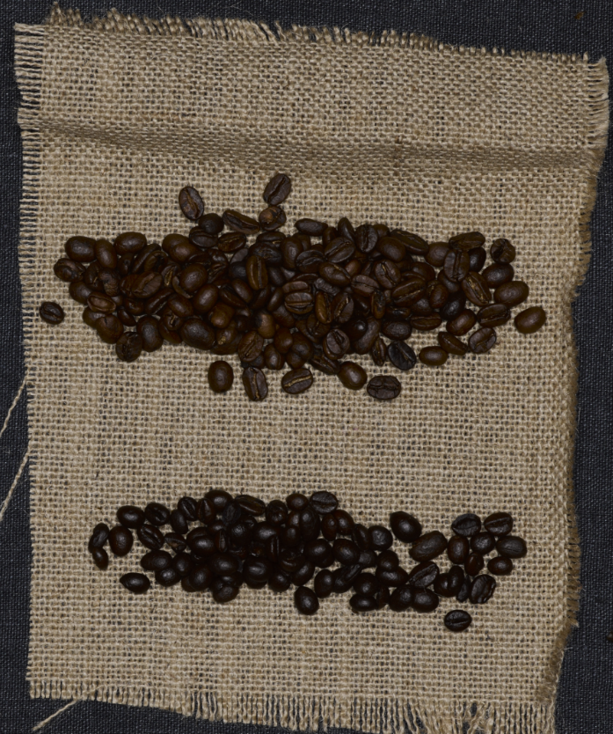
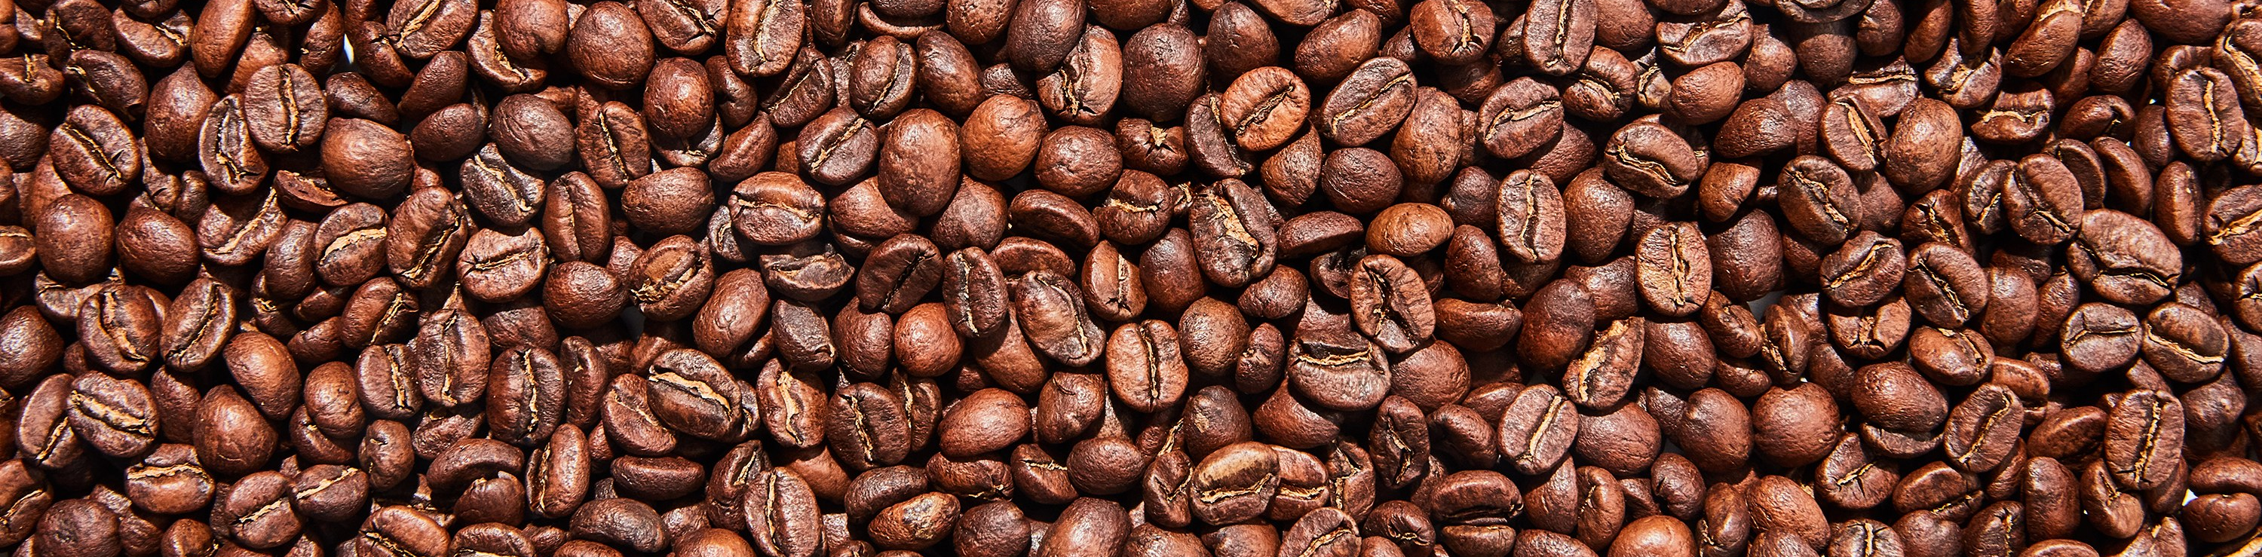
RISTRETTO BLEND
55% Arabica beans from Columbia and Brazil:
Chocolate, creamy delicate notes
45% Robusta beans from India and
Kenya:
Body and bitterness
30% ABV

Slide 19
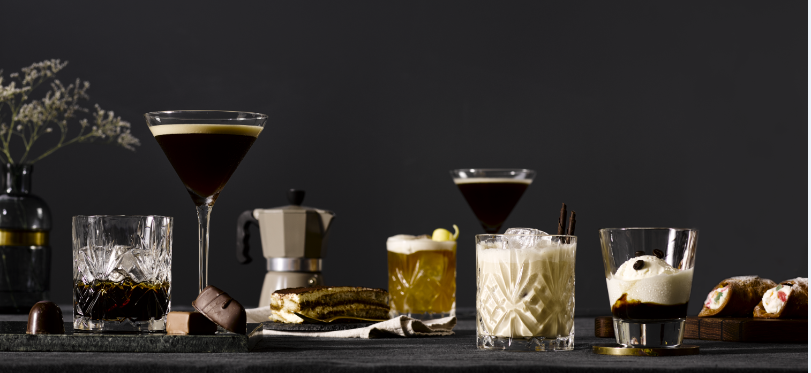
GALLIANO ESPRESSO
Stage 1
Coffee beans are macerated* in alcohol and
Stage 2
Rested for 15 days
Stage 3
Blended with water and sugar.
There’s no added coloring or any artificial ingredients.
water, pressed, re-macerated and pressed
PRODUCTION NOTES
*Means soaking the flavoring and coloring ingredients usually in a cold spirit. This could take a very long time, but may be the only possible method of retaining the character and color of some plants.

Slide 20
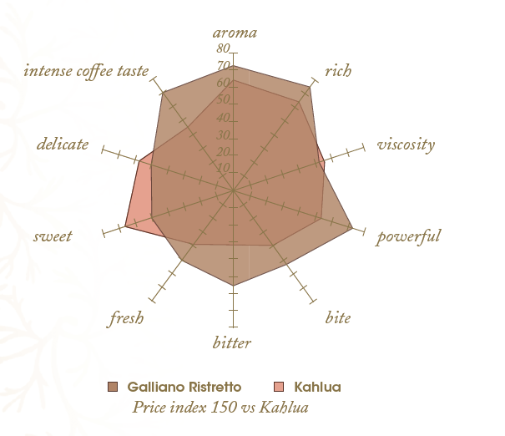
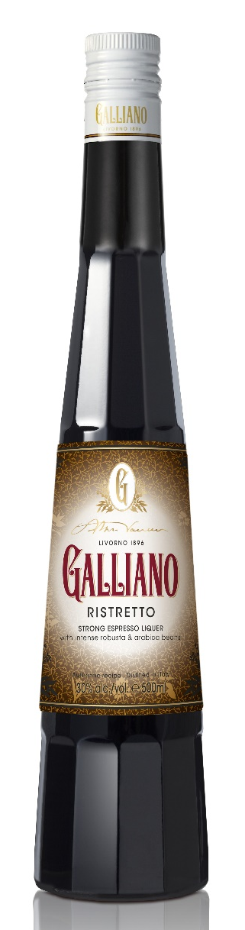
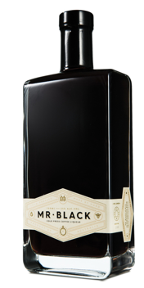
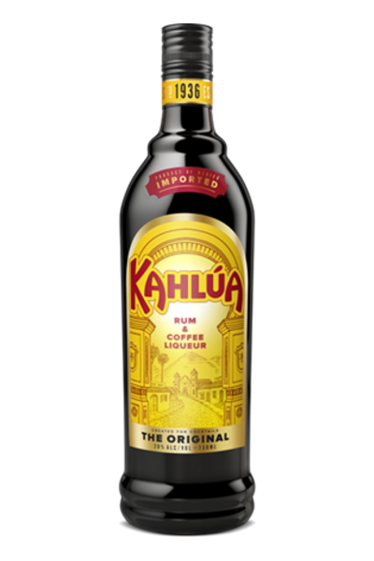
GALLIANO ESPRESSO VS COMPETITION
VS
VS

Slide 21
RETAIL GUIDELINES

Slide 22
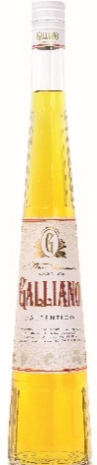











Shelf Positioning & Pricing
Super Premium: 750 ml $32-35; 375 ml $19-22 (RSP)
Super Premium: price index 150 vs Kahlua
In corresponding categories:
L’Autentico -> premium liqueurs
Espresso -> coffee liqueurs
L’Aperitivo -> Italian aperitifs
Super Premium: in line with Campari

Slide 23
COCKTAIL STRATEGY

Slide 24


2 key activation moments
Galliano Frizzante:
Sparkling cocktails
Brunch | Happy Hour | Welcome Drink | Celebration
Galliano coffee:
Indulgent cocktails
Brunch | Dessert | Apres Ski

Slide 25



GALLIANO FRIZZANTE
Frizzante = Sparkling in Italian
Notes:
AGO: explain key drinks → sparkling negroni = sbagliato. Change gin into prosecco

Slide 26


GALLIANO coffee
Espresso Martini
1 oz Galliano Espresso
1 oz Vodka
1 oz Espresso
0.25 oz Simple Syrup
Galliano Hot Shot
1 oz Galliano L’Autentico
1 oz Hot Coffee
1 oz Whipped Cream
Notes:
AGO: explain key drinks → sparkling negroni = sbagliato. Change gin into prosecco

Slide 27



The bartender’s collection
Red Light Negroni
1 oz Galliano L’Aperitivo 1 oz Sweet Vermouth 1 oz Bols Genever
Galliano Sour
2 oz Galliano L’Autentico
1 oz Fresh Lemon Juice
0.25 oz simple syrup
Egg white
The Gold Rush
1.5 oz Galliano L’Autentico
1 oz Mezcal
0.75 oz Fresh Lime Juice
0.5 oz Agave
Pinch of Salt
Frozen Irish Coffee
1.25oz Irish Whiskey
0.75oz Galliano Espresso
3oz Cold Brew Coffee
1oz Chocolate Milk
1 scoop chocolate ice cream
Blend with a handful of ice cubes
Notes:
AGO: explain key drinks → sparkling negroni = sbagliato. Change gin into prosecco

Slide 28

TARget consumer
Notes:
AGO: explain key drinks → sparkling negroni = sbagliato. Change gin into prosecco

Slide 29

ELEVATOR PITCH
What is Galliano?
Classic Italian herbal liqueur, blended from 30 different herbs and spices.
What is Galliano Espresso?
Classic Italian espresso liqueur with bold and intense coffee flavor, all natural ingredients
What is Galliano L’Aperitivo?
Well-balanced Italian bitter blended from 50 Mediterranean herbs and citruses
Notes:
AGO: explain key drinks → sparkling negroni = sbagliato. Change gin into prosecco

Slide 30



SOCIAL MEDIA
Galliano Liqueur USA
@GallianoCocktails

