Slide 1
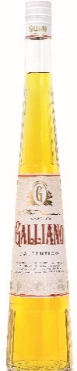
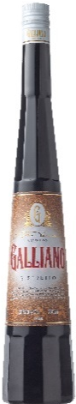
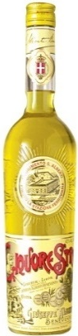
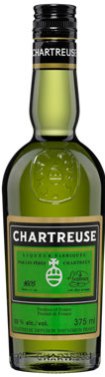
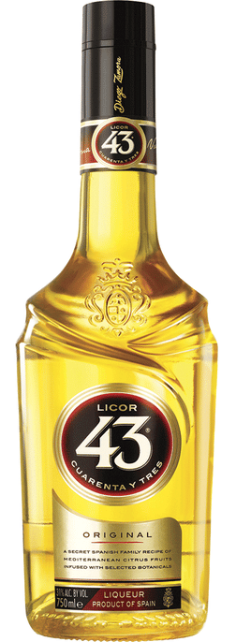
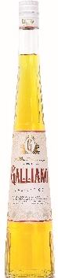
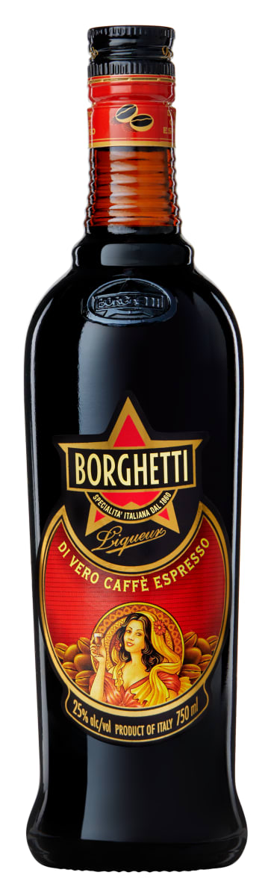
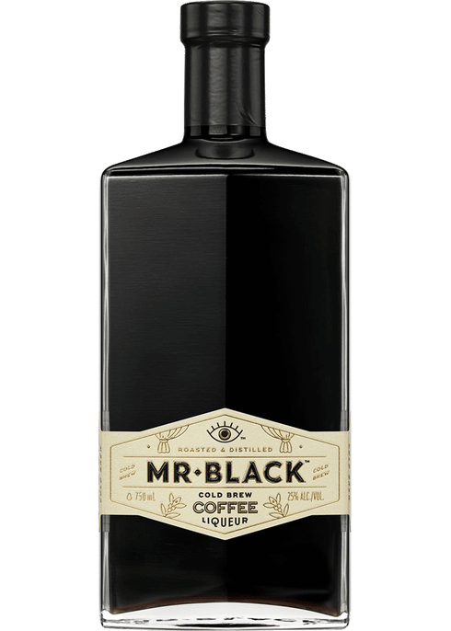


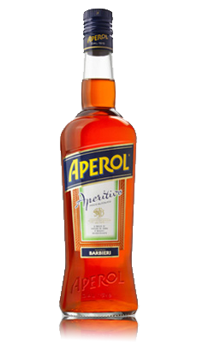

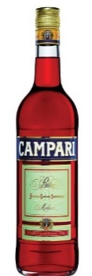
Galliano Shelf Positioning
375 $18-21, 750 $31-35
375 $14-16, 750 $23-25
In corresponding categories:
L’autentico -> super premium imported liqueurs
Ristretto -> coffee liqueurs to the right of Mr. Black
L’Aperitivo -> Italian aperitifs to the right of Campari
As famiglia - only on the floor/ end cap
375 $15-17
Notes:
Super premium! Italian family each flavor is a character on its own

