Slide 1



MEDIA COVERAGE
2024-2025

Slide 2




May 28, 2025
Online Visits: 5,000
Click to view article

Slide 3

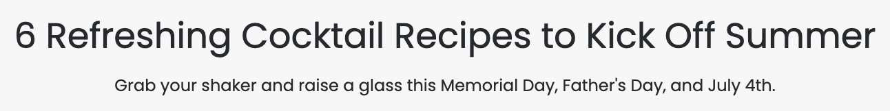

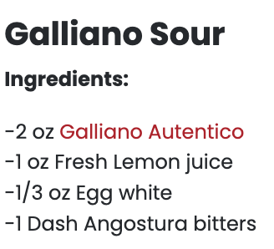
May 15, 2025
Online Visits: 1,227,877
Click to view article

Slide 4

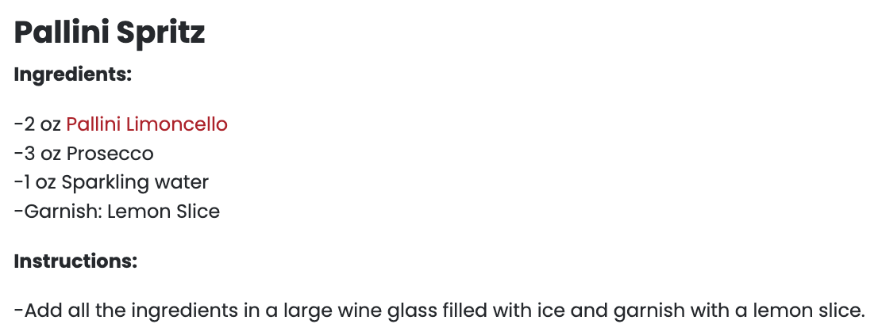
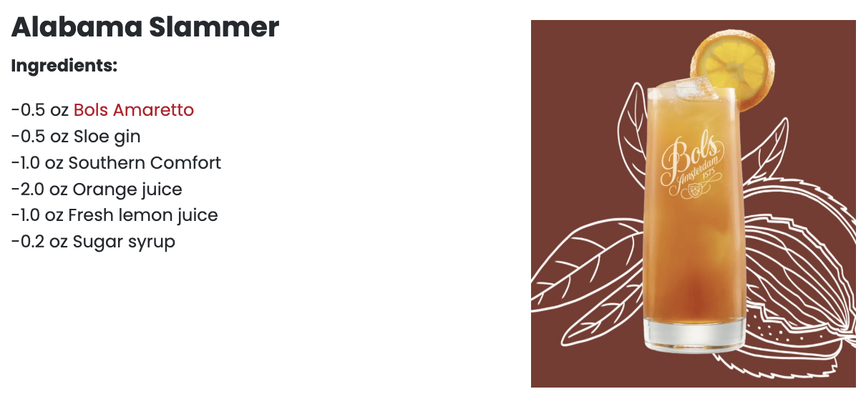

Slide 5



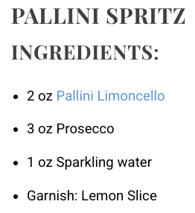
April 17, 2025
Online Visits: 9,643
Click to view article

Slide 6


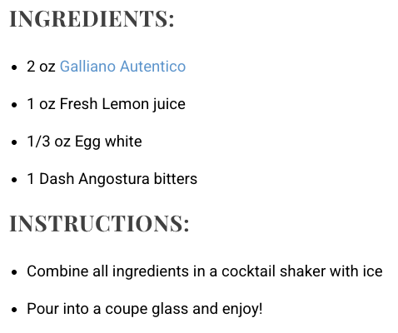

Slide 7

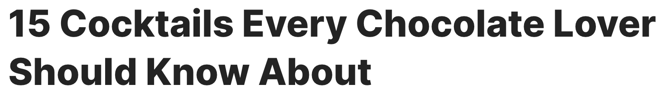



March 18, 2025
Online Visits: 5,382,704
Click to view article

Slide 8

 | March 18, 2025 Online Visits: 407,199,536 Click to view article
Syndications from Chowhound

Slide 9



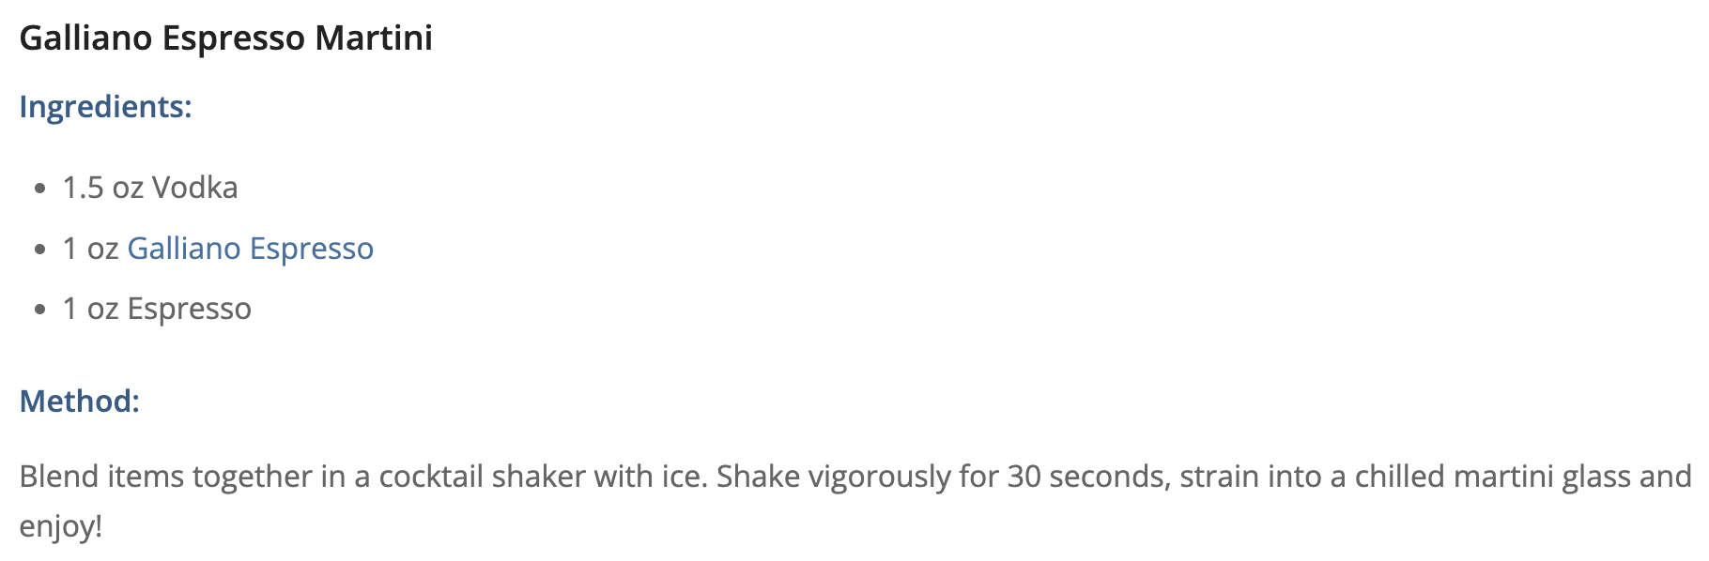
March 14, 2025
Online Visits: 5,000
Click to view article

Slide 10

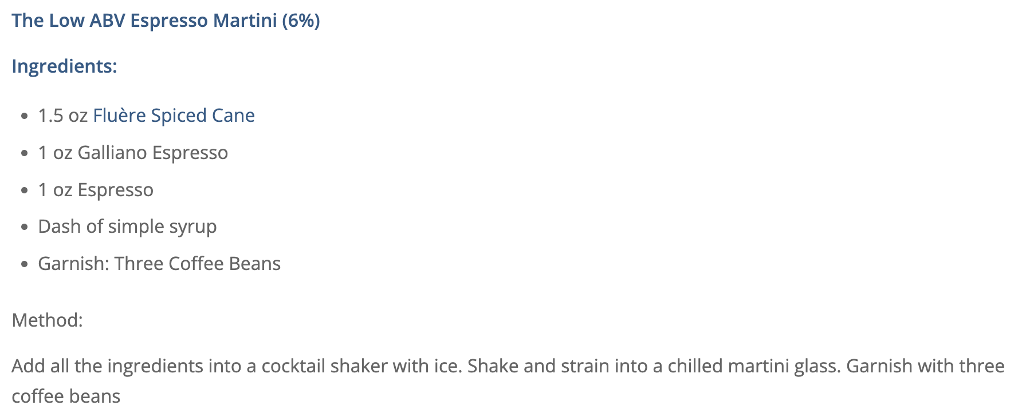

Slide 11

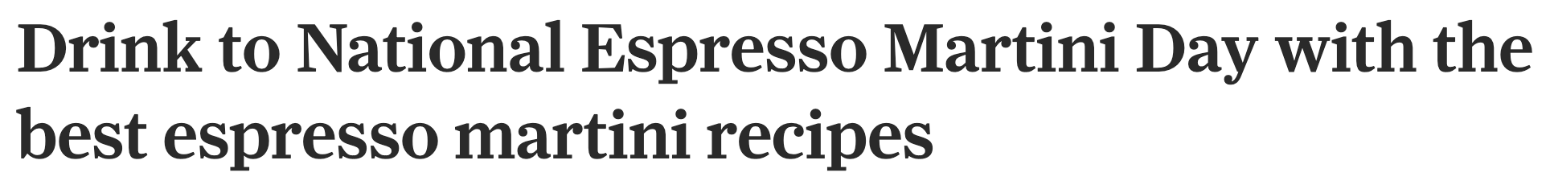
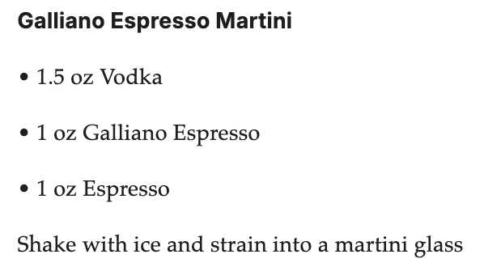
March 10, 2025
Online Visits: 4,436,041
Click to view article

Slide 12

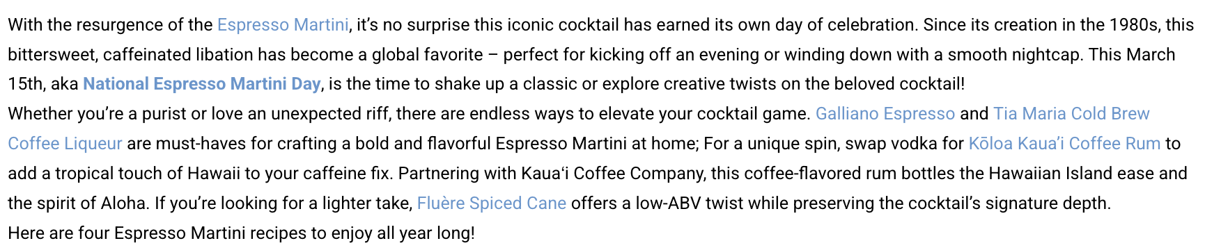
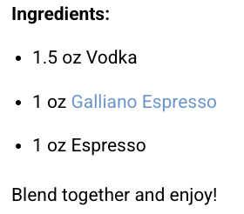
March 10, 2025
Online Visits: 11,931
Click to view article

Slide 13

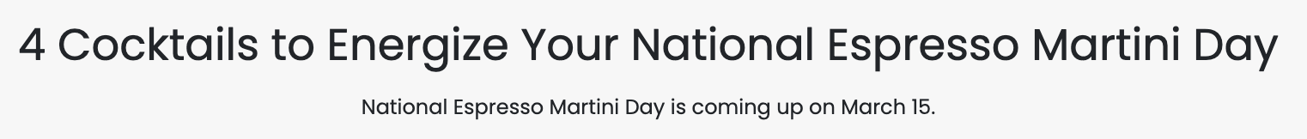
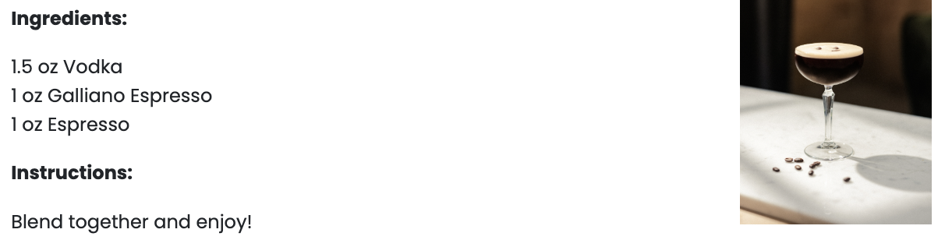
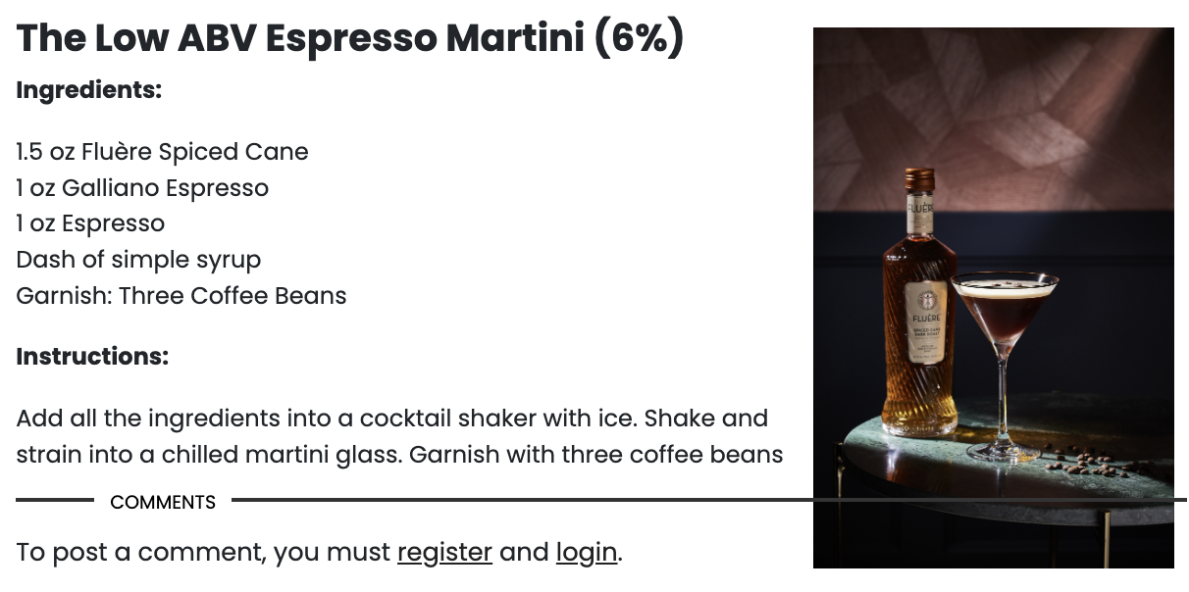
February 27, 2025
Online Visits: 1,308,616
Click to view article

Slide 14

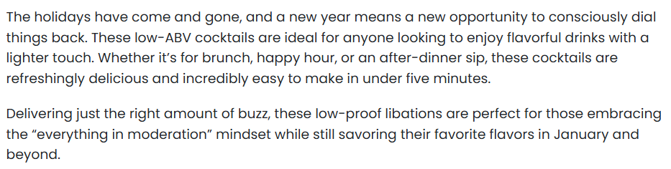
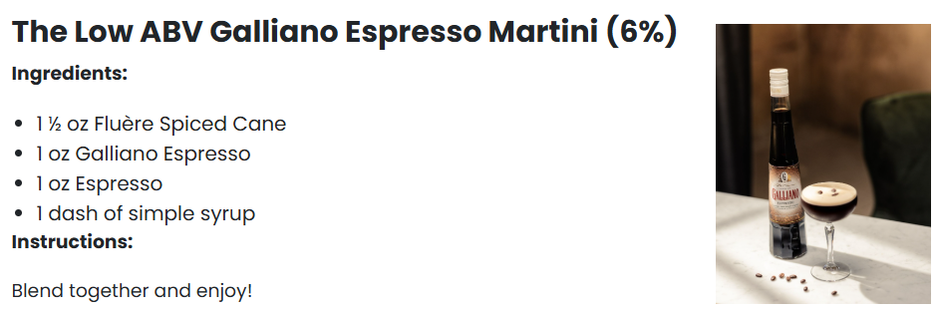
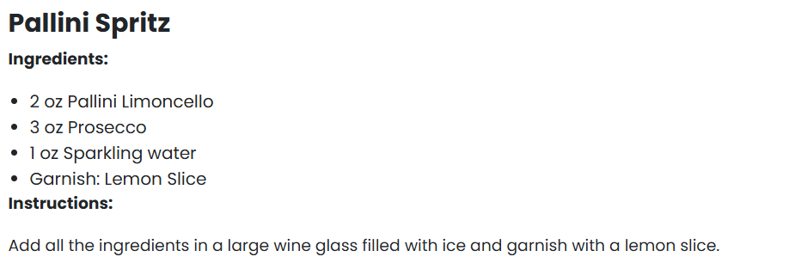

January 22, 2025
Online Visits: 1,567,783
Click to view article

Slide 15

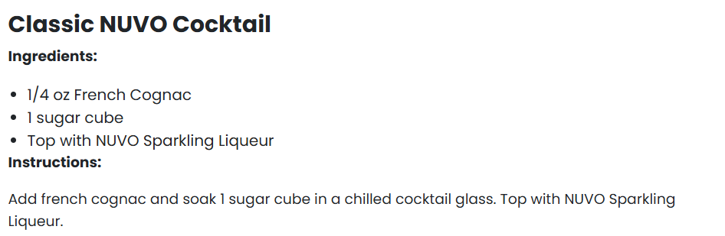
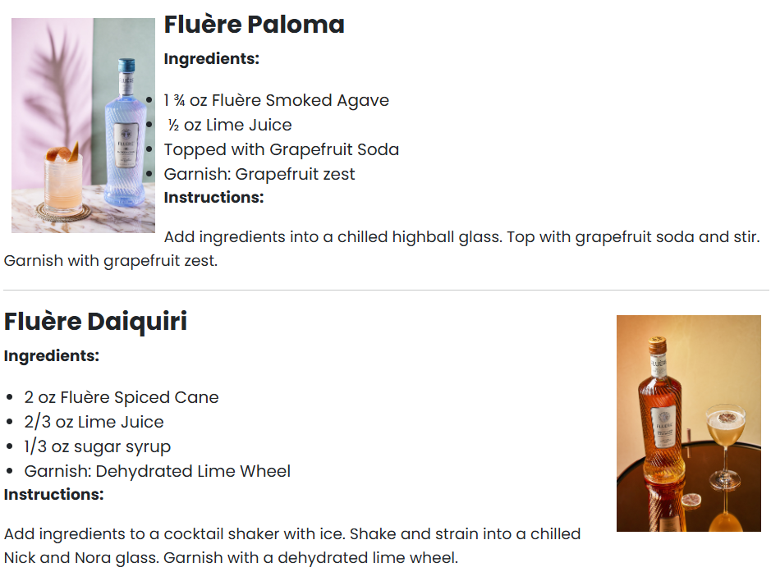

Slide 16

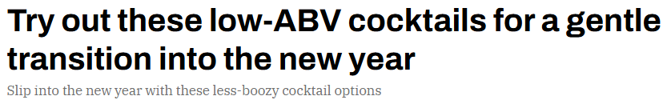

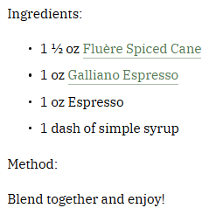
January 15, 2025
Online Visits: 480,560
Click to view article

Slide 17


Slide 18

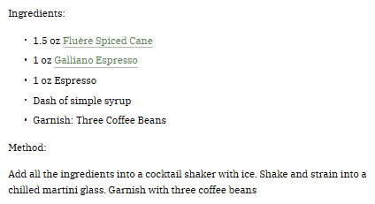


Slide 19

 | January 15, 2025 Online Visits: 413,750,923 Click to view article
Syndications from The Manual

Slide 20



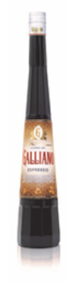

January/February 2025 Issue
Print Circulation: 5,000

Slide 21


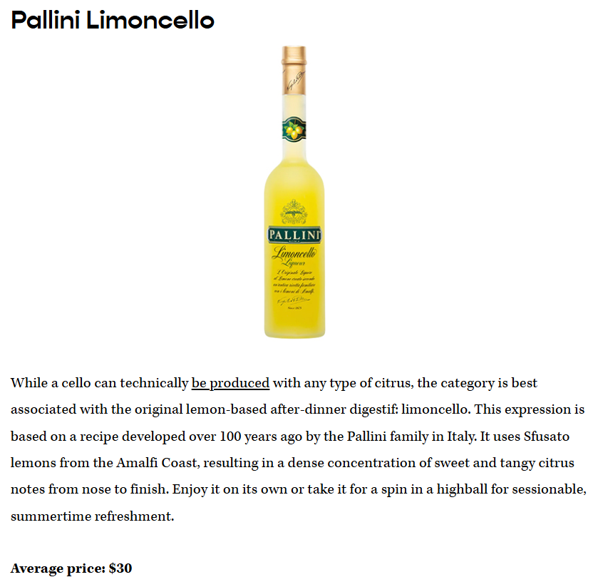
December 24, 2024
Online Views: 1,094,038
Click to view article

Slide 22


Slide 23

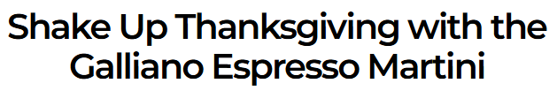

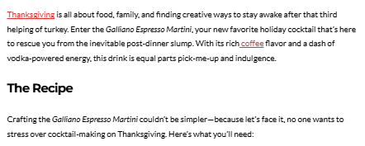
November 21, 2024
Online Visits: 80,493
Click to view article

Slide 24


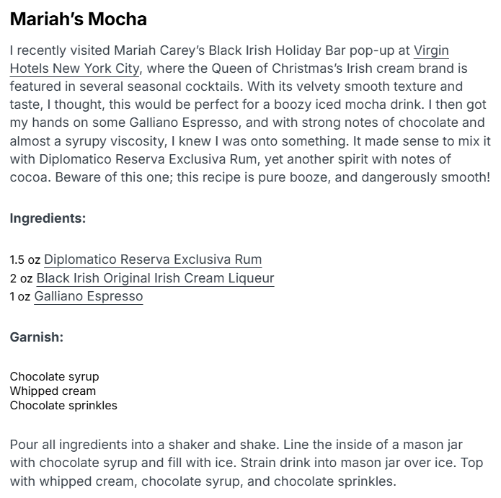
November 20, 2024
Online Visits: 187,283
Click to view article

Slide 25


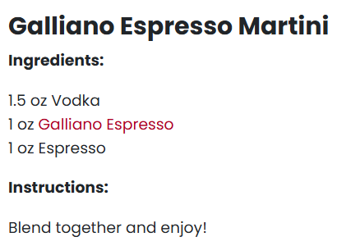

November 12, 2024
Online Visits: 1,276,678
Click to view article

Slide 26

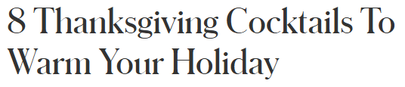

November 11, 2024
Online Visits: 94,326,403
Click to view article

Slide 27


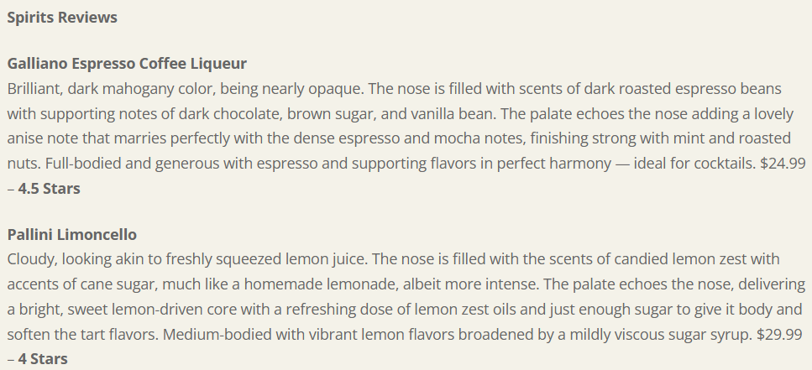
November 6, 2024
Online Visits: 5,000
Click to view article

Slide 28


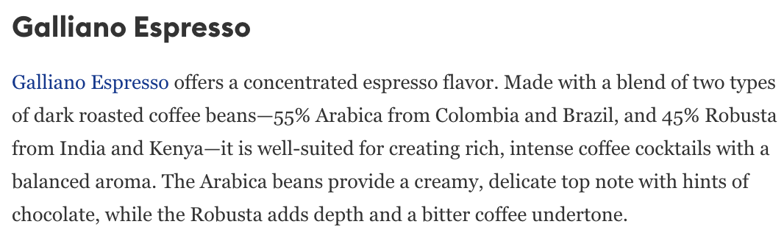
October 1, 2024
Online Visits: 99,621,955
Click to view article

Slide 29


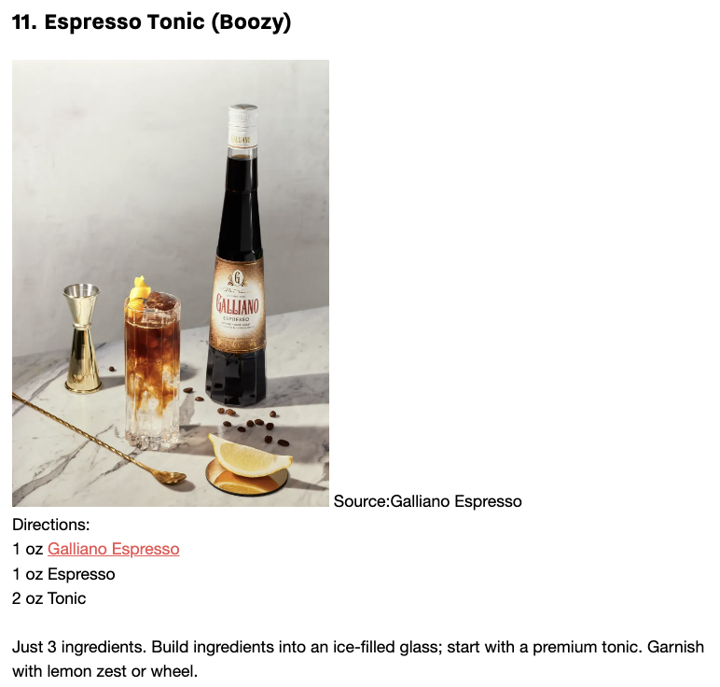
October 1, 2024
Online Visits: 48,781
Click to view article

Slide 30








 | October 1, 2024 Online Visits: 49,125 Click to view article
 | October 1, 2024 Online Visits: 50,539 Click to view article
 | October 1, 2024 Online Visits: 160,550 Click to view article
 | October 1, 2024 Online Visits: 71,803 Click to view article
 | October 1, 2024 Online Visits: 5,000 Click to view article
 | October 1, 2024 Online Visits: 5,000 Click to view article
 | October 1, 2024 Online Visits: 49,352 Click to view article
 | October 1, 2024 Online Visits: 61,284 Click to view article
Syndications from Cassius

Slide 31


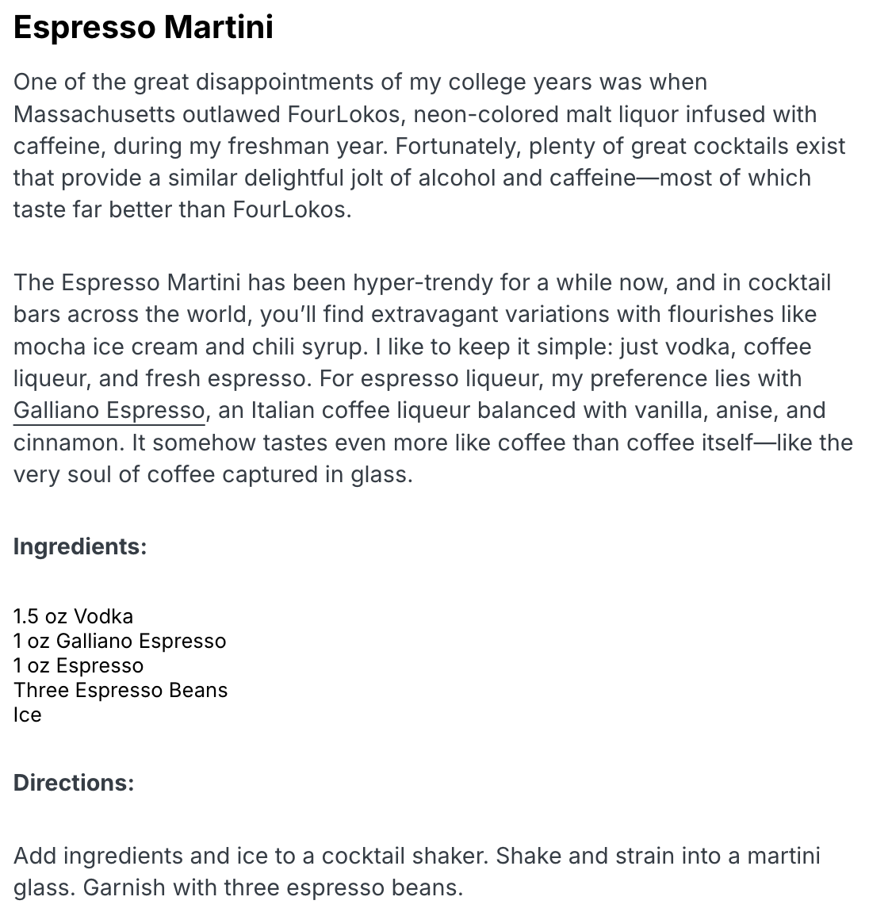

September 27, 2024
Online Visits: 187,312
Click to view article

Slide 32
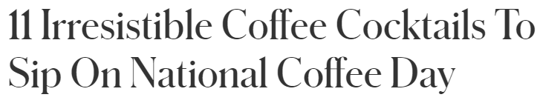


September 21, 2024
Online Visits: 99,621,955
Click to view article

Slide 33
