Slide 1


MEDIA COVERAGE
2024-2025

Slide 2

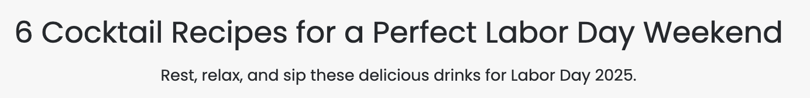

Date: 8/21/2025
Online Visits: 1,419,055
Click to view article

Slide 3
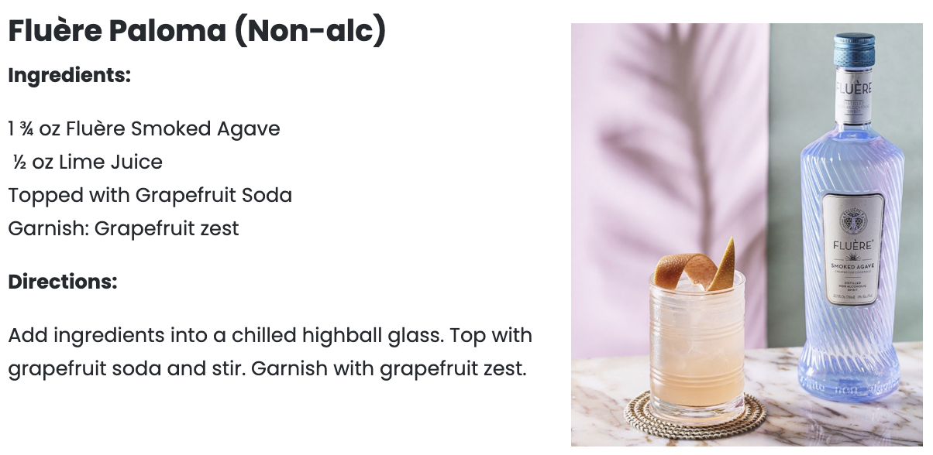


Slide 4


Date: 8/19/2025
Online Visits: 5,000
Click to view article

Slide 5


Slide 6



Date: 7/23/2025
Online Visits: 78,095
Click to view article

Slide 7




May 8, 2025
Online Visits: 32,310
Click to view article

Slide 8





 | May 8, 2025 Online Visits: 24,715 Click to view article
 | May 8, 2025 Online Visits: 192,919 Click to view article
 | May 8, 2025 Online Visits: 5,448 Click to view article
 | May 8, 2025 Online Visits: 5,000 Click to view article
 | May 9, 2025 Online Visits: 78,704 Click to view article
Syndications from Cassius

Slide 9




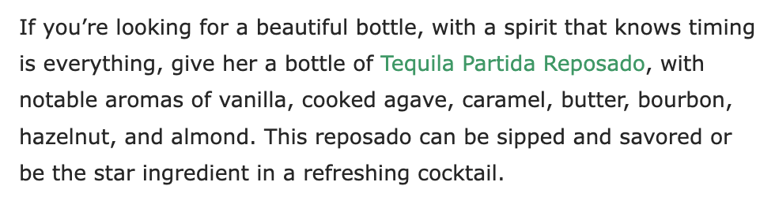
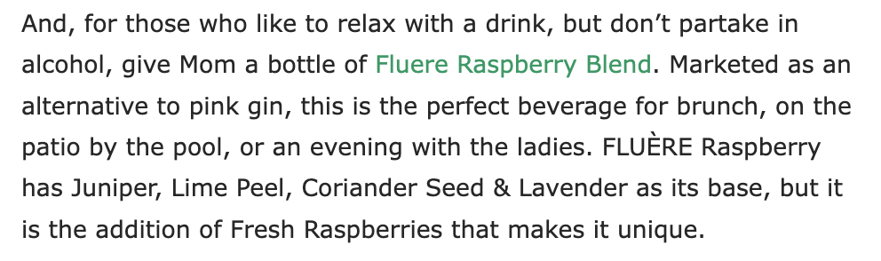
May 6, 2025
Online Visits: 13,021
Click to view article

Slide 10



April 6, 2025
Followers: 196
Click to view post

Slide 11


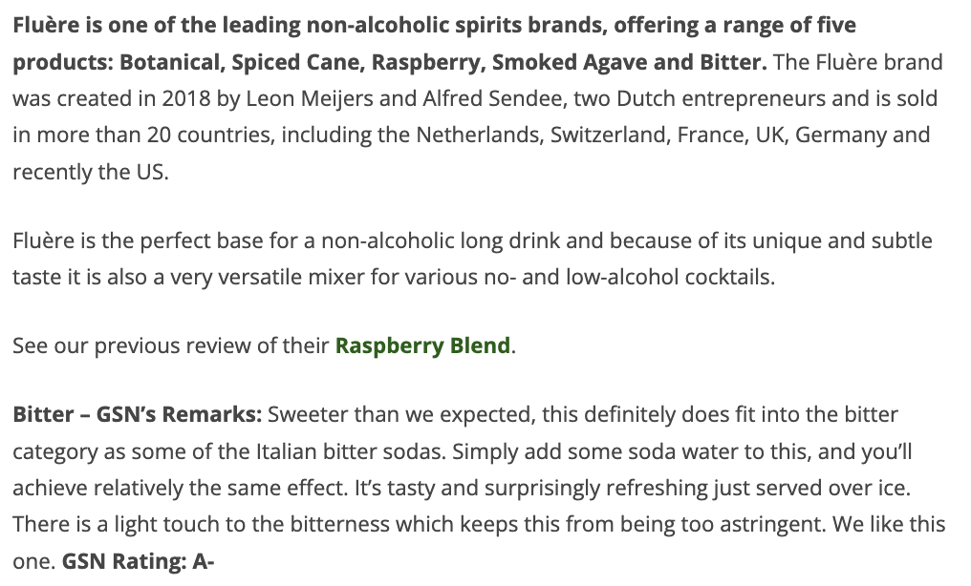
April 6, 2025
Online Visits: 5,000
Click to view article

Slide 12
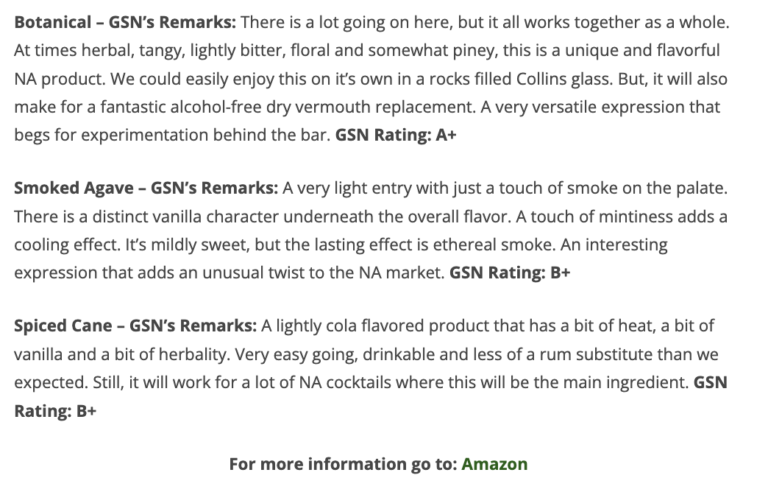


Slide 13

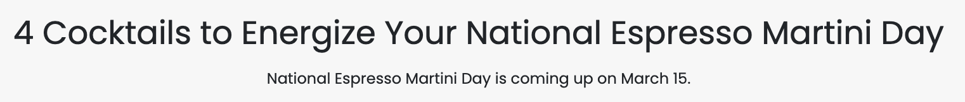
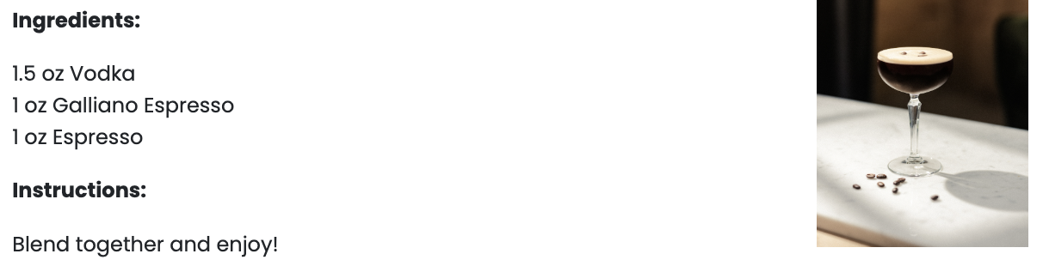
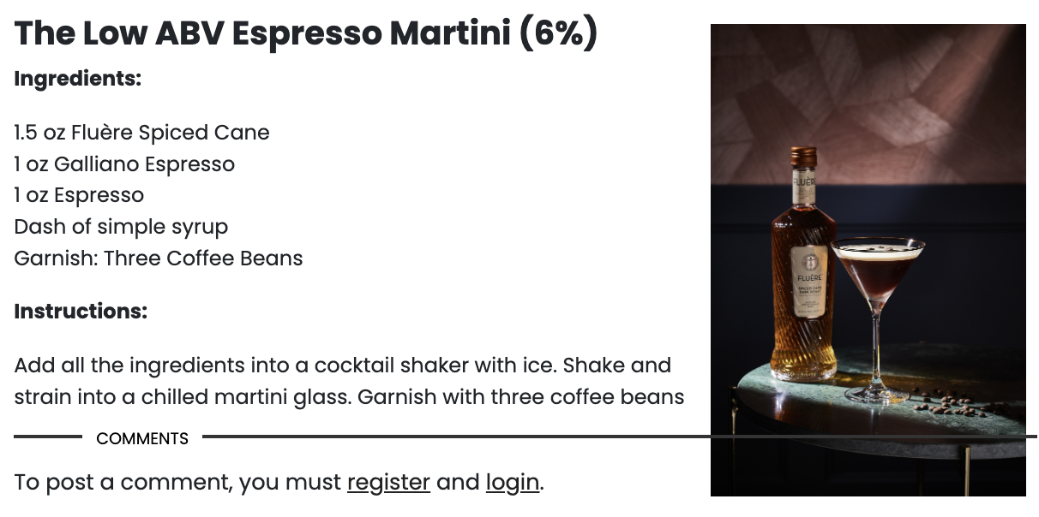
February 27, 2025
Online Visits: 1,308,616
Click to view article

Slide 14

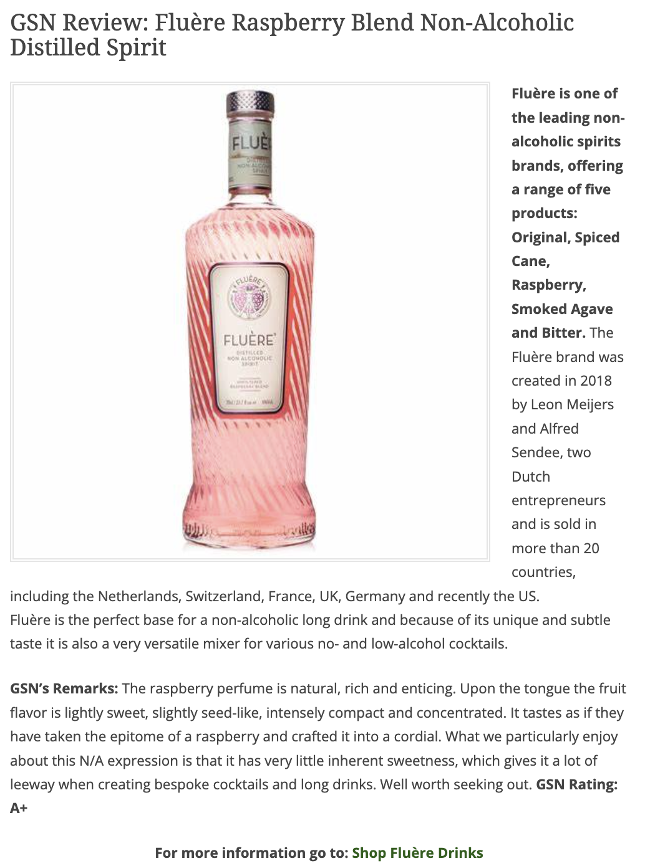
February 21, 2025
Online Visits: 5,000
Click to view article

Slide 15

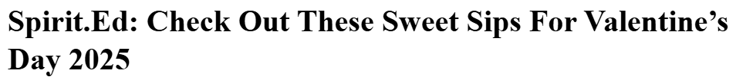

February 14, 2025
Online Visits: 42,949
Click to view article

Slide 16


Slide 17






 | February 14, 2025 Online Visits: 60,048 Click to view article
 | February 14, 2025 Online Visits: 33,956 Click to view article
 | February 14, 2025 Online Visits: 5,000 Click to view article
 | February 14, 2025 Online Visits: 170,764 Click to view article
 | February 14, 2025 Online Visits: 7,376 Click to view article
 | February 14, 2025 Online Visits: 45,773 Click to view article
Syndications from Cassius

Slide 18


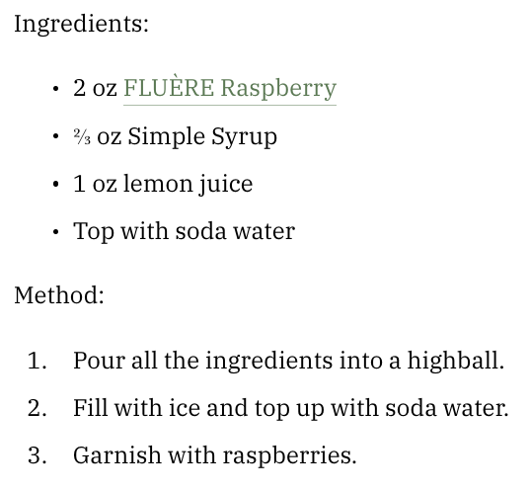

March 26, 2025
Online Visits: 953,553
Click to view article

Slide 19

 | March 26, 2025 Online Visits: 127,227,053 Click to view article
Syndication from The Manual

Slide 20



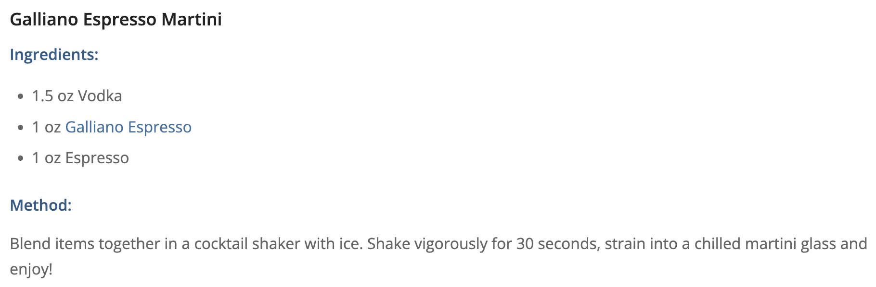
March 14, 2025
Online Visits: 5,000
Click to view article

Slide 21

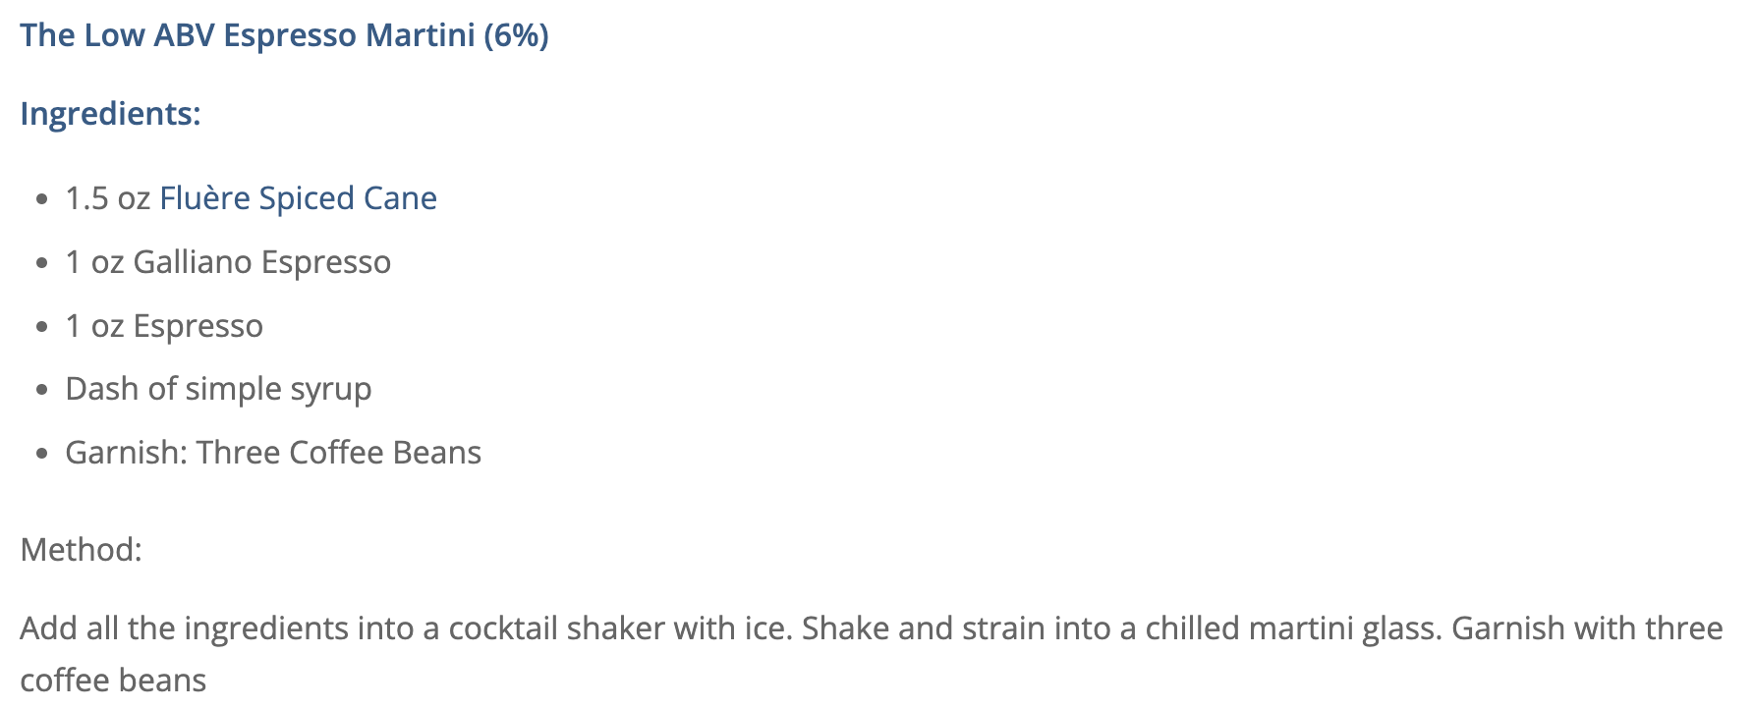

Slide 22

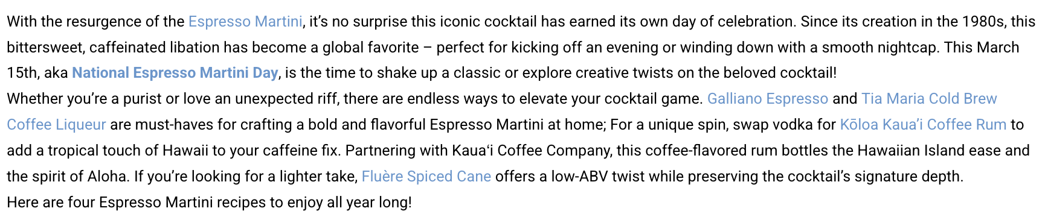
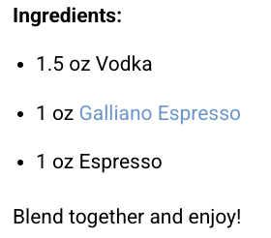
March 10, 2025
Online Visits: 11,931
Click to view article

Slide 23
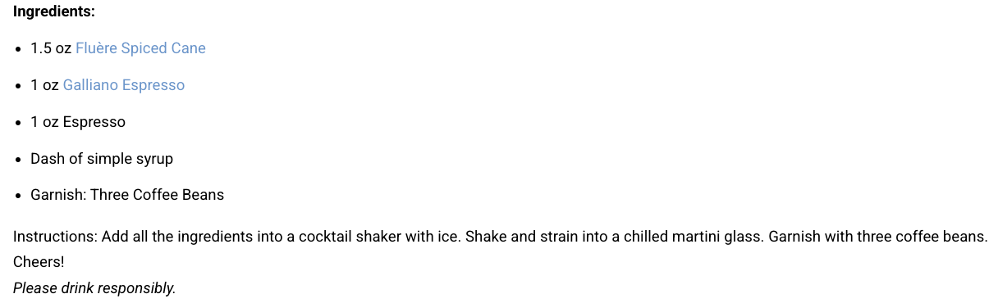

Slide 24

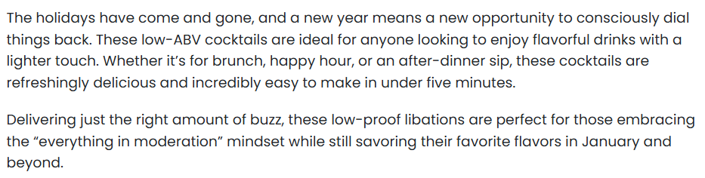
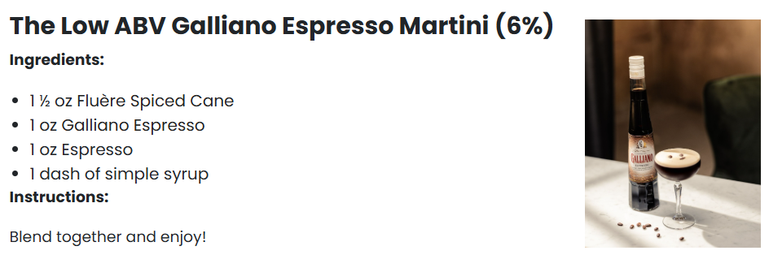
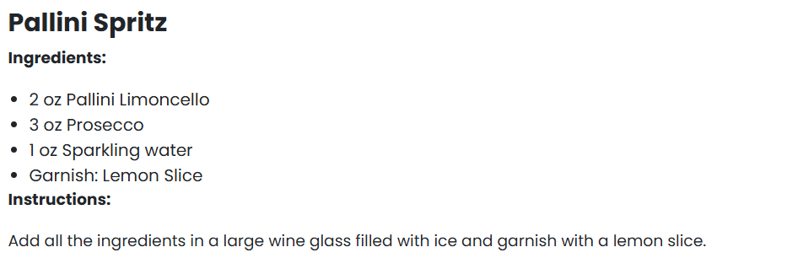

January 22, 2025
Online Visits: 1,567,783
Click to view article

Slide 25

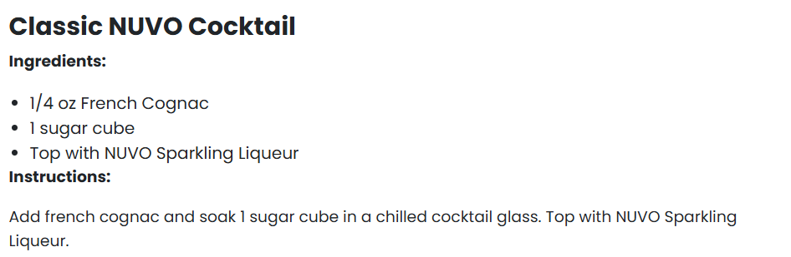
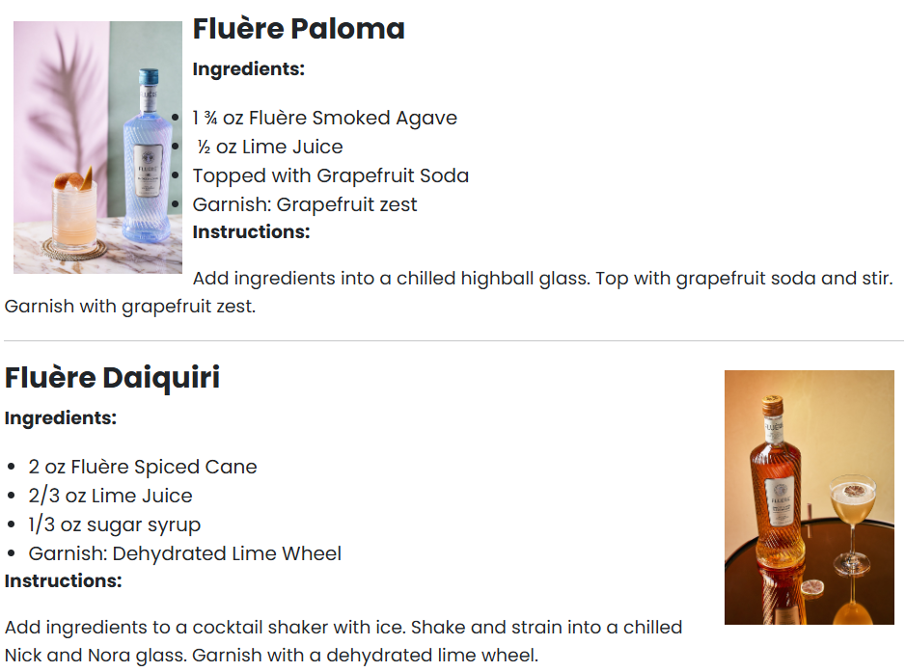

Slide 26




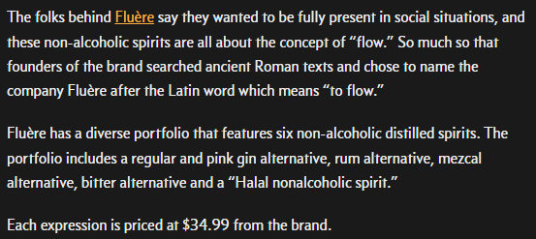
January 18, 2025
Online Visits: 61,745
Click to view article

Slide 27

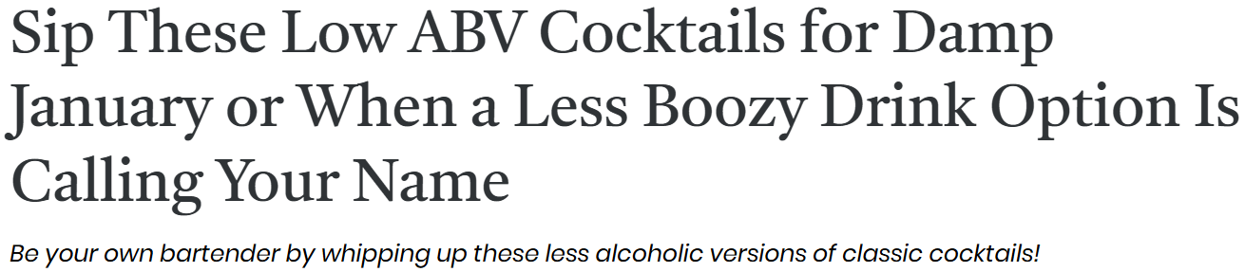


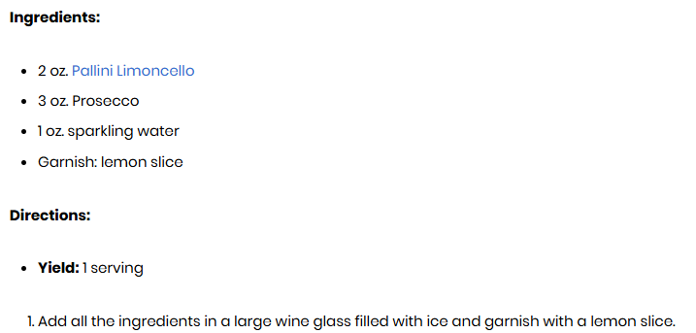
January 17, 2025
Online Visits: 693,695
Click to view article

Slide 28
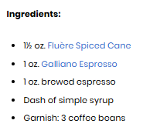

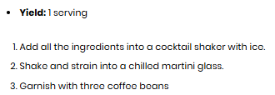


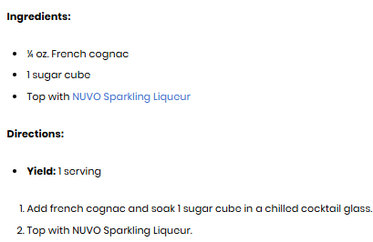

Slide 29







 | January 17, 2025 Online Visits: 975,948 Click to view article
 | January 17, 2025 Online Visits: 70,867 Click to view article
 | January 17, 2025 Online Visits: 737,081 Click to view article
 | January 17, 2025 Online Visits: 445,392 Click to view article
 | January 17, 2025 Online Visits: 136,939 Click to view article
 | January 17, 2025 Online Visits: 1,275,976 Click to view article
 | January 17, 2025 Online Visits: 1,437,841 Click to view article
Syndications from First For Women

Slide 30

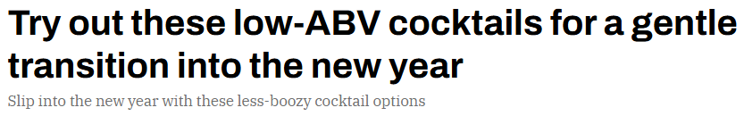

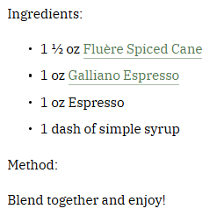
January 15, 2025
Online Visits: 480,560
Click to view article

Slide 31
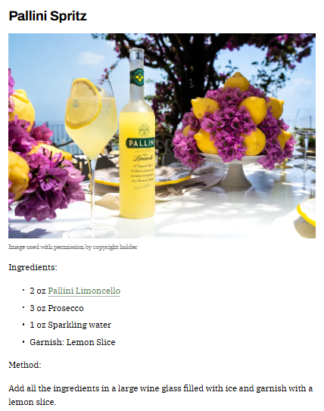

Slide 32

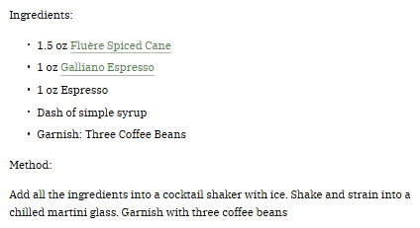


Slide 33

 | January 15, 2025 Online Visits: 413,750,923 Click to view article
Syndications from The Manual

Slide 34

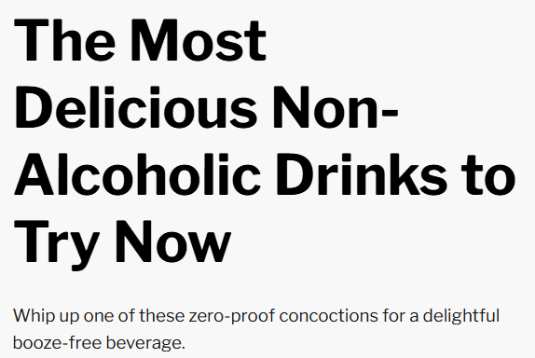
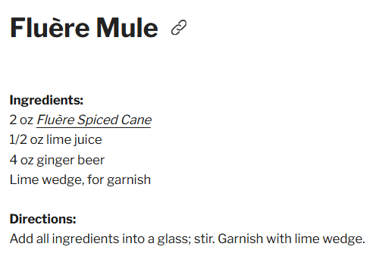

January 14, 2025
Online Visits: 587,602
Click to view article

Slide 35



January 14, 2025
Online Visits: 44,579
Click to view article

Slide 36
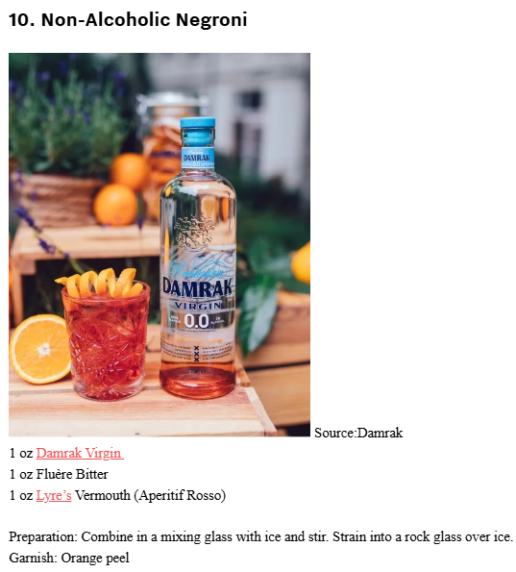

Slide 37


Slide 38


 | January 14, 2025 Online Visits: 5,000 Click to view article
 | January 14, 2025 Online Visits: 20,894 Click to view article
Syndications from Cassius

Slide 39

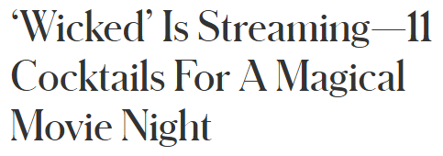

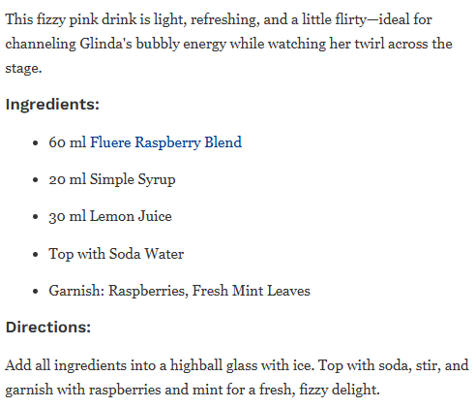

January 13, 2025
Online Visits: 88,209,424
Click to view article

Slide 40
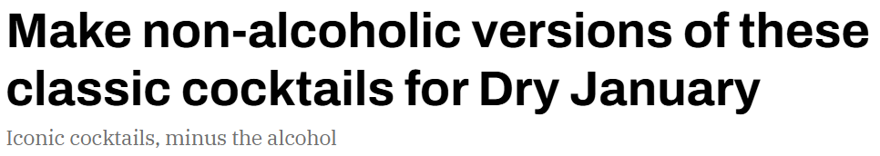
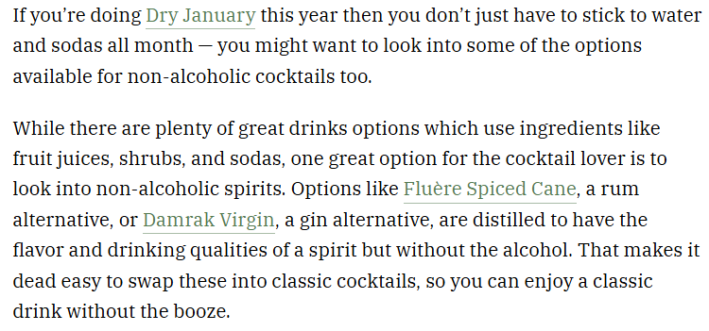

January 8, 2025
Online Visits: 480,560
Click to view article

Slide 41
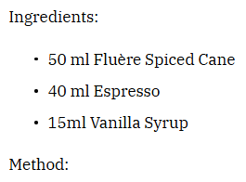



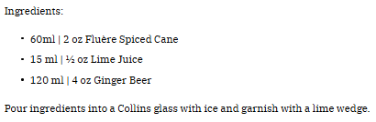

Slide 42

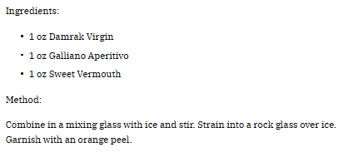

Slide 43

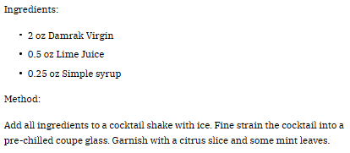

Slide 44


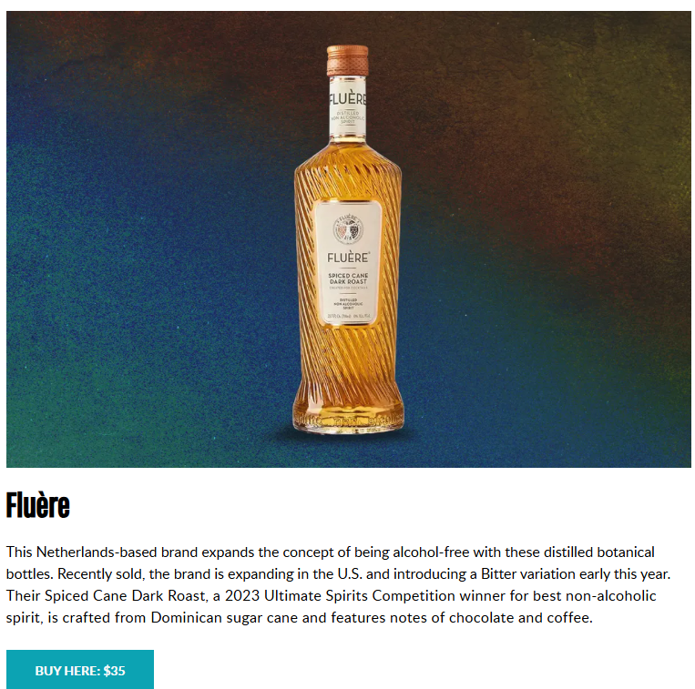
January 8, 2025
Online Visits: 648,365
Click to view article

Slide 45




December 30, 2024
Online Views: 16,882,775
Click to view article

Slide 46

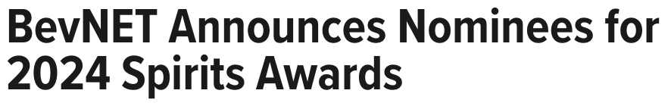


December 12, 2024
Online Views: 115,726
Click to view article

Slide 47




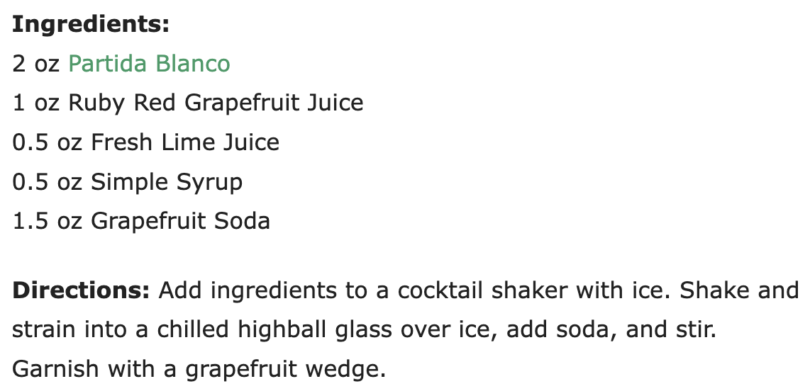
November 18, 2024
Online Visits: 20,523
Click to view article

Slide 48


