Slide 1

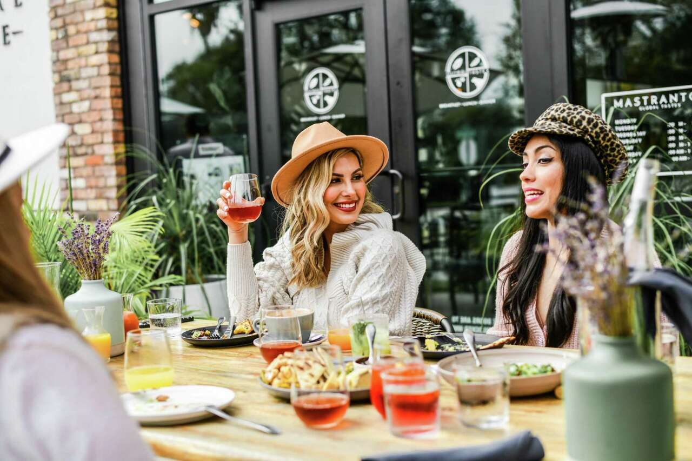
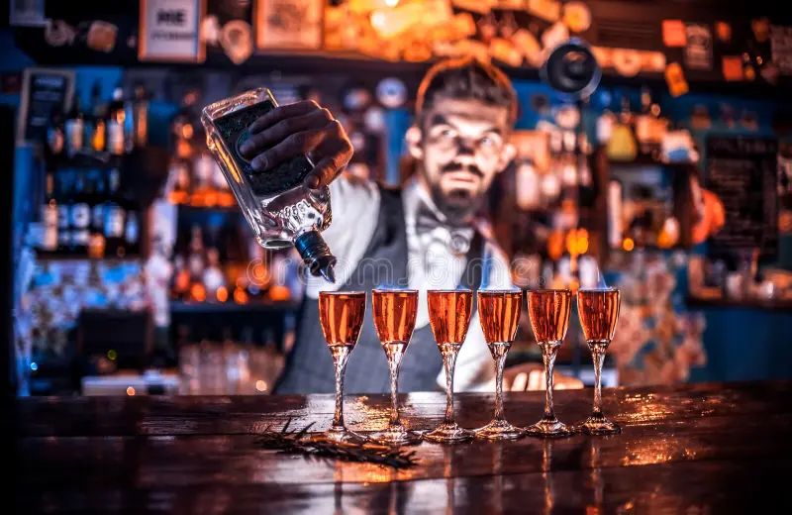
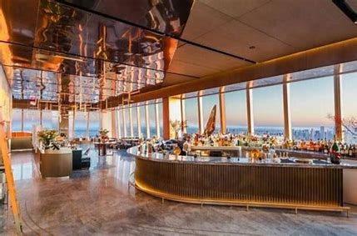
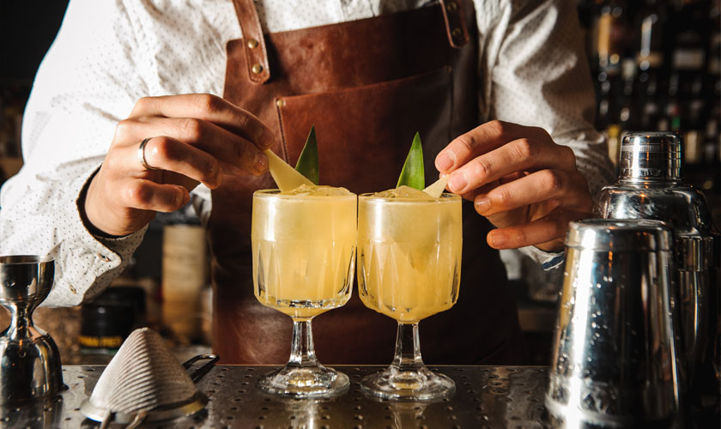
TARGET ACCOUNTS
TRIAL
ON PREMISE
AND SUGGESTED COCKTAIL VARIATIONS
Brunch Spots
Trendy Cocktail Bars
Fluère Spritz
Fluère Paloma
Fluère Daiquiri
Fluère Negroni
Hotel / Rooftop Bars
Restaurants With Craft Cocktails
Fluère Gimlet
Fluère Spritz
Fluère Margarita
Fluère
Mule

