Slide 1
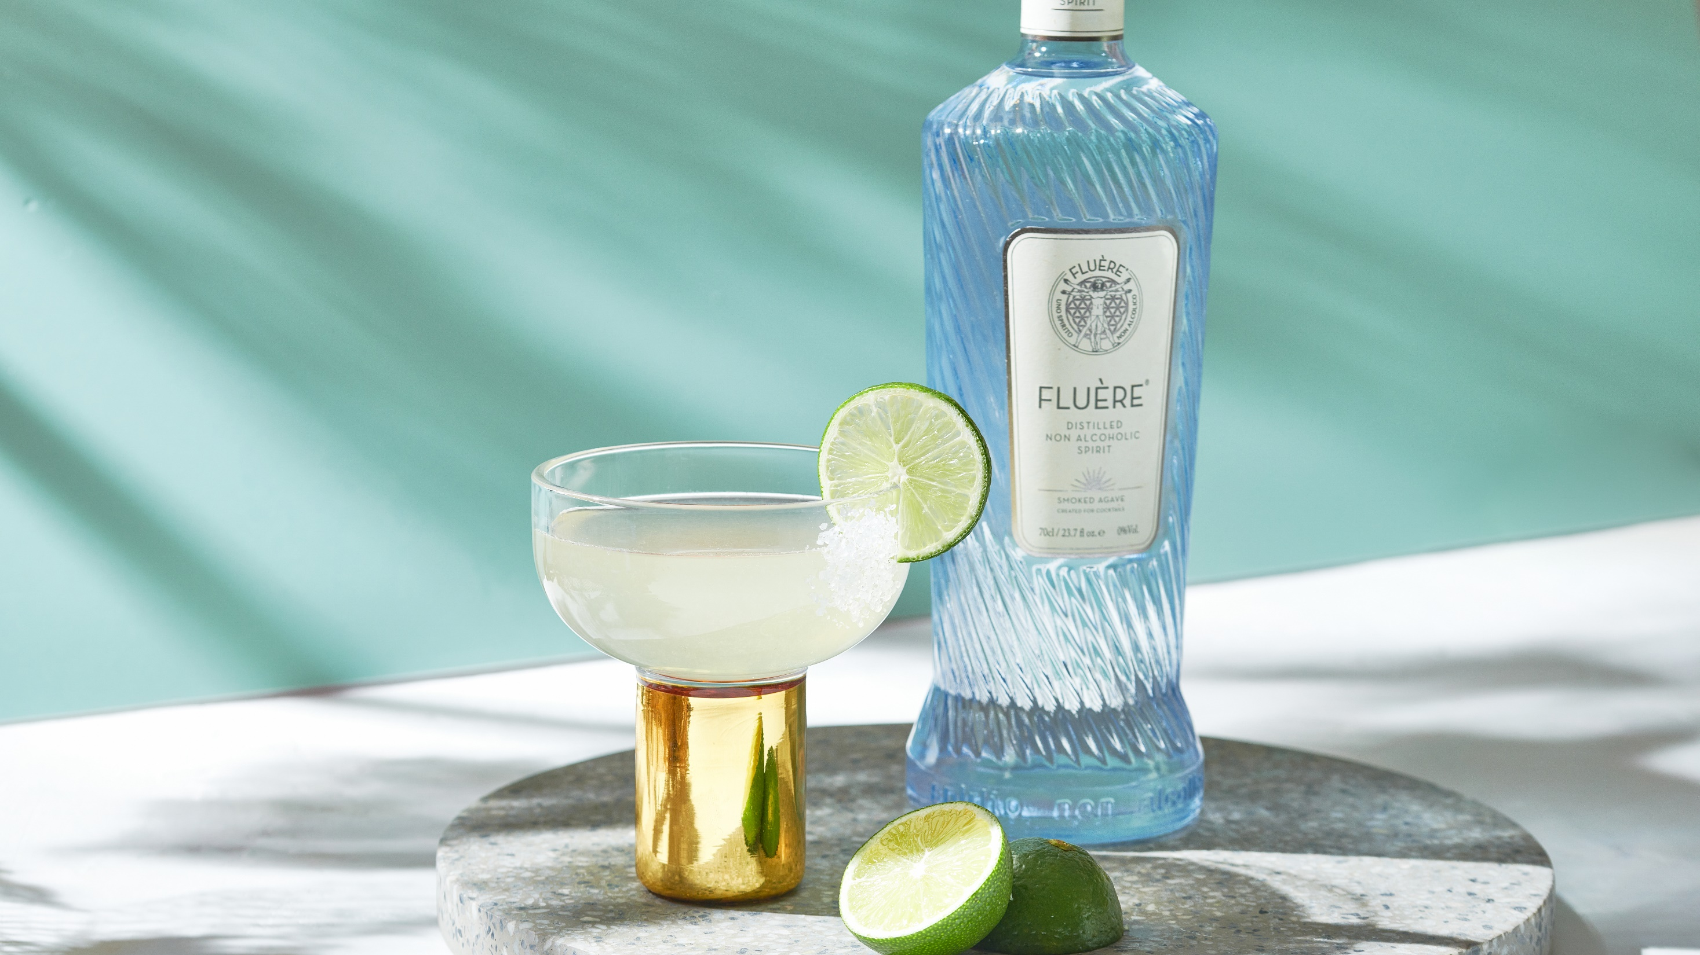
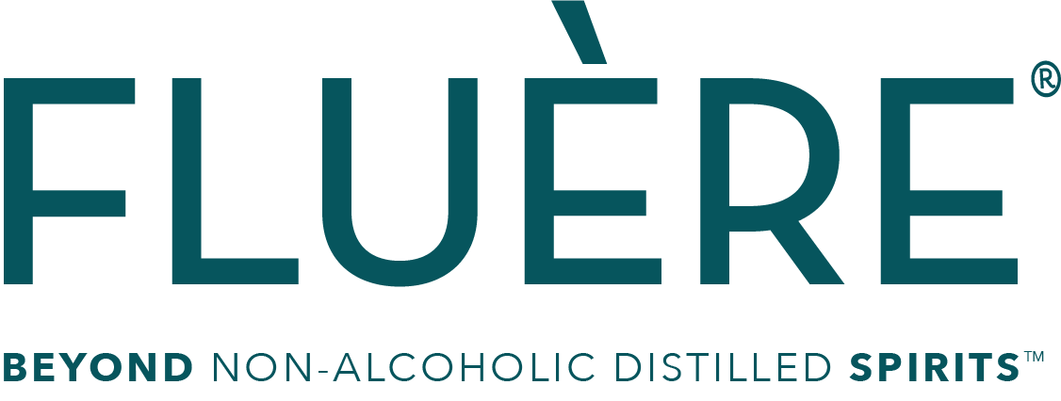

Slide 2
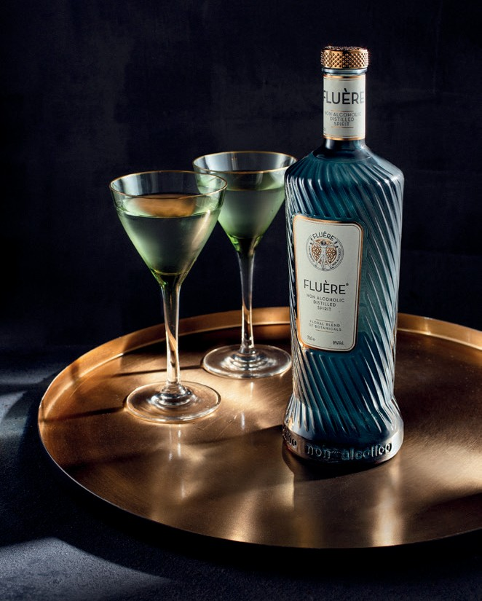
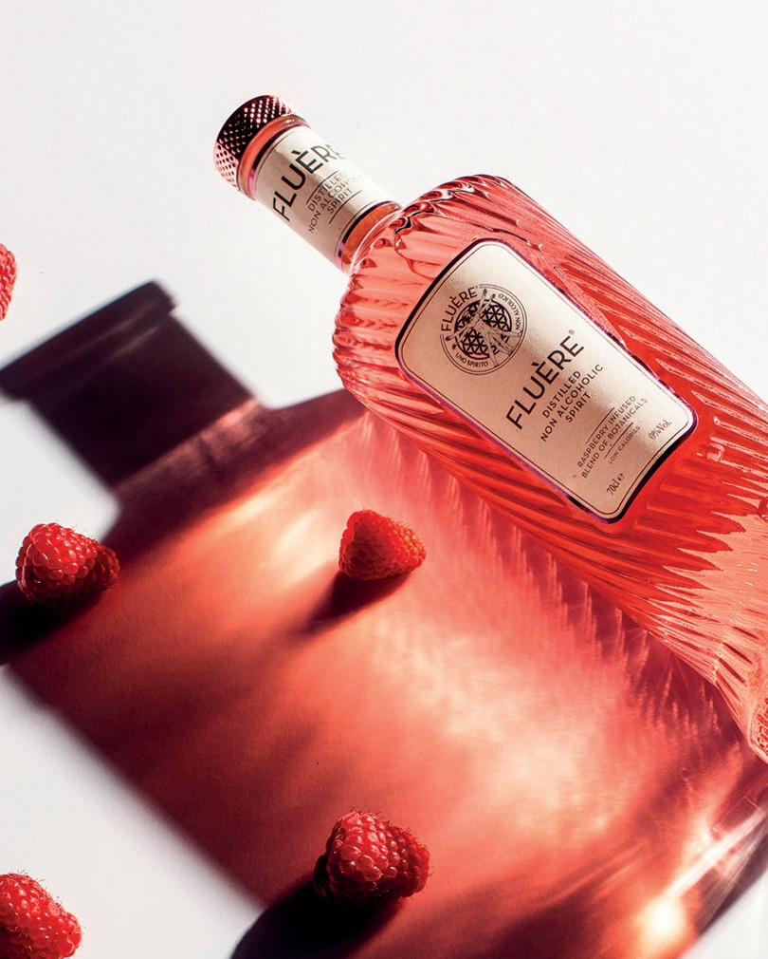
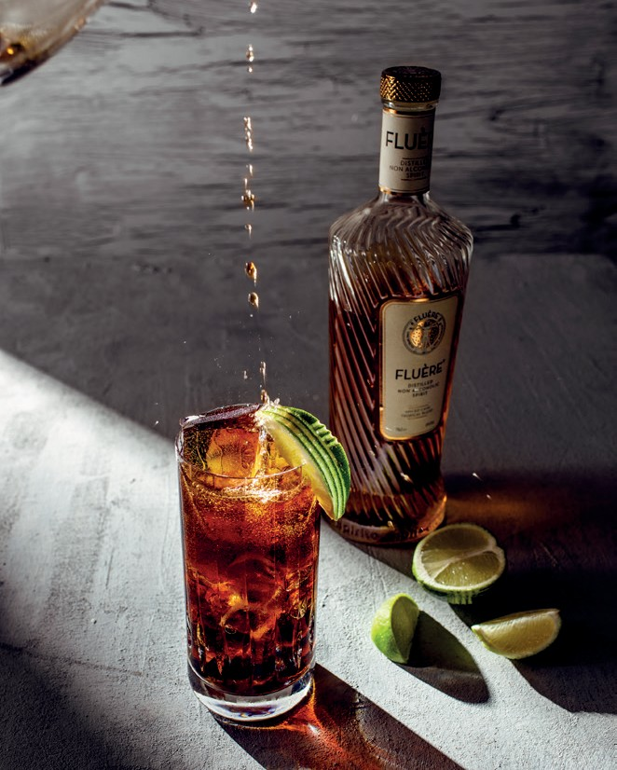
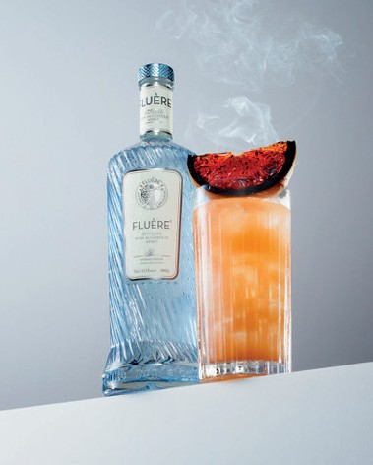
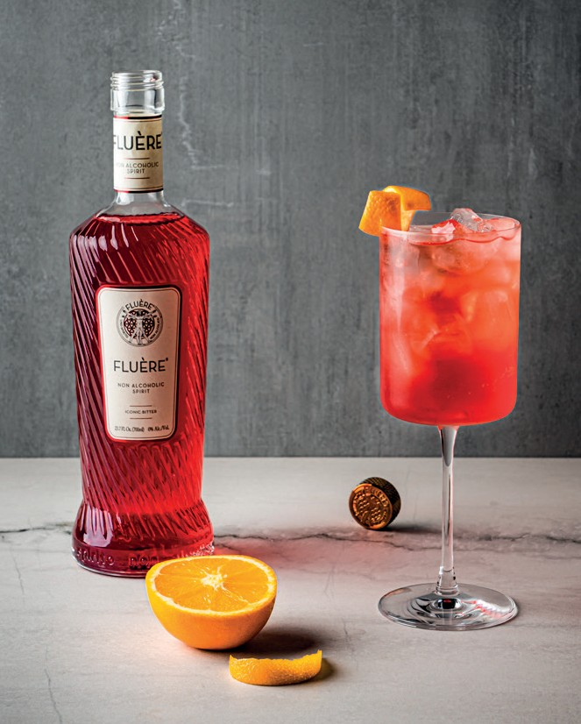
FLUÈRE
NON ALCOHOLIC SPIRIT RANGE
Offering the most attractive and adventurous no & lower alcoholic cocktails in the market

Slide 3
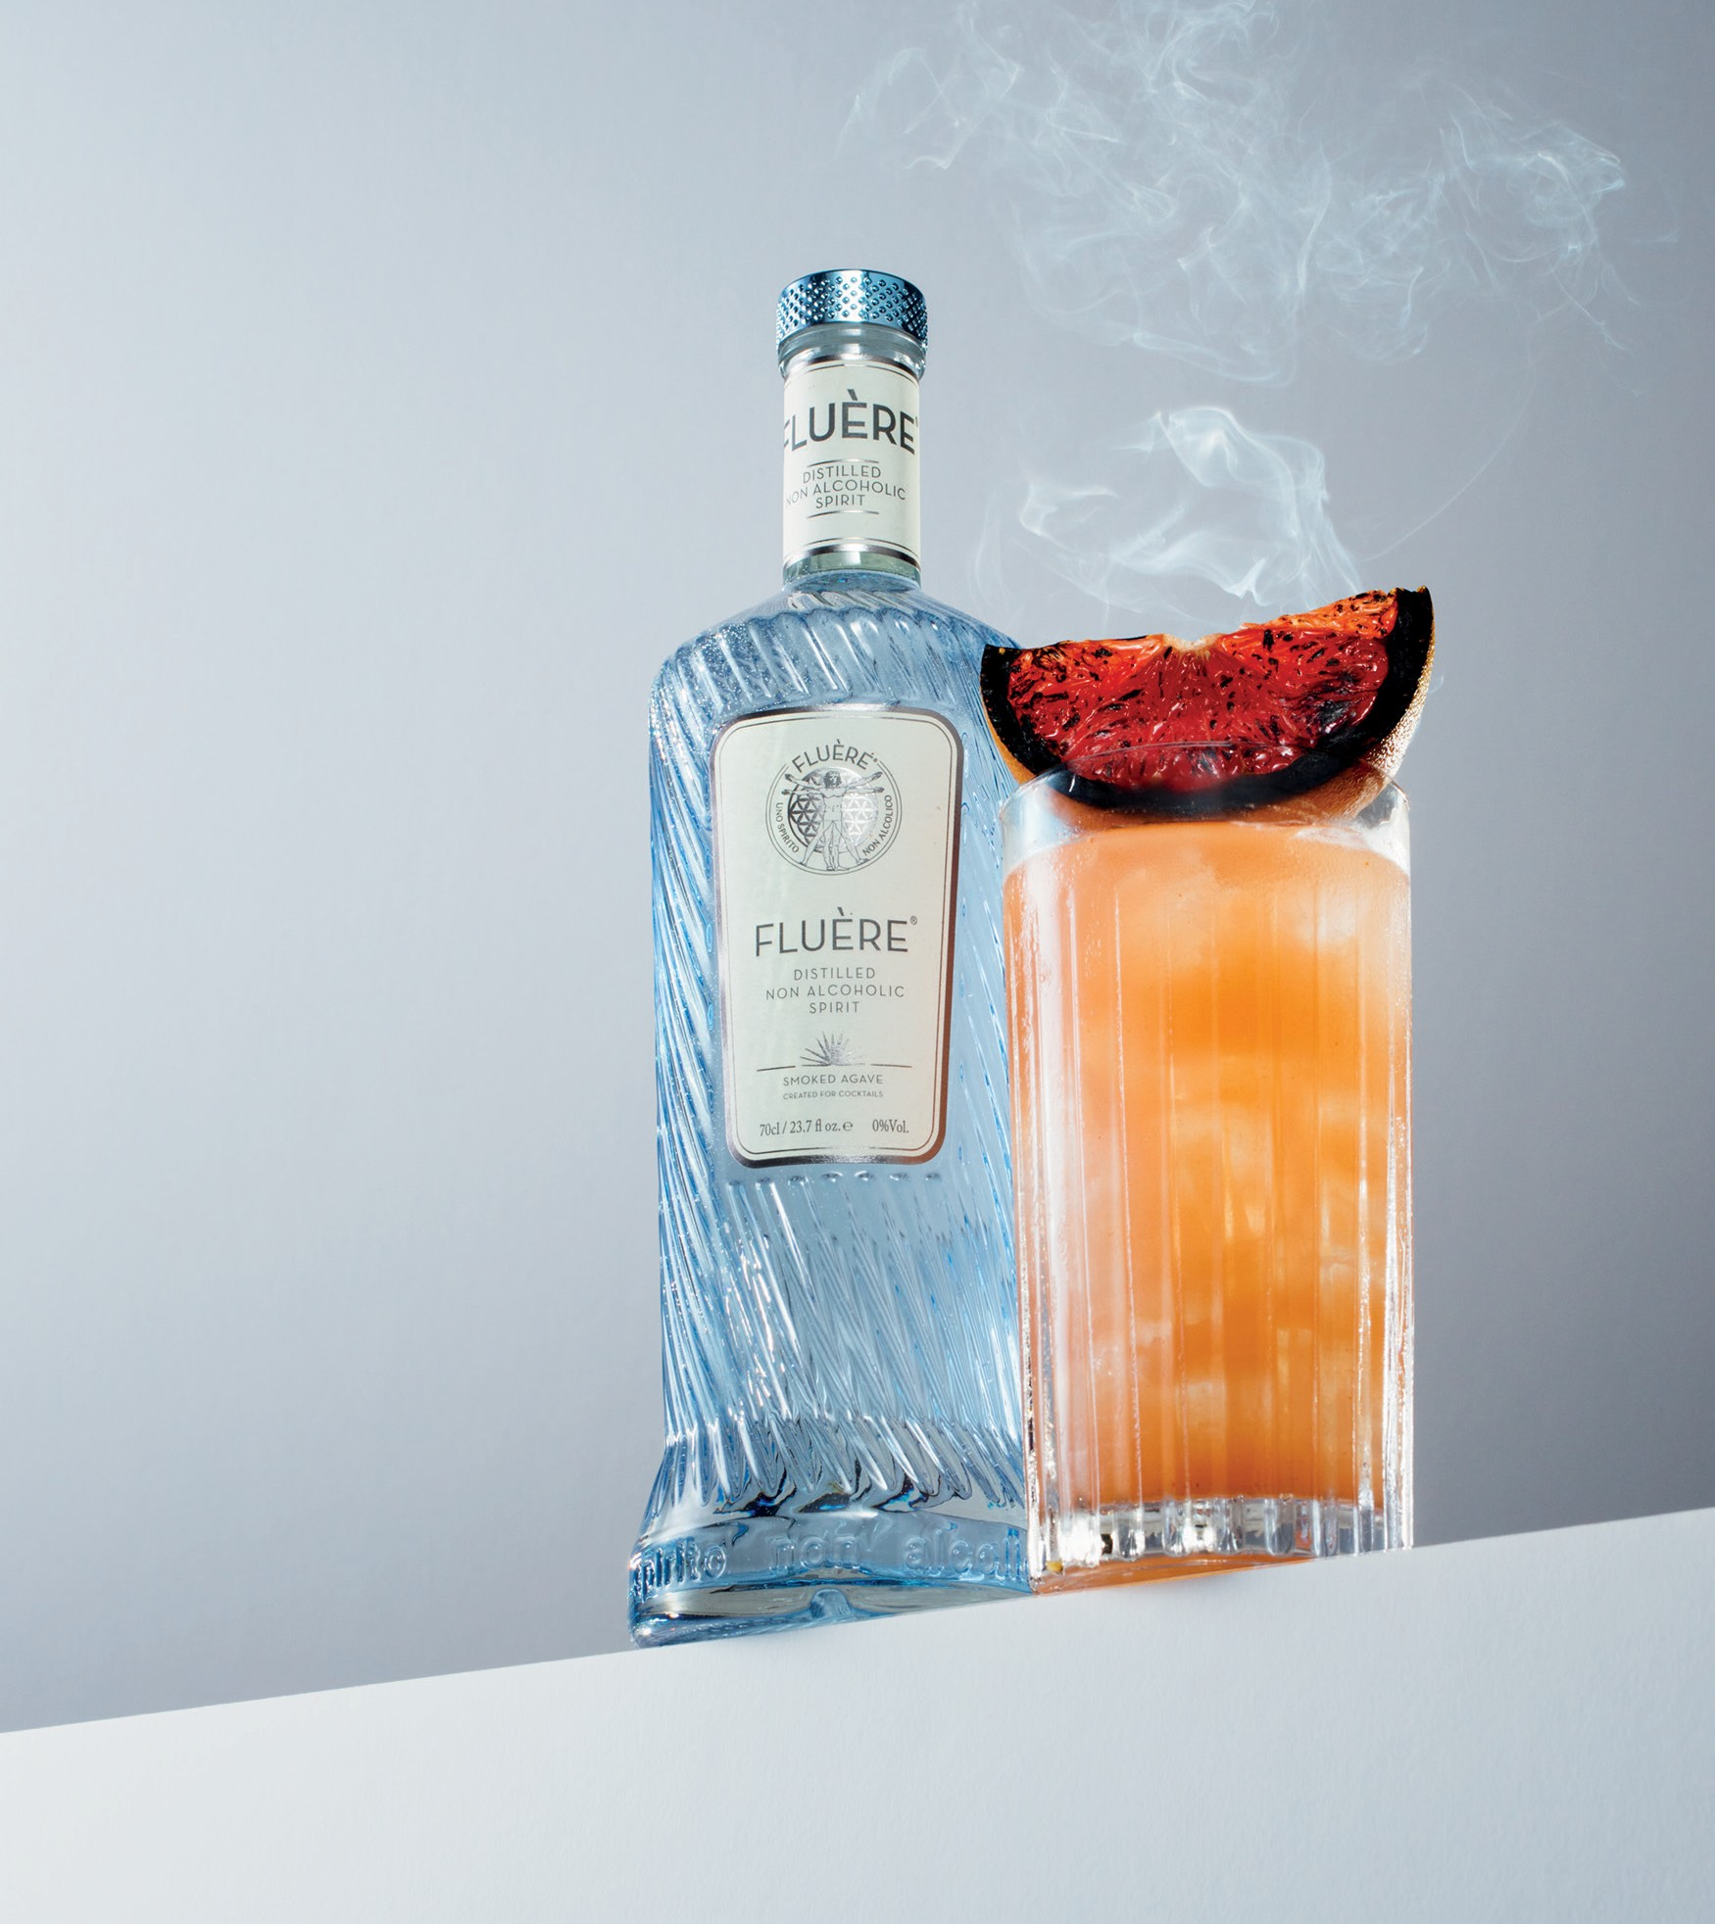

NON–ALCOHOL CONSUMPTION IS ON THE RISE
79%
Of Bartenders agree that non/ lower alcohol products:
can help increase profit margins
by upselling standard soft drinks
  are a great substitution for standard soft/hot drinks
83%
Of Bartenders agree that non/lower alcohol products are versatile and well suited to different cocktail occasions throughout the day
75%
Three-quarters of consumers intend to maintain or increase their lower/non alcoholic consumption.
IWSR Non-and_Lower-Alcohol Strategic Study 2021
Non alcoholic is forecast to see its volumes increase by 25% between 2022 and 2026
(IWSR 2023)
Bron: Nielseniq november 2022

Slide 4
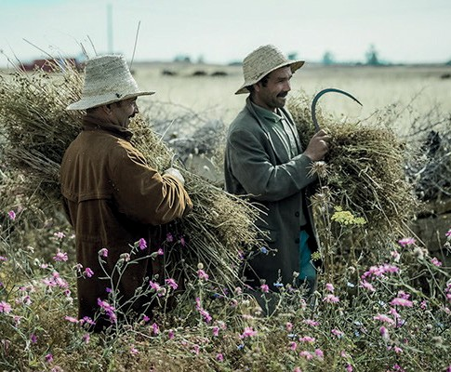
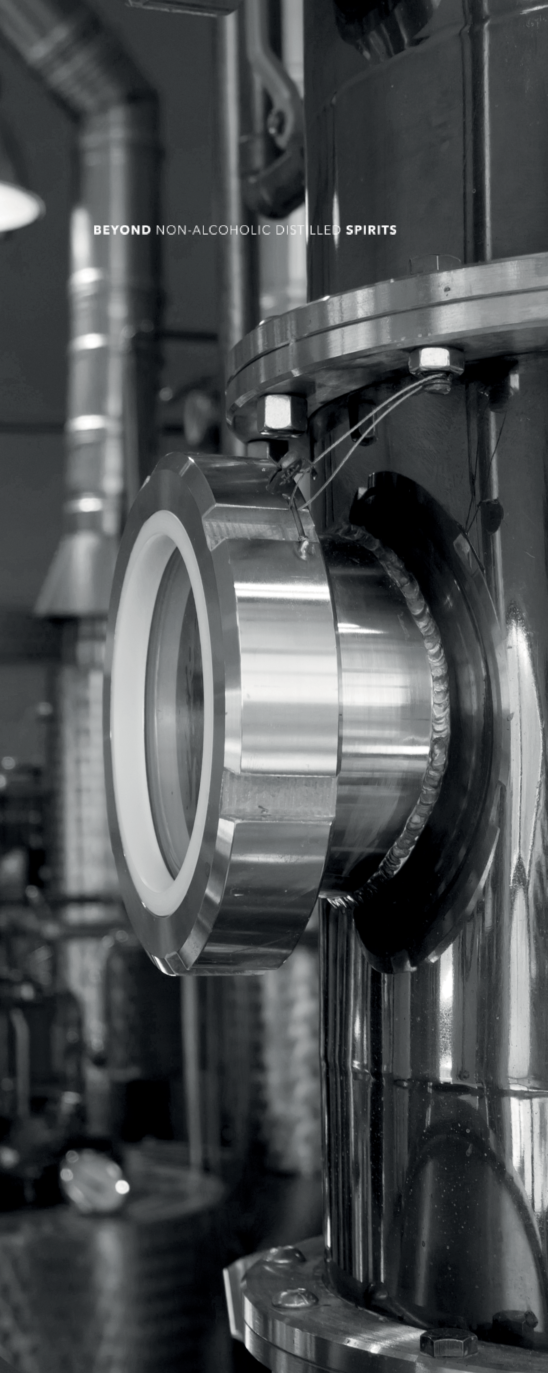
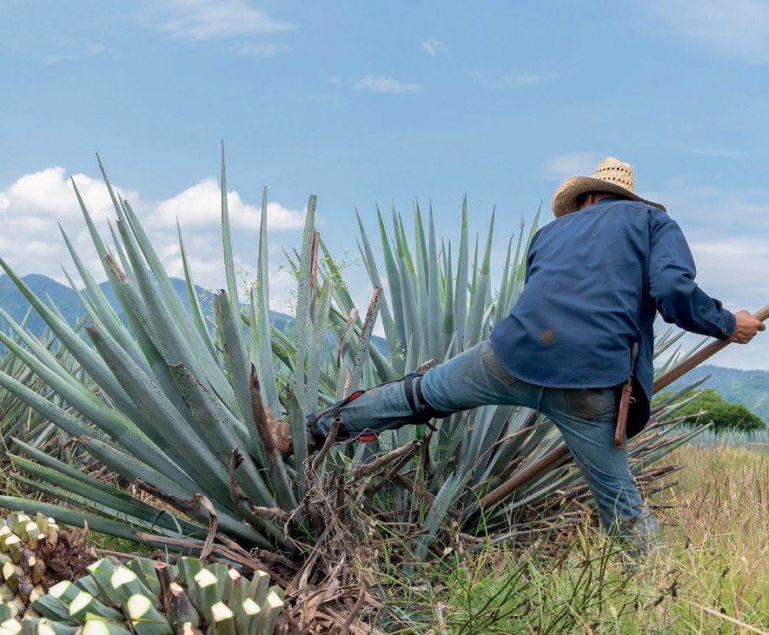
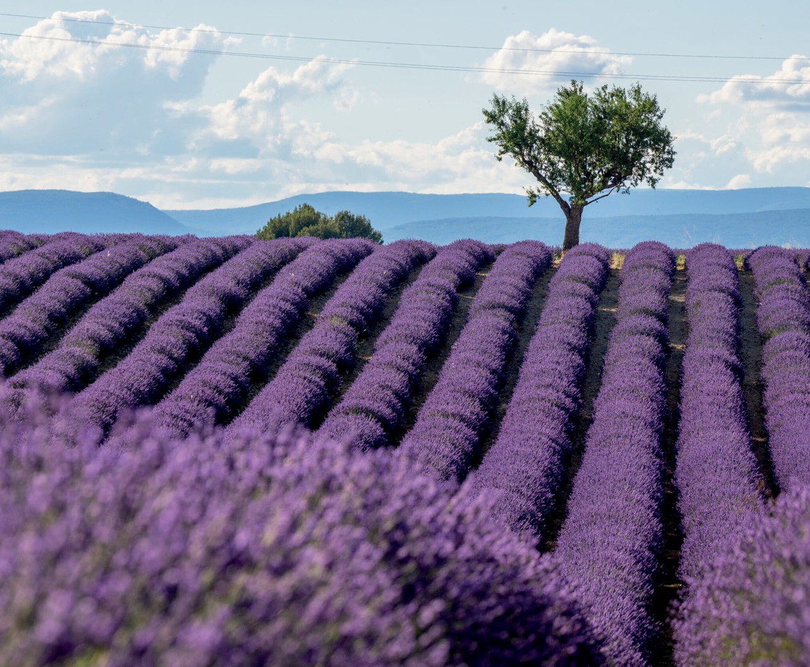
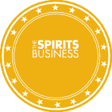
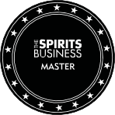
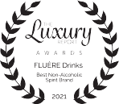

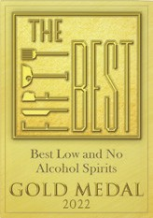
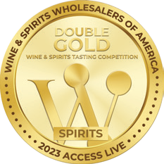
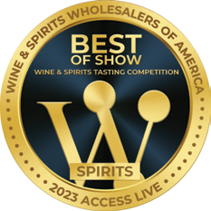

BEST-IN-CLASS UNIQUE TASTE
Fluère has a unique complex, mature taste and unique after bite.
Made with the same complex distilling techniques used for spirits & high-end perfume houses.
  Superior production methods; hydrosteam distillation
  High quality ingredients/botanicals; all individually distilled.
Highly regarded by both industry and consumers
  The premium award winning non-alcoholic range.
The most stable Non-Alcoholic liquid out there as tunnel pasteurization is applied after bottling. 24 months shelf life.
O
W
&
N
O
M
A
O
W
&
N
O
M
A
L
S
L
S
E
T
E
T
H
E
H
E
T
R
T
R
GLOBAL
LOW & NO MASTERS
GOLD 2023
S
S
GOLD 2021
2021

Slide 5
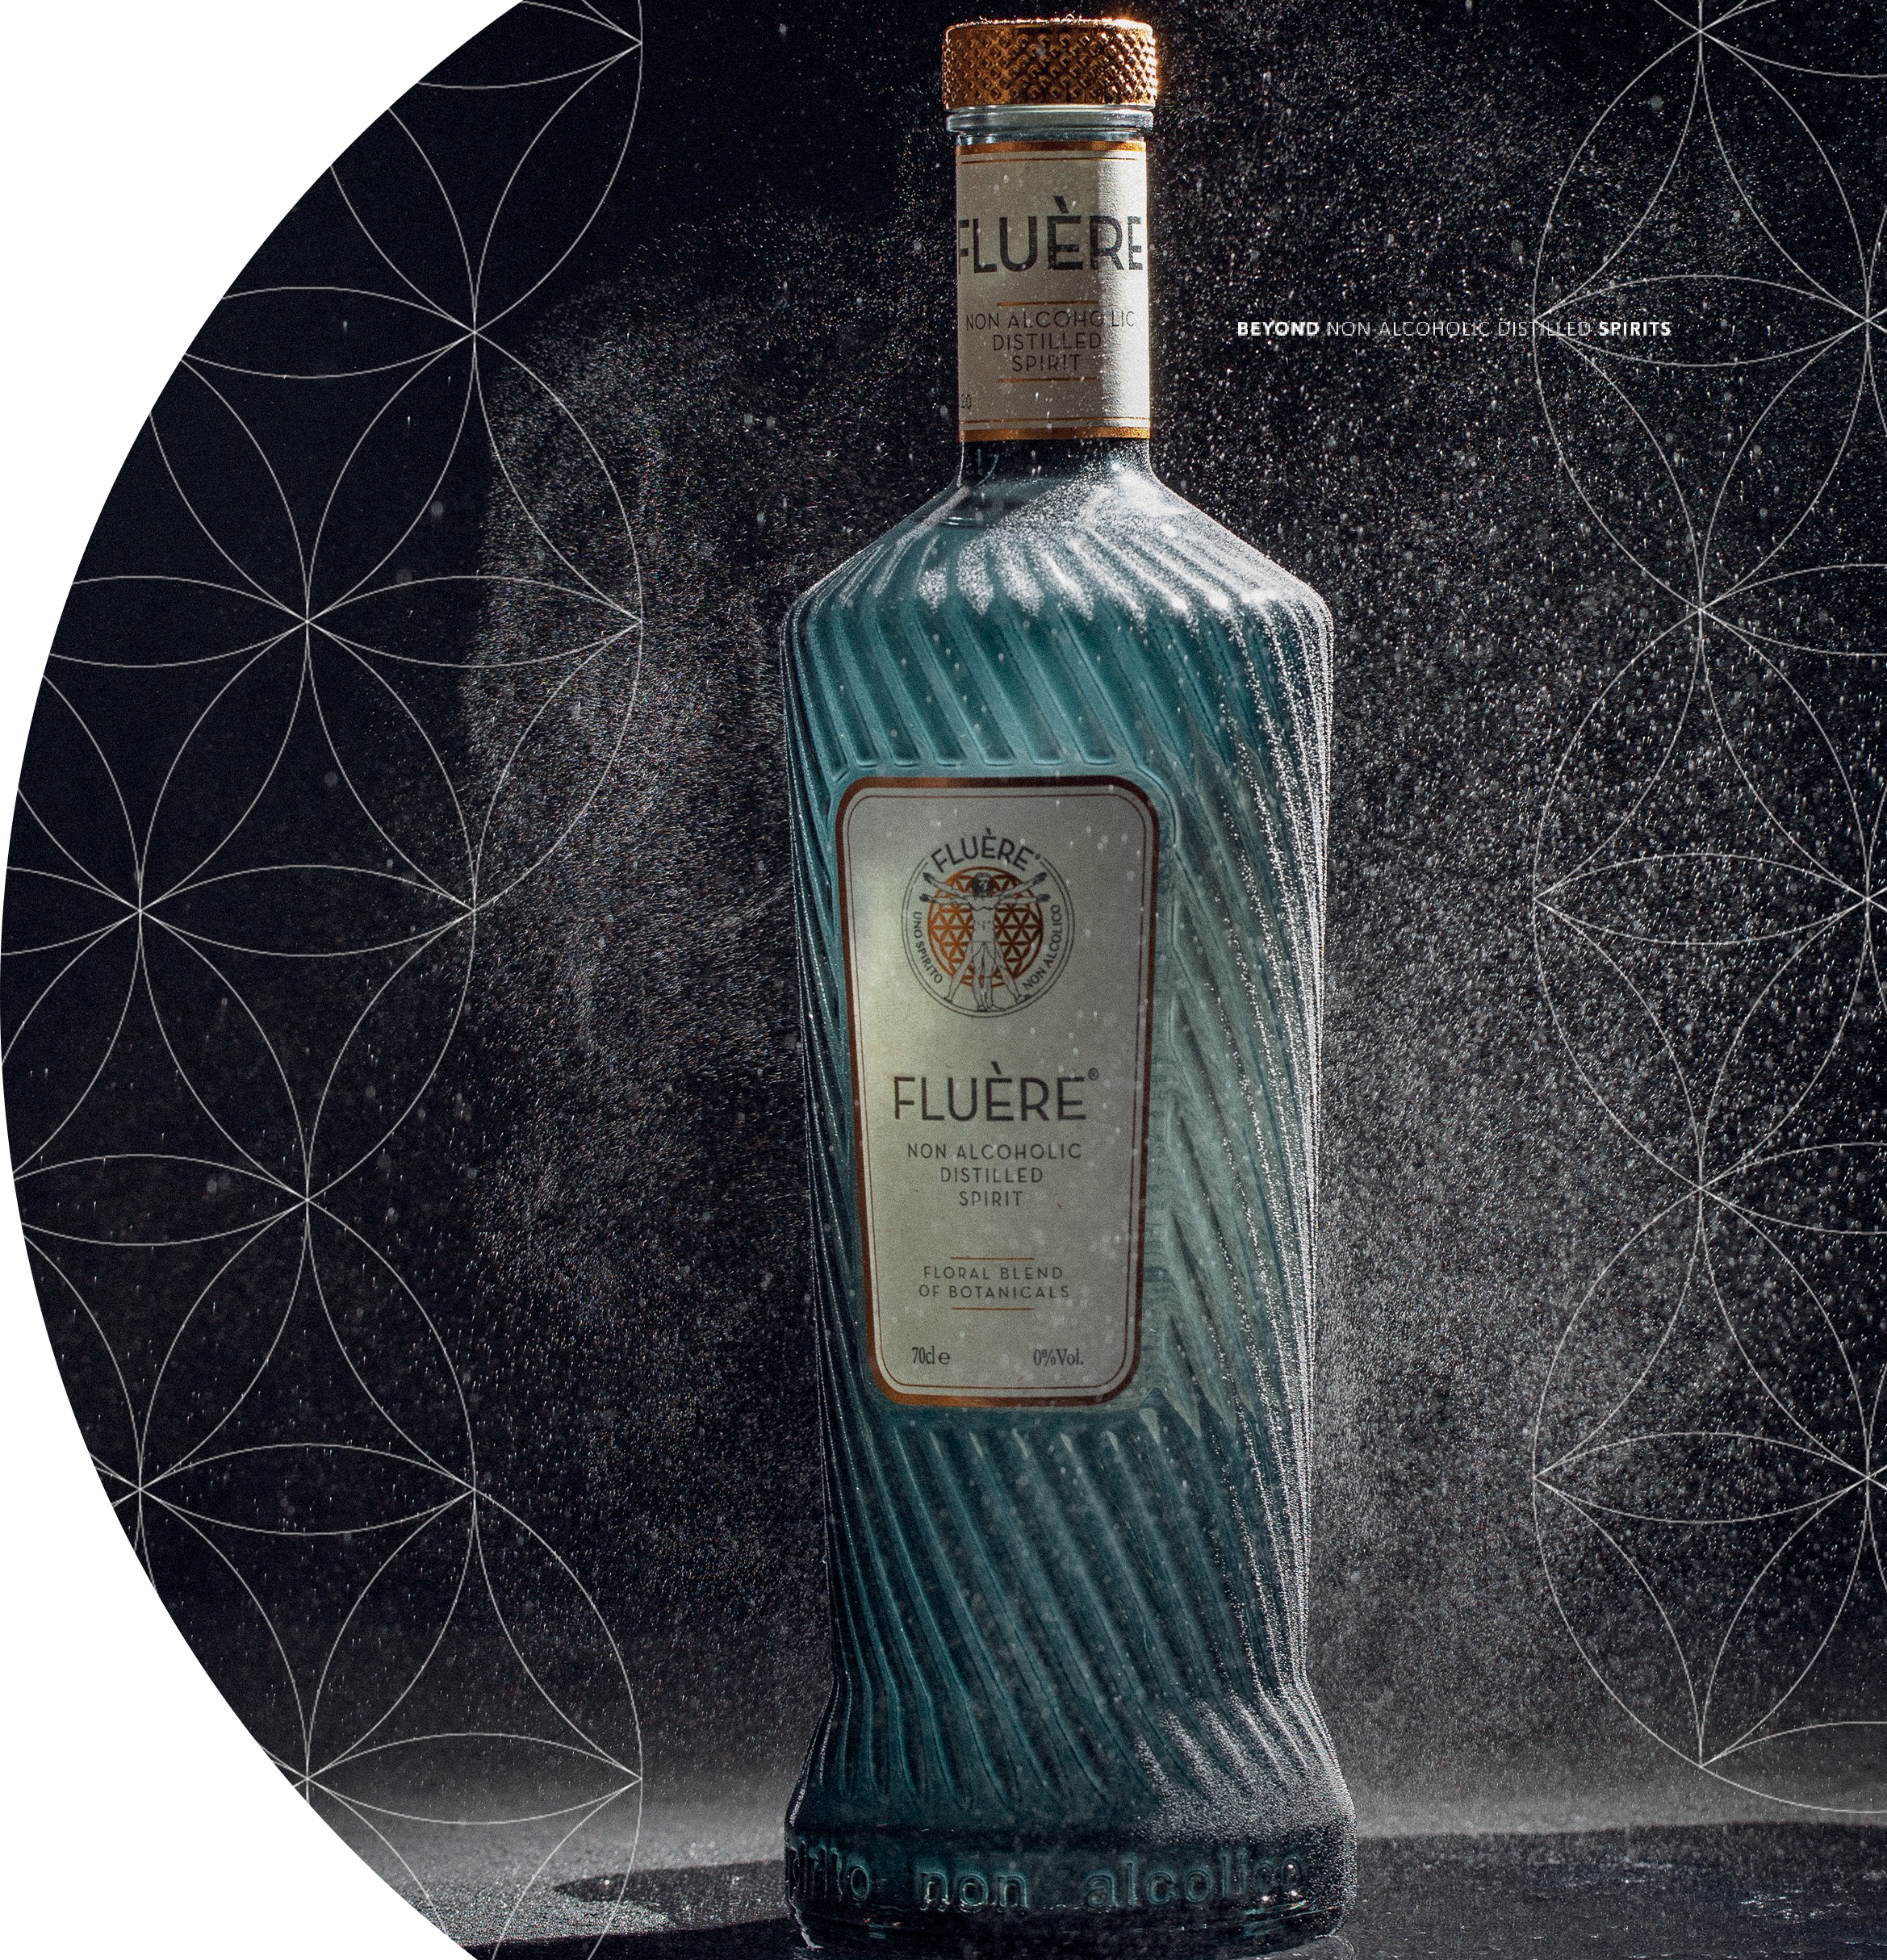
OUTSTANDING DESIGN
Bottle stand out
  A true hero for your back bar
  Directly appealing to bartending community
Fluère meaning
  Latin Word for ‘Flow/Flowing’.
  Flow represented in bottle & brand design (lines representing harmonious flow
of a tranquil river)
  The concept of ‘flow’ is fundamental to Fluère, that feeling of purpose, energy, ease of movement physically and mentally.

Slide 6
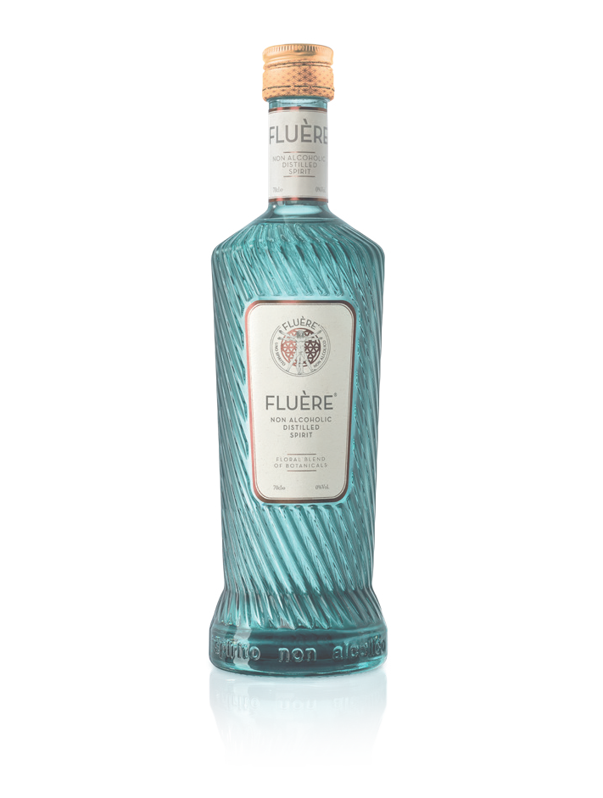
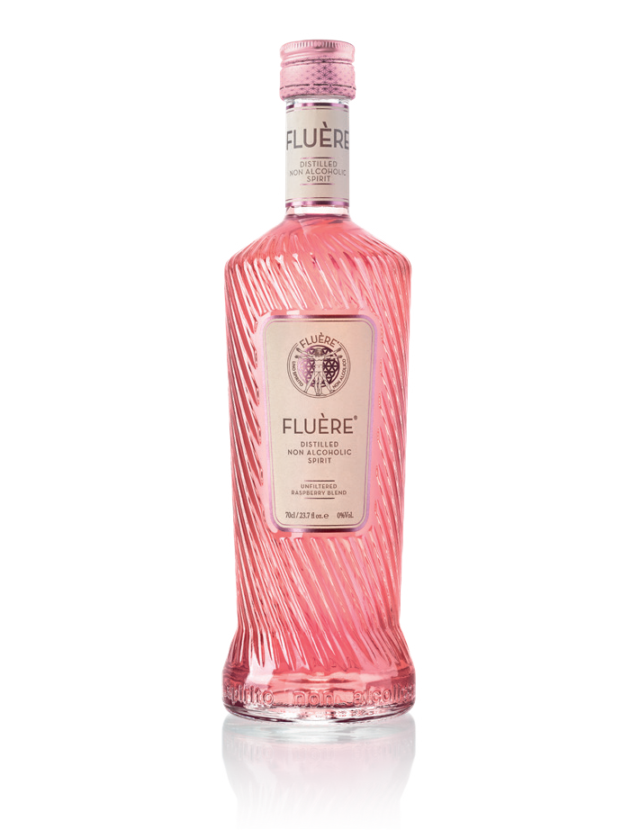
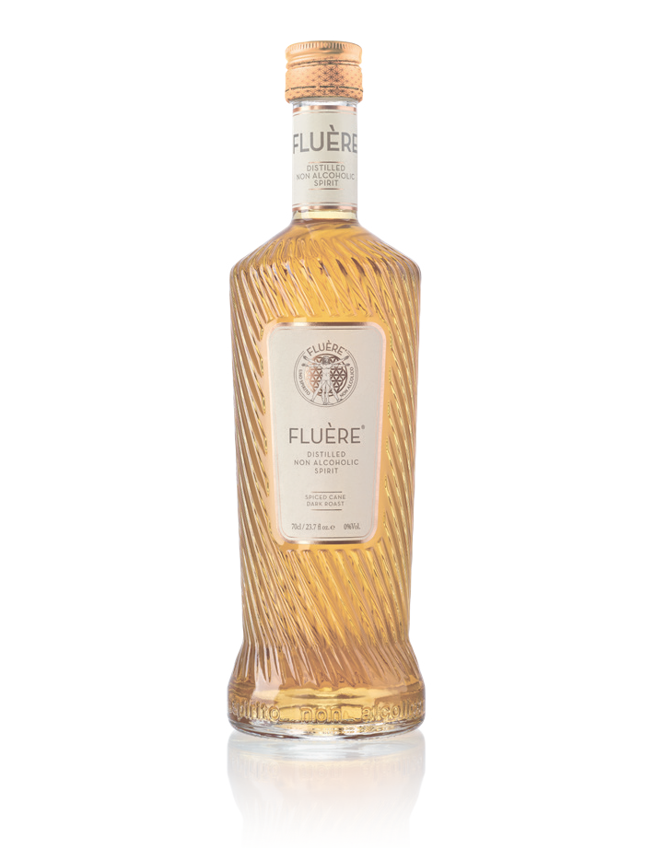
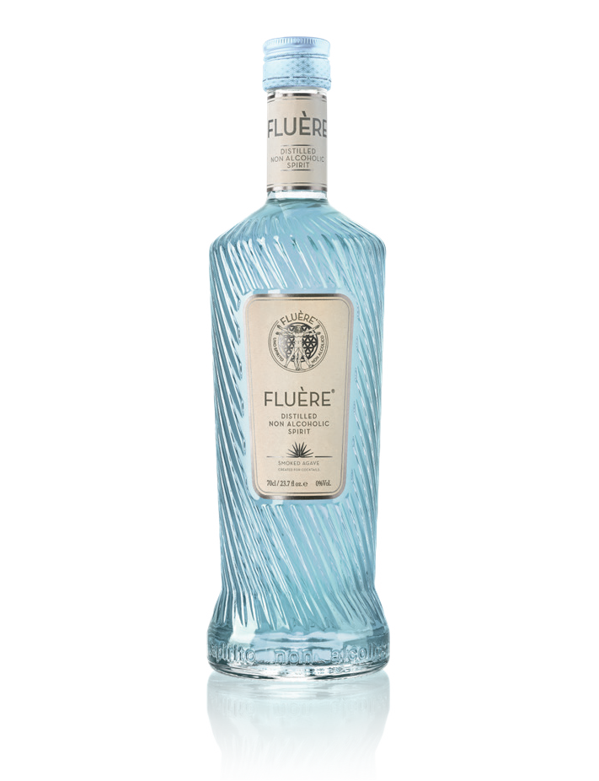
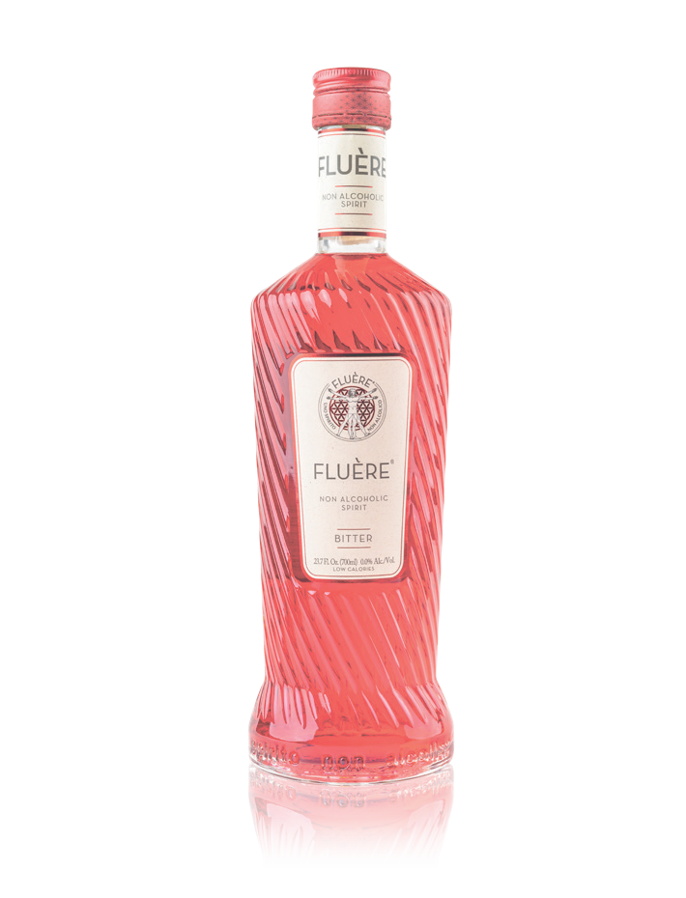

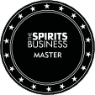
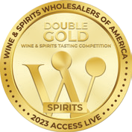
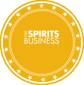
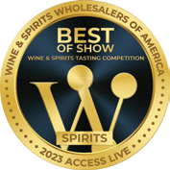
NON ALCOHOLIC COCKTAIL INGREDIENTS
O
W
&
N
O
M
A
O
W
&
N
O
M
A
L
S
L
S
E
T
E
T
H
E
H
E
T
R
T
R
2021
S
GOLD 2021
S
Fluère Original blend
Floral * Crisp * Citrus
Coriander seed & lime peel give a bright and zesty character to the nose whilst the lavender and Juniper add herbal & floral notes.
Fluère Raspbery blend
Fresh * Raspberry * Smooth
Floral, piney notes from the Juniper and a zing of citrus from Lime peel,
combined with the sweet- ness of the fresh raspberry.
Fluère Spiced Cane
Rich * Spiced Cane * Complex
Notes of chocolate and coffee on the nose and a sweet, complex, earthy palate. The richness of the dominican sugar cane mixes with hints of tonka bean and spice.
Fluère Smoked Agave
Smokey * Agave * Earthy
Characteristic vegetal sweetness of agave with a hint of black pepper. Smoked hickory wood to give that smokey, earthy richness that goes with it.
Fluère Bitter
Zesty * Bitter Sweet * Herbal
Herbaceous quinine bitterness balanced with syrupy sweetness flavored with orange zest. Long lingering quinine, zesty orange and orange bitterness.
- Gin alternative -
- Pink Gin alternative -
- Rum alternative -
- Mezcal alternative -
- Bitter alternative -

Slide 7
FLUÈRE BRAND

Slide 8
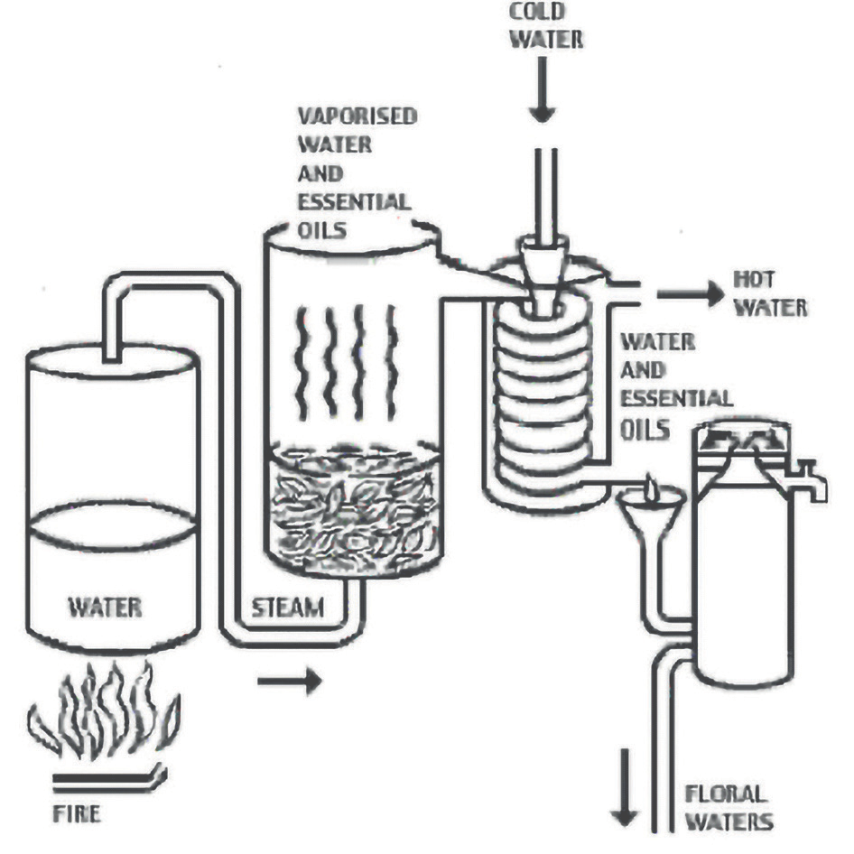
HOW FLUÈRE IS MADE DETAILED
Fluère contains only the best ingredients and finest botanicals.
Sugar cane molasses from the Dominican Republic .
Fresh Agave Salmiana juice from Mexico.
This process where steam is used to gently open-up botanicals and break down cell walls is to release aroma and flavor compounds at very low ABV.
Blended by master distillers in the Netherlands to Ensure aroma and flavor consistency throughout our products.
Our bottle unit has BRC AA grade certification and we are unique by using tunnel pasteurization.

Slide 9
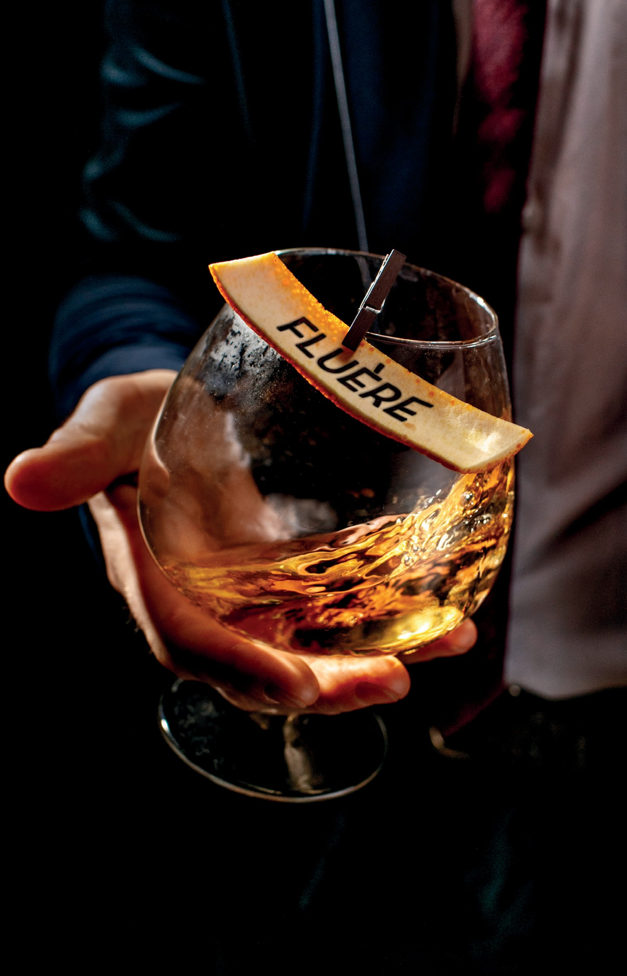
BRAND VALUES
At Fluère we try to Live by Our 4 Brand Values Every Day. The Values Reflect What we Believe in. Not Only for our Products and our Brand but for the World and Everyone on it!
Mindful
Fluère is in Control, Conscious and Sensible
Cosmopolitan
Fluère is Balanced, Educated and Innovative
Intriguing
Fluère is Fascinating and Interesting
Adventurous
Fluère is Entrepreneurial, Fashionable and Inspiring

Slide 10

BRAND VALUES
Fluère is Beyond What You’re Drinking – It’s About Enjoying the Moment and Making Your Life Really Yours.
Cocktail Experience without the Alcohol
Empowers my Healthy Lifestyle
Luxurious Look & Feel
Makes Me Feel in the Know
Complex Botanical Flavors
Reflects my Mature Taste
Adventurous & Balanced Palette
Gives me a Festive Feeling

Slide 11
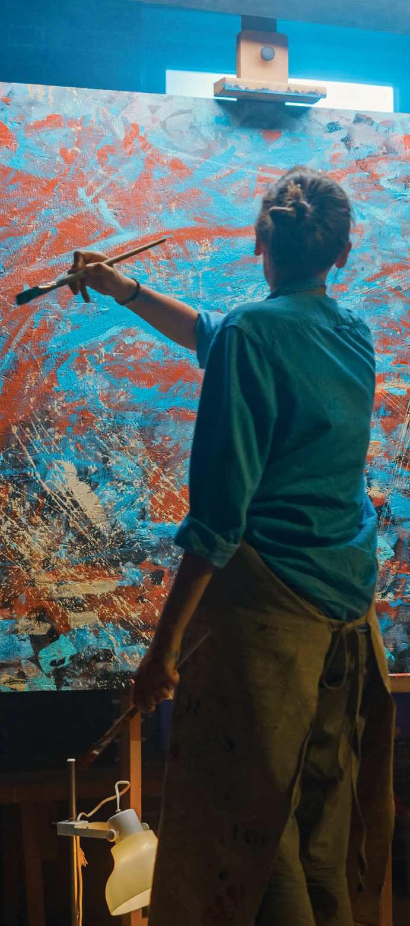

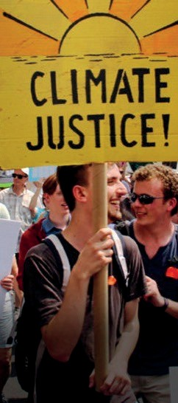
TARGET AUDIENCE
Targeting an ’Energetic Expressive’ Consumer
The young and conscious at heart, 25-40 years old, above average to higher income.
In search of escapism and optimism, need for fun and entertainment, enjoys going out.
Health conscious and focused on their wellbeing.
Active, experimental, inventive and willing to invest time for DIY fresh cooking, crafting and gardening.
Cultivated and suspicious towards marketing and overpromising brands.
Social, community feeling and encouraging harmony.

Slide 12

HOW
TO DRINK

Slide 13
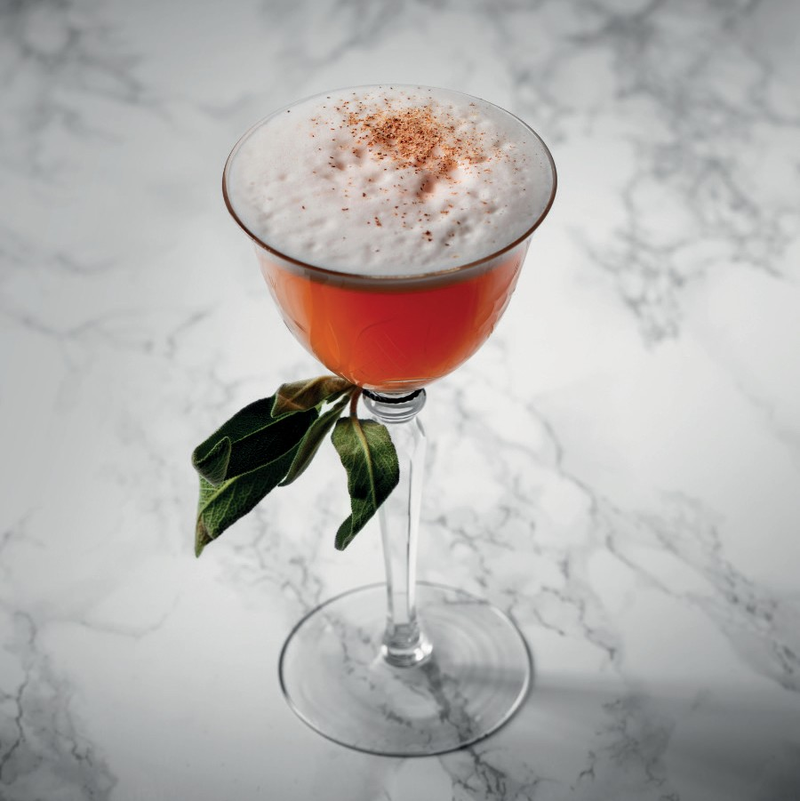
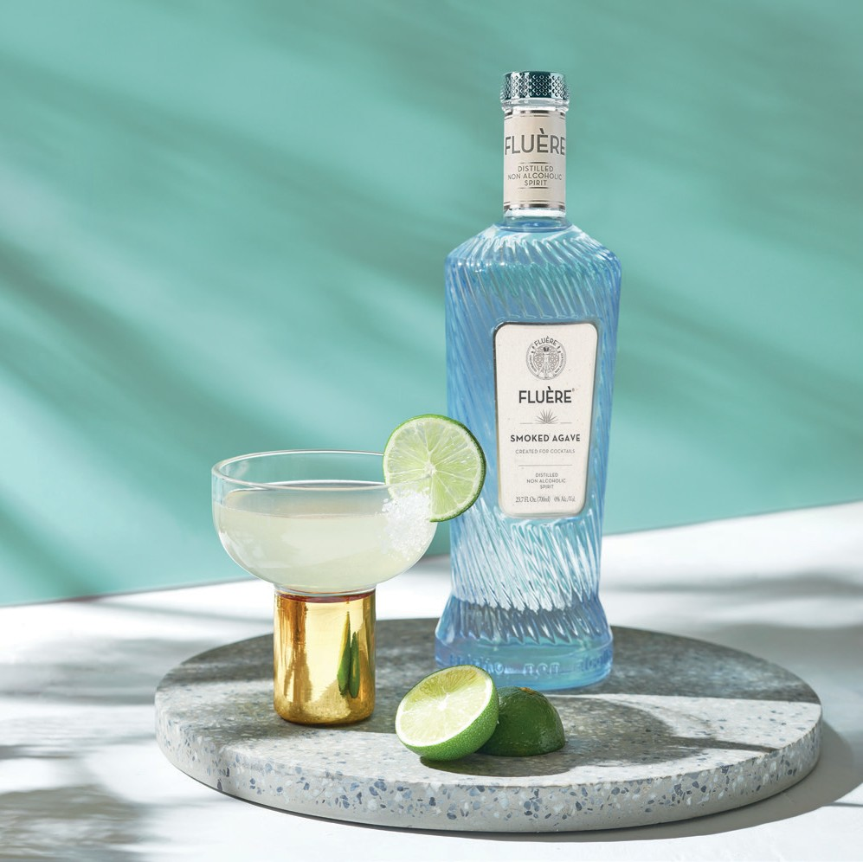
FOCUS ON
2 SEGMENTS
Non Alcoholic cocktails
Cocktails with lower alcohol

Slide 14
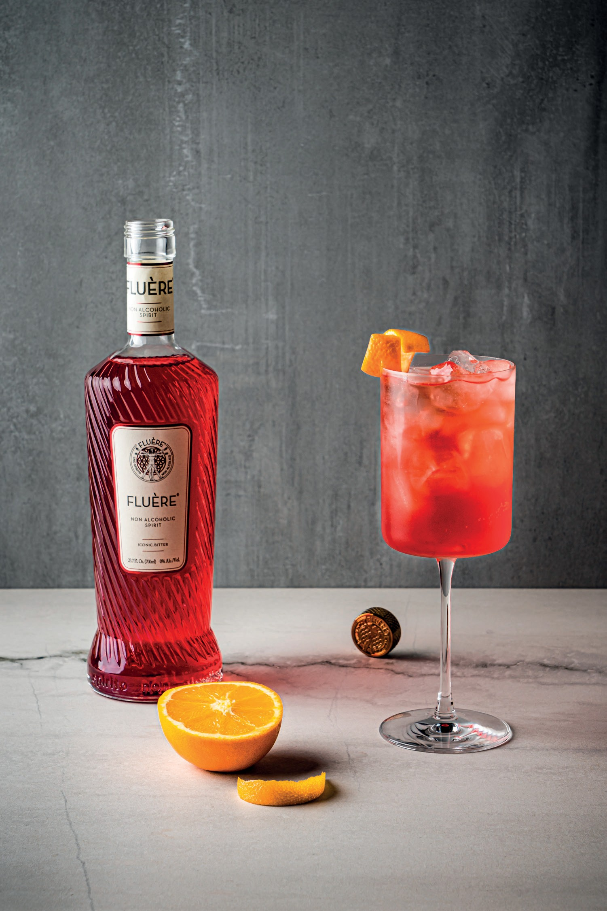
DYNAMICS
NON ALCOHOLIC COCKTAILS
Consumers choosing to live a more balanced lifestyle; the ’Sober Curious’ movement.
Especially (Young) millennials, Gen Z group are getting more conscious and demanding regarding the type of cocktails they’re willing to drink.
2-5 brands within non alcoholic segment is being stocked
Specific ‘Non Alcoholic cocktail segment’ (often called ‘mocktails’) almost on
all cocktail menu’s in on trade environment and well respected.
The Fluère complete range enables crafting exciting non alcoholic variants
of well-known cocktails without compromising in flavour.
* Nielsen, November 2022

Slide 15
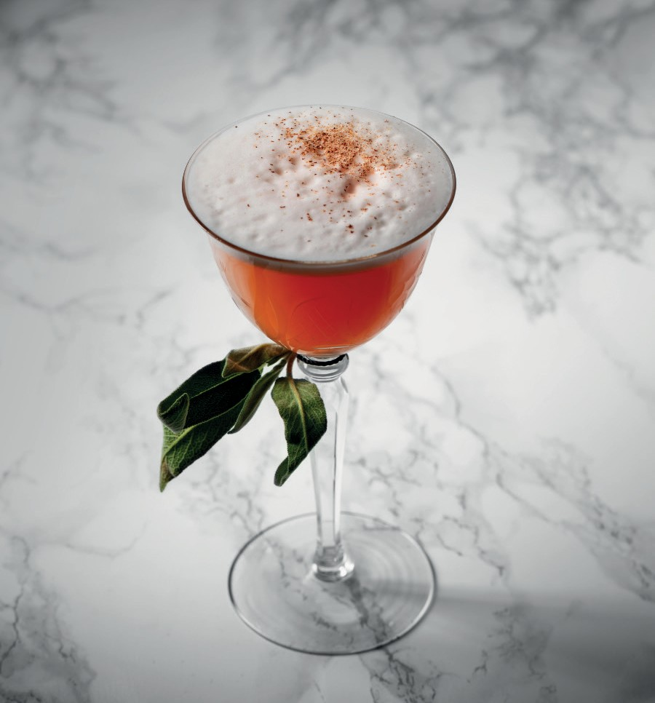
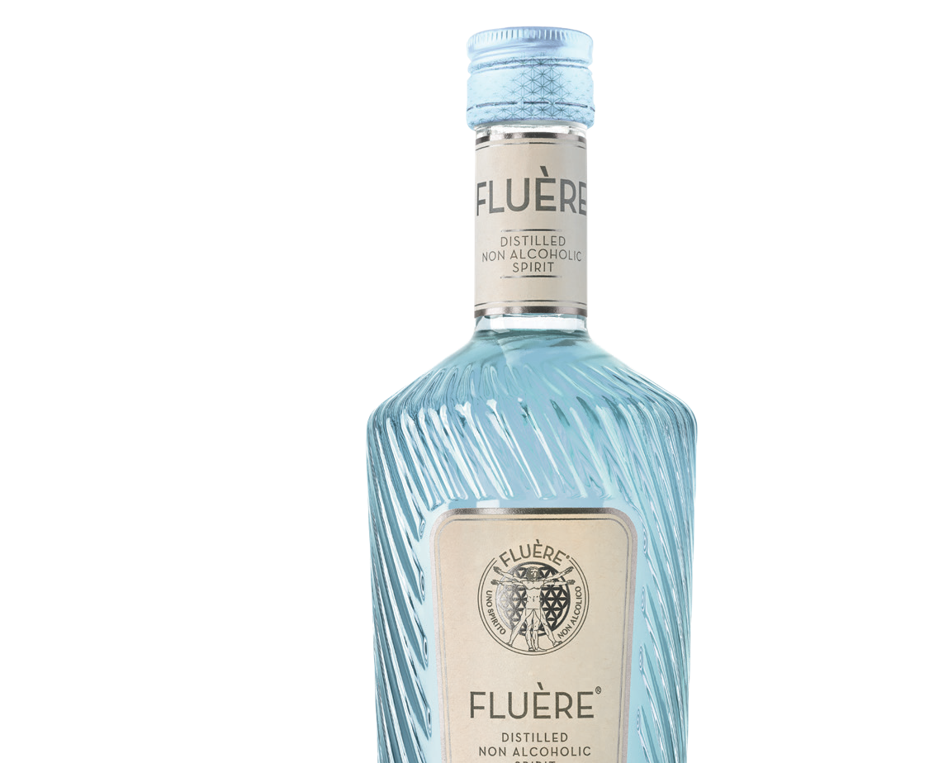
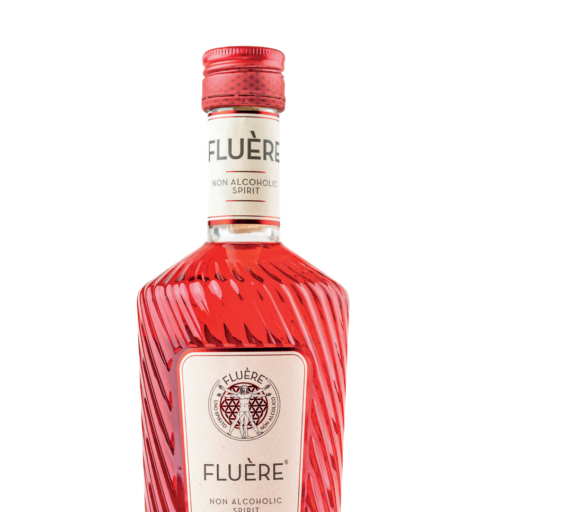
FLUÈRE’S FIRST CHOICE
NON ALCOHOLIC COCKTAILS
The Fluère Paper Train; a non alcoholic variant of the ‘Paper Plane’ with
both Fluère Smoked Agave and Fluère Bitter.
The original Paper Plane is rapidly growing in popularity and entering
the top 20 of world’s top 100 cocktails* (*Difford’s Guide 2022).
Fluère is able to add the smoked mezcal flavour without alcohol and without compromising in flavour. This against
a lower cost price vs mezcal, which makes it also interesting for a bar owner.
A must try non alcoholic cocktail.
Always present Fluère in a cocktail
1.5 oz Fluère Smoked Agave 0.75 oz Fluère Bitter
0.5 oz fresh lime juice
Egg white (or replacement) Dash sugar syrup

Slide 16
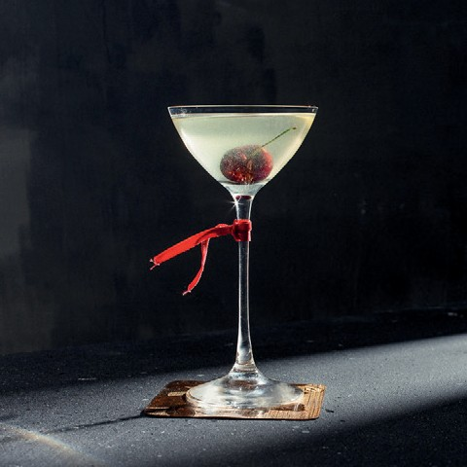
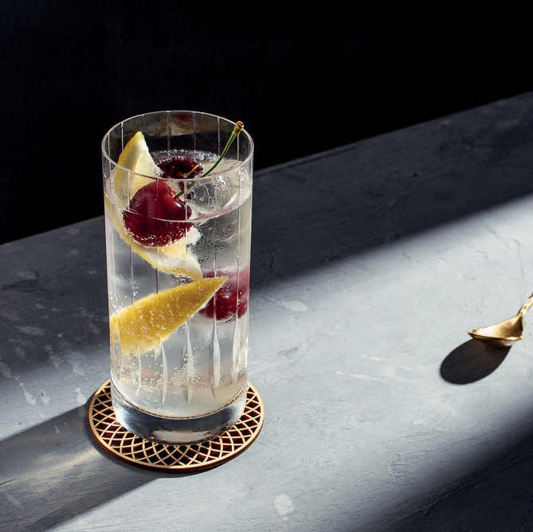
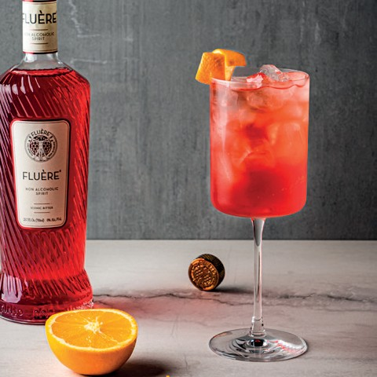
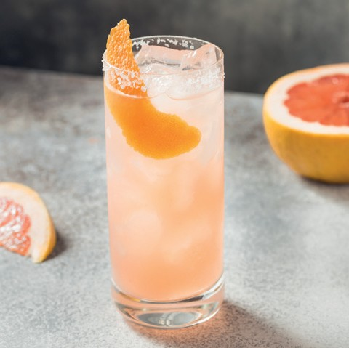
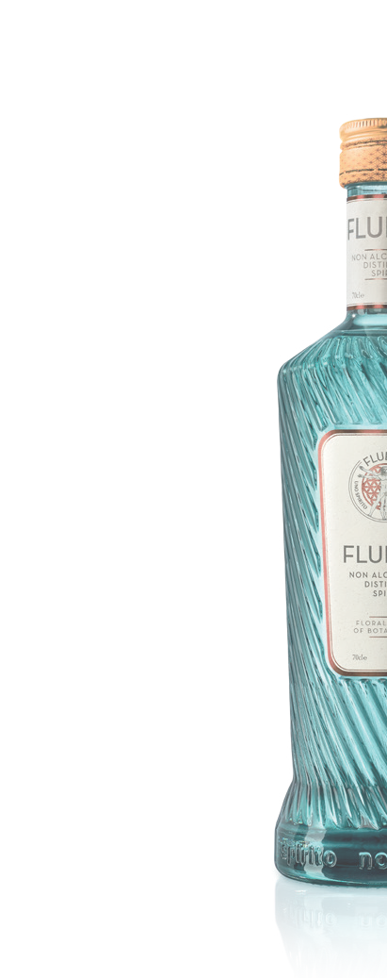
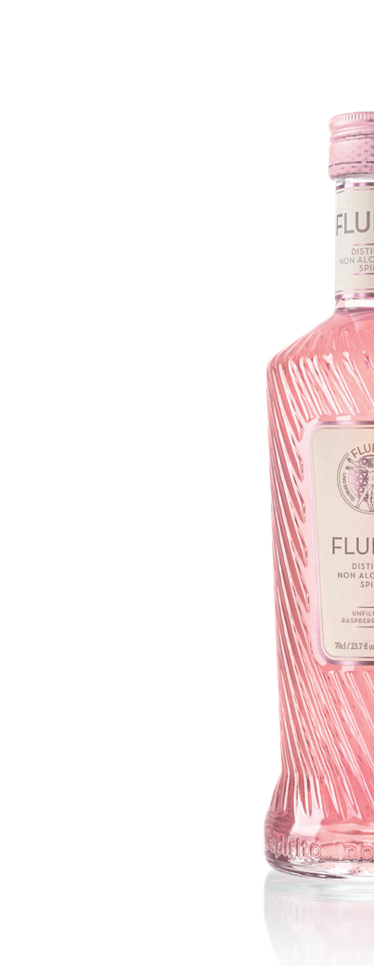
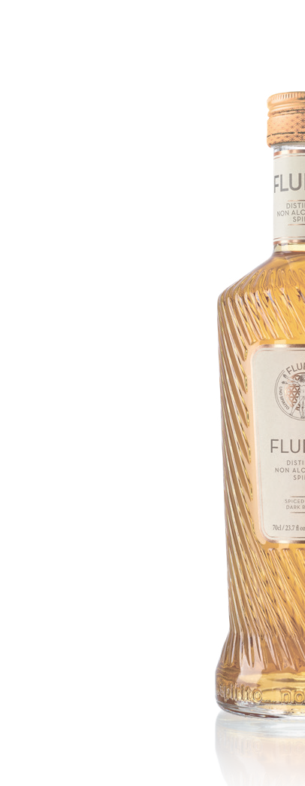
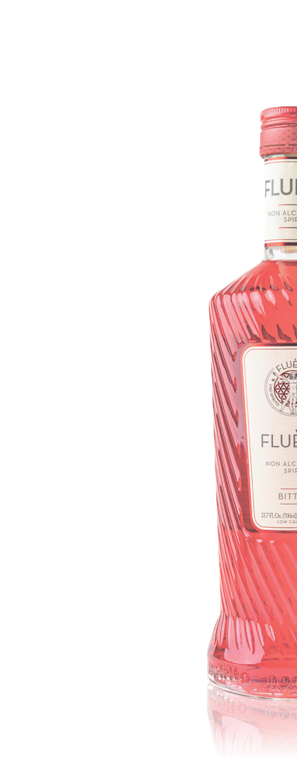
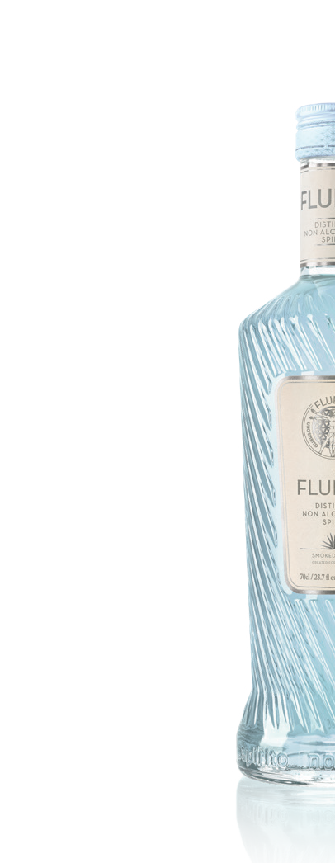
SIGNATURE NON ALCOHOLIC COCKTAILS BY SPIRIT
Fluère Gimlet
Fluère Collins
Fluère Mule
Fluère Bitter Soda
Fluère Paloma
2 oz Fluère Original
0.75 oz Lime juice
0.75 oz simple syrup
Garnish with a maraschino cherry placed in
the bottom of the glass.
2 oz Fluère Raspberry
1 oz Lemon juice
0.75 oz simple syrup
Soda Water
Garnish with lemon
wedge and maraschino
cherry
2 oz Fluère Spiced Cane
5 oz ginger beer
Squeeze of lime
2 oz Fluère Bitter
4 oz Soda water
Garnish with orange zest.
1.5 oz Fluère Smoked Agave
0.5 oz Lime Juice
Topped with Grapefruit Soda
Garnish with a
grapefruit zest.

Slide 17
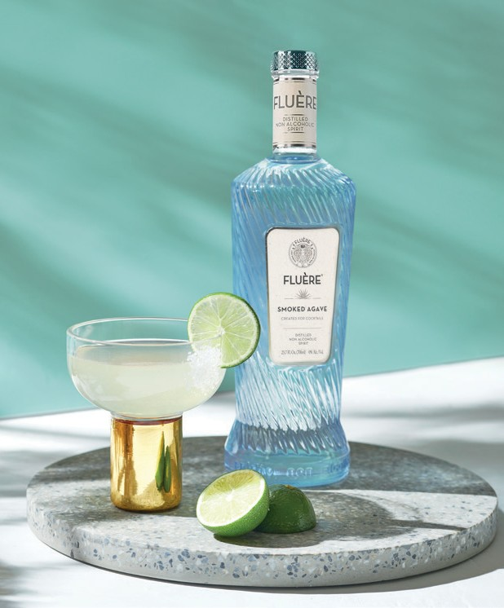
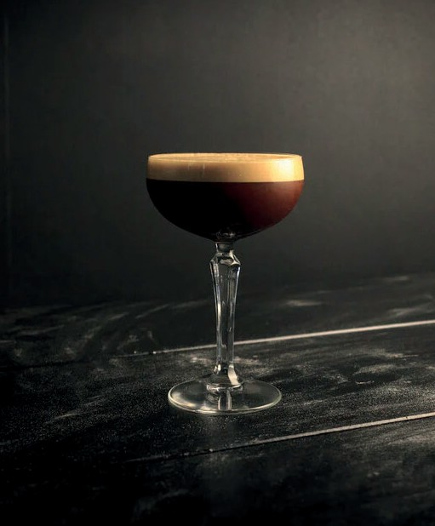
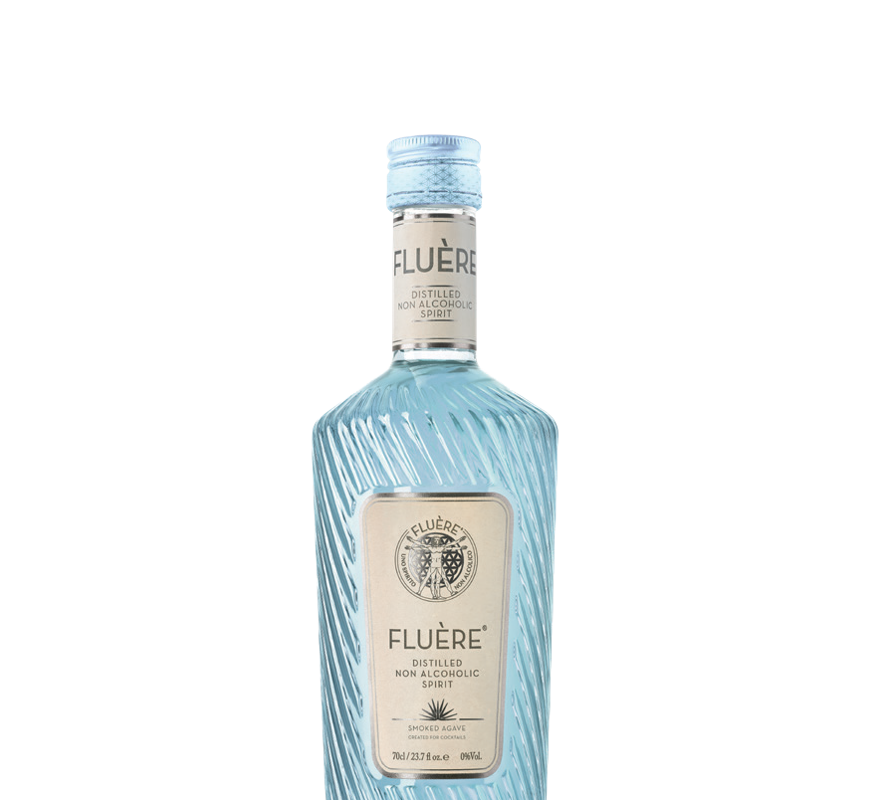



SIGNATURE COCKTAILS WITH LOWER ALCOHOL
Fluère Margarita
Fluère Espresso Martini
from 23,1% to 6,5 % | from 3,3 units to 0,9
60 ml Fluère Smoked Agave 20 ml Lime juice
10 ml Simple syrup
25 ml Bols Triple Sec liqueur. Garnish with a lime wheel
Fluère adds smoothness and subtle smokiness
from 16,5% to 6,4 % | from 3,3 units to 0,9
40 ml Fluère Spiced Cane 30 ml Galliano Espresso 30 ml Espresso
10 ml Simple surup
Garnish with some roasted coffee beans
Fluère Spiced Cane adds an extra flavor dimension with caramel and roasted coffee beans
The Fluère Espresso Martini is a lower alcohol variant of the classic Espresso Martini, replacing the
base spirit vodka for Fluère Spiced Cane. Resulting in an even richer flavour, adding a layer of caramel and cinnamon.
The Original Espresso Martini is a
very popular cocktail within the Global
Cocktail top 5*. (* Difford’s guide 2022).
The Fluère Margarita is a lower alcohol variant of the classic Margarita, replacing the base
spirit Tequila for Fluère Agave. Resulting in a more smooth variant with subtle smokiness.
The Original Margarita is a very popular cocktail within the Global Cocktail top 10*. (* Difford’s guide 2022).

Slide 18
PREFERRED MENU SETUP: ONE COCKTAIL SEGMENT
Cocktails
Galliano Espresso Martini
Galliano Espresso, Vodka, Espresso, sugar syrup. Garnish: Coffee beans.
16,5%
$ 15
Paper train
Fluère Smoked agave, Fluère Bitter, Lime Juice, sugar syrup and Egg White.
0%
Non Alcoholic
$ 14
Very Old Fashioned
Bols barrel aged Genever, Angustura bitter, sugar syrup. Served over large ice cubes.
30%
High Alcohol
$ 17
Fluère Spiced Margarita
Partida Blanco, fresh squeezed lime juice, Agave nectar, topped with premium filtered house water and garnished with a wedge of lime
Be industry leader to support adding ABV behind the cocktail: Cocktail section can be one section (all inclusive) when adding
the ABV level behind the menu.
They all classify as tasty cocktails
and offer a great choice for consumer when it comes to alcohol intake.
23%
$ 17
High Alcohol
6,5%
$ 15
0%
$ 13
Fluère Smoked Agave, lime juice, sugar syrup, Bols Triple sec liquor.
Served chilled with a wedge of lime.
Lower Alcohol
Fluère Smoked Agave, lime juice, sugar syrup, Served chilled with a wedge of lime.
No Alcohol

Slide 19



SELL IN SUMMARY PITCH
Worlds Award Winning Non Alcoholic Spirit range
One stop shop for non alcoholic spirit alternatives.
Unique, sophisticated flavour profile
No comprise in flavour vs alcoholic variant. Always taste Fluère in a cocktail. Outstanding production methods. All botanicals separately distilled. Most stable liquid through pasteurization.
Most attractive, high luxury design
A true hero for you backbar.
’All day cocktail concept’ due to boundless non and lower alcoholic cocktail opportunities. Increase margin and revenue.
Strong signature cocktails
Non Alcoholic ’first choice’ cocktail: The Fluère Paper Train.
Signature cocktails with lower alcohol: Fluère Margarita & Fluère Espresso Martini.

