Slide 1


MEDIA COVERAGE
2024-2025

Slide 2

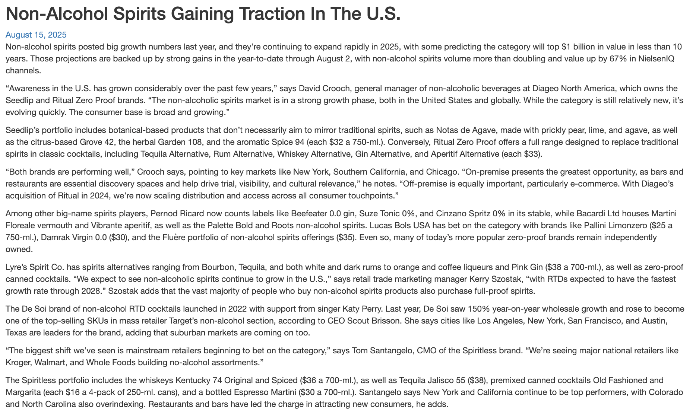
Date: 8/15/2025
Online Visits: 6,909
Click to view article

Slide 3


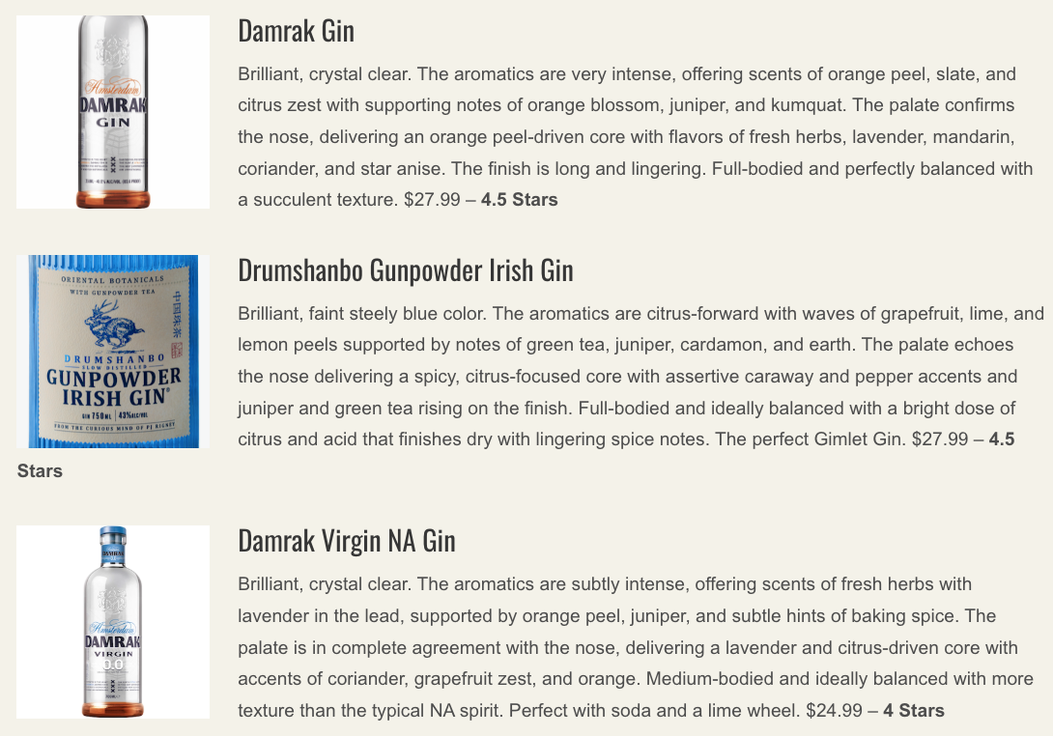

Date: 7/9/2025
Online Visits: 5,000
Click to view article

Slide 4


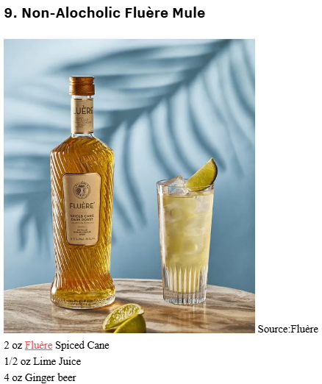
January 14, 2025
Online Visits: 44,579
Click to view article

Slide 5
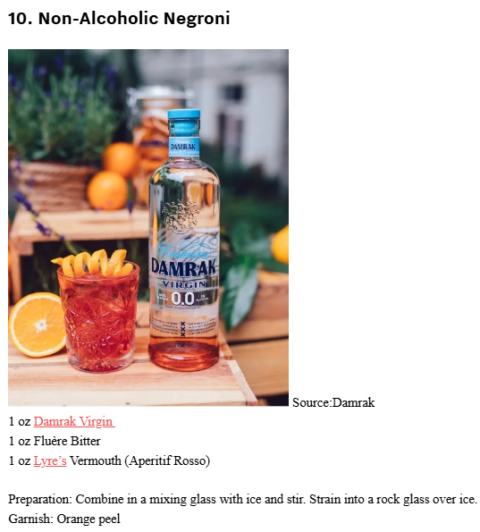

Slide 6
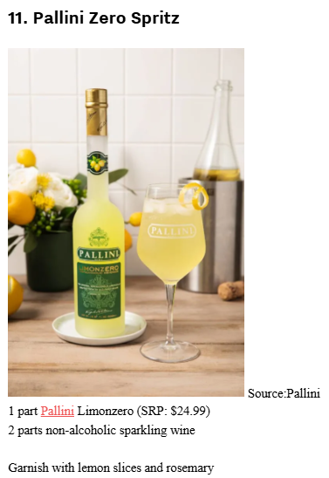

Slide 7

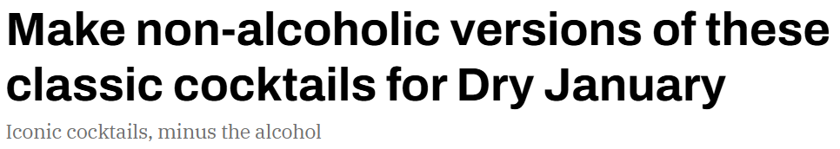
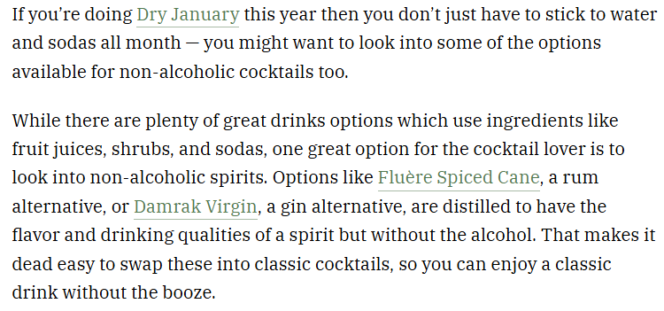

January 8, 2025
Online Visits: 480,560
Click to view article

Slide 8
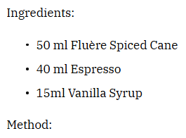



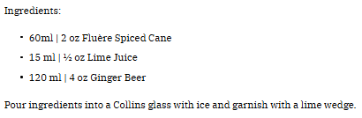

Slide 9

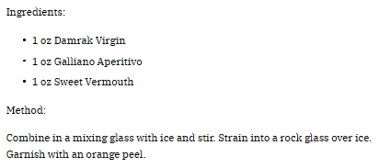

Slide 10

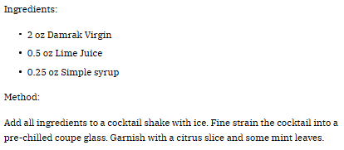

Slide 11


 | January 14, 2025 Online Visits: 5,000 Click to view article
 | January 14, 2025 Online Visits: 20,894 Click to view article
Syndications from Cassius

Slide 12


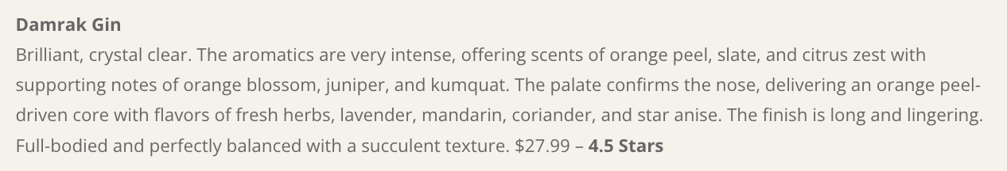
December 18, 2024
Online Views: 5,000
Click to view article

