Slide 1

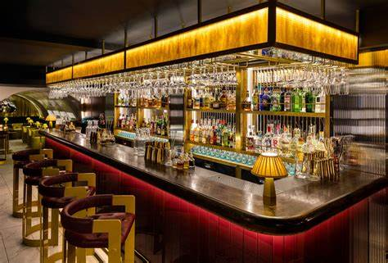

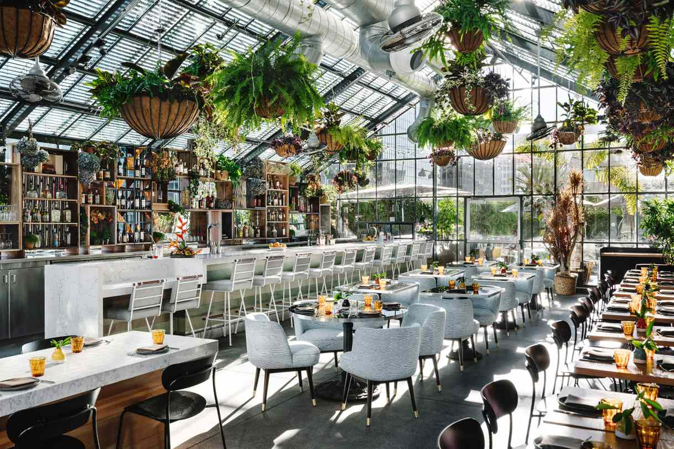
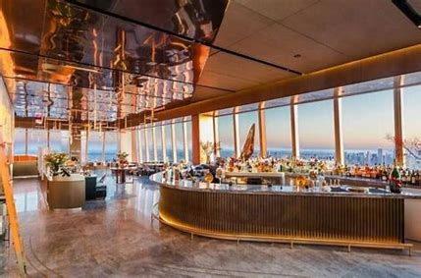
TARGET ACCOUNTS
TRIAL
ON PREMISE
AND SUGGESTED COCKTAIL VARIATIONS
Craft Cocktail Bars
Nightclub & Dance Venue
Damrak
Gin & Tonic
Damrak
Citrus Collins
Virgin
Gin & Tonic
Virgin
Citrus Collins
Damrak Martini
Damrak
Gin Fizz
Virgin
Gin Fizz
Virgin
Berry Smash
Brunch Spots
Wine and Champagne Bars
Damrak
Gin Mimosa
Damrak
Ginger Gin Fizz
Virgin
Mimosa
Virgin Berry Lemonade
Gin Spritz
Cucumber
& Mint Gin Cooler
Virgin Spritz
Virgin
Cucumber & Mint Cooler

