Slide 1
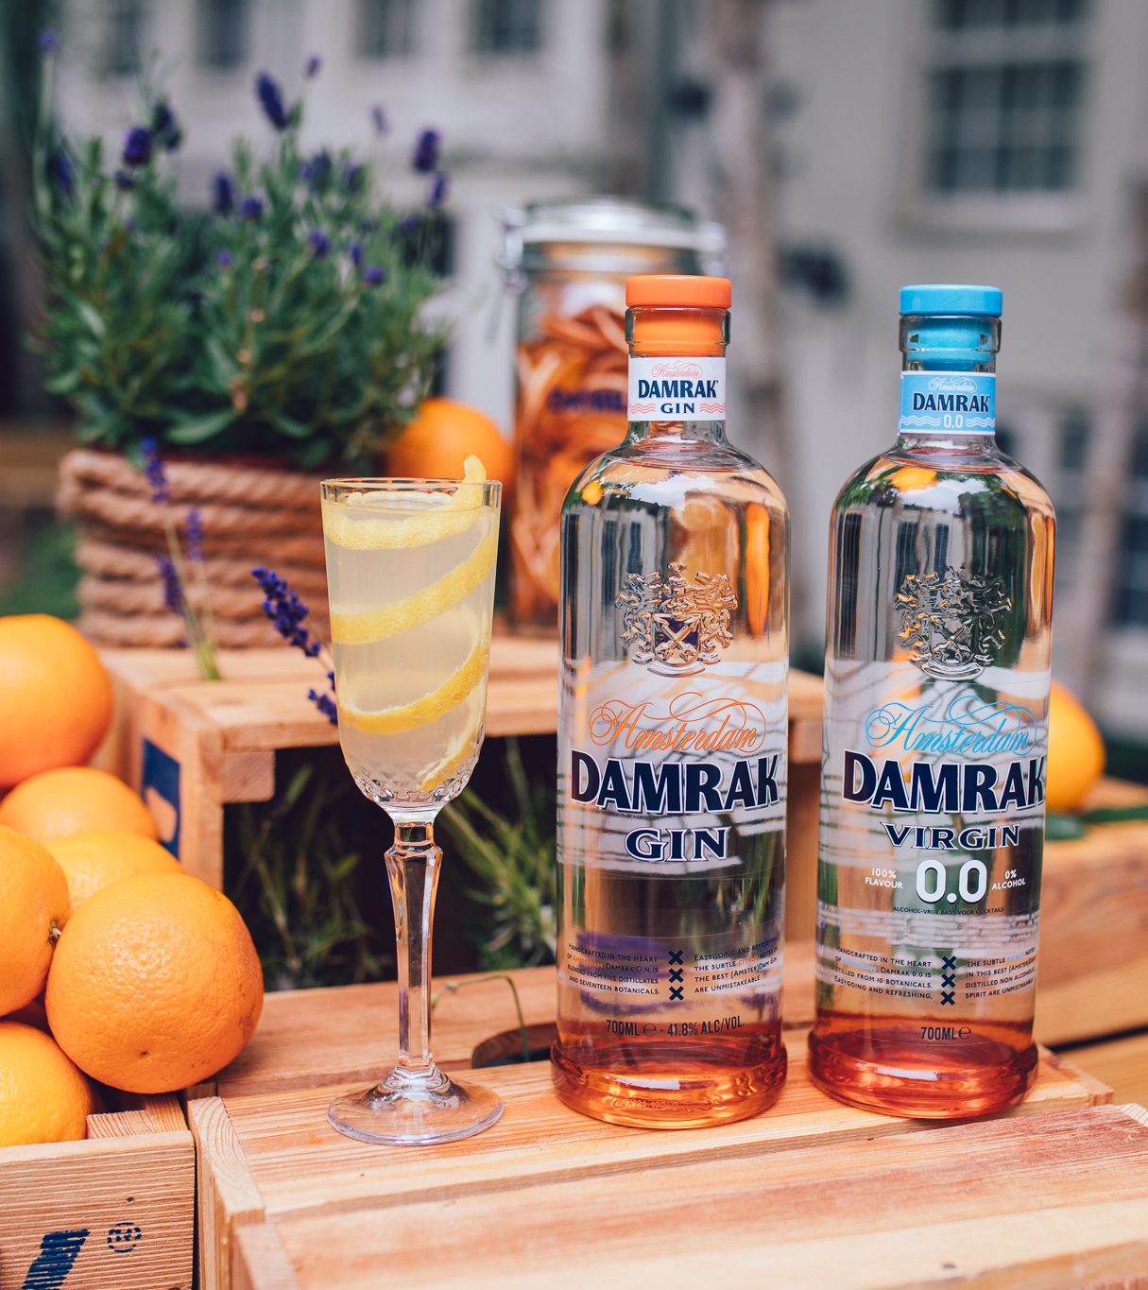

1% pledge to support our planet
81% of millennials say they want to support brands with corporate citizenship
Dam Right!
Damrak joined 1% for the Planet, pledging to donate 1% of all sales to support nonprofit organizations focused on the environment.
Meaning each cocktail ordered & each bottle sold is benefiting great causes, including efforts to slow down climate change.
Trade customers are welcome to use 1% for the planet logo next to Damrak cocktails listing on the menu / price tag or in any communication about the brand.

