Slide 1

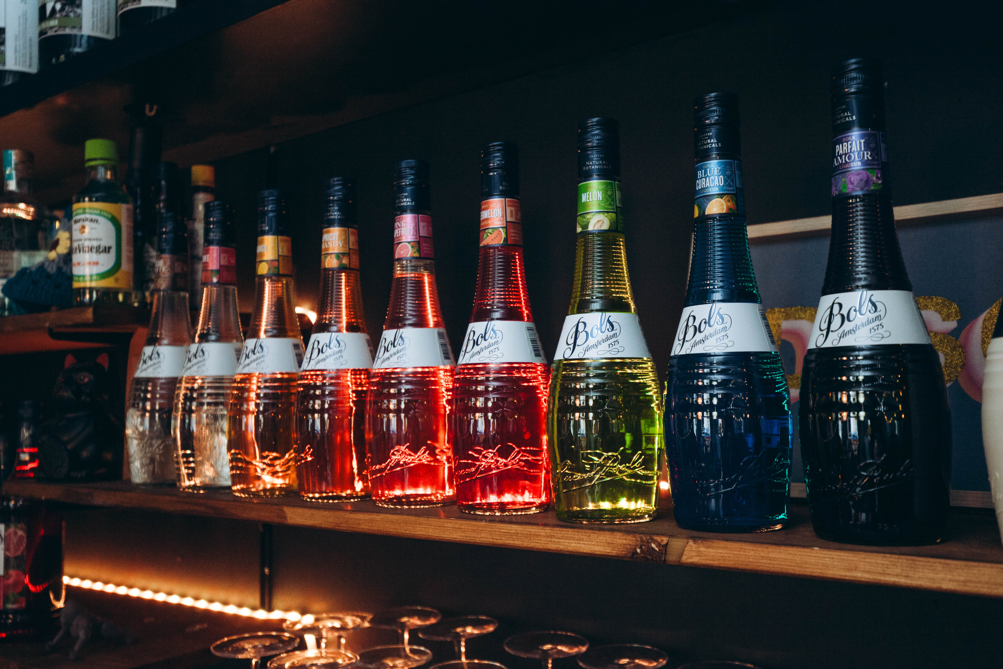
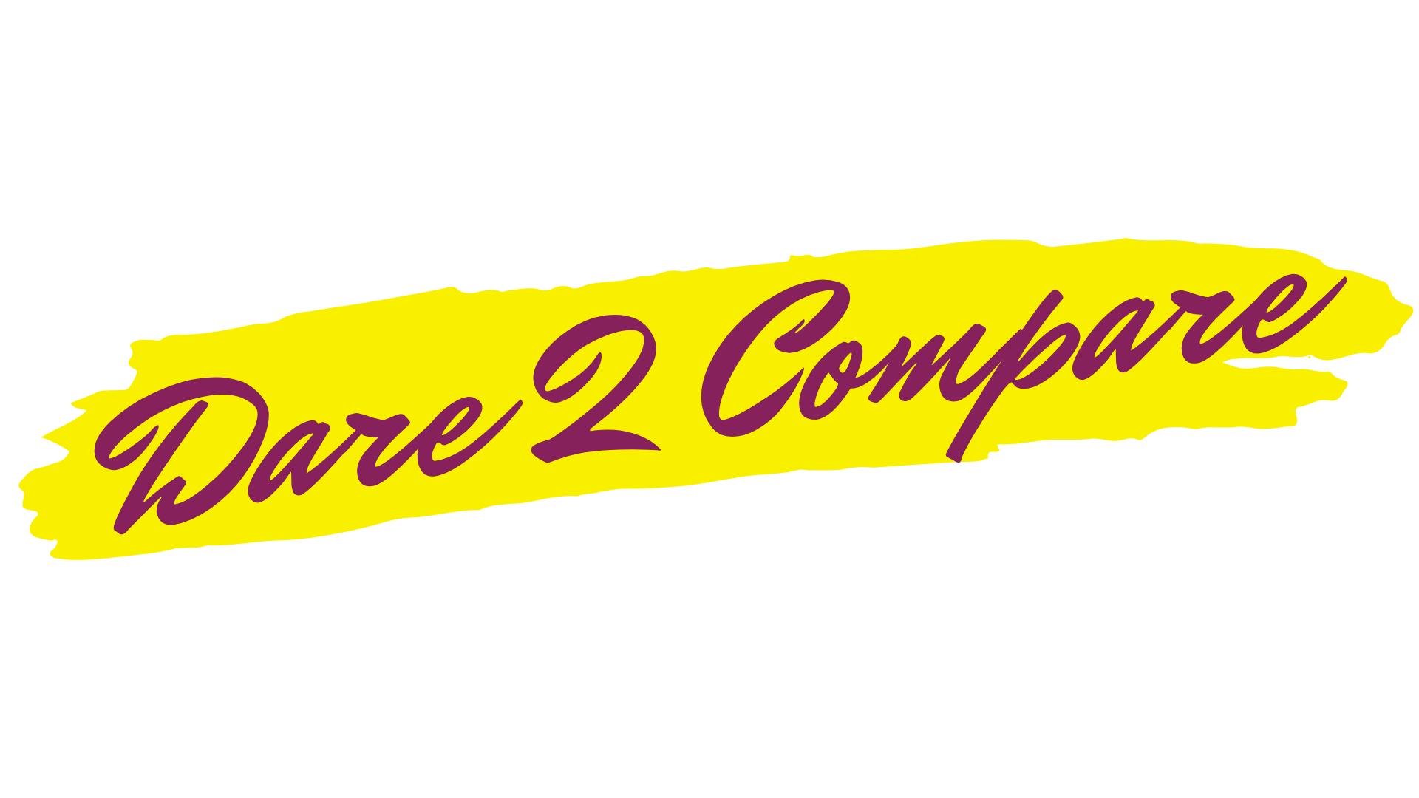

Slide 2
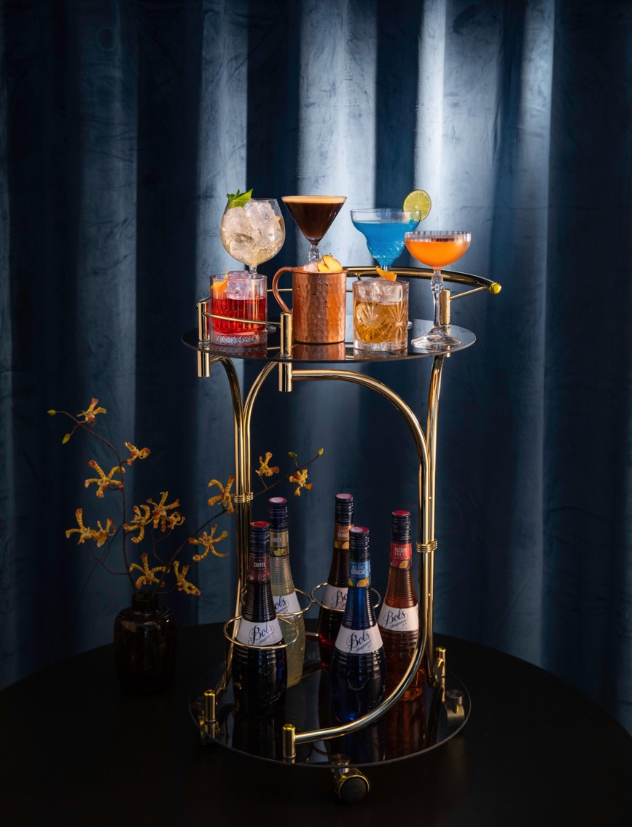
BOLS
THE NO. 1 COCKTAIL BRAND GLOBALLY

Slide 3
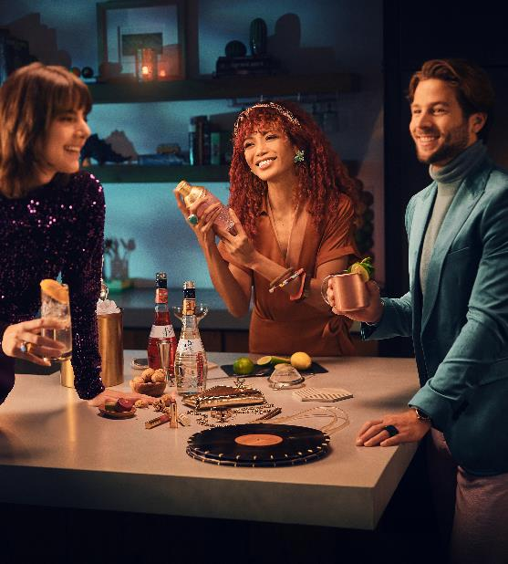
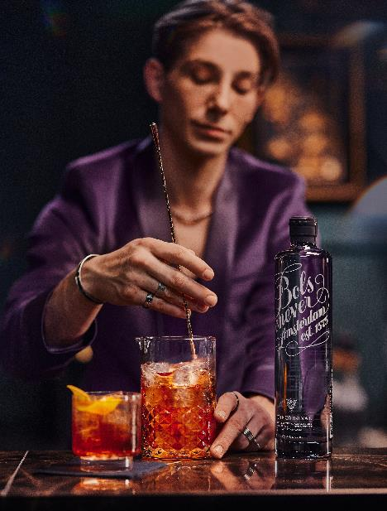
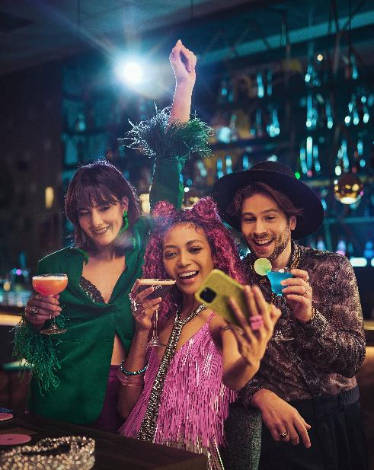

BOLS COCKTAILS
IS HERE TO INSPIRE YOU TO EXPLORE THE WORLD OF COCKTAILS AND CREATE MAGIC

Slide 4
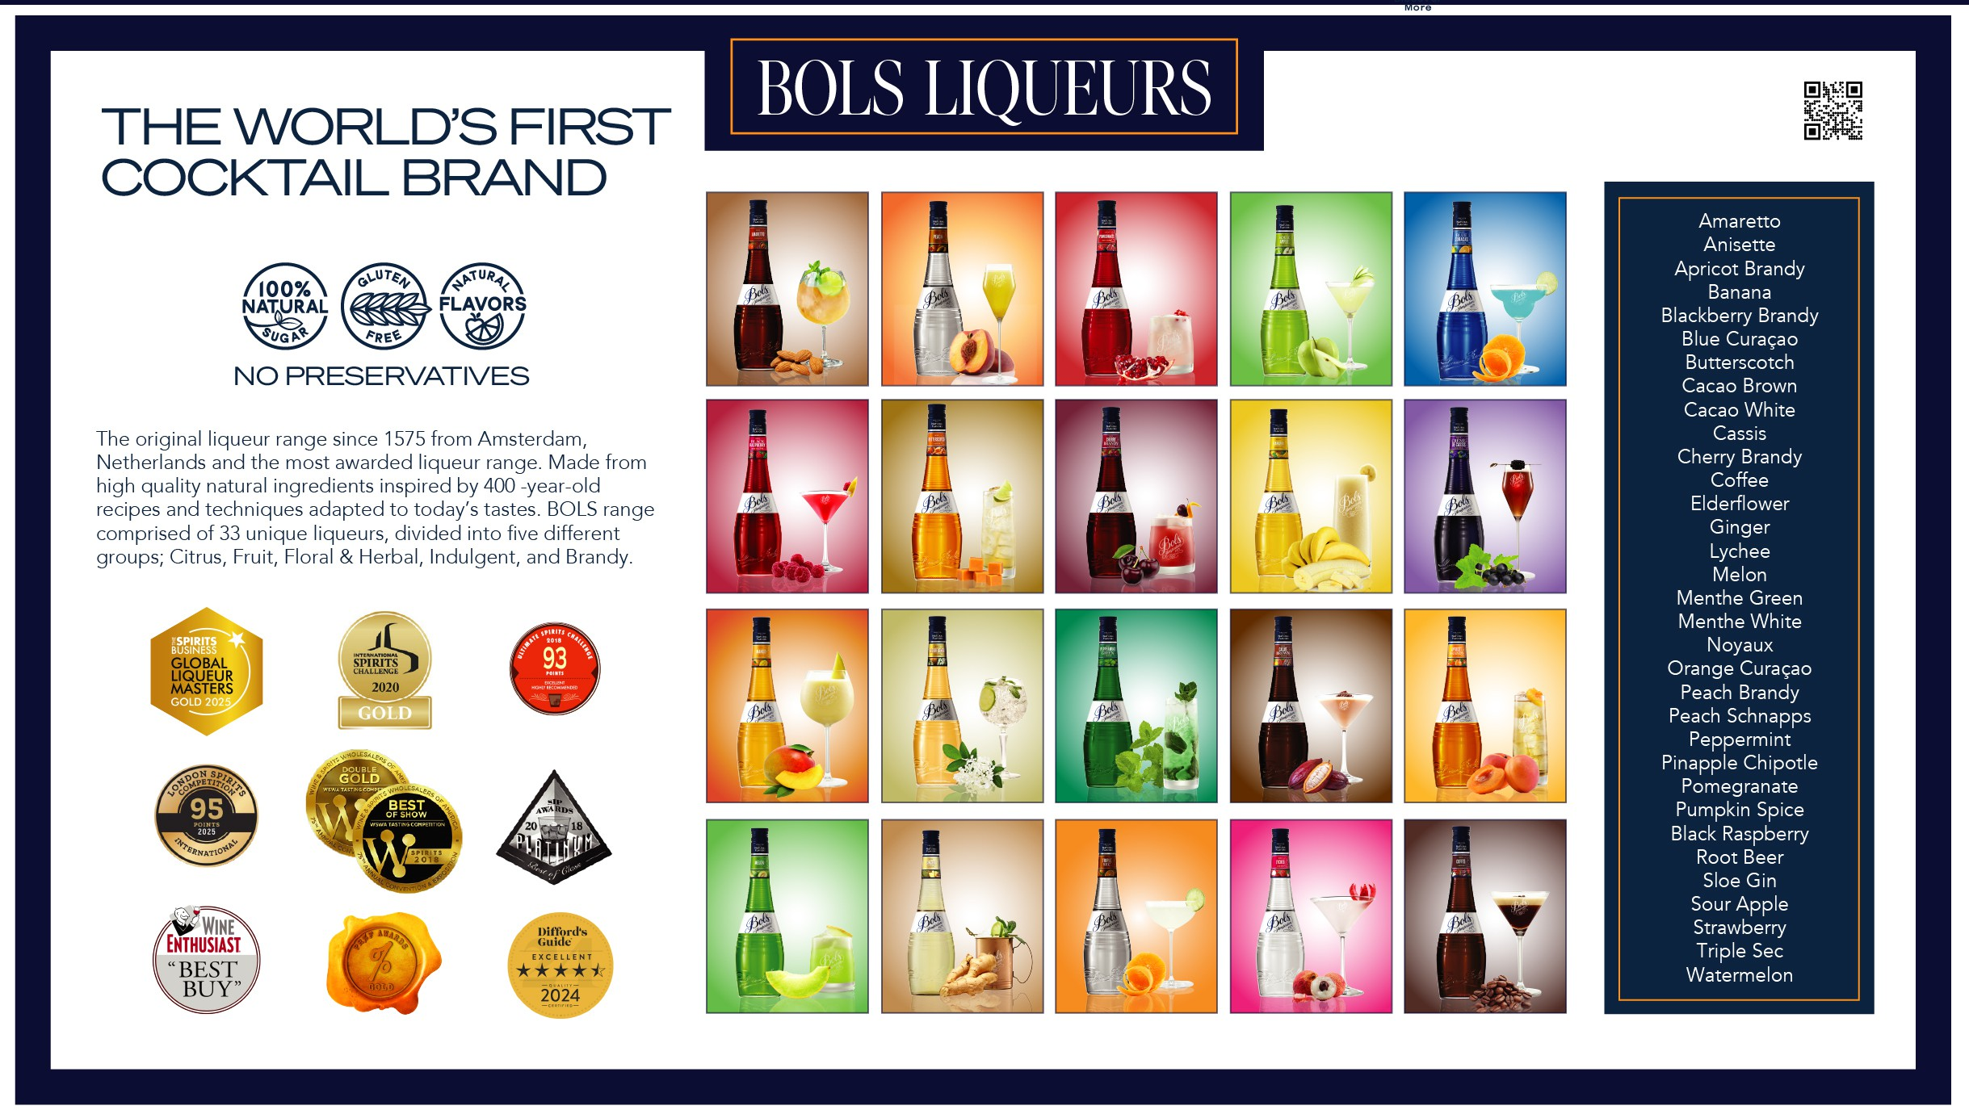

Slide 5
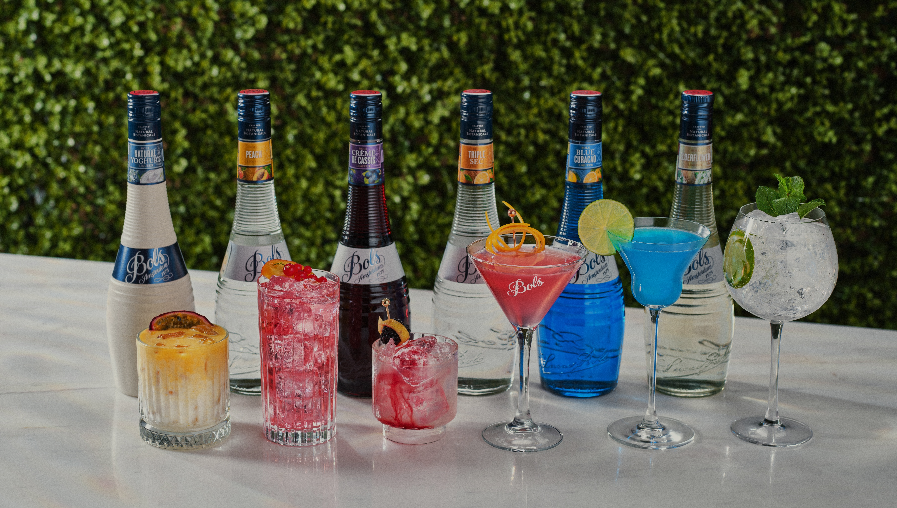
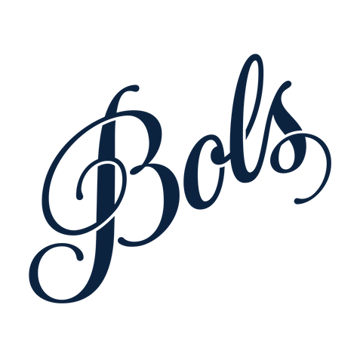
What is it?
  An initiative to give you the best sales arguments!
  A sum up of the best reasons to prefer the Bols range over their competitors after our comparative research with a panel of bartenders, industry experts and consumers.
  Our bold take: our liqueur range has nothing to envy the global category leaders, rather we argue that they offer the authentic flavor and amazing mixability in cocktails .

Slide 6



Our claim: we excel in…
FLAVOR
COCKTAILS
MARGIN
  Made for cocktails
  All our Bols Liqueurs give a very clean and explicit botanical flavor that elevates cocktails and fuels creativity.
  Better value proposition.
  Equal (if not better) quality, yet more affordable option and still with international premium allure.
  → Our liqueur delivers the authentic flavor it advertises, standing out from competitors by capturing the essence of the taste in a more genuine way.
  All liqueurs made with natural botanicals.

Slide 7
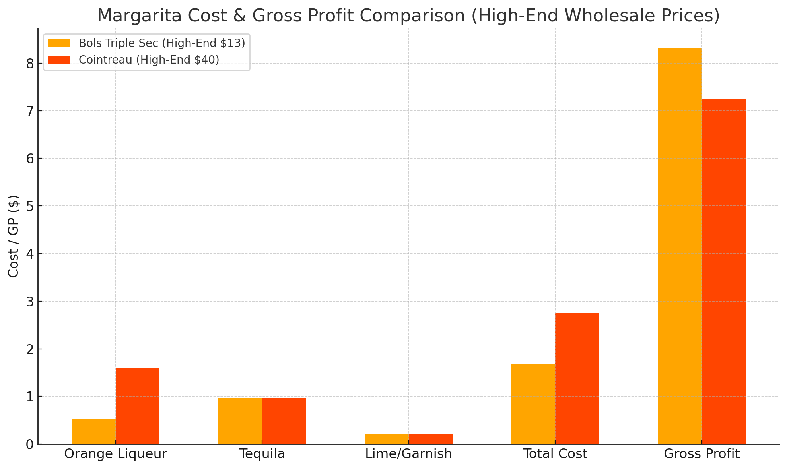
A BETTER DRINK, A BIGGER WALLET
Ingredient | Bols Triple Sec($13) | Cointreau ($40)
Orange Liqueur (30 ml) | $0.52 | $1.60
Tequila Blanco (50 ml) | $0.96 | $0.96
Lime Juice & Garnish | $0.20 | $0.20
Total Cost per Margarita | $1.68 | $2.76
Gross Profit ($) (at Sales Price $10) | $8.32 | $7.24
GP % | 83.2% | 72.4%

Slide 8
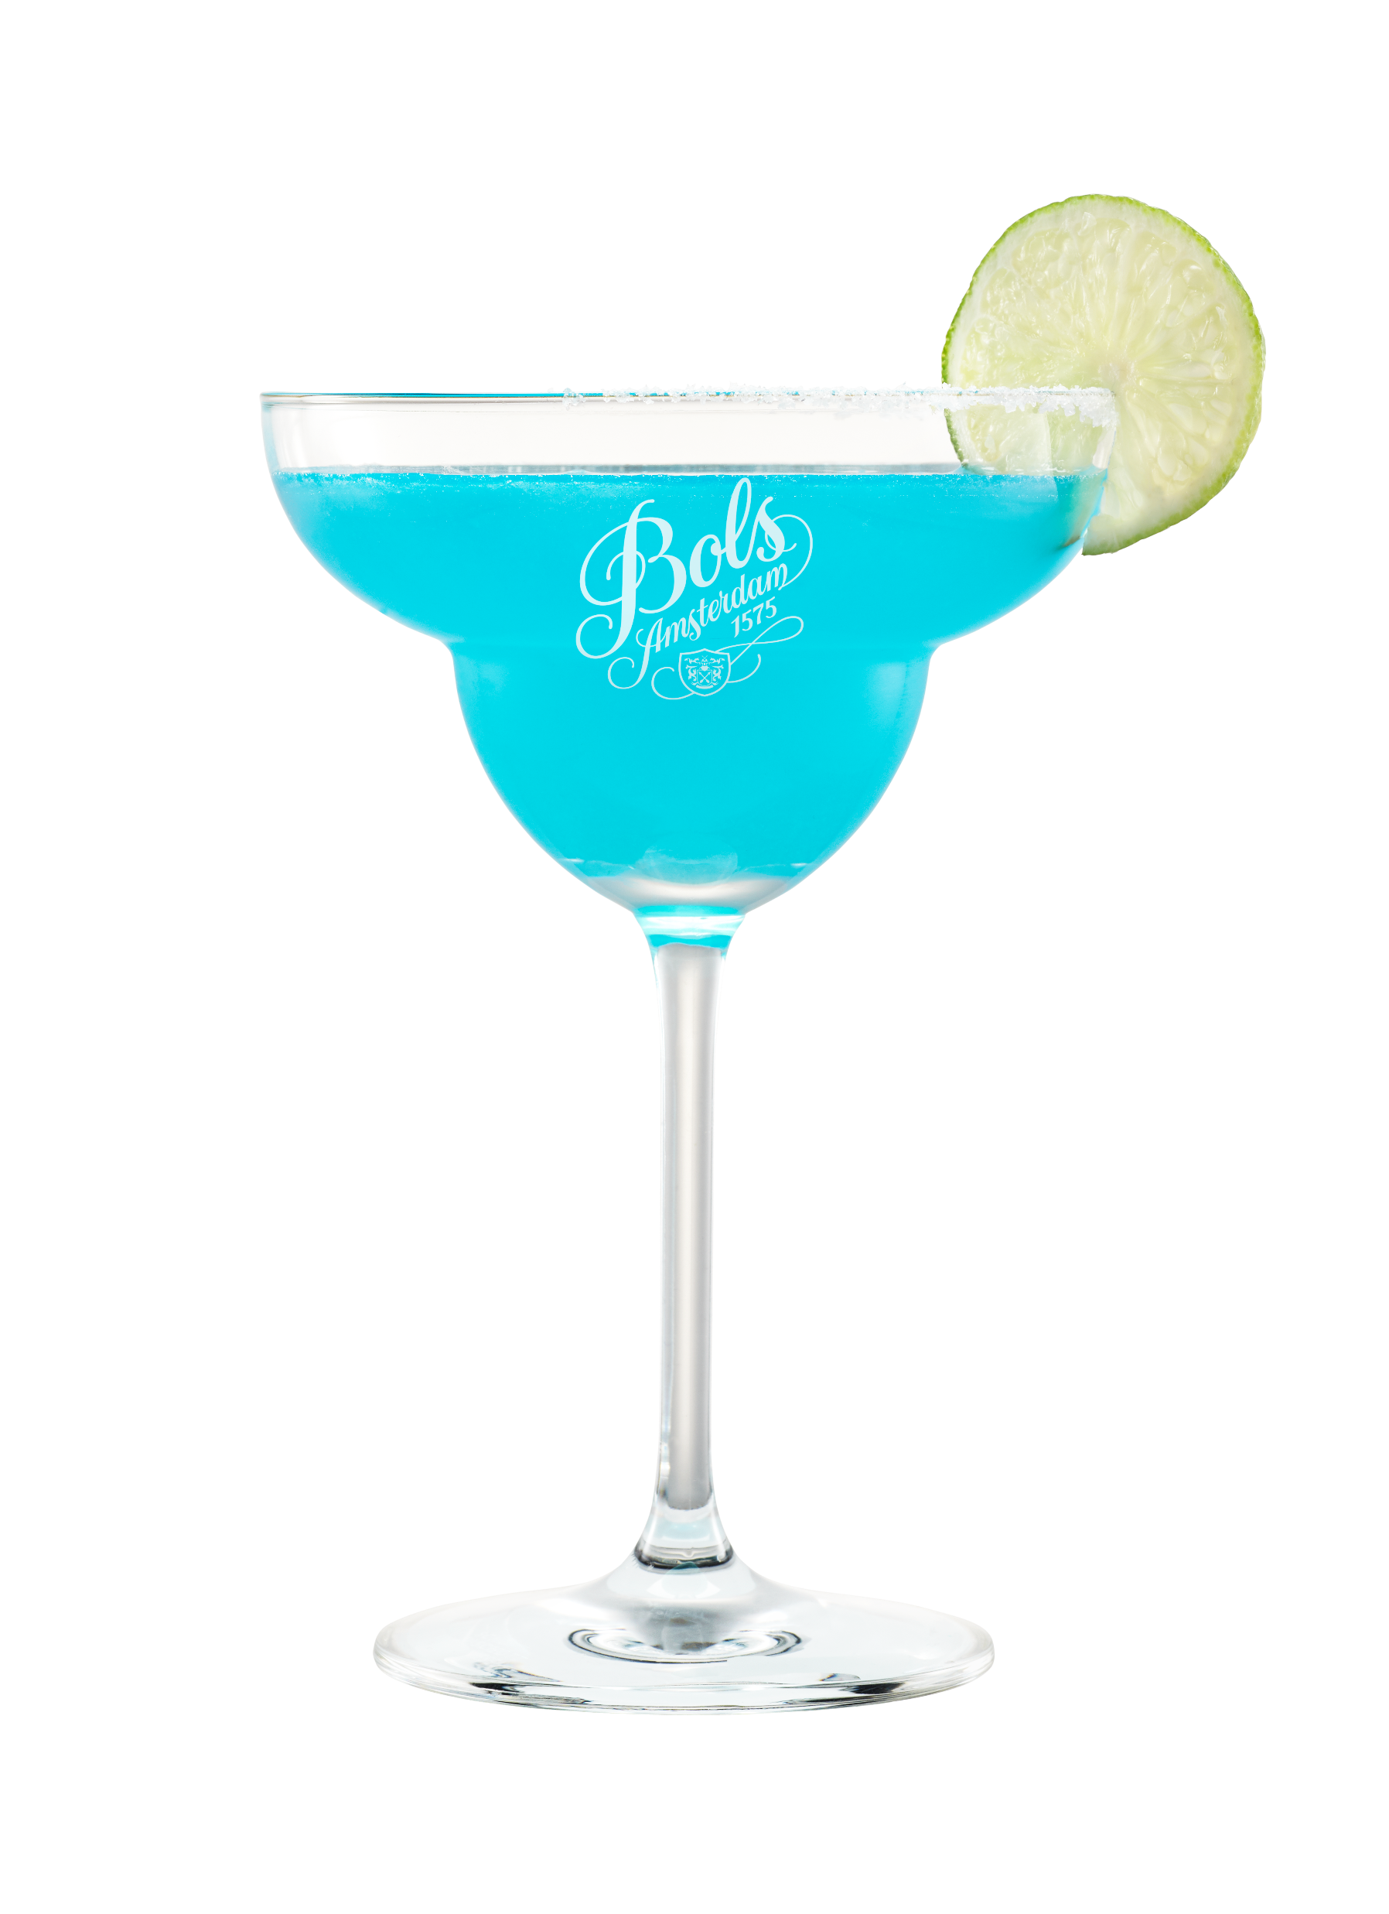
EXTRA GP SERVING… Bols Triple Sec VS Cointreau
Weekly, monthly & yearly implications
  Serving 100 margarita’s a week
  $108 per week
  $464,4 per month
  $5572,80 per year
  Serving 300 margarita’s a week
  $324 per week
  $1393,2 per month
  $16718,4 per year
  Serving 500 margarita’s a week
  $540 per week
  $2322 per month
  $27864 per year

Slide 9
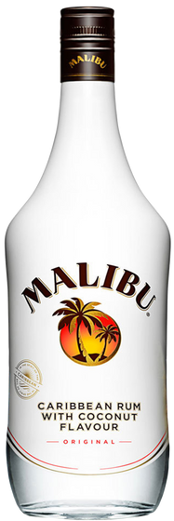
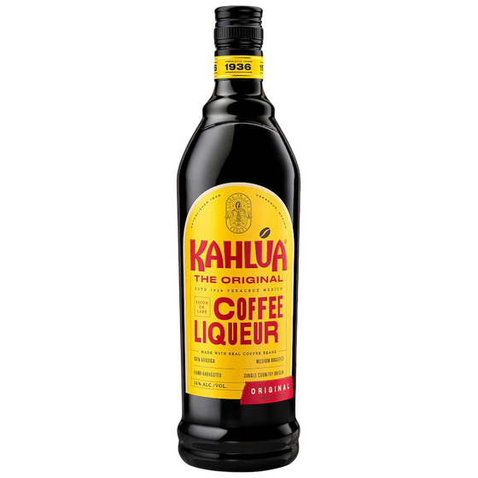
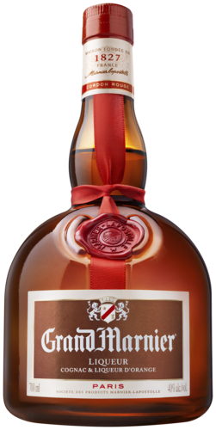
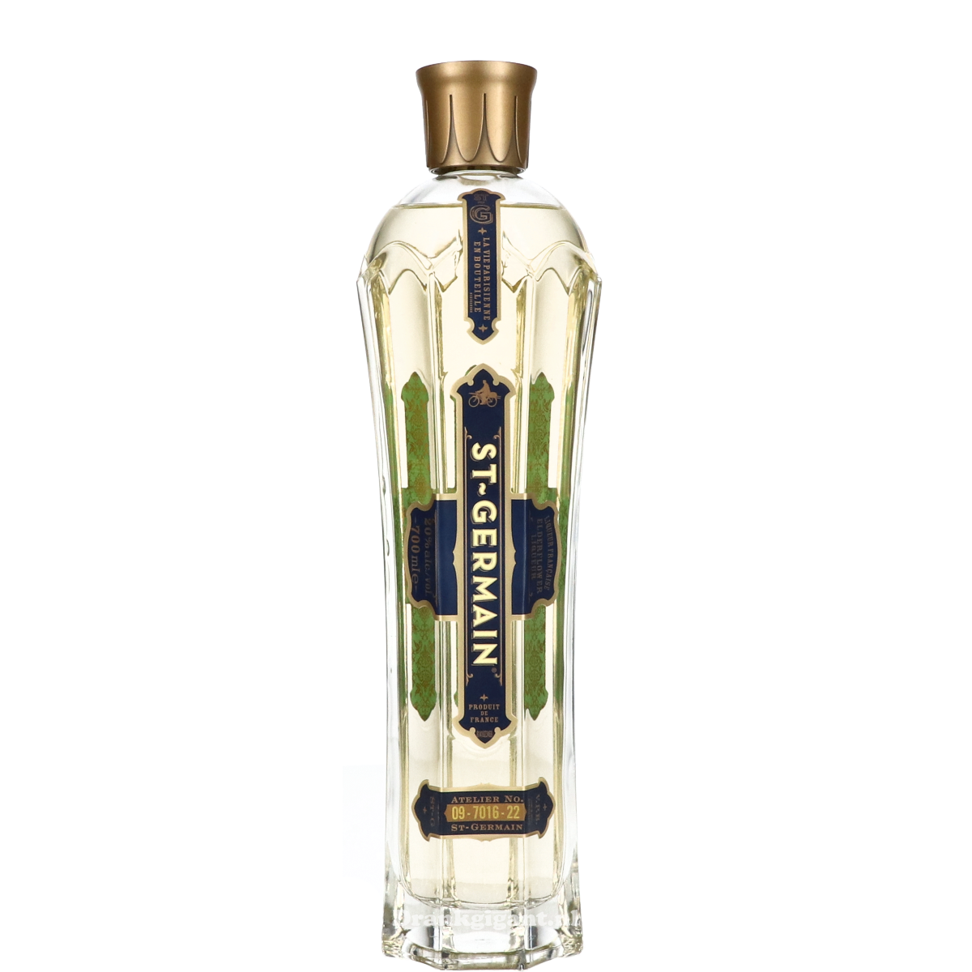
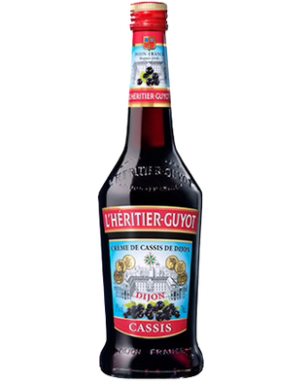
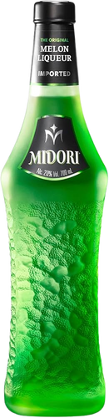
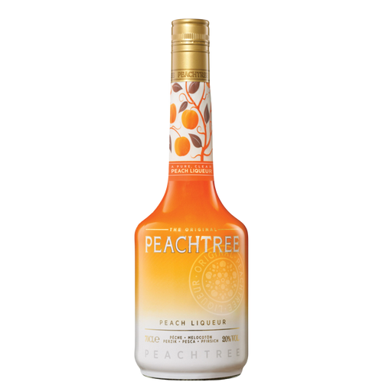
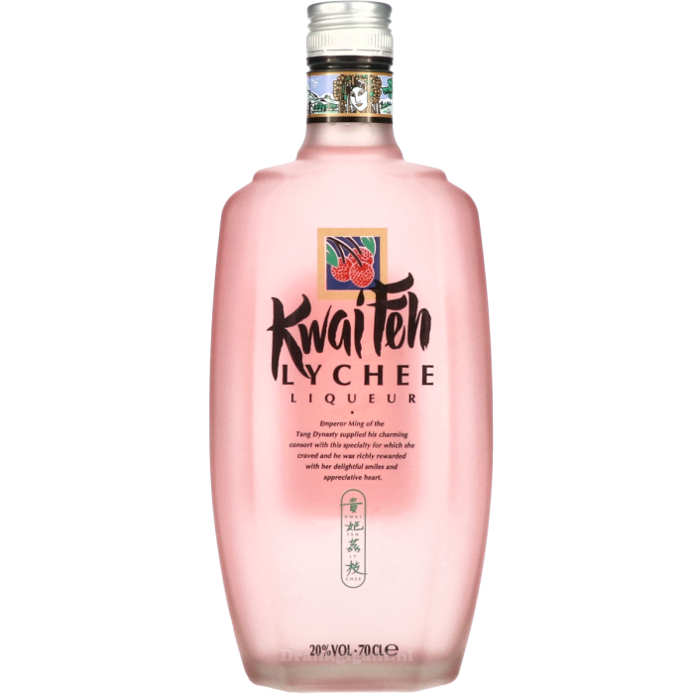
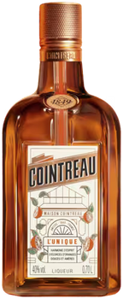
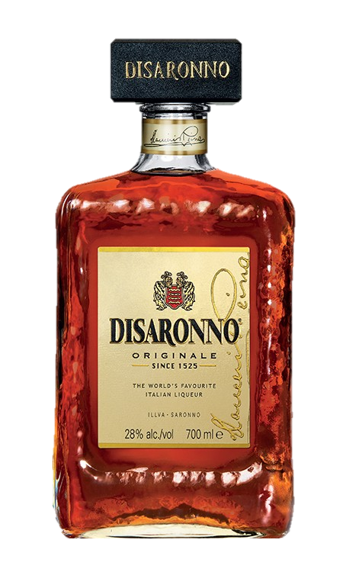
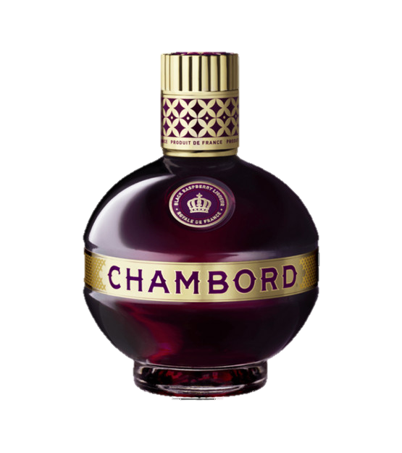
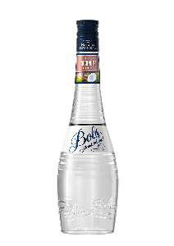
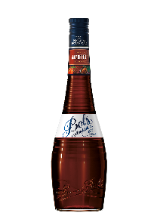
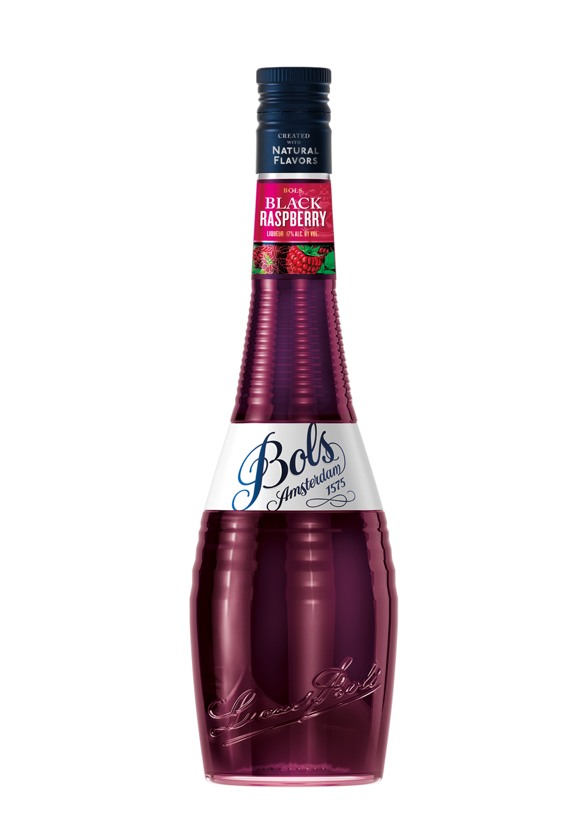
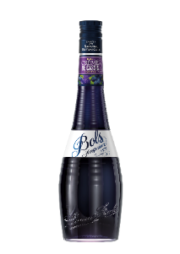
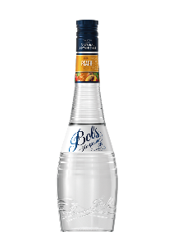
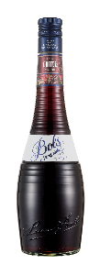
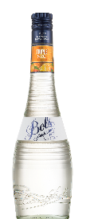
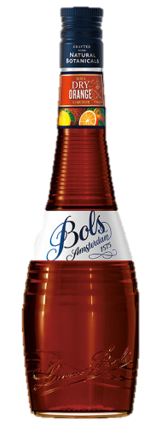

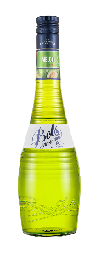
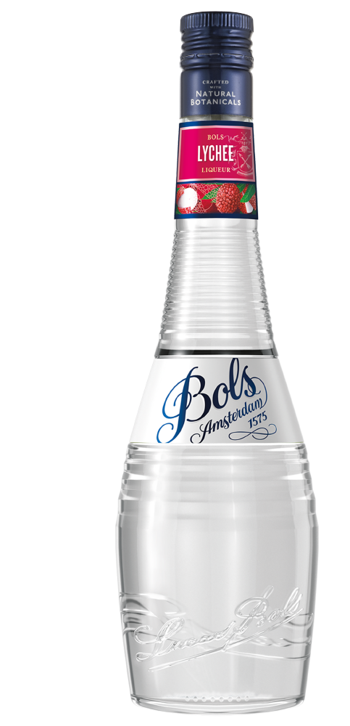
MAJOR OPPORTUNITIES IF YOU
WITH THE “CATEGORY LEADERS”
BOLS VS. THE CATEGORY LEADERS
Largest Liqueur flavors & its global category leaders (in order of Size of Sales based on 2024 IWSR data)
Coconut
Coffee
Triple Sec
Amaretto
Dry Orange
Elderflower
Raspberry
Cr de Cassis
Melon
Peach
Lychee
Notes:
MR Black

Slide 10
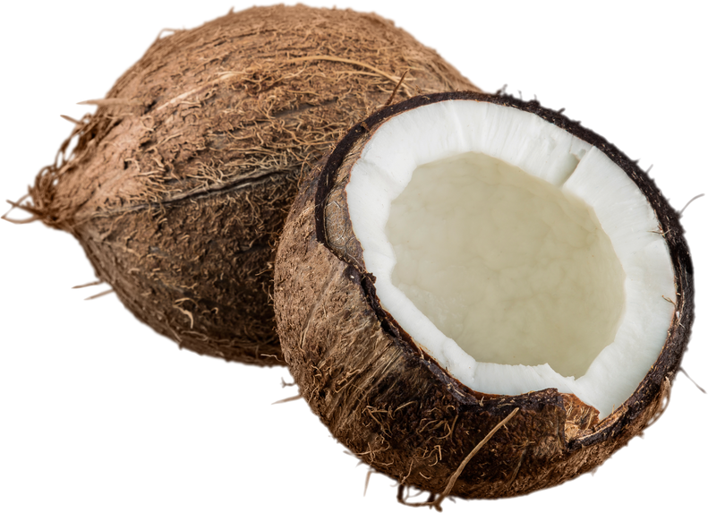
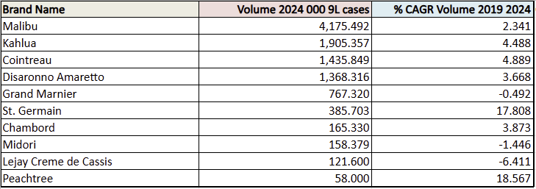
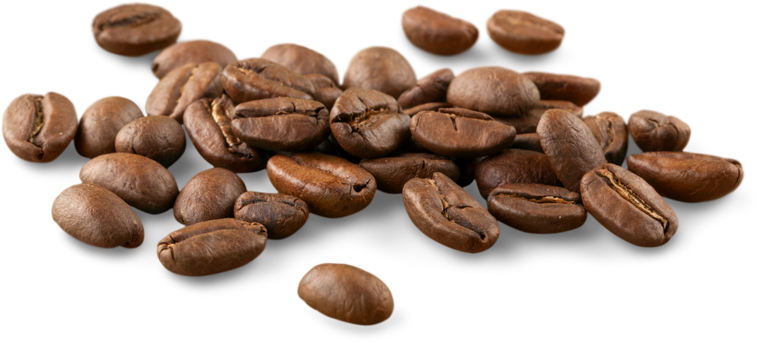
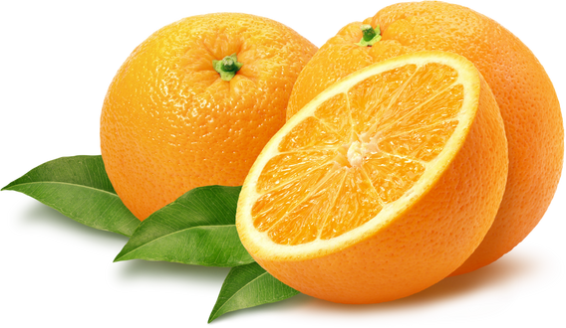
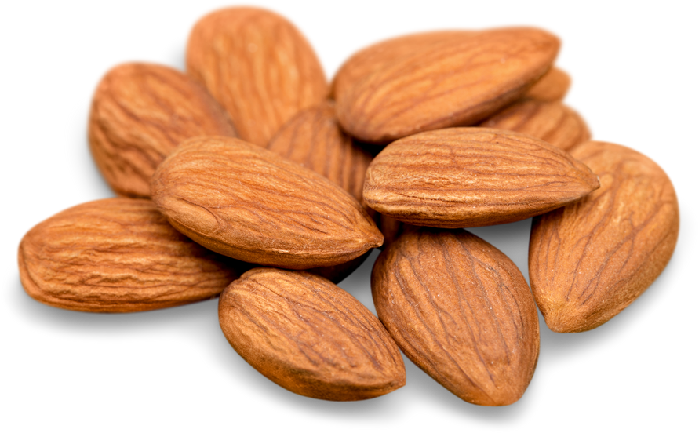
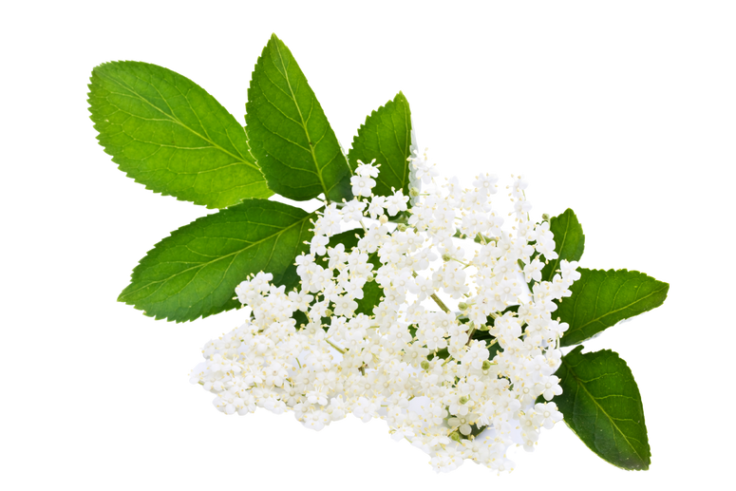
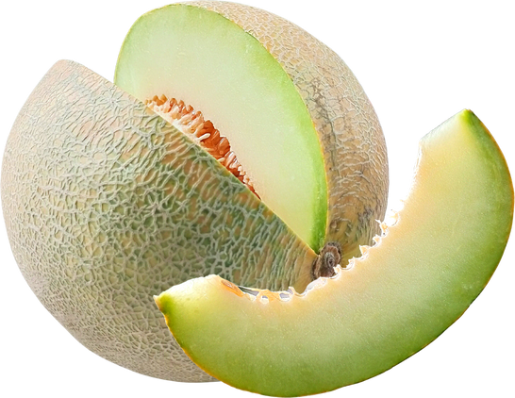
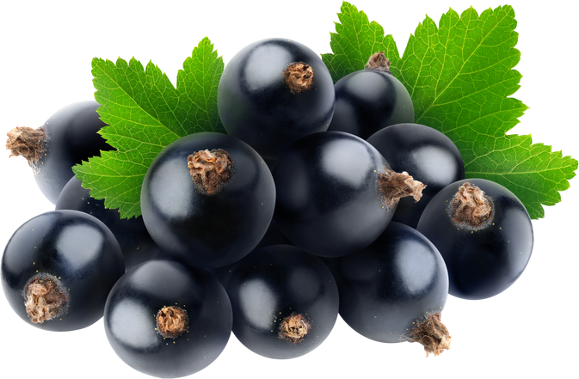
TOTAL GLOBAL VOLUME OF KEY PLAYERS
(based on 2024 IWSR data)

Slide 11
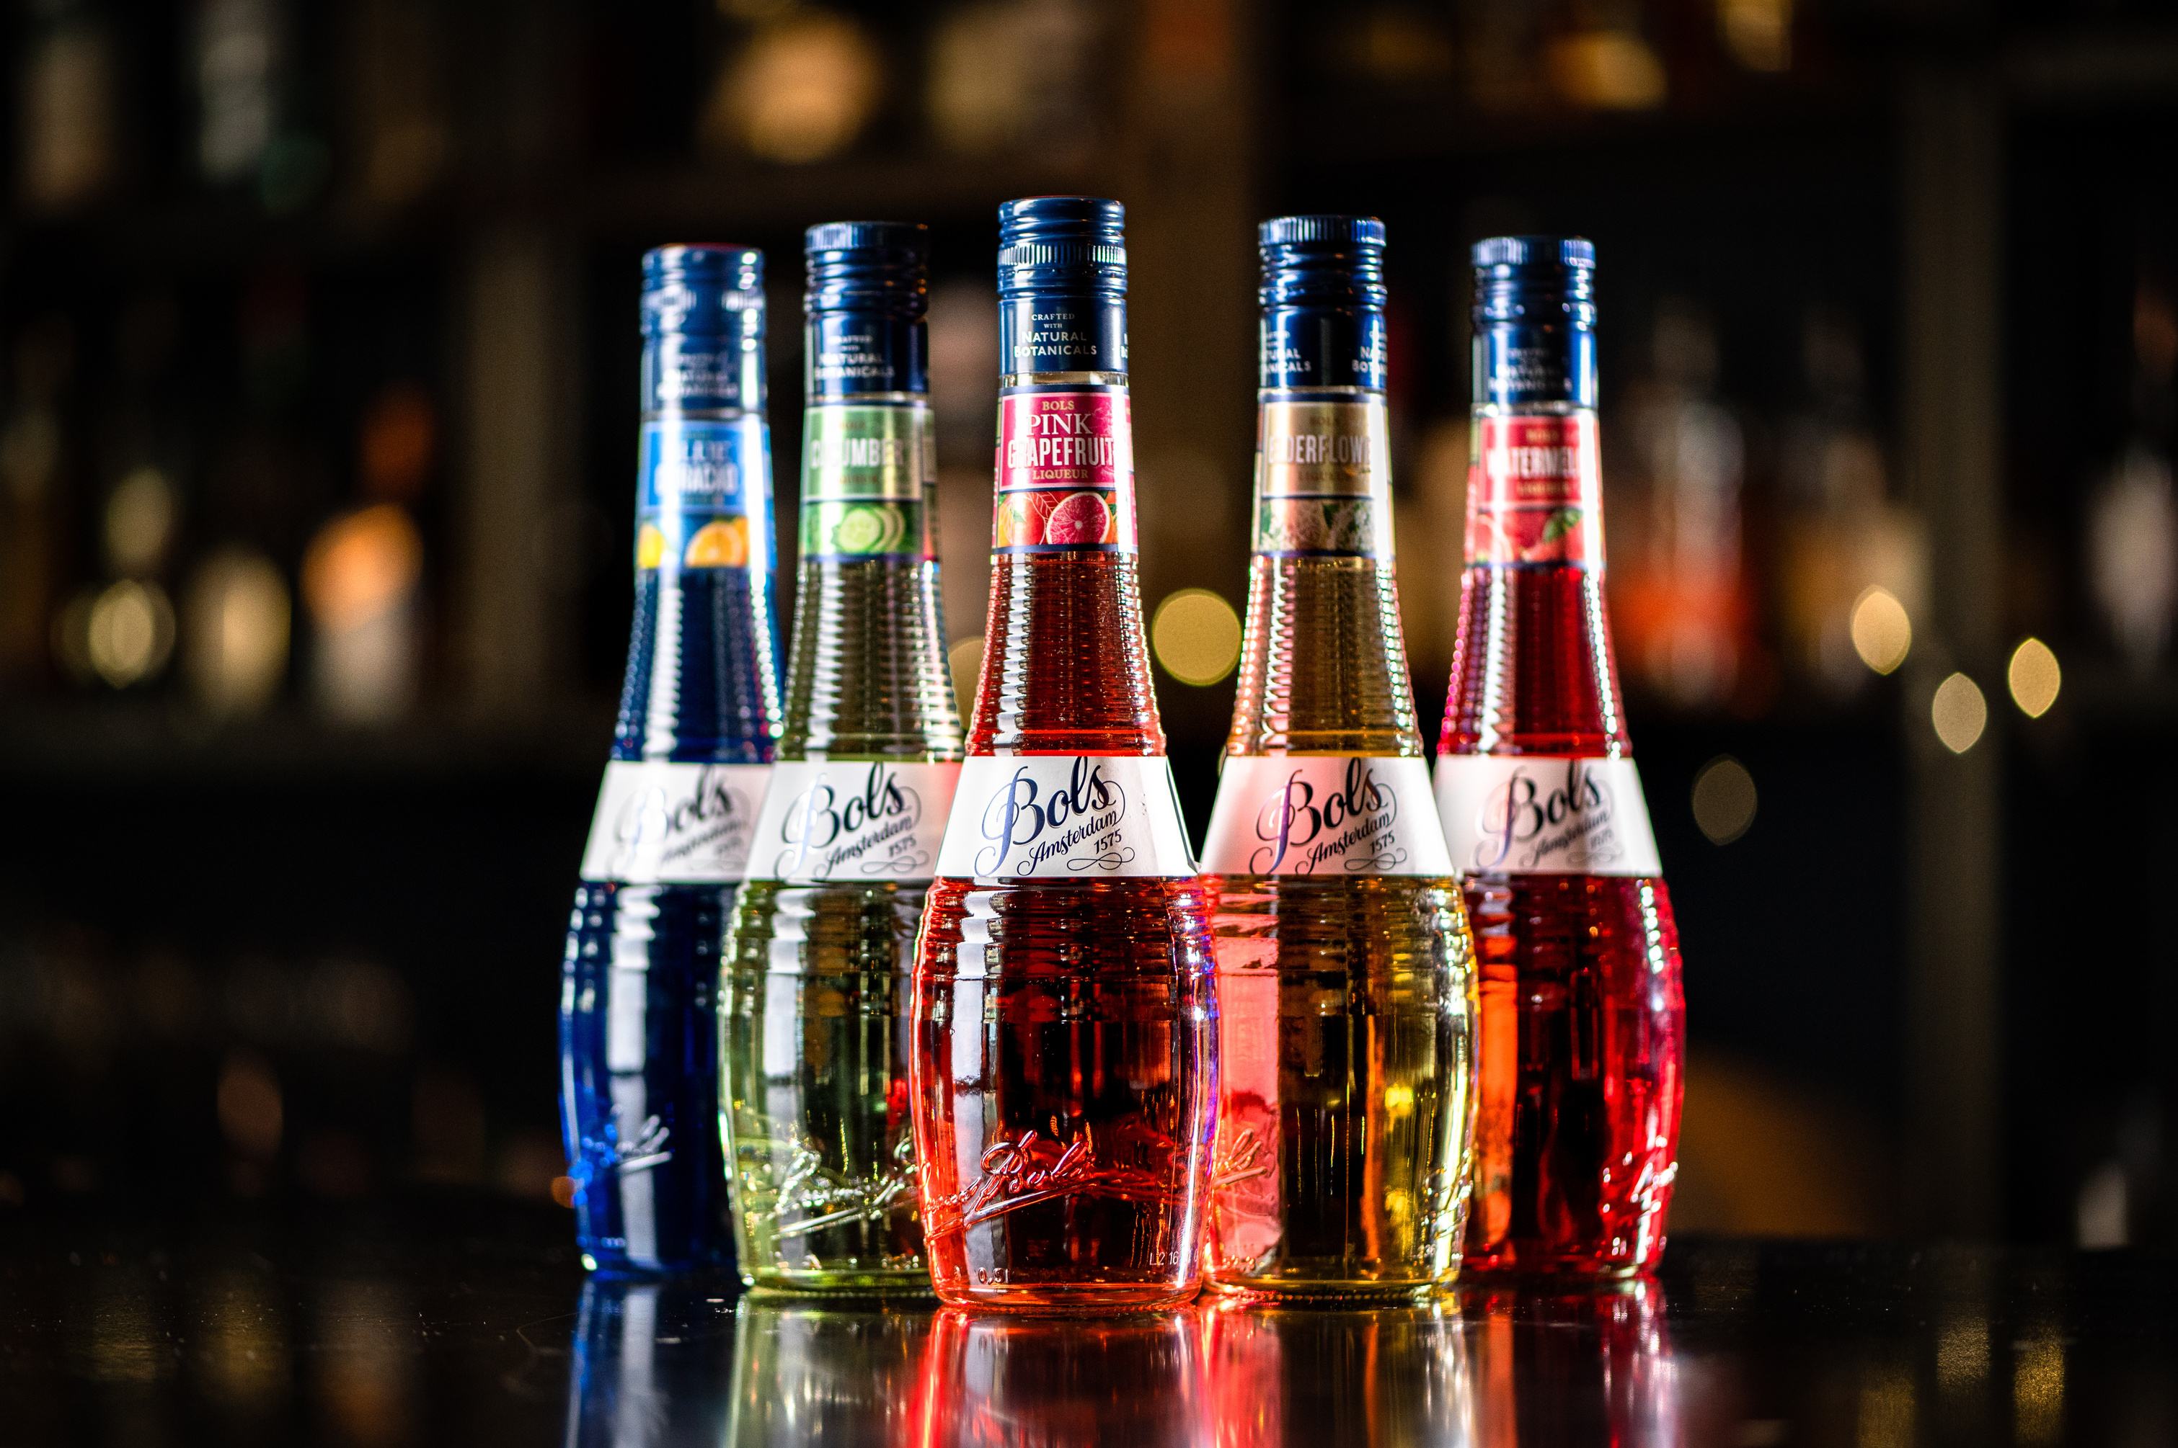

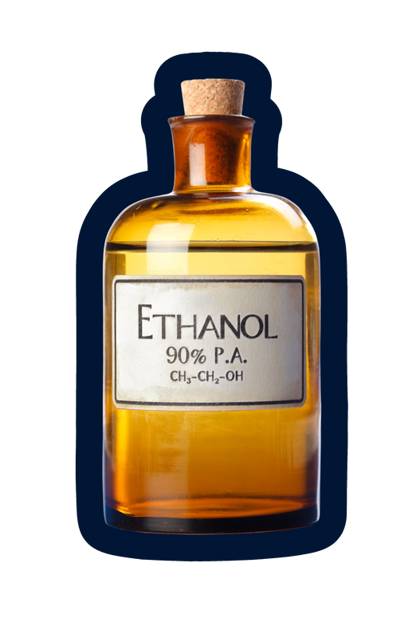

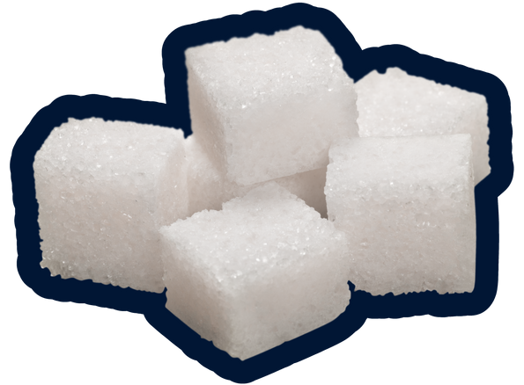

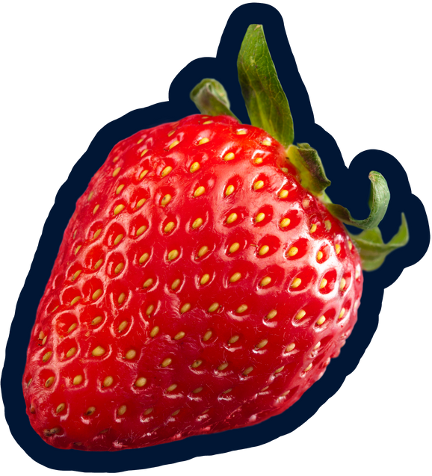





Liqueurs
Liqueurs
A liqueur is a flavored and sweetened spirit.
According to EU regulations:
  For the production of liqueurs, a base spirit of any raw material may be used. Bols uses sugar beet molasse neutral alcohol.
  Sugar: a minimum of 100 grams per liter must be added. Crème de.. A minimum of 250 grams of sugar per liter must be added.
  Flavor: Bols uses maceration, infusion, percolation and distillation for the flavoring of their liqueurs. Fresh fruit juices may also be added.
A liqueur must have a minimum of 15% abv.
Liqueurs are sometimes referred to as cordials in the USA, but cordial in other parts of the world indicates a nonalcoholic syrup.
Some producers call liqueurs schnapps. They are typically at least 40% and only lightly sweetened if at all.

Slide 12
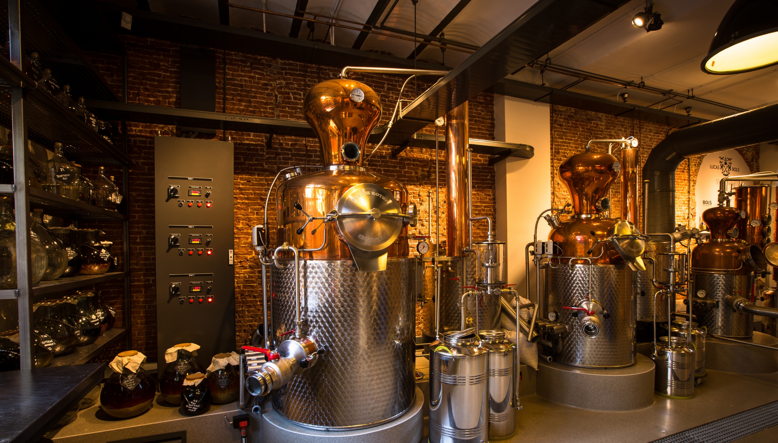
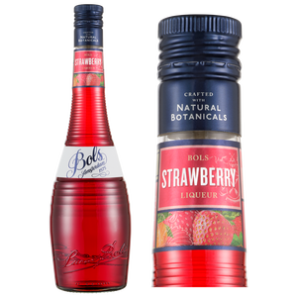
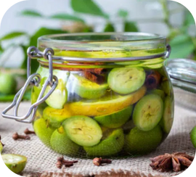

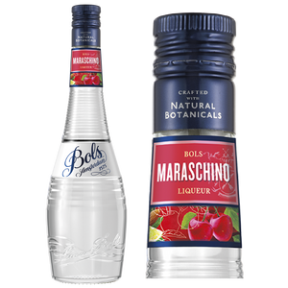
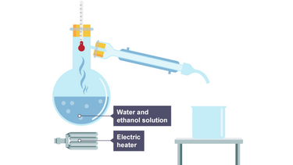
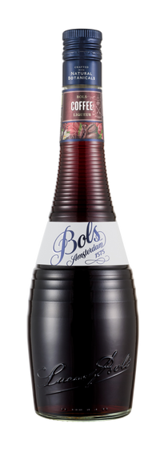

Liqueur production
Liqueur Production
3 methods to add flavor to your liqueur:
MACERATION
Mainly for soft fruit that would disintegrate if distilled: the fruit or herbs are left sitting around in neutral spirit until they absorb the flavor. This produces a colored extract called a tincture.
RE-DISTILLATION
Just like good-quality gin: add your flavoring agents (herbs, fruits, whatnot) to spirit and re-distill it. Distillation is normally used for harder ingredients like fruit peels, seeds and roots, and produces a clear distillate called an esprit.
PERCOLATION
Just like making an espresso: put your (hard) ingredients into a filter and drip alcohol down through them. Percolation produces a dark, typically slightly bitter extract called a tincture.

Slide 13

Why use liqueurs?
Flavoring powerhouse for cocktails
Appealing drinks made easy
A stable flavor all year round
Focus on low unit drinks
  Loud flavor from natural botanicals.
  A colorful and versatile range to create any cocktails.
  Enjoy your favorite flavor and drink even in winter.
  A responsible drinking experience for more enjoyment!

Slide 14



HOW TO: conduct a
tasting (3 levels)
  Depending on the resources available to you and the type of crowd you are trying to reach
Tier
Tier
Tier
Neat tasting
Easy Mix
Star cocktail
  Comparative tasting of the two liquids with a mixer.
  WHY: see how the flavor shines in practice when diluted with approachable mixers.
  Comparative tasting of the two liquids in the signature cocktail. (Most popular drink associated with the flavor.
  WHY: see how the flavor shines in practice with complex recipes.
  Comparative tasting of the two liquids pure.
  WHY: Focus on liquid quality and raw flavor.

Slide 15



Tasting judging criteria:
  Two variables to consider when conducting the tasting with either tiers.
Authenticity
Mixability
  → Taste as close to the natural botanical/fruit.
  → Taste like the single flavor it advertise on the bottle (you get what you buy)
  → How the flavor shines through other ingredients.
  → The strength and balance of the product in a mixed drink.

Slide 16

Watch the "DARE 2 COMPARE:
HOW TO CONDUCT A TASTING" Video

Slide 17


QUESTIONNAIRE

Slide 18





DRY ORANGE- 24% ABV
Neat tasting:
Signature Cocktail
Distilled natural oils of Curaçao
orange peels giving bitter-sweet flavor, warm spice and a pleasant dry finish.
  In a Mai Tai, Bols Dry Orange brings depth, complexity, and a clean citrus backbone.
Easy Mix Option: Mix it with ginger beer for a spicy, citrus highball.

Slide 19

Watch the "DARE 2 COMPARE:
DRY ORANGE" Video

Slide 20






BLACK RASPBERRY- 17% ABV
Neat tasting:
Signature Cocktail
Fresh macerated black raspberry for tangy, deep red berry notes with a clean, juicy finish.
  In a French Martini, Bols brings bright raspberry flavor that balances perfectly with pineapple and vodka.
Easy Mix Option: mix with Tonic for an effortless refreshing highball.

Slide 21

Watch the "DARE 2 COMPARE: BLACK RASPBERRY" Video

Slide 22





COCONUT USA- 17% ABV
Neat tasting:
Signature Cocktail
Strong & fresh floral raw coconut profile. Nose of green young coconut with a rum’s bite. Low sugar keeps it crisp and balanced. Flavor opens into clean, toasted coconut notes.
  In a Pina Colada, the coconut flavor of Bols stays natural and silky for an easier balance.
Easy Mix Option: Mix with Ginger Beer for a tropical and spicy highball.

Slide 23

Watch the "DARE 2 COMPARE:
COCONUT" Video

Slide 24
Q&A / Stress test
"We already carry A-brands in our portfolio. This program could get us in trouble with our other suppliers"
We completely understand. The beauty of Bols' extensive range is flexibility. If one flavor creates conflict, we have many other flavors to explore together. Though, many successful partners run dual strategies: A-brands in the back bar for premium visibility, Bols in the speed rail for high-volume cocktails. Or channel separation across your distribution network (premium vs mainstream). It's about smart portfolio management, not replacement.
"We don't want to speak negatively about competitors or brands from other importers"
Absolutely agree. That's not what Dare to Compare is about. We focus on what makes Bols unique: authentic single-forward flavors, 100% natural botanicals, specifically crafted for cocktail mixing and exceptional value for money. Other brands excel in different areas, where we simply shine in cocktail performance. Dare to Compare is a positive, taste-first conversation that lets the liquid speak for itself.
"You're not coming with a marketing budget or listing fee. Why should we prioritize this?"
We believe in taste and margin as the ultimate convincers. The combination of superior flavor performance and improved margins creates its own business case. That said, we're always open to discussing tailored support for committed partners. Let the liquid prove itself first.
"The A-brand (e.g. Malibu) is a brand that consumers know and ask for, Bols isn't"
Most cocktail orders focus on the drink, not the brand. Consumers ask for "a Margarita" or "Cosmopolitan," not "a Cointreau Cosmopolitan." For high-volume, flavor-forward cocktails where taste and consistency matter most, Bols delivers superior results. Brand-specific requests are rare in everyday service. Where they do occur, a dual strategy gives you the best of both worlds.
"I need those A-brands on my back bar for recognition and premiumization"
The most successful model is hybrid: keep A-brands visible on your back bar for brand recognition, pour Bols from your speed rail for volume cocktails. Consumers will be positively surprised by the superior taste, your bottom line benefits from better margins. Premium perception meets operational excellence.
"But these brands are listed on our menu – we can't just remove them or substitute"
If there's a contractual obligation, we respect that. However, if there's flexibility, consider using generic ingredient names instead of brand callout: "Triple Sec" instead of "Cointreau." Today's consumers increasingly value transparency and authenticity over brand names. They want to know what's in their drink rather than being marketed to. This approach gives you commercial flexibility and puts the focus back on your venue's craft.

Slide 25
Q&A / Stress test
"You promise better taste, but how do I know this will deliver better results?"
We have the proof. Dare to Compare has been successfully executed across multiple markets globally, with high percentage bartender preference rates in blind taste tests. We'll gladly share relevant case studies and success stories from markets similar to yours, including conversion rates, volume growth and venue testimonials. The program works because it's built on a simple truth: better taste plus better margins equals better business.
"The category leader invests heavily in marketing and activations – what does Bols offer in return?"
Bols is a globally recognized brand sold in 110+ markets with 450 years of cocktail heritage. We support partners extensively through on-trade activations like Bols Cocktail Battle, digital content creation, Bols Bartending Academy resources and extensive POS and merchandise programs. We invest where it matters most, in the people who create the drinks and the experiences that drive consumer loyalty. We’re happy to share more insights on this in your market specifically.
"Your competition (De Kuyper and other liqueur ranges) tells the same story – why are you different?"
Bols stands apart through 450 years of liqueur-making expertise, global presence in 110+ markets, 100% natural botanicals with no artificial flavors and purpose-built formulation for cocktails. Competitors can not claim that. Every flavor is specifically developed to shine in mixed drinks, not as standalone drinks. Bols isn't just another liqueur range: we're the original and we're still the best at what we do: making cocktails taste exceptional.
“Why use Bols liqueurs vs syrups in cocktails?”
Due to it’s alcoholic base, liqueurs add complex, layered flavors, not one-dimensional sweetness and sugar. The alcohol content carries the oils of the natural botanicals in your cocktails. This results in a stable flavor profile across ice, dilution & temperature and a better balance & mouthfeel in the finished drink. Liqueurs give also a better control of the sweetness due to a lower sugar content than syrups. Besides, liqueurs are essential in many iconic and classic cocktail recipes. A margarita with orange syrup is not a margarita, it’s overly sweet and out of balance; an espresso martini would be overly sweet with coffee syrup and not balanced enough with only coffee.
Bols liqueurs don’t just flavor cocktails.. they give them character, complexity and identity.
“What style of rum is used for the Bols Coconut?”
For our Bols Coconut we use a a pot still rum from the West Indies distillery. We re-distill this at our distillery to create a higher ester, and hence more flavorful rum. This shines through in both the liqueur and your cocktails.

Slide 26


