Slide 1
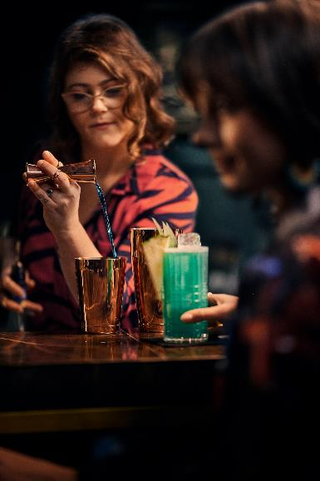
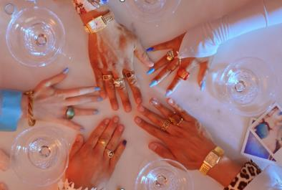
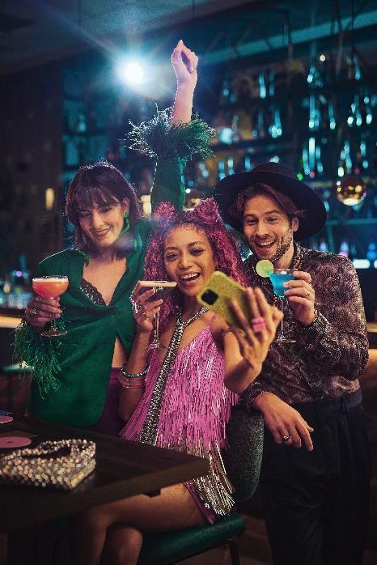
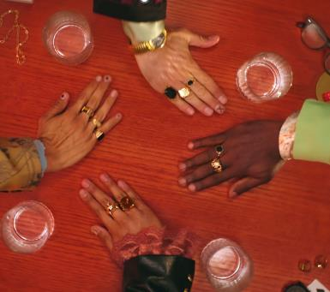
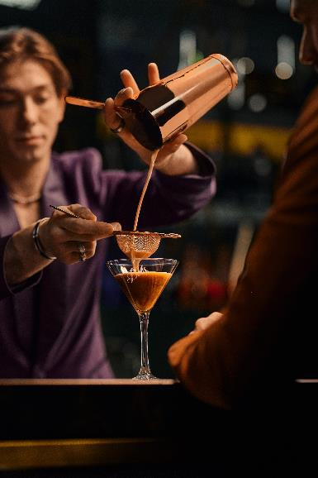

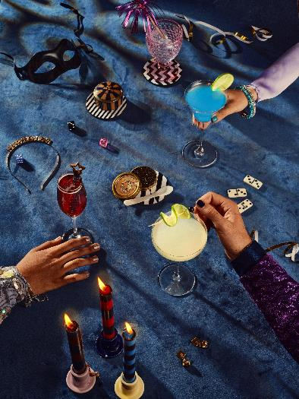
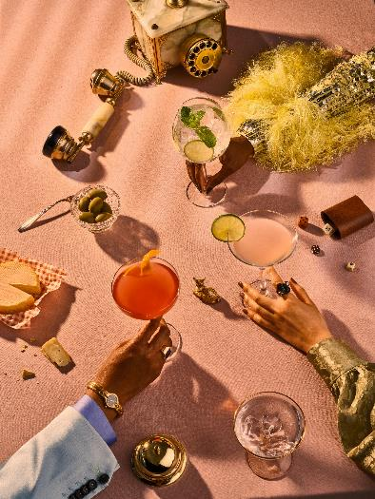
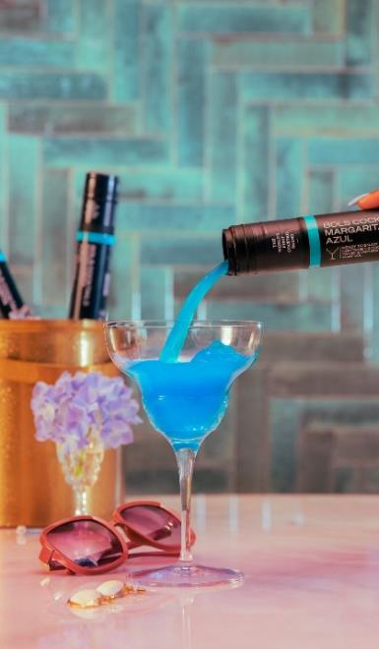
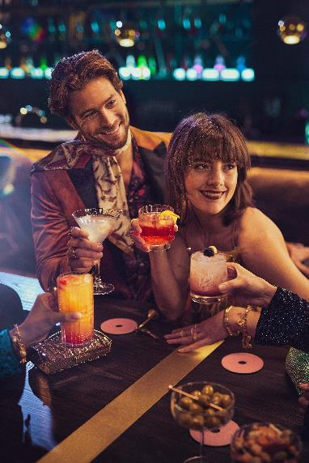
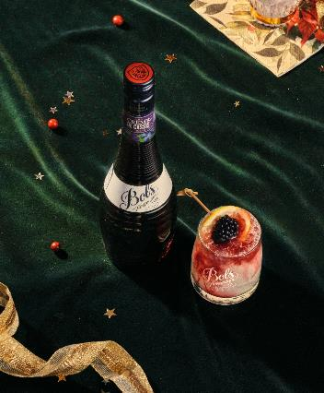
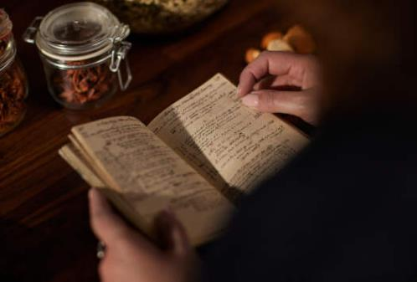
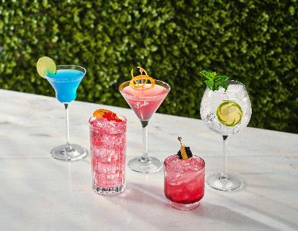

Liqueurs
“dare to compare”

Slide 2

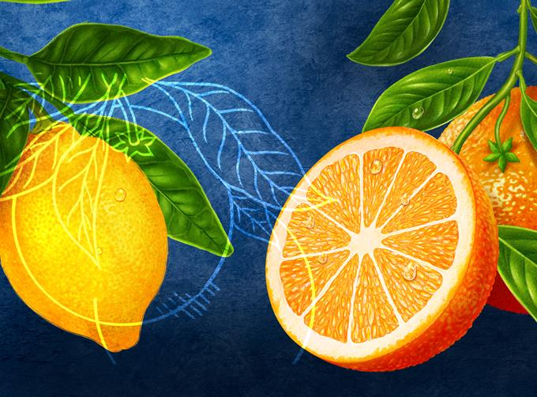

BOLS LIQUEURS’
UNIQUE BENEFIT
THE ONLY LIQUEUR RANGE
CRAFTED WITH NATURAL BOTANICALS
Bols liqueurs are crafted with natural botanicals to enrich their flavour and to create unique tasting cocktails. We are the only liqueur range to do so!
It is our philosophy that our liqueurs taste like real fruit, herbs or spices. This means that in order to match the real taste, you have to use real, natural botanicals.
It simply tastes better!

Slide 3
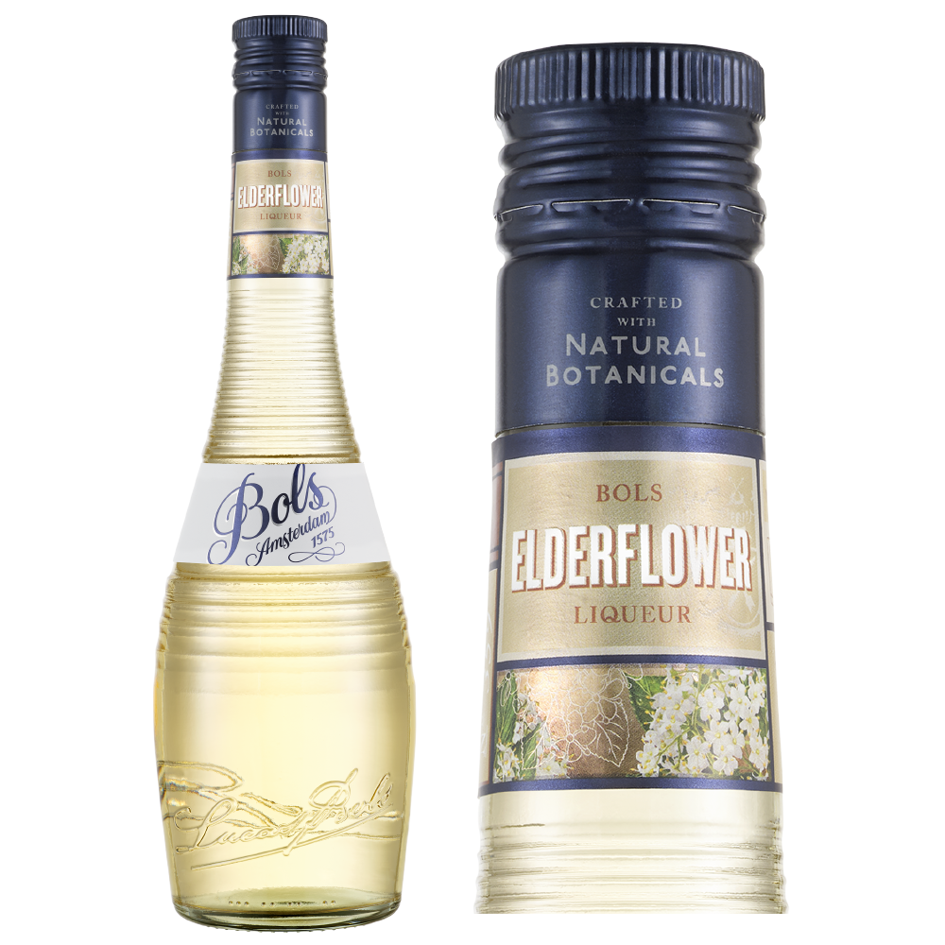


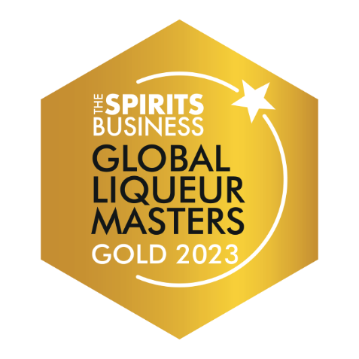
NATIONAL QUARTERLY FOCUS
APRIL-MAY-JUNE

Slide 4

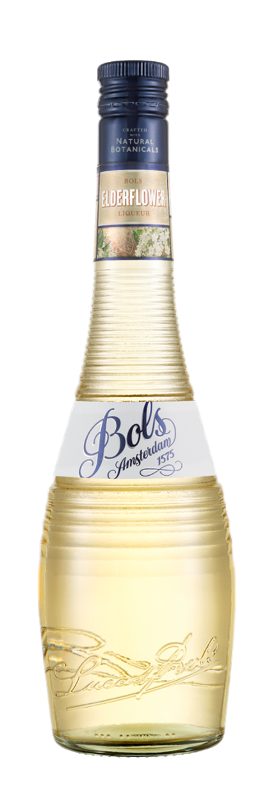

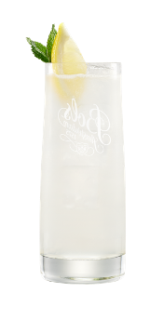
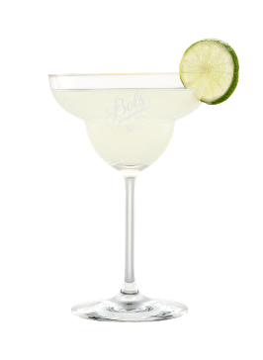
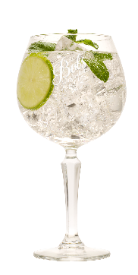
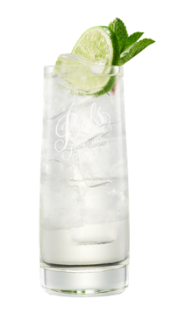
ELDERFLOWER – 17% ABV
Bols Elderflower is made from the cream coloured, honey scented blossoms of the elder tree. The elder tree blooms in early summer with crisp and somewhat juicy flowers which give Bols Elderflower a really fresh and fragrant flavour. Its pleasant aroma and full bouquet capture the feeling of a beautiful summer day, thanks to the secret extraction method of the Lucas Bols Master Distiller.
FLAVOUR PROFILE | COLOUR | FLAVOUR | THE NOSE
Floral | Light gold | Fresh and very floral | Full bouquet of honey scented elder blossoms, with a hint of apple
How to Enjoy:
Best served in one of our delicious cocktails,
also perfect when poured over Bols Genever
or with tonic water on ice.​
Scan for
more cocktail inspiration
Mixologist’s Choice
Elderflower Collins:
30ml Bols Elderflower​
30ml Bols Genever​
20ml Fresh lemon juice​
10ml Sugar Syrup​
Top up Soda Water
Shake all the ingredients,
except the soda water,
with ice and strain in
a Collins glass over
cubed ice. Top with
soda water and garnish
with a lemon wedge.
​
Popular Choice
Elderflower Margarita:
25ml Bols Elderflower​
45ml Tequila Blanco​
30ml Fresh Lime Juice
Shake all ingredients with cubed ice and fine strain into
a margarita glass.
Garnish with
lime wheel.
Elderflower Spritz
60ml Bols Elderflower
90ml Prosecco
30ml Soda water
Pour over cubed ice.
Garnish with
lime wheel.
Easy Mix
1/4 Bols Elderflower
3/4 Tonic water
Pour over cubed ice.

Slide 5
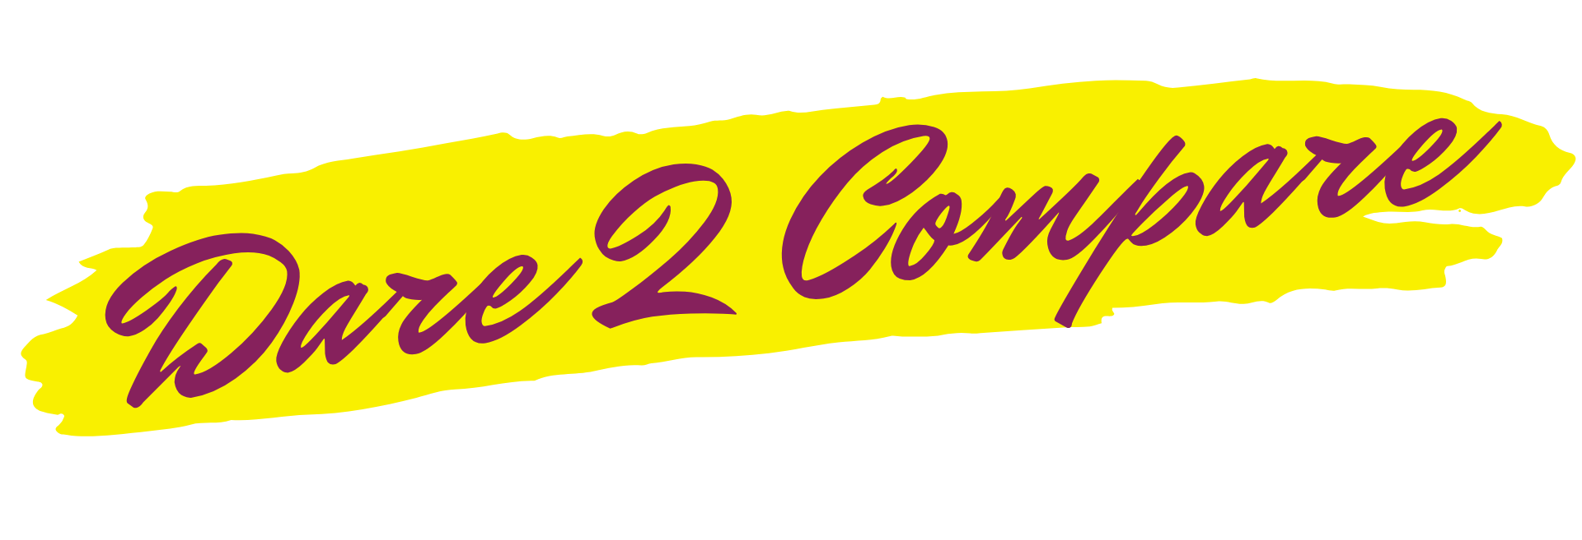
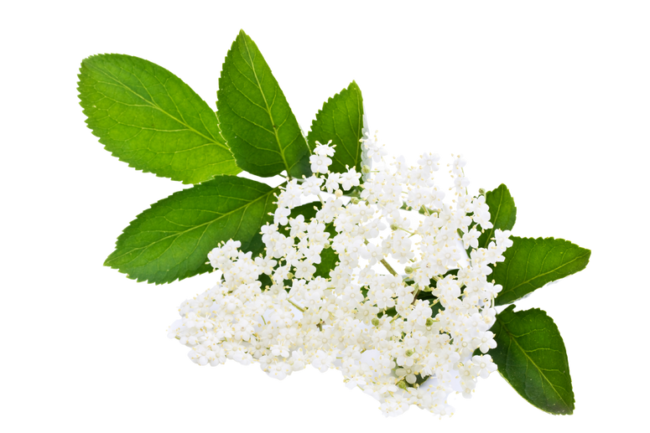
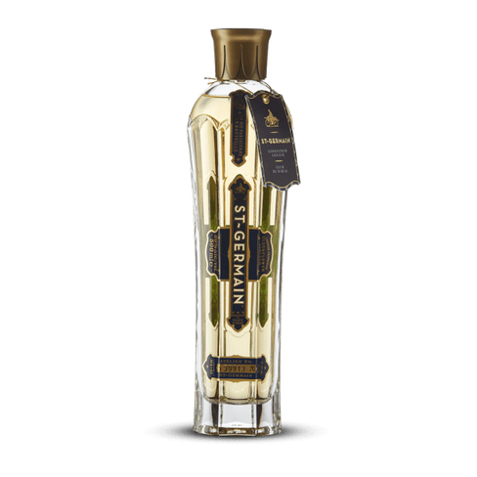

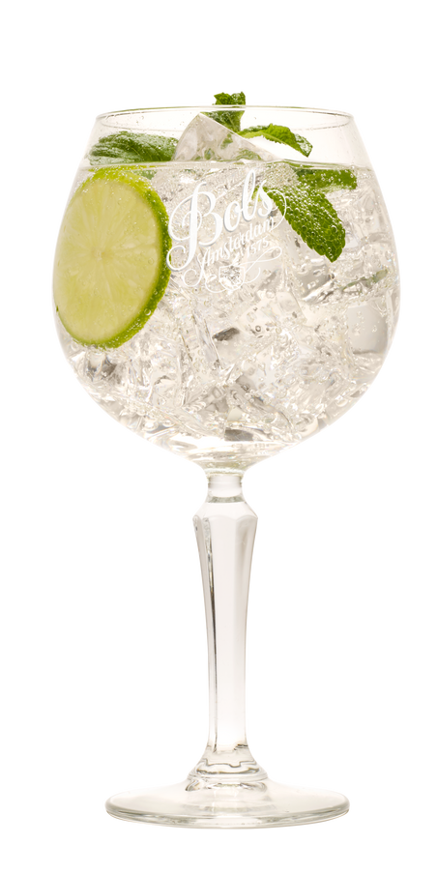
ELDERFLOWER- 17% ABV
VS
Global category leader
  Balanced sweetness without overpowering.
  Intense elderflower flavor with rose and citrus hints.
In Neat tasting:
Grassy and floral notes
add depth.
As a Cocktail ingredient:
Perfumed, clean Elderflower taste enhances cocktail complexity while staying subtle.
$0.48 vs $1.08 per oz
56% savings

Slide 6

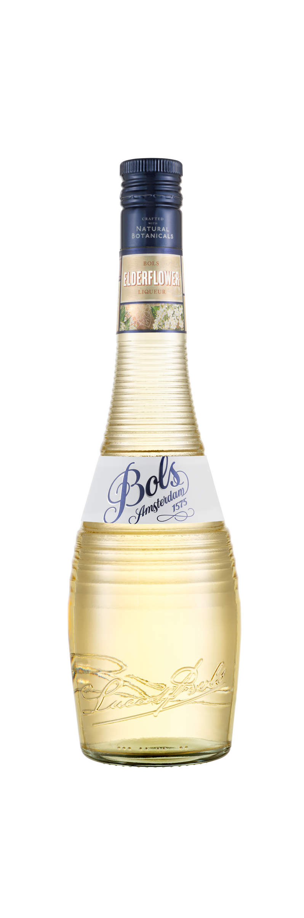


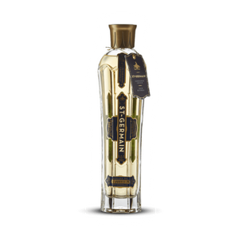
SIGNATURE COCKTAIL- ELDERFLOWER SPRITZ
The Key benefits of using a Bols Liqueur:
  Crisp & clean elderflower aroma: More floral intensity.
  More versatile & cost-effective: Higher margin without sacrificing quality and flavor.
Q: Why should a bar make an elderflower spritz with Bols Elderflower instead of St Germain?
A: Bols enhances the floral elegance without unnecessary sweetness, creating a more refreshing, balanced Spritz that guests will love.

Slide 7
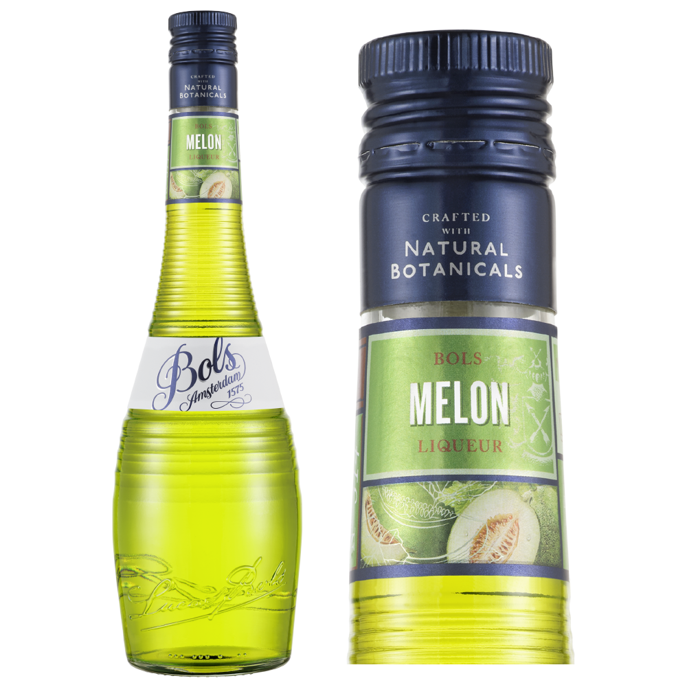
NATIONAL QUARTERLY FOCUS
JUL-AUG-SEPT

Slide 8

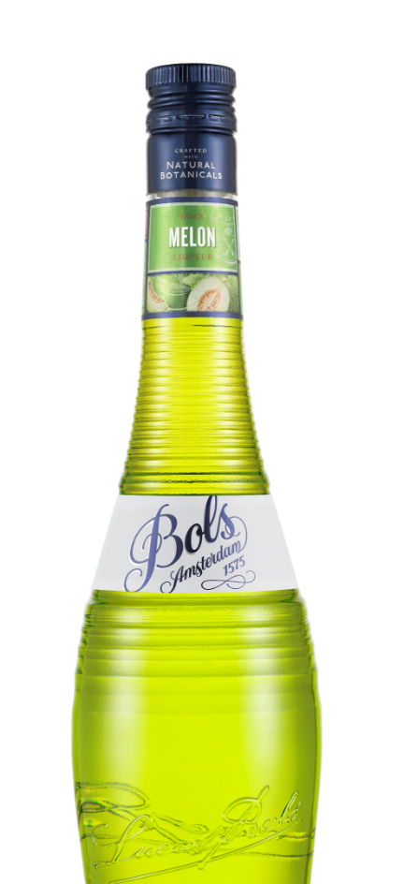

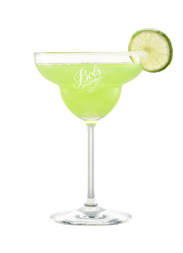
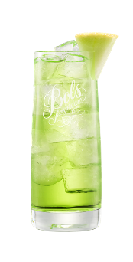
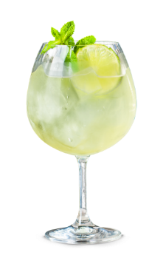
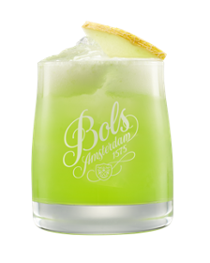
MELON – 17% ABV
Bols Melon is a light emerald green liqueur based on the honeydew melon, which originated in California and became extremely popular in Europe from the 19th century onwards. Melon has been a very popular liqueur since the late 1970s, and it is in two drinks that Bols Melon really made its name – the notorious party drink Dirty Sex on the Beach and the June Bug, which is present on the drinks list of thousands of bars all around the world.
FLAVOUR PROFILE | COLOUR | FLAVOUR | THE NOSE
Fruity | Light green | Freshly cut and cold honeydew melon​ | Smooth and sweet sun ripened melon
How to Enjoy:
Best served in one of our delicious cocktails:
Scan for
more cocktail inspiration
Mixologist’s Choice
Melon Sour:
60ml Bols Melon​
30ml Fresh Lemon Juice​
10ml Sugar Syrup​
15ml Egg White​
Shake all ingredients to emulsify the drink. Add ice and shake to cool,
strain in a rocks glass
filled with cubed ice.
Garnish with a melon slice.
Popular Choice
Melon Margarita:
15ml Bols Melon​
15ml Bols Triple Sec​
30ml Tequila Blanco​
30ml Fresh Lime Juice​
Shake all ingredients with ice.
Fine strain in pre-chilled
margarita glass. Garnish with
a lime wedge and a sugar rim.
Easy Mix
1/4 Bols Melon
3/4 Tonic Water
Pour over cubed ice
Spritz
3 parts Prosecco
2 parts Bols Melon
1 part Soda water
Pour over cubed ice.

Slide 9
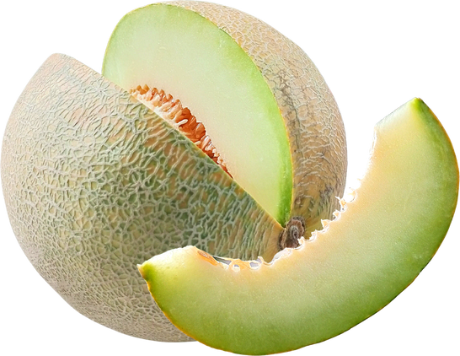
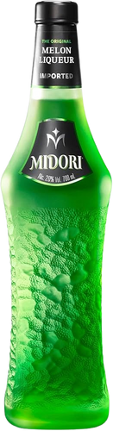
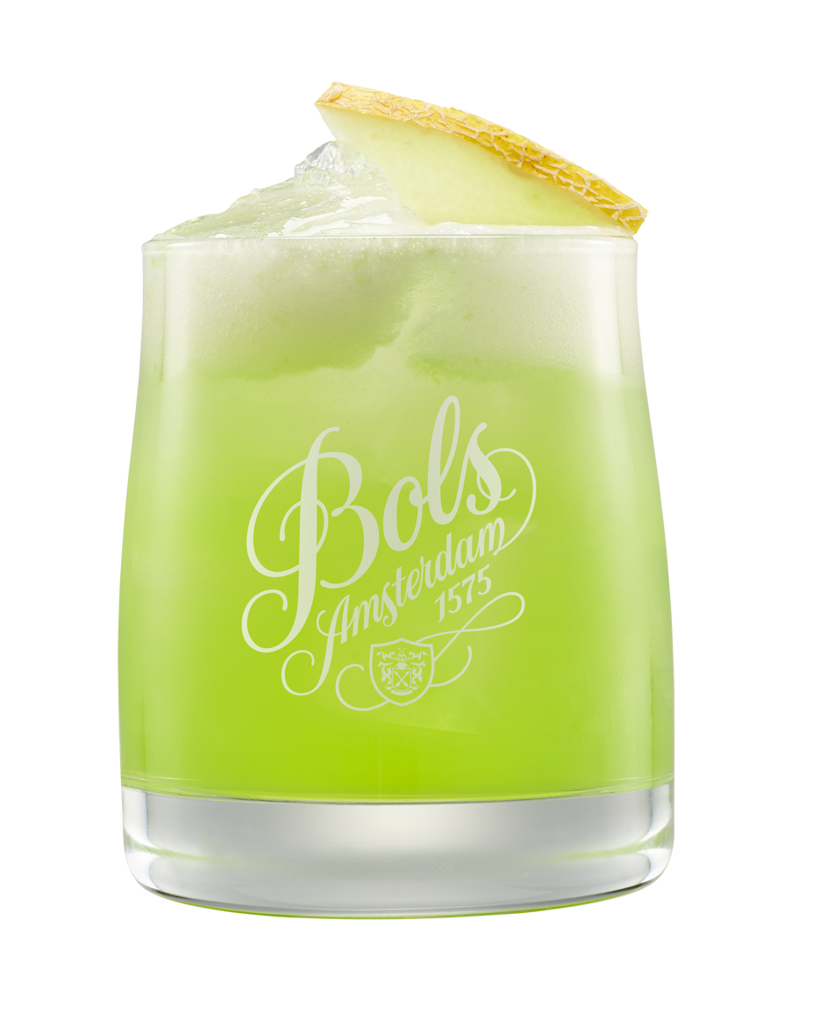
MELON- 17% ABV
VS
Global category leader
  Fresh, delicate aroma mirrors real fruit.
  Balanced profile with a longer finish.
In Neat tasting:
Authentic melon flavor with
light nuttiness.
As a Cocktail ingredient:
Smooth, light drinking experience.
Ideal for creating well-rounded cocktails.
$0.30 vs $0.55 per oz
45% savings

Slide 10
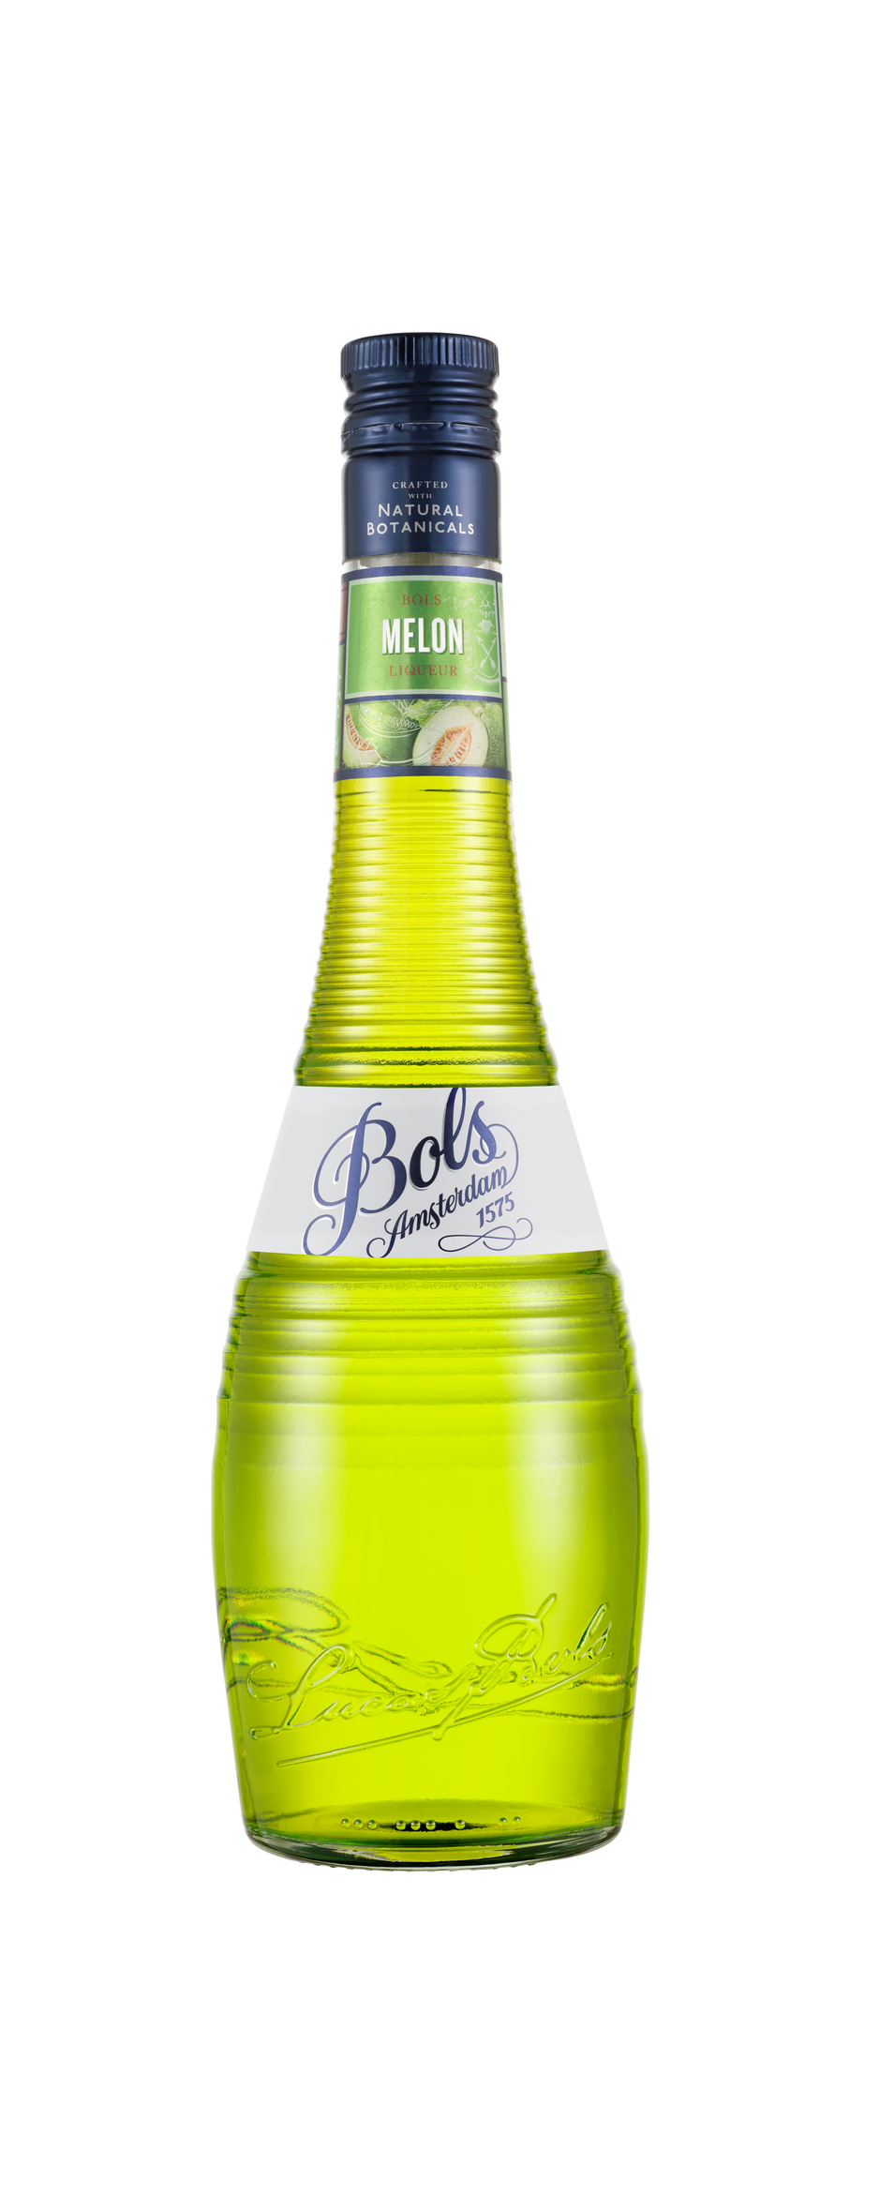

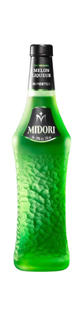
SIGNATURE COCKTAIL-
MELON SOUR
The Key benefits of using a Bols Liqueur:
  Stronger honeydew flavor: Less artificial, more vibrant and fresh fruitiness.
  Less syrupy, better balance: Keeps drinks refreshing, not overly sweet.
Q: Why should a bar make a Melon Sour with Bols Melon instead of Midori?
A: Bols delivers a more vibrant melon punch with better balance, creating a lighter, more drinkable Melon Sour.

Slide 11
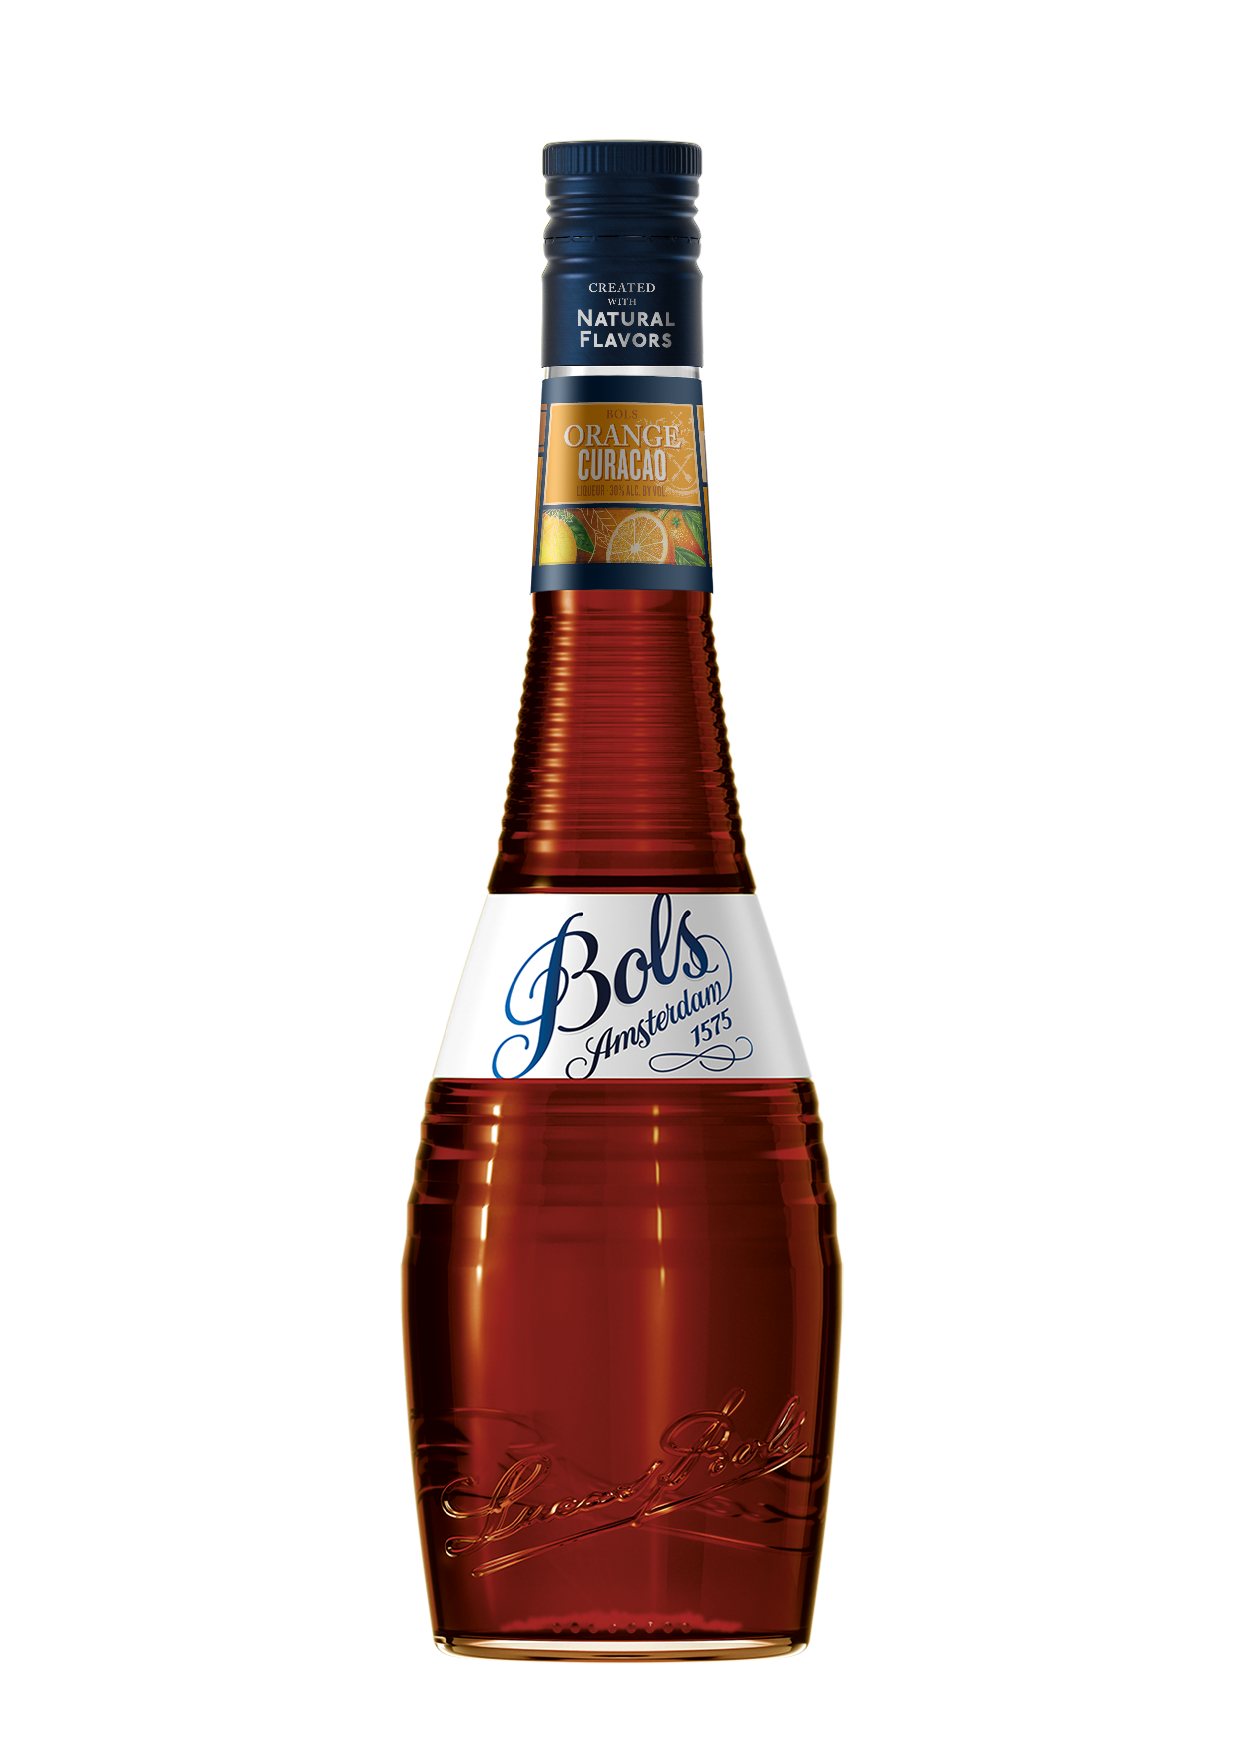
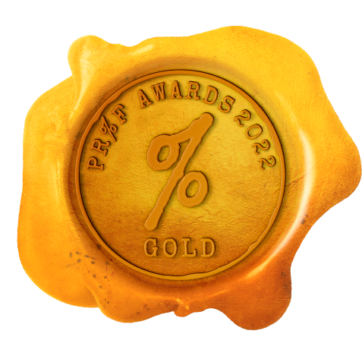
NATIONAL QUARTERLY FOCUS
OCT-NOV-DEC

Slide 12

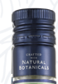

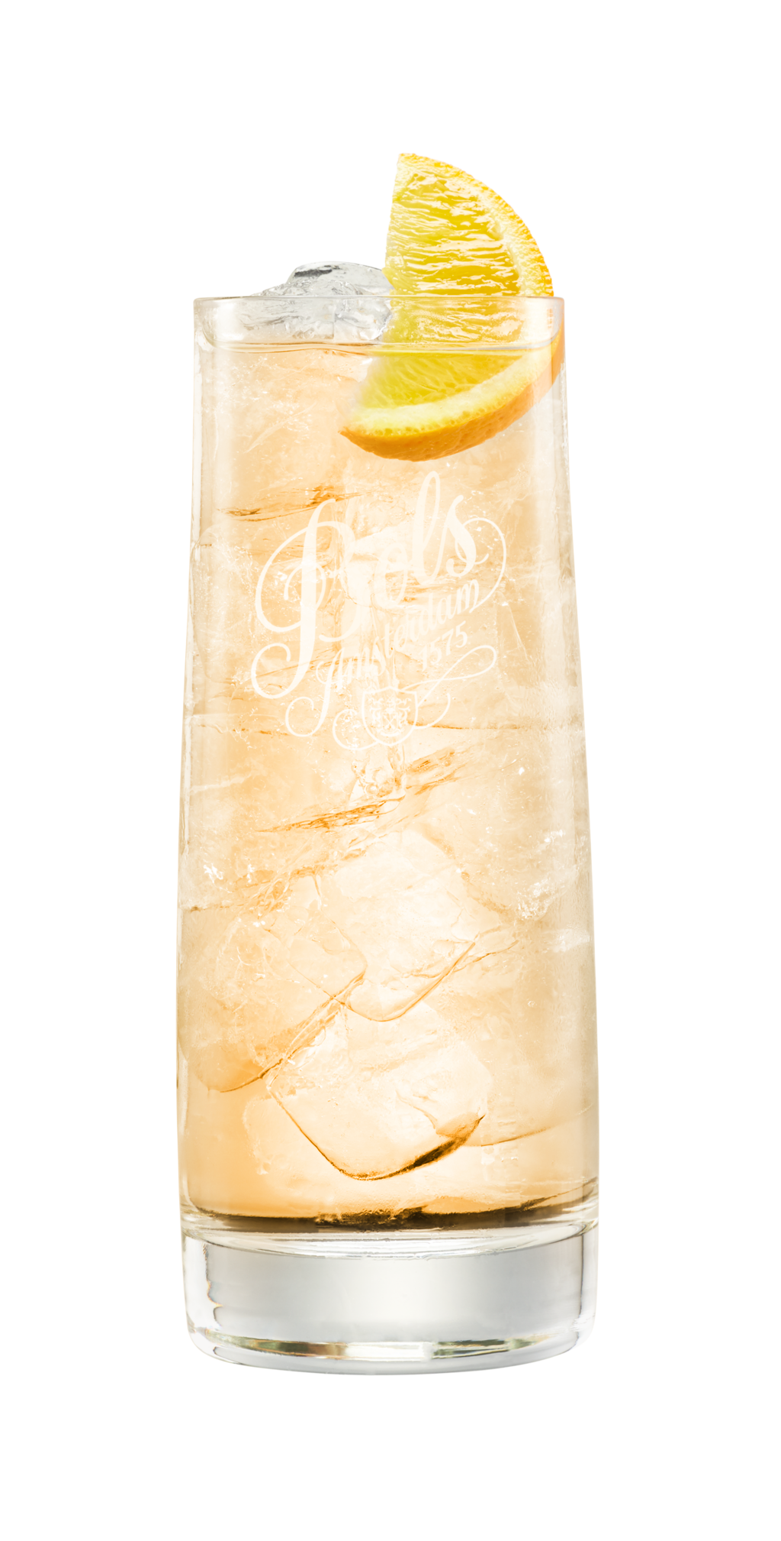
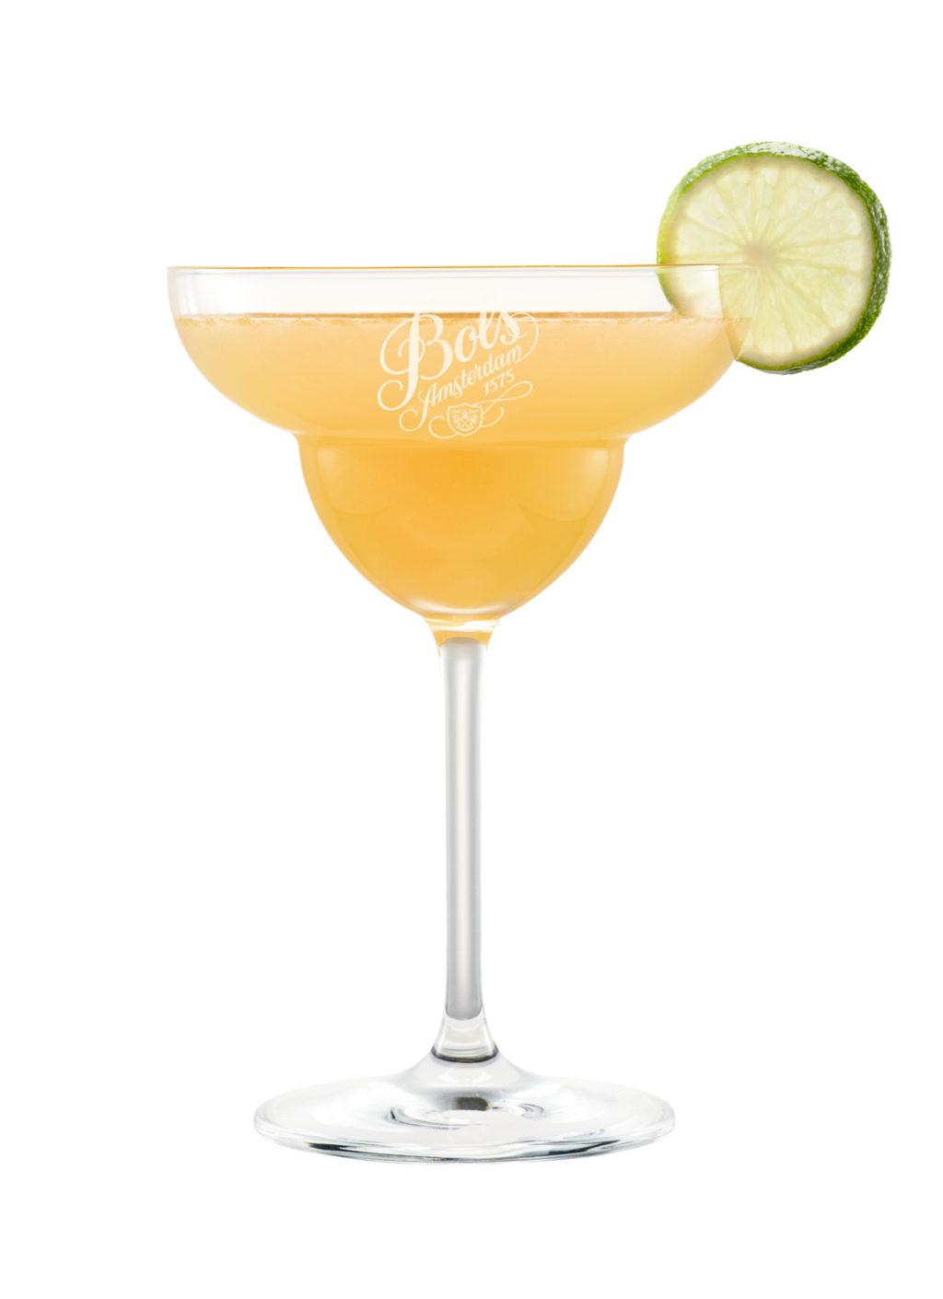
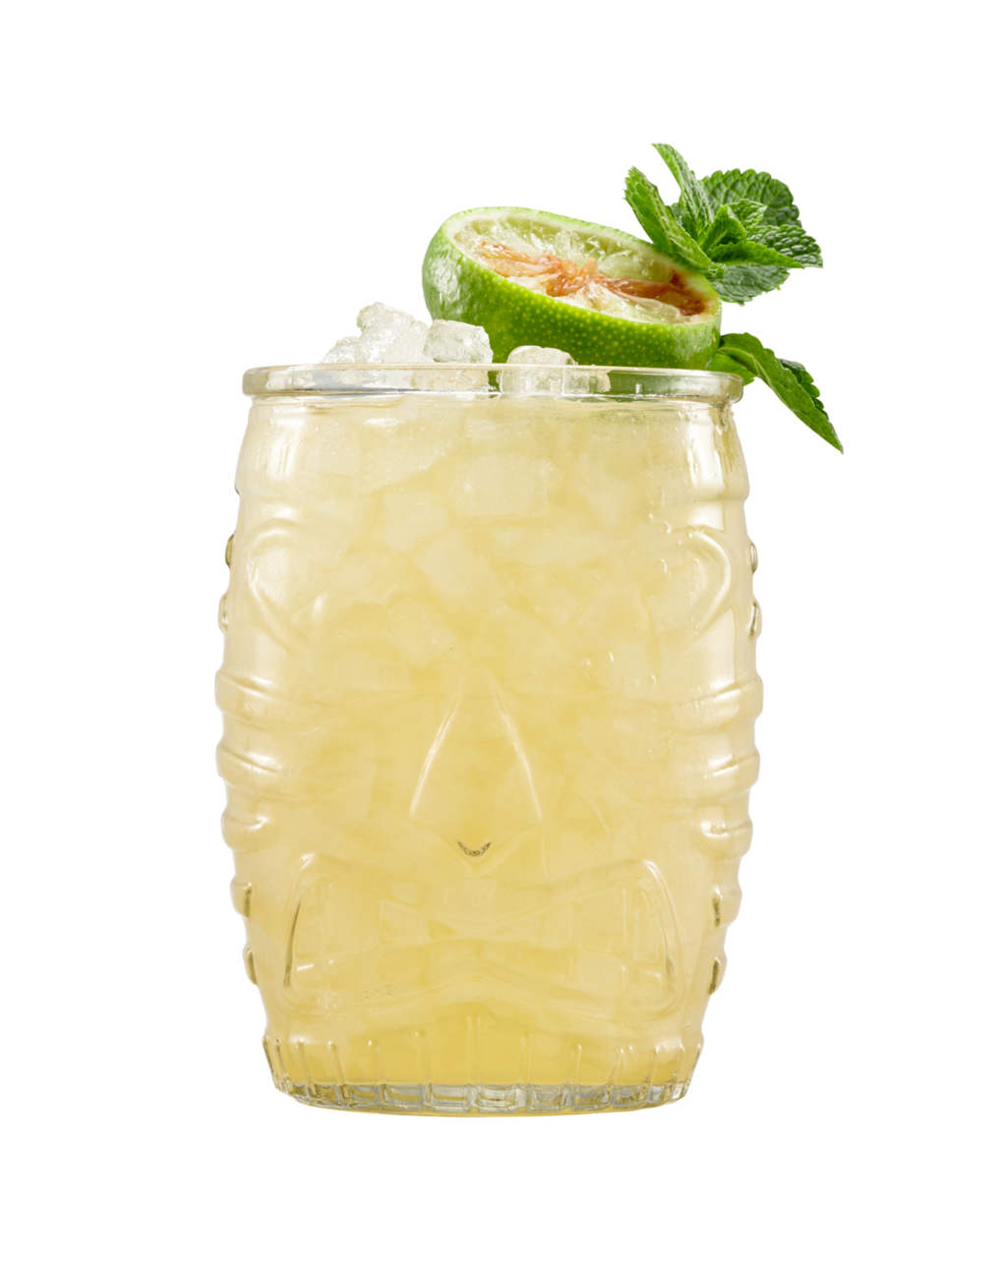
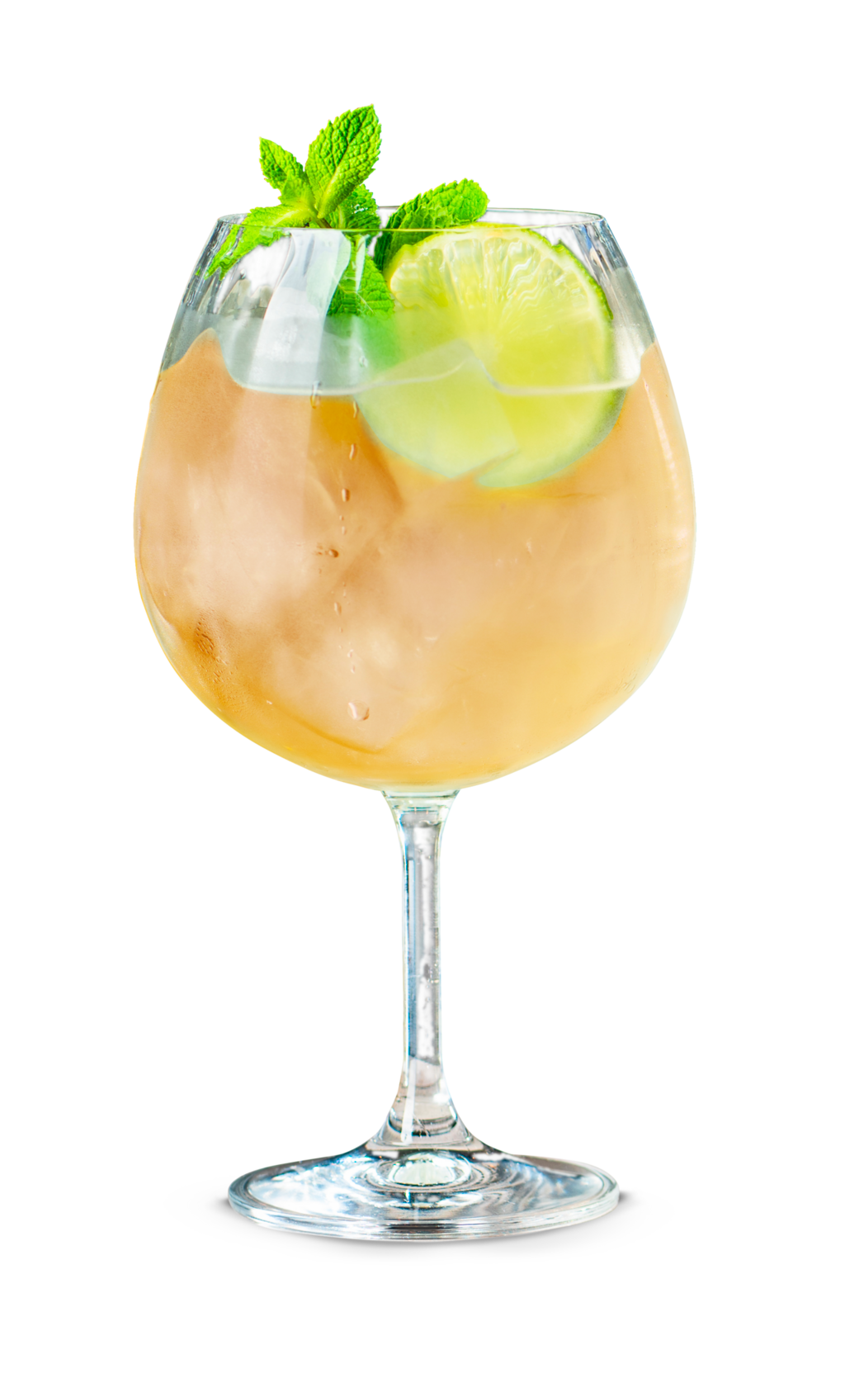
ORANGE CURACAO – 24% ABV
Bols Orange Curacao is famous for its unparalleled aroma, taste and beautiful deep orange glow that matches its rich full flavour. Made from Curacao orange peel distillates and a hint of rum, it gives fine citrus on the palate, balanced by fruity sweetness for a dry and firm finish. Bols Orange is THE ingredient to use in the world’s most important rum cocktails. 24% ABV
FLAVOUR PROFILE | COLOUR | FLAVOUR | THE NOSE
Fruity | Dark Gold, Orange Glow | Fine citrus balanced by fruity sweetness, dry and firm finish | Fresh orange with a hint of rum
How to Enjoy:
Best served in one of our delicious cocktails:
Scan for
more cocktail inspiration
Mixologist’s Choice
Aged Mai Tai:
25ml Bols Orange Curacao
45ml Bols Barrel Aged Genever
25ml Fresh Lime Juice
5ml Orgeat Syrup
10 ml Sugar Syrup (2:1)
Shake all ingredients with ice
And strain into a tiki glass over
Crushed ice. Garnish with lime
shell and a mint sprig.
Popular Choice
Margarita:
30ml Bols Orange Curacao
40ML Tequila Blanco
25ml Lime juice
Shake all ingredients and
pour into a margarita glass.
Garnish with a lime wedge
and a half salt rim.
Easy Mix
1/4 Bols Orange Curacao
3/4 Tonic water
Pour over cubed ice.
Spritz
3 parts Prosecco
2 parts Bols Orange Curacao
1 part Soda water
Pour over cubed ice.

Slide 13
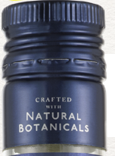
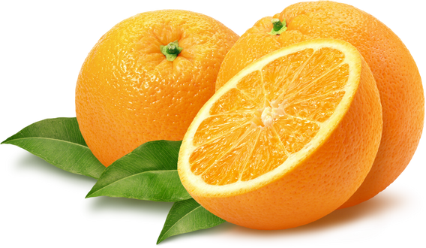

ORANGE CURACAO- 24% ABV
VS
Global category leader
  Bright orange zest notes add citrus-forward freshness to cocktails
  Perfect for bright, balanced, and refreshing drinks.
In Neat tasting:
Fresh orange aroma, hint of rum.
Fine citrus, fruity sweetness, dry finish
As a Cocktail ingredient:
Enhances cocktails by adding rich, bittersweet citrus depth, balancing acidity with nuanced sweetness, enhancing aroma, and contributing vibrant color and complexity.
$0.30 vs $1.00 per oz
70% savings

Slide 14
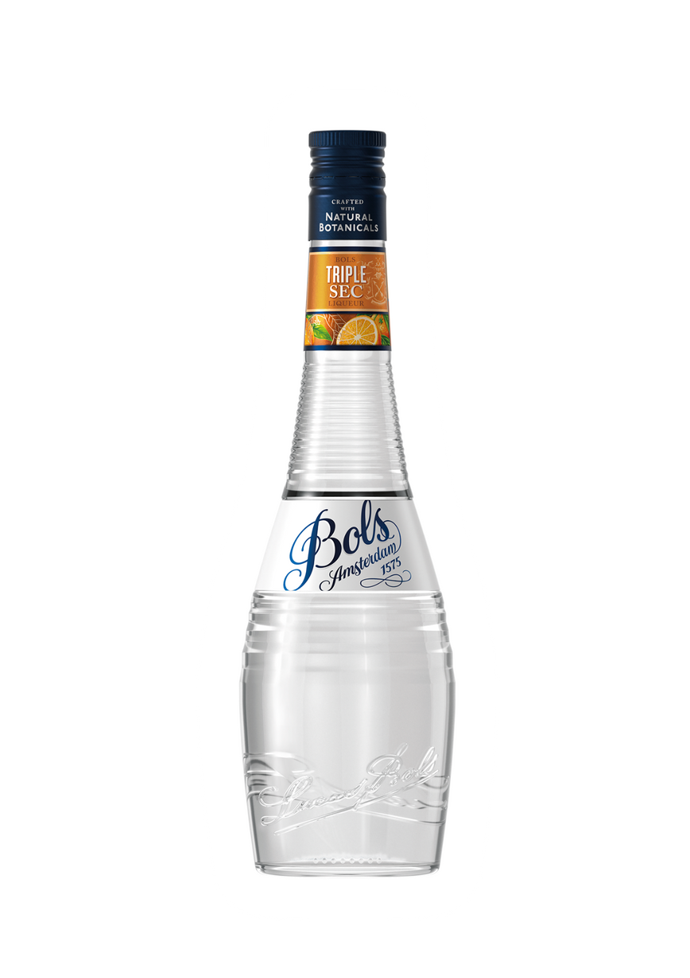
SIGNATURE COCKTAIL-
MARGARITA
The Key benefits of using a Bols Liqueur:
  Bright orange zest notes at 24% ABV that add citrus-forward freshness to cocktails
  Bright, balanced, and refreshing drinks at a lower cost.
Q: Why should a bartender make a Margarita with
Bols Orange Curacao instead of Grand Marnier ?
A: Bols citrus-forward freshness leads to bright, balanced, and refreshing Margaritas. Grand Marnier’s notes of oak vanilla and spice can be overpowering

