Slide 1
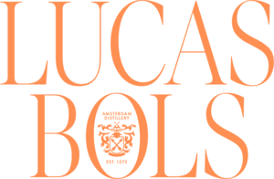

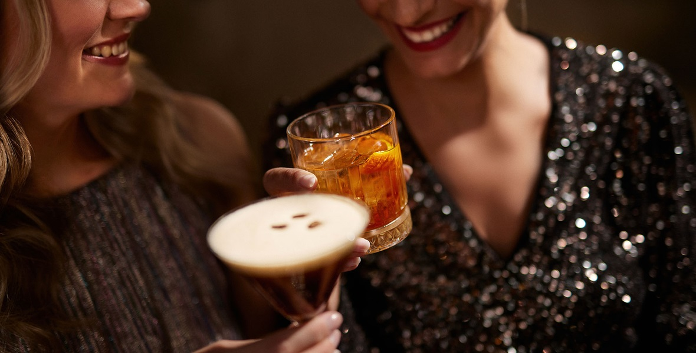

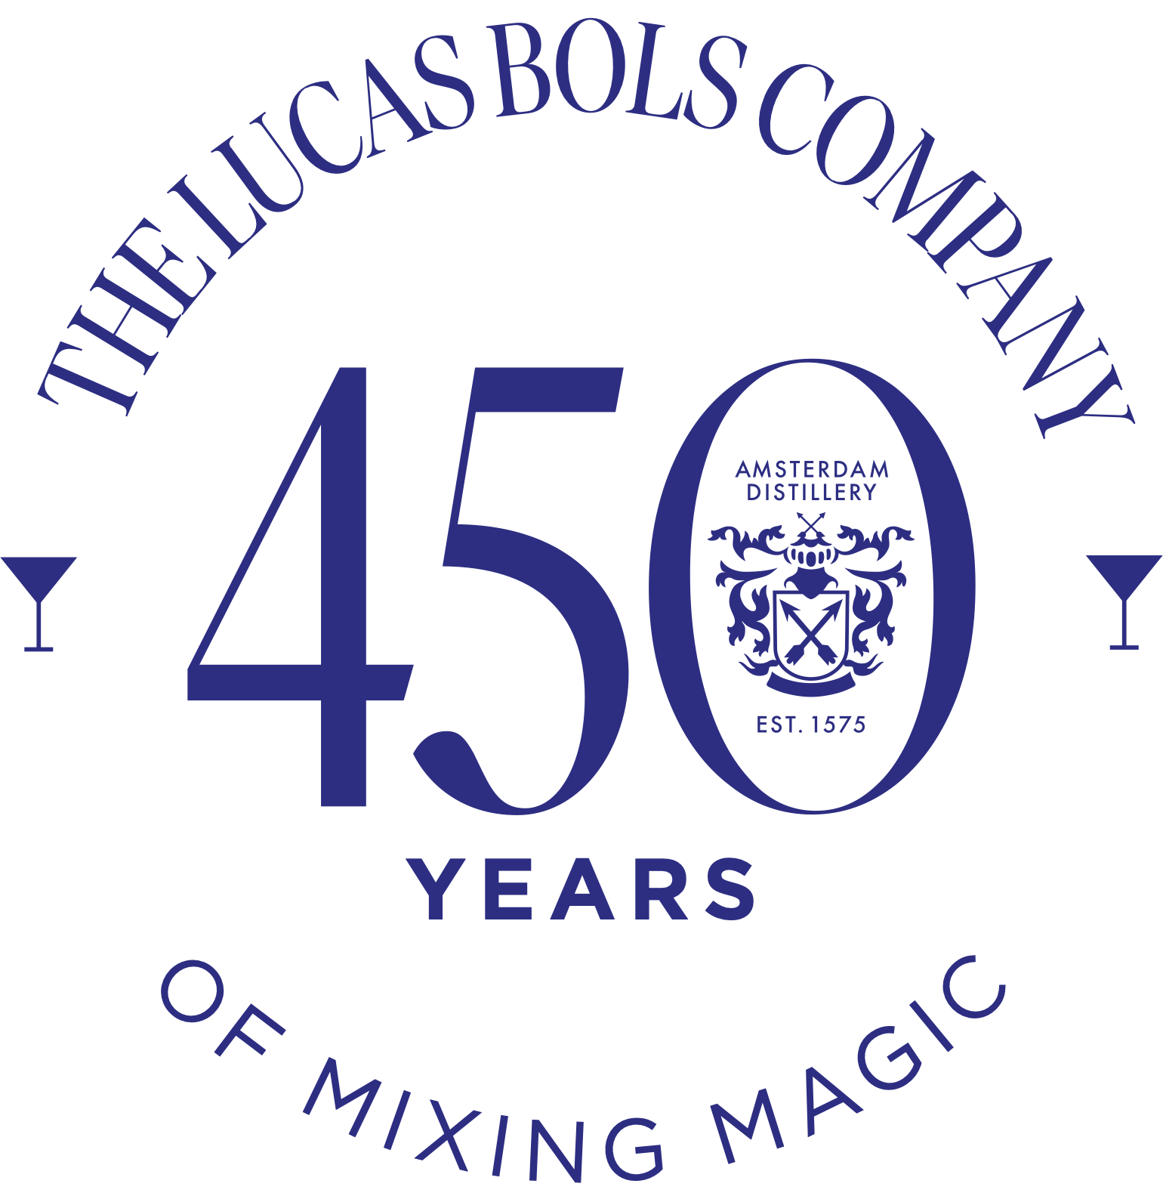

OUR MISSION IS TO CREATE GREAT COCKTAIL EXPERIENCES AROUND THE WORLD
FOR 450 YEARS SINCE 1575

Slide 2

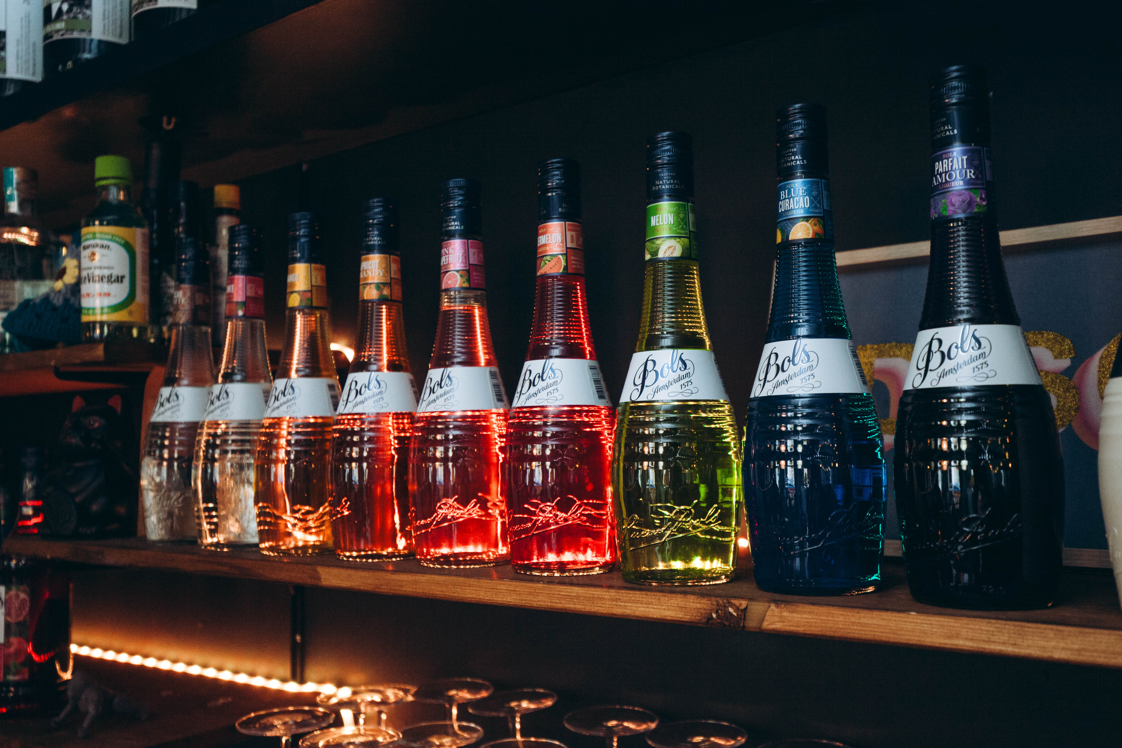


Slide 3
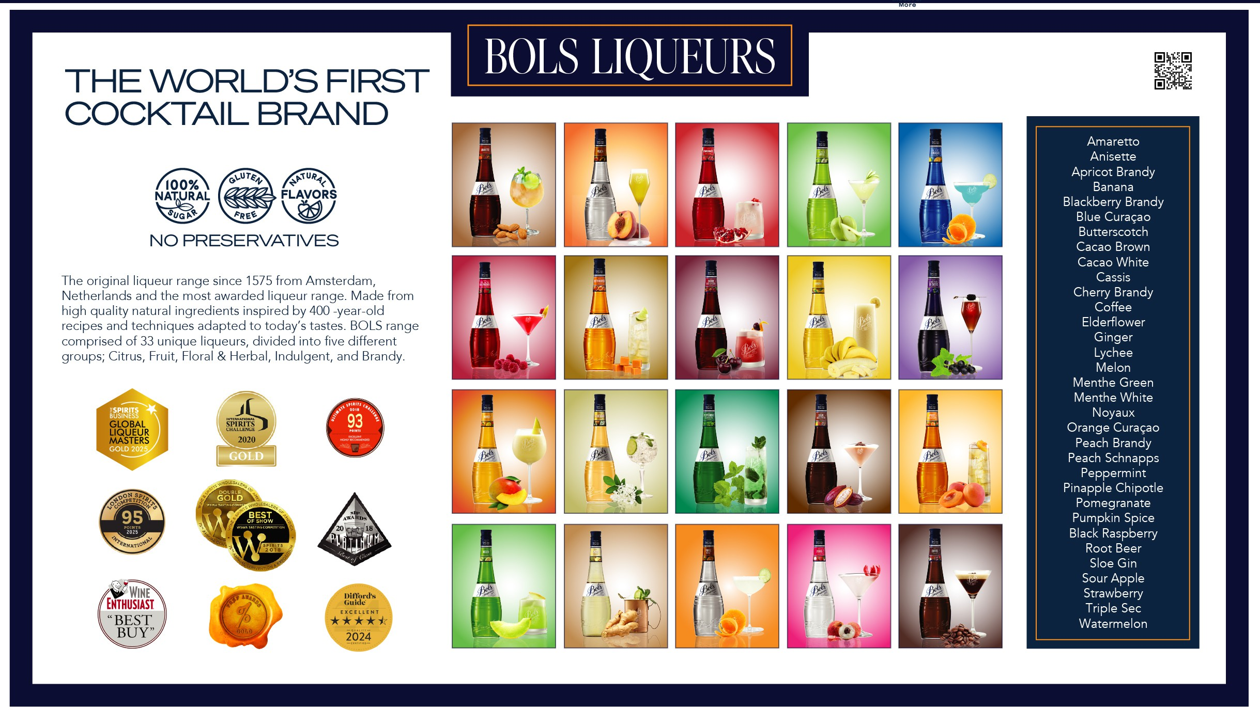

Slide 4
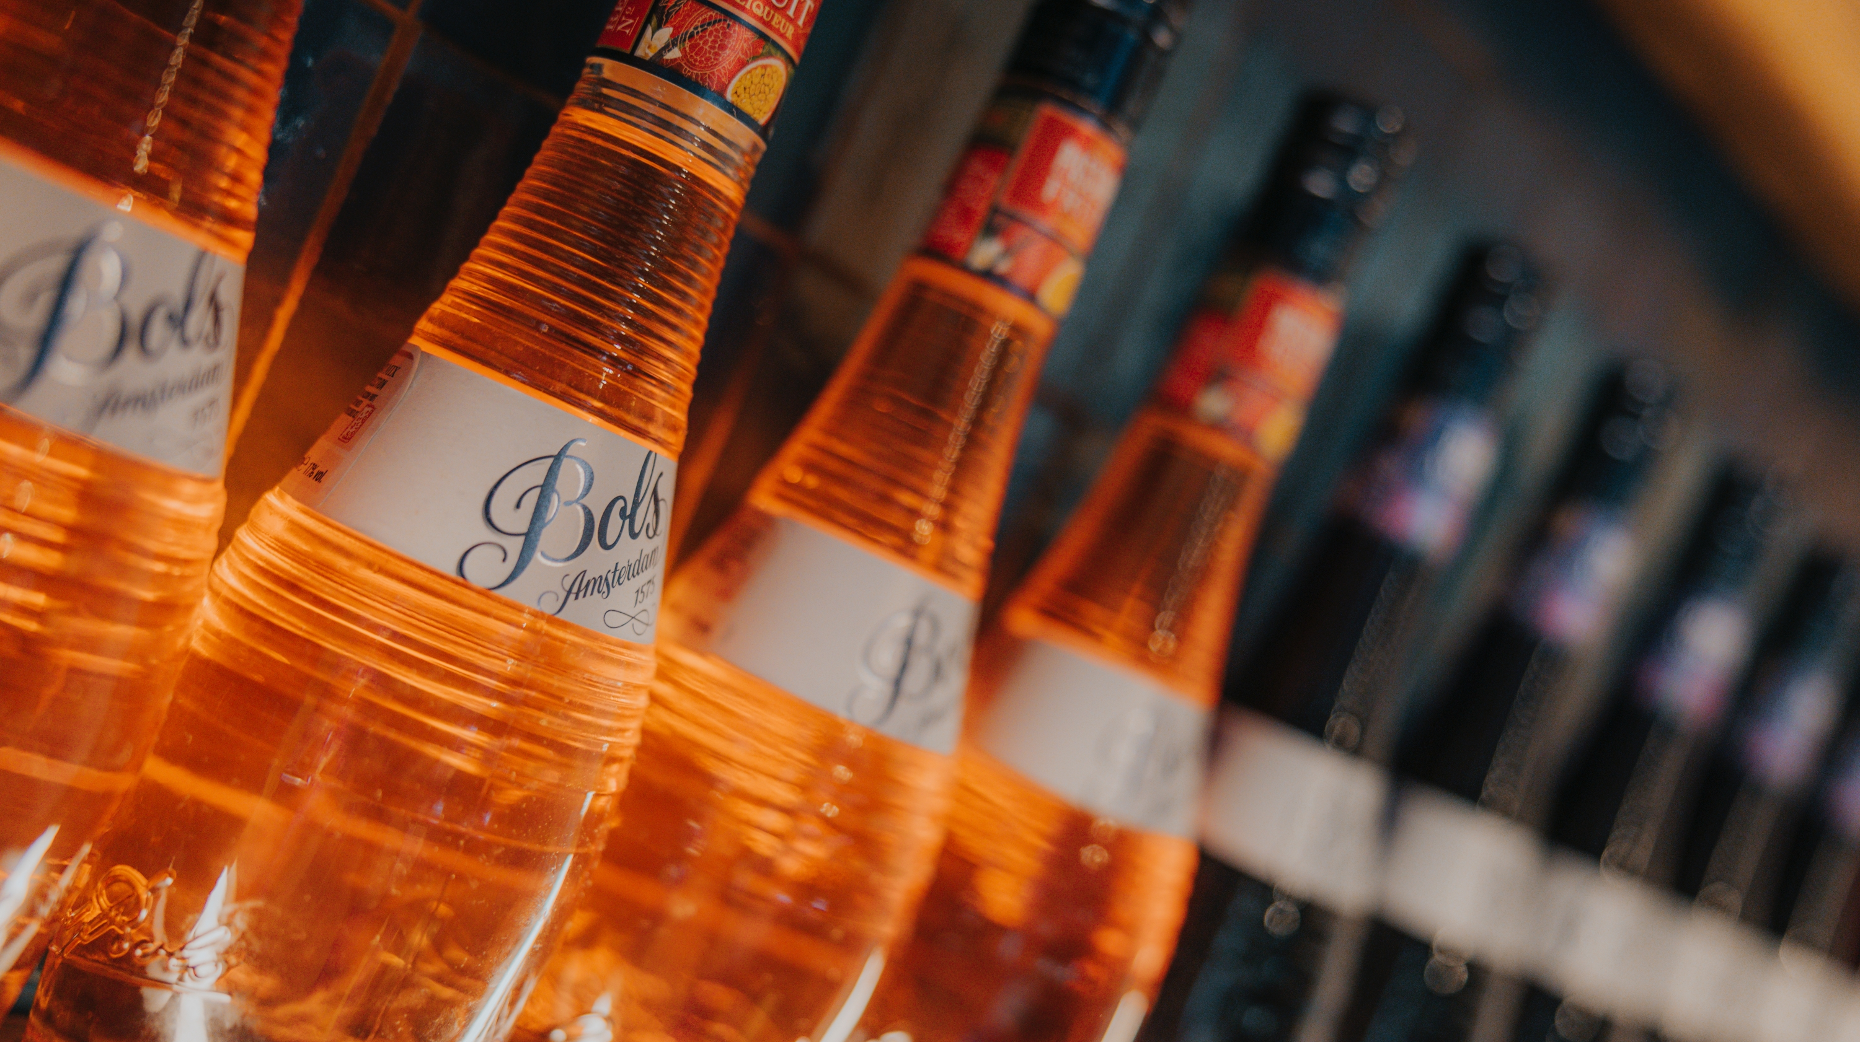




Why liqueurs?
Flavoring powerhouse for cocktails
Appealing drinks made easy
A stable flavor all year round
Focus on low unit drinks
  Loud flavor from natural botanicals.
  A colorful and versatile range to create any cocktails.
  Enjoy your favorite flavor and drink even in winter.
  A responsible drinking experience for more enjoyment!

Slide 5
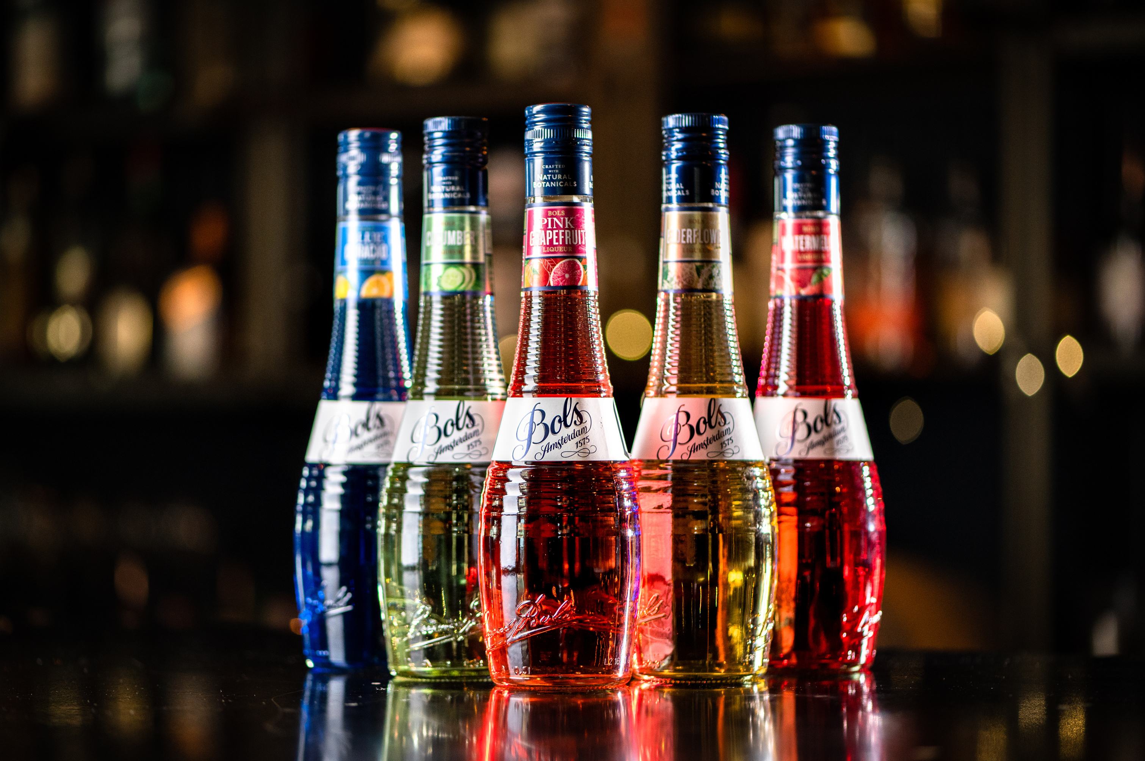

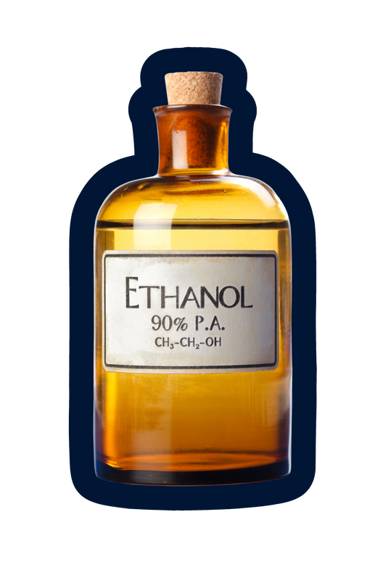

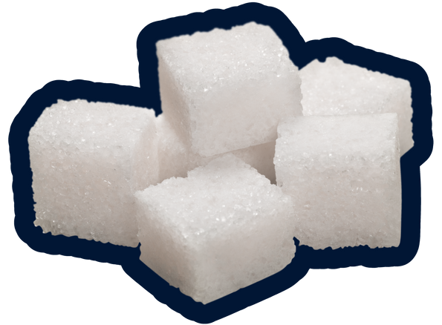

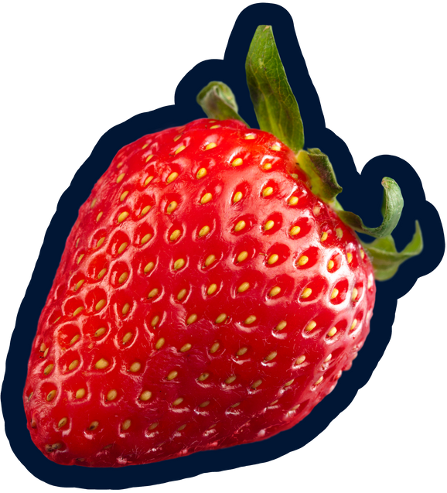

Liqueurs
Liqueurs
A liqueur is a flavored and sweetened spirit.
According to EU regulations:
  For the production of liqueurs, a base spirit of any raw material may be used. Bols uses sugar beet molasse neutral alcohol.
  Sugar: a minimum of 100 grams per liter must be added. Crème de.. A minimum of 250 grams of sugar per liter must be added.
  Flavor: Bols uses maceration, infusion, percolation and distillation for the flavoring of their liqueurs. Fresh fruit juices may also be added.
A liqueur must have a minimum of 15% abv.
Liqueurs are sometimes referred to as cordials in the USA, but cordial in other parts of the world indicates a nonalcoholic syrup.
Some producers call liqueurs schnapps. They are typically at least 40% and only lightly sweetened if at all.

Slide 6
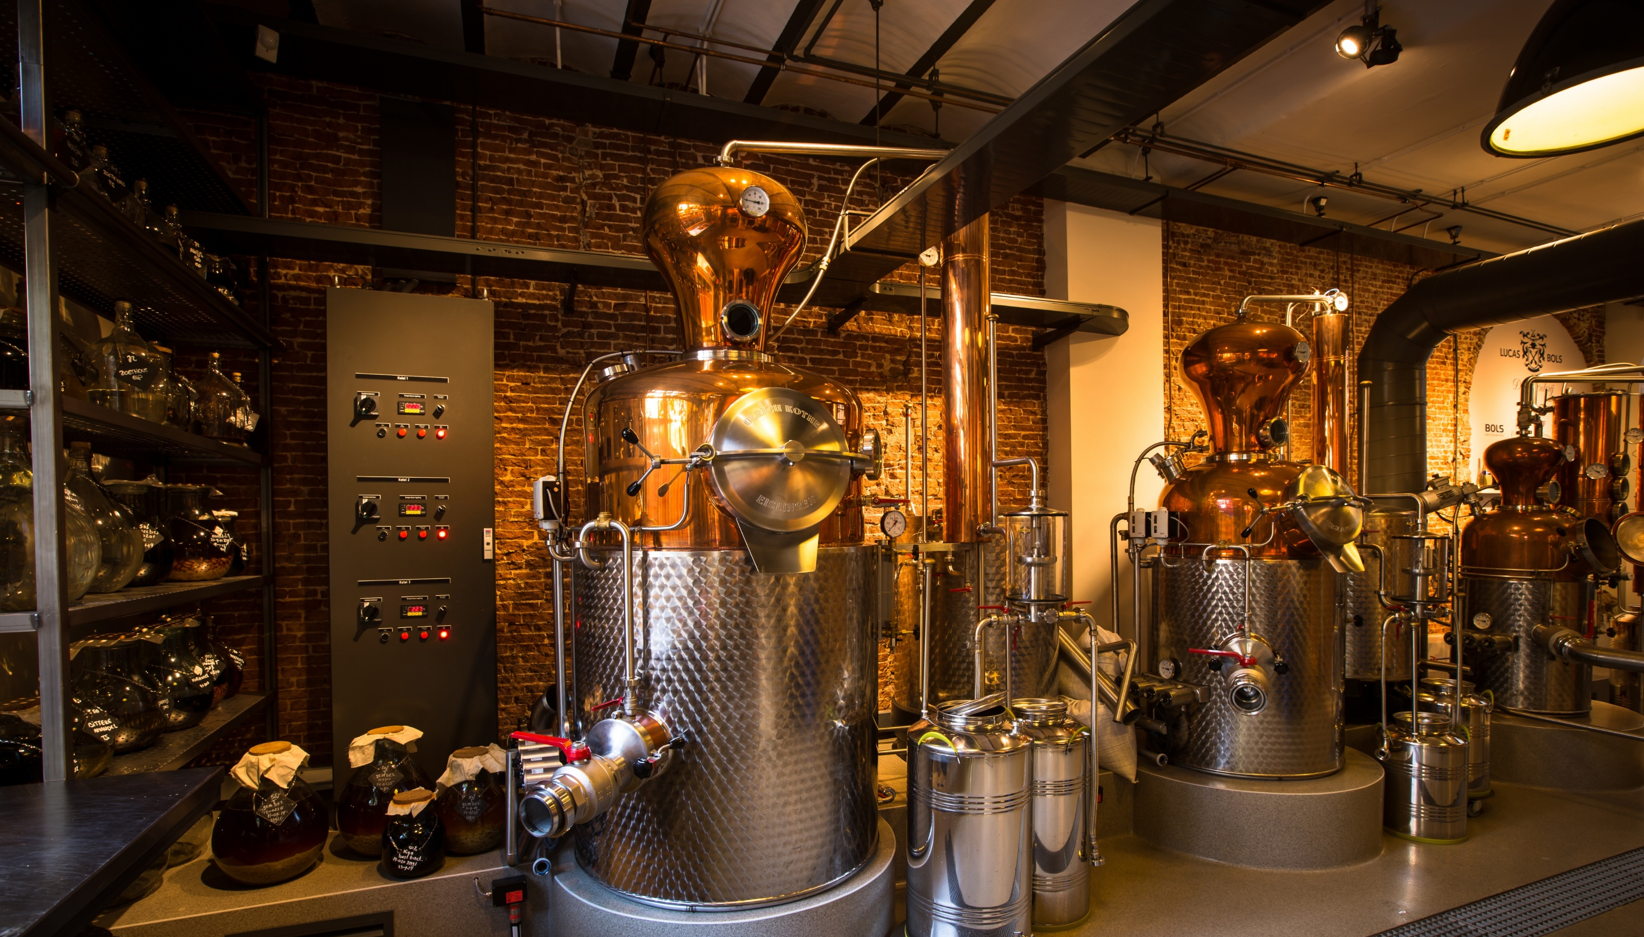
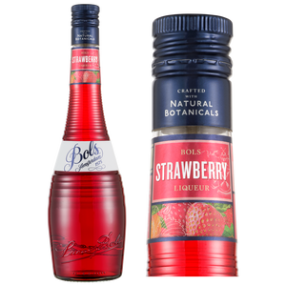
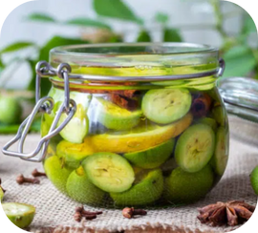

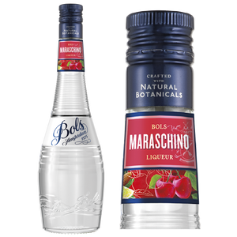
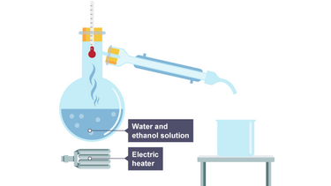
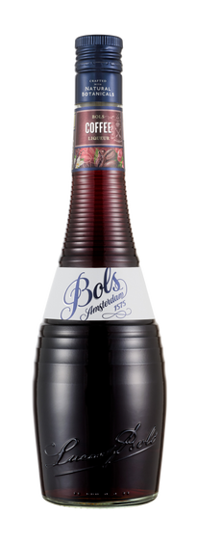
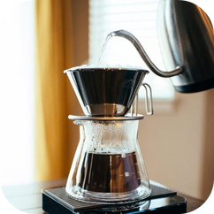
Liqueur production
Liqueur Production
3 methods to add flavor to your liqueur:
MACERATION
Mainly for soft fruit that would disintegrate if distilled: the fruit or herbs are left sitting around in neutral spirit until they absorb the flavor. This produces a colored extract called a tincture.
RE-DISTILLATION
Just like good-quality gin: add your flavoring agents (herbs, fruits, whatnot) to spirit and re-distill it. Distillation is normally used for harder ingredients like fruit peels, seeds and roots, and produces a clear distillate called an esprit.
PERCOLATION
Just like making an espresso: put your (hard) ingredients into a filter and drip alcohol down through them. Percolation produces a dark, typically slightly bitter extract called a tincture.

Slide 7
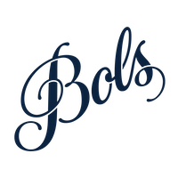



Our claim: we excel in…
FLAVOR
COCKTAILS
MARGIN
  Made for cocktails
  All our Bols Liqueurs give a very clean and explicit botanical flavor that elevates cocktails and fuels creativity.
  Better value proposition.
  Equal (if not better) quality, yet more affordable option and still with international premium allure.
  → Our liqueur delivers the authentic flavor it advertises, standing out from competitors by capturing the essence of the taste in a more genuine way.
  All liqueurs made with natural botanicals.

Slide 8



HOW TO: conduct a
tasting (3 levels)
  Depending on the resources available to you and the type of crowd you are trying to reach
Tier
Tier
Tier
Neat tasting
Easy Mix
Star cocktail
  Comparative tasting of the two liquids with a mixer.
  WHY: see how the flavor shines in practice when diluted with approachable mixers.
  Comparative tasting of the two liquids in the signature cocktail. (Most popular drink associated with the flavor.
  WHY: see how the flavor shines in practice with complex recipes.
  Comparative tasting of the two liquids pure.
  WHY: Focus on liquid quality and raw flavor.

Slide 9


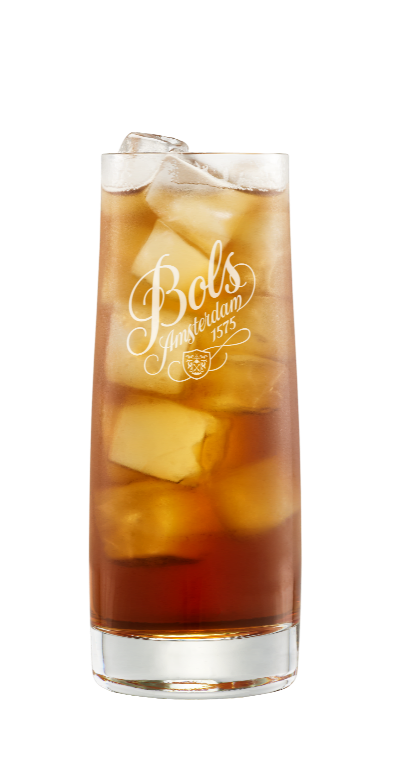
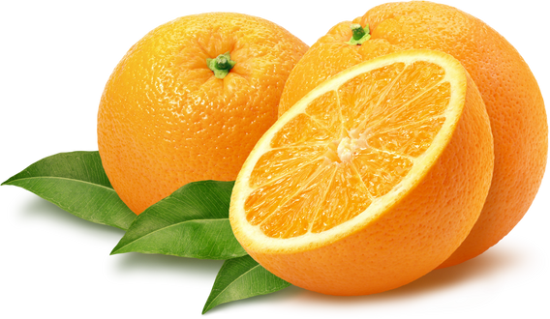
Tasting judging criteria:
  Two variables to consider when conducting the tasting with either tiers.
Authenticity
Mixability
  → Taste as close to the natural botanical/fruit.
  → Taste like the single flavor it advertise on the bottle (you get what you buy)
  → How the flavor shines through other ingredients.
  → The strength and balance of the product in a mixed drink.

Slide 10
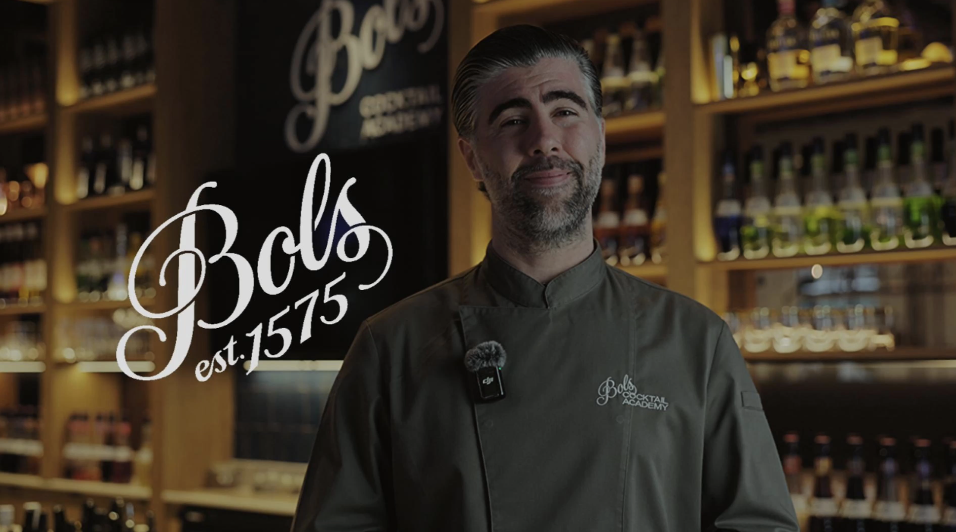
Watch the "DARE 2 COMPARE:
HOW TO CONDUCT A TASTING" Video

Slide 11
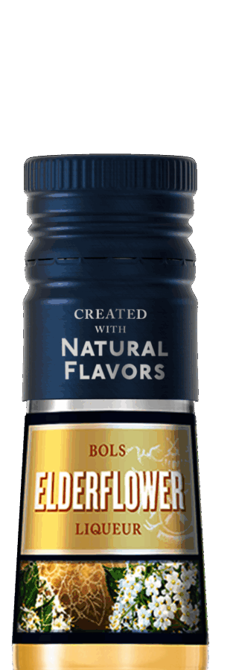
ELDERFLOWER COCKTAIL TRENDS IN THE USA
What’s trending in U.S. cocktails
Elderflower has fully graduated from niche to mainstream cocktail modifier, particularly via spritz culture. Coverage from Forbes describes how lighter spritzes built around elderflower liqueur are reshaping seasonal menus and cocktail preferences, focused on refreshment and approachability. (Forbes)
Meanwhile Business Insider reports the Hugo Spritz — a prosecco-plus-elderflower serve — has surged in popularity, outpacing the traditional Aperol spritz with strong search growth and social media buzz. (Business Insider)
Regional bar coverage also notes a resurgence of elderflower, which once dominated menus and is now returning as bartenders revisit floral flavors with modern creativity. (San Francisco Standard)
Why guests are ordering
Light, floral profile: Elderflower adds aromatic sweetness without heaviness. Coverage highlights how this aligns perfectly with the wider consumer shift toward lighter, lower-ABV beverages and all-day drinking. (Facebook)
Spritz culture boom: Spritzes are one of the most dynamic cocktail categories in 2025, and elderflower offers a floral alternative to the classic Aperol profile. (BeverageDaily.com)
Premium cues: The association of elderflower with European aperitivo culture and refined social occasions continues to drive interest among consumers seeking elevated experiences.
Market Proof points
• Forbes trend coverage identifies elderflower-built spritzes as core to 2025’s lighter cocktail movement. (Forbes)
• Business Insider reports exponential search growth and mainstream crossover for elderflower spritz formats like the Hugo Spritz in the U.S. (Business Insider)
• Regional bar reporting confirms a renewed interest in elderflower cocktail usage beyond its initial trend wave. (San Francisco Standard)
• Category reports signal the broader spritz trend continuing strongly, with elderflower as one of its leading modifiers. (BeverageDaily.com)

Slide 12

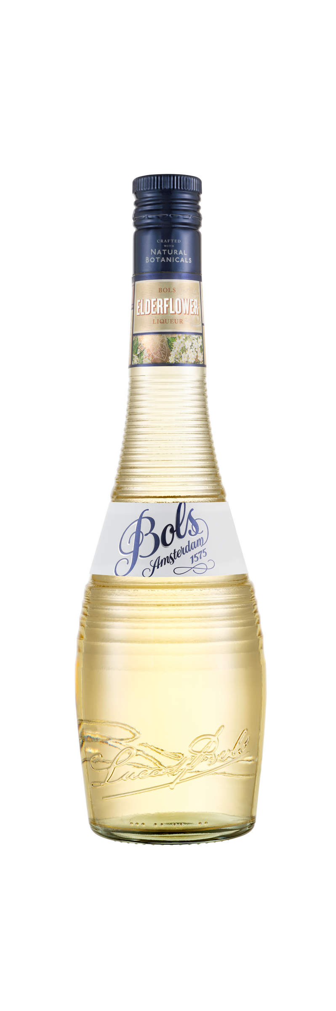
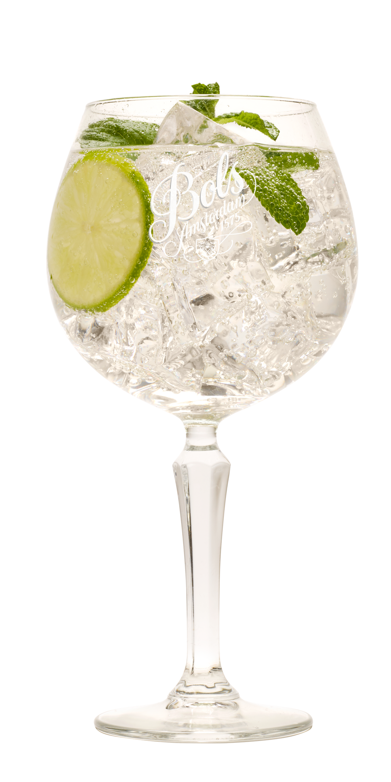


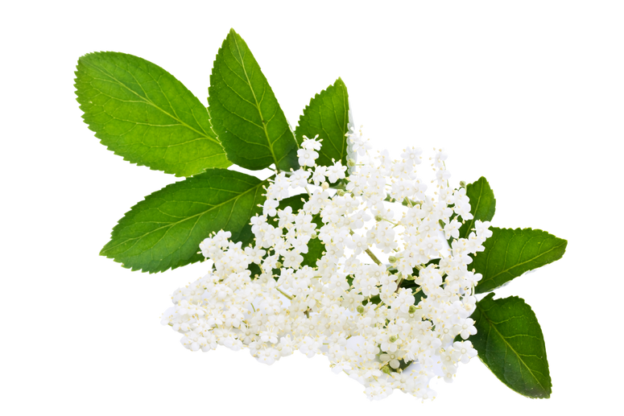
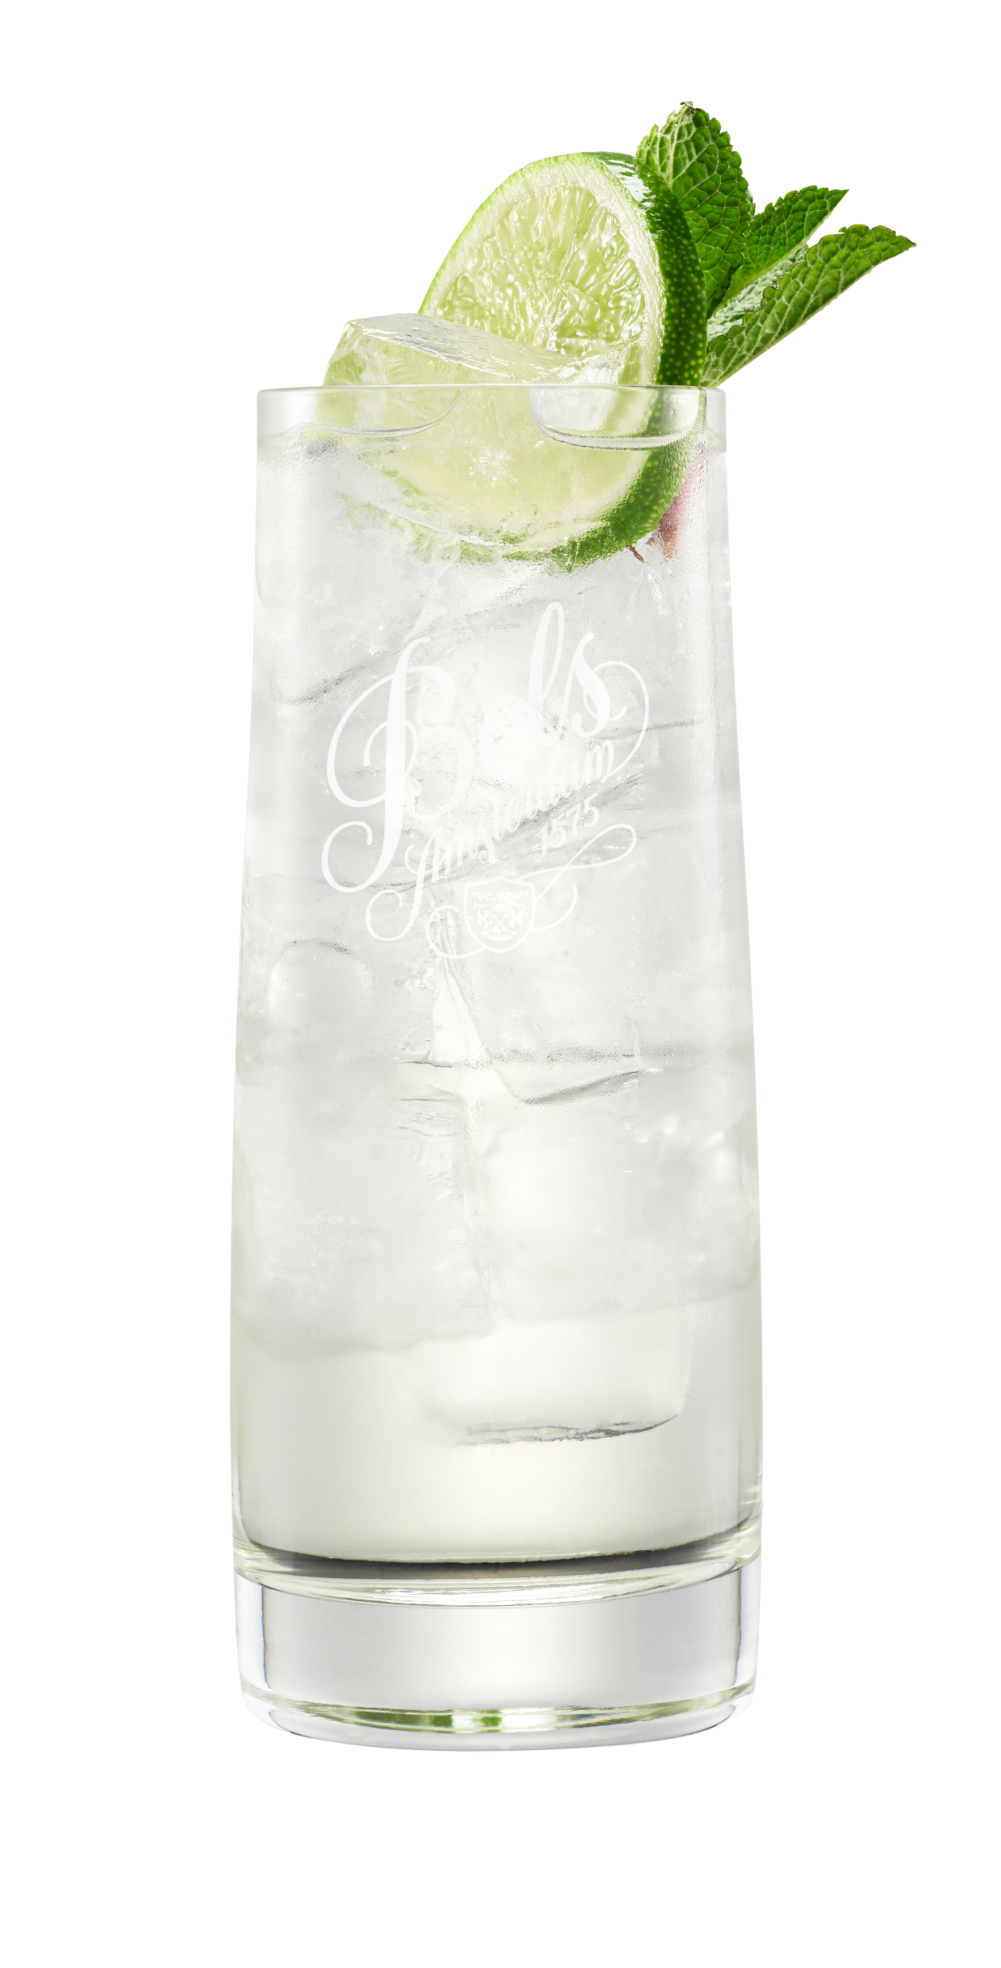
ELDERFLOWER- 17% ABV
Neat tasting:
Signature Cocktail
Made with distilled natural elderflower blossoms for bright floral notes and a clean, lightly sweet finish.
  In an Elderflower Spritz, Bols Elderflower brings crisp floral intensity without clashing with the bubbles.
Easy Mix Option: Mix with tonic water for a refreshing, aromatic highball.

Slide 13
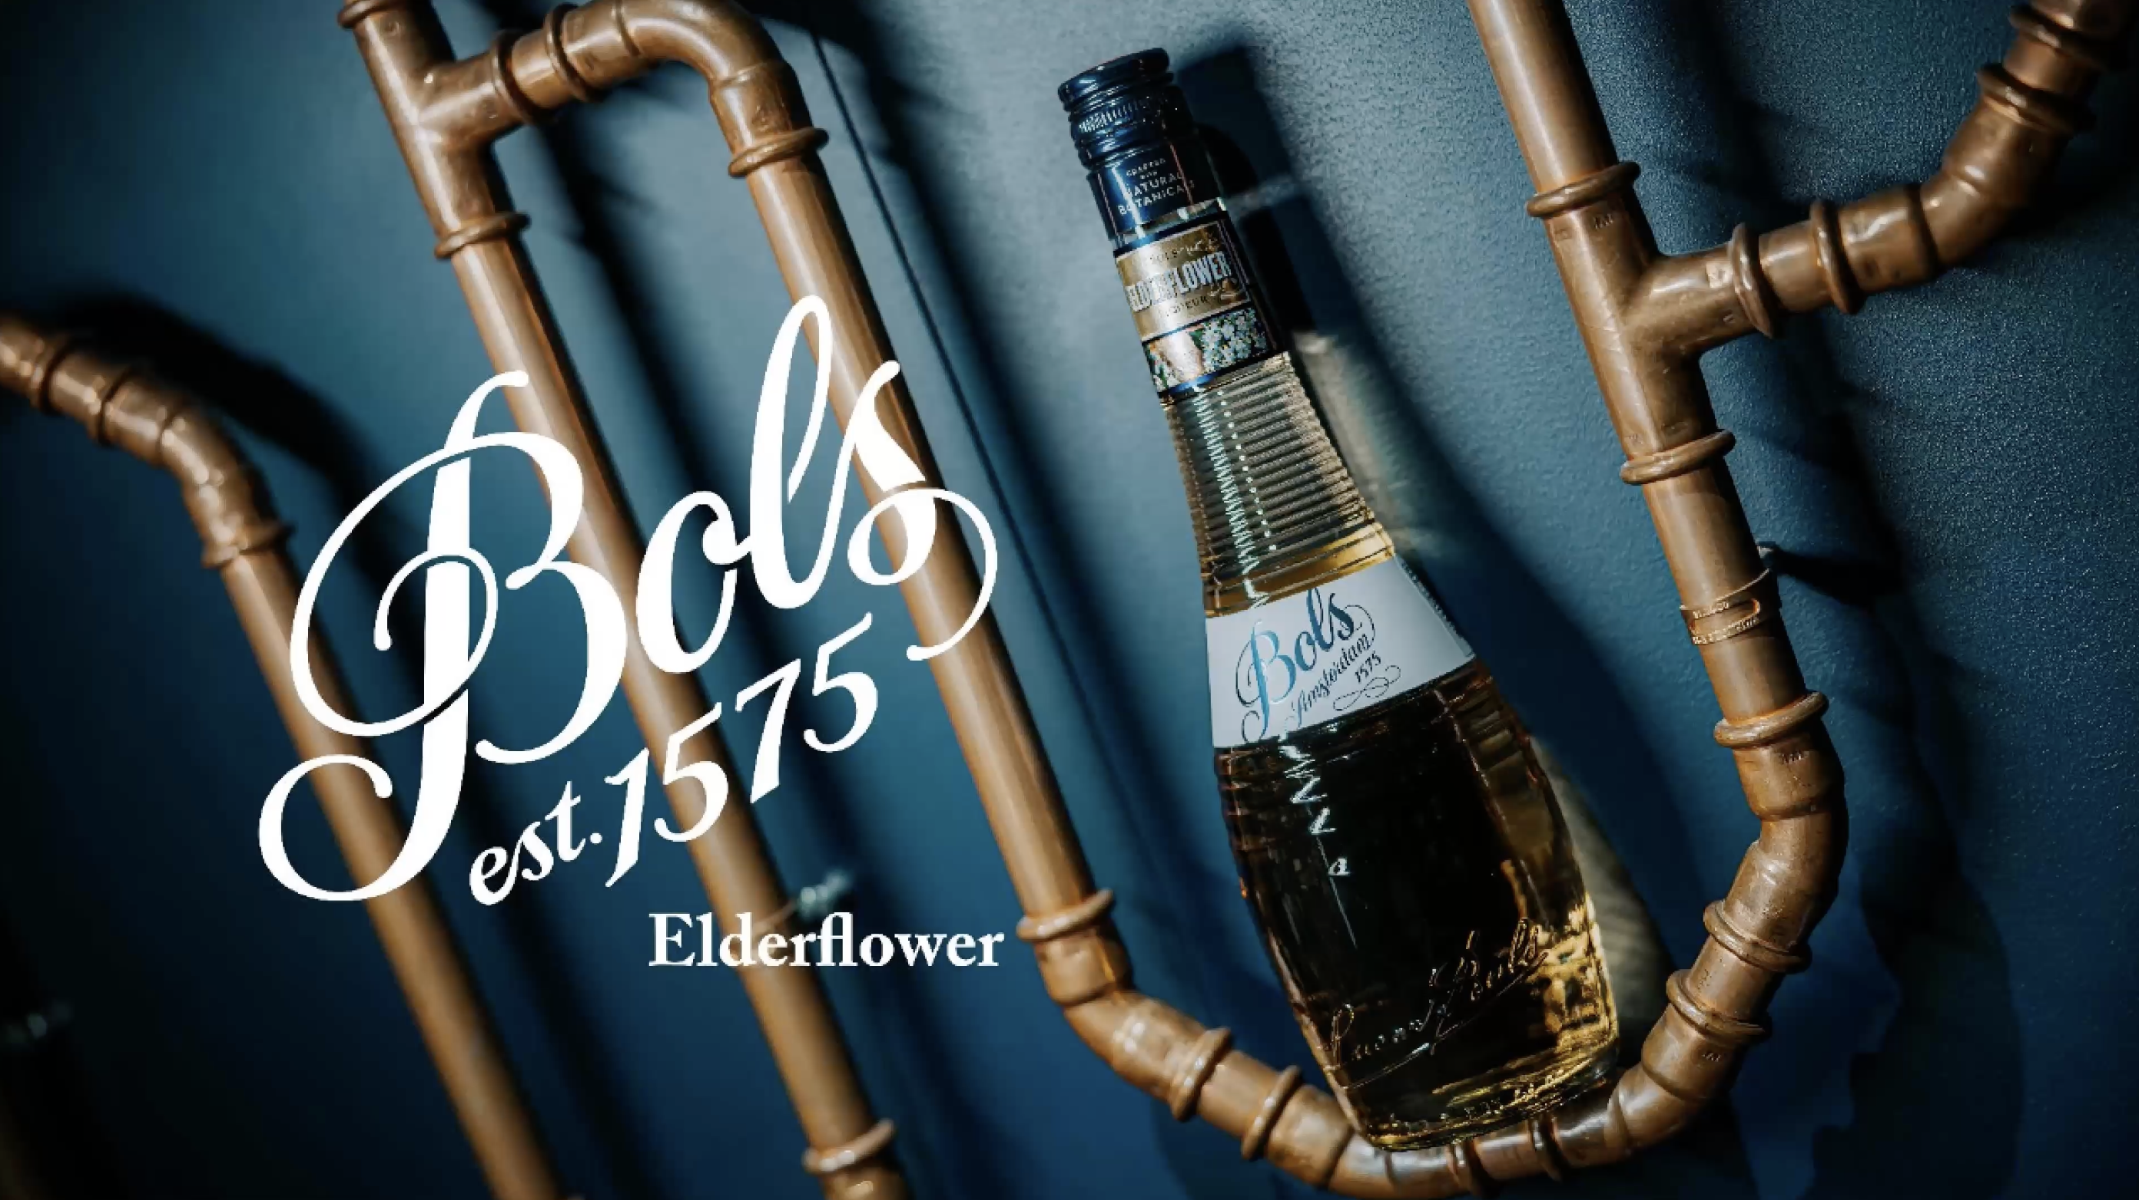
Watch the "DARE 2 COMPARE:
ELDERFLOWER" Video

Slide 14
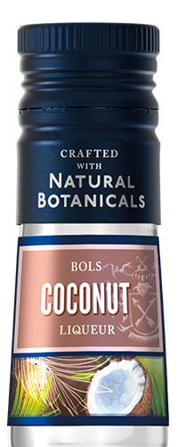
COCONUT COCKTAIL TRENDS IN THE USA
What’s trending in U.S. cocktails
Coconut’s appeal is shifting from classic beach drinks to year-round mixology innovation. Trend reports highlight tropical flavors like coconut becoming a core flavor cue in 2025 cocktail culture — “evok[ing] sunny escapes in every glass” and appearing alongside papaya, mango, and dragon fruit in seasonal trend forecasting. (Wine Enthusiast)
Bartenders are now incorporating coconut into modern riffs like coconut espresso martinis and coconut margaritas, moving the flavor beyond piña coladas and tiki into premium specialty formats. Longside these emerging serves, industry coverage shows coconut expanding into non-traditional applications, including fat-washed spirits and textured presentations. (PUNCH)
Proof point: Agave + tropical hybrid formats (e.g., coconut margarita) are gaining bar traction as operators seek fresh, approachable riffs on classics. (PUNCH)
Why guests are ordering
Texture & smoothness: Coconut adds body without dairy, making drinks feel indulgent yet refreshing.
Escapism & familiarity: Tropical cues resonate with guests seeking sunshine-in-a-glass experiences — a theme widely noted in cocktail trend analyses for 2025 and beyond. (Wine Enthusiast)
Social shareability: Coconut garnishes, creamy layers, and high-visuality serves make these drinks ideal for Instagram/TikTok discovery—accelerating experimentation at the bartender and consumer levels.
Market Proof points
• Trend authority Punch features coconut techniques and riffs from Margaritas to Espresso Martinis as part of contemporary cocktail innovation. (PUNCH)
• Flavorman trend forecasts explicitly include “coconut” among tropical staples poised to “steal the spotlight.” (Wine Enthusiast)
• Coconut-forward serves like coconut margaritas are highlighted in bar trend coverage, signaling cross-genre adoption. (PUNCH)
• TikTok data shows coconut-centric drinks like the Coconut Lime Cooler gaining traction in summer beverage trends. (tastewise)

Slide 15
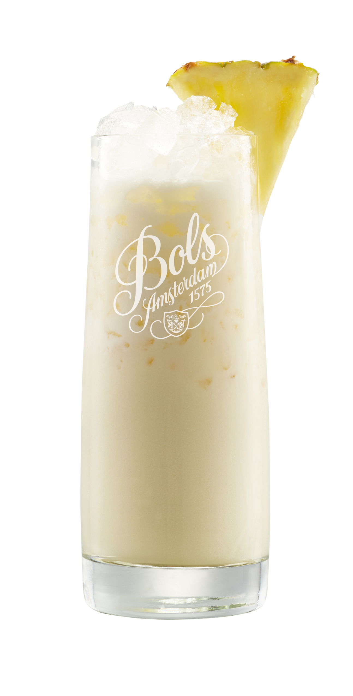
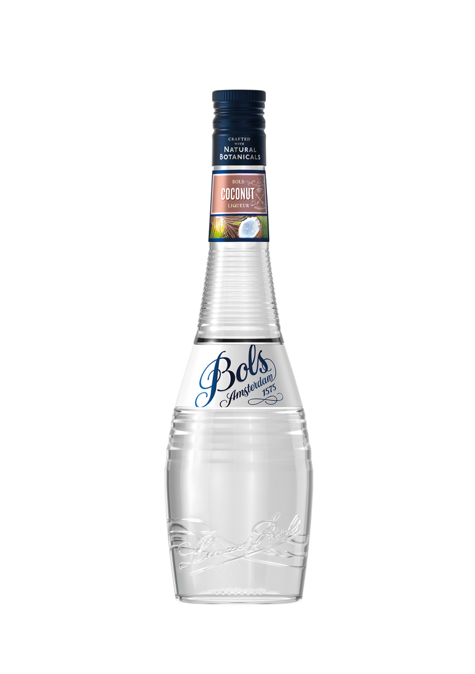


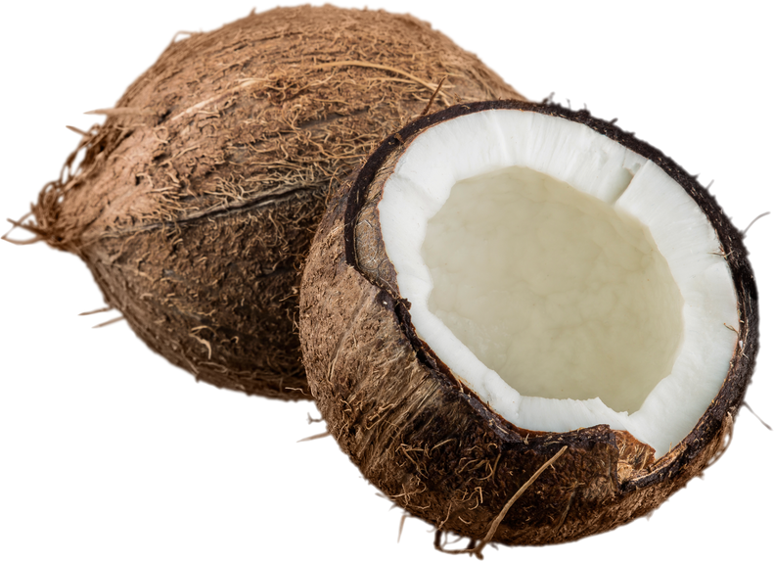
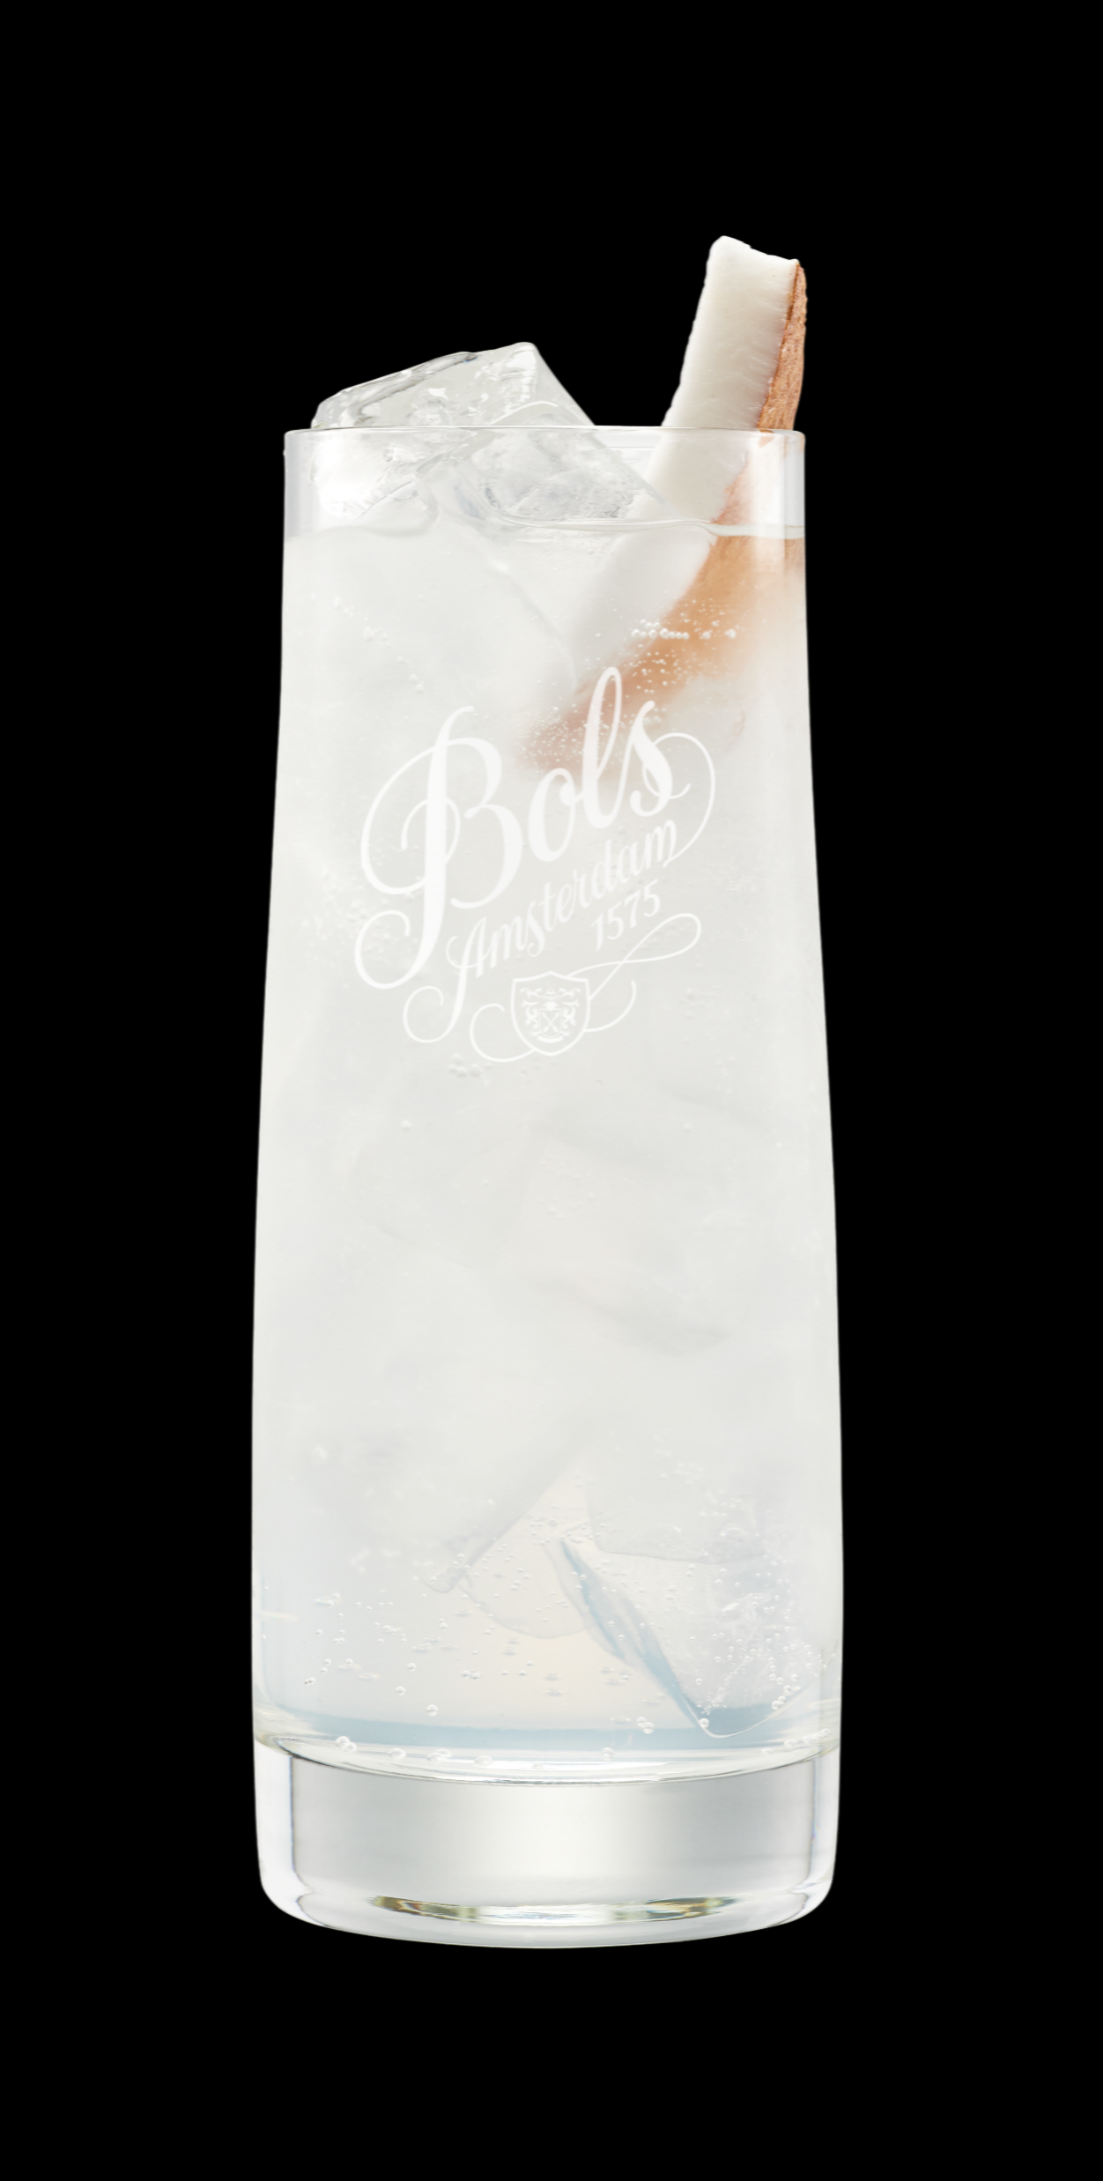
COCONUT USA- 21% ABV
Neat tasting:
Signature Cocktail
Strong & fresh floral raw coconut profile. Nose of green young coconut with a rum’s bite. Low sugar keeps it crisp and balanced. Flavor opens into clean, toasted coconut notes.
  In a Pina Colada, the coconut flavor of Bols stays natural and silky for an easier balance.
Easy Mix Option: Mix with Ginger Beer for a tropical and spicy highball.

Slide 16
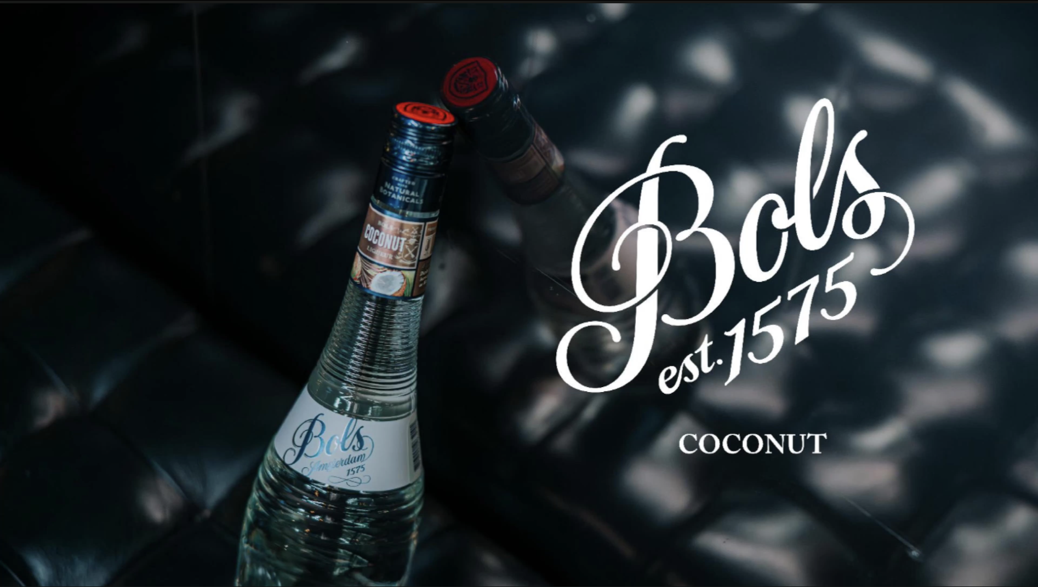
Watch the "DARE 2 COMPARE:
COCONUT" Video

Slide 17
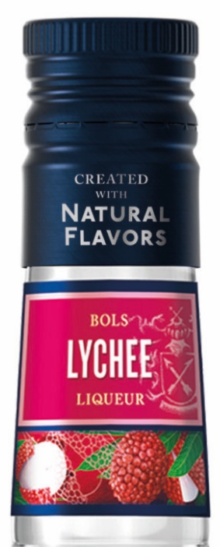
LYCHEE COCKTAIL TRENDS IN THE USA
What’s trending in US cocktails
Lychee is back on menus—powered by the martini resurgence + ‘90s/Y2K nostalgia. Operators are reviving “fun martinis” (Cosmo, Lemon Drop, Appletini) and Lychee Martini is one of the headline returns, now upgraded with better spirits and more balanced specs. (Food & Wine)
It’s also riding the broader wave of Asian-inspired cocktail cues (lychee, yuzu, pandan, shiso, etc.), giving bartenders an “exotic-but-approachable” flavor story guests recognize. (Forbes)
Chain reaction effect: once the Lychee Martini trends, it pulls through lychee spritzes, lychee sours, and tropical highballs—easy seasonal LTOs for spring/summer and “pink, glossy, photo-ready” moments year-round. (The Drinks Business)
Why guests are ordering
Flavor: floral-fruity, softly sweet, “perfumed” but not heavy—an easy yes for vodka/martini drinkers and tropical cocktail fans. (Southern Glazers)
Social/media factor: lychee’s look (garnish fruit, pale pink/clear builds, luxe glassware) makes it inherently postable. (Food & Wine)
Pop-culture fuel: mainstream lifestyle coverage is actively calling out the Lychee Martini comeback, which helps it travel from trend bars into broad on-premise. (Better Homes & Gardens)
Market Proof points
Lychee US on premise cocktail menu placements have grown 333% Jan 2026 vs Jan 2023 (Source: SommAi)
Major U.S. distributor trend reporting flags “Luscious Lychee” tied directly to the renewed martini craze. (Southern Glazers)
National trend coverage out of Tales of the Cocktail 2025 specifically spotlights Lychee Martinis as a key trend heading into 2026. (InsideHook)
City-level evidence: outlets like Eater document lychee martinis trending again in major metro bar scenes (example: D.C.). (Eater DC)

Slide 18
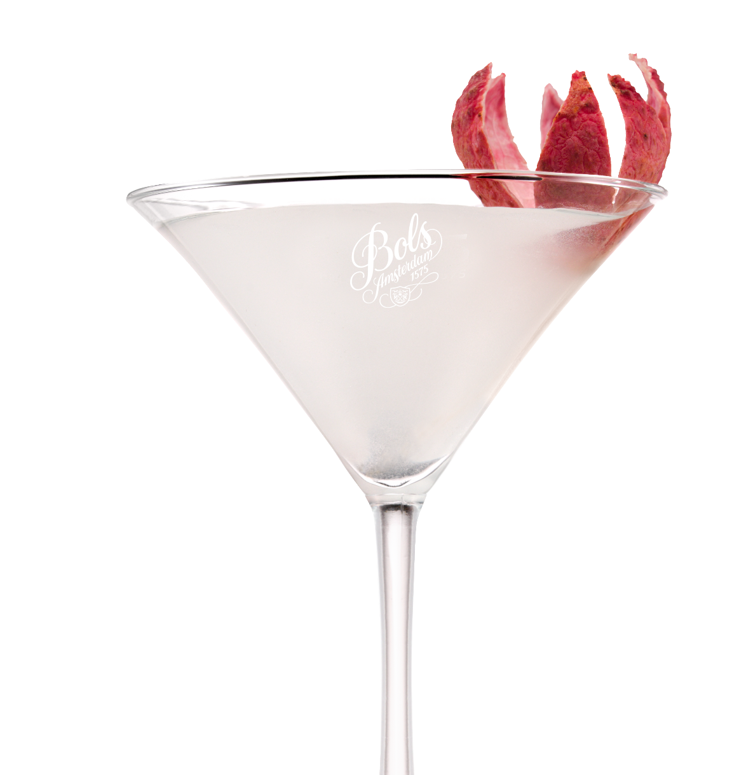
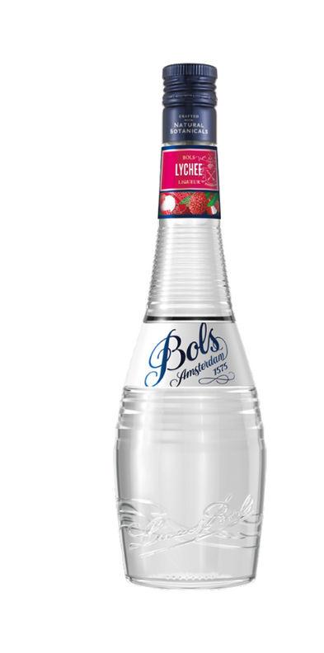

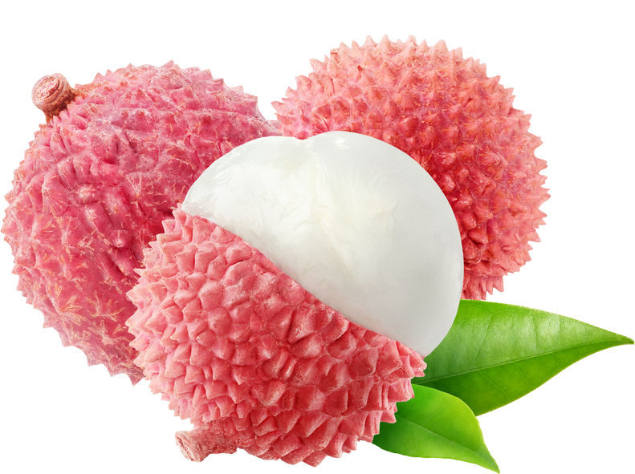
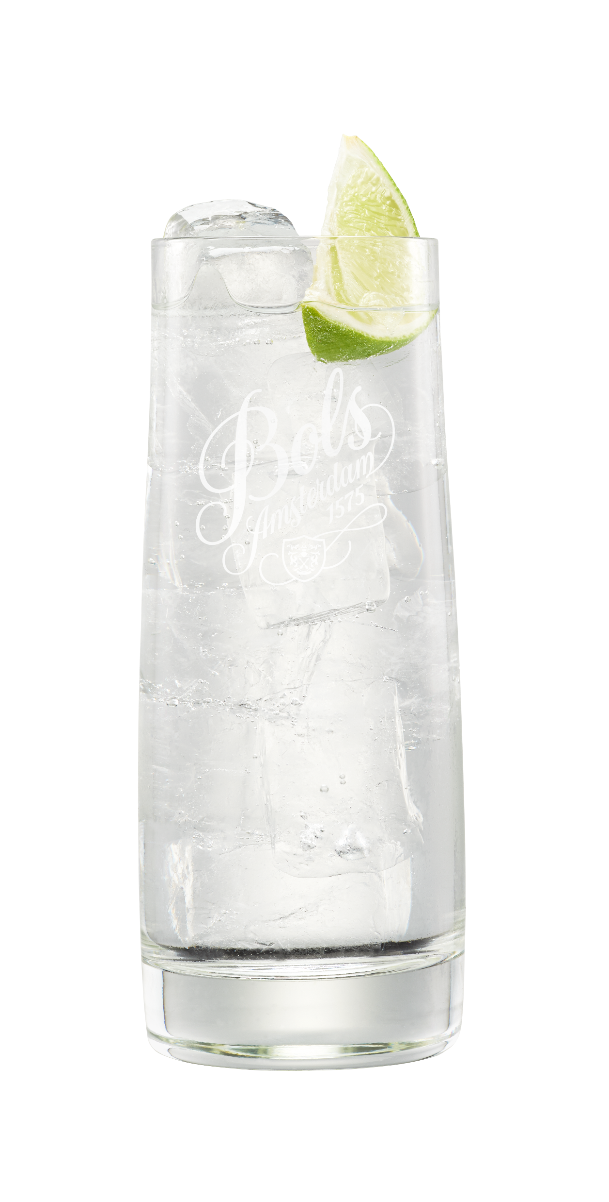
LYCHEE- 17% ABV
Neat tasting:
Signature Cocktail
Fresh distilled lychee fruit, floral sweetness, and no chemical aftertaste.
  In a Lychee Martini, the clean lychee aroma stays bright and fragrant.
Easy Mix Option: Mix it with soda water for a fresh, juicy highball.

Slide 19
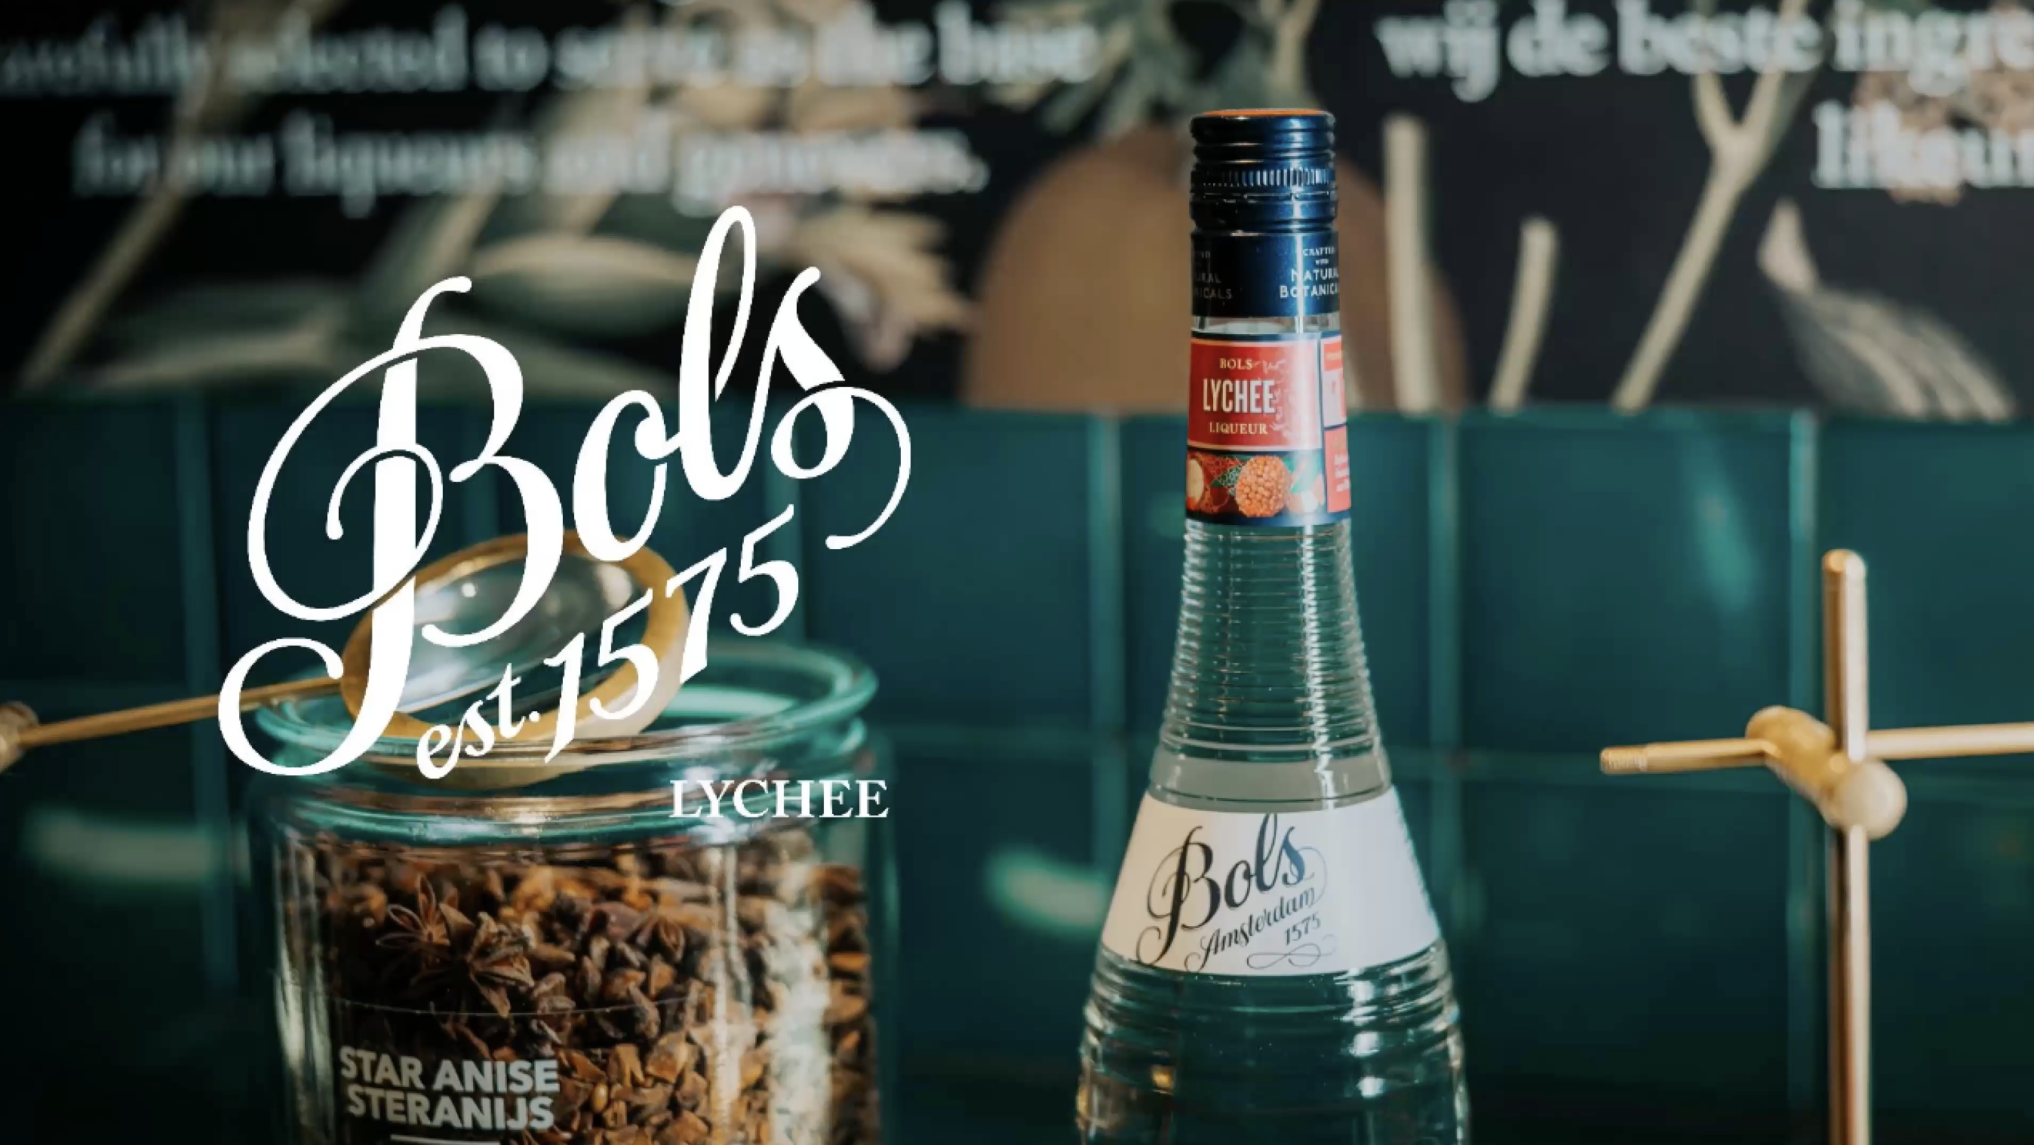
Watch the "DARE 2 COMPARE:
LYCHEE" Video

Slide 20
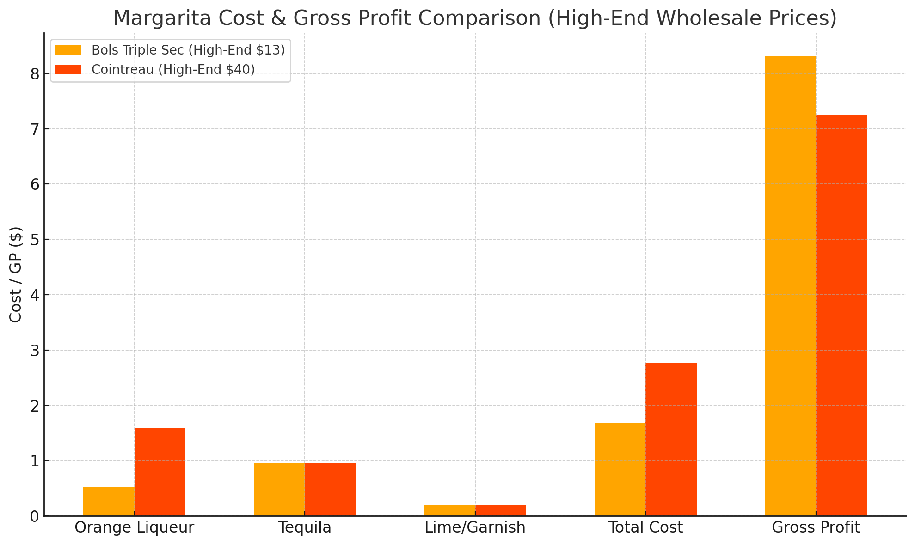

MARGINS: A BETTER DRINK, A BIGGER WALLET
Ingredient | Bols Triple Sec($13) | Cointreau ($40)
Orange Liqueur (30 ml) | $0.52 | $1.60
Tequila Blanco (50 ml) | $0.96 | $0.96
Lime Juice & Garnish | $0.20 | $0.20
Total Cost per Margarita | $1.68 | $2.76
Gross Profit ($) (at Sales Price $10) | $8.32 | $7.24
GP % | 83.2% | 72.4%

Slide 21
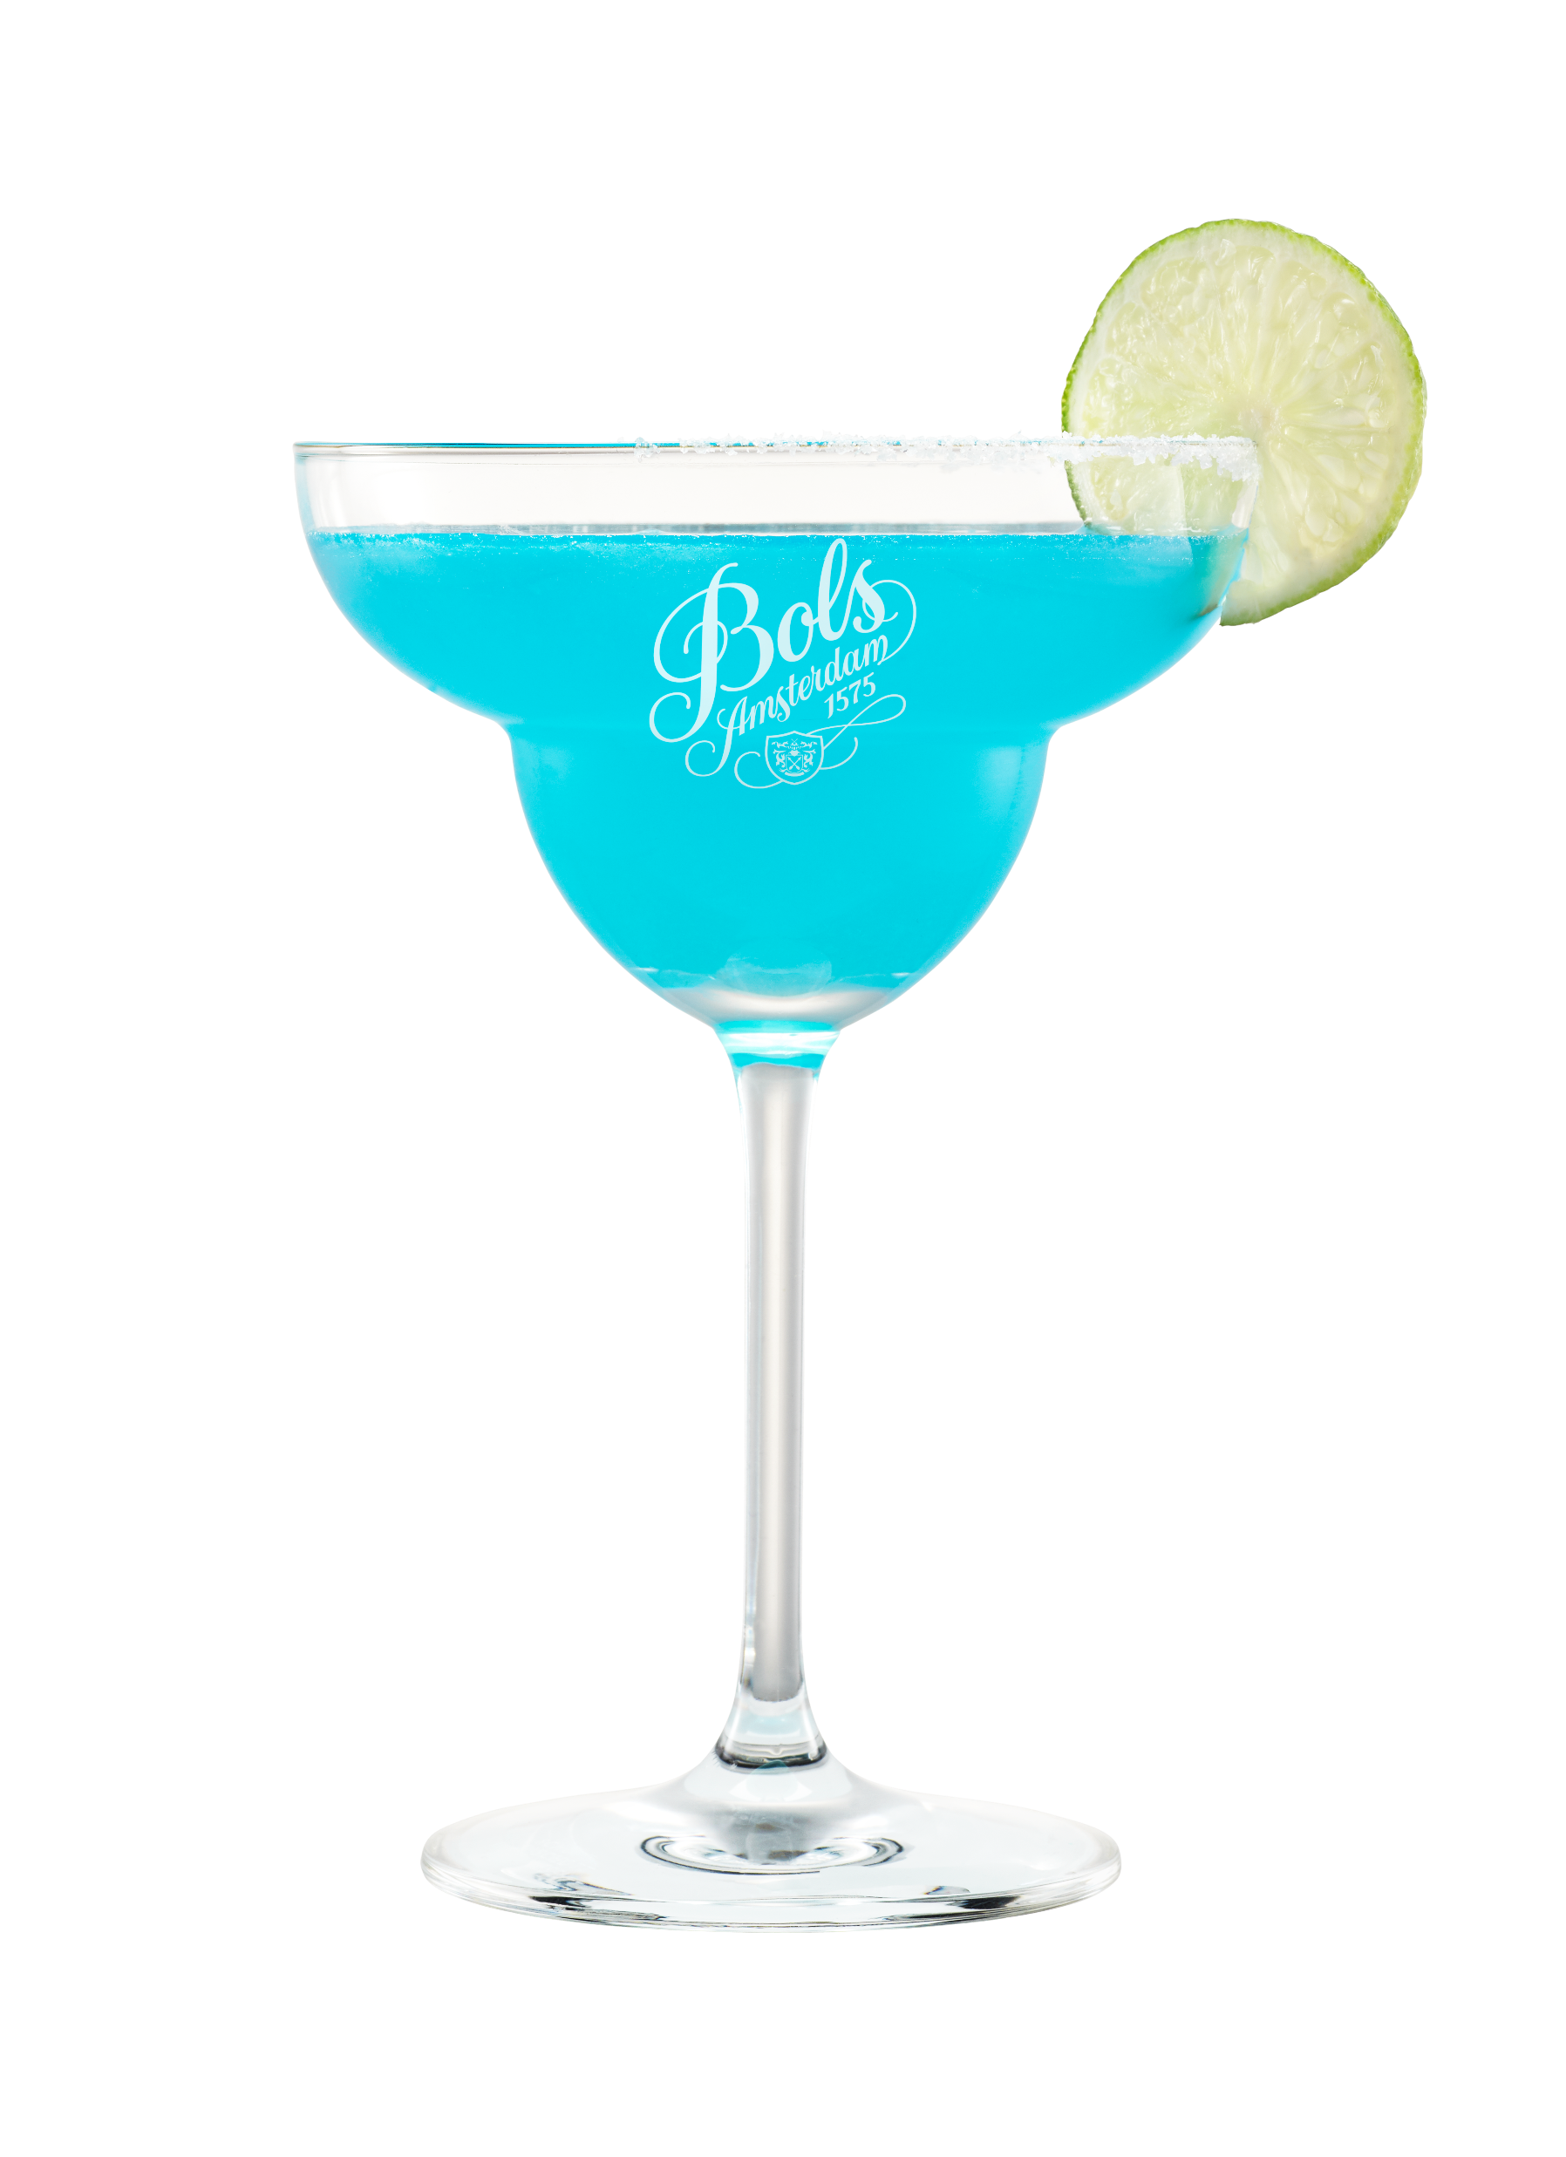
EXTRA GP SERVING… Bols Triple Sec VS Cointreau
Weekly, monthly & yearly implications
  Serving 100
  margarita’s a week
  BOLS delivers extra
  $108 per week
  $464 per month
  $5,573 per year
  Serving 300
  margarita’s a week
  BOLS delivers extra
  $324 per week
  $1,393 per month
  $16,718 per year
  Serving 500
  margarita’s a week
  BOLS delivers extra
  $540 per week
  $2,322 per month
  $27,864 per year

Slide 22
Q&A / Objections
"We already carry A-brands in our portfolio. This program could get us in trouble with our other suppliers"
We completely understand. The beauty of Bols' extensive range is flexibility. If one flavor creates conflict, we have many other flavors to explore together. Though, many successful partners run dual strategies: A-brands in the back bar for premium visibility, Bols in the speed rail for high-volume cocktails. Or channel separation across your distribution network (premium vs mainstream). It's about smart portfolio management, not replacement.
"We don't want to speak negatively about competitors or brands from other importers"
Absolutely agree. That's not what Dare to Compare is about. We focus on what makes Bols unique: authentic single-forward flavors, 100% natural botanicals, specifically crafted for cocktail mixing and exceptional value for money. Other brands excel in different areas, where we simply shine in cocktail performance. Dare to Compare is a positive, taste-first conversation that lets the liquid speak for itself.
"You're not coming with a marketing budget or listing fee. Why should we prioritize this?"
We believe in taste and margin as the ultimate convincers. The combination of superior flavor performance and improved margins creates its own business case. That said, we're always open to discussing tailored support for committed partners. Let the liquid prove itself first.
"The A-brand (e.g. Malibu) is a brand that consumers know and ask for, Bols isn't"
Most cocktail orders focus on the drink, not the brand. Consumers ask for "a Margarita" or "Cosmopolitan," not "a Cointreau Cosmopolitan." For high-volume, flavor-forward cocktails where taste and consistency matter most, Bols delivers superior results. Brand-specific requests are rare in everyday service. Where they do occur, a dual strategy gives you the best of both worlds.
"I need those A-brands on my back bar for recognition and premiumization"
The most successful model is hybrid: keep A-brands visible on your back bar for brand recognition, pour Bols from your speed rail for volume cocktails. Consumers will be positively surprised by the superior taste, your bottom-line benefits from better margins. Premium perception meets operational excellence.
"But these brands are listed on our menu – we can't just remove them or substitute"
If there's a contractual obligation, we respect that. However, if there's flexibility, consider using generic ingredient names instead of brand callout: "Triple Sec" instead of "Cointreau." Today's consumers increasingly value transparency and authenticity over brand names. They want to know what's in their drink rather than being marketed to. This approach gives you commercial flexibility and puts the focus back on your venue's craft.

Slide 23
Q&A / Objections
"You promise better taste, but how do I know this will deliver better results?"
We have the proof. Dare to Compare has been successfully executed across multiple markets globally, with high percentage bartender preference rates in blind taste tests. We'll gladly share relevant case studies and success stories from markets similar to yours, including conversion rates, volume growth and venue testimonials. The program works because it's built on a simple truth: better taste plus better margins equals better business.
"The category leader invests heavily in marketing and activations – what does Bols offer in return?"
Bols is a globally recognized brand sold in 110+ markets with 450 years of cocktail heritage. We support partners extensively through on-trade activations like Bols Cocktail Battle, digital content creation, Bols Bartending Academy resources and extensive POS and merchandise programs. We invest where it matters most, in the people who create the drinks and the experiences that drive consumer loyalty. We’re happy to share more insights on this in your market specifically.
"Your competition (De Kuyper and other liqueur ranges) tells the same story – why are you different?"
Bols stands apart through 450 years of liqueur-making expertise, global presence in 110+ markets, 100% natural botanicals with no artificial flavors and purpose-built formulation for cocktails. Competitors can not claim that. Every flavor is specifically developed to shine in mixed drinks, not as standalone drinks. Bols isn't just another liqueur range: we're the original and we're still the best at what we do: making cocktails taste exceptional.
“Why use Bols liqueurs vs syrups in cocktails?”
Due to it’s alcoholic base, liqueurs add complex, layered flavors, not one-dimensional sweetness and sugar. The alcohol content carries the oils of the natural botanicals in your cocktails. This results in a stable flavor profile across ice, dilution & temperature and a better balance & mouthfeel in the finished drink. Liqueurs give also a better control of the sweetness due to a lower sugar content than syrups. Besides, liqueurs are essential in many iconic and classic cocktail recipes. A margarita with orange syrup is not a margarita, it’s overly sweet and out of balance; an espresso martini would be overly sweet with coffee syrup and not balanced enough with only coffee.
Bols liqueurs don’t just flavor cocktails.. they give them character, complexity and identity.
“What style of rum is used for the Bols Coconut?”
For our Bols Coconut we use a a pot still rum from the West Indies distillery. We re-distill this at our distillery to create a higher ester, and hence more flavorful rum. This shines through in both the liqueur and your cocktails.

Slide 24
