Slide 1
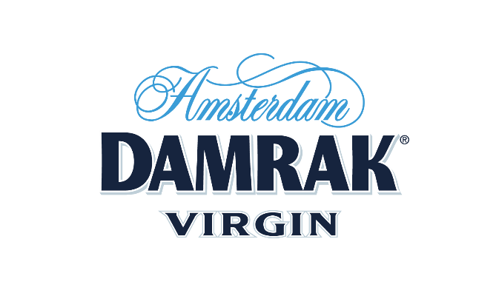

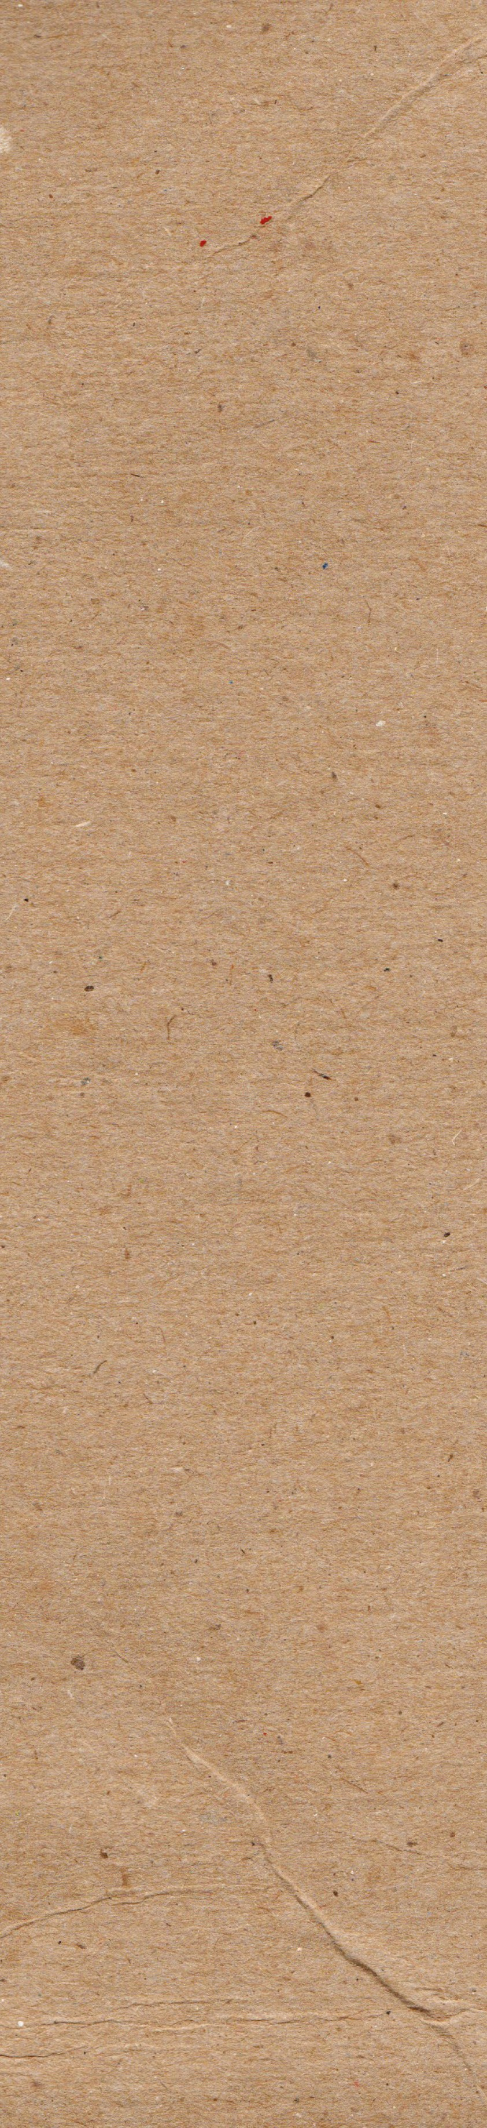

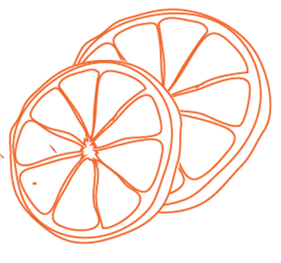
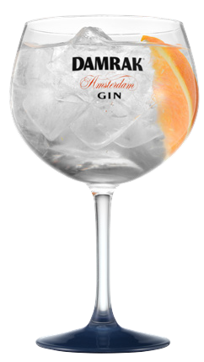

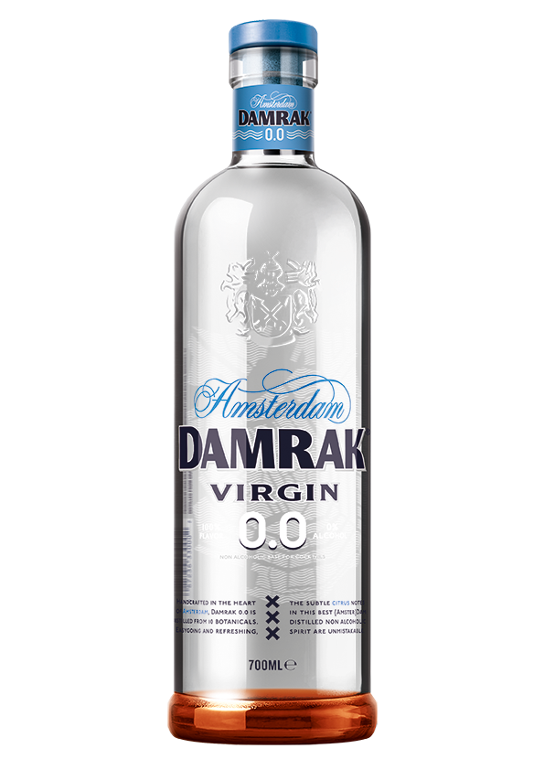
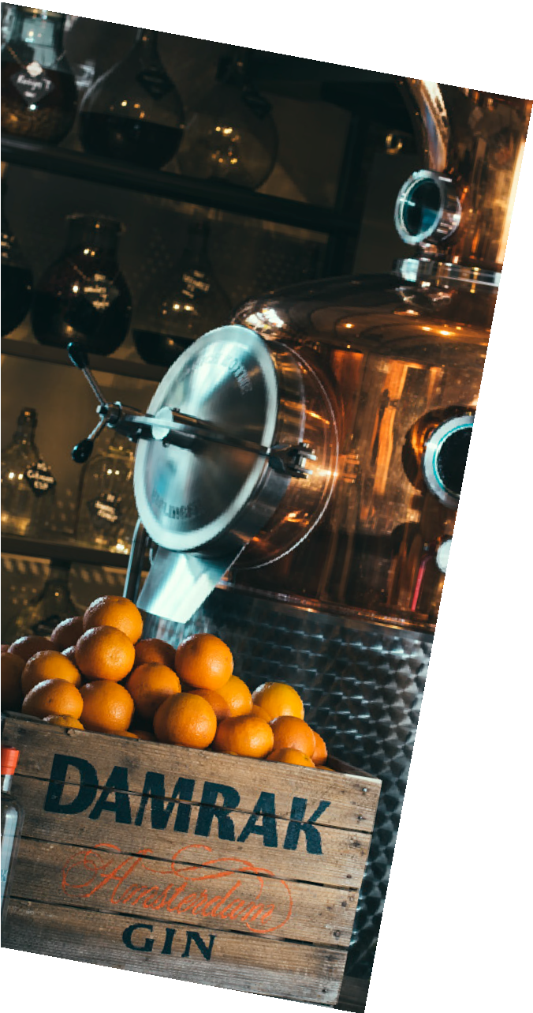
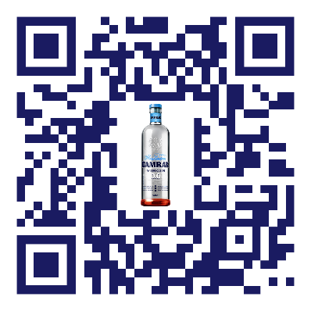
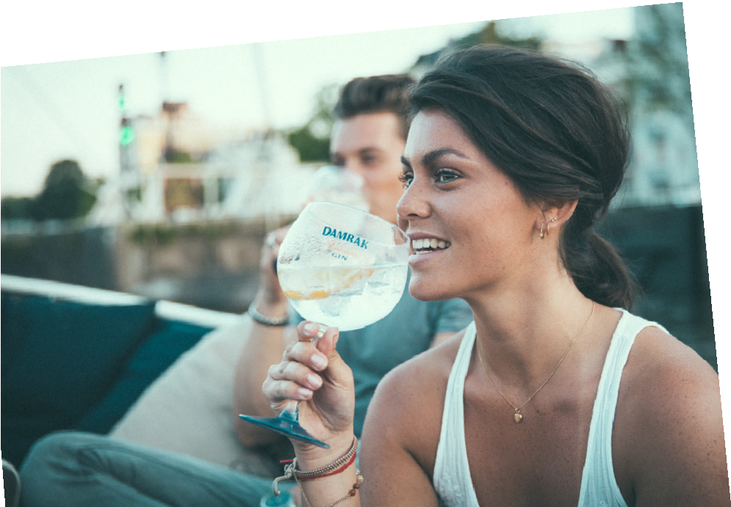
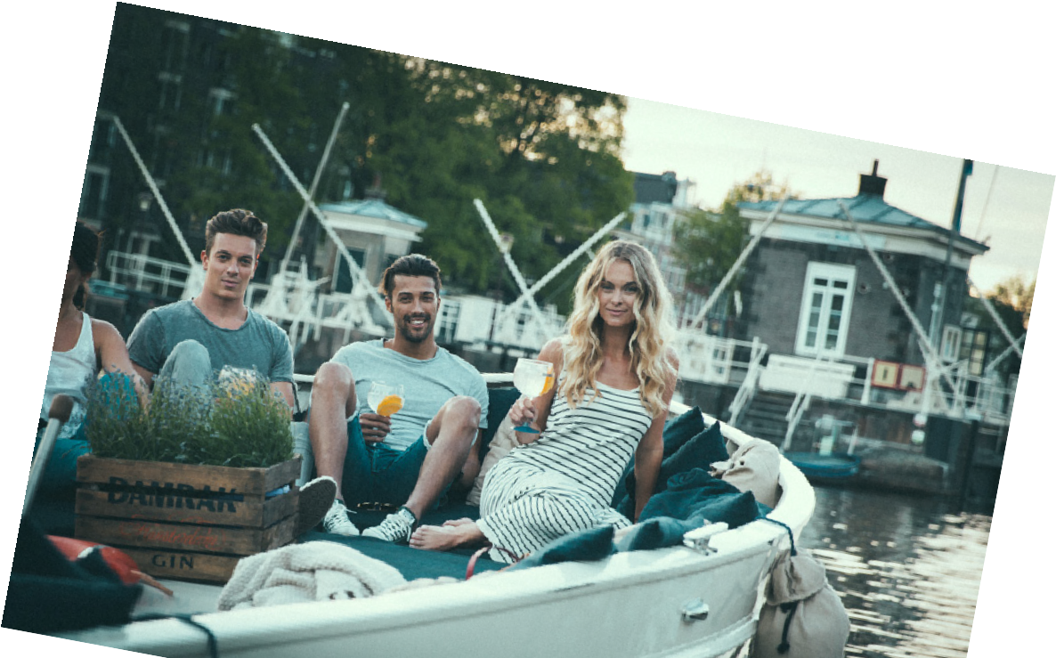





0% alcohol 100% flavor
virgin?
For the sober curious, fit boys and girls, designated drivers and everyone else amongst us interested in an alcohol-free cocktail – meet Damrak VirGin.
It is everything Damrak is, simply (but in truth, very complexly) reformulated to eliminate the alcohol.
Still made in the heart of Amsterdam by our crafty distilling team by carefully extracting flavors from a collection of 10 botanicals.
FLAVOR NOTES
Citrus-forward classic gin-inspired flavor with pronounced orange and refreshing lemon.
Creating a high-quality non-alcoholic drink without compromising on flavor is not easy. But we wouldn’t be a real Amsterdammer if we stopped trying. And after 2 years of mixing, blending and perfecting the recipe, we did it. And boy are we proud! Without losing the unique Damrak taste, even at 0% alcohol, you can now enjoy a cocktail when you don’t want the buzz.
The best dam
Virgin & Tonic
1 part Damrak Virgin
3 parts Tonic Water
1-2 Orange Slices
F
claim they ARE MAKING EFFORTS TO REDUCE ALCOHOL CONSUMPTION- nIELSEN
Virgin mule
66% of millennials
1 part Damrak Virgin
¼ part Lemon juice
3 parts Ginger Beer
Scan for The best dam
COCKTAILS
Pricing & special offers:
F
“This is the smoothest of all the gin-inspired zero-proof spirits I’ve tried.”

